Slide 1


Leveraging Human Knowledge for Machine Learning Curriculum Design
Matthew E. Taylor
teamcore.usc.edu/taylorm

Slide 2

Overview
Want agents to learn difficult problems
  Lots of data needed (time)
  Picking a correct bias (NFL)
Taxi driving example
Use human to design sequence of tasks
  Basic car control
  Parking lot navigation
  Small Town
  Los Angeles
Why not have agents select tasks?

Slide 3
Problem Statement
Humans can selecting a training sequence
Results in faster training / better performance

Slide 4
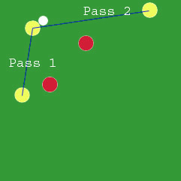
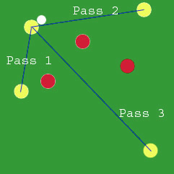
Task Transfer
Source
S, A
Target
S’, A’
Reduce total training time by picking source task(s)
Learn sequence of source tasks, then learn (previously unknown) task

Slide 5
Problem Statement
Humans can selecting a training sequence
Results in faster training / better performance
Meta-planning problem for agent learning
MDP
MDP
MDP
MDP
MDP
MDP
MDP
?

Slide 6
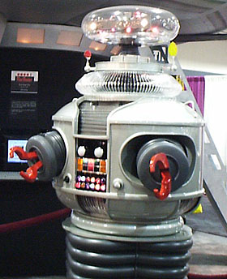
Type of Shaping
Assume agents could learn on their own
Think of Skinner (1953)
Not “RL Shaping” [Colombetti and Dorigo (1993) or Ng (1999)]
DANGER: Negative Transfer

Slide 7
Not On-line or Interactive Help
Advice / Demonstration / Imitation
  Human unable or unwilling
Picking sequence of tasks
  How to best learn important skills / ideas

Slide 8
Types of Useful Information
Common Sense
  Soccer balls roll after being kicked
  Friction reduces an object’s speed
Domain Knowledge
  It is easier to complete short passes than long passes
Algorithmic Knowledge
  State space size can impact learning speed

Slide 9
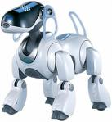
Useful?
Training time critical
Agent needs robust understanding of domain
  (rare affordances)
Consumer Level
  Low bar for background knowledge
  Save consumer time

Slide 10
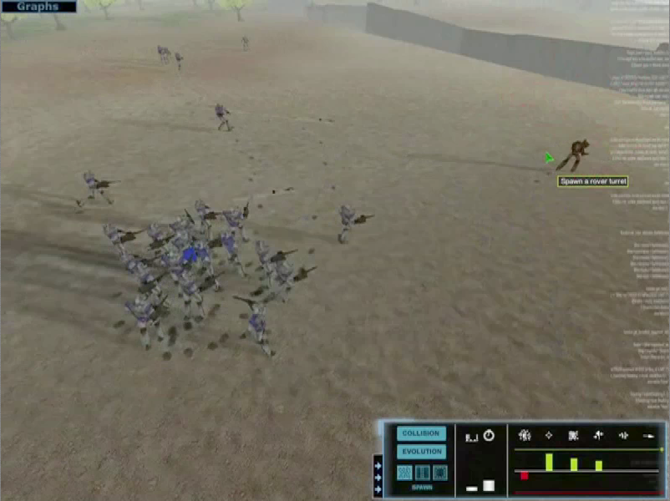
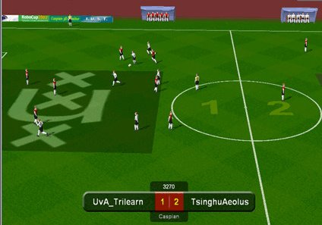
Possible Domains?
Nero
RoboCup Coach

Slide 11

Path of Study
Determine what makes a good sequence
  Increasing Difficulty
  Basic skills (options)
  Basic concepts / learn useful abstractions
  Retrospective analysis
Education literature?
On-line sequence adaptation? (social scaffolding)

Slide 12
Conclusion
Leveraging human knowledge
Both experts and non-experts
Where is constructing a task sequence superior?
  Easy
  Effective
How can we construct such sequences well?
  Transfer Learning / Lifelong Learning Analysis
  Empirical studies

Slide 14
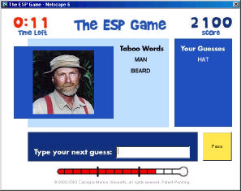
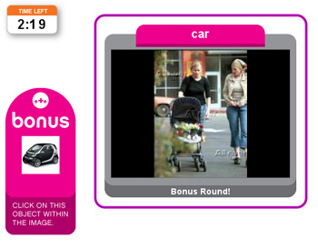
Possible Domains?
Nero
ESP, Peekaboom
RoboCup Coach

