Slide 1




Diverse M-Best Solutions in Markov Random Fields
,
,
,
Dhruv Batra
TTI-Chicago /
Virginia Tech
Payman Yadollahpour
TTI-Chicago
Abner Guzman-Rivera
UIUC
Greg Shakhnarovich
TTI-Chicago

Slide 2

Local Ambiguity
Graphical Models
x₁
Hat
x₂
MAP
Inference
…
x_{n}
Cat
Most Likely Assignment
Notes:
The visual perception problem have a lot of local ambiguity. If I ask you to recognize this patch, you probably won’t be able to.
Graphical models are useful tools that allow us to model all variables of interest, write down local beliefs in terms of node & edge energies, and then use these to make a global prediction by jointly minimizing this energy function, also called MAP inference.

Slide 3

Problems with MAP
Model-Class is Wrong!
-- Approximation Error
  Human Body ≠ Tree
Figure Courtesy: [Yang & Ramanan ICCV ‘11]
Notes:
Unfortunately, we often run into a number of problems with MAP.
Most often, our model is simply wrong. So even if we predict the most probable state from our model, it could be very far from ground-truth.
For example, a tree model assumes that we walk around like this, with our limbs always un-occluded.

Slide 4
Problems with MAP
Model-Class is Wrong!
Not Enough Training Data!
-- Approximation Error
-- Estimation Error
Notes:
Even if your model is rich enough, you may not have enough training data to learn the correct parameters.

Slide 5
Problems with MAP
Model-Class is Wrong!
Not Enough Training Data!
MAP is NP-Hard
-- Approximation Error
-- Estimation Error
-- Optimization Error
Notes:
Even if you have enough training data, actually computing MAP may be NP-hard.

Slide 6


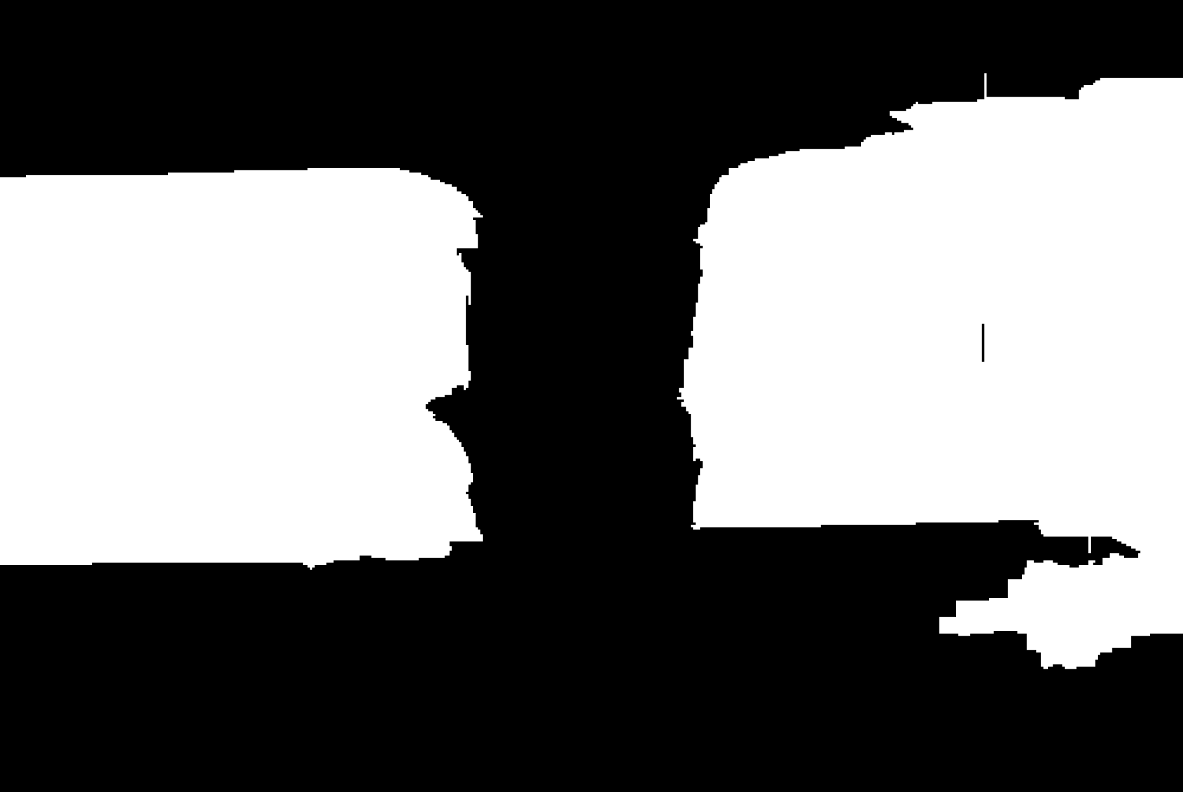

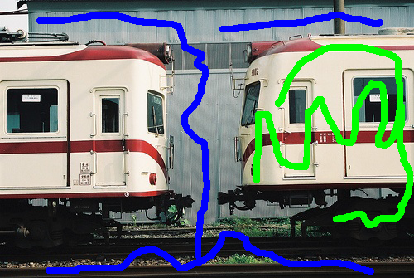
Problems with MAP
Model-Class is Wrong!
Not Enough Training Data!
MAP is NP-Hard
Inherent Ambiguity
-- Approximation Error
-- Estimation Error
-- Optimization Error
-- Bayes Error
?
?
Rotating clockwise /
anti-clockwise?
Old Lady looking left /
Young woman looking away?
One instance /
Two instances?
Notes:
Even if you can compute MAP, there may simply be multiple acceptable answers.
For example, this woman could be rotating left or rotating right.
This could be a young woman looking away or an old lady looking left.
When we have a user-in-the-loop, different users may expect different outputs from the same input.

Slide 7
Problems with MAP
Model-Class is Wrong!
Single Prediction = Uncertainty Mismanagement
Not Enough Training Data!
MAP is NP-Hard
Inherent Ambiguity
-- Approximation Error
-- Estimation Error
-- Optimization Error
Make Multiple Predictions!
-- Bayes Error
Notes:
So where does that leave us?
When your model is wrong, your data is insufficient, you can’t compute the optimal MAP and you’re not sure which answer the user wanted anyway, making a single best prediction is simply inadequate. What we need to do is to make multiple plausible predictions!

Slide 8


Multiple Predictions
x
x
x
x
x
x
x
x
x
x
x
x
x
Sampling
Porway & Zhu, 2011
TU & Zhu, 2002
Rich History
Notes:
So how can we make multiple predictions.
Well, it’s a probabilistic model. We could sample from the distribution. Unfortunately, sampling is rather wasteful since we observe the same modes of the distribution over and over again. And if there is a low-probability mode, we will have to wait a long time to observe a sample from it.

Slide 9
Multiple Predictions
✓
Sampling
M-Best MAP
Ideally:
M-Best Modes
Porway & Zhu, 2011
TU & Zhu, 2002
Rich History
Flerova et al., 2011
Fromer et al., 2009
Yanover et al., 2003
Notes:
We could ask for the top M most probably states from the model, called the M Best MAPs. Unfortunately, these solutions are typically minor perturbations of each other.
What we’d like to extract are the top M /modes/ of this distribution, i.e. solve the M-Best Mode problem.
However, there are technical challenges because this is a discrete distribution, and we have to deal with combinatorial optimization.

Slide 10
Multiple Predictions
✓
This Paper: Diverse M-Best in MRFs
Sampling
M-Best MAP
Don’t hope for diversity. Explicitly encode it.
Not guaranteed to be modes.
Ideally:
M-Best Modes
Porway & Zhu, 2011
TU & Zhu, 2002
Rich History
Flerova et al., 2011
Fromer et al., 2009
Yanover et al., 2003
Notes:
In this paper we present an algorithm to find a set of diverse M-Best solutions from discrete probabilistic models.
We elevate diversity to a first-class citizen by explicitly encoding it into our approach, rather than post-processing for diversity.
Our solutions are not guaranteed to be modes, but are often very useful for applications.

Slide 11
MAP Integer Program
kx1
Notes:
Let me begin by writing the MAP problem, which involves minimizing an energy composed of node terms & edge terms.
Instead of each variable being an integer between 1 and k, we will represent them as indicator vectors of length k.

Slide 12
MAP Integer Program
1
0
0
0
kx1
Notes:
So this is xi = 1.

Slide 13
MAP Integer Program
0
1
0
0
kx1
Notes:
So this is xi = 2.

Slide 14
MAP Integer Program
0
0
1
0
kx1
Notes:
This is xi = 3.

Slide 15
MAP Integer Program
0
0
0
1
kx1
Notes:
And this is xi = 4.

Slide 16
MAP Integer Program
0
0
0
1
kx1
k²x1
Notes:
We can do the same thing at edges, where the indicator vector is of length k^2

Slide 17
MAP Integer Program
0
0
0
1
kx1
k²x1
Notes:
So this is the Linear Integer program whose solution in the MAP state.

Slide 18
MAP Integer Program
Graphcuts, BP, Expansion, etc
Notes:
We typically solve this with algorithms like graph-cuts, BP, alpha-expansion. Etc.

Slide 19
Diverse 2nd-Best
Diversity
MAP
Notes:
So now, how can we find a diverse 2nd best solution?
We present a fairly general formulation, that simply adds this inequality to the problem. There is task-specific diversity function Delta that measures the dissimilarity or distance between two full configurations, and we force the 2nd best solution to be at least k distance away from MAP.

Slide 20
Diverse M-Best
Notes:
The extension from 2nd best to M best is fairly straightforward. We simply add more inequalities incrementally to further restrict the search space.

Slide 21
Diverse 2nd-Best
Q1: How do we solve DivMBest?
Q2: What kind of diversity functions are allowed?
Q3: How much diversity?
See Paper for Details
Notes:
In order to keep things simple, I’ll focus on the 2nd best problem in this talk and everything I describe will naturally extend to the M-Best case.
Now, given this general formulation, there are a few different questions we can ask.
In this talk, I will answer the first question, partially answer the second, and not answer the third. I encourage you to see the paper for details.
So let’s look at the first question.

Slide 22

Diverse 2nd-Best
Lagrangian Relaxation
Many ways to solve:
Diversity-Augmented Energy
Primal
upergradient Ascent. Optimal. Slow.
See Paper for Details
2. Binary Search. Optimal for M=2. Faster.
3. Grid-search on lambda. Sub-optimal. Fastest.
Dualize
Dual
Div2Best energy
Concave (Non-smooth)
Lower-Bound on Div2Best En.
Notes:
We do not solve this problem in the “Primal” form. Instead, we dualize the diversity constraint, ie add it as a penalty to the objective. So whenever we find a solution that is less than k distance away, we pay a penalty of lambda.
This is known as the Lagrangian relaxation. It has an interesting interpretation as the diversity augmented energy, which involves finding low-energy high-diversity solutions.
The Lagrangian function is known to provide a concave lower-bound to the Primal solution; and the tightest lower-bound can be found by maximizing this function.
There are several ways to solve this Lagrangian dual problem.
We can use 1) supergradient ascent 2) binary search or 3) grid search.
For our experiments, we use grid search over lambda, which is suboptimal but the fastest.

Slide 23
Diverse 2nd-Best
Q1: How do we solve Div2Best?
Q2: What kind of diversity functions are allowed?
Q3: How much diversity?
See Paper for Details
Notes:
So now let’s look at how we measure diversity.

Slide 24

Diversity
[Special Case] 0-1 Diversity M-Best MAP
  [Yanover NIPS03; Fromer NIPS09; Flerova Soft11]
[Special Case] Max Diversity [Park & Ramanan ICCV11]
Hamming Diversity
Cardinality Diversity
Any Diversity
See Paper for Details
Notes:
Our formulation allows several kinds of diversity functions.
With a 0-1 diversity, we get the special case of M-Best MAP.
With a max-diversity, we get the formulation of Park & Ramanan from last year.
We can use hamming diversity, cardinality diversity, basically any diversity function that allows efficient inference with diversity-augmented-energy.
In this talk, I am going to describe the simplest diversity – Hamming diversity; and details of the others can be found in the paper.

Slide 25
Hamming Diversity
0
1
0
0
0
1
0
0
0 1 0 0
1 0 0 0
Notes:
Hamming Diversity can be expressed with a sum of dot-products of indicator vectors.
If the vectors are the same, their dot-product is 1, and if they are different, their dot-product is 0. Thus this sum counts the no. of variables that have the same label as MAP.

Slide 26


Hamming Diversity
Diversity Augmented Inference:
Notes:
Hamming Diversity has the property that it factorizes with the node energies, so we can think of diversity augmented score as having perturbed node energies, that absorb the previous solutions vectors.

Slide 27
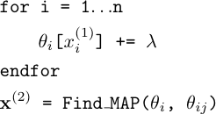
Hamming Diversity
Diversity Augmented Inference:
Unchanged.
Can still use graph-cuts!
Simply edit node-terms. Reuse MAP machinery!
Notes:
This can be implemented with these 4 lines of pseudo-code. Simply write a for loop over the variables, increment the unary costs of the labels seen in MAP and run MAP again.
That’s it!
Thus we can reuse all the existing MAP machinery.
Another interesting thing is that we did not modify the edge energies, so there was some structure in the edge terms, it is preserved. For instance, if they were submodular, they continue to be submodular and we can use graph-cuts for the second best problem.

Slide 28
Experiments
3 Applications
  Interactive Segmentation: Hamming, Cardinality (in paper)
  Pose Estimation: Hamming
  Semantic Segmentation: Hamming
Baselines:
  M-Best MAP (No Diversity)
  Confidence-Based Perturbation (No Optimization)
Metrics
  Oracle Accuracies
    User-in-the-loop; Upper-Bound
  Re-ranked Accuracies
Notes:
Let me show some results.
We test DivMBest on 3 applications: interactive segmentation, pose estimation and semantic segmentation.
We compare against two baselines: M-Best MAP that has no notion of diversity; and a Confidence-based baseline that produces the changes confused variables to achieve the same level of diversity as our solutions, but has no optimization.
I will report results using two metric – Oracle accuracies, ie the accuracy of the best solution in a set of M.
And Re-ranked accuracies, ie accuracies achieved by an automatic algorithm that picks one of these M.

Slide 29
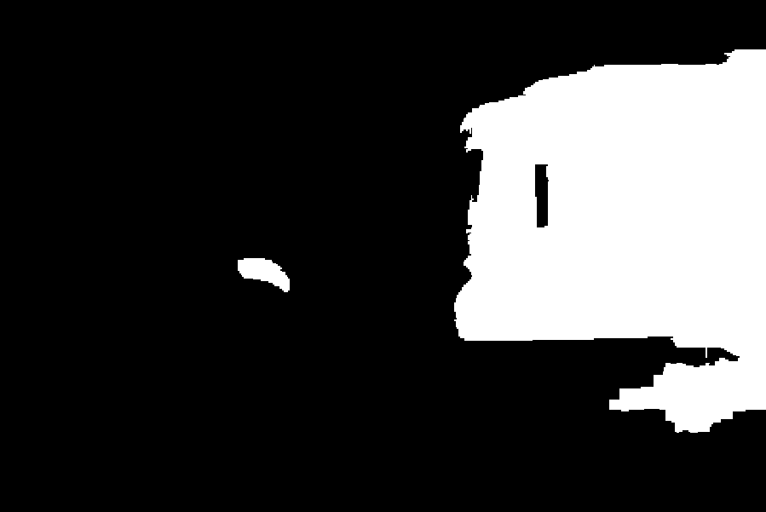

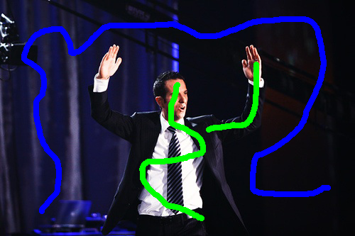
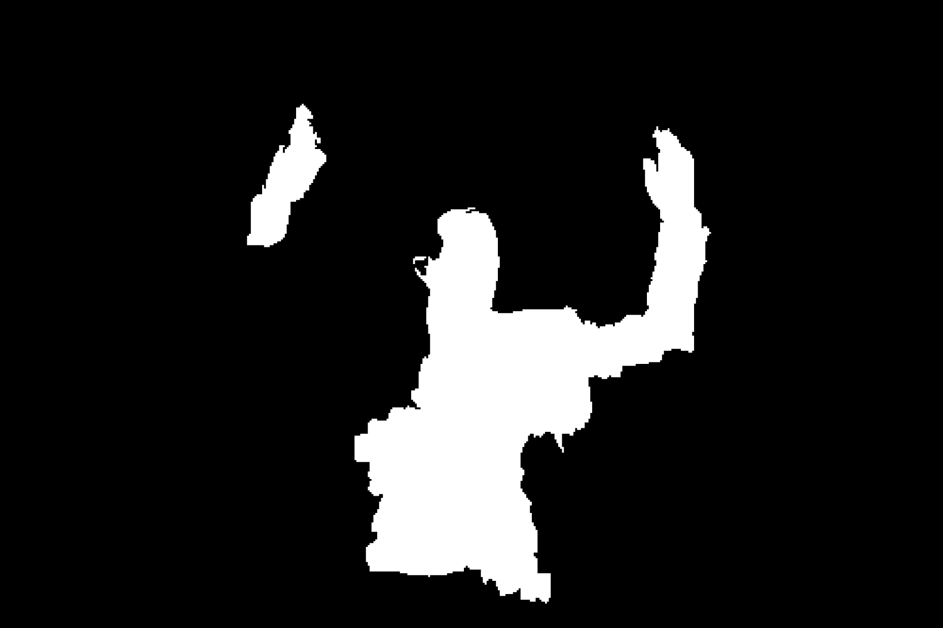


Experiment #1
Interactive Segmentation
  Model: Color/Texture + Potts Grid CRF
  Inference: Graph-cuts
  Dataset: 50 train/val/test images
Image + Scribbles
MAP
2nd Best MAP
Diverse 2nd Best
1-2 Nodes Flipped
100-500 Nodes Flipped
Notes:
The first experiment is interactive segmentation, where a user provides scribbles on images and we use graph-cuts for inference.
This is the second-best solution without diversity. We can see that it is nearly identical to MAP with a few nodes flipped.
This is the second-best solutions with diversity. We can see that these solutions are significantly different. In one case, we found another instance of the object, and in another, we completed a thin long structure.

Slide 30
Experiment #1
+3.62%
+1.61%
+0.05%
(Oracle)
(Oracle)
(Oracle)
M=6
Notes:
Quantitatively, here is the how well MAP performs on our dataset.
And these are the oracle accuracy for different methods. We can see that DivMBest outperforms both baselines.

Slide 31
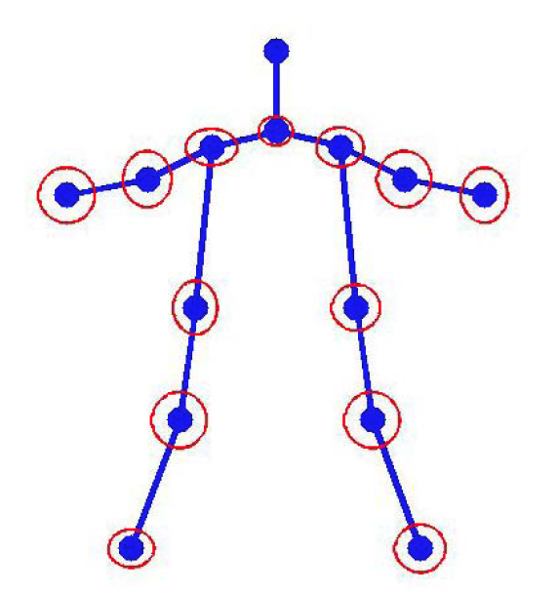
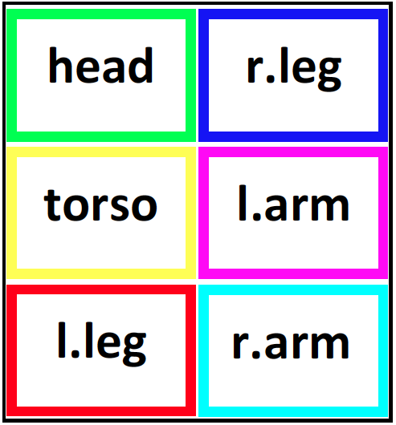
Experiment #2
Pose Tracking
  Model: Mixture of Parts from [Park & Ramanan, ICCV ‘11]
  Inference: Dynamic Programming
  Dataset: 4 videos, 585 frames
Image Credit: [Yang & Ramanan, ICCV ‘11]
Notes:
Next, we applied our approach to pose-tracking in videos.
We replicated the setup of Park & Ramanan who use a mixture of parts tree model. Exact inference can be performed by dynamic programming.

Slide 32
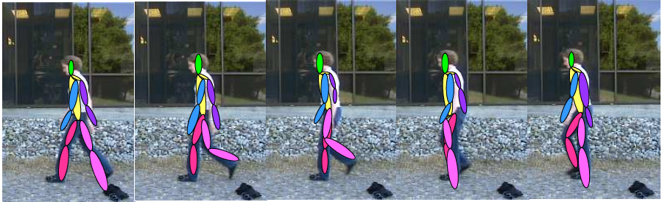
Experiment #2
Pose Tracking w/ Chain CRF
M Best
Solutions
Image Credit: [Yang & Ramanan, ICCV ‘11]
Notes:
We compute M solutions in each frame of the video, and then choose a smooth trajectory using the Viterbi algorithm.

Slide 33
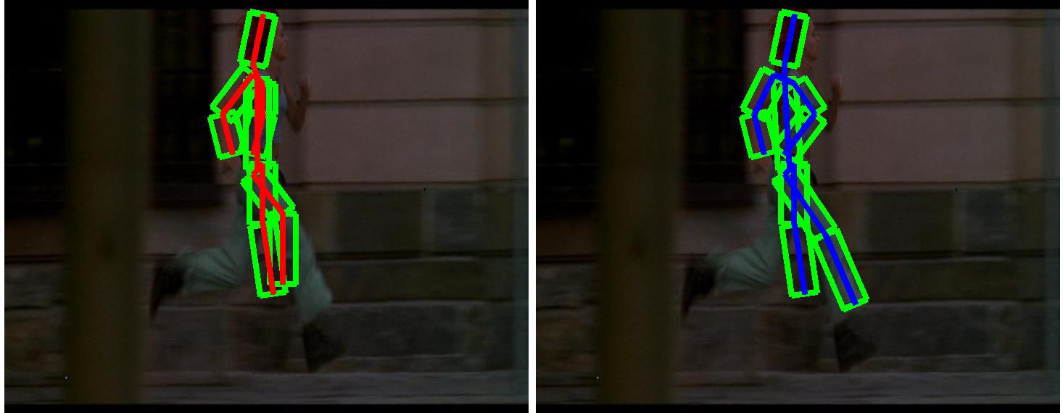
Experiment #2
MAP
DivMBest + Viterbi
Notes:
Here, on the left, I am showing you the MAP pose on each frame. We can see that is quite noisy and jumps around, while the DivMBest solution is smooth.

Slide 34
Experiment #2
Better
DivMBest (Re-ranked)
13% Gain
Same Features
Same Model
[Park & Ramanan, ICCV ‘11] (Re-ranked)
PCP Accuracy
Confidence-based Perturbation (Re-ranked)
#Solutions / Frame
Notes:
Here are quantitative results. On the x axis are the no. of solutions per frame. On the Y axis is PCP accuracy of the trajectory.
The confidence based baseline does not benefit from multiple solutions.
This is the result from Park & Ramanan. And this is our approach.
We can see that we get an improvement of 13 PCP points with the same model and exactly the same features, just a different way of computing multiple solutions.

Slide 35
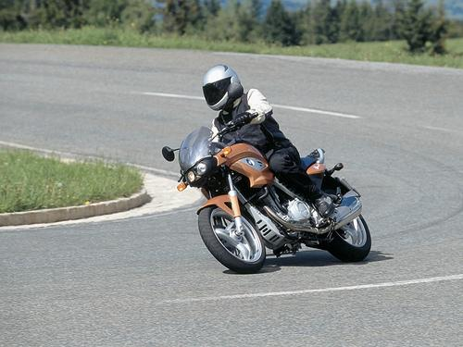
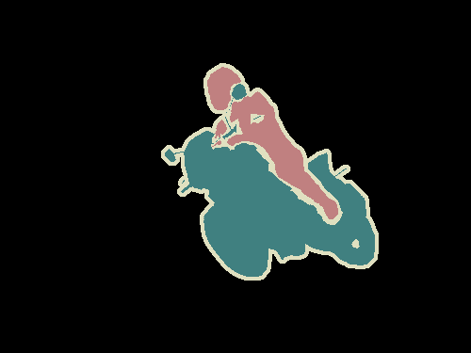


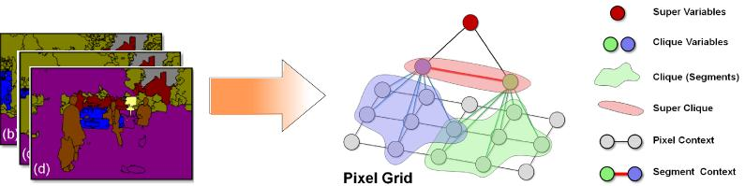
Experiment #3
Semantic Segmentation
  Model: Hierarchical CRF [Ladicky et al. ECCV ’10, ICCV ‘09]
  Inference: Alpha-expansion
  Dataset: Pascal Segmentation Challenge (VOC 2010)
    20 categories + background; 964 train/val/test images
  Image Credit: [Ladicky et al. ECCV ’10, ICCV ’09]
Notes:
Finally, we applied DivMBest to Semantic Segmentation on the PASCAL 2010 dataset.
We use the model of Ladicky et al., where approximate inference is performed with alpha-expansion.

Slide 36


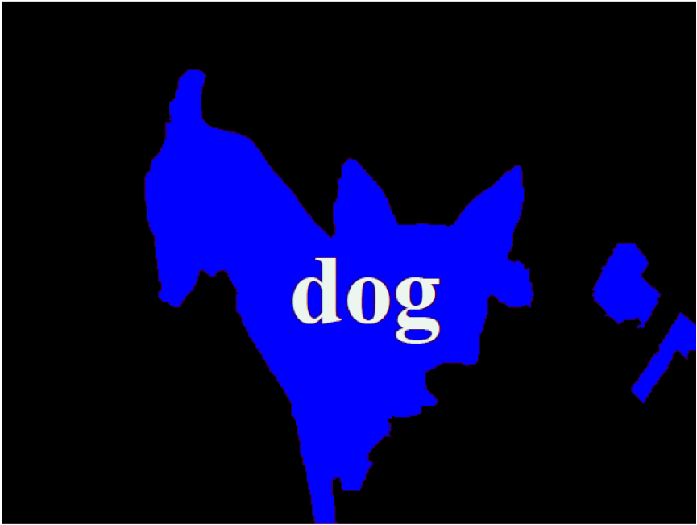
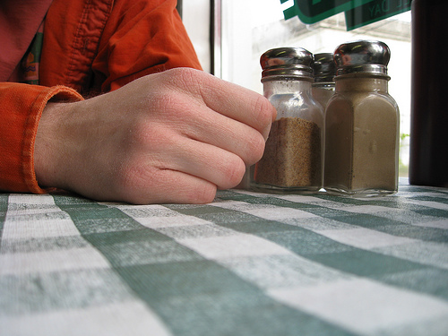
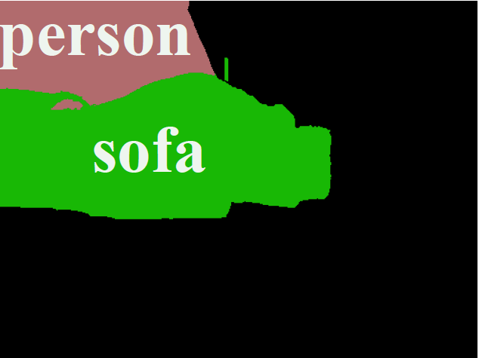
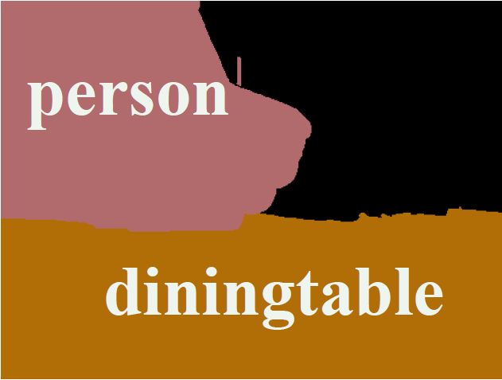
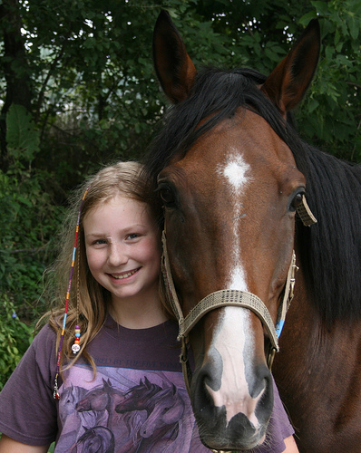
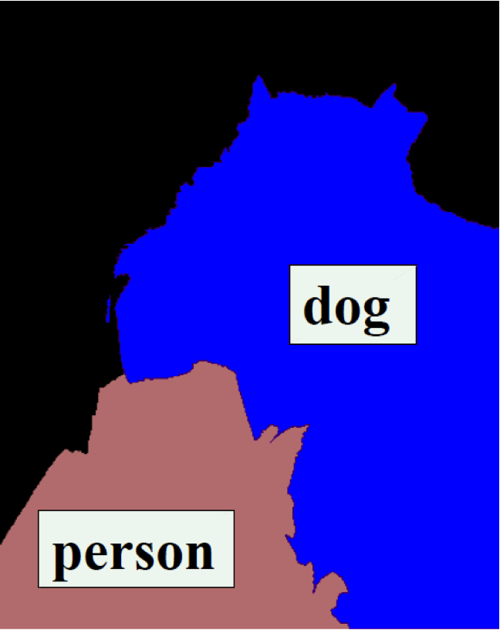
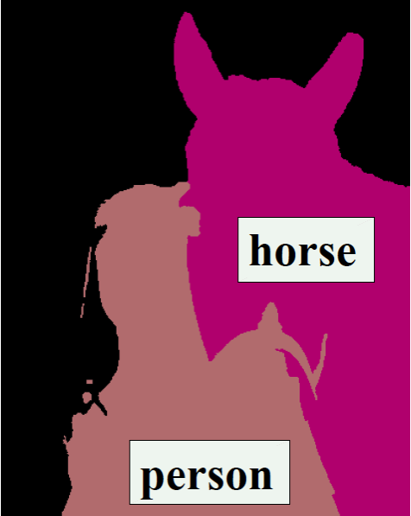
Experiment #3
Input
MAP
Best of 10-Div
Notes:
Here are some example results.
We can see that for the first image, the MAP solution is wrong.
But if we compute 10 diverse solutions, one of them does in fact have the correct answer.

Slide 37
Experiment #3
DivMBest (Oracle)
Better
22%-gain possible
Same Features
Same Model
PACAL Accuracy
DivMBest (Re-ranked) [Yadollahpour et al.]
Confidence-based Perturbation (Oracle)
MAP
#Solutions / Image
Notes:
Here are some quantitative results.
On the x axis are the number of solutions per image, 1 to 30; and on the y-axis are PASCAL accuracies.
This is the MAP accuracy of this model. The ORACLE accuracies perturbation baseline are not much higher.
And here are the ORACLE accuracies for DivMBest. We can see an improvement of 22%-point is possible, which is very significant for this dataset. And this is all with the exactly the same model, same features, just by producing 30 solutions instead of 1.
In preliminary work, we have automatically reranked these solutions to outperform MAP, but further closing this gap is ongoing work.

Slide 38
Summary
All models are wrong
Some beliefs are useful
DivMBest
  First principled formulation for Diverse M-Best in MRFs
  Efficient algorithm. Re-uses MAP machinery.
  Big impact possible on many applications!
Notes:
In summary, not matter what the problem, all models are wrong, but some of their beliefs might be useful.
Our proposed algorithm give you a wait to exploit these beliefs by producing diverse M-Best solutions in discrete models.
It’s an efficient algorithm that re-uses existing MAP machinery.
And we believe there is a big impact possible on many applications.

Slide 39
Thank you!
Think about YOUR problem.
Are you or a loved one, tired of a single solution?
If yes, then DivMBest might be right for you!*
* DivMBest is not suited for everyone. People with perfect models, and love of continuous
variables should not use DivMBest. Consult your local optimization expert before starting
DivMBest. Please do not drive or operate heavy machinery while on DivMBest.

