Slide 1
Sampling and Volume Computation in High Dimension
Santosh Vempala

Slide 2
Tutorial outline
Intro to high dimension and convexity
  Volume distribution, logconcavity
  Ellipsoids
  Lower bounds
Algorithms
  Rounding
  Volume/Integration
  Optimization
  Sampling
Probability
  Markov chains
  Conductance
  Mixing of ball walk
  Mixing of hit-and-run
Geometry
  Isoperimetry
  Concentration
  Localization and applications
Open problems

Slide 3
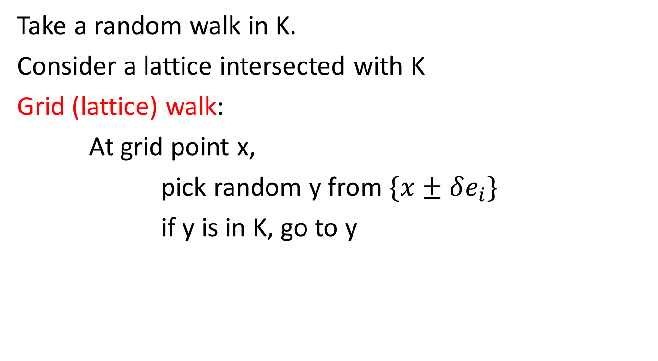
How to sample?
Take a random walk in K.
Consider a lattice intersected with K
Grid (lattice) walk:
At grid point x,
pick random y from $\{x±δe_{i}\}$
if y is in K, go to y

Slide 4
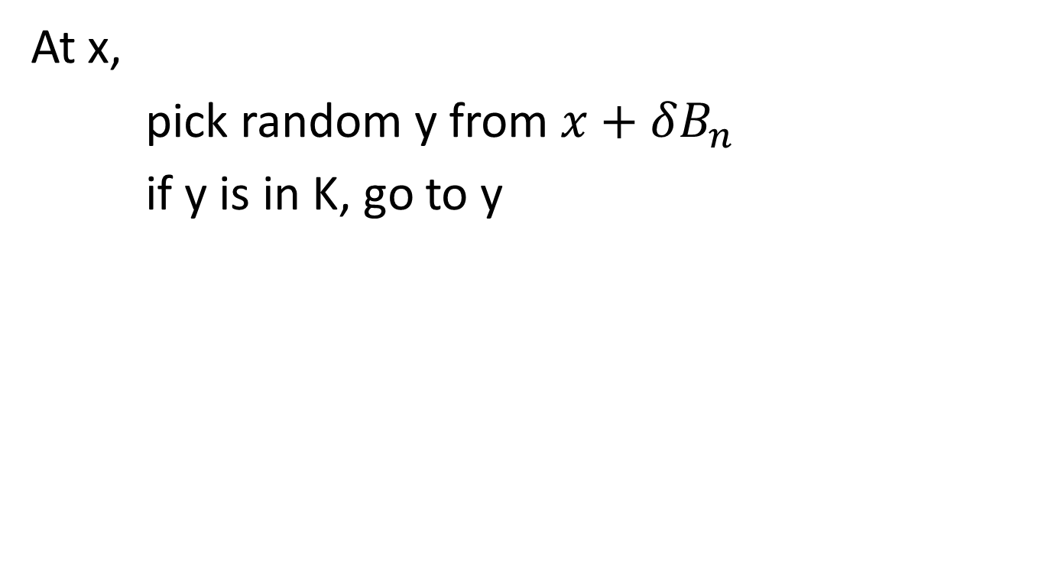
Ball walk
At x,
pick random y from $x+δB_{n}$
if y is in K, go to y

Slide 5
Hit-and-run
[Boneh, Smith]
At x,
-pick a random chord L through x
-go to a uniform random point y on L

Slide 6
Part 3: Probability
Markov chains
Convergence
Conductance
1-step coupling

Slide 7
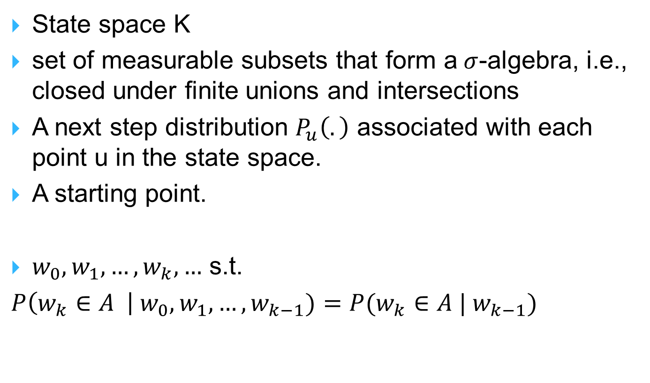
Markov chains
State space K
set of measurable subsets that form a$σ$-algebra, i.e., closed under finite unions and intersections
A next step distribution $P_{u}\left(.\right)$ associated with each point u in the state space.
A starting point.
$w_{0},w_{1},…,w_{k},…$ s.t.
$P\left(w_{k}∈A \right| w_{0}, w_{1},…,w_{k−1})=P(w_{k}∈A | w_{k−1})$

Slide 8
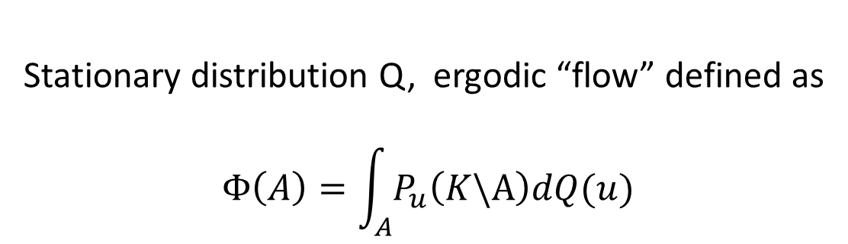
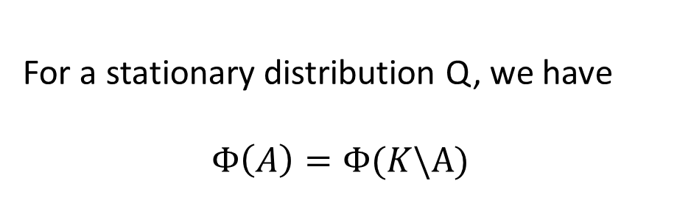
Convergence
Stationary distribution Q, ergodic “flow” defined as
$$Φ\left(A\right)=\int_{A}{P_{u}\left(K\backslash A\right)dQ(u)}$$
For a stationary distribution Q, we have
$$Φ\left(A\right)=Φ(K\backslash A)$$

Slide 9
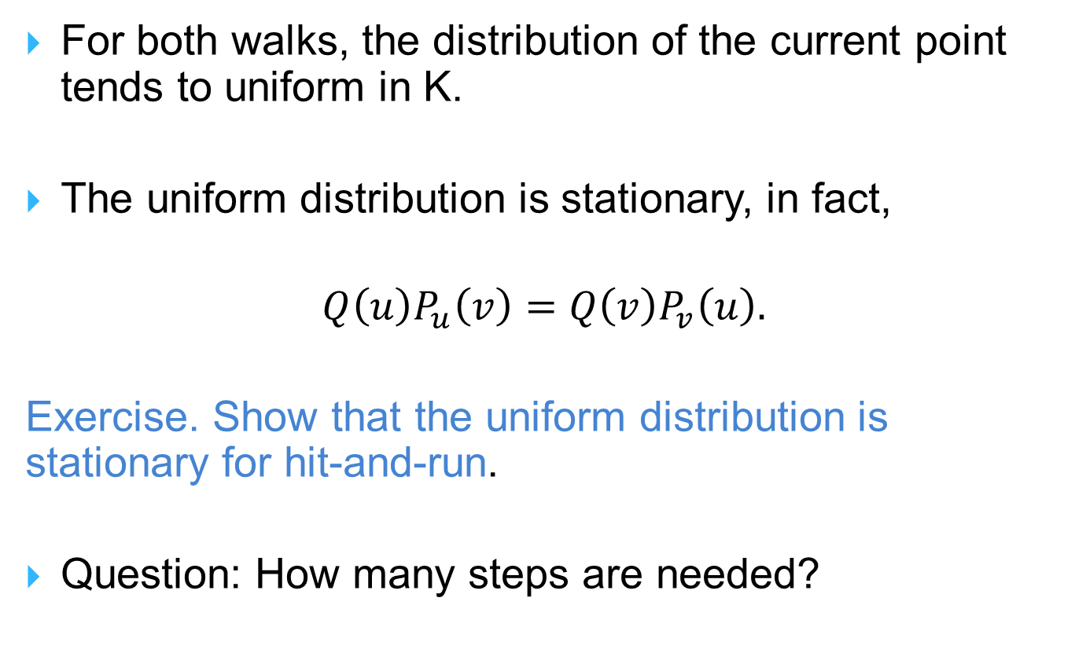
Random walks in K
For both walks, the distribution of the current point tends to uniform in K.
The uniform distribution is stationary, in fact,
$$Q\left(u\right)P_{u}\left(v\right)=Q\left(v\right)P_{v}\left(u\right).$$
Exercise. Show that the uniform distribution is stationary for hit-and-run.
Question: How many steps are needed?

Slide 10
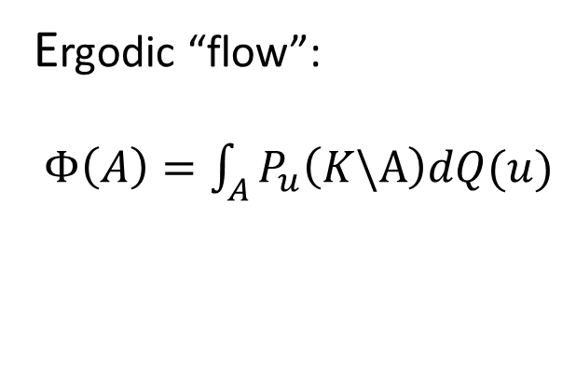
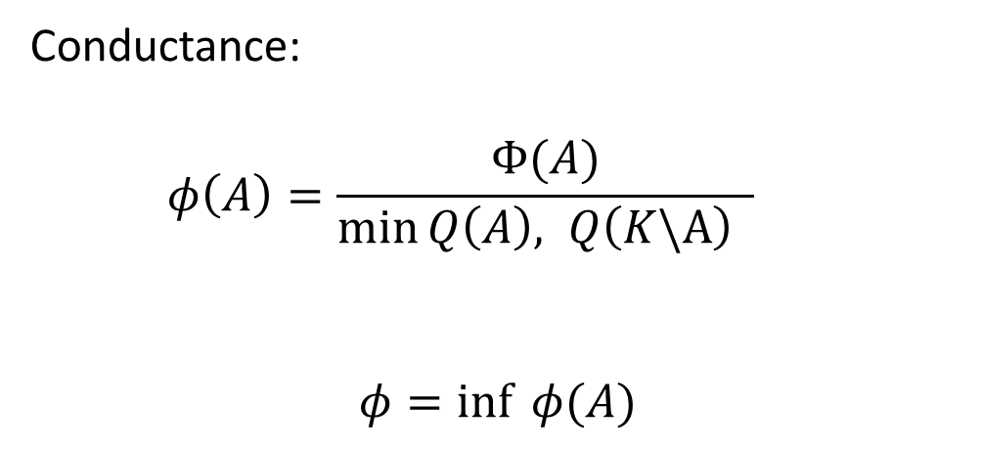
Conductance
Ergodic “flow”:
$Φ\left(A\right)=\int_{A}{P_{u}\left(K\backslash A\right)dQ(u)}$
Conductance:
$$φ\left(A\right)=\frac{Φ(A)}{\min{Q\left(A\right), Q\left(K\backslash A\right) }}$$
$$φ=\inf{ φ(A)}$$

Slide 11
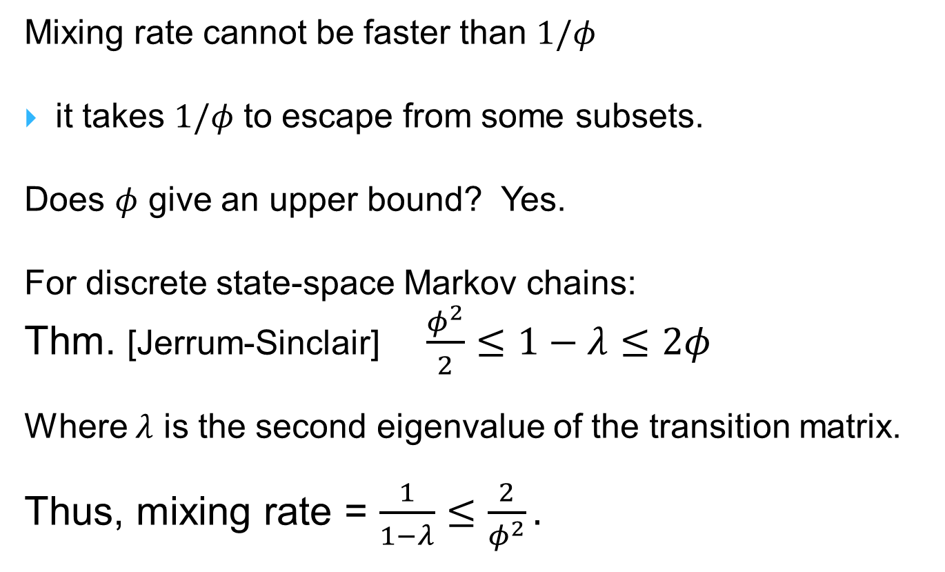
Conductance and convergence
Mixing rate cannot be faster than $1/φ$
it takes $1/φ$ to escape from some subsets.
Does $φ$ give an upper bound? Yes.
For discrete state-space Markov chains:
Thm. [Jerrum-Sinclair] $\frac{φ^{2}}{2}≤1−λ≤2φ$
Where $λ$ is the second eigenvalue of the transition matrix.
Thus, mixing rate = $\frac{1}{1−λ}≤\frac{2}{φ^{2}}.$

Slide 12
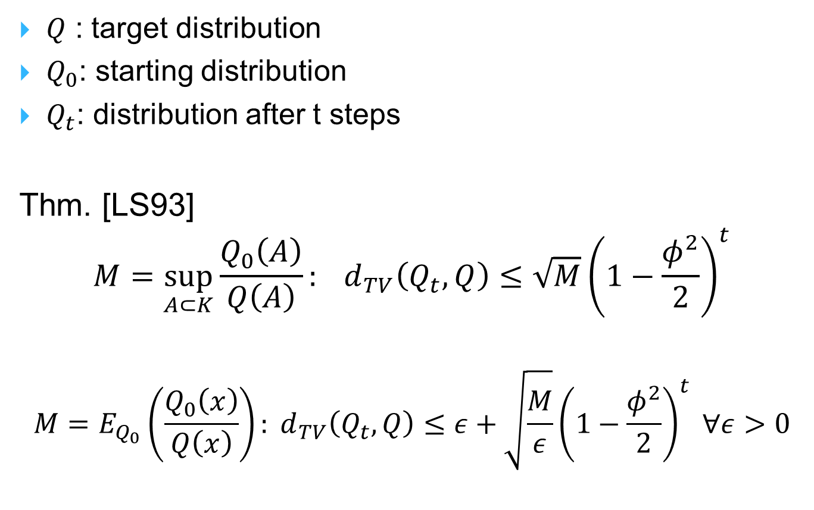
Rate of convergence
$Q$ : target distribution
$Q_{0}$: starting distribution
$Q_{t}$: distribution after t steps
Thm. [LS93]
$$M=\sup_{A⊂K}{\frac{Q_{0}\left(A\right)}{Q\left(A\right)}}: d_{TV}\left(Q_{t},Q\right)≤\sqrt{M}{\left(1−\frac{φ^{2}}{2}\right)}^{t}$$
$$M=E_{Q_{0}}\left(\frac{Q_{0}\left(x\right)}{Q\left(x\right)}\right): d_{TV}\left(Q_{t},Q\right)≤ε+\sqrt{\frac{M}{ε}}{\left(1−\frac{φ^{2}}{2}\right)}^{t} ∀ε>0$$

Slide 13
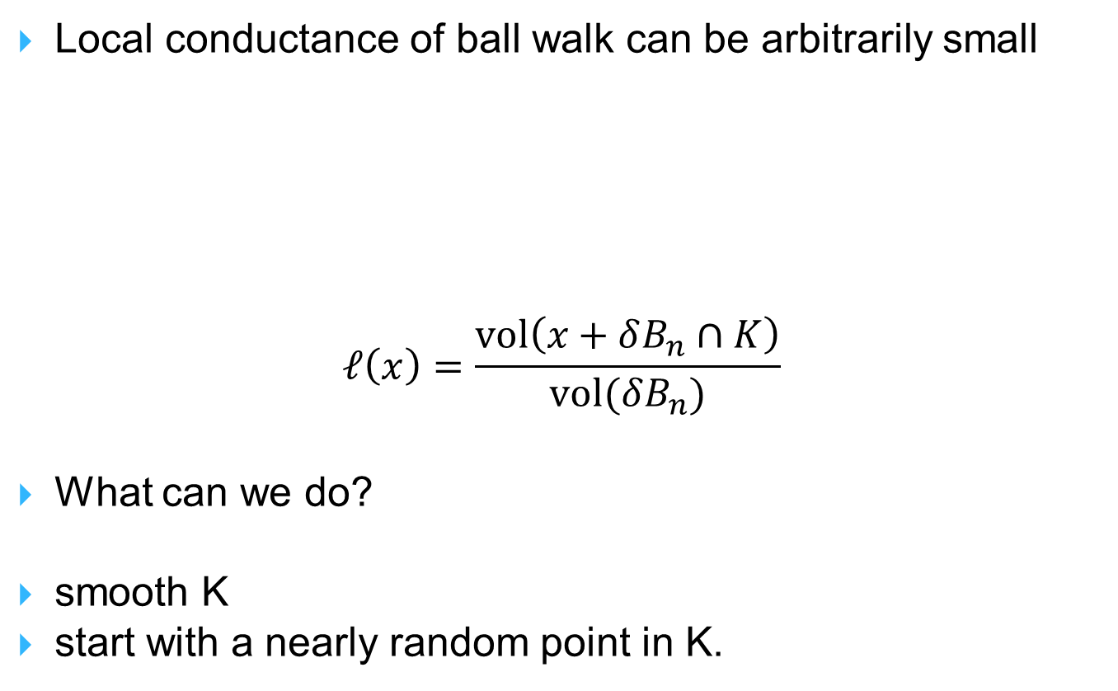
How to bound conductance?
Local conductance of ball walk can be arbitrarily small
$$ℓ\left(x\right)=\frac{vol\left(x+δB_{n}∩K\right)}{vol(δB_{n})}$$
What can we do?
smooth K
start with a nearly random point in K.

Slide 14

Smoothing a convex body
$$K^{′}=K+αB_{n}$$
Each point of the original body has a small ball around it.
What about new points? A ball of radius $α$ containing the point is fully contained in K.

Slide 15

Smoothing a convex body
$$K^{′}=K+αB_{n}$$
A ball of radius $α$ containing the point is contained in K.
Choosing $α≥δ\sqrt{n}$ ensures that every point has local conductance at least a constant.

Slide 16
Conductance
Consider an arbitrary measurable subset S.
We need to show that the escape probability from S is large.

Slide 17
Bounding the conductance
Need:
Points that do not cross over are far from each other
If two subsets are far, then the rest of the set is large

Slide 18

One-step distributions
Idea:
$d\left(P_{u}, P_{v}\right)$ large
the balls around u,v have small intersection
u,v must be far

Slide 19


Prob. distance Geometric distance
Lemma. $u,v∈K, ℓ\left(u\right), ℓ\left(v\right)≥ℓ$ for the ball walk with $δ$-steps. If
$$d\left(u,v\right)≤\frac{tδ}{\sqrt{n}},$$
then $d\left(P_{u}, P_{v}\right)≤1+t−ℓ$.

Slide 20

Coupling 1-step distributions
$$d\left(P_{u},P_{v}\right)= vol( ) ≤t$$
if $ℓ<1, d\left(P_{u},P_{v}\right)≤t+1−ℓ$

Slide 21
Conductance
Need:
Nearby points have overlapping one-step distributions
Large subsets have large boundaries [isoperimetry]

Slide 22
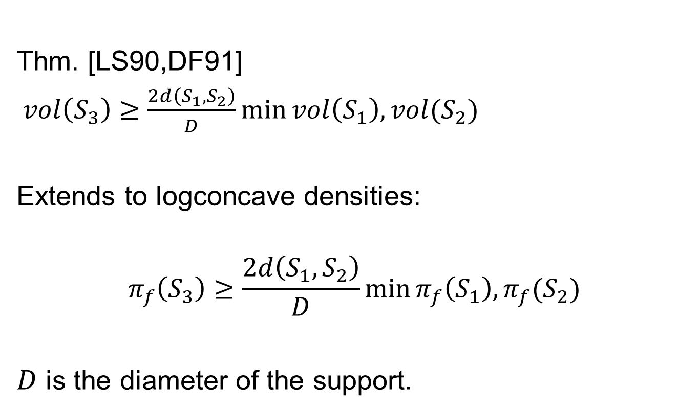
Isoperimetry
Thm. [LS90,DF91]
$vol\left(S_{3}\right)≥\frac{2d\left(S_{1},S_{2}\right)}{D}\min{vol\left(S_{1}\right), vol(S_{2})}$
Extends to logconcave densities:
$$π_{f}\left(S_{3}\right)≥\frac{2d\left(S_{1},S_{2}\right)}{D}\min{π_{f}\left(S_{1}\right), π_{f}(S_{2})}$$
$D$ is the diameter of the support.

Slide 23
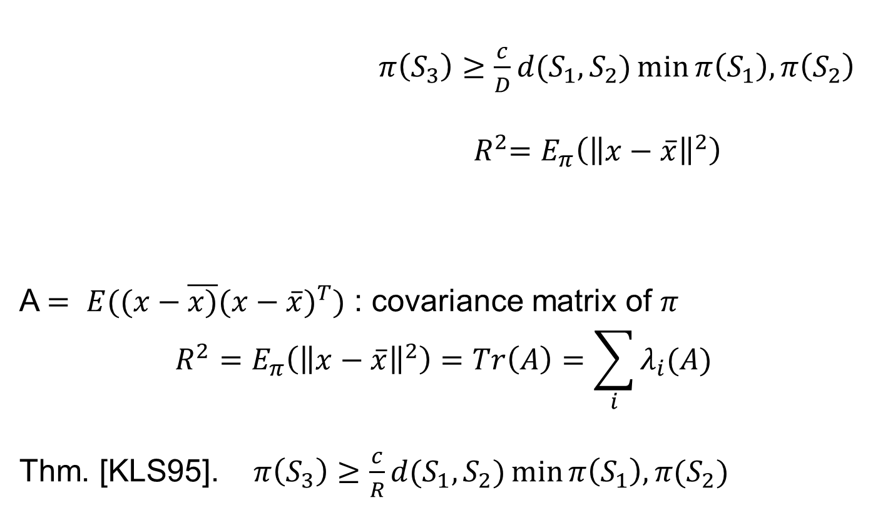
Isoperimetry
$π\left(S_{3}\right)≥\frac{c}{D}d(S_{1},S_{2})\min{π\left(S_{1}\right), π\left(S_{2}\right)}$
${{ R}^{2}=E}_{π}\left({\left\|x−\overline{x}\right\|}^{2}\right)$
A $= E((x−\overline{x)}({x−\overline{x})}^{T})$ : covariance matrix of $π$
$${R^{2}=E}_{π}\left({\left\|x−\overline{x}\right\|}^{2}\right)=Tr\left(A\right)=\sum_{i}{λ_{i}(A)}$$
Thm. [KLS95]. $π\left(S_{3}\right)≥\frac{c}{R}d(S_{1},S_{2})\min{π\left(S_{1}\right), π(S_{2})}$

Slide 24
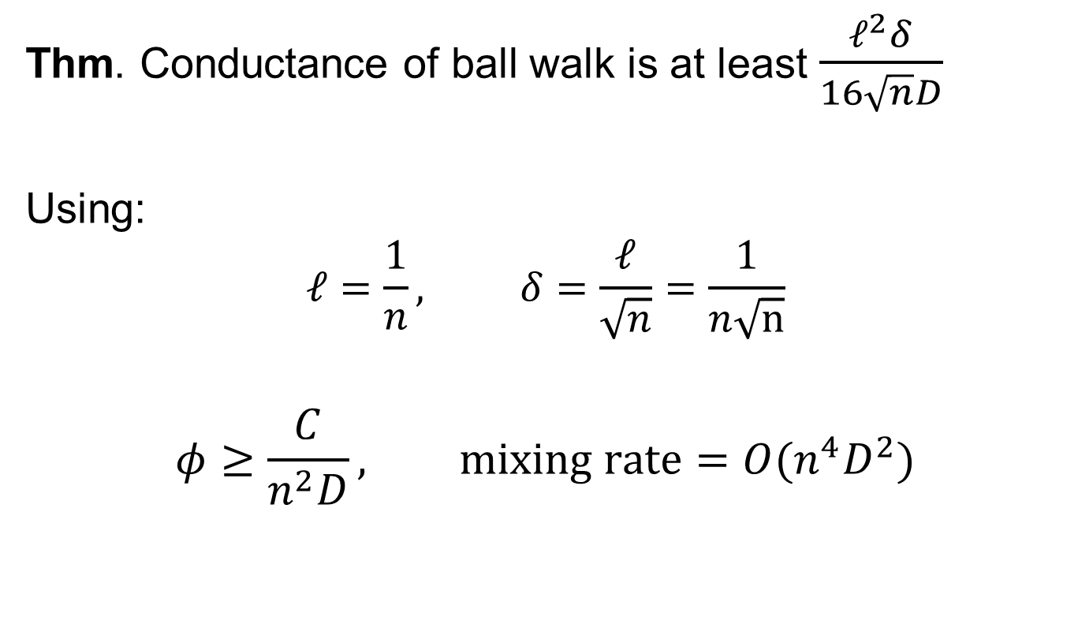
Conductance
Thm. Conductance of ball walk is at least $\frac{ℓ^{2}δ}{16\sqrt{n}D}$
Using:
$$ℓ=\frac{1}{n}, δ=\frac{ℓ}{\sqrt{n}}=\frac{1}{n\sqrt{n}}$$
$$φ≥\frac{C}{n^{2}D}, mixing rate=O(n^{4}D^{2})$$

Slide 25
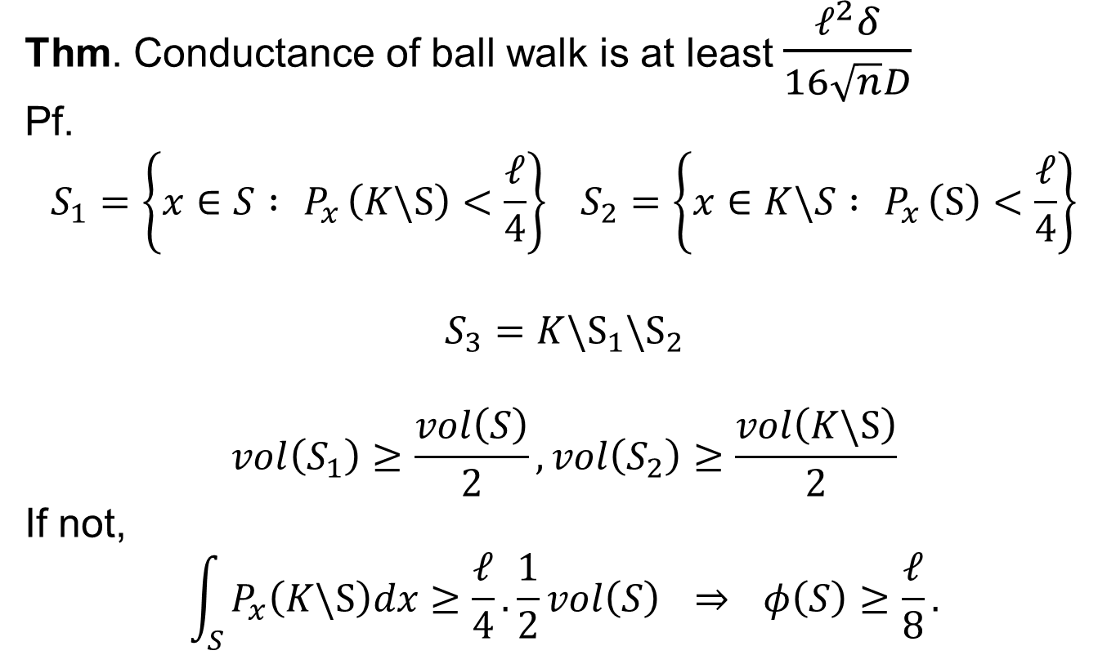
Conductance: proof
Thm. Conductance of ball walk is at least $\frac{ℓ^{2}δ}{16\sqrt{n}D}$
Pf.
$$S_{1}=\left\{x∈S :{ P}_{x}\left(K\backslash S\right)<\frac{ℓ}{4}\right\} S_{2}=\left\{x∈K\backslash S :{ P}_{x}\left(S\right)<\frac{ℓ}{4}\right\}$$
$$S_{3}=K\backslash S_{1}\backslash S_{2}$$
$$vol\left(S_{1}\right)≥\frac{vol\left(S\right)}{2}, vol\left(S_{2}\right)≥\frac{vol\left(K\backslash S\right)}{2}$$
If not,
$$\int_{S}{P_{x}\left(K\backslash S\right)dx≥\frac{ℓ}{4}.\frac{1}{2}vol\left(S\right) \overset{⇒}{} φ\left(S\right)≥\frac{ℓ}{8}.}$$

Slide 26
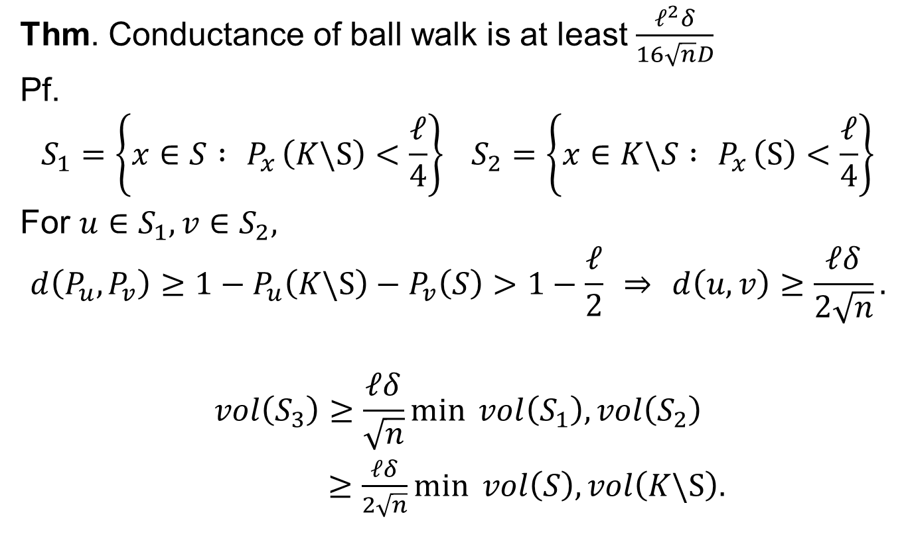
Conductance: proof
Thm. Conductance of ball walk is at least $\frac{ℓ^{2}δ}{16\sqrt{n}D}$
Pf.
$$S_{1}=\left\{x∈S :{ P}_{x}\left(K\backslash S\right)<\frac{ℓ}{4}\right\} S_{2}=\left\{x∈K\backslash S :{ P}_{x}\left(S\right)<\frac{ℓ}{4}\right\}$$
For $u∈S_{1}, v∈S_{2},$
$$d\left(P_{u}, P_{v}\right)≥1−P_{u}\left(K\backslash S\right)−P_{v}\left(S\right)>1−\frac{ℓ}{2} \overset{⇒}{} d\left(u,v\right)≥\frac{ℓδ}{2\sqrt{n}}.$$
$$vol\left(S_{3}\right)≥\frac{ℓδ}{\sqrt{n}}\min{ vol\left(S_{1}\right),vol\left(S_{2}\right)}$$
$≥\frac{ℓδ}{2\sqrt{n}}\min{ vol\left(S\right), vol\left(K\backslash S\right).}$

Slide 27
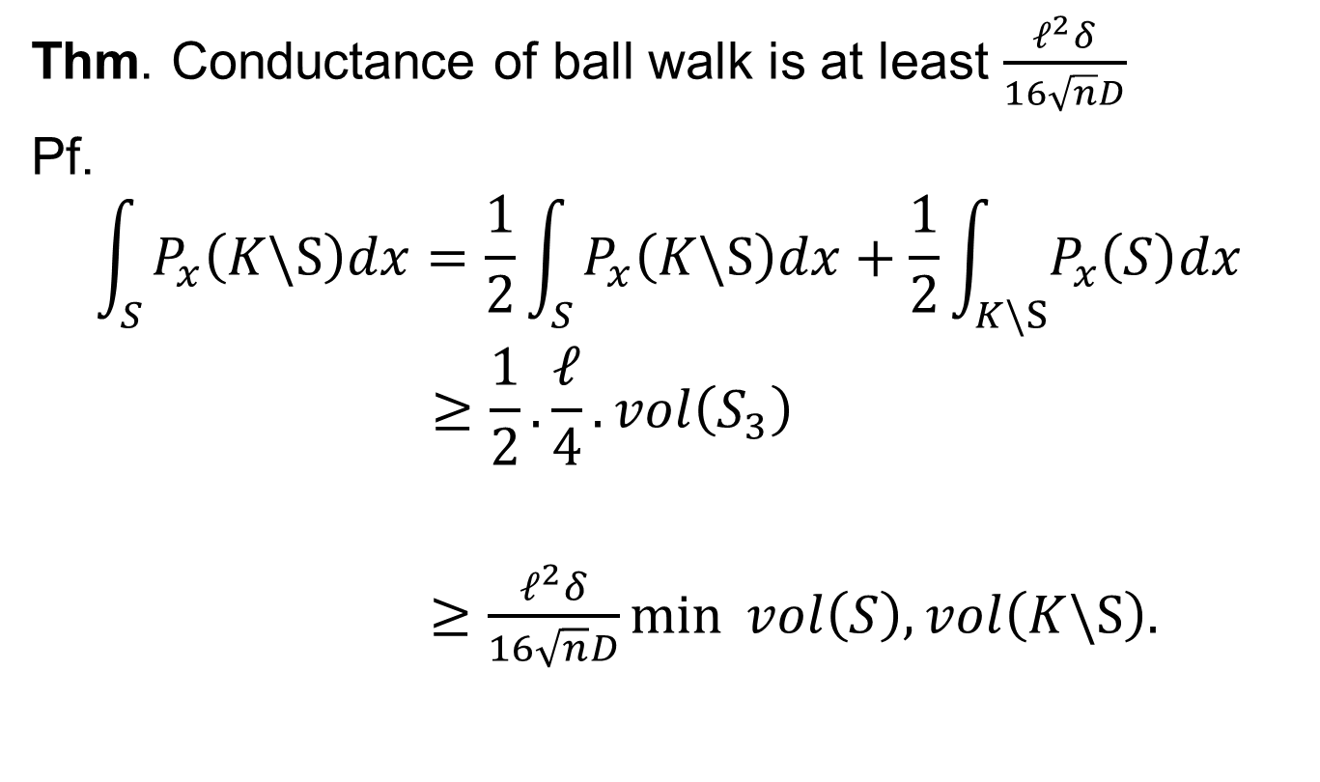
Conductance: proof
Thm. Conductance of ball walk is at least $\frac{ℓ^{2}δ}{16\sqrt{n}D}$
Pf.
$$\int_{S}{P_{x}\left(K\backslash S\right)dx=\frac{1}{2}\int_{S}{P_{x}\left(K\backslash S\right)dx+\frac{1}{2}\int_{K\backslash S}{P_{x}\left(S\right)dx}}}$$
$$≥\frac{1}{2}.\frac{ℓ}{4}.vol\left(S_{3}\right)$$
$≥\frac{ℓ^{2}δ}{16\sqrt{n}D}\min{ vol\left(S\right), vol\left(K\backslash S\right).}$

Slide 28
Convergence of the ball walk
Thm. [LS93, KLS97] If S is convex, then the ball walk with an M-warm start reaches an (independent) nearly random point in poly(n, D, M) steps.
Strictly speaking, this is not rapid mixing!
How to get the first random point?
Better dependence on diameter D?

Slide 29
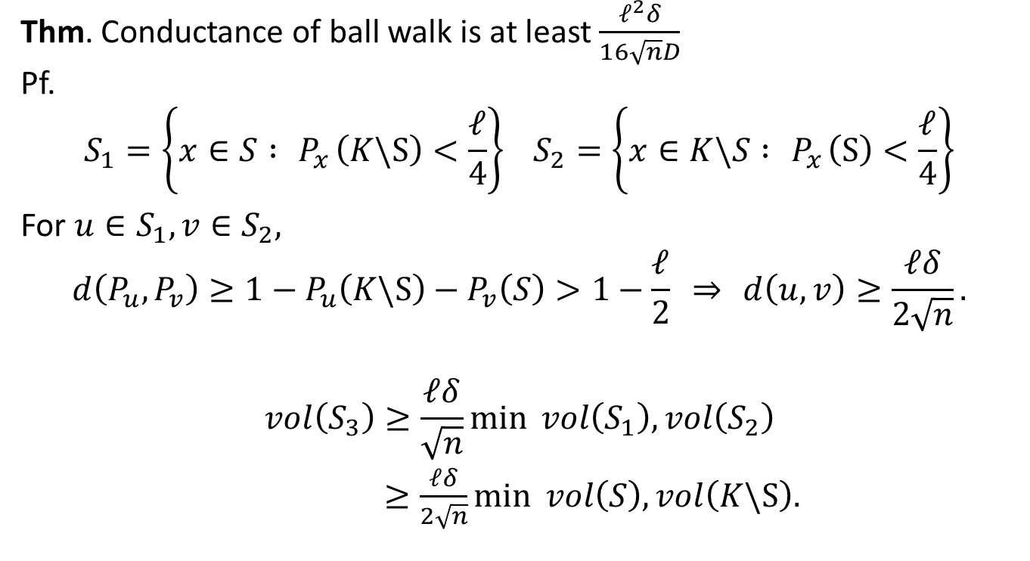
Speedy walk: a thought experiment
Take sequence of points visited by ball walk:
$$w_{0}, w_{1}, w_{2},w_{3},…, w_{i}, w_{i+1},w_{i+3}…$$
Subsequence of “proper” attempts that stay inside K
This subsequence is a Markov chain and is rapidly mixing from any point
For a warm start, the total number of steps is only a constant factor higher

Slide 30
Is rapid mixing possible?
Ball walk can have bad starts, but
Hit-and-run escapes from corners
Min distance isoperimetry is too coarse

Slide 31
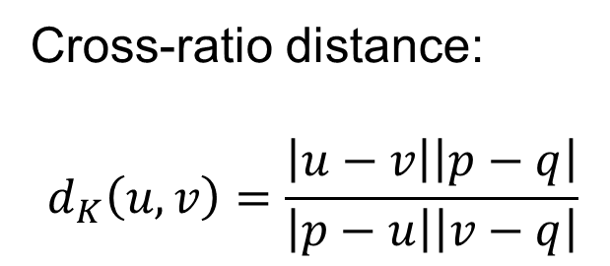
Distance for hit-and-run
Cross-ratio distance:
$$d_{K}\left(u,v\right)=\frac{\left|u−v\right|\left|p−q\right|}{\left|p−u\right|\left|v−q\right|}$$
Thm. [L;LV] ${ π}_{f}\left(S_{3}\right)≥d_{K}\left(S_{1},S_{2}\right)π_{f}\left(S_{1}\right)π_{f}(S_{2})$

Slide 32

Average distance isoperimetry
How to average distance?
$h\left(x\right)≤\frac{1}{3}min{ \left\{d\left(u,v\right) : u∈S_{1}, v∈S_{2}, x∈ℓ(x,y)\right\}}$
Thm.[LV04] $π\left(S_{3}\right)≥E\left(h\left(x\right)\right)π(S_{1})π(S_{2})$

Slide 33
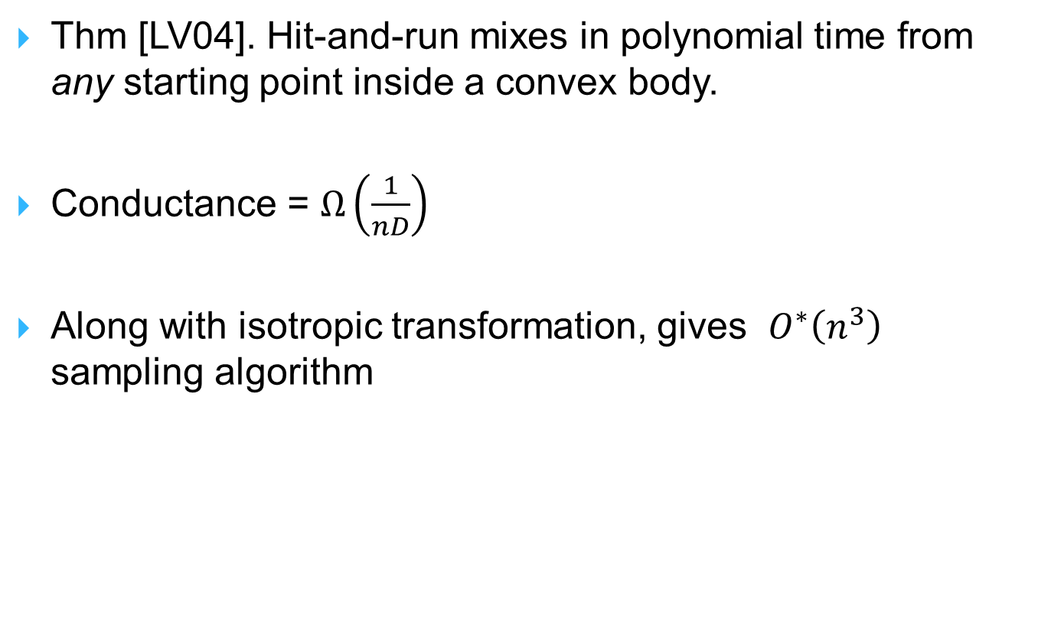
Hit-and-run mixes rapidly
Thm [LV04]. Hit-and-run mixes in polynomial time from any starting point inside a convex body.
Conductance = $Ω\left(\frac{1}{nD}\right)$
Along with isotropic transformation, gives $O^{∗}\left(n^{3}\right)$ sampling algorithm

Slide 34
Part 4: Geometry
Isoperimetry
Localization
Concentration
Other applications

Slide 35
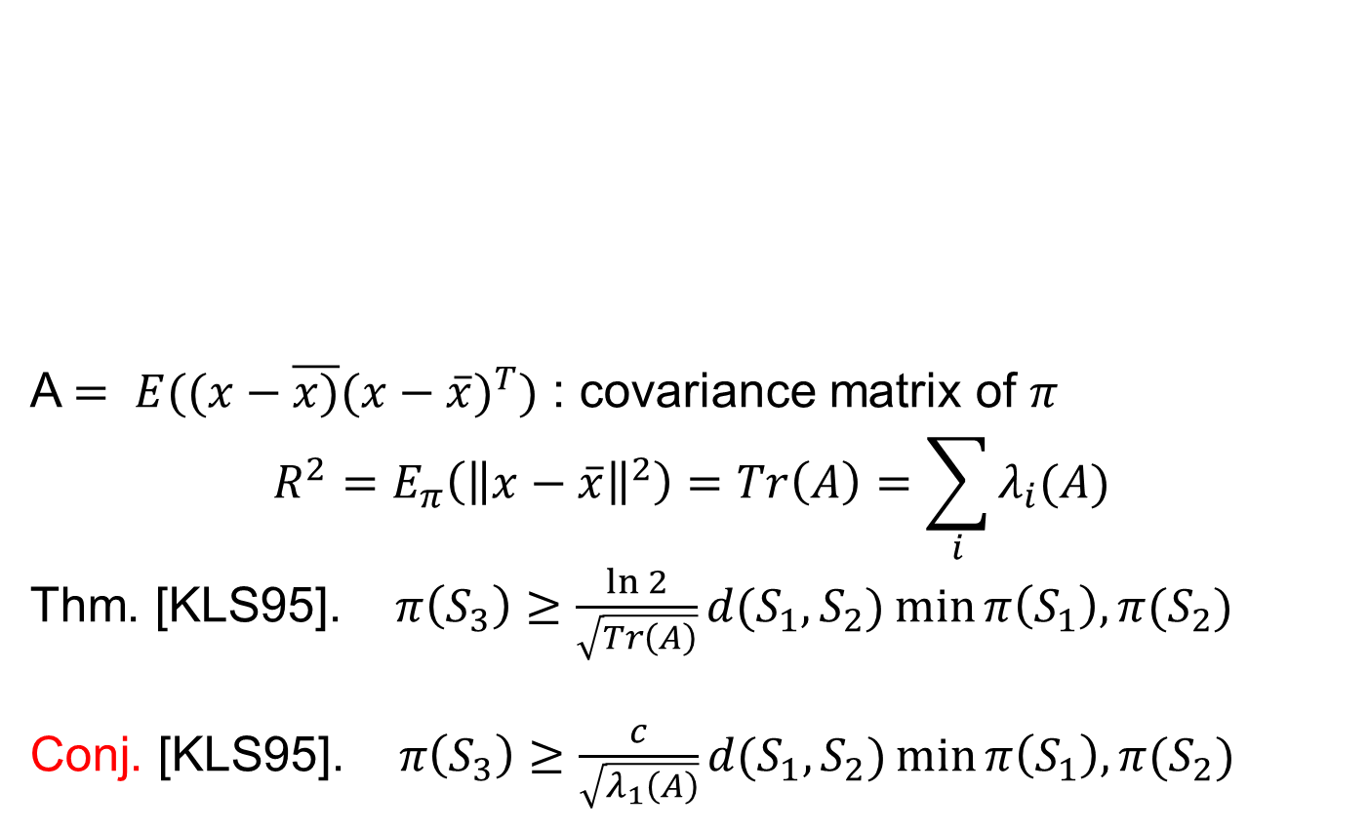
Isoperimetry: KLS conjecture
A $= E((x−\overline{x)}({x−\overline{x})}^{T})$ : covariance matrix of $π$
$${R^{2}=E}_{π}\left({\left\|x−\overline{x}\right\|}^{2}\right)=Tr\left(A\right)=\sum_{i}{λ_{i}(A)}$$
Thm. [KLS95]. $π\left(S_{3}\right)≥\frac{\ln{2}}{\sqrt{Tr\left(A\right)}}d(S_{1},S_{2})\min{π\left(S_{1}\right), π(S_{2})}$
Conj. [KLS95]. $π\left(S_{3}\right)≥\frac{c}{\sqrt{λ_{1}\left(A\right)}}d(S_{1},S_{2})\min{π\left(S_{1}\right), π(S_{2})}$

Slide 36
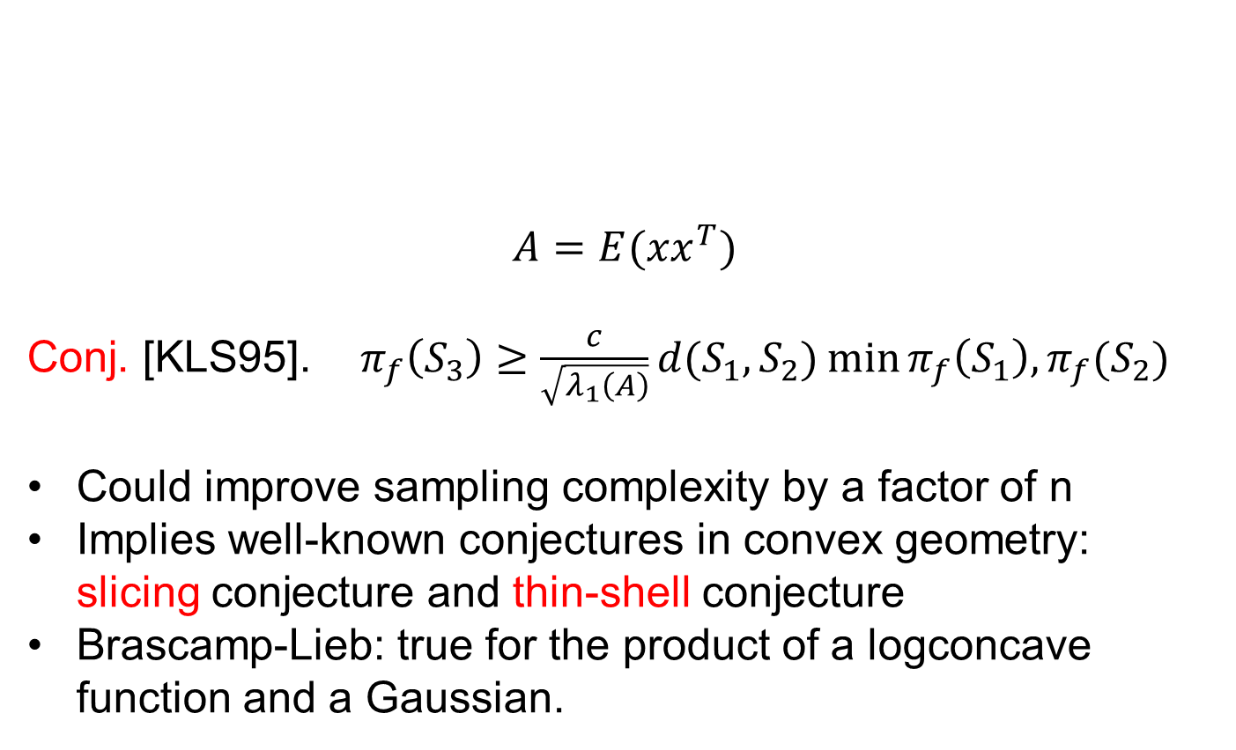
KLS hyperplane conjecture
$$A=E(xx^{T})$$
Conj. [KLS95]. $π_{f}\left(S_{3}\right)≥\frac{c}{\sqrt{λ_{1}\left(A\right)}}d(S_{1},S_{2})\min{π_{f}\left(S_{1}\right), π_{f}(S_{2})}$
Could improve sampling complexity by a factor of n
Implies well-known conjectures in convex geometry: slicing conjecture and thin-shell conjecture
Brascamp-Lieb: true for the product of a logconcave function and a Gaussian.

Slide 37
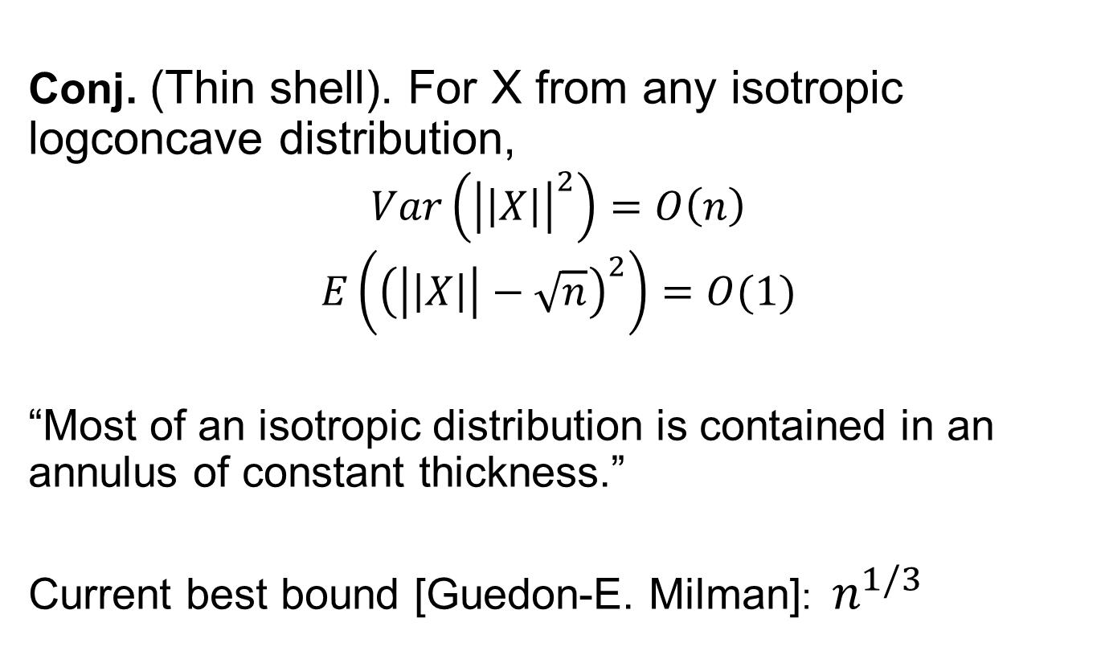
Thin shell conjecture
Conj. (Thin shell). For X from any isotropic logconcave distribution,
$$Var\left({\left|\left|X\right|\right|}^{2}\right)=O\left(n\right)$$
$$E\left({\left(\left|\left|X\right|\right|−\sqrt{n}\right)}^{2}\right)=O(1)$$
“Most of an isotropic distribution is contained in an annulus of constant thickness.”
Current best bound [Guedon-E. Milman]: $n^{1/3}$

Slide 38
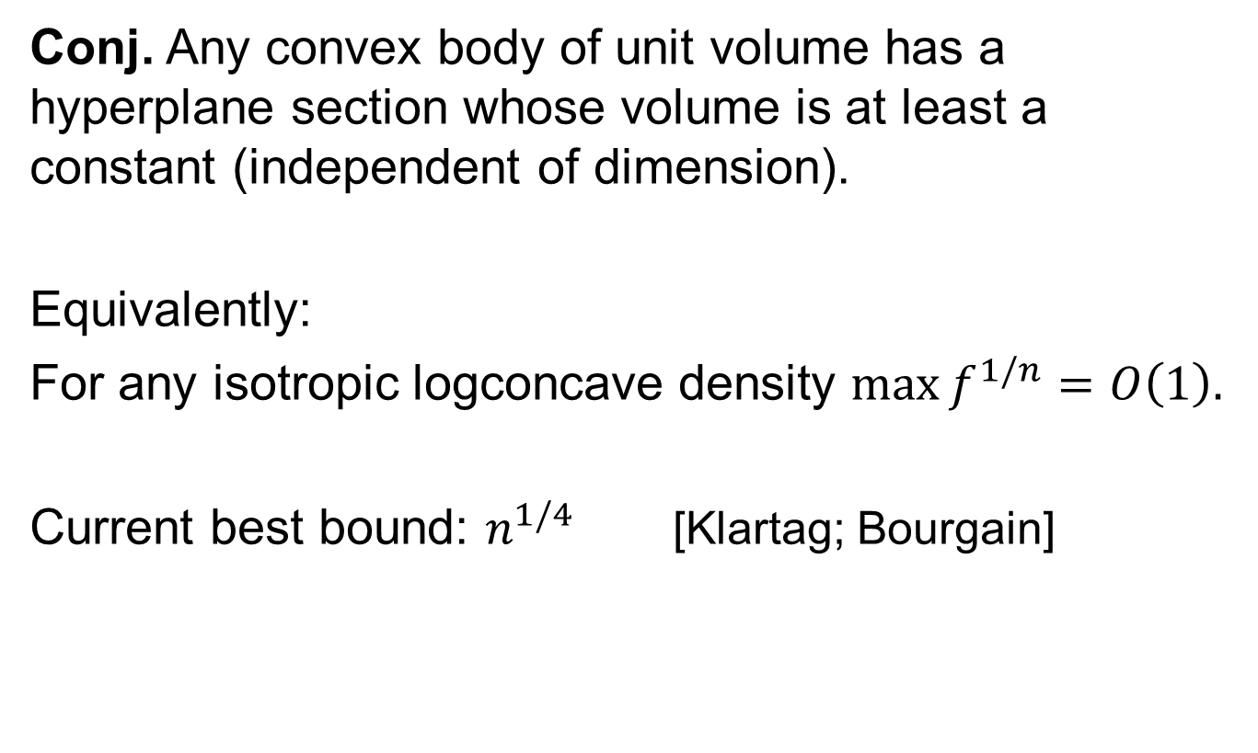
Slicing (or Hyperplane) conjecture
Conj. Any convex body of unit volume has a hyperplane section whose volume is at least a constant (independent of dimension).
Equivalently:
For any isotropic logconcave density $\max{f^{1/n}}=O\left(1\right).$
Current best bound: $n^{1/4}$ [Klartag; Bourgain]

Slide 39
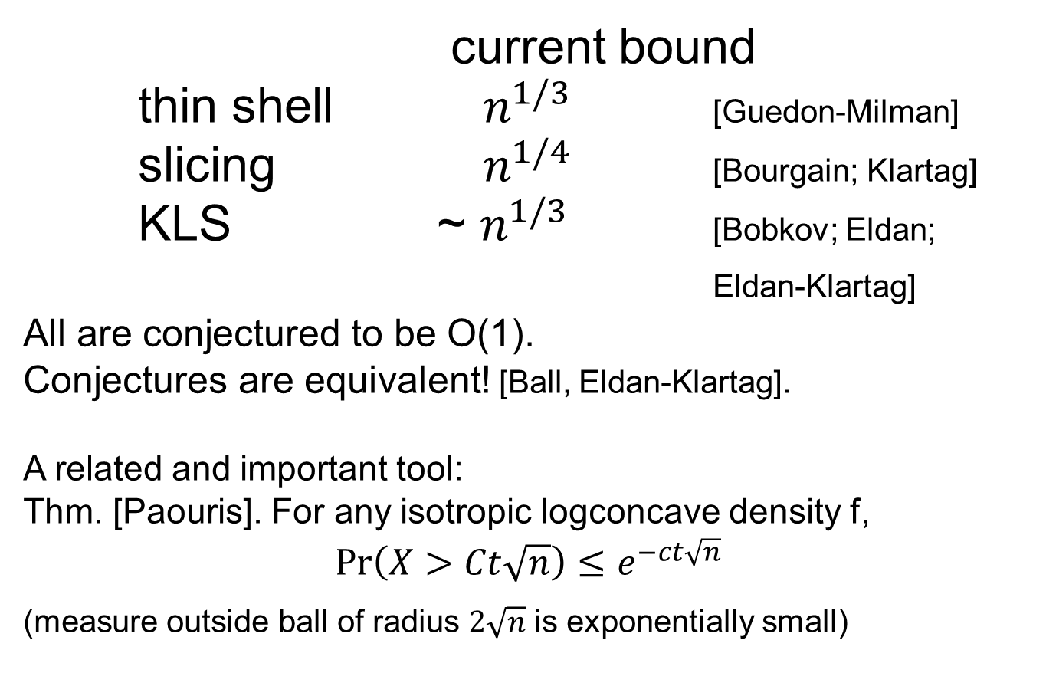
KLS, Slicing, Thin-shell
current bound
thin shell $n^{1/3}$ [Guedon-Milman]
slicing $n^{1/4}$ [Bourgain; Klartag]
KLS ~ $n^{1/3}$ [Bobkov; Eldan;
Eldan-Klartag]
All are conjectured to be O(1).
Conjectures are equivalent! [Ball, Eldan-Klartag].
A related and important tool:
Thm. [Paouris]. For any isotropic logconcave density f,
$${\underset{}{Pr}\left(X>Ct\sqrt{n}\right)≤e}^{−ct\sqrt{n}}$$
(measure outside ball of radius $2\sqrt{n}$ is exponentially small)

Slide 40
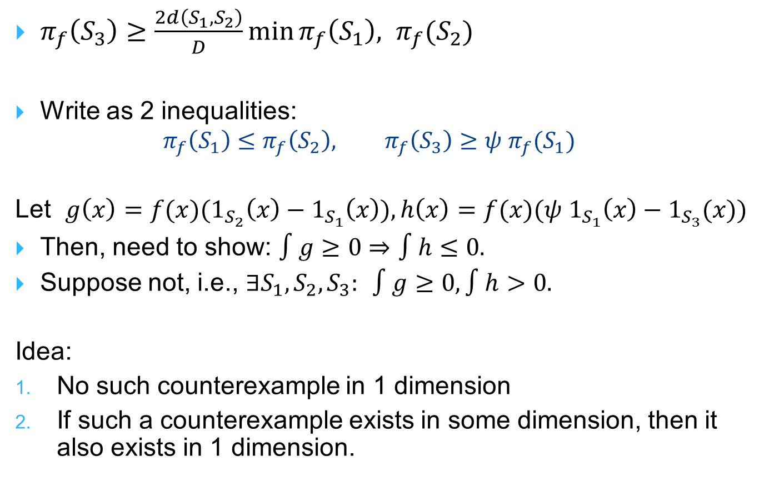
Isoperimetry via localization
$π_{f}\left(S_{3}\right)≥\frac{2d\left(S_{1},S_{2}\right)}{D}\min{π_{f}\left(S_{1}\right), π_{f}(S_{2})}$
Write as 2 inequalities:
  $$π_{f}\left(S_{1}\right)≤π_{f}\left(S_{2}\right), π_{f}\left(S_{3}\right)≥ψ π_{f}(S_{1})$$
Let $g\left(x\right)={f(x)(1}_{S_{2}}\left(x\right)−1_{S_{1}}\left(x\right)), h\left(x\right)=f(x)(ψ 1_{S_{1}}\left(x\right)−1_{S_{3}}(x))$
Then, need to show: $∫g≥0⇒∫h≤0.$
Suppose not, i.e., $∃S_{1},S_{2}, S_{3}:$ $∫g≥0, ∫h>0.$
Idea:
No such counterexample in 1 dimension
If such a counterexample exists in some dimension, then it also exists in 1 dimension.

Slide 41
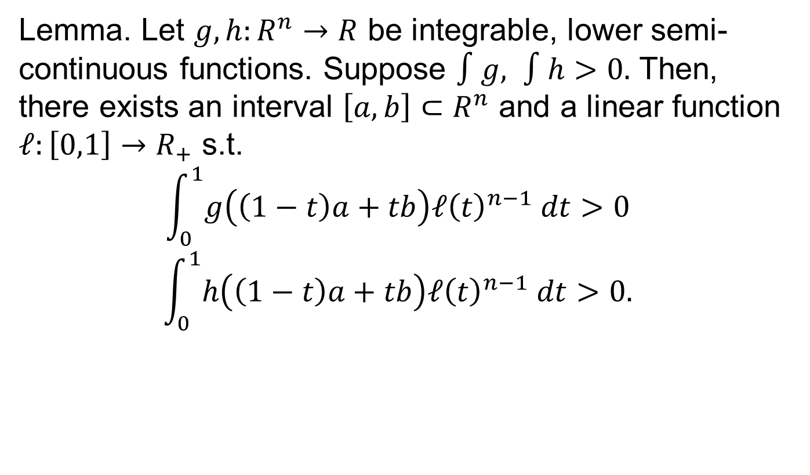
Localization lemma [LS, KLS]
Lemma. Let $g,h:R^{n}→R$ be integrable, lower semi-continuous functions. Suppose $∫g, ∫h>0.$ Then, there exists an interval $\left[a,b\right]⊂R^{n}$ and a linear function $ℓ:\left[0,1\right]→R_{+}$ s.t.
$$\int_{0}^{1}{g\left(\left(1−t\right)a+tb\right)ℓ{\left(t\right)}^{n−1} dt>0 }$$
$$\int_{0}^{1}{h\left(\left(1−t\right)a+tb\right)ℓ{\left(t\right)}^{n−1} dt>0. }$$

Slide 42
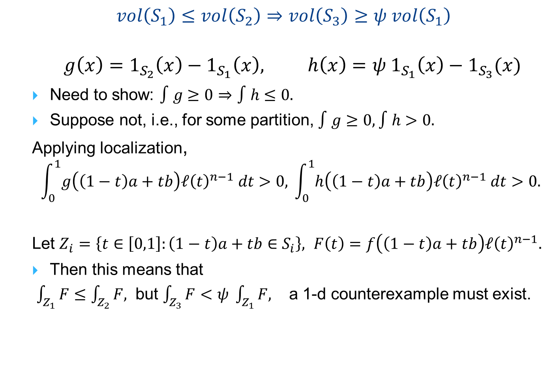
Isoperimetry via localization
  $$vol\left(S_{1}\right)≤vol\left(S_{2}\right)⇒vol\left(S_{3}\right)≥ψ vol\left(S_{1}\right)$$
$$g\left(x\right)=1_{S_{2}}\left(x\right)−1_{S_{1}}\left(x\right), h\left(x\right)=ψ 1_{S_{1}}\left(x\right)−1_{S_{3}}(x)$$
Need to show: $∫g≥0⇒∫h≤0.$
Suppose not, i.e., for some partition, $∫g≥0, ∫h>0.$
Applying localization,
$$\int_{0}^{1}{g\left(\left(1−t\right)a+tb\right)ℓ{\left(t\right)}^{n−1} dt>0, }\int_{0}^{1}{h\left(\left(1−t\right)a+tb\right)ℓ{\left(t\right)}^{n−1} dt>0. }$$
Let $Z_{i}=\left\{t∈\left[0,1\right]:\left(1−t\right)a+tb∈S_{i}\right\}, F\left(t\right)=f\left(\left(1−t\right)a+tb\right)ℓ{\left(t\right)}^{n−1}.$
Then this means that
$\int_{Z_{1}}{F≤\int_{Z_{2}}{F, }}$ but $\int_{Z_{3}}{F<ψ \int_{Z_{1}}{F,} }$ a 1-d counterexample must exist.

Slide 43
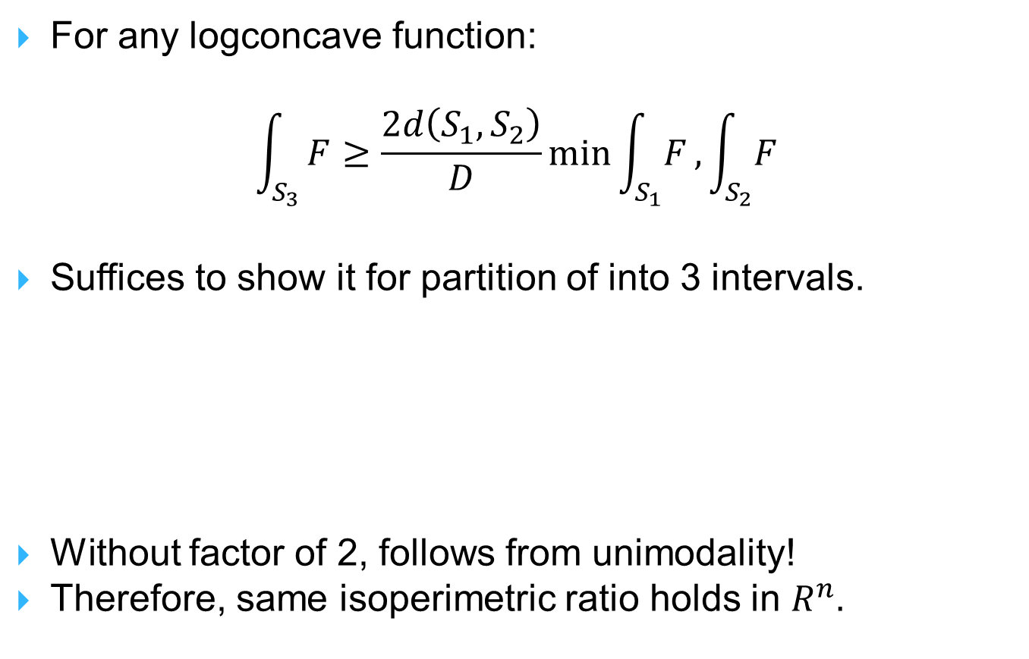
Isoperimetry in 1 dimension
For any logconcave function:
$$\int_{S_{3}}{F≥\frac{2d\left(S_{1},S_{2}\right)}{D}}\min{\int_{S_{1}}{F}, \int_{S_{2}}{F}}$$
Suffices to show it for partition of into 3 intervals.
Without factor of 2, follows from unimodality!
Therefore, same isoperimetric ratio holds in $R^{n}.$

Slide 44
Localization: many applications
Carberry-Wright on concentration of polynomials
Isoperimetry for cross-ratio distance, Dikin distance etc.
For the analysis of algorithms
Can be viewed as proof by contradiction
Or as proof by induction [Chandrasekaran-Dadush-V., Eldan]

Slide 45
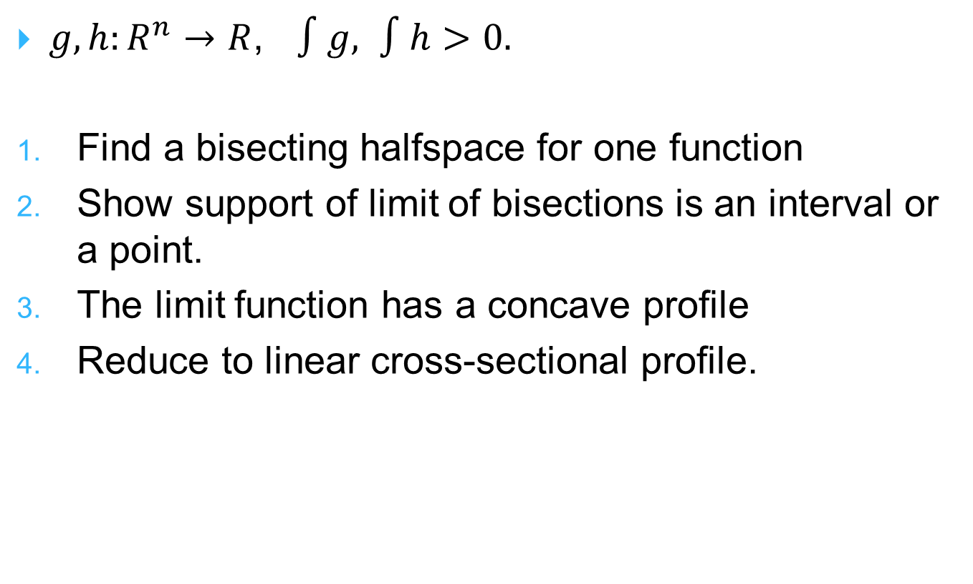
Proof of localization lemma
$g,h:R^{n}→R$, $∫g, ∫h>0.$
Find a bisecting halfspace for one function
Show support of limit of bisections is an interval or a point.
The limit function has a concave profile
Reduce to linear cross-sectional profile.

Slide 46
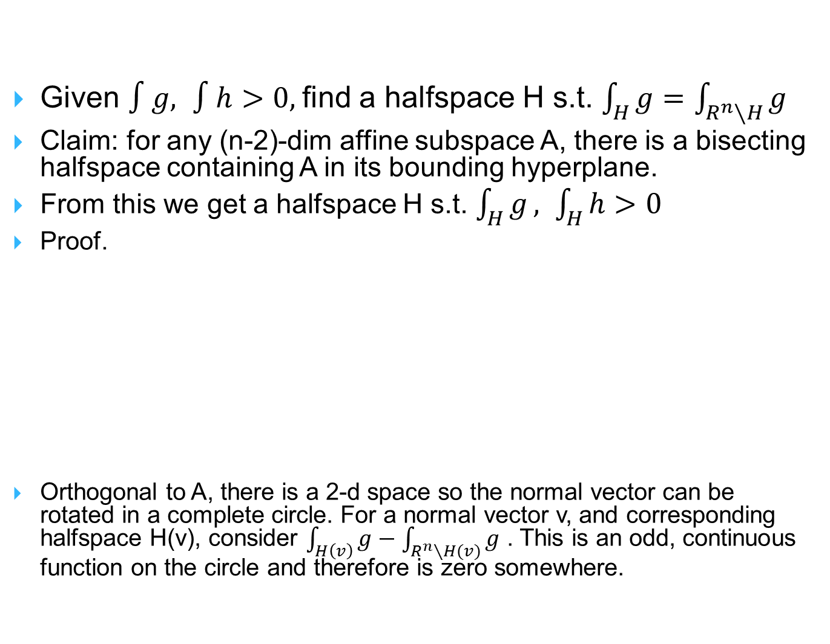
Bisection
Given $∫g, ∫h>0,$find a halfspace H s.t. $\int_{H}{g=\int_{R^{n}∖H}{g}}$
Claim: for any (n-2)-dim affine subspace A, there is a bisecting halfspace containing A in its bounding hyperplane.
From this we get a halfspace H s.t. $\int_{H}{g}, \int_{H}{h}>0$
Proof.
Orthogonal to A, there is a 2-d space so the normal vector can be rotated in a complete circle. For a normal vector v, and corresponding halfspace H(v), consider $\int_{H\left(v\right)}{g}−\int_{R^{n}∖H(v)}{g}$ . This is an odd, continuous function on the circle and therefore is zero somewhere.

Slide 47

Limit of bisections
Apply bisection as long as the support contains a 2-d plane with an interior rational point.
Consider the sequence of supports$K⊃K_{1}⊃K_{2}⊃…$
The supports are convex
The limiting support is 1-d: a point or an interval.

Slide 48
Concave profile
Consider cross-sectional radius function.
Replace each cross-section by ball of same volume; then by Brunn-Minkowski, the radius is a concave function
Each concave function is bounded and the sequence converges to a concave limit.
going to linear functions takes more work!
Generalized to more inequalities [Fradelizi-Guedon].

Slide 49
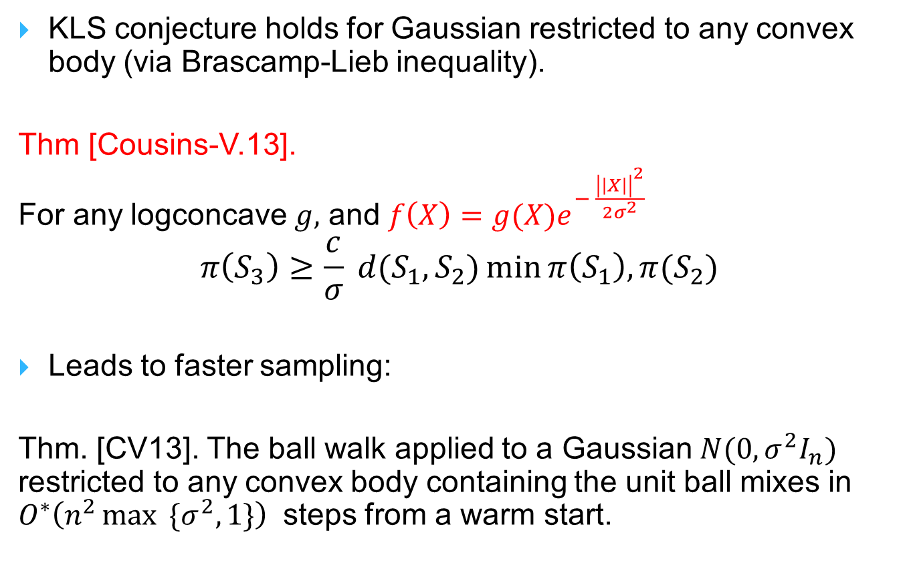
Gaussian sampling
KLS conjecture holds for Gaussian restricted to any convex body (via Brascamp-Lieb inequality).
Thm [Cousins-V.13].
For any logconcave $g,$ and $f\left(X\right)={g(X)e}^{− \frac{{\left|\left|X\right|\right|}^{2}}{2σ_{}^{2}}}$
$$π\left(S_{3}\right)≥\frac{c}{σ} d(S_{1},S_{2})\min{π\left(S_{1}\right), π(S_{2})}$$
Leads to faster sampling:
Thm. [CV13]. The ball walk applied to a Gaussian $N(0,σ^{2}I_{n})$ restricted to any convex body containing the unit ball mixes in $O^{∗}\left(n^{2}\max{ \{σ^{2},1\}}\right)$ steps from a warm start.
Notes:
No known analog of KLS for Hit-and-Run

Slide 50
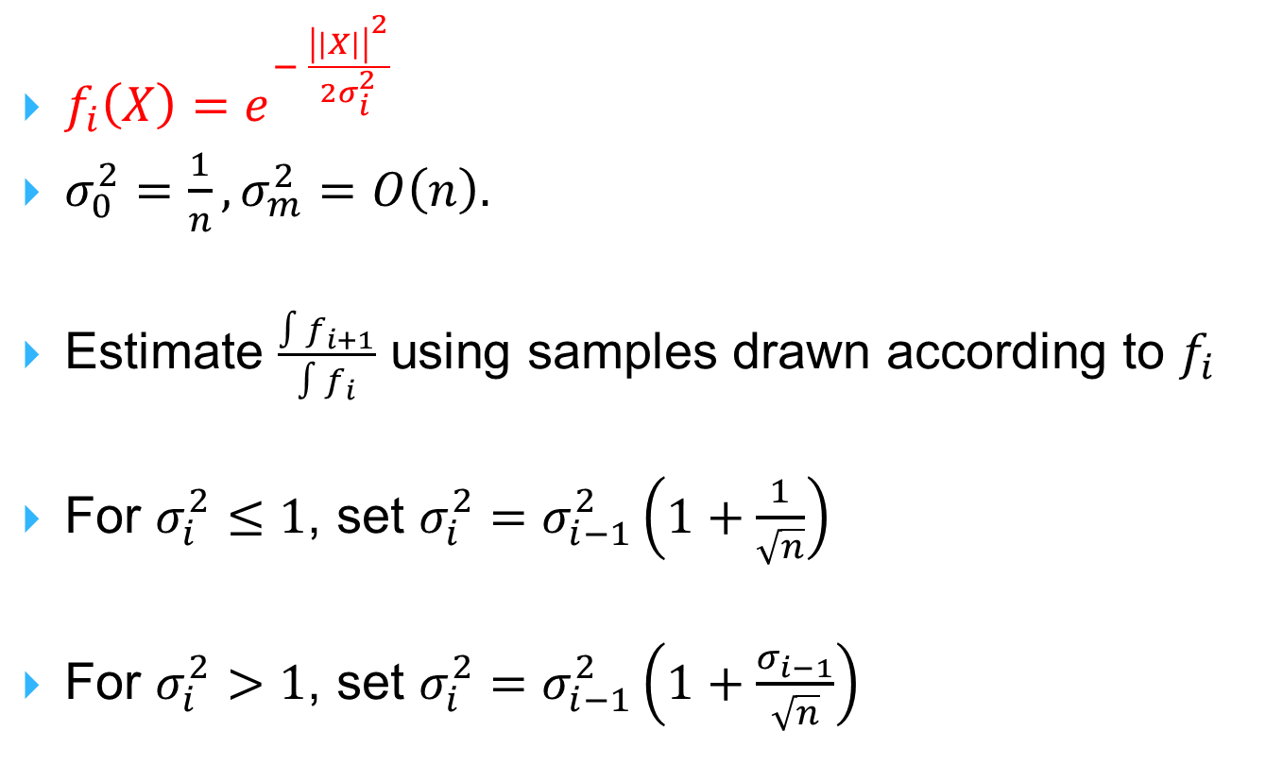
Gaussian Cooling (adaptive annealing)
$f_{i}\left(X\right)=e^{− \frac{{\left|\left|X\right|\right|}^{2}}{2σ_{i}^{2}}}$
$σ_{0}^{2}=\frac{1}{n}, σ_{m}^{2}=O\left(n\right).$
Estimate $\frac{∫f_{i+1}}{∫f_{i}}$ using samples drawn according to $f_{i}$
For $σ_{i}^{2}≤1$, set $σ_{i}^{2}=σ_{i−1}^{2}\left(1+\frac{1}{\sqrt{n}}\right)$
For $σ_{i}^{2}>1$, set $σ_{i}^{2}=σ_{i−1}^{2}\left(1+\frac{σ_{i−1}}{\sqrt{n}}\right)$

Slide 51
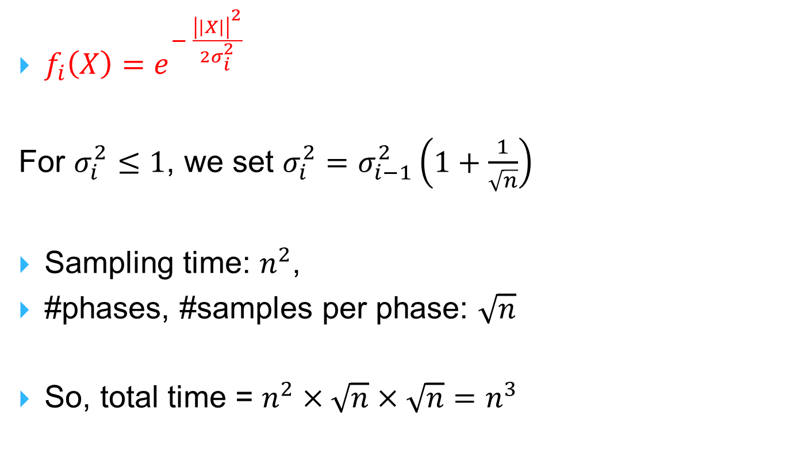
Gaussian Cooling
$f_{i}\left(X\right)=e^{− \frac{{\left|\left|X\right|\right|}^{2}}{2σ_{i}^{2}}}$
For $σ_{i}^{2}≤1$, we set $σ_{i}^{2}=σ_{i−1}^{2}\left(1+\frac{1}{\sqrt{n}}\right)$
Sampling time: $n^{2}$,
#phases, #samples per phase: $\sqrt{n}$
So, total time = $n^{2}×\sqrt{n}×\sqrt{n}=n^{3}$

Slide 52
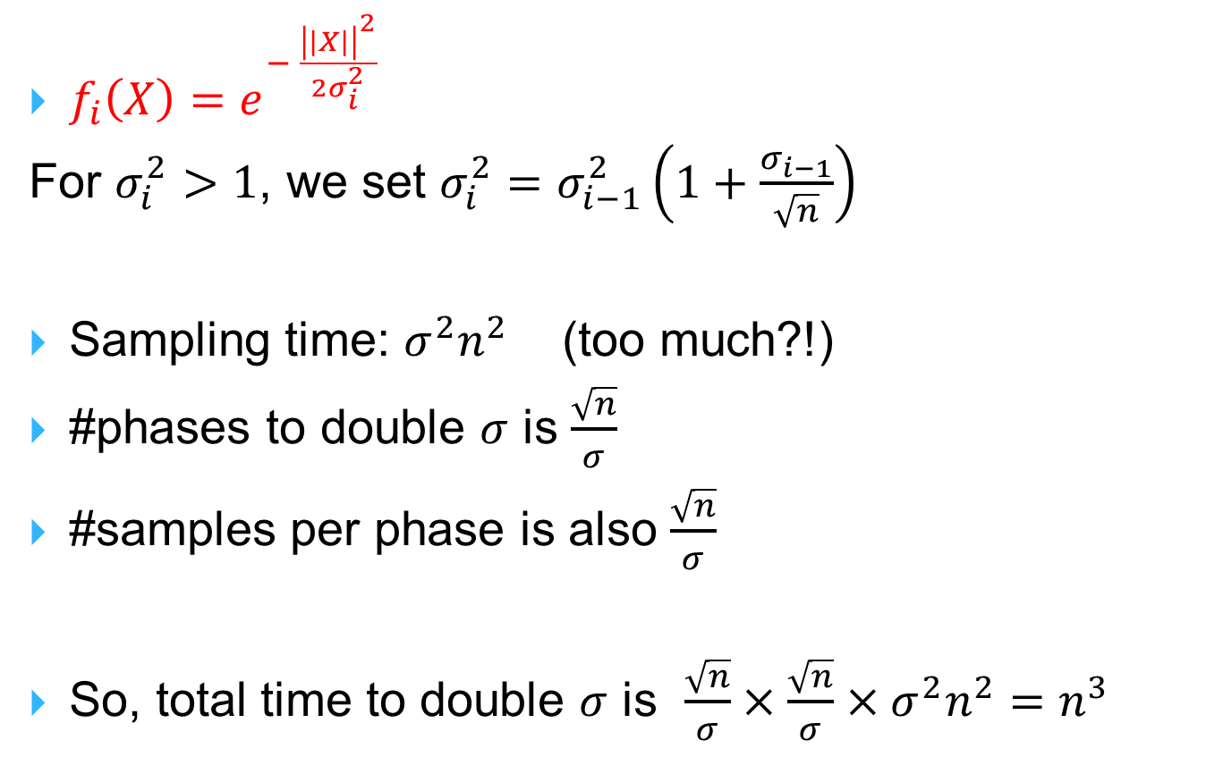
Gaussian Cooling
$f_{i}\left(X\right)=e^{− \frac{{\left|\left|X\right|\right|}^{2}}{2σ_{i}^{2}}}$
For $σ_{i}^{2}>1$, we set $σ_{i}^{2}=σ_{i−1}^{2}\left(1+\frac{σ_{i−1}}{\sqrt{n}}\right)$
Sampling time: $σ^{2}n^{2}$ (too much?!)
#phases to double $σ$ is $\frac{\sqrt{n}}{σ}$
#samples per phase is also $\frac{\sqrt{n}}{σ}$
So, total time to double $σ$ is $\frac{\sqrt{n}}{σ}×\frac{\sqrt{n}}{σ}×σ^{2}n^{2}=n^{3}$

Slide 53
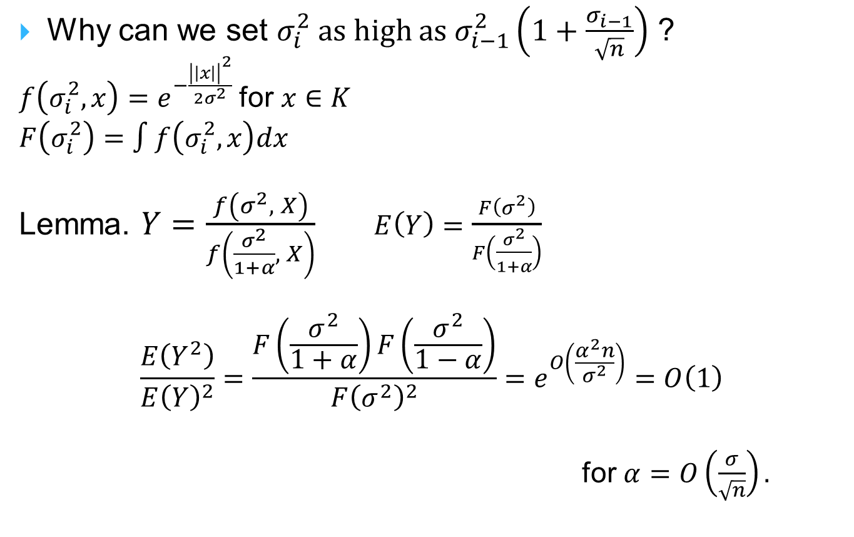
Variance of ratio estimator
Why can we set $σ_{i}^{2}$ as high as $σ_{i−1}^{2}\left(1+\frac{σ_{i−1}}{\sqrt{n}}\right)$ ?
$f\left(σ_{i}^{2}, x\right)=e^{−\frac{{\left|\left|x\right|\right|}^{2}}{2σ^{2}}}$ for $x∈K$
$F\left(σ_{i}^{2}\right)=∫f\left(σ_{i}^{2},x\right)dx$
Lemma. $Y=\frac{f\left(σ_{}^{2}, X\right)}{f\left(\frac{σ_{}^{2}}{1+α}, X\right)} E\left(Y\right)=\frac{F\left(σ_{}^{2}\right)}{F\left(\frac{σ_{}^{2}}{1+α}\right)}$
$$\frac{E\left(Y^{2}\right)}{E{\left(Y\right)}^{2}}=\frac{F\left(\frac{σ^{2}}{1+α}\right)F\left(\frac{σ^{2}}{1−α}\right)}{F{\left(σ^{2}\right)}^{2}}=e^{O\left(\frac{α^{2}n}{σ^{2}}\right)}=O\left(1\right)$$
for $α=O\left(\frac{σ}{\sqrt{n}}\right).$

Slide 54
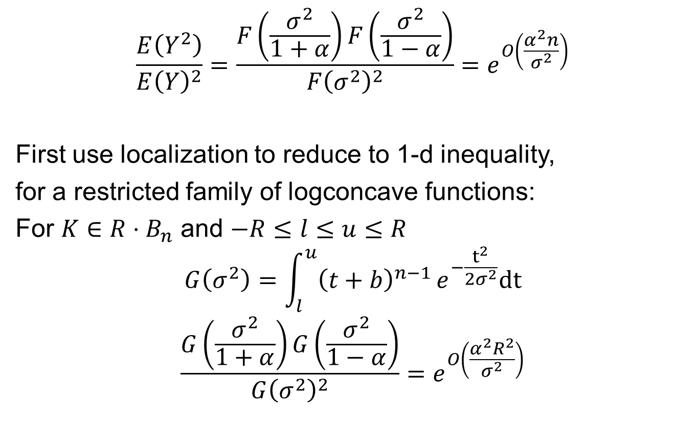
Variance of ratio estimator
$$\frac{E\left(Y^{2}\right)}{E{\left(Y\right)}^{2}}=\frac{F\left(\frac{σ^{2}}{1+α}\right)F\left(\frac{σ^{2}}{1−α}\right)}{F{\left(σ^{2}\right)}^{2}}=e^{O\left(\frac{α^{2}n}{σ^{2}}\right)}$$
First use localization to reduce to 1-d inequality,
for a restricted family of logconcave functions:
For $K∈R⋅B_{n}$ and $−R≤l≤u≤R$
$$G\left(σ^{2}\right)=\int_{l}^{u}{{\left(t+b\right)}^{n−1}}e^{−\frac{t^{2}}{2σ^{2}}}dt$$
$$\frac{G\left(\frac{σ^{2}}{1+α}\right)G\left(\frac{σ^{2}}{1−α}\right)}{G{\left(σ^{2}\right)}^{2}}=e^{O\left(\frac{α^{2}R^{2}}{σ^{2}}\right)}$$

Slide 55

Variance of ratio estimator
$$\frac{G\left(\frac{σ^{2}}{1+α}\right)G\left(\frac{σ^{2}}{1−α}\right)}{G{\left(σ^{2}\right)}^{2}}=e^{O\left(\frac{α^{2}R^{2}}{σ^{2}}\right)} ⇔$$
$E\left(t^{2}\right)=\frac{\int_{l}^{u}{t^{2}{\left(t+b\right)}^{n−1}e^{−\frac{t^{2}}{2σ^{2}}}dt}}{\int_{l}^{u}{{\left(t+b\right)}^{n−1}e^{−\frac{t^{2}}{2σ^{2}}}dt}}$, $\frac{dE\left(t^{2}\right)}{dσ^{2}}≤c$

Slide 56
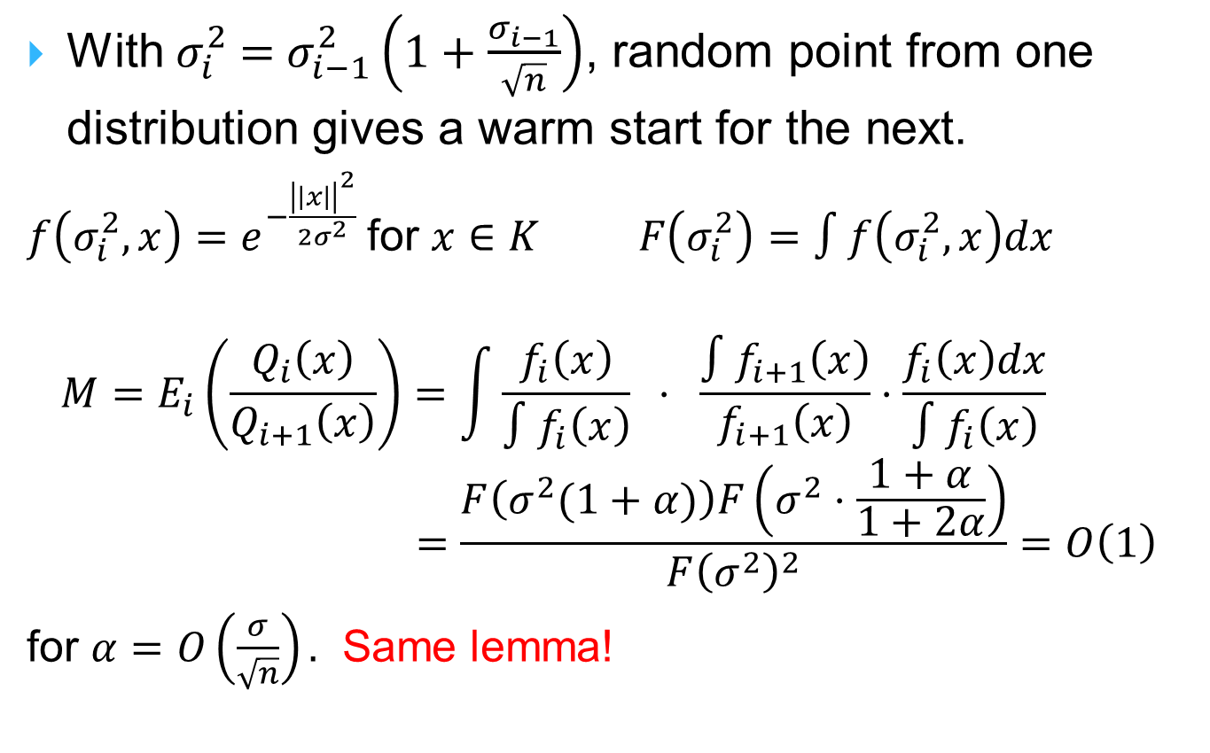
Warm start
With $σ_{i}^{2}$ = $σ_{i−1}^{2}\left(1+\frac{σ_{i−1}}{\sqrt{n}}\right)$, random point from one distribution gives a warm start for the next.
$f\left(σ_{i}^{2}, x\right)=e^{−\frac{{\left|\left|x\right|\right|}^{2}}{2σ^{2}}}$ for $x∈K F\left(σ_{i}^{2}\right)=∫f\left(σ_{i}^{2},x\right)dx$
$$M=E_{i}\left(\frac{Q_{i}\left(x\right)}{Q_{i+1}\left(x\right)}\right)=\int{\frac{f_{i}\left(x\right)}{∫f_{i}\left(x\right)} ⋅ }\frac{∫f_{i+1}\left(x\right)}{f_{i+1}\left(x\right)}⋅\frac{f_{i}\left(x\right)dx}{∫f_{i}\left(x\right)}$$
$$=\frac{F\left(σ^{2}(1+α)\right)F\left(σ^{2}⋅\frac{1+α}{1+2α}\right)}{F{\left(σ^{2}\right)}^{2}}=O\left(1\right)$$
for $α=O\left(\frac{σ}{\sqrt{n}}\right).$ Same lemma!

Slide 57
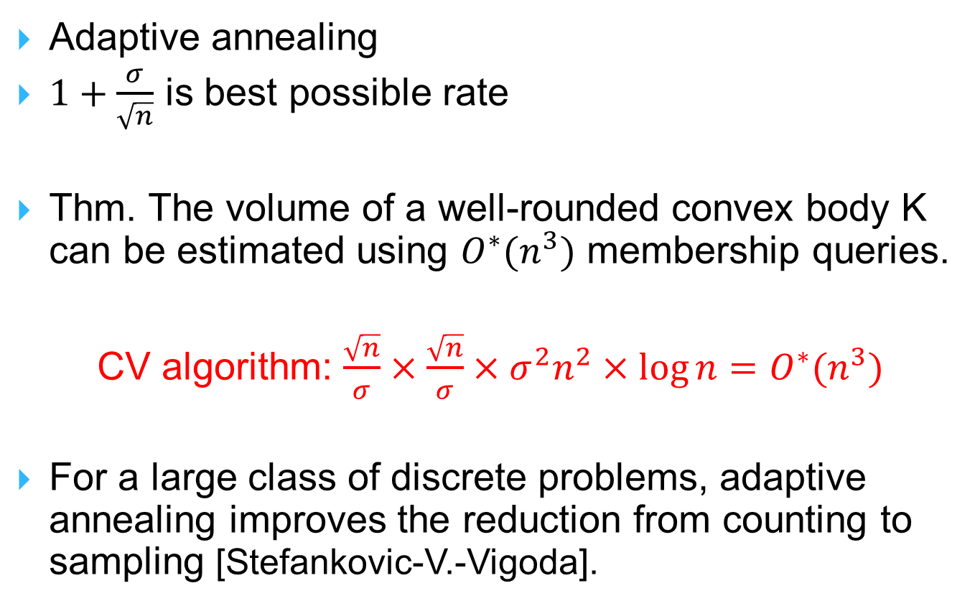
Gaussian Cooling [CV14]
Adaptive annealing
$1+\frac{σ}{\sqrt{n}}$ is best possible rate
Thm. The volume of a well-rounded convex body K can be estimated using ${O^{∗}(n}^{3})$ membership queries.
CV algorithm: $\frac{\sqrt{n}}{σ}×\frac{\sqrt{n}}{σ}×σ^{2}n^{2}×\log{n}={O^{∗}(n}^{3})$
For a large class of discrete problems, adaptive annealing improves the reduction from counting to sampling [Stefankovic-V.-Vigoda].

Slide 58
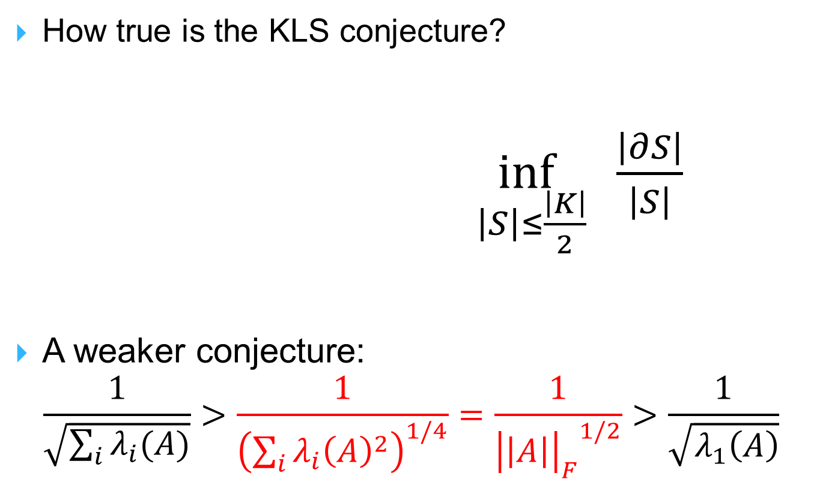
Open questions: Geometry
How true is the KLS conjecture?
$\inf_{\left|S\right|≤\frac{\left|K\right|}{2}}{ \frac{\left|∂S\right|}{\left|S\right|}}$
A weaker conjecture:
$$\frac{1}{\sqrt{\sum_{i}{λ_{i}(A)}}}>\frac{1}{{\left(\sum_{i}{λ_{i}{\left(A\right)}^{2}}\right)}^{1/4}}=\frac{1}{{{\left|\left|A\right|\right|}_{F}}^{1/2}}>\frac{1}{\sqrt{λ_{1}\left(A\right)}}$$

Slide 59
Open questions: Geometry
Does John position imply convex body is well-rounded?
Conj. For any convex body, the center of gravity lies in the John ellipsoid.
(within any constant scaling of John ellipsoid implies answer is YES to first question).

Slide 60
Open questions: Probability
Q1. Does ball walk mix rapidly starting at a single nice point, e.g., the centroid?
Q2. When to stop? How to check convergence to stationarity on the fly? Does it suffice to check that the measures of all halfspaces have converged?
(Note: poly(n) sample can estimate all halfspace measures approximately)

Slide 61
Open questions: Probability/Algorithms
Faster isotropy/rounding?
  How to get information before reaching stationary?
To make isotropic:
run for N steps; transform using covariance; repeat.

Slide 62
Open questions: Algorithms
Analyze Coordinate hit-and-run: saves a factor of n in implementing each step compared to ball walk or hit-and-run.
Dikin and other barrier function based walks for explicit bodies?
  [Kannan-Narayanan; Narayanan] Dikin walk with standard barrier function is rapidly mixing.

Slide 63
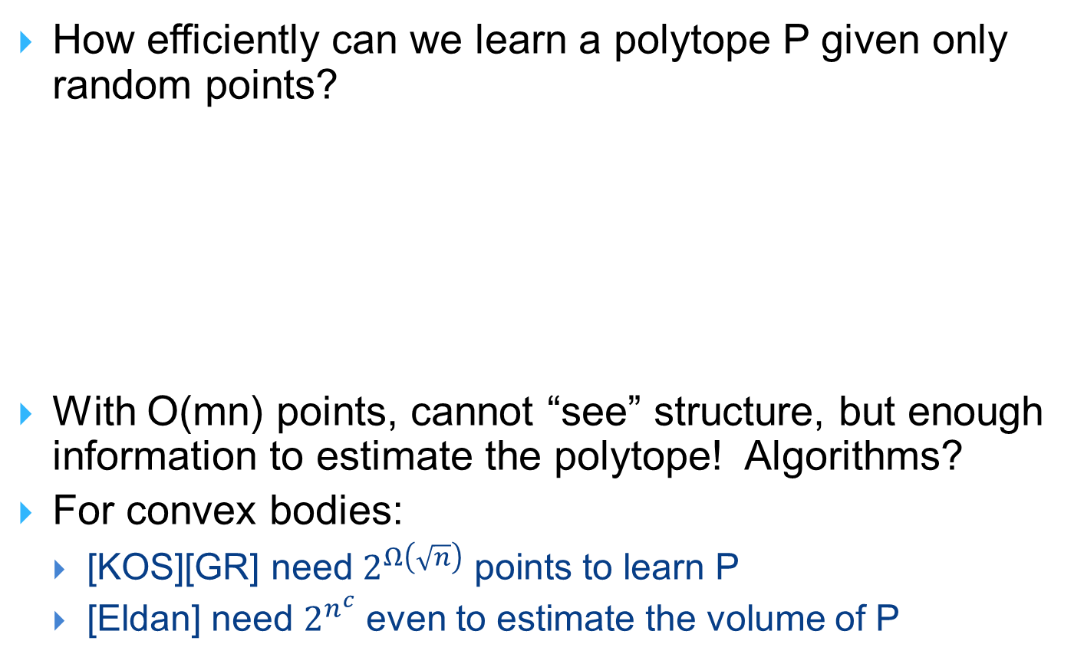
Open questions: Algorithms
How efficiently can we learn a polytope P given only random points?
With O(mn) points, cannot “see” structure, but enough information to estimate the polytope! Algorithms?
For convex bodies:
  [KOS][GR] need $2^{Ω\left(\sqrt{n}\right)}$ points to learn P
  [Eldan] need $2^{n^{c}}$ even to estimate the volume of P

Slide 64

Open questions: Algorithms
Can we estimate the volume of an explicit polytope in deterministic polynomial time?
$$Ax≤b$$

