Slide 1
Submodular meets Structured:
Finding Diverse Subsets in
Exponentially-Large Structured Item Sets
(and what to do with them)
Dhruv Batra
Virginia Tech

Slide 2
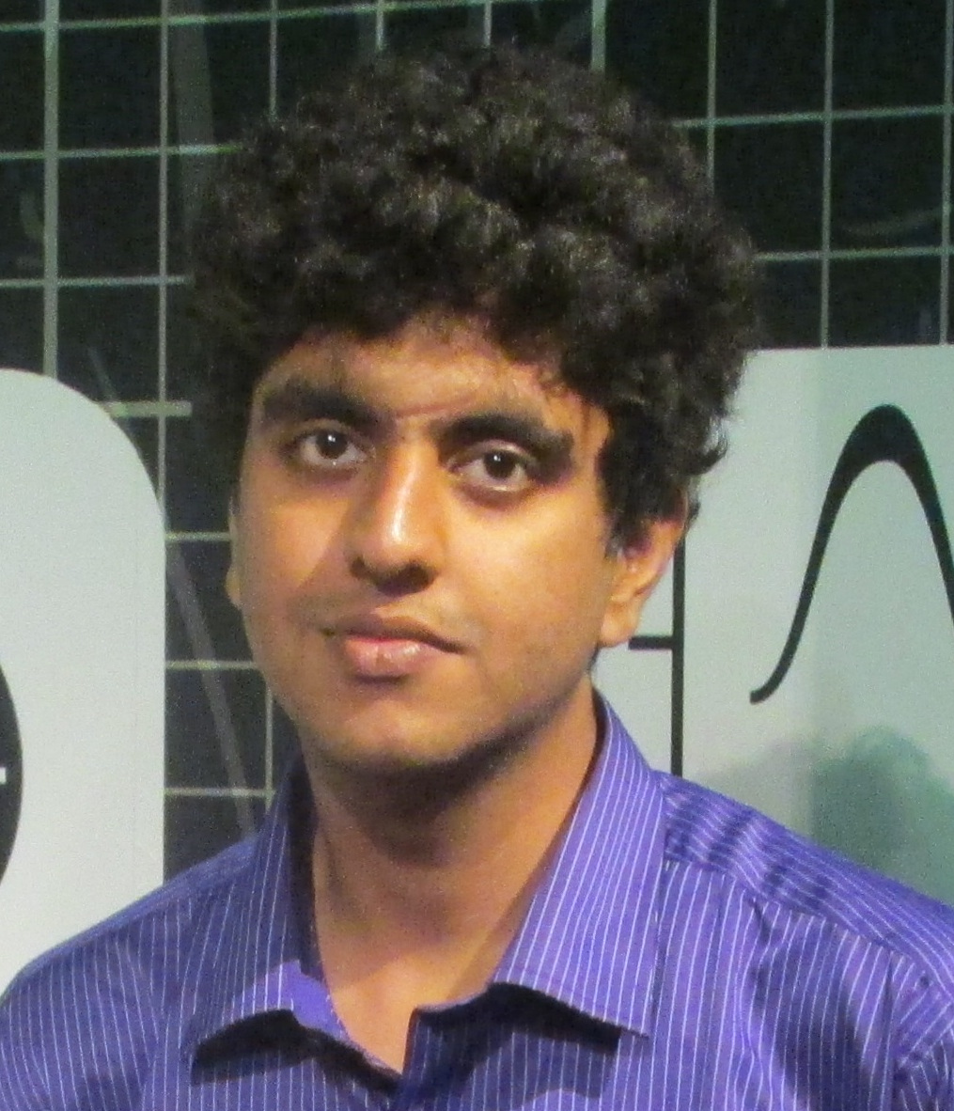
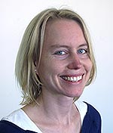
Submodular meets Structured:
Finding Diverse Subsets in
Exponentially-Large Structured Item Sets
(and what to do with them)
Dhruv Batra
Virginia Tech
Adarsh Prasad
Stefanie Jegelka
Joint work with:
Students: Aishwarya Agrawal (VT), Harsh Agrawal (VT), Neelima Chavali (VT), Michael Cogswell (VT),
Gordon Christie (VT), Abner Guzman-Rivera (UIUC), Ankit Laddha (CMU), Adarsh Prasad (UT-Austin),
Xiao Lin (VT), Clint Solomon (VT), Qing Sun (VT), Payman Yadollahpour (TTIC)
Colleagues: Stefanie Jegelka (UC Berkeley), Pushmeet Kohli (MSR), Greg Shakhnarovich (TTIC),
Danny Tarlow (MSR).

Slide 3
Motivation: Uncertainty in AI
“uncertainty arises because of
limitations in our ability to observe the world,
limitations in our ability to model it,
and possibly even because of innate non-determinism.”
-- Koller & Friedman

Slide 4


Local Ambiguity
slide credit: Fei-Fei Li, Rob Fergus & Antonio Torralba

Slide 5
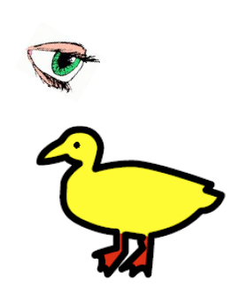
“I saw her duck”
Image Credit: Liang Huang

Slide 6
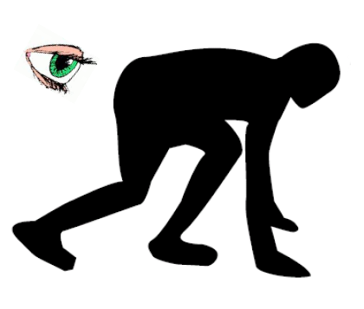
“I saw her duck”
Image Credit: Liang Huang

Slide 7
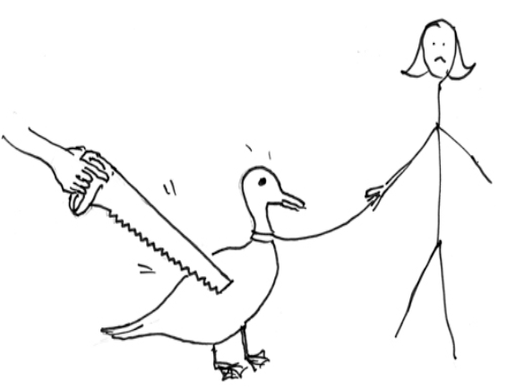
“I saw her duck”
Image Credit: Liang Huang

Slide 8
“I saw her duck with a telescope…”
Image Credit: Liang Huang

Slide 9
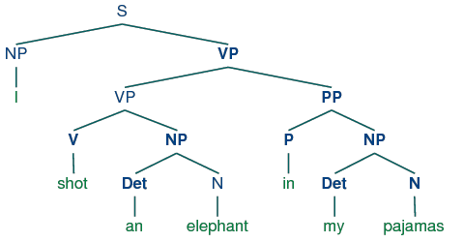
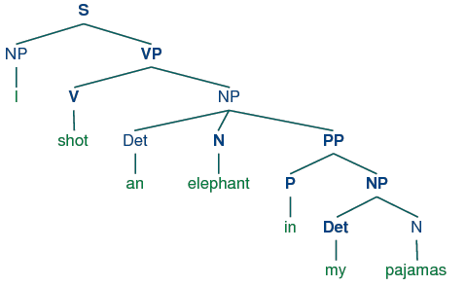
Global Ambiguity
“While hunting in Africa, I shot an elephant in my pajamas.
How an elephant got into my pajamas, I’ll never know!”
  Groucho Marx (1930)

Slide 10
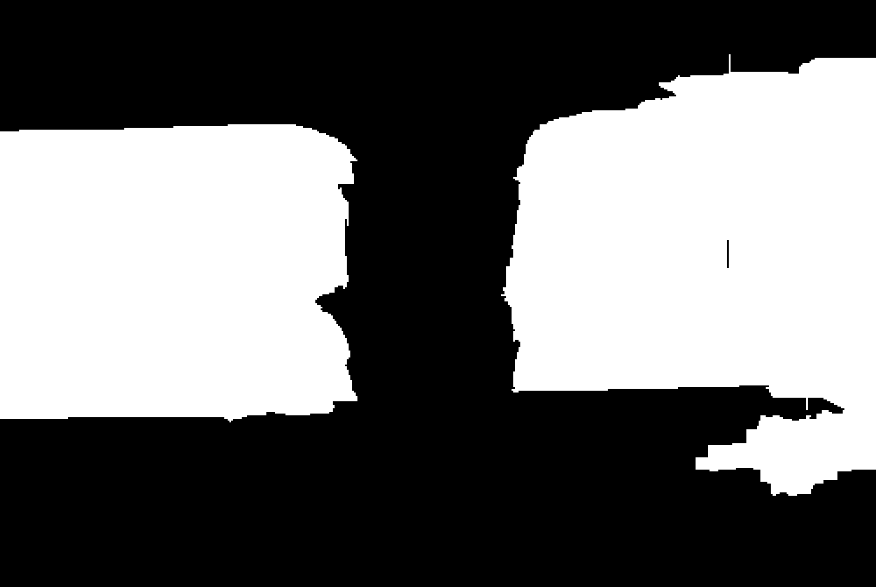
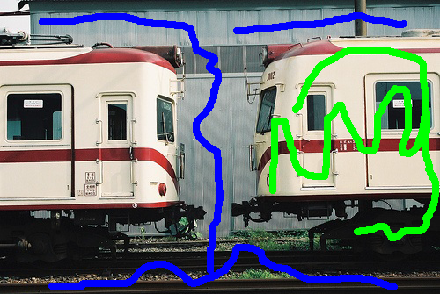
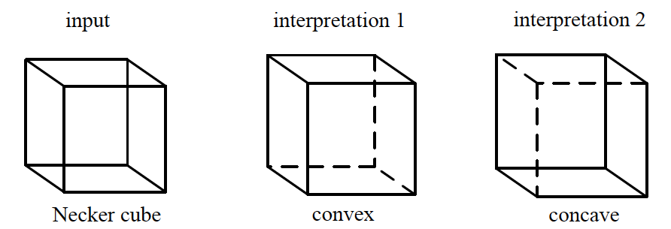
Why is there ambiguity?
Bayes Error
-- Not enough information
“I saw her duck”
?
?
One instance /
Two instances?
Notes:
Even if you can compute MAP, there may simply be multiple acceptable answers.
For example, this woman could be rotating left or rotating right.
This could be a young woman looking away or an old lady looking left.
When we have a user-in-the-loop, different users may expect different outputs from the same input.

Slide 11
Problems
Model-Class is Wrong!
Single Prediction = Uncertainty Mismanagement
Not Enough Training Data!
MAP is NP-Hard
Inherent Ambiguity
-- Approximation Error
-- Estimation Error
-- Optimization Error
Need: Better Representation of Uncertainty
-- Bayes Error
Notes:
So where does that leave us?
When your model is wrong, your data is insufficient, you can’t compute the optimal MAP and you’re not sure which answer the user wanted anyway, making a single best prediction is simply inadequate. What we need to do is to make multiple plausible predictions!

Slide 12
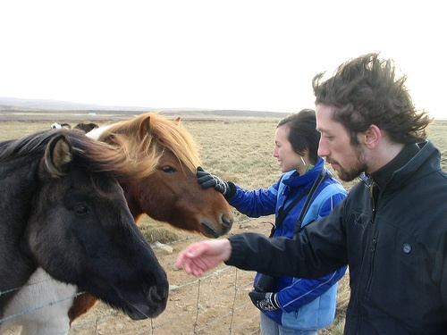
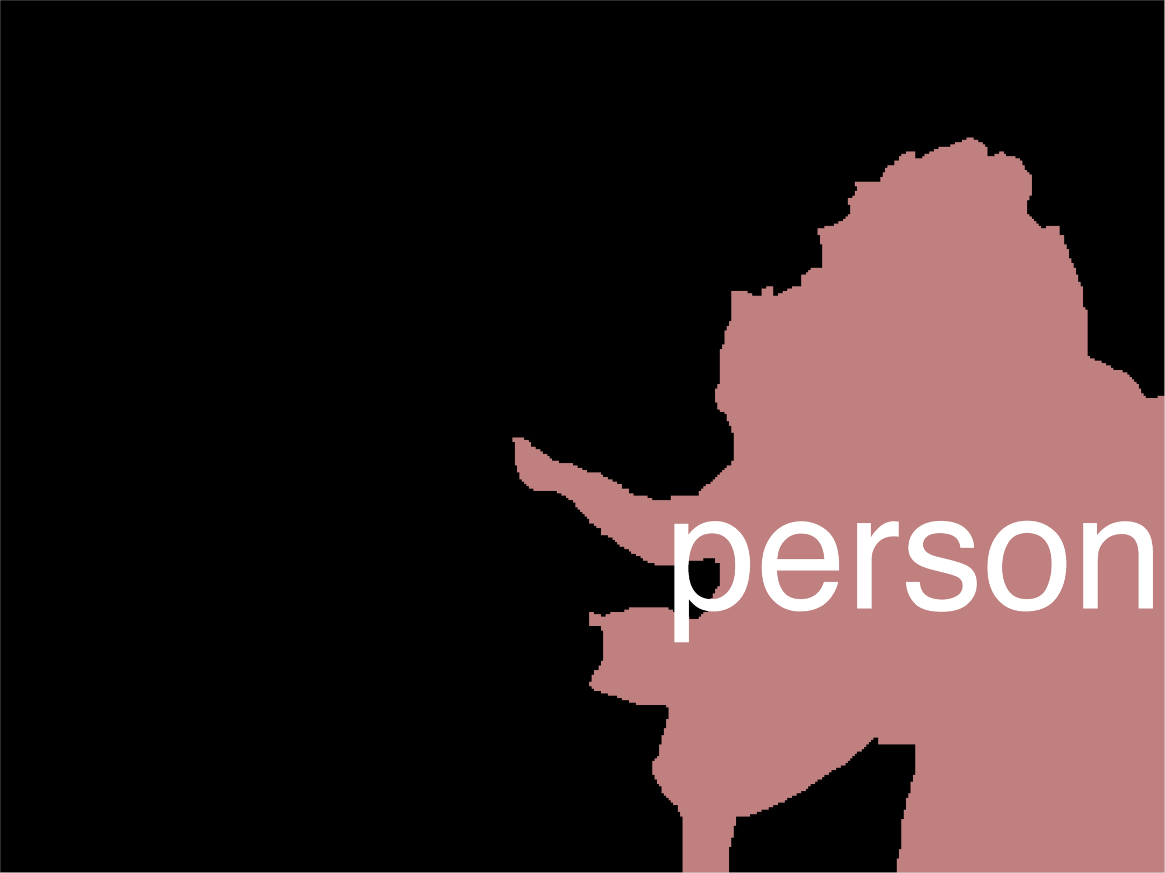
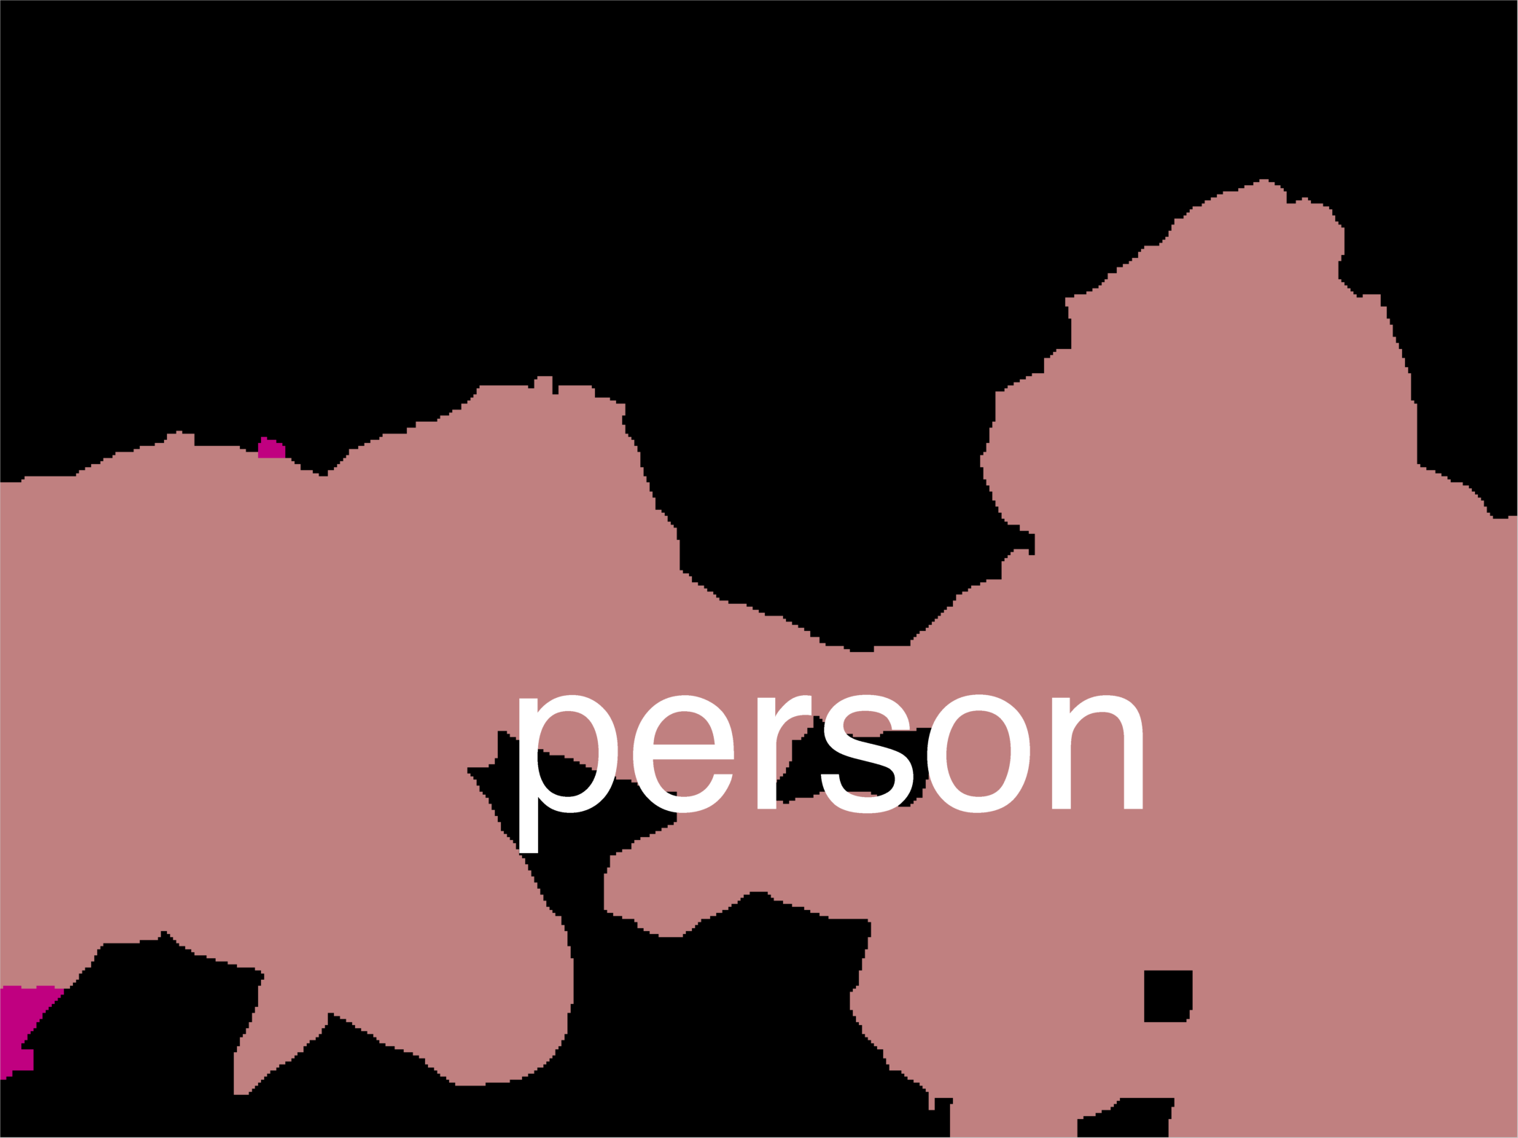
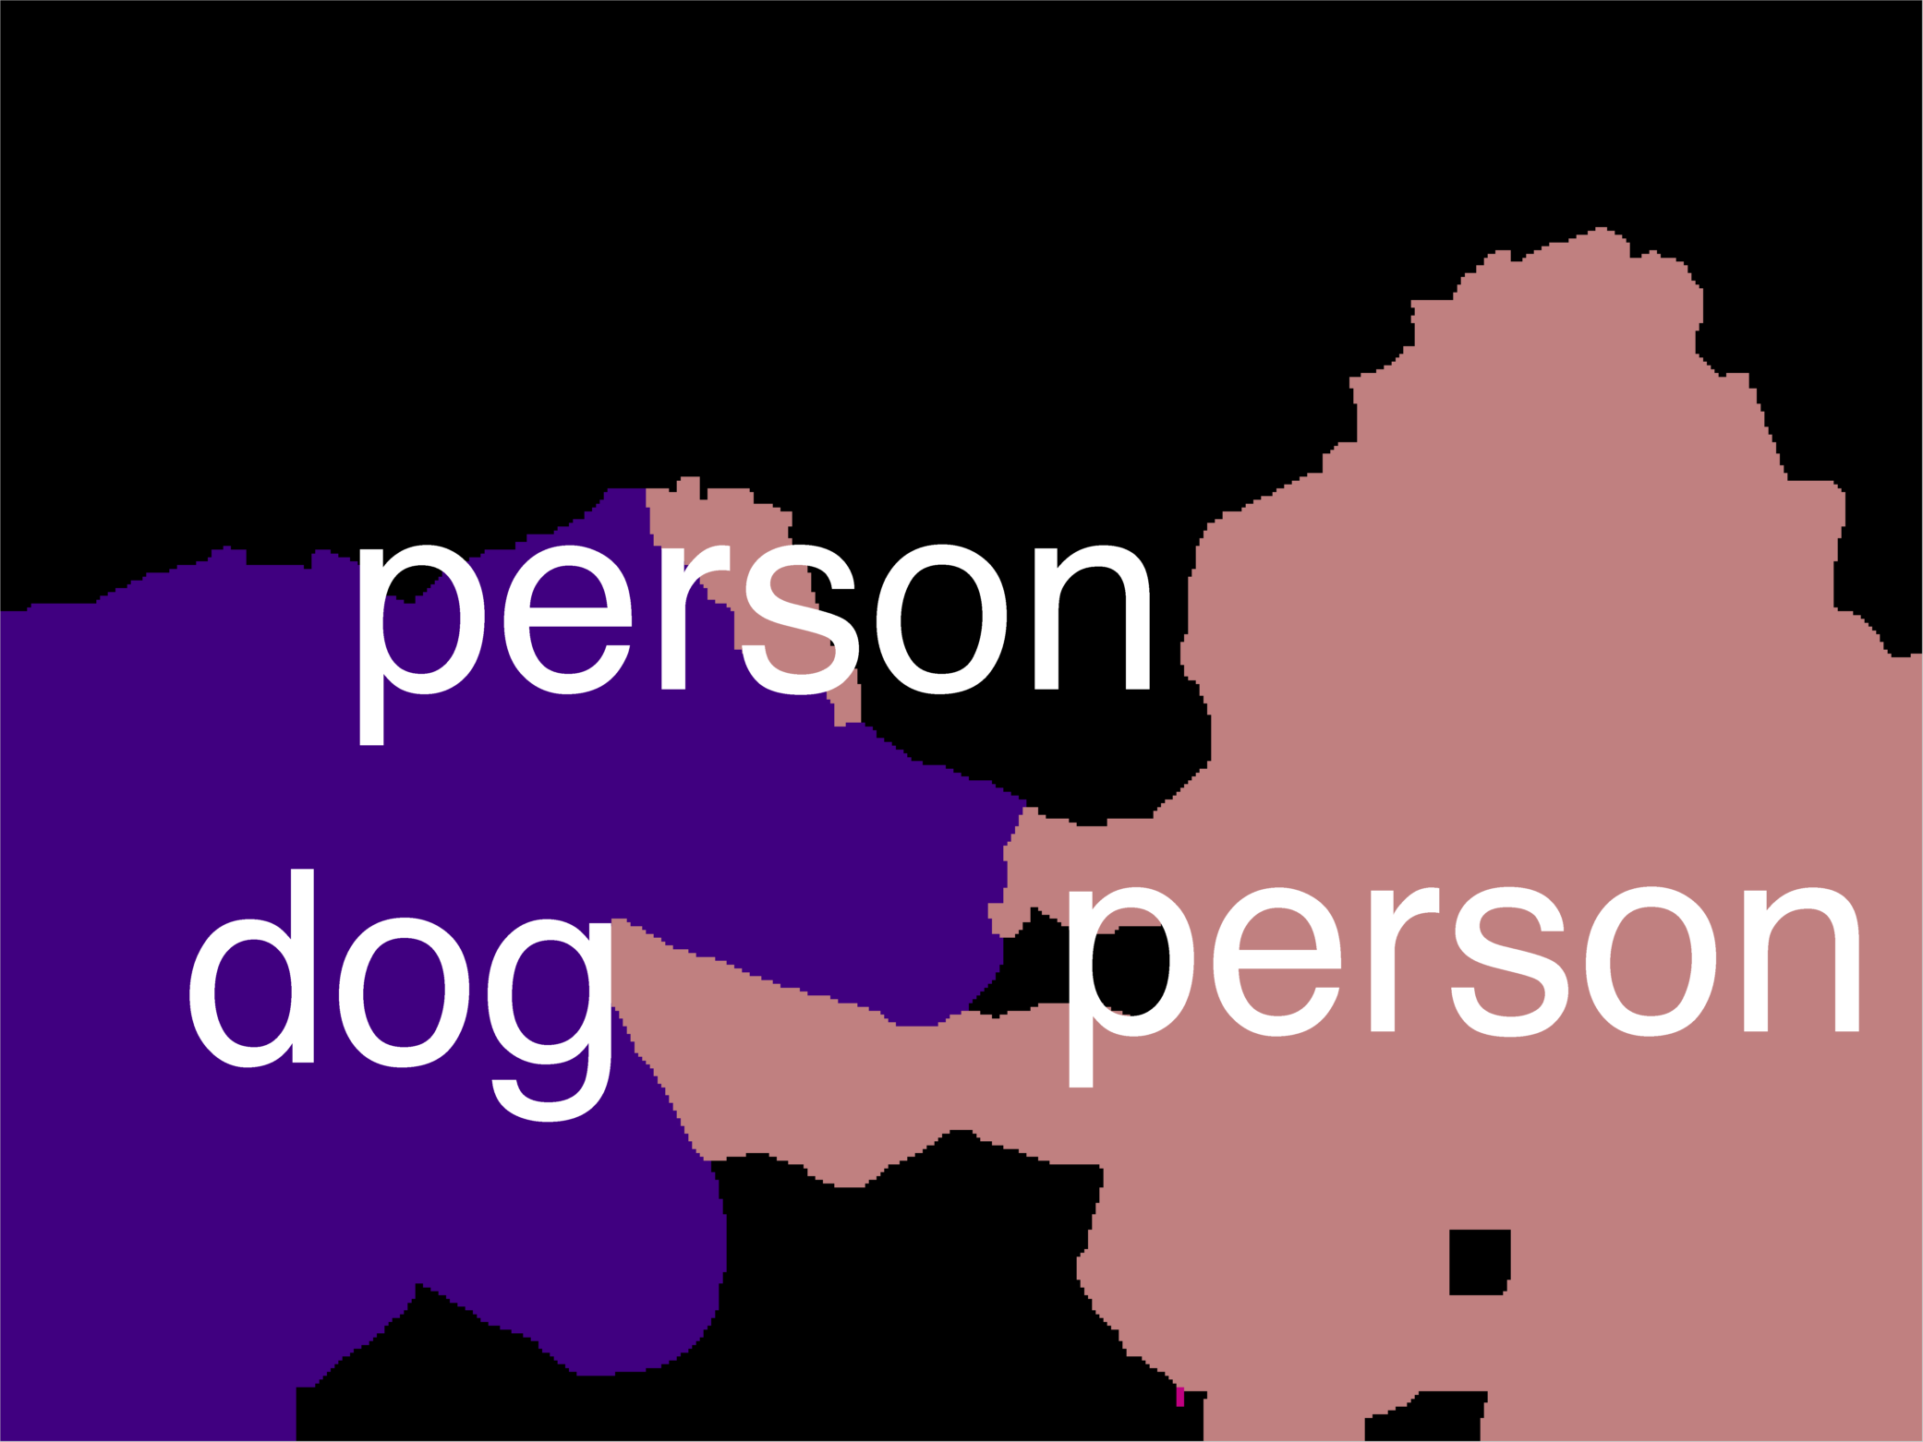
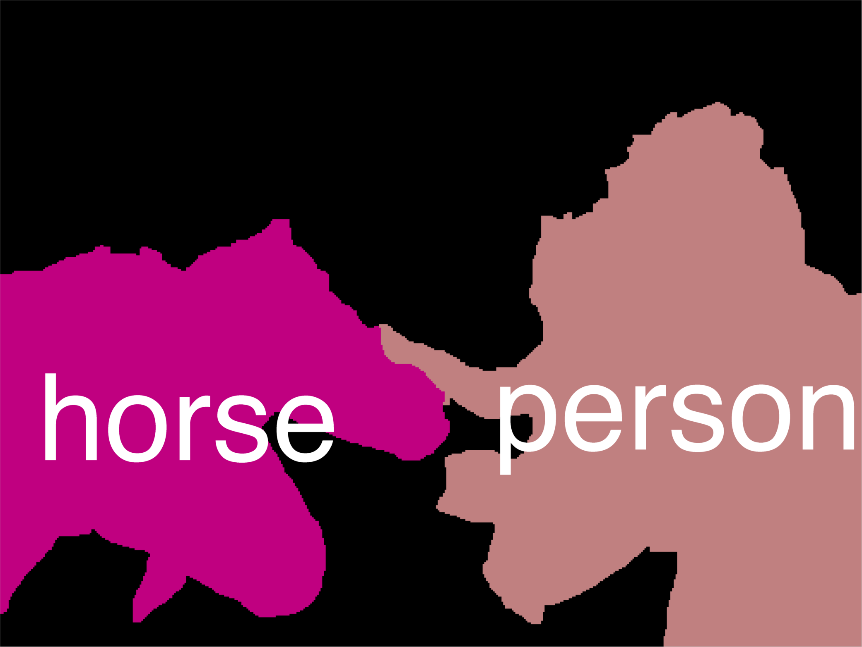
Example Result
Now what?

Slide 13
Outline of the talk
Part 1
Part 2
Now what?

Slide 14
Exponentially-Large Item Set
Semantic Segmentation

Slide 15
Exponentially-Large Item Set
Pose Estimation

Slide 16
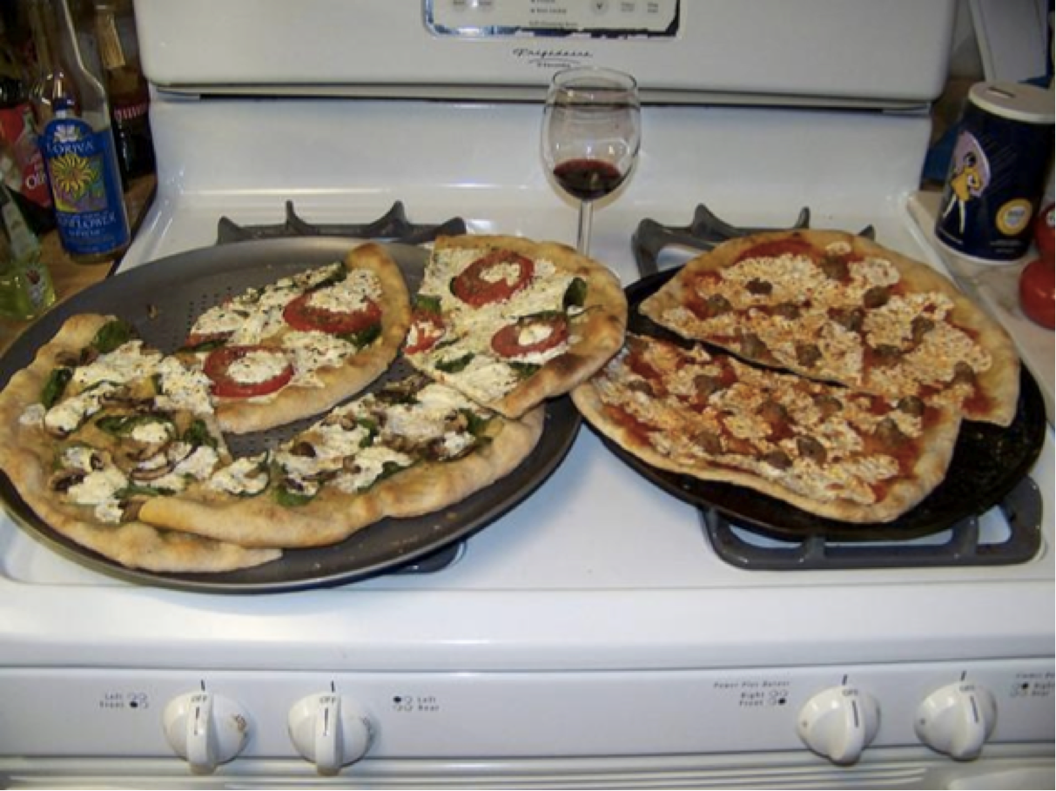
Exponentially-Large Item Set
Image Captioning
Two pizzas sitting
on top of a stove
top oven.
A pizza sitting on
top of a pan on
top of a stove.
there is a man
sitting in a
dish pizza
A wine glass and
three pizzas
on top of an oven.

Slide 17
Quality/Score of Items

Slide 18
Diverse Subset Selection

Slide 19
Subset Selection
Our work: Diverse M-Best Solutions
[ECCV ’12; NIPS ‘14]
Greedy Submodular Maximization
Provably Near-Optimal Subset Selection

Slide 20
Objective = Score + Diversity

Slide 21
(Modular) Score + (Submodular) Diversity
radius = r
radius = r
radius = r
radius = r

Slide 22
Submodularity in a slide

Slide 23
Submodularity in a slide

Slide 24
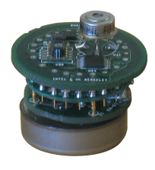
Submodularity in a slide
A={y¹,y²}
y¹
y²
y
F(A U {y}) − F(A)
≥
F(B U {y}) − F(B)
y¹
y²
y³
y⁴
y
B = {y¹,y²,y³,y⁴}
Slide Credit: submoduliarity.org

Slide 25
Greedy Submodular Maximization
Score
Marginal Gain in Diversity

Slide 26
Greedy Submodular Maximization

Slide 27
Greedy Submodular Maximization

Slide 28
Greedy Submodular Maximization
radius = r
radius = r
radius = r
radius = r

Slide 29
Greedy Submodular Maximization
radius = r
radius = r
radius = r
radius = r

Slide 30
Greedy Submodular Maximization
Exponentially Large Space!
Can’t enumerate

Slide 31
Score = Factor Graph
y₁
1 1 10 0
kx1
y₂
10
MAP
Inference
0
…
10
10
0
10
y_{n}
kxk
Most Likely Assignment
Node Scores /
Local Rewards
Edge Scores /
Distributed Prior

Slide 32
Greedy Subset Selection
radius = r
radius = r
radius = r
radius = r

Slide 33
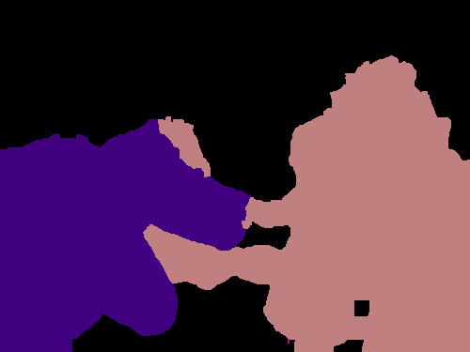


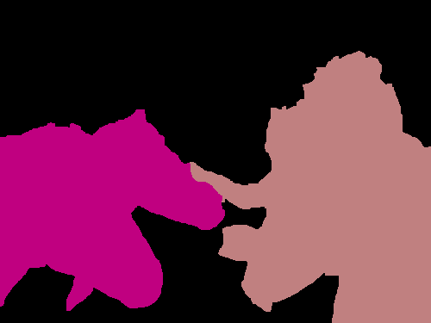


Diversity via Groups
person
dog
person
dog
horse
person
horse
dog
horse

Slide 34
Diversity = Coverage of Groups
person
dog
person
dog
horse
person
horse
dog
horse

Slide 35
Diversity = (Soft) Coverage of Groups
person
dog
person
dog
horse
person
horse
dog
horse

Slide 36
Diversity = Coverage of Groups
person
dog
person
dog
horse
person
horse
dog
horse

Slide 37
Marginal Gain = Label Score
0
+1
0
+1
0
1
1
person
dog
person
dog
1
2
horse
person
horse
dog
1
horse

Slide 38
Greedy Subset Selection
+
Just a modified MAP call!

Slide 39
Diversity = High-Order Potential (HOP)
+
Diversity HOP
Label Occurrence Label Costs [Delong et al. CVPR10]
Label Transitions Cooperative Cuts [Jegelga et al. CVPR 11;
Kohli et al. CVPR13]
Hamming Ball Cardinality Potential [Tarlow et al AISTATS10]
DivMBest Node Potential Perturb [Batra et al ECCV12]

Slide 40
[Prasad, Jegelka, Batra, NIPS14]

Slide 41
Outline of the talk
Part 1
Part 2
Now what?

Slide 42
Your Options
Nothing: User-in-the-loop [ECCV12]
  Additional Information: None
Tracking [ECCV12]
  Additional Information: Time
(Approximate) Min Bayes Risk [CVPR14]
  Additional Information: Loss function
Re-ranking [CVPR13]
  Additional Information: higher-order constraints
Holistic Scene Understanding [Under Review]
Increasing Side Information

Slide 43
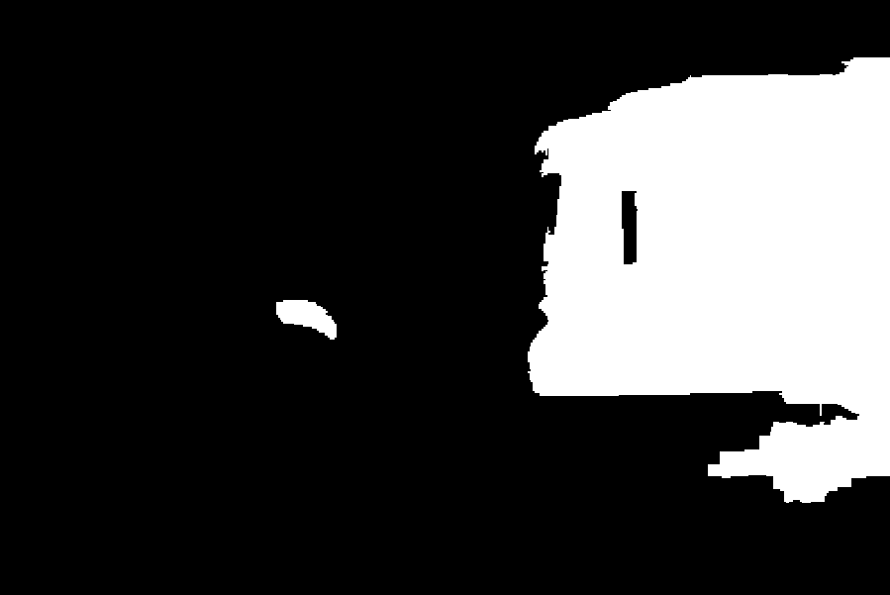

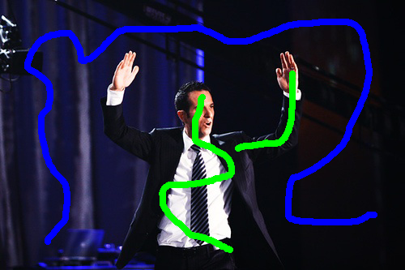



Interactive Segmentation
Setup
  Model: Color/Texture + Potts Grid CRF
  Inference: Graph-cuts
  Dataset: 50 train/val/test images from PASCAL
Image + Scribbles
MAP
2nd Best MAP
Diverse 2nd Best
1-2 Nodes Flipped
100-500 Nodes Flipped
[Batra, Yadollahpour, Guzman-Rivera, Shakhnarovich, ECCV12]
Notes:
The first experiment is interactive segmentation, where a user provides scribbles on images and we use graph-cuts for inference.
This is the second-best solution without diversity. We can see that it is nearly identical to MAP with a few nodes flipped.
This is the second-best solutions with diversity. We can see that these solutions are significantly different. In one case, we found another instance of the object, and in another, we completed a thin long structure.

Slide 44
Your Options
Nothing: User-in-the-loop [ECCV12]
  Additional Information: None
Tracking [ECCV12]
  Additional Information: Time
(Approximate) Min Bayes Risk [CVPR14]
  Additional Information: Loss function
Re-ranking [CVPR13]
  Additional Information: higher-order constraints
Holistic Scene Understanding [Under Review]
Increasing Side Information

Slide 45
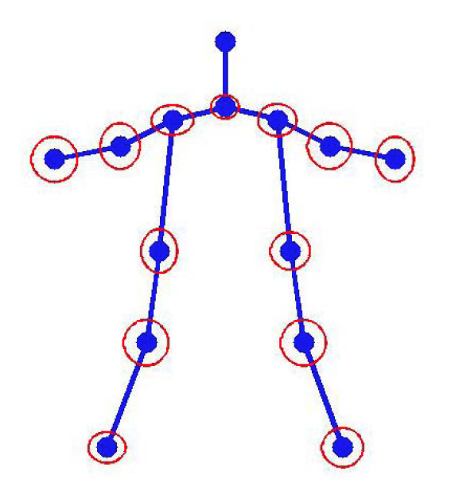
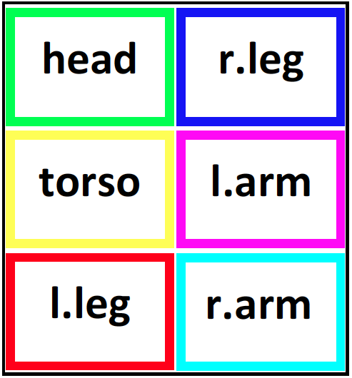
Pose Estimation
Setup
  Model: Mixture of Parts Tree [Park & Ramanan, ICCV ‘11]
  Inference: Dynamic Programming
  Dataset: PARSE
Image Credit: [Yang & Ramanan, ICCV ‘11]
Notes:
Next, we applied our approach to pose-tracking in videos.
We replicated the setup of Park & Ramanan who use a mixture of parts tree model. Exact inference can be performed by dynamic programming.

Slide 46
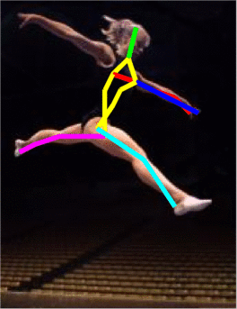
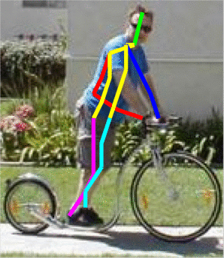
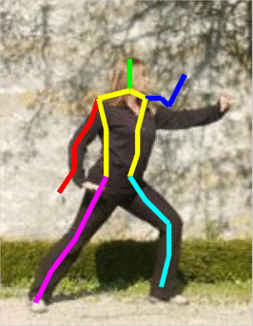
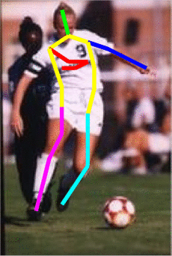
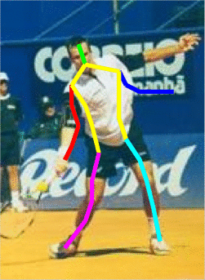
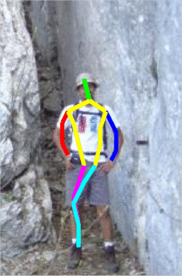
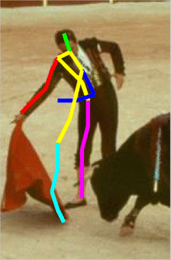
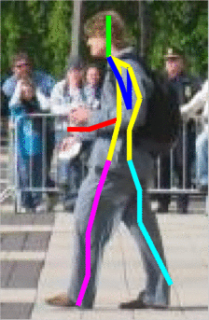
Pose Estimation: 10 guesses/frame
a
[Premachandran, Tarlow, Batra, CVPR14]

Slide 47
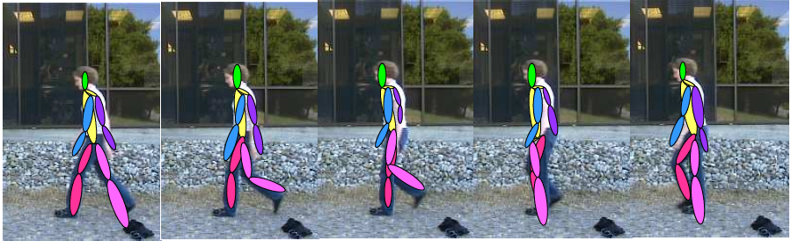
Pose Tracking
Chain CRF with M states at each frame
DivMBest
Solutions
Image Credit: [Yang & Ramanan, ICCV ‘11]
Notes:
We compute M solutions in each frame of the video, and then choose a smooth trajectory using the Viterbi algorithm.

Slide 48
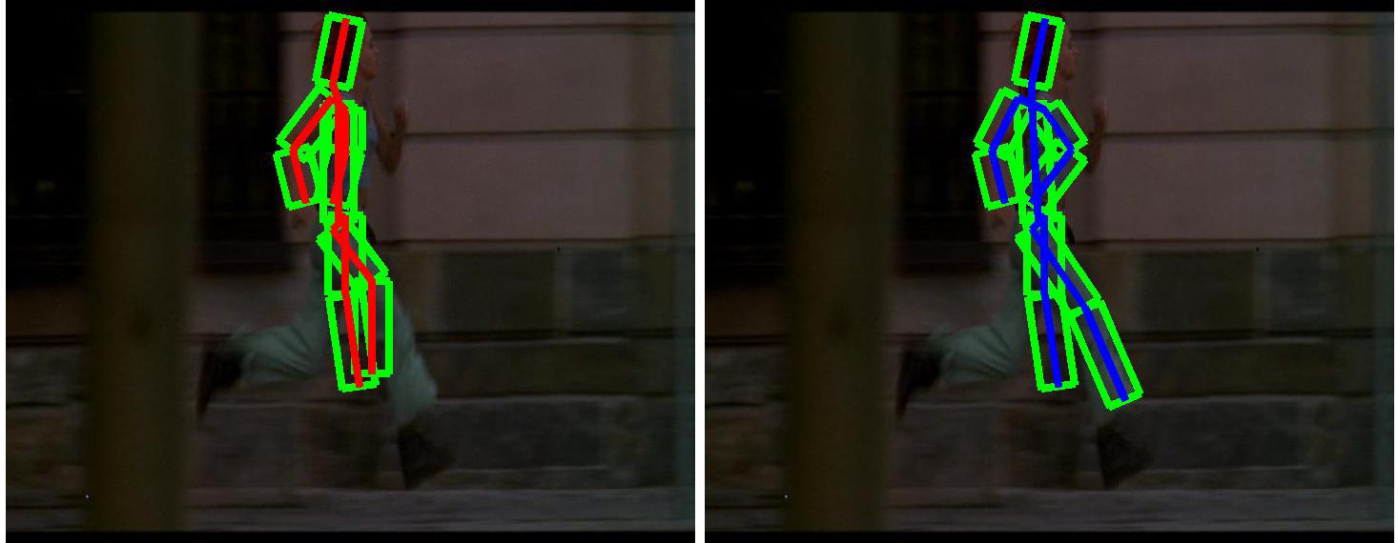
Pose Tracking
MAP / 1-Best
DivMBest + Viterbi
[Batra, Yadollahpour, Guzman-Rivera, Shakhnarovich, ECCV12]
Notes:
Here, on the left, I am showing you the MAP pose on each frame. We can see that is quite noisy and jumps around, while the DivMBest solution is smooth.

Slide 49
Your Options
Nothing: User-in-the-loop [ECCV12]
  Additional Information: None
Tracking [ECCV12]
  Additional Information: Time
(Approximate) Min Bayes Risk [CVPR14]
  Additional Information: Loss function
Re-ranking [CVPR13]
  Additional Information: higher-order constraints
Holistic Scene Understanding [Under Review]

Slide 50
Pose Estimation: 10 guesses/frame
a
[Premachandran, Tarlow, Batra, CVPR14]

Slide 51
Statistics 101
Loss
  Hamming, Jaccard Index, …
“True” Distribution
Expected Loss:
Min Bayes Risk
Fit model (CRF, etc) to mimic

Slide 52
DivMBest for MBR
Min Bayes Risk
Two Problems
Approximate MBR:
Intractable
Intractable

Slide 53
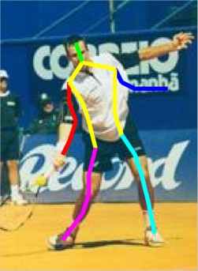
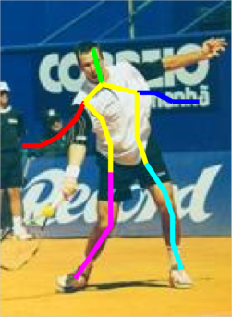
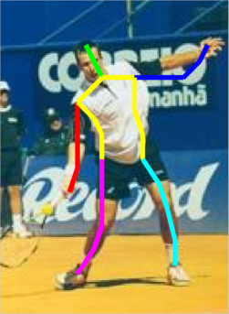
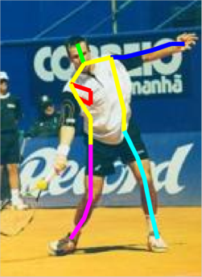
DivMBest for MBR
,
MxM

Slide 54
DivMBest for MBR
,
MxM
Mx1

Slide 55
Pose Estimation
Better
DivMBest (Oracle)
22%-gain possible
Same Features
Same Model
~7% Gain
Same Model
No new information!
MBR [PTB, CVPR14]
State of art 2012
[Yang & Ramanan PAMI12]
#Solutions / Frame
[Premachandran, Tarlow, Batra, CVPR14]

Slide 56
Your Options
Nothing: User-in-the-loop [ECCV12]
  Additional Information: None
Tracking [ECCV12]
  Additional Information: Time
(Approximate) Min Bayes Risk [CVPR14]
  Additional Information: Loss function
Re-ranking [CVPR13]
  Additional Information: higher-order constraints
Holistic Scene Understanding [Under Review]

Slide 57
Example Result

Slide 58
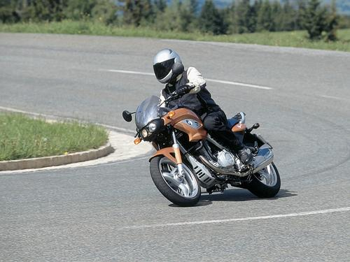
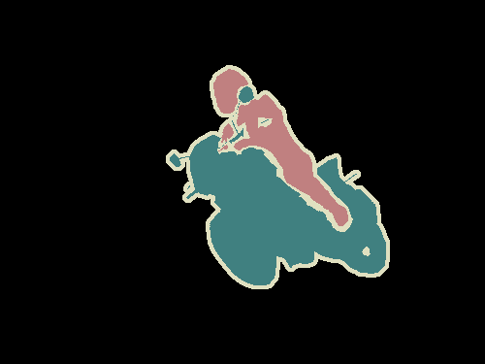
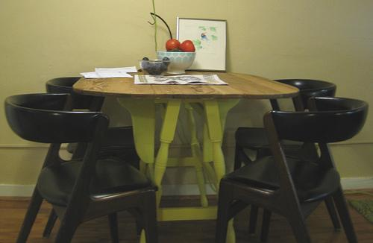

Semantic Segmentation
Setup
  Models: Second-Order Pooling Flat CRF [Carreira ECCV12]
  Inference: Greedy Pasting
  Dataset: Pascal Segmentation Challenge (VOC 2012)
    20 categories + background; ~1500 train/val/test images
Notes:
Finally, we applied DivMBest to Semantic Segmentation on the PASCAL 2010 dataset.
We use the model of Ladicky et al., where approximate inference is performed with alpha-expansion.

Slide 59
Large-Margin Re-ranking
[Yadollahpour, Batra, Shakhnarovich, CVPR13]

Slide 60
Large-Margin Re-ranking
[Yadollahpour, Batra, Shakhnarovich, CVPR13]

Slide 61
Large-Margin Re-ranking
[Yadollahpour, Batra, Shakhnarovich, CVPR13]

Slide 62
Large-Margin Re-ranking
[Yadollahpour, Batra, Shakhnarovich, CVPR13]

Slide 63
PASCAL VOC Semantic Segmentation
Better
DivMBest (Oracle)
15%-gain possible
Same Features
Same Model
PACAL Accuracy
Deep SegNet [Under Review]
+Deep Features
[CVPR14 workshop]
[Hariharan ECCV14]
Re-ranking [CVPR13]
MBR [CVPR14]
MAP
[Carriera ECCV12]
Previous state of art
#Solutions / Image

Slide 64
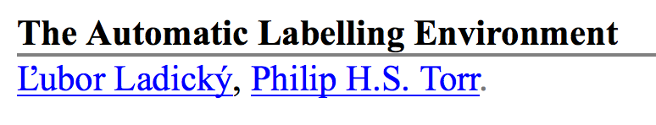
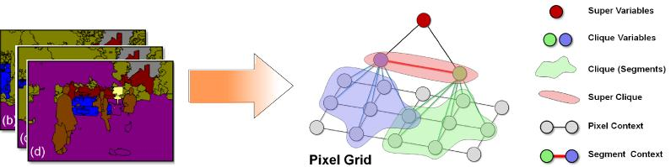
My history with PASCAL Leaderboard
Better
PACAL Accuracy
20%-gain possible
Same Features
Same Model
ALE-DivMBest (Oracle)
ALE-Re-ranking [CVPR13]
ALE
[Ladicky ICCV09]
VOC10
#Solutions / Image

Slide 65
My history with PASCAL Leaderboard
Better
15%-gain possible
Same Features
Same Model
O2P-DivMBest (Oracle)
PACAL Accuracy
O2P-Re-ranking [CVPR13 + CVPR14workshop]
O2P
[Carriera ECCV12]
Winner of VOC12
ALE-DivMBest (Oracle)
ALE-Re-ranking [CVPR13]
ALE
[Ladicky ICCV09]
VOC10
#Solutions / Image

Slide 66
My history with PASCAL Leaderboard
Better
[DeepLab-CRF ICLR15]
[TTIC-Zoomout CVPR15]
O2P-DivMBest (Oracle)
[Hypercolumns” CVPR15]
PACAL Accuracy
O2P-Re-ranking [CVPR13 + CVPR14workshop]
O2P
[Carriera ECCV12]
Winner of VOC12
ALE-DivMBest (Oracle)
ALE-Re-ranking [CVPR13]
ALE
[Ladicky ICCV09]
VOC10
#Solutions / Image

Slide 67
Your Options
Nothing: User-in-the-loop [ECCV12]
  Additional Information: None
Tracking [ECCV12]
  Additional Information: Time
(Approximate) Min Bayes Risk [CVPR14]
  Additional Information: Loss function
Re-ranking [CVPR13]
  Additional Information: higher-order constraints
Holistic Scene Understanding [Under Review]

Slide 68
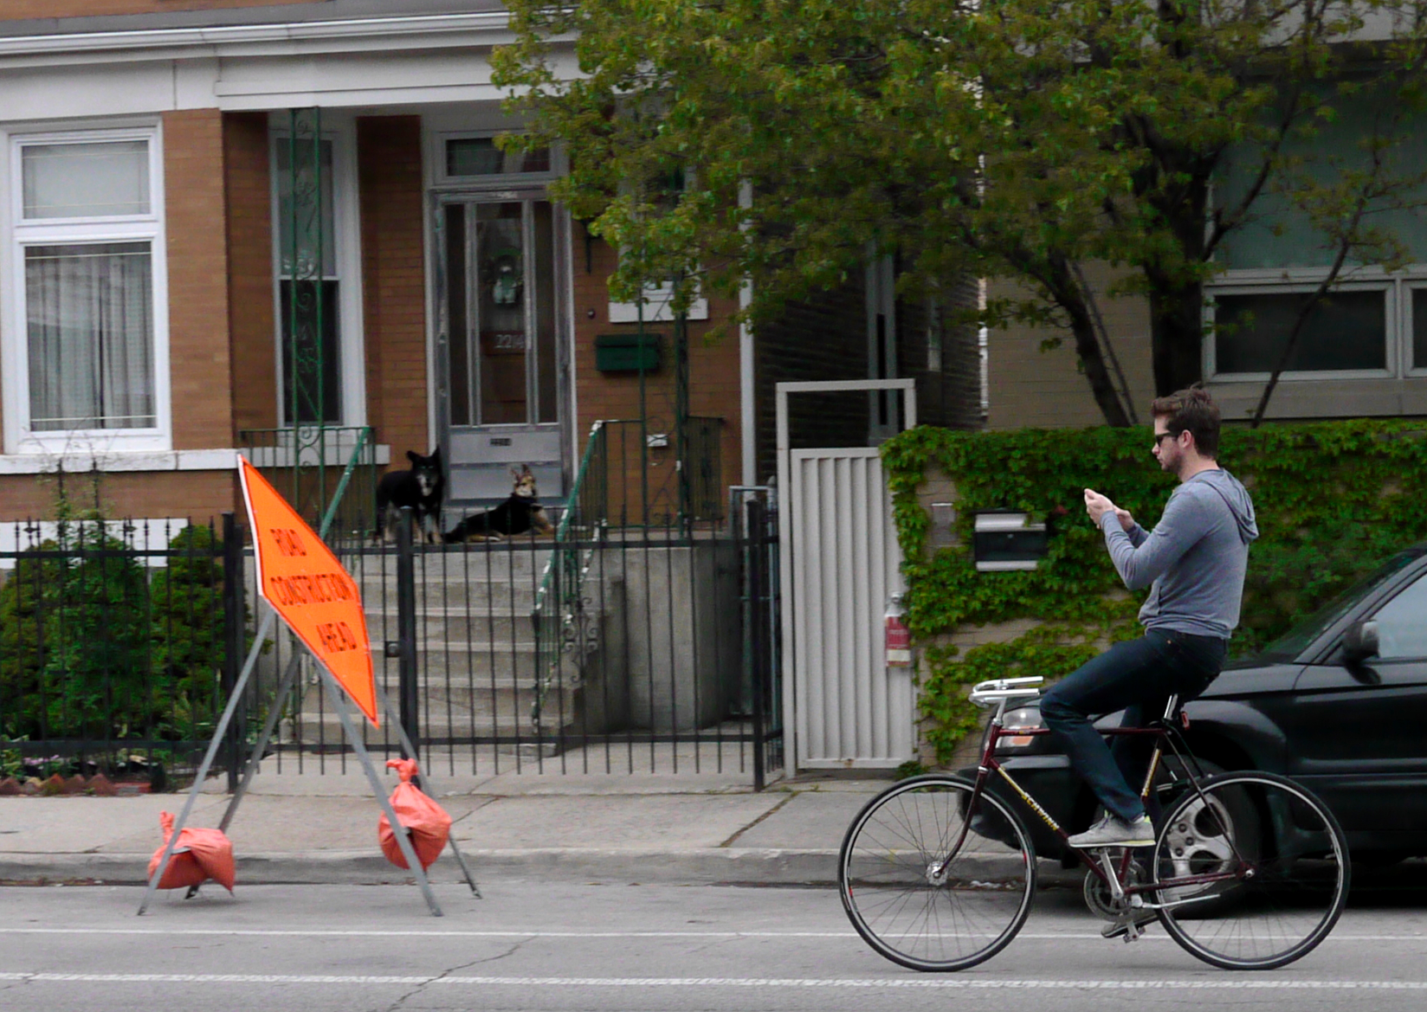
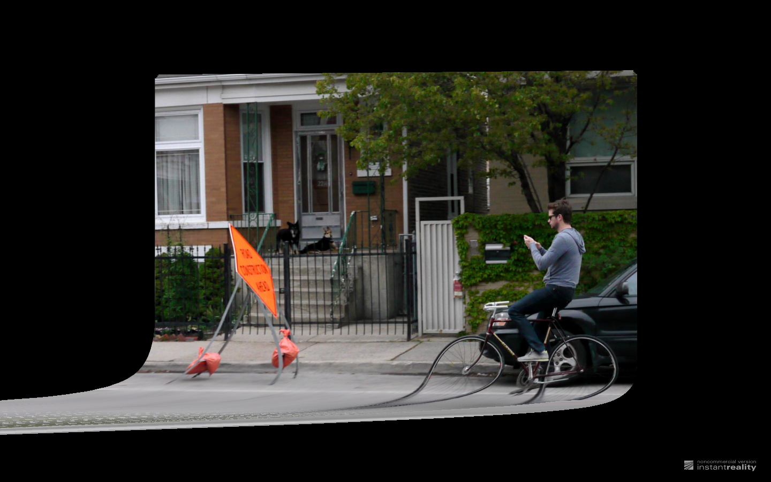
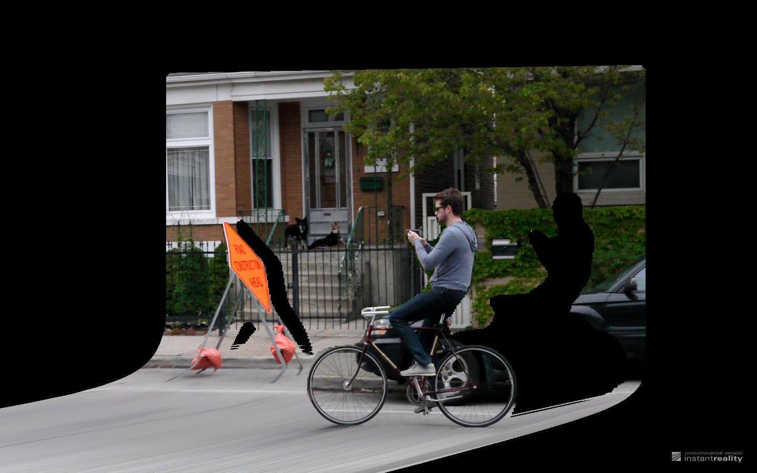
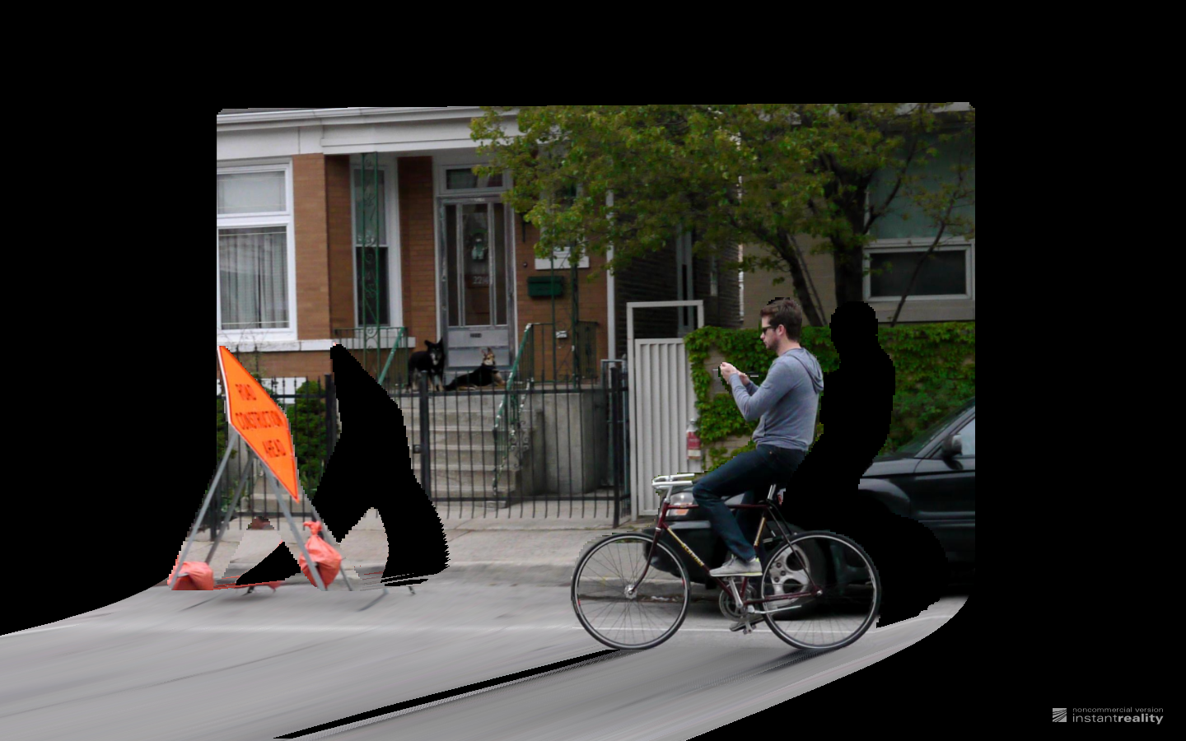
Pose Estimation
Coarse 3D Layout
Object Segmentation
Scene Recognition
Street
Hypothesis
#1
Inside City
Hypothesis
#2
Consistent
Consistent
Consistent
Construction
Hypothesis
#M

Slide 69
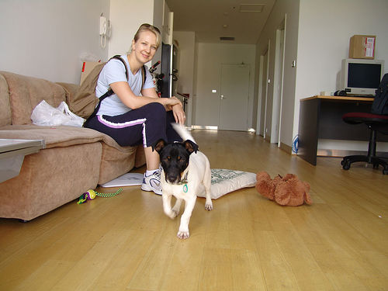
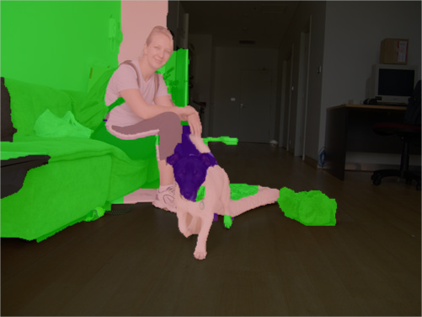
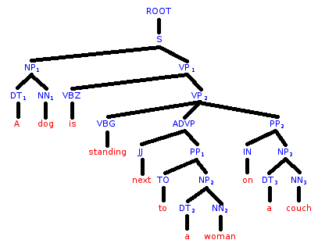
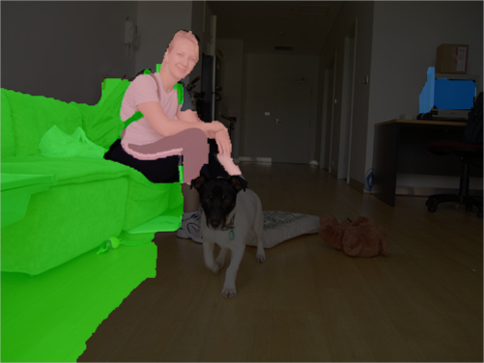

PASCAL
Sentence Dataset
“A dog is standing next to a woman
on a couch”
Ambiguity:
(dog next to woman) on couch
vs dog next to (woman on couch)
Vision: Semantic Segmentation
NLP: Sentence Parsing
Labels: Chairs, desks, etc
Output: Parse Tree
Hypothesis
#1
Person
Couch
Dog
Consistent
Person
Hypothesis
#M
Couch

Slide 70

Joint Re-Ranking
prep_on(woman, couch)
Person
Couch
Dog

Slide 71
Joint Re-Ranking
Person
Couch
Dog
Person
Couch

Slide 72



Joint Re-Ranking
with
on
by

Slide 73

Joint Re-Ranking
Vision-alone
~9% Gain
Language-alone
Vision+Language

Slide 74






NYU-v2 RGBD Dataset
Semantic Segmentation
3D Support Estimation
Labels: Chairs, desks, etc
Supported from below, behind, etc
Hypothesis
#1
Other Structure
Wall
Wall
Other Prop
Table
Other Structure
Wall
Hypothesis
#M
Television
Chair
Table

Slide 75
NYU-v2 RGBD Dataset
Semantic Segmentation
3D Support Estimation
Labels: Chairs, desks, etc
Supported from below, behind, etc
Hypothesis
#1
Other Structure
Wall
Wall
Other Prop
Table
Other Structure
Wall
Hypothesis
#M
Television
Chair
Table

Slide 76


Slide 79
NYU-v2 RGBD Dataset
Semantic Segmentation
3D Support Estimation
Labels: Chairs, desks, etc
Supported from below, behind, etc
Hypothesis
#1
Other Structure
Wall
Wall
Other Prop
Table
Other Structure
Wall
Hypothesis
#M
Television
Chair
Table

Slide 80
NYU-v2 RGBD Dataset
Semantic Segmentation
3D Support Estimation
Labels: Chairs, desks, etc
Supported from below, behind, etc
Hypothesis
#1
Other Structure
Wall
Wall
Other Prop
Table
Consistent
Other Structure
Wall
Hypothesis
#M
Television
Chair
Table

Slide 81


Interpretation: Projected Message Passing
Vision: Semantic Segmentation
NLP: Sentence Parsing
Vision: Human Body Pose
Vision: 3D Layout

Slide 82
Summary
Perception problems are ambiguous
All models are wrong
Need communication between many different modules or perception sub-problems
Key Problem: State-space explosion
  {all-3D-states} x {all-segmentation-states} x …
Key Idea:
  Keep around multiple plausible structured hypotheses
  Natural connections to submodular maximization
Notes:
In summary, not matter what the problem, all models are wrong, but some of their beliefs might be useful.
Our proposed algorithm give you a wait to exploit these beliefs by producing diverse M-Best solutions in discrete models.
It’s an efficient algorithm that re-uses existing MAP machinery.
And we believe there is a big impact possible on many applications.

Slide 83



Acknowledgements
Students
  Virginia Tech
    Aishwarya Agrawal, Harsh Agrawal, Neelima Chavali, Michael Cogswell, Gordon Christie, Xiao Lin, Clint Solomon, Qing Sun
  External
    Abner Guzman-Rivera (UIUC), Ankit Laddha (CMU), Adarsh Prasad (UT-Austin), Payman Yadollahpour (TTIC)
Collaborators
  Stefanie Jegelka (UC Berkeley), Pushmeet Kohli (MSR) Greg Shakhnarovich (TTIC), Danny Tarlow (MSR)
Sponsors

Slide 84
Thanks!

