Slide 1
On Graph-Structured Discrete Labelling Problems in Computer Vision: Learning, Inference and Applications
Dhruv Batra
Carnegie Mellon University

Slide 2
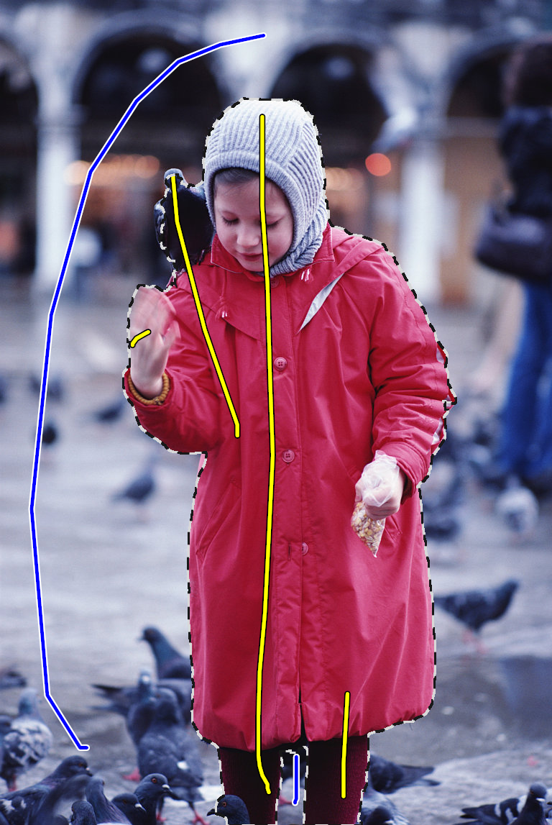
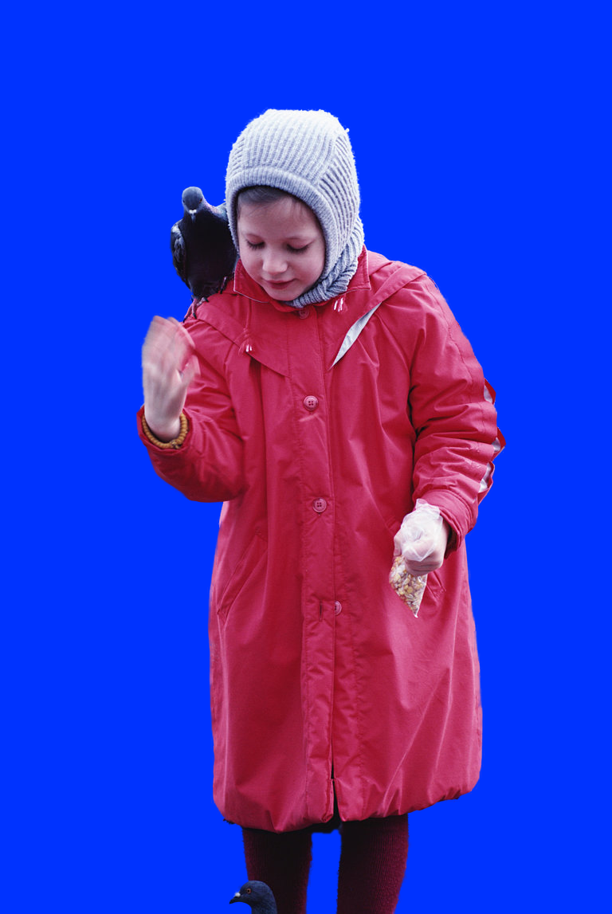
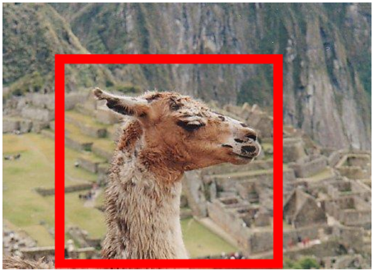
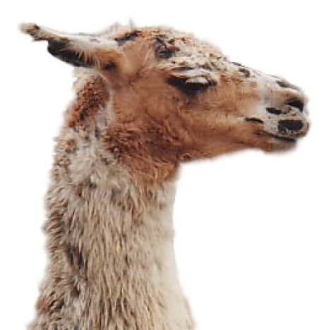
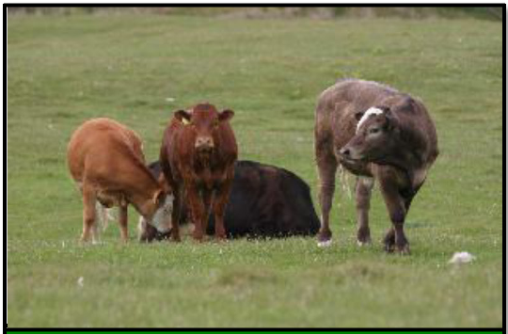
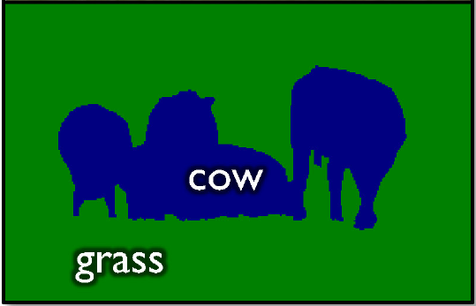
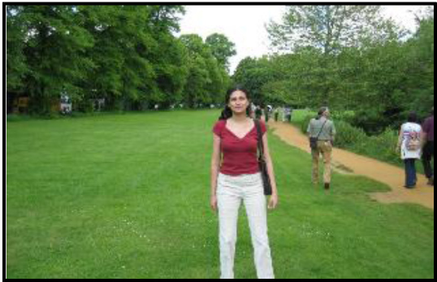
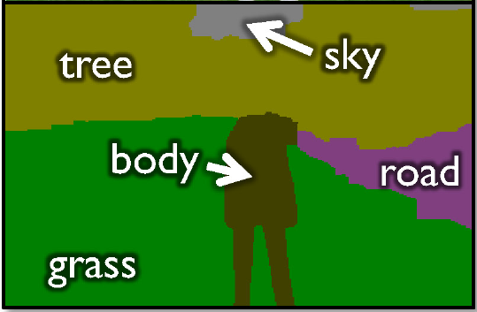
Labelling Problems in Vision
Segmentation
[Ren et al. ECCV ’06], [Boykov and Jolly, ICCV ’01], [Rother et al., SIGGRAPH ’04]
[He et al. ECCV ’06], [Yang et al. CVPR ’07], [Shotton et al. IJCV ’09], [Batra et al. CVPR ’08].

Slide 3
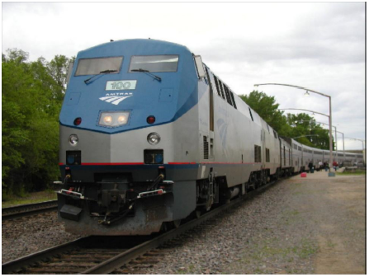
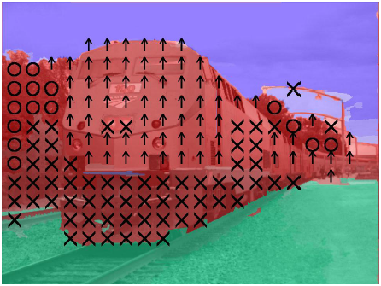
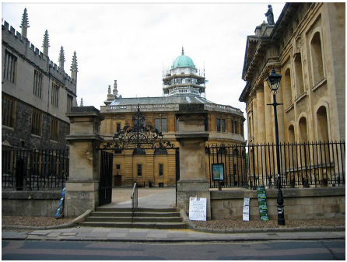
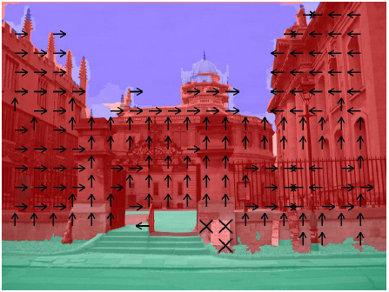
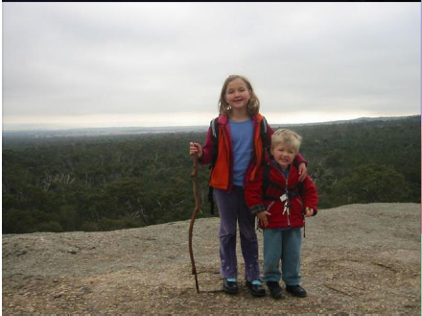
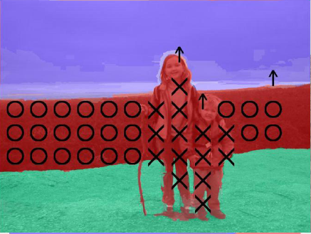
Labelling Problems in Vision
Geometric Labelling
[Hoiem et al. IJCV ’07], [Hoiem et al. CVPR ’08], [Saxena PAMI ’08], [Ramalingam et al. CVPR ‘08].

Slide 4
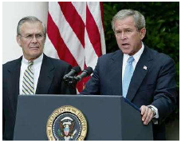
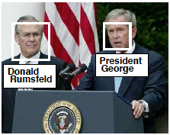
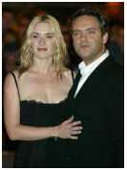
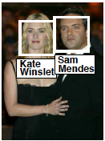
Labelling Problems in Vision
Name-Face Association
[Berg et al. CVPR ’04, Phd-Thesis ‘07], [Gallagher et al. CVPR ’08].
President George W. Bush makes a statement in the Rose Garden while Secretary of Defense Donald Rumsfeld looks on, July 23, 2003. Rumsfeld said the United States would release graphic photographs of the dead sons of Saddam Hussein to prove they were killed by American troops. Photo by Larry Downing/Reuters
British director Sam Mendes and his partner actress Kate Winslet arrive at the London premiere of ’The Road to Perdition’, September 18, 2002. The films stars Tom Hanks as a Chicago hit man who has a separate family life and co-stars Paul Newman and Jude Law. REUTERS/Dan Chung
Mildred and Lisa
Lisa
Mildred

Slide 5
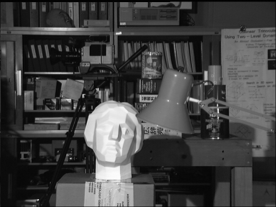
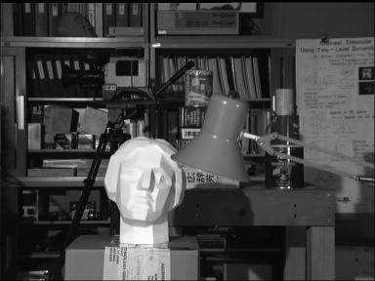
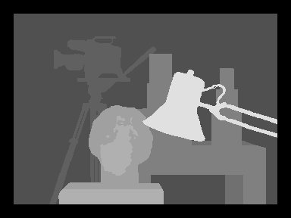
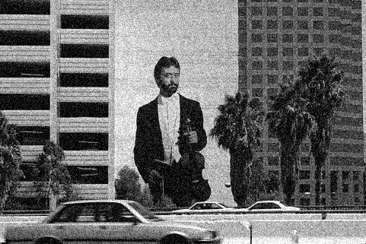
Labelling Problems in Vision
Stereo (Disparity Labelling)
[Roy and Cox, ICCV ‘98], [Boykov et al. CVPR ’97, PAMI ‘01], [Scharstein et al. PAMI ’02].
Motion Flow
[Boykov et al. PAMI ’01]
Denoising
[Sebastiani et al. Signal Proc. ’97], [Roth et al. IJCV ‘09], [Li et al. ECCV ’08], [Ishikawa CVPR ’09].
Left image
Right image
Disparity map

Slide 6
Structured Prediction
Set of discrete random variables
(Pairwise) Cost/Energy Function
MAP Inference
X₁
X₂
…
X_{n}
Node Energies / Local Costs
Edge Energies / Distributed Prior

Slide 7
My Thesis
This Talk
Part I: Learning
From partially-labelled data [Batra et al. BMVC ‘08]
From fully-labelled data [Batra et al. CVPR ‘08]
Part II: Inference
Beyond Trees: MAP Inference via Outer-Planar Decomposition [Batra et al. CVPR ’10a]
Part III: Applications
Interactive Co-segmentation [Batra et al. CVPR ’10b]
3D Modelling [Under Preparation]

Slide 8
Inference
MAP problem
In general NP-hard
Exact Algorithms for subclasses
Trees [Pearl, AAAI ’82]
Submodular Energies [Hammer ’65, Kolmogorov PAMI ’04]
Planar Ising Models / Outer-planar graphs [Schraudolph NIPS ’08]
Approximate Algorithms
Loopy BP [Pearl, ‘88]
Tree-Reweighted MP [Wainwright ‘05, Kolmogorov ’06, Komodakis ‘07]
Outer-Planar Decomposition (OPD)

Slide 9
Decomposition Methods
Decompose into subproblems
Intractable
Easy / Tractable

Slide 10
Decomposition Methods
Comparisons:
Max-Product BP [Pearl, ’88]
Tree-Reweighted MP [Wainwright ‘05, Kolmogorov ’06, Komodakis ‘07]

Slide 11
Decomposition Methods
Progression
BP
TRW
OPD
Increasingly Complex Sub-problems
Star-graphs
Trees
Outer-planar graphs

Slide 12
Outer-planarity
G is outer-planar
Allows a planar embedding
All nodes are accessible from “outside”
Lie on an unbounded external face
Add an extra node connected to all other.
Result should be planar.
Examples
Trees
A lot more, e.g.
1
1
2
2
4
3
3
4
1
2
4
3

Slide 13
Inference in Outer-Planar Graphs
Low Treewidth (=2)
Amenable to dynamic programming
Figure Courtesy: Pedro Felzenszwalb, Ph.D. Thesis

Slide 14
Inference in Outer-Planar Graphs
Planar-Cut Construction
[Schraudolph et al. NIPS ’08]
Source (0)
X₁
X₂
X₄
X₃
E(X₁,X₂,X₃,X₄)
X₁ = 1 X₂ = 0 X₃ = 0 X₄ = 1
Cost of st-cut = 8
E(1,0,0,1) = 8 + const

Slide 15
Outer-planar Decomposition
Outer-planarity is a strong constraint
These are not OP:
So now?
We will leverage this new subclass to propose a new approximate MAP inference algorithm
Outer-Planar Decomposition (OPD)
Very important for vision

Slide 16
Outer-planar Decomposition
OPD
Non-outerplanar graph

Slide 17
Outer-planar Decomposition
OPD
Planar-Cut
OPD
Non-outerplanar graph

Slide 18
Outer-planar Decomposition
Decomposition
Message-Passing
OPD-MP: Generalizes BP
OPD-DD: Generalizes TRW-DD
OPD-T: Generalizes TRW-T
OPD-S: Generalizes TRW-S
messages
messages
Accumulator Variables
Min-marginals
[Dual Decomposition, Komodakis, ICCV ‘07, CVPR ‘09]
MAP states
[Wainwright, Inf. Theory ’05]
[Kolmogorov, PAMI ‘06]

Slide 19
Outer-planar Decomposition
OPD
messages
Till Convergence
Agreement Variables

Slide 20
Guarantees
OPD-MP
Contains BP as a special case
To explore: if optimality properties of BP [Weiss & Freeman ’01; Sanghavi et al. ‘09] carry over to the generalized case
OPD-DD
Can be analyzed as projected subgradient ascent on Lagrangian dual.
Guaranteed to converge.
Contains TRW as a special case
Guaranteed to perform better than TRW-DD

Slide 21
Experiments
Synthetic (constructed) energies
Real-world applications
Face-Gender Labelling
Semantic Object Segmentation
Optical Flow

Slide 22
Experiments
Synthetic parameters
Randomly sampled energies from Gaussian dist.

Slide 23
Results
Synthetic parameters
Randomly sampled energies from Gaussian dist.
Energy
Lower bound
Harder Problems (More interaction)
K₄: 2-label problem

Slide 24
Results
Synthetic parameters
Randomly sampled energies from Gaussian dist.
30 x 30 grid: 2-label

Slide 25
Results
Synthetic parameters
Varying graph structure
Fully connected (K₅₀)
Planar (grids, Delaunay traingulations)
Varying density
Randomly sampling edges
Varying number of subgraphs

Slide 26
Experiments
Gender-Face Assignment
Not independent problems
Need to incorporate “social context”
Average male is taller than average female
People position themselves according to certain social norms

Slide 27
Experiments
Gender-Face Assignment
Node energies:
Confidence of local appearance based classifiers
Edge energies
Pairwise features describing relative location, scale, etc
Get nearest-neighbours from a large labelled dataset [Gallagher Collection Dataset]
Histogram of pairwise gender assignments in neighbours

Slide 28
Results
Gender-Face Assignment
Energy Min ≠ 100% acc
[Tappen & Freeman ’03] [Szeliski et al. ‘08]

Slide 29
Overview
Part I: Learning
From partially-labelled data [Batra et al. BMVC ‘08]
From fully-labelled data [Batra et al. CVPR ‘08]
Part II: Inference
Beyond Trees: MAP Inference via Outer-Planar Decomposition [Batra et al. CVPR ’10a]
Part III: Applications
Interactive Co-segmentation [Batra et al. CVPR ’10b]
3D Modelling [Under Review]

Slide 30
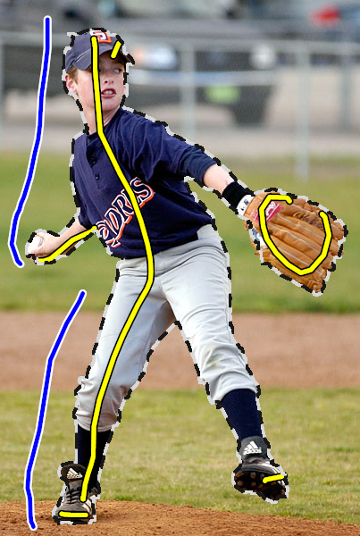
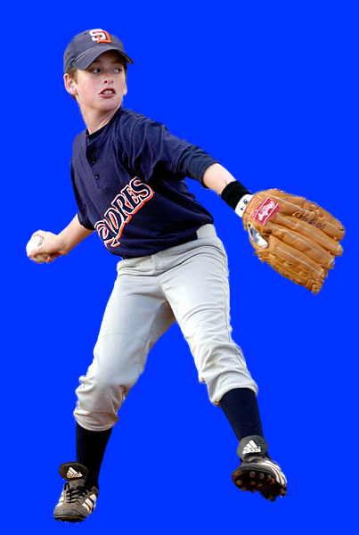
Background
Interactive Segmentation
[Li et al. SIGGRAPH ’04], [Boykov and Jolly, ICCV ’01], [Batra et al. BMVC ’08].
[Rother et al. GrabCut, SIGGRAPH ’04].

Slide 31
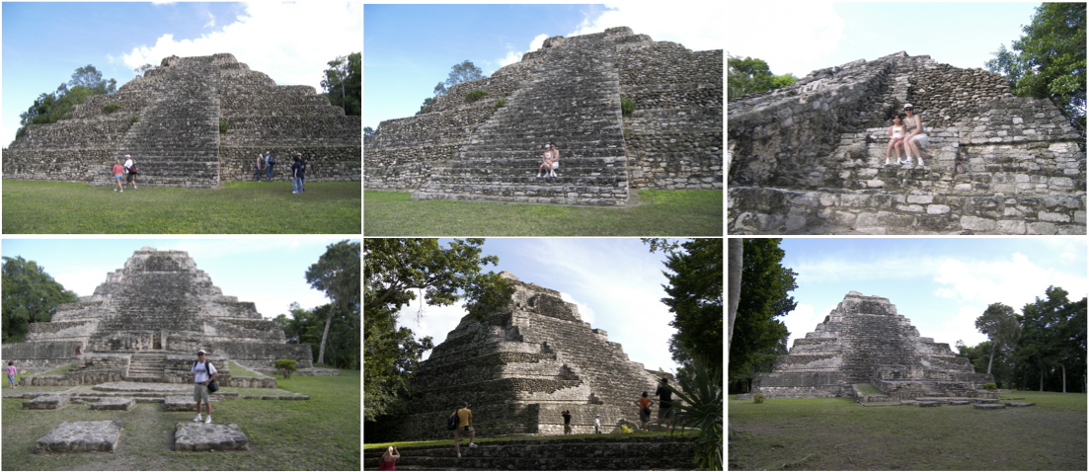
Background
Consumer image collections are typically related

Slide 32
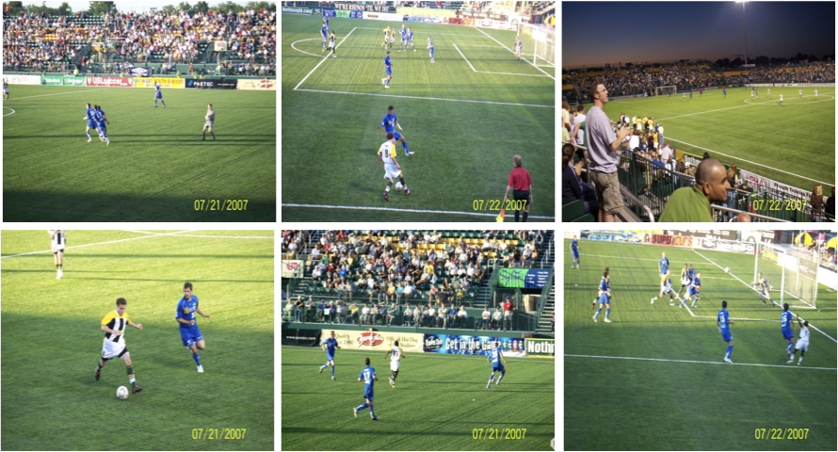
Background
Consumer image collections are typically related

Slide 33
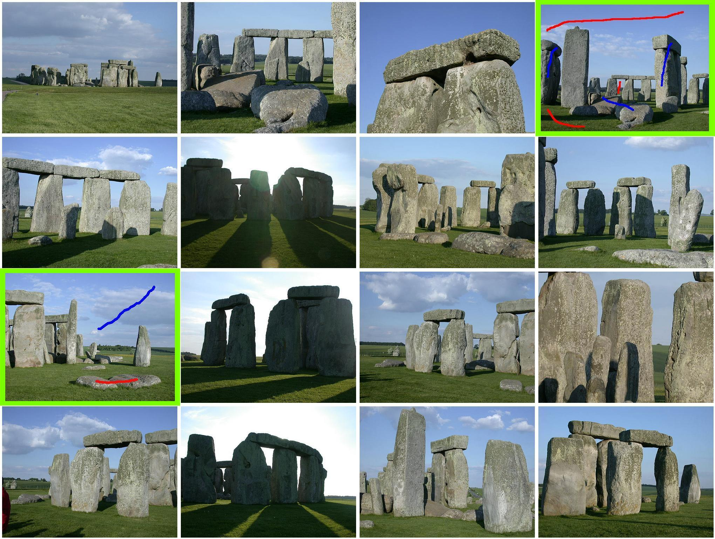
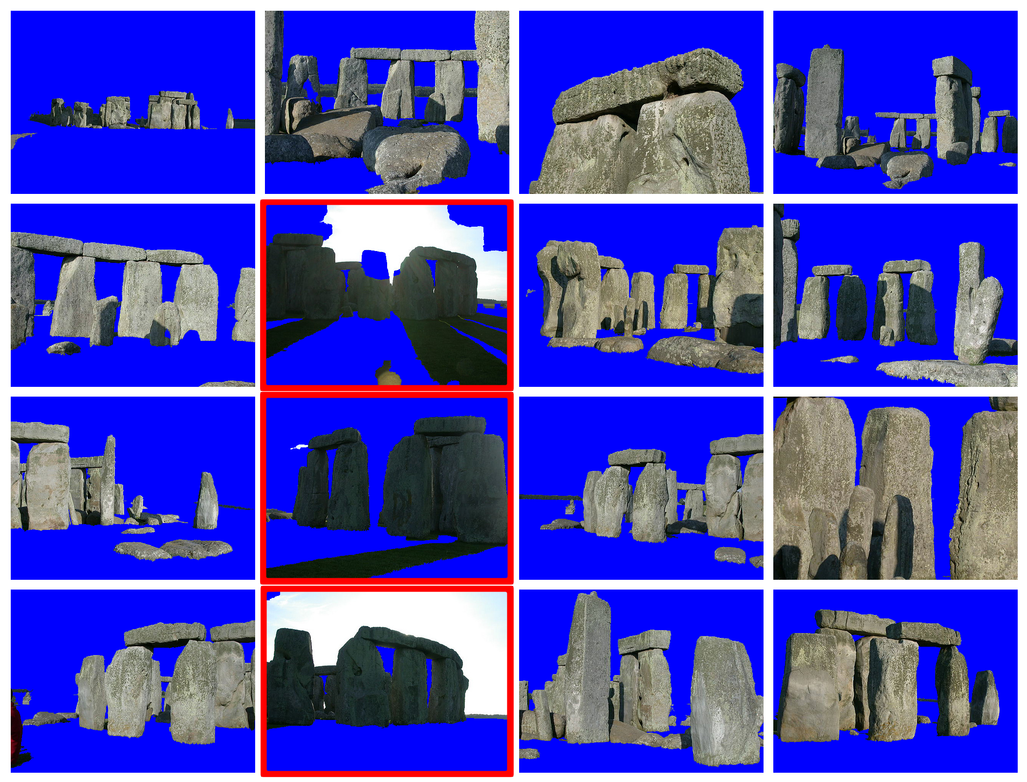
Interactive Co-segmentation

Slide 34
Interactive Co-segmentation
Group Appearance Model

Slide 35
Interactive Co-segmentation
Energy functions per image
Basic setup:
Scribble image(s)
Learn Group Appearance Models
Set up energy minimization problem
Minimize energies to segment all images
Unary Appearance Model (GMMs)
Pairwise Appearance Model (Distance Metric Learning)

Slide 36
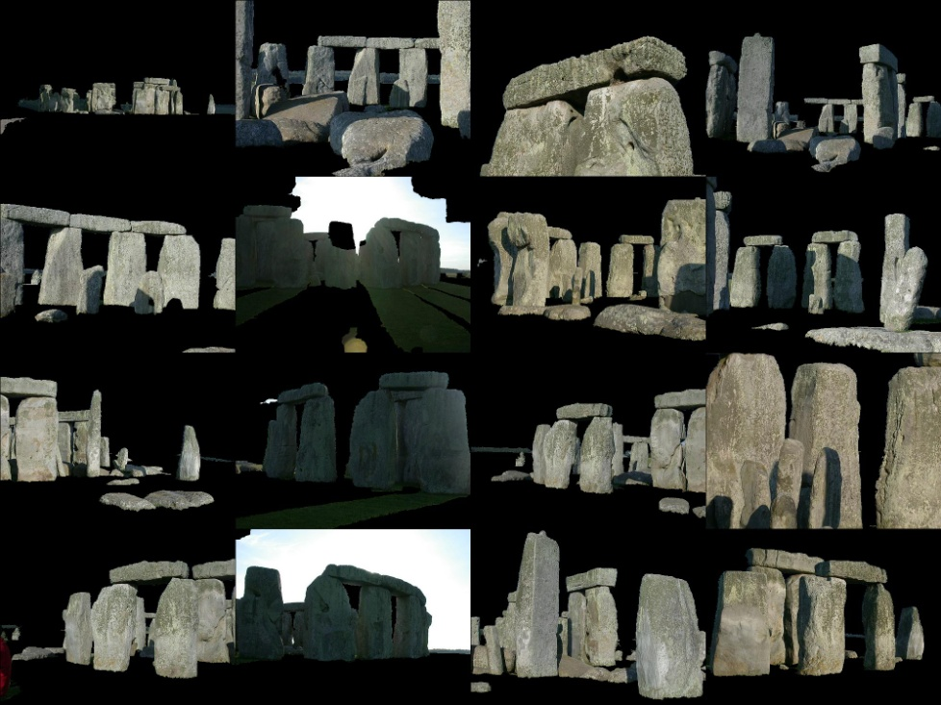
Interactive Co-segmentation

Slide 37
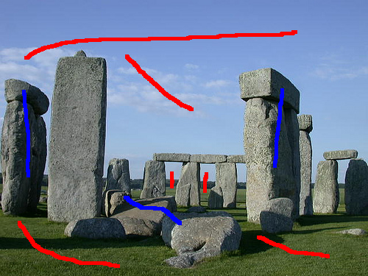
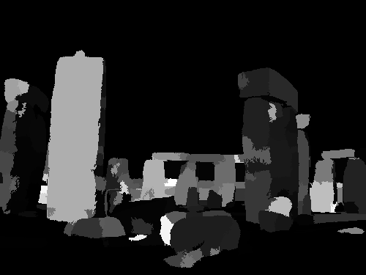
Scribble Guidance
Recommendation Maps

Slide 38
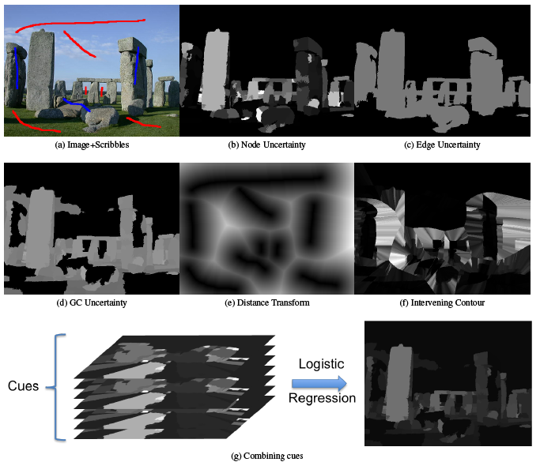
Scribble Guidance

Slide 39
Interactive Co-segmentation

Slide 40
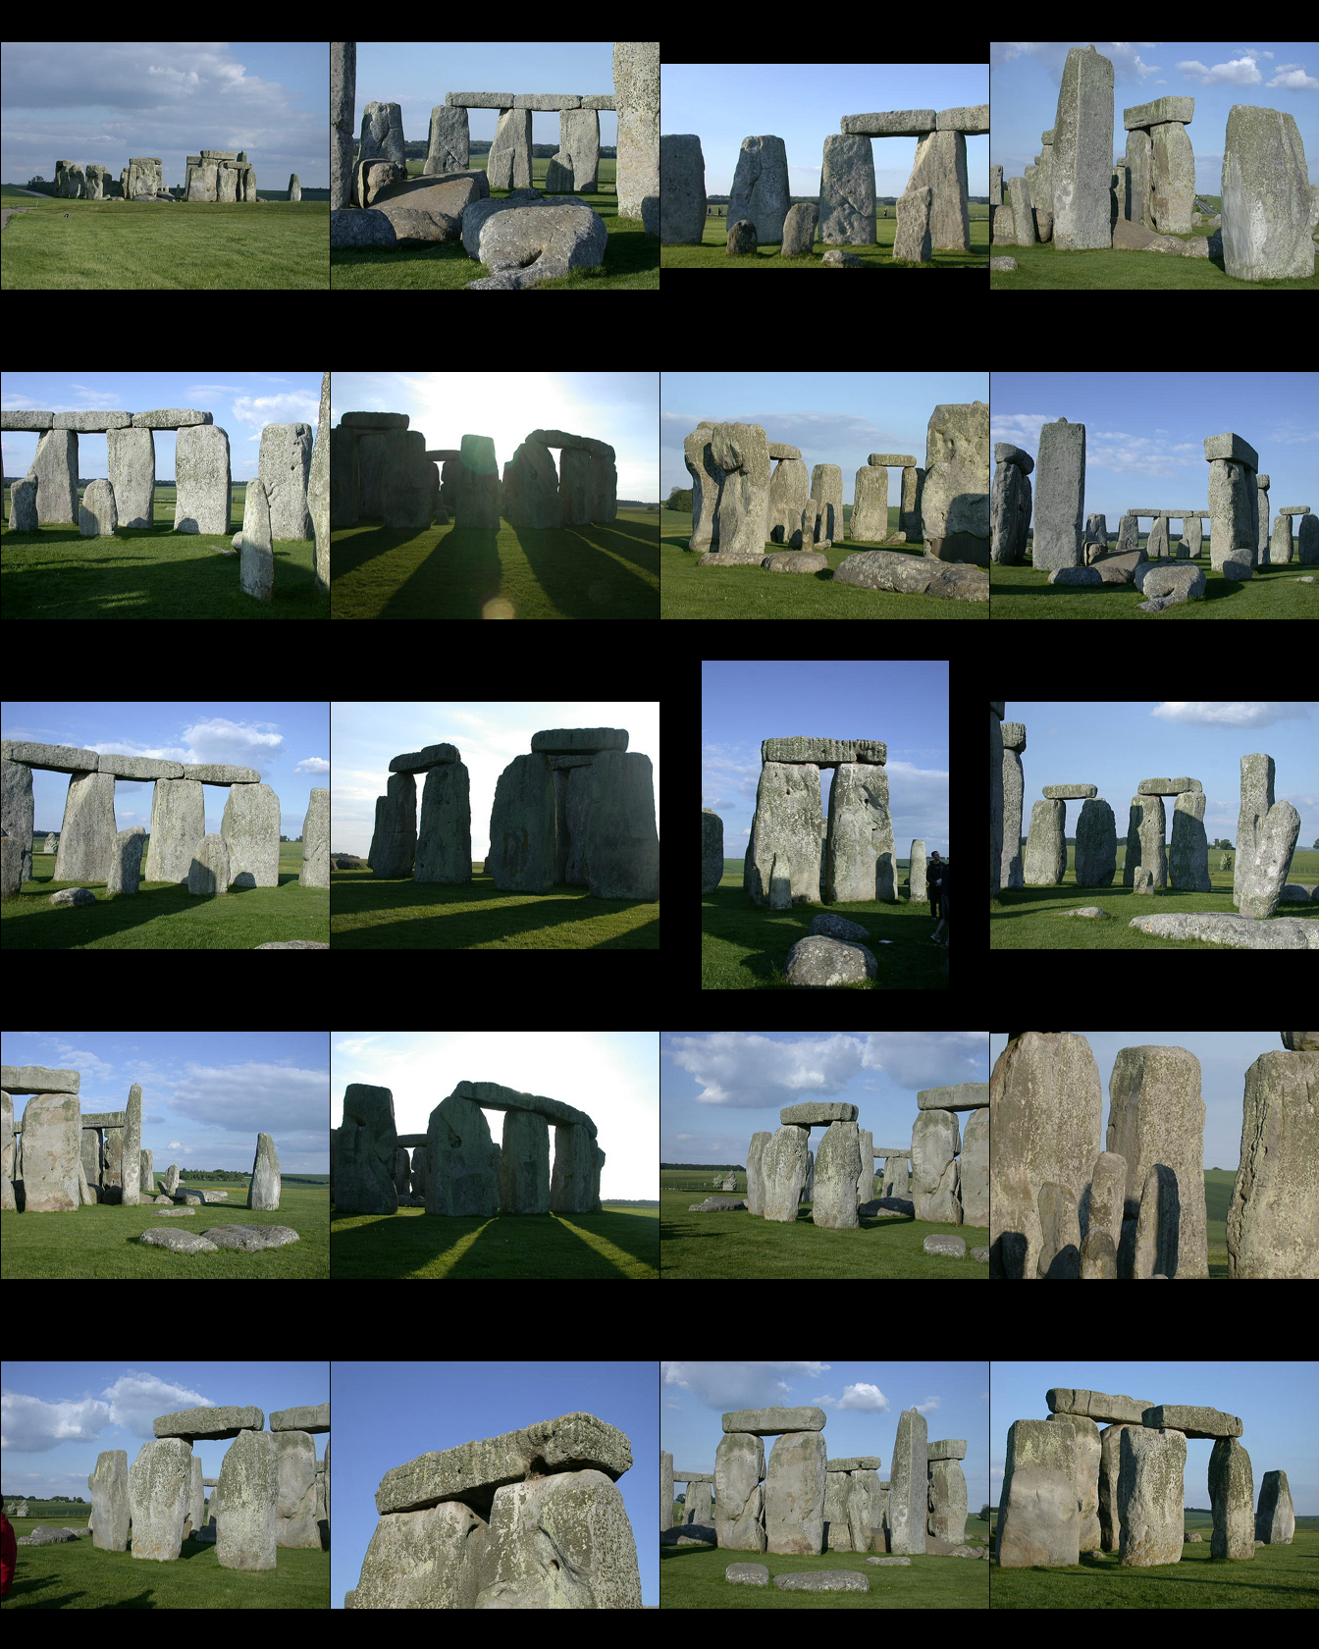
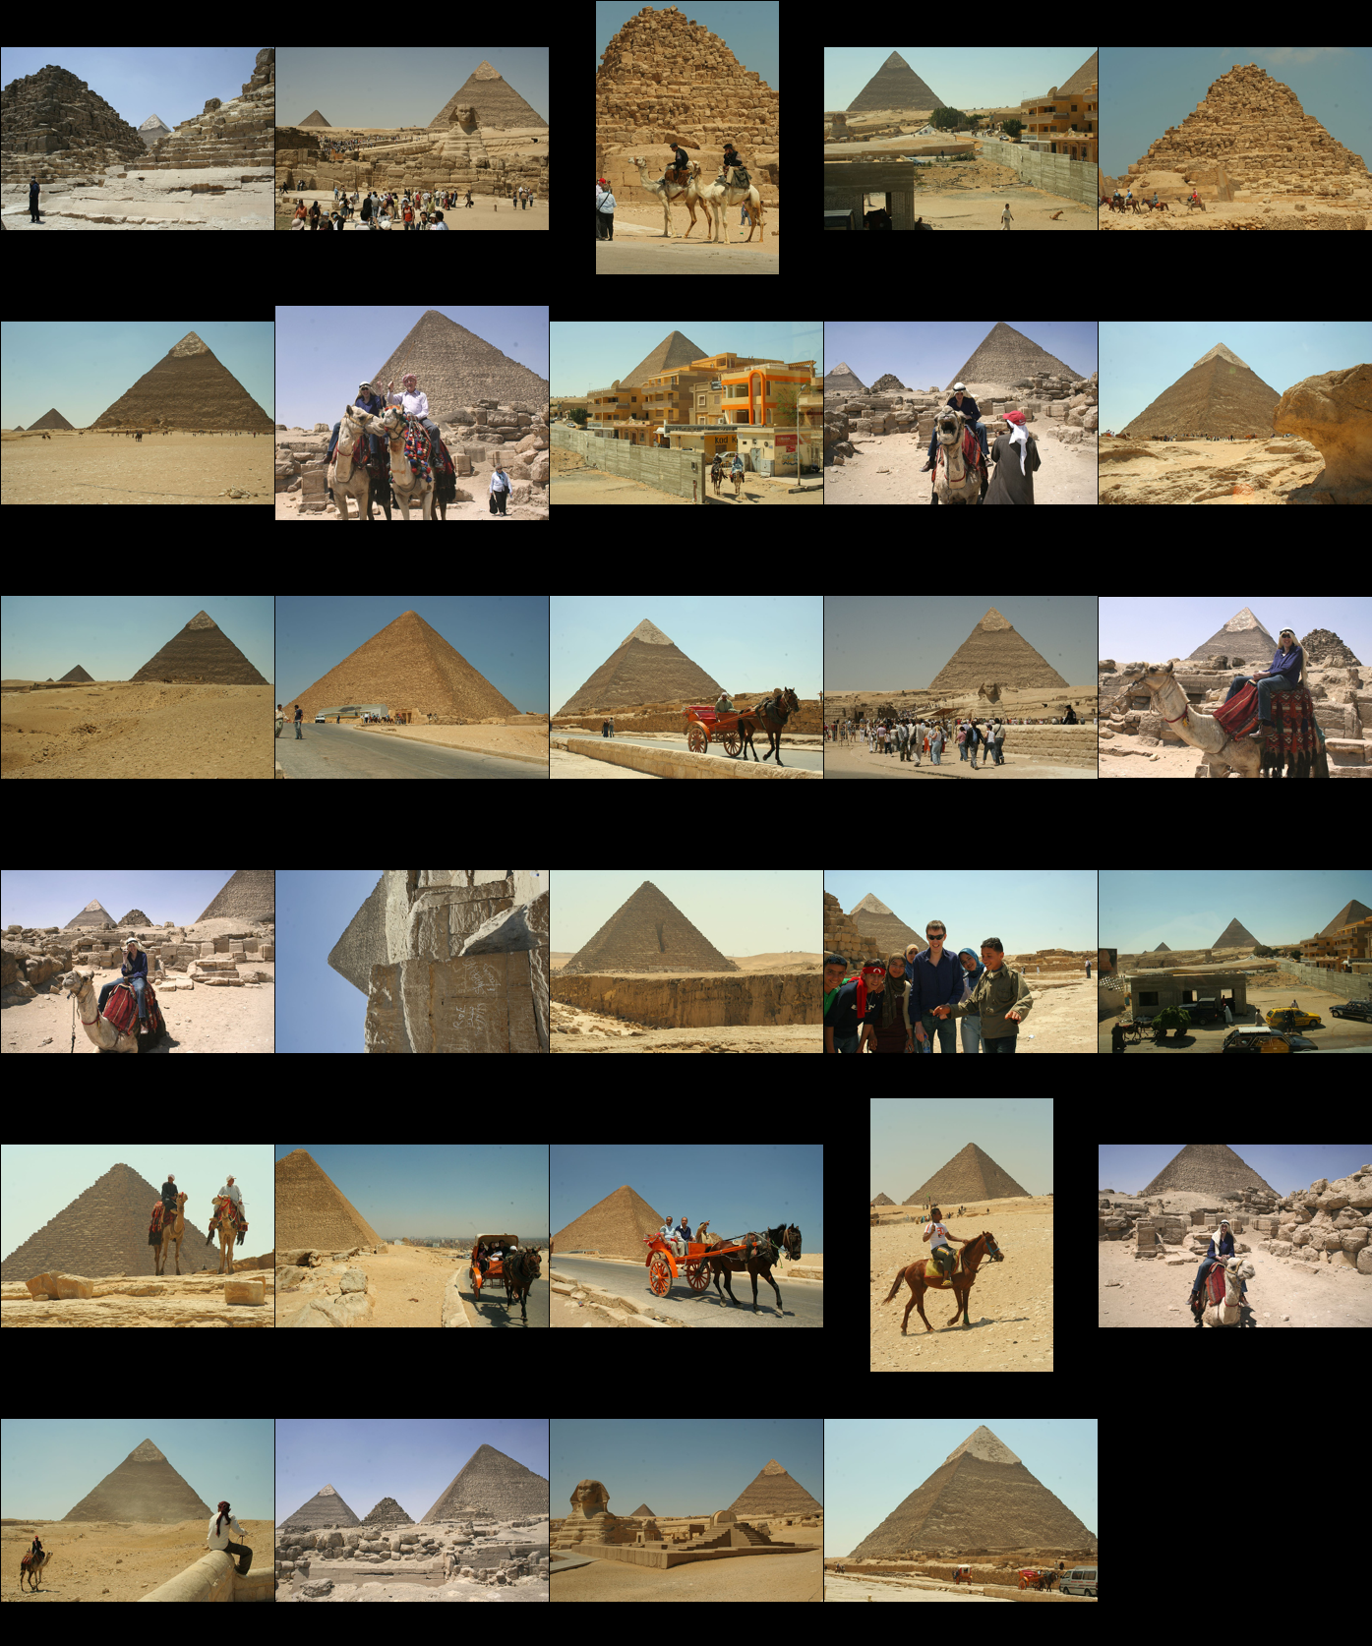
Dataset
Landmarks

Slide 41
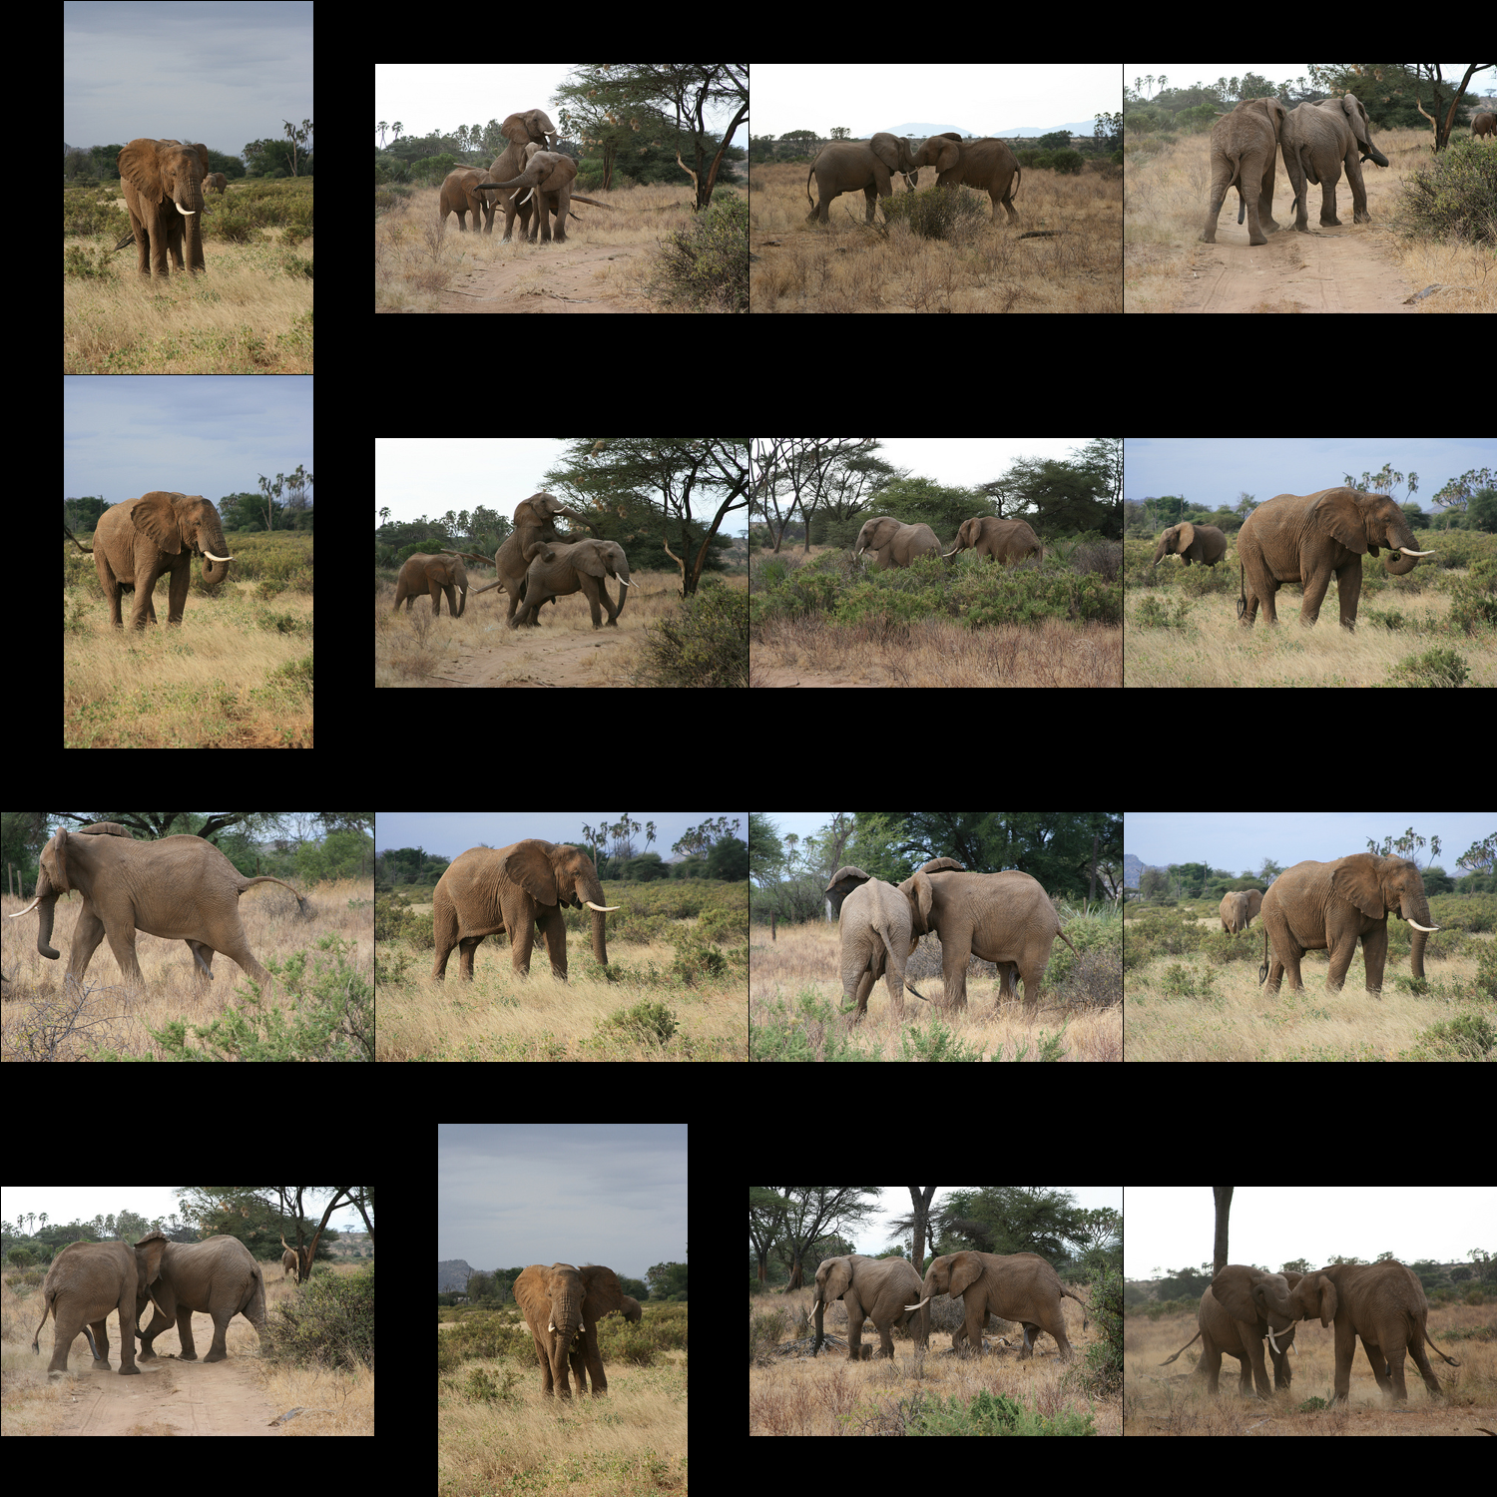
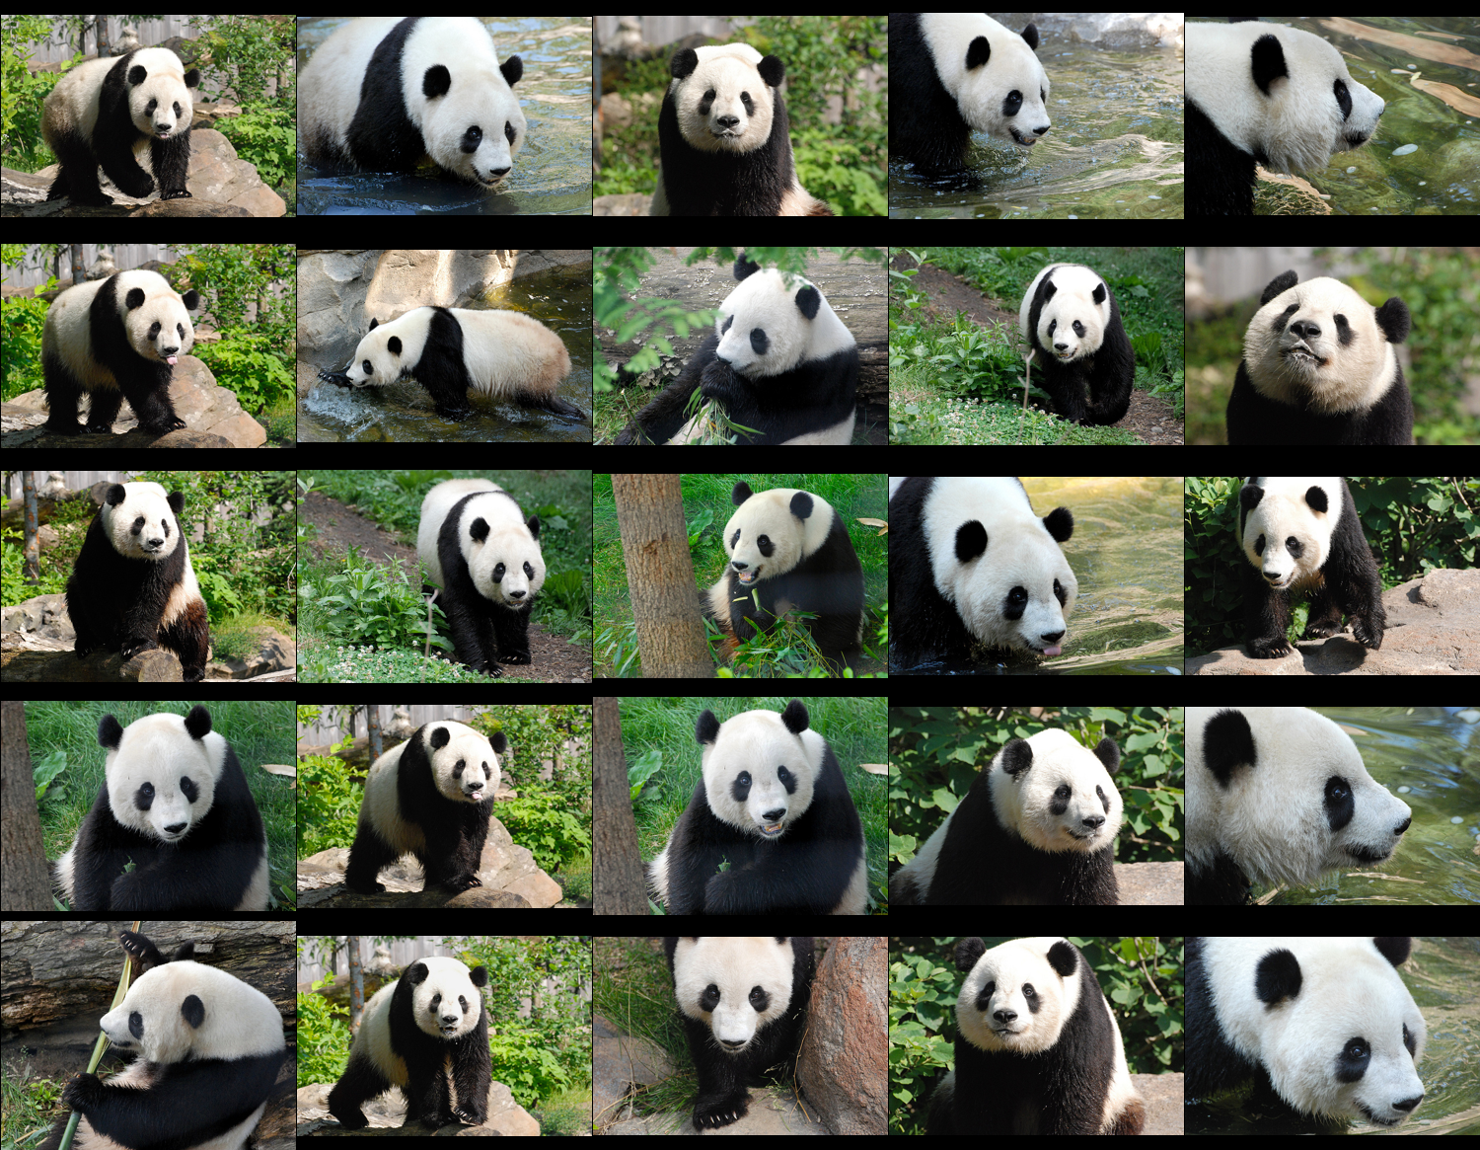
Dataset
Natural Scenes / Animal

Slide 42
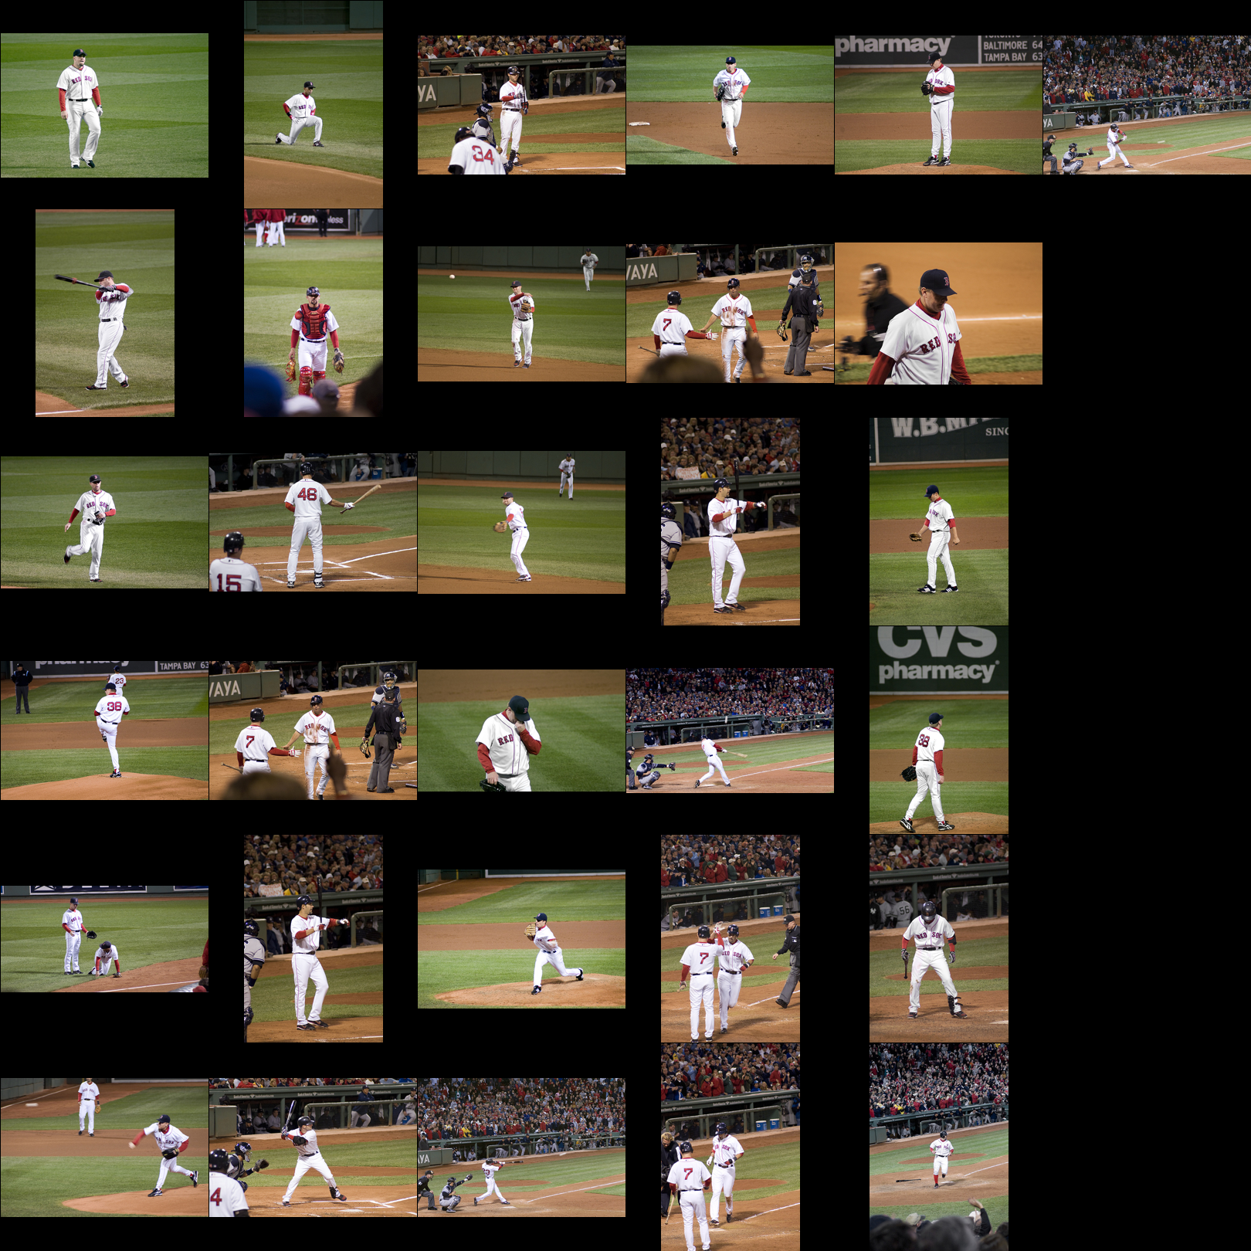
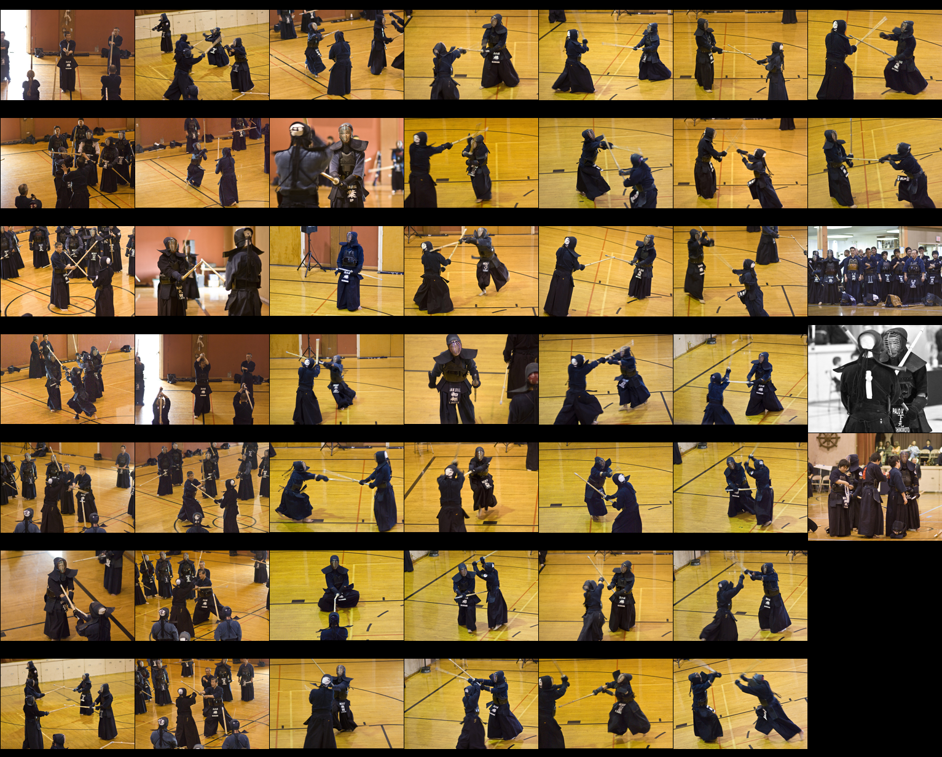
Dataset
Sports

Slide 43
Dataset

Slide 44
Mine Is Bigger Than Yours
Dataset Statistics
Title Plagiarized from David Forsyth’s talk at CVPR 2010.

Slide 45
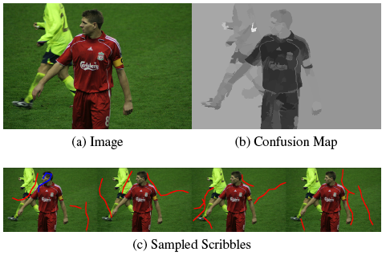
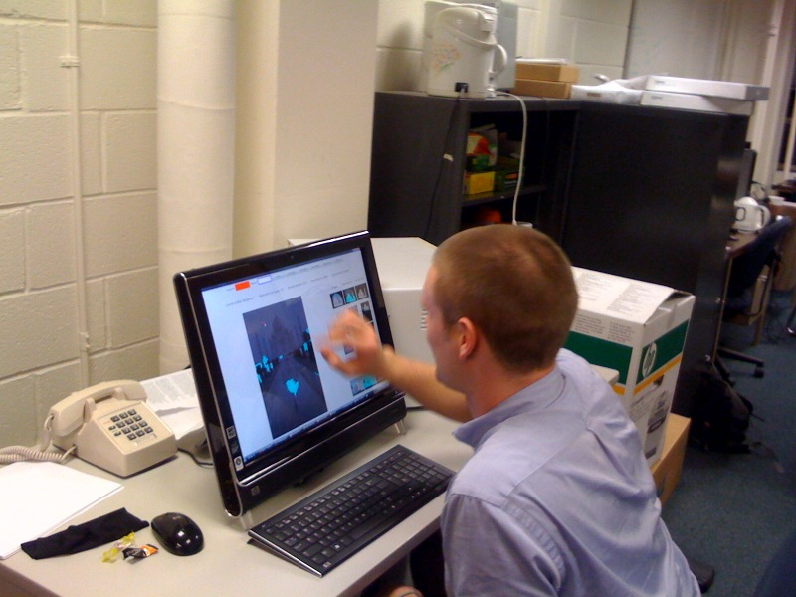
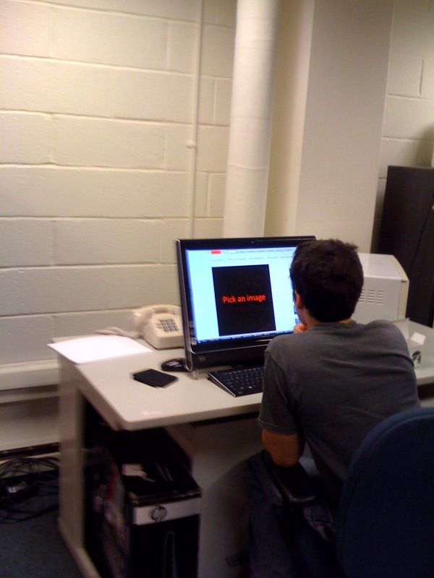
iCoseg: Experiments
Machine Simulations
User Study

Slide 46
iCoseg: Results
Can effectively guide users without ever looking at all images!
Machine Simulations
User Study

Slide 47
3D Modelling
Interactive Co-segmentation + Shape from Silhouettes
iModel Video
[Kowdle et al. Under Prep]

Slide 48
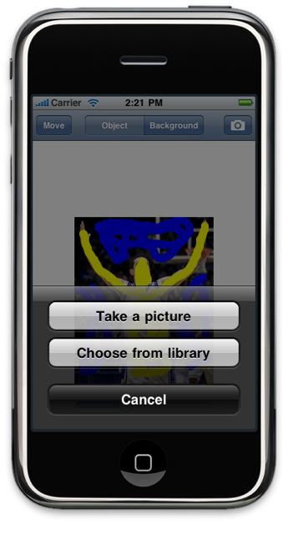
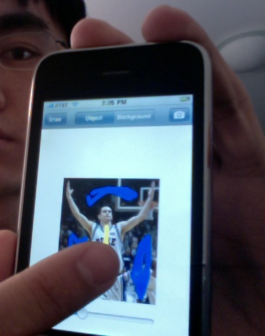
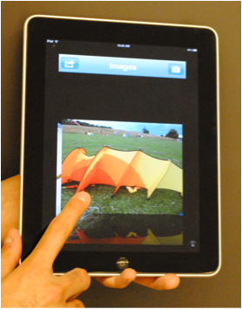
iPhone App
App Video
Jointly with Jason Lew, Adarsh Kowdle

Slide 49
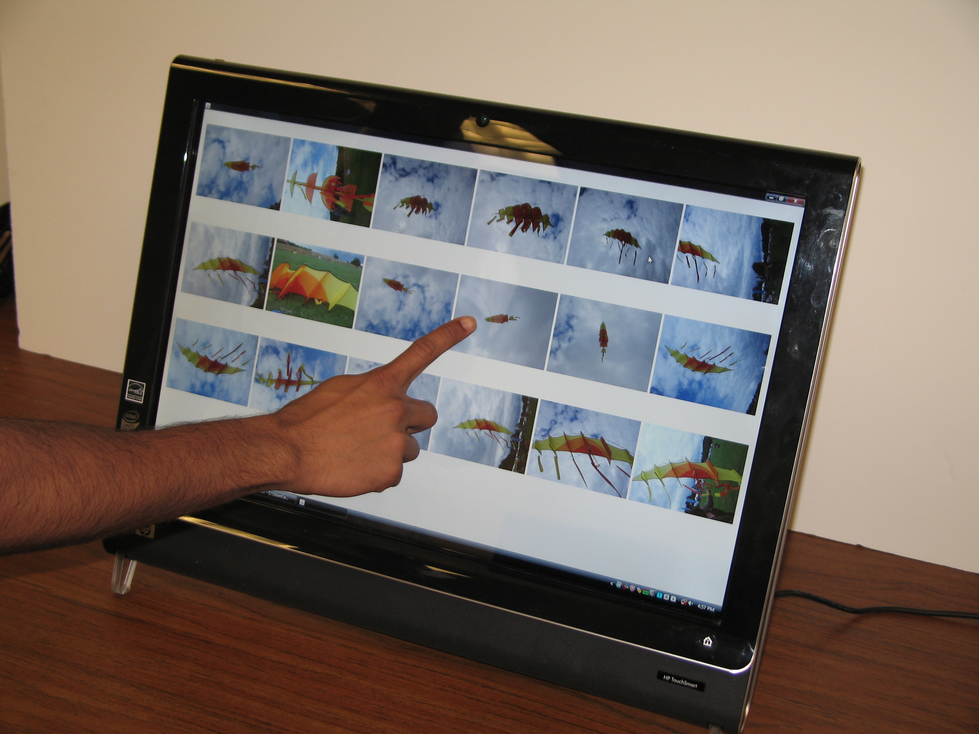
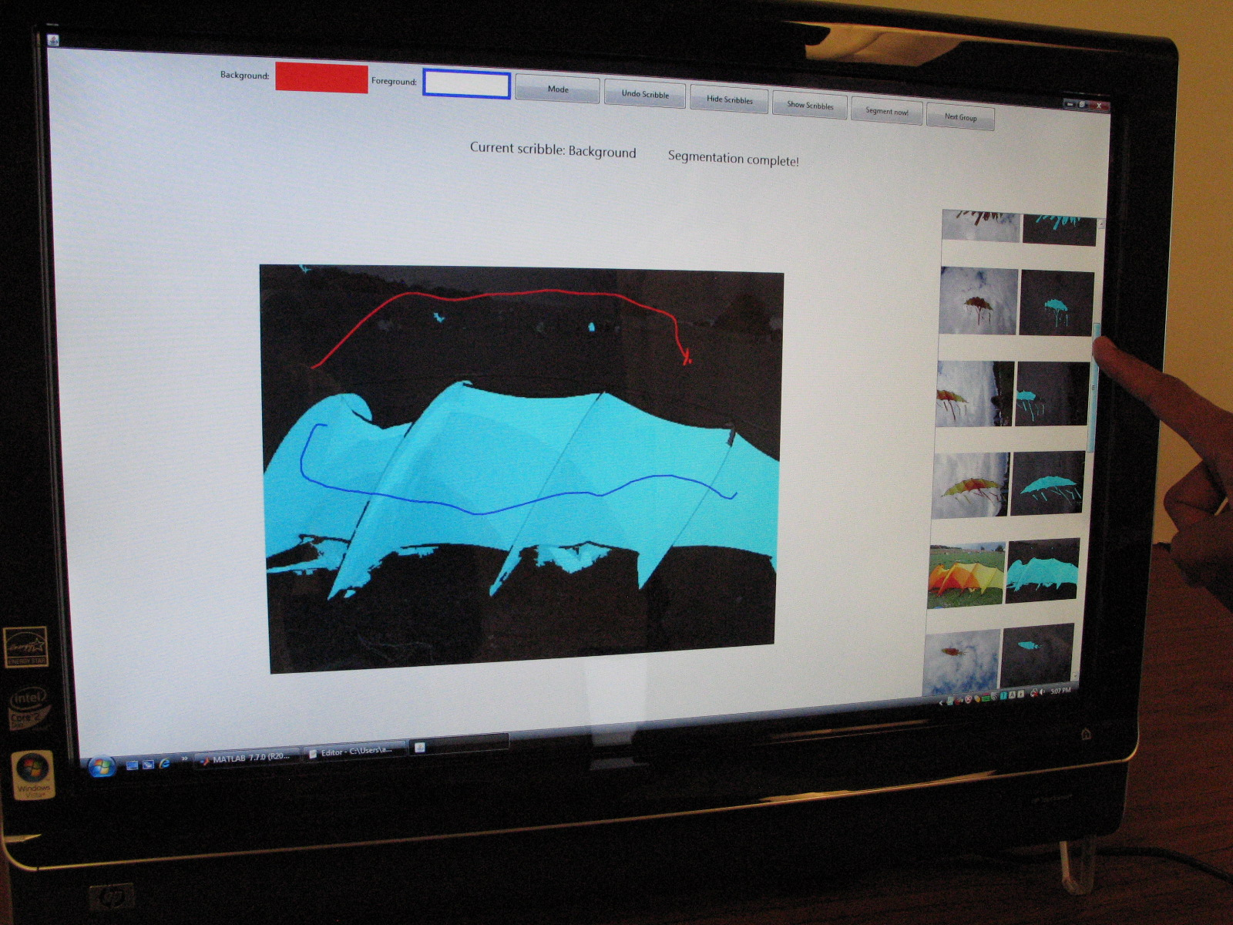
Summary
Graph-Structured Labelling Problems are ubiquitous!
pixels / regions / faces /etc are never independent
My thesis:
Learning: energy functions
Inference: Start-of-art inference engine
Applications: Interactive Co-segmentation & 3D Modelling
Theory
Applications

Slide 50
Thank You!
Co-authors:
OPD: Andrew Gallagher, Devi Parikh, Tsuhan Chen;
iCoseg: Adarsh Kowdle, Jason Lew, Devi Parikh, Kevin Tang, Jiebo Luo, Tsuhan Chen

Slide 51
Future Work
Where do sub-graphs come from?
One natural idea:
(Orthogonal) Projections of Primal Energy onto Outer-Planar Energies
This contains an NP-hard problem
Maximum outer-planar sub-graph problem

Slide 52
Future Work
Where do sub-graphs come from?
Currently using Greedy Heuristic:
Start with a spanning tree
Add edges till maximal outer-planar
Remove edges from graph, repeat

Slide 53
Decompositions
Heuristic:
Able to find 2-subgraph decompositions surprisingly often

Slide 54
Future Work
In Future
Start with a large family of subgraphs
Pick a collection
Perform Inference
Greedily pick next → most improvement in lower bound
Diminishing returns / Submodularity?
Greedy >= 63% of OPT

Slide 55
Future Work
Beyond OPD
?
BP
TRW
OPD
Star-graphs
Trees
Outer-planar graphs
Treewidth = 1
Treewidth = 2
Treewidth = 3,4,…, k

Slide 56
Future Work
Combining Exact Inference Algorithms
Submodularity
Max-flow / min-cut
Constraint on parameters
Constraint on structure
Outer-planarity Low-Treewidth
Dynamic Programming
1
3
2

Slide 57
Future Work
Combining Exact Inference Algorithms
Exact Inference Graph-Cuts
Exact Inference Dynamic Programming

Slide 58
Future Work
Open Questions:
M-Best MAP solutions from decomposition methods?
Confidence measures (min-marginals) from decomposition methods?
Do decomposition ideas extend to harder problems like min-prod-sum instead min-sum?
Distributed processing?

Slide 59
Proof Sketch
Equivalent Binary Integer Programming Formulation
Equivalent Linear Programming Formulation

Slide 60
Proof Sketch
Primal corresponding to dual-decomposition
Outer-Bound on the Marginal Polytope
Kept
Relaxed

Slide 61
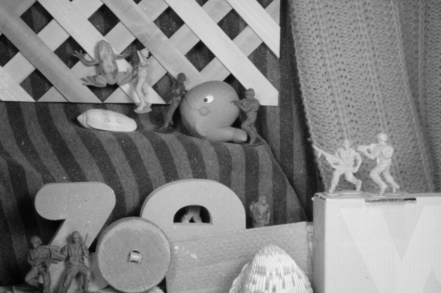
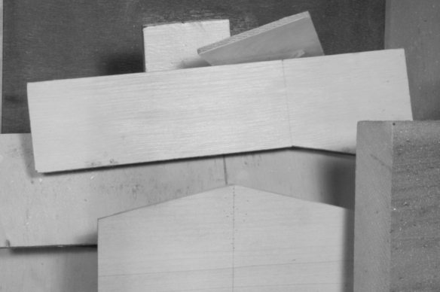
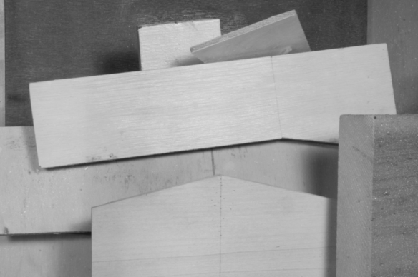
Results
Optical Flow
Army
Wooden

Slide 62
Experiment
Multi-class Object Labelling
Node Optimal States
Co-occurance

Slide 63
Results
Multi-class Object Labelling

Slide 64
Take-home Messages
Interesting idea of identifying tractable subproblems within intractable ones
First step towards structures topologically more complex than trees
OPD-approximation is guaranteed to be tighter than baselines (like TRW)
OPD is useful for hard vision problems

Slide 65
K₅₀
Synthetic parameters
Randomly sampled energies from Gaussian dist.
K₅₀: 2-label problem

Slide 66
K₅₀
Effect of Number of Decompositions

Slide 67
K₅₀
Effect of Number of Decompositions

Slide 68
K₅₀: Multi-Label
Synthetic parameters
Randomly sampled energies from Gaussian dist.
K₅₀: 4-label problem

Slide 69
Higher-Order Cliques
Order Reduction
Kolmogorov-Zabih Reduction [KZ ’04; Freedman & Drineas ’05; Ishikawa ‘09]
Reduction by Substitution
Factor
Variable

Slide 70
Higher-Order Cliques
Experiments with synthetic energies
50-node Delaunay Planar

Slide 71
Planar Inference
Planar-Cut
Source (0)
X₁
X₂
X₄
X₃
E(X₁,X₂,X₃,X₄)
Outer-planarity
Planar-cut

Slide 72
Outer-planar Decomposition
OPD-DD: Message
OPD
Non-outerplanar graph
Agreement Variables

Slide 73
Decomposition Methods
“Certificate” property
Decomposition Lower Bound
Flow-value >k
s
t
G
Cut-value <= k
Given graph G, can we push an s-t flow of value > k?

Slide 74
Max-flow / Min-cut
Construction
[Hammer ‘65], [Kolmogorov, PAMI ’04]
Source (0)
2
9
X₁
1
E(X₁,X₂)
X₂
2
5
4
Sink (1)
X₁ = 1 X₂ = 0
Cost of st-cut = 8
E(1,0) = 8 + const

Slide 75
Inference
Construction
[Hammer ‘65], [Kolmogorov, PAMI ’04]
Source (0)
2
9
X₁
1
E(X₁,X₂)
X₂
2
5
4
Sink (1)
Submodularity!
Max-flow / min-cut

Slide 76
Planar Inference
Planar-Cut Construction
[Schraudolph et al. NIPS ’08]

Slide 77
Run-Time
Run-time:
K iterations x D decompositions x N cuts
Complexity of min-cut
Best known algorithm:
Current implementation:
Complexity of max-flow/min-cut
(Smart) Push-relabel:
(Dynamic tree) Push-relabel

Slide 78
Outer-planar Decomposition
OPD
messages
Agreement Variables

Slide 79
Outer-planar Decomposition
OPD-MP: Message
OPD
Non-outerplanar graph
Agreement Variables

Slide 80
Outer-planar Decomposition
OPD-MP: Message
OPD
Non-outerplanar graph
Message
Agreement Variables
Min-marginal

Slide 81
Dynamic Planar Cuts
How many cuts?
2*N [Naively]
N+1 [Slightly smarter]
1 + N updates [Proposed]
OPD
message
Non-outerplanar graph
Agreement Variables

Slide 82
Dual Decomposition
Primal problem
Re-formulate
Langragian Relaxation
Lower-Bound
Komodakis ICCV ‘07; Bertsekas ’99

Slide 83
Dual Decomposition
Dual (Master) Problem
Dual (Slave) Problems
Can solve master with Projected Subgradient Ascent

Slide 84
Dual Decomposition
Projected Subgradient Ascent
What is subgradient?

Slide 85
Dual Decomposition
Primal problem
Want to solve independently
To parallelize
Each sub-problem easy, cumulative problem hard

Slide 86
Dual Decomposition
Primal problem
Re-formulate
Relax (Langragian dual)

Slide 87
Dual Decomposition
Dual (Master) Problem
Dual (Slave) Problems
Can solve master with Projected Subgradient descent

Slide 88
Dual Decomposition
Projected Subgradient Descent
What is subgradient?

Slide 89
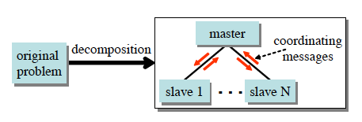
Dual Decomposition
Overview

Slide 90
MAP
Goal
Integer Program formulation

Slide 91
MAP as TRW
Distribute parameters:
Decompose energy

Slide 92
MAP as DD
Primal Problem
Dual

Slide 93
MAP as DD
Dual (Master) Problem
Dual (Slave) Problems
Can solve master with Projected Subgradient descent

Slide 94
MAP as DD
Algorithm
Interpretation

Slide 95
MAP as DD
Theoretical Guarantees

