Slide 1
Beyond Trees: MRF Inference via Outer-Planar Decomposition [(To appear) CVPR ‘10]
Dhruv Batra Carnegie Mellon University
Joint work: Andrew Gallagher (Eastman Kodak), Devi Parikh (TTI-C), Tsuhan Chen (Cornell, CMU)

Slide 2
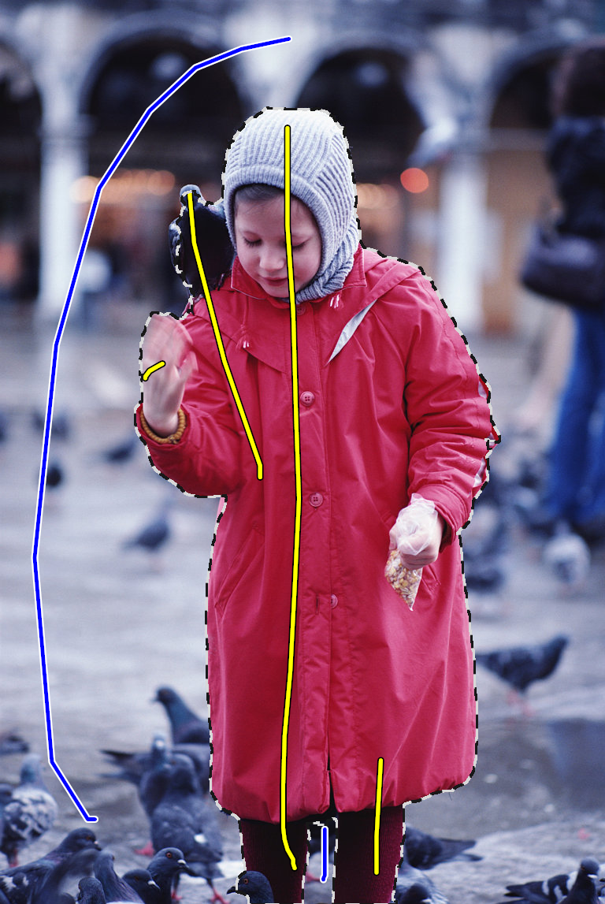
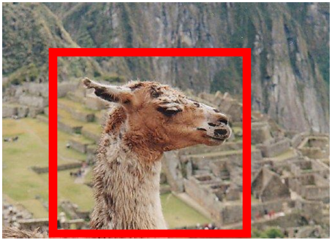
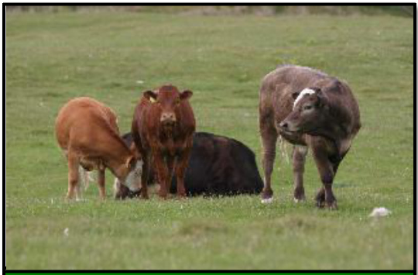
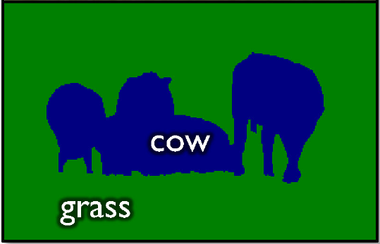
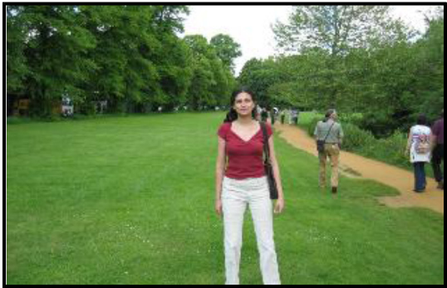
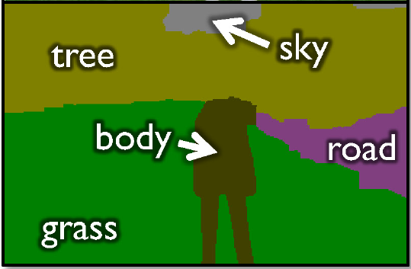
Labelling Problems in Vision
Segmentation
[Ren et al. ECCV ’06], [Boykov and Jolly, ICCV ’01], [Batra et al. BMVC ’08], [Rother et al., SIGGRAPH ’04]
[He et al. ECCV ’06], [Yang et al. CVPR ’07], [Shotton et al. IJCV ’09], [Batra et al. CVPR ’08].

Slide 3
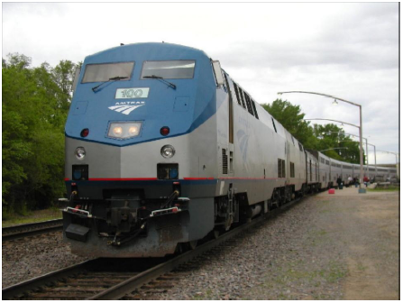
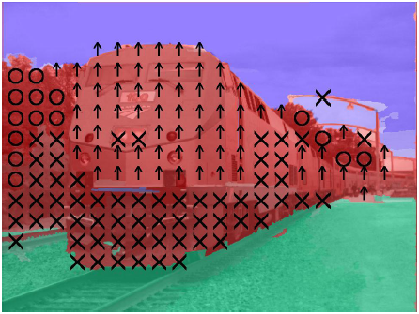
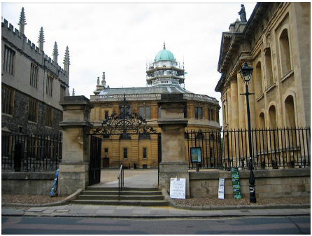
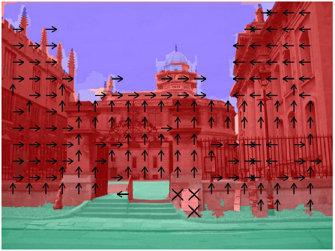
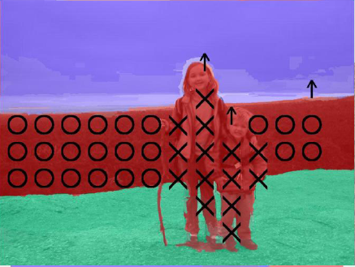
Labelling Problems in Vision
Geometric Labelling
[Hoiem et al. IJCV ’07], [Hoiem et al. CVPR ’08], [Saxena PAMI ’08], [Ramalingam et al. CVPR ‘08].

Slide 4
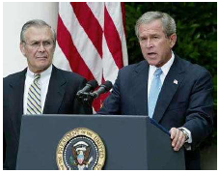
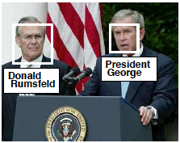
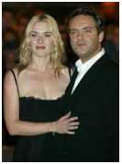
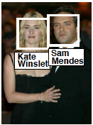
Labelling Problems in Vision
Name-Face Association
[Berg et al. CVPR ’04, Phd-Thesis ‘07], [Gallagher et al. CVPR ’08].
President George W. Bush makes a statement in the Rose Garden while Secretary of Defense Donald Rumsfeld looks on, July 23, 2003. Rumsfeld said the United States would release graphic photographs of the dead sons of Saddam Hussein to prove they were killed by American troops. Photo by Larry Downing/Reuters
British director Sam Mendes and his partner actress Kate Winslet arrive at the London premiere of ’The Road to Perdition’, September 18, 2002. The films stars Tom Hanks as a Chicago hit man who has a separate family life and co-stars Paul Newman and Jude Law. REUTERS/Dan Chung
Lisa
Mildred
Mildred and Lisa

Slide 5
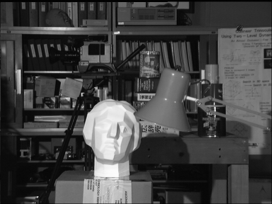
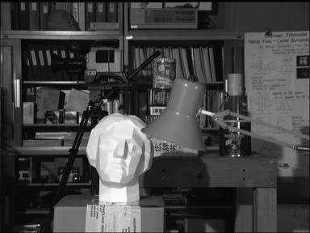
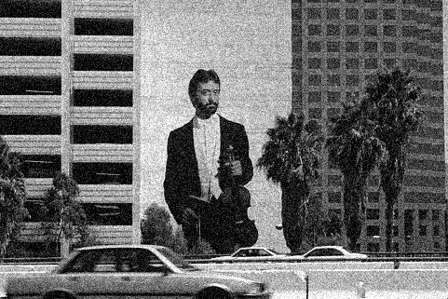
Labelling Problems in Vision
Stereo (Disparity Labelling)
[Roy and Cox, ICCV ‘98], [Boykov et al. CVPR ’97, PAMI ‘01], [Scharstein et al. PAMI ’02].
Motion Flow
[Boykov et al. PAMI ’01]
Denoising
[Sebastiani et al. Signal Proc. ’97], [Roth et al. IJCV ‘09], [Li et al. ECCV ’08], [Ishikawa CVPR ’09].
Left image
Right image
Disparity map

Slide 6
Markov Random Fields
Set of random variables
Pairwise MRF
MAP Inference
X₁
X₂
…
X_{n}

Slide 7
Inference
MAP problem
In general NP-hard
Exact Algorithms for subclasses
Trees [Pearl, AAAI ’82]
Submodular Energies [Hammer ’65, Kolmogorov PAMI ’04]
Outer-planar graphs [Schraudolph NIPS ’08]
Approximate Algorithms
Loopy BP [Pearl, ‘88]
Tree-Reweighted MP [Wainwright ‘05, Kolmogorov ’06, Komodakis ‘07]
Outer-Planar Decomposition (OPD)

Slide 8
Decomposition Methods
Decompose into subproblems

Slide 9
Decomposition Methods
Comparisons:
Max-Product BP [Pearl, ’88]
Tree-Reweighted MP [Wainwright ‘05, Kolmogorov ’06, Komodakis ‘07]

Slide 10
Decomposition Methods
Progression
BP
TRW
OPD

Slide 11
Outer-planarity
G is outer-planar
Allows a planar embedding
All nodes are accessible from “outside”
Lie on an unbounded external face
Add an extra node connected to all other. Result should be planar.
Examples
Trees
A lot more, e.g.
1
1
2
2
4
3
3
4
1
2
4
3

Slide 12
Planar Inference
Planar-Cut Construction
[Schraudolph et al. NIPS ’08]
Source (0)
X₁
X₂
X₄
X₃
E(X₁,X₂,X₃,X₄)
X₁ = 1 X₂ = 0 X₃ = 0 X₄ = 1
Cost of st-cut = 8
E(1,0,0,1) = 8 + const

Slide 13
Planar Inference
Planar-Cut
Source (0)
X₁
X₂
X₄
X₃
E(X₁,X₂,X₃,X₄)
Outer-planarity
Planar-cut

Slide 14
Outer-planar Decomposition
Outer-planarity is a strong constraint
These are not OP:
So now?
We will leverage this new subclass to propose a new approximate MAP inference algorithm
Outer-Planar Decomposition (OPD)
Very important for vision

Slide 15
Outer-planar Decomposition
OPD
Non-outerplanar graph

Slide 16
Outer-planar Decomposition
OPD
Planar graphs
OPD
Non-outerplanar graph

Slide 17
Outer-planar Decomposition
OPD
Message-Passing
OPD-MP: Generalizes BP
OPD-DD: Generalizes TRW-DD
OPD-T: Generalizes TRW-T
OPD-S: Generalizes TRW-S
[Dual Decomposition, Komodakis, ICCV ‘07, CVPR ‘09]
[Wainwright, Inf. Theory ’05]
[Kolmogorov, PAMI ‘06]

Slide 18
Outer-planar Decomposition
OPD
messages
Agreement Variables

Slide 19
Outer-planar Decomposition
OPD-MP: Message
OPD
Non-outerplanar graph
Agreement Variables

Slide 20
Outer-planar Decomposition
OPD-MP: Message
OPD
Non-outerplanar graph
Message
Agreement Variables
Min-marginal

Slide 21
Guarantees
OPD-MP
same as BP
None!
Contains BP as a special case
OPD-DD
Can be analyzed as projected subgradient ascent on dual.
Guaranteed to converge.
Contains TRW as a special case
Guaranteed to perform better than TRW!

Slide 22
Decompositions
Where do sub-graphs come from?
In general: NP-hard
Maximum outer-planar sub-graph problem

Slide 23
Decompositions
Where do sub-graphs come from?
Heuristic:
Start with a spanning tree
Add edges till maximal outer-planar
Remove edges from graph, repeat

Slide 24
Outer-Planar Decomposition
For Grids:
Theorem [Goncalves STOC ‘05]: Every planar graph can be decomposed into 2 outer-planar graphs
Linear-time algorithm

Slide 25
Experiments
Synthetic (constructed) energies
Real-world applications
Face-Gender Labelling
Semantic Object Segmentation
Optical Flow

Slide 26
Experiments
Synthetic parameters
Randomly sampled energies from Gaussian dist.

Slide 27
Results
Synthetic parameters
Randomly sampled energies from Gaussian dist.
Energy
K₄: 2-label problem
Lower bound
Harder Problems (More interaction)

Slide 28
Results
Synthetic parameters
Randomly sampled energies from Gaussian dist.
30 x 30 grid: 2-label

Slide 29
Results
Gender-Face Assignment

Slide 30
Results
Multi-class Object Labelling

Slide 31
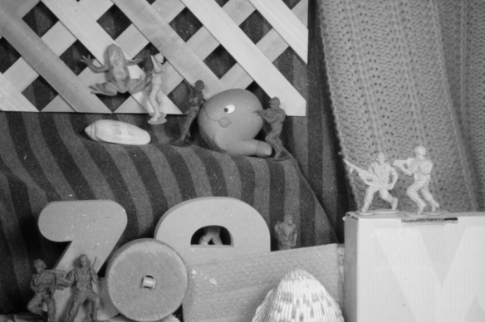
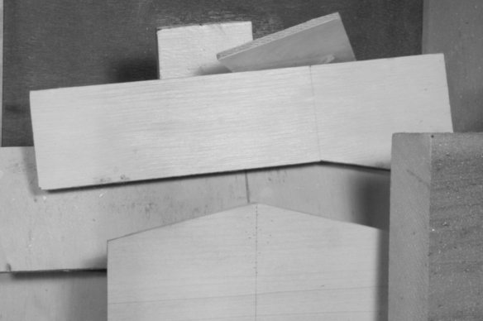
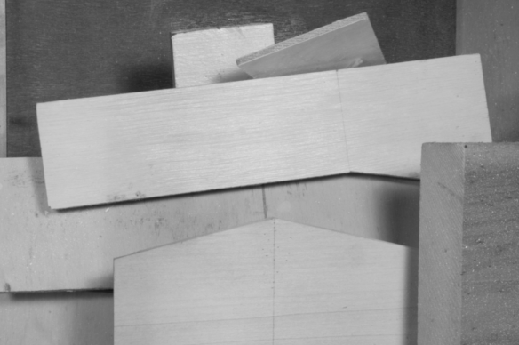
Results
Optical Flow
Army
Woodel

Slide 32
Take-home Messages
For people working on these problems:
First step towards structures topologically more complex than trees
OPD-approximation is guaranteed to be tighter than TRW
OPD is useful for hard non-submodular problems
Traditional vision benchmarks might be saturated
For people using BP/TRW:
Stop!
Use OPD.

Slide 33
Thank You!

Slide 34
Results
Synthetic parameters
Randomly sampled energies from Gaussian dist.
K₅₀: 2-label problem

Slide 35
Results
Synthetic parameters
Randomly sampled energies from Gaussian dist.
K₅₀: 4-label problem

Slide 36
Outer-planar Decomposition
OPD-DD: Message
OPD
Non-outerplanar graph
Agreement Variables

Slide 37
Decompositions
Heuristic:
Able to find 2-subgraph decompositions surprisingly often

Slide 38
Decomposition Methods
“Certificate” property
Decomposition Lower Bound
Flow-value >k
s
t
G
Cut-value <= k
Given graph G, can we push an s-t flow of value > k?

Slide 39
Max-flow / Min-cut
Construction
[Hammer ‘65], [Kolmogorov, PAMI ’04]
Source (0)
2
9
X₁
1
E(X₁,X₂)
X₂
2
5
4
Sink (1)
X₁ = 1 X₂ = 0
Cost of st-cut = 8
E(1,0) = 8 + const

Slide 40
Inference
Construction
[Hammer ‘65], [Kolmogorov, PAMI ’04]
Source (0)
2
9
X₁
1
E(X₁,X₂)
X₂
2
5
4
Sink (1)
Submodularity!
Max-flow / min-cut

Slide 41
Planar Inference
Planar-Cut Construction
[Schraudolph et al. NIPS ’08]

Slide 42
Outer-planar Decomposition
On Grid Graph
C1
C2
C3
C4
C1
C2
C2
C3
C3
C4
decomp
Non-outerplanar graph

Slide 43
Convergence
Guarantees
Currently, same as BP
None!
Possible TRW-S scheduling schemes

Slide 44
Run-Time
Run-time:
K iterations x D decompositions x N cuts
Complexity of min-cut
Best known algorithm:
Current implementation:
Complexity of max-flow/min-cut
(Smart) Push-relabel:
(Dynamic tree) Push-relabel

Slide 45
Dynamic Planar Cuts
How many cuts?
2*N [Naively]
N+1 [Slightly smarter]
1 + N updates [Proposed]
OPD
message
Non-outerplanar graph
Agreement Variables

Slide 46
Inference
Construction
[Hammer ‘65], [Kolmogorov, PAMI ’04]
Source (0)
2
9
X₁
1
E(X₁,X₂)
X₂
2
5
4
Sink (1)
X₁ = 1 X₂ = 0
Cost of st-cut = 8
E(1,0) = 8 + const

Slide 47
Planar Inference
Comparison
Submodularity!
Max-flow / min-cut
Constraint on parameters
Constraint on structure
Outer-planarity!
Planar-cut
1
3
2

Slide 48
Dual Decomposition
Primal problem
Want to solve independently
To parallelize
Each sub-problem easy, cumulative problem hard

Slide 49
Dual Decomposition
Primal problem
Re-formulate
Relax (Langragian dual)

Slide 50
Dual Decomposition
Dual (Master) Problem
Dual (Slave) Problems
Can solve master with Projected Subgradient descent

Slide 51
Dual Decomposition
Projected Subgradient Descent
What is subgradient?

Slide 52
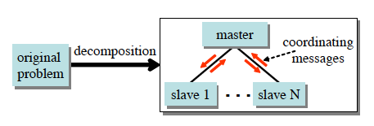
Dual Decomposition
Overview

Slide 53
MAP
Goal
Integer Program formulation

Slide 54
MAP as TRW
Distribute parameters:
Decompose energy

Slide 55
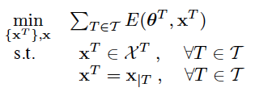
MAP as DD
Primal Problem
Dual

Slide 56
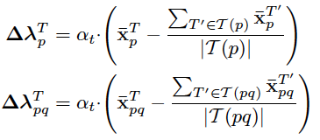
MAP as DD
Dual (Master) Problem
Dual (Slave) Problems
Can solve master with Projected Subgradient descent

Slide 57
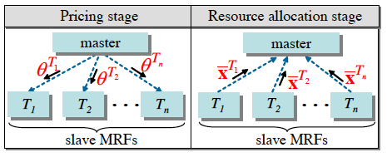
MAP as DD
Algorithm
Interpretation

Slide 58
MAP as DD
Theoretical Guarantees

