Slide 1
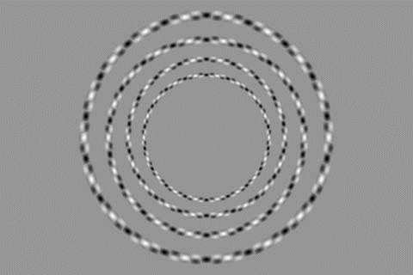

Slide 2
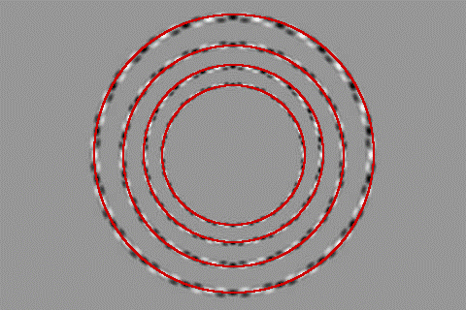

Slide 3

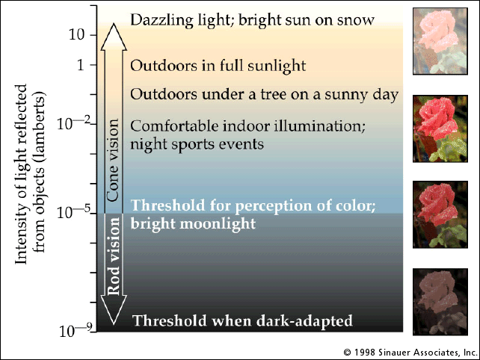
Recap – Light, Cameras, Eyes
λ
light source
?

Slide 4
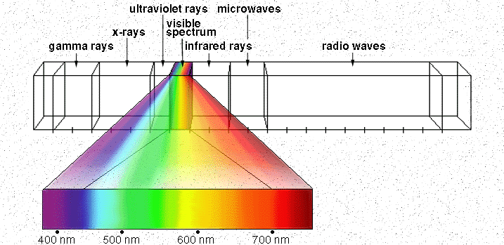

Electromagnetic Spectrum
Human Luminance Sensitivity Function
http://www.yorku.ca/eye/photopik.htm
Notes:
At least 3 spectral bands required (e.g. R,G,B)

Slide 5
Visible Light
Why do we see light of these wavelengths?
…because that’s where the
Sun radiates EM energy
© Stephen E. Palmer, 2002
Notes:
Because that’s where the Sun’s peak radiation was
Because the atmosphere is fairly transparent in that range
Because biology has many important markers in that range (but that’s because of the previous two reasons)

Slide 6
The Physics of Light
Any patch of light can be completely described
physically by its spectrum: the number of photons
(per time unit) at each wavelength 400 - 700 nm.
© Stephen E. Palmer, 2002

Slide 7
The Physics of Light
Some examples of the spectra of light sources
© Stephen E. Palmer, 2002

Slide 8
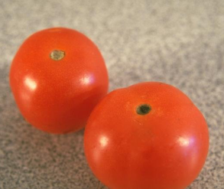
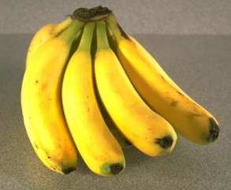
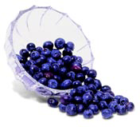
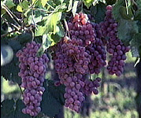
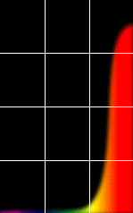
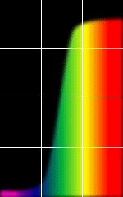
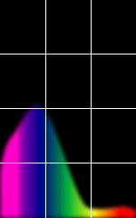
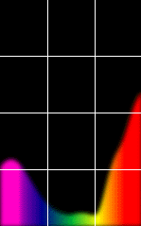
The Physics of Light
Some examples of the reflectance spectra of surfaces
Red
Yellow
Blue
Purple
% Photons Reflected
400 700
400 700
400 700
400 700
Wavelength (nm)
© Stephen E. Palmer, 2002

Slide 9
The Psychophysical Correspondence
There is no simple functional description for the perceived
color of all lights under all viewing conditions, but …...
A helpful constraint:
Consider only physical spectra with normal distributions
mean
area
variance
© Stephen E. Palmer, 2002

Slide 10
The Psychophysical Correspondence
Mean
Hue
# Photons
Wavelength
© Stephen E. Palmer, 2002

Slide 11
The Psychophysical Correspondence
Variance
Saturation
# Photons
Wavelength
© Stephen E. Palmer, 2002

Slide 12
The Psychophysical Correspondence
Area
Brightness
# Photons
Wavelength
© Stephen E. Palmer, 2002

Slide 13
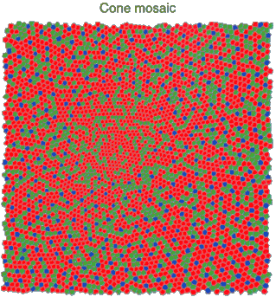
Physiology of Color Vision
Three kinds of cones:
Why are M and L cones so close?
Why are there 3?
© Stephen E. Palmer, 2002

Slide 14


Impossible Colors
Can you make the cones respond in ways that typical light spectra never would?
http://en.wikipedia.org/wiki/Impossible_colors

Slide 15
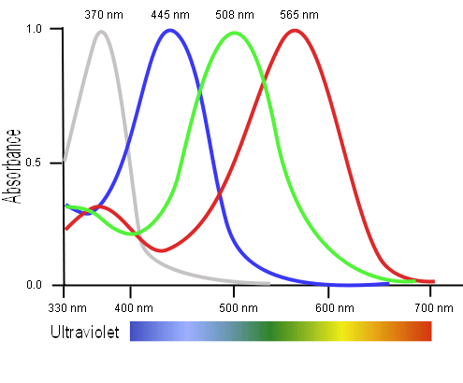
Tetrachromacy
Bird cone responses
Most birds, and many other animals, have cones for ultraviolet light.
Some humans, mostly female, seem to have slight tetrachromatism.

Slide 16
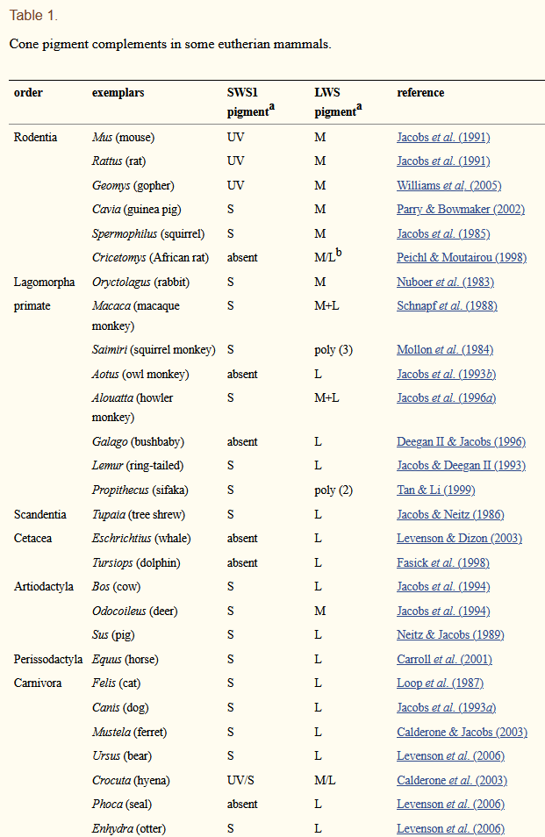
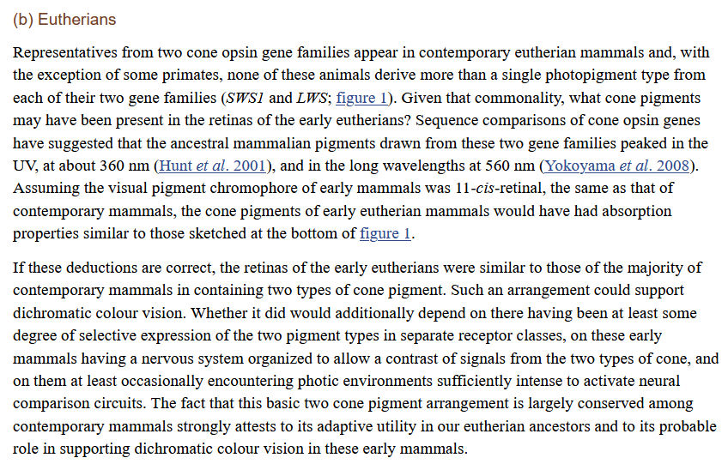
Jacobs GH. Evolution of colour vision in mammals. Philos Trans R Soc Lond B Biol Sci. 2009;364(1531):2957-2967. doi:10.1098/rstb.2009.0039

Slide 17
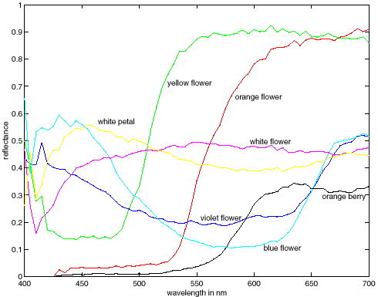
More Spectra
metamers
Notes:
Metamerism can be illuminant based or observer based. Color blindness produced well known instances of metamerism.

Slide 18
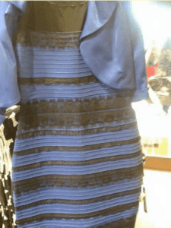
Color can be ambiguous

Slide 19
Color can be ambiguous

Slide 20
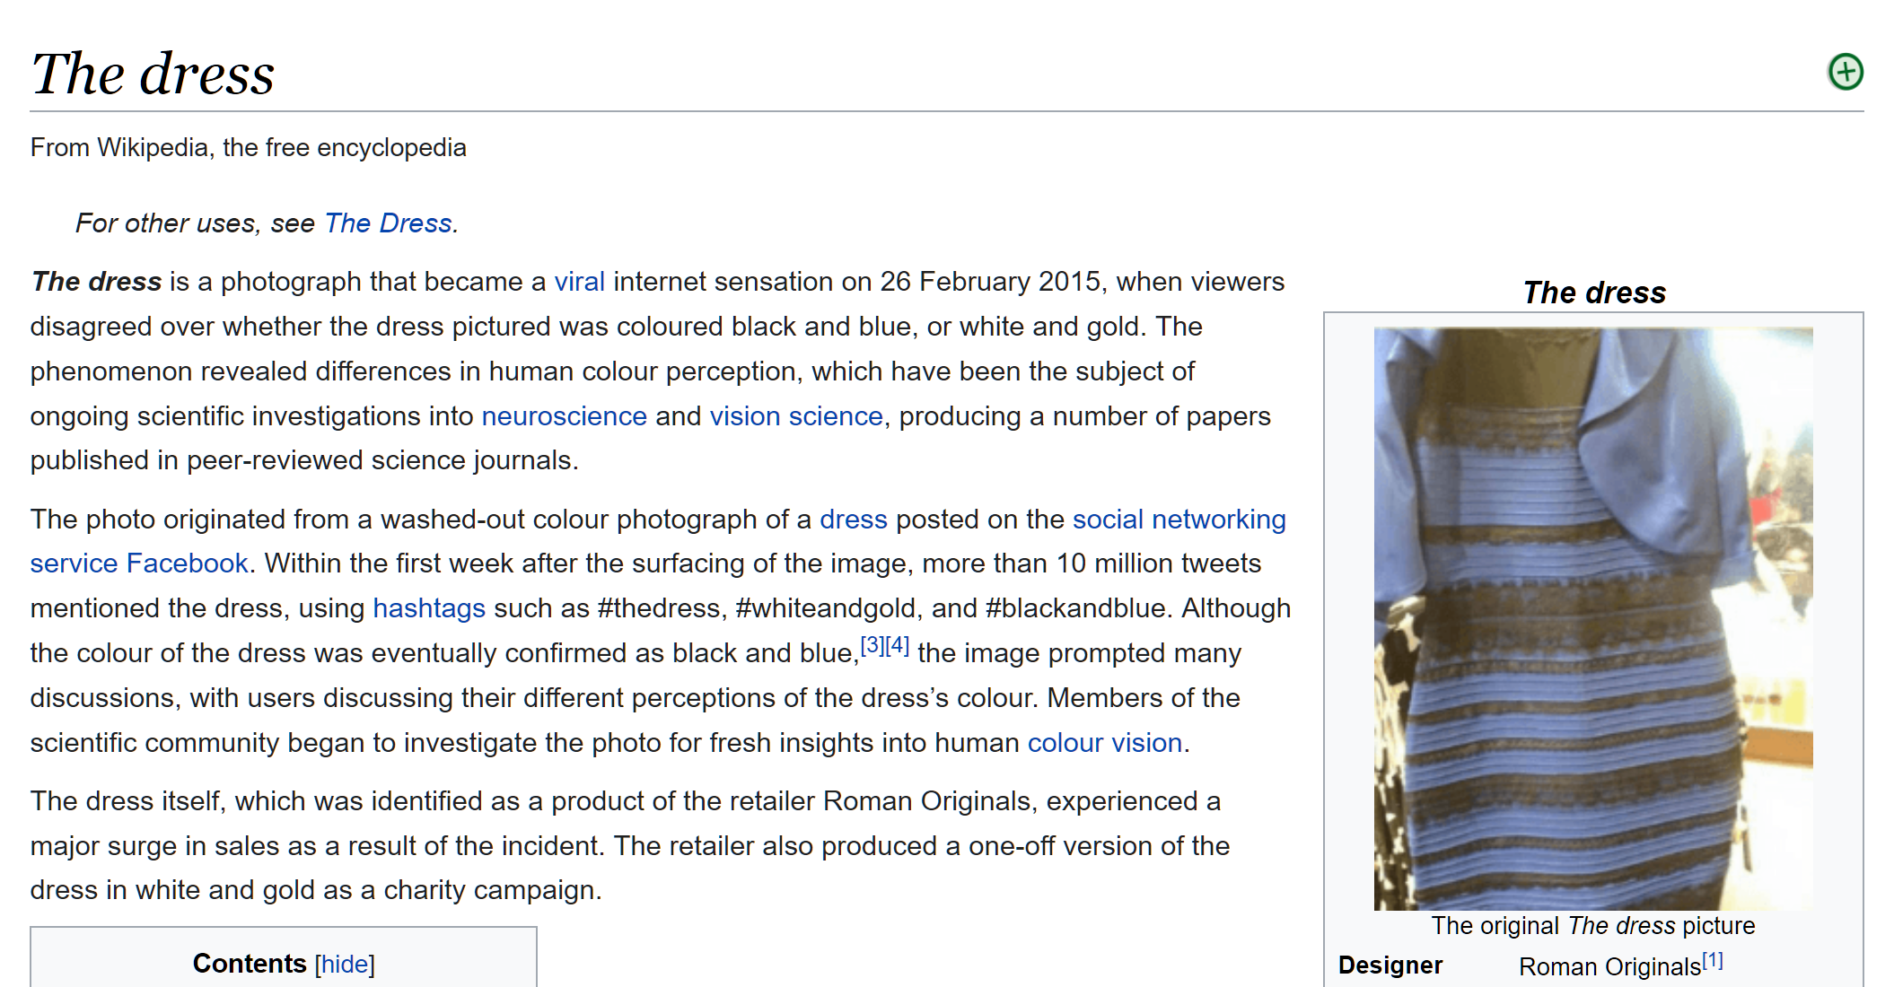
https://en.wikipedia.org/wiki/The_dress

Slide 21
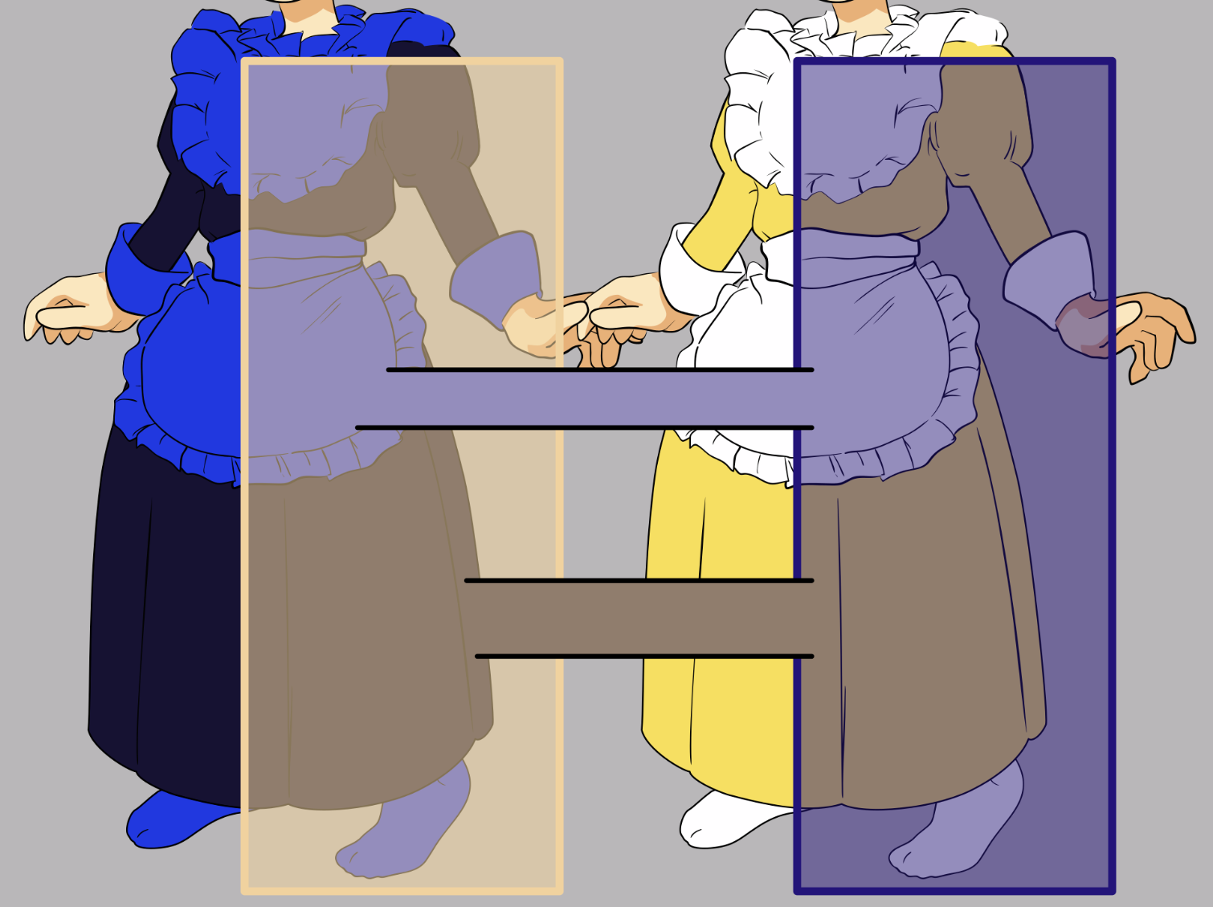
https://en.wikipedia.org/wiki/The_dress
Notes:
https://en.wikipedia.org/wiki/The_dress

Slide 22
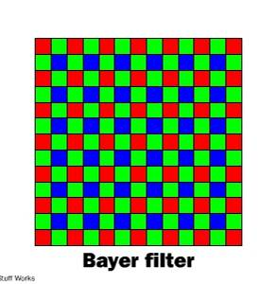
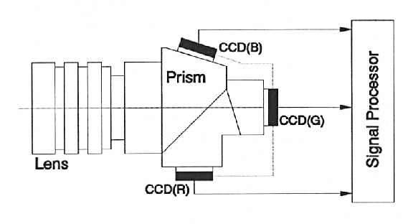
Color Sensing in Camera (RGB)
3-chip vs. 1-chip: quality vs. cost
Why more green?
Why 3 colors?
http://www.cooldictionary.com/words/Bayer-filter.wikipedia
Slide by Steve Seitz

Slide 23


Practical Color Sensing: Bayer Grid
Estimate RGB
at ‘G’ cells from neighboring values
Slide by Steve Seitz

Slide 24
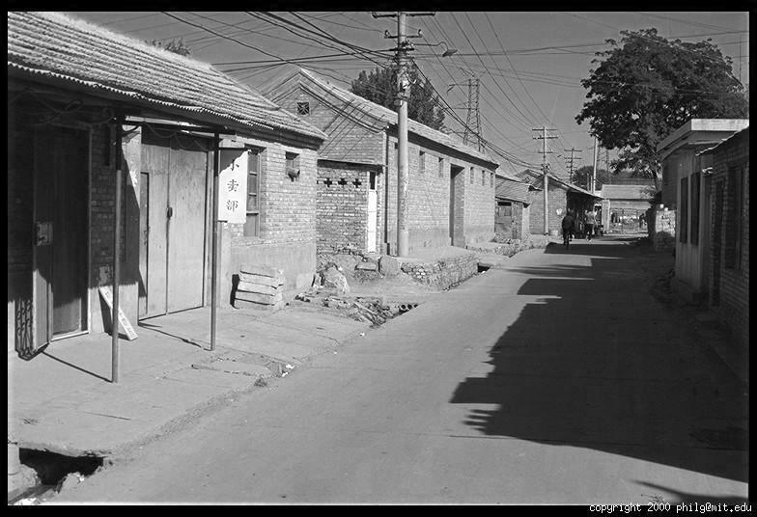
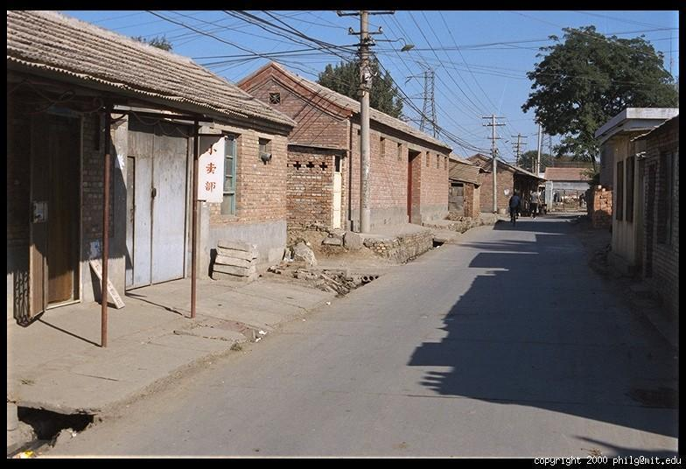
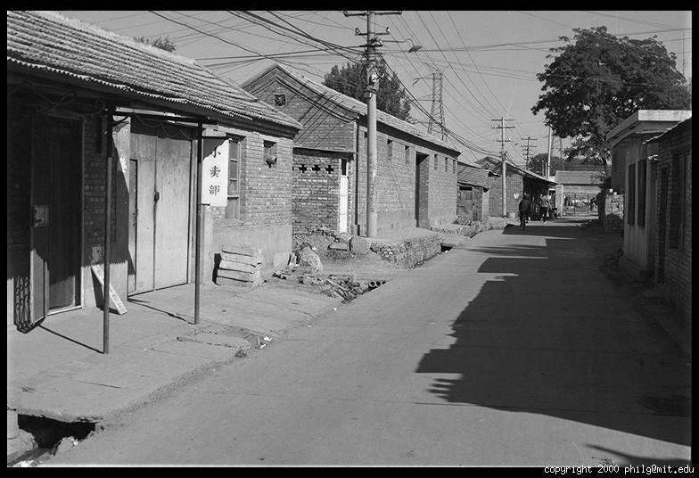
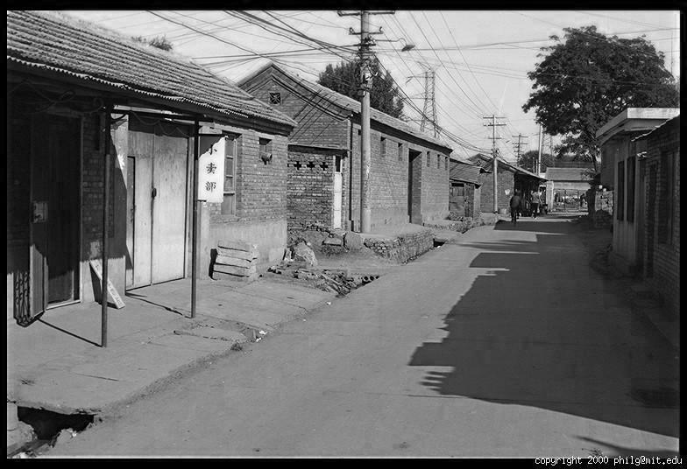
Color Image
R
G
B

Slide 25
Images in Matlab
Images represented as a matrix
Suppose we have a NxM RGB image called “im”
  im(1,1,1) = top-left pixel value in R-channel
  im(y, x, b) = y pixels down, x pixels to right in the b^{th} channel
  im(N, M, 3) = bottom-right pixel in B-channel
column
row
R
0.92 | 0.93 | 0.94 | 0.97 | 0.62 | 0.37 | 0.85 | 0.97 | 0.93 | 0.92 | 0.99
0.95 | 0.89 | 0.82 | 0.89 | 0.56 | 0.31 | 0.75 | 0.92 | 0.81 | 0.95 | 0.91
0.89 | 0.72 | 0.51 | 0.55 | 0.51 | 0.42 | 0.57 | 0.41 | 0.49 | 0.91 | 0.92
0.96 | 0.95 | 0.88 | 0.94 | 0.56 | 0.46 | 0.91 | 0.87 | 0.90 | 0.97 | 0.95
0.71 | 0.81 | 0.81 | 0.87 | 0.57 | 0.37 | 0.80 | 0.88 | 0.89 | 0.79 | 0.85
0.49 | 0.62 | 0.60 | 0.58 | 0.50 | 0.60 | 0.58 | 0.50 | 0.61 | 0.45 | 0.33
0.86 | 0.84 | 0.74 | 0.58 | 0.51 | 0.39 | 0.73 | 0.92 | 0.91 | 0.49 | 0.74
0.96 | 0.67 | 0.54 | 0.85 | 0.48 | 0.37 | 0.88 | 0.90 | 0.94 | 0.82 | 0.93
0.69 | 0.49 | 0.56 | 0.66 | 0.43 | 0.42 | 0.77 | 0.73 | 0.71 | 0.90 | 0.99
0.79 | 0.73 | 0.90 | 0.67 | 0.33 | 0.61 | 0.69 | 0.79 | 0.73 | 0.93 | 0.97
0.91 | 0.94 | 0.89 | 0.49 | 0.41 | 0.78 | 0.78 | 0.77 | 0.89 | 0.99 | 0.93
G
0.92 | 0.93 | 0.94 | 0.97 | 0.62 | 0.37 | 0.85 | 0.97 | 0.93 | 0.92 | 0.99
0.95 | 0.89 | 0.82 | 0.89 | 0.56 | 0.31 | 0.75 | 0.92 | 0.81 | 0.95 | 0.91
0.89 | 0.72 | 0.51 | 0.55 | 0.51 | 0.42 | 0.57 | 0.41 | 0.49 | 0.91 | 0.92
0.96 | 0.95 | 0.88 | 0.94 | 0.56 | 0.46 | 0.91 | 0.87 | 0.90 | 0.97 | 0.95
0.71 | 0.81 | 0.81 | 0.87 | 0.57 | 0.37 | 0.80 | 0.88 | 0.89 | 0.79 | 0.85
0.49 | 0.62 | 0.60 | 0.58 | 0.50 | 0.60 | 0.58 | 0.50 | 0.61 | 0.45 | 0.33
0.86 | 0.84 | 0.74 | 0.58 | 0.51 | 0.39 | 0.73 | 0.92 | 0.91 | 0.49 | 0.74
0.96 | 0.67 | 0.54 | 0.85 | 0.48 | 0.37 | 0.88 | 0.90 | 0.94 | 0.82 | 0.93
0.69 | 0.49 | 0.56 | 0.66 | 0.43 | 0.42 | 0.77 | 0.73 | 0.71 | 0.90 | 0.99
0.79 | 0.73 | 0.90 | 0.67 | 0.33 | 0.61 | 0.69 | 0.79 | 0.73 | 0.93 | 0.97
0.91 | 0.94 | 0.89 | 0.49 | 0.41 | 0.78 | 0.78 | 0.77 | 0.89 | 0.99 | 0.93
B
0.92 | 0.93 | 0.94 | 0.97 | 0.62 | 0.37 | 0.85 | 0.97 | 0.93 | 0.92 | 0.99
0.95 | 0.89 | 0.82 | 0.89 | 0.56 | 0.31 | 0.75 | 0.92 | 0.81 | 0.95 | 0.91
0.89 | 0.72 | 0.51 | 0.55 | 0.51 | 0.42 | 0.57 | 0.41 | 0.49 | 0.91 | 0.92
0.96 | 0.95 | 0.88 | 0.94 | 0.56 | 0.46 | 0.91 | 0.87 | 0.90 | 0.97 | 0.95
0.71 | 0.81 | 0.81 | 0.87 | 0.57 | 0.37 | 0.80 | 0.88 | 0.89 | 0.79 | 0.85
0.49 | 0.62 | 0.60 | 0.58 | 0.50 | 0.60 | 0.58 | 0.50 | 0.61 | 0.45 | 0.33
0.86 | 0.84 | 0.74 | 0.58 | 0.51 | 0.39 | 0.73 | 0.92 | 0.91 | 0.49 | 0.74
0.96 | 0.67 | 0.54 | 0.85 | 0.48 | 0.37 | 0.88 | 0.90 | 0.94 | 0.82 | 0.93
0.69 | 0.49 | 0.56 | 0.66 | 0.43 | 0.42 | 0.77 | 0.73 | 0.71 | 0.90 | 0.99
0.79 | 0.73 | 0.90 | 0.67 | 0.33 | 0.61 | 0.69 | 0.79 | 0.73 | 0.93 | 0.97
0.91 | 0.94 | 0.89 | 0.49 | 0.41 | 0.78 | 0.78 | 0.77 | 0.89 | 0.99 | 0.93

Slide 26
Images in Matlab Python
Images represented as a matrix
Suppose we have a NxM RGB image called “im”
  im(0,0,0) = top-left pixel value in R-channel
  im(y, x, b) = y pixels down, x pixels to right in the b^{th} channel
  im(N-1, M-1, 2) = bottom-right pixel in B-channel
column
row
R
0.92 | 0.93 | 0.94 | 0.97 | 0.62 | 0.37 | 0.85 | 0.97 | 0.93 | 0.92 | 0.99
0.95 | 0.89 | 0.82 | 0.89 | 0.56 | 0.31 | 0.75 | 0.92 | 0.81 | 0.95 | 0.91
0.89 | 0.72 | 0.51 | 0.55 | 0.51 | 0.42 | 0.57 | 0.41 | 0.49 | 0.91 | 0.92
0.96 | 0.95 | 0.88 | 0.94 | 0.56 | 0.46 | 0.91 | 0.87 | 0.90 | 0.97 | 0.95
0.71 | 0.81 | 0.81 | 0.87 | 0.57 | 0.37 | 0.80 | 0.88 | 0.89 | 0.79 | 0.85
0.49 | 0.62 | 0.60 | 0.58 | 0.50 | 0.60 | 0.58 | 0.50 | 0.61 | 0.45 | 0.33
0.86 | 0.84 | 0.74 | 0.58 | 0.51 | 0.39 | 0.73 | 0.92 | 0.91 | 0.49 | 0.74
0.96 | 0.67 | 0.54 | 0.85 | 0.48 | 0.37 | 0.88 | 0.90 | 0.94 | 0.82 | 0.93
0.69 | 0.49 | 0.56 | 0.66 | 0.43 | 0.42 | 0.77 | 0.73 | 0.71 | 0.90 | 0.99
0.79 | 0.73 | 0.90 | 0.67 | 0.33 | 0.61 | 0.69 | 0.79 | 0.73 | 0.93 | 0.97
0.91 | 0.94 | 0.89 | 0.49 | 0.41 | 0.78 | 0.78 | 0.77 | 0.89 | 0.99 | 0.93
G
0.92 | 0.93 | 0.94 | 0.97 | 0.62 | 0.37 | 0.85 | 0.97 | 0.93 | 0.92 | 0.99
0.95 | 0.89 | 0.82 | 0.89 | 0.56 | 0.31 | 0.75 | 0.92 | 0.81 | 0.95 | 0.91
0.89 | 0.72 | 0.51 | 0.55 | 0.51 | 0.42 | 0.57 | 0.41 | 0.49 | 0.91 | 0.92
0.96 | 0.95 | 0.88 | 0.94 | 0.56 | 0.46 | 0.91 | 0.87 | 0.90 | 0.97 | 0.95
0.71 | 0.81 | 0.81 | 0.87 | 0.57 | 0.37 | 0.80 | 0.88 | 0.89 | 0.79 | 0.85
0.49 | 0.62 | 0.60 | 0.58 | 0.50 | 0.60 | 0.58 | 0.50 | 0.61 | 0.45 | 0.33
0.86 | 0.84 | 0.74 | 0.58 | 0.51 | 0.39 | 0.73 | 0.92 | 0.91 | 0.49 | 0.74
0.96 | 0.67 | 0.54 | 0.85 | 0.48 | 0.37 | 0.88 | 0.90 | 0.94 | 0.82 | 0.93
0.69 | 0.49 | 0.56 | 0.66 | 0.43 | 0.42 | 0.77 | 0.73 | 0.71 | 0.90 | 0.99
0.79 | 0.73 | 0.90 | 0.67 | 0.33 | 0.61 | 0.69 | 0.79 | 0.73 | 0.93 | 0.97
0.91 | 0.94 | 0.89 | 0.49 | 0.41 | 0.78 | 0.78 | 0.77 | 0.89 | 0.99 | 0.93
B
0.92 | 0.93 | 0.94 | 0.97 | 0.62 | 0.37 | 0.85 | 0.97 | 0.93 | 0.92 | 0.99
0.95 | 0.89 | 0.82 | 0.89 | 0.56 | 0.31 | 0.75 | 0.92 | 0.81 | 0.95 | 0.91
0.89 | 0.72 | 0.51 | 0.55 | 0.51 | 0.42 | 0.57 | 0.41 | 0.49 | 0.91 | 0.92
0.96 | 0.95 | 0.88 | 0.94 | 0.56 | 0.46 | 0.91 | 0.87 | 0.90 | 0.97 | 0.95
0.71 | 0.81 | 0.81 | 0.87 | 0.57 | 0.37 | 0.80 | 0.88 | 0.89 | 0.79 | 0.85
0.49 | 0.62 | 0.60 | 0.58 | 0.50 | 0.60 | 0.58 | 0.50 | 0.61 | 0.45 | 0.33
0.86 | 0.84 | 0.74 | 0.58 | 0.51 | 0.39 | 0.73 | 0.92 | 0.91 | 0.49 | 0.74
0.96 | 0.67 | 0.54 | 0.85 | 0.48 | 0.37 | 0.88 | 0.90 | 0.94 | 0.82 | 0.93
0.69 | 0.49 | 0.56 | 0.66 | 0.43 | 0.42 | 0.77 | 0.73 | 0.71 | 0.90 | 0.99
0.79 | 0.73 | 0.90 | 0.67 | 0.33 | 0.61 | 0.69 | 0.79 | 0.73 | 0.93 | 0.97
0.91 | 0.94 | 0.89 | 0.49 | 0.41 | 0.78 | 0.78 | 0.77 | 0.89 | 0.99 | 0.93

Slide 27
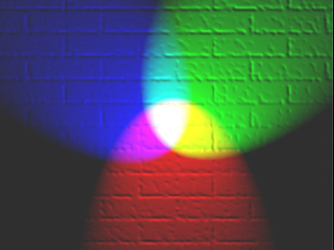
Color spaces
How can we represent color?
http://en.wikipedia.org/wiki/File:RGB_illumination.jpg

Slide 28

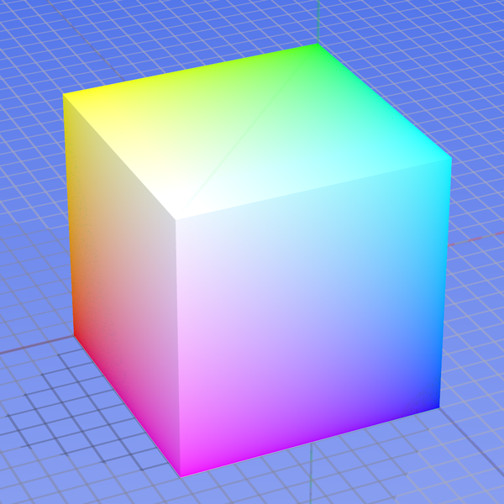
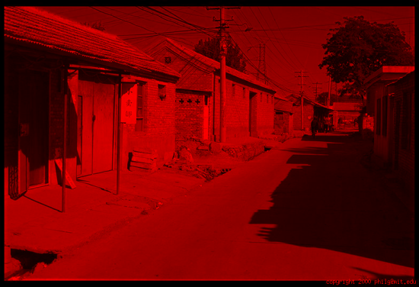
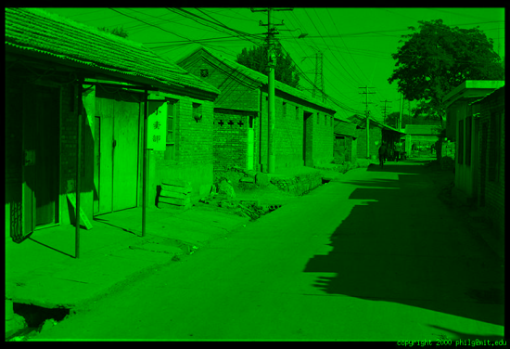
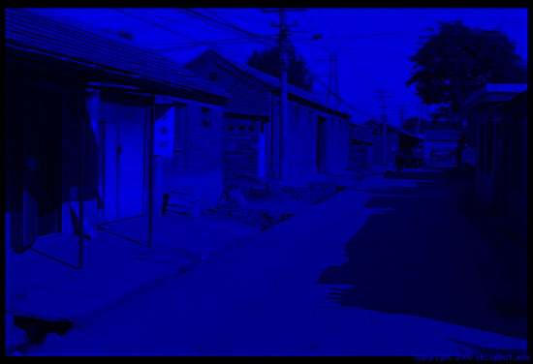
Color spaces: RGB
Default color space
0,1,0
R
(G=0,B=0)
1,0,0
G
(R=0,B=0)
0,0,1
B
(R=0,G=0)
Some drawbacks
Strongly correlated channels
Non-perceptual
Image from: http://en.wikipedia.org/wiki/File:RGB_color_solid_cube.png

Slide 29
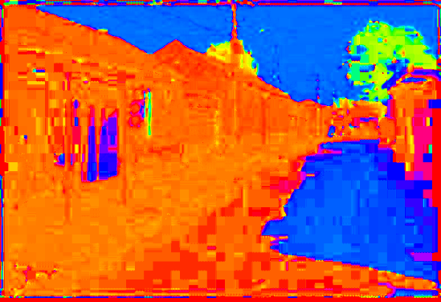
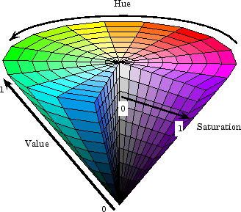
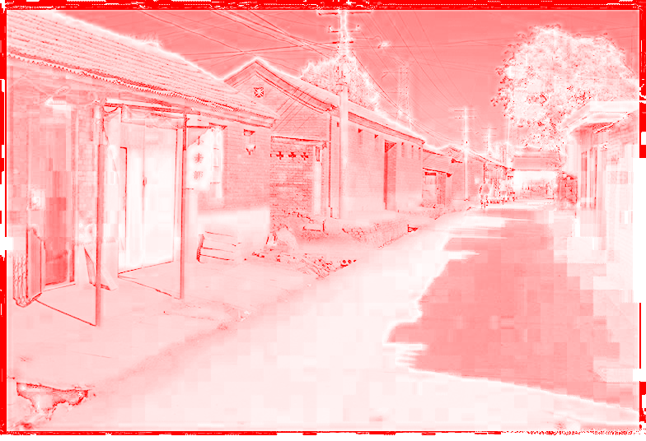
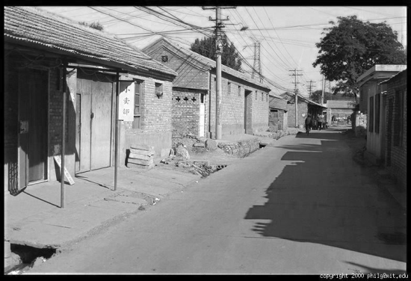
Color spaces: HSV
Intuitive color space
H
(S=1,V=1)
S
(H=1,V=1)
V
(H=1,S=0)

Slide 30
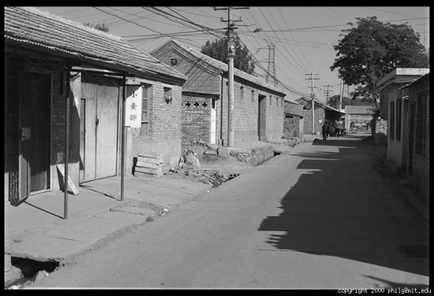





Color spaces: YCbCr
Fast to compute, good for compression, used by TV
Y=0
Y=0.5
Y
(Cb=0.5,Cr=0.5)
Cr
Cb
(Y=0.5,Cr=0.5)
Cb
Y=1
Cr
(Y=0.5,Cb=05)

Slide 31
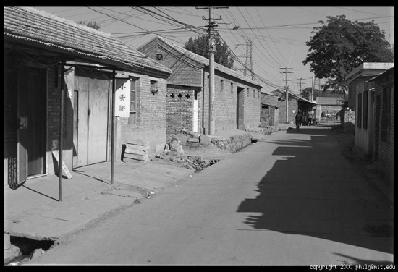
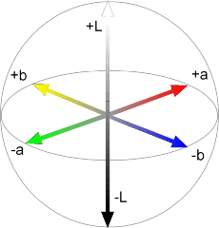
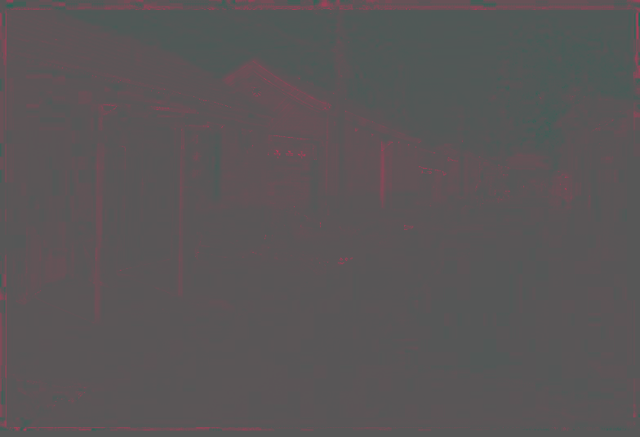
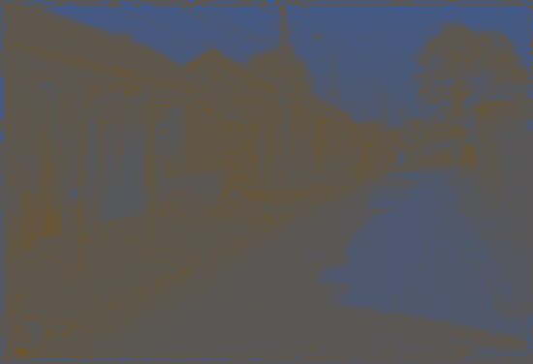
Color spaces: L*a*b*
“Perceptually uniform”* color space
L
(a=0,b=0)
a
(L=65,b=0)
b
(L=65,a=0)

Slide 32
If you had to choose, would you rather go without luminance or chrominance?

Slide 33
If you had to choose, would you rather go without luminance or chrominance?

Slide 34
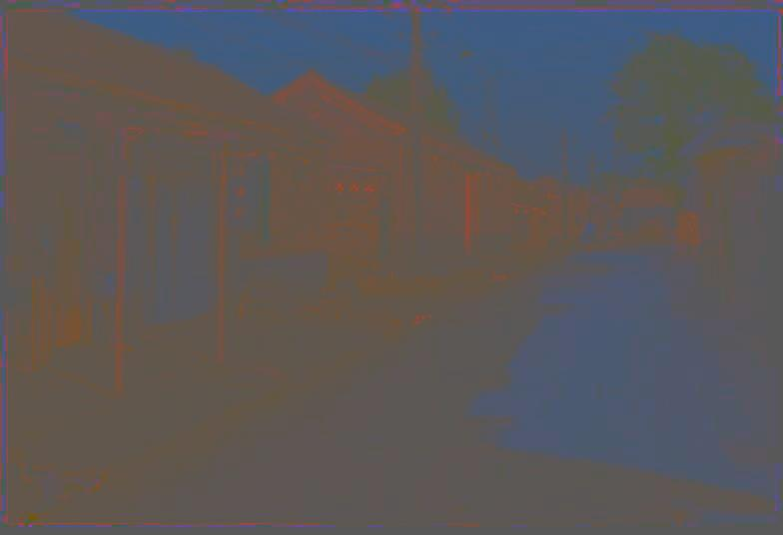
Most information in intensity
Only color shown – constant intensity

Slide 35

Most information in intensity
Only intensity shown – constant color

Slide 36
Most information in intensity
Original image

Slide 37
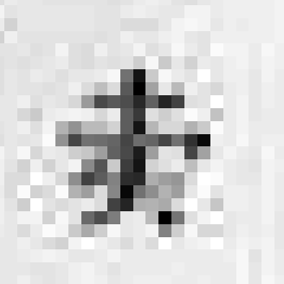
Back to grayscale intensity
0.92 | 0.93 | 0.94 | 0.97 | 0.62 | 0.37 | 0.85 | 0.97 | 0.93 | 0.92 | 0.99
0.95 | 0.89 | 0.82 | 0.89 | 0.56 | 0.31 | 0.75 | 0.92 | 0.81 | 0.95 | 0.91
0.89 | 0.72 | 0.51 | 0.55 | 0.51 | 0.42 | 0.57 | 0.41 | 0.49 | 0.91 | 0.92
0.96 | 0.95 | 0.88 | 0.94 | 0.56 | 0.46 | 0.91 | 0.87 | 0.90 | 0.97 | 0.95
0.71 | 0.81 | 0.81 | 0.87 | 0.57 | 0.37 | 0.80 | 0.88 | 0.89 | 0.79 | 0.85
0.49 | 0.62 | 0.60 | 0.58 | 0.50 | 0.60 | 0.58 | 0.50 | 0.61 | 0.45 | 0.33
0.86 | 0.84 | 0.74 | 0.58 | 0.51 | 0.39 | 0.73 | 0.92 | 0.91 | 0.49 | 0.74
0.96 | 0.67 | 0.54 | 0.85 | 0.48 | 0.37 | 0.88 | 0.90 | 0.94 | 0.82 | 0.93
0.69 | 0.49 | 0.56 | 0.66 | 0.43 | 0.42 | 0.77 | 0.73 | 0.71 | 0.90 | 0.99
0.79 | 0.73 | 0.90 | 0.67 | 0.33 | 0.61 | 0.69 | 0.79 | 0.73 | 0.93 | 0.97
0.91 | 0.94 | 0.89 | 0.49 | 0.41 | 0.78 | 0.78 | 0.77 | 0.89 | 0.99 | 0.93

Slide 38
Wrap up: Why do we care about cameras and eyes?
Notes:
December 6th, 2021 New York Times

Slide 39
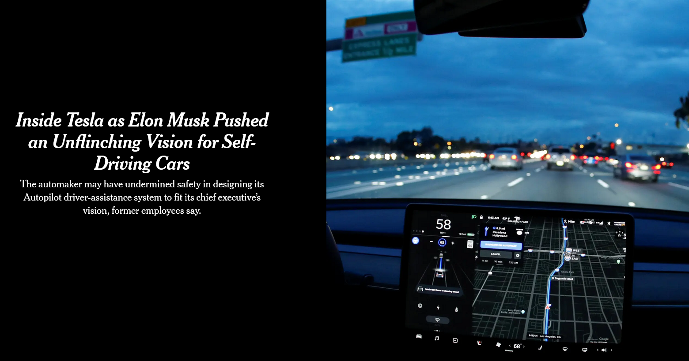
Notes:
December 6th, 2021 New York Times

Slide 40
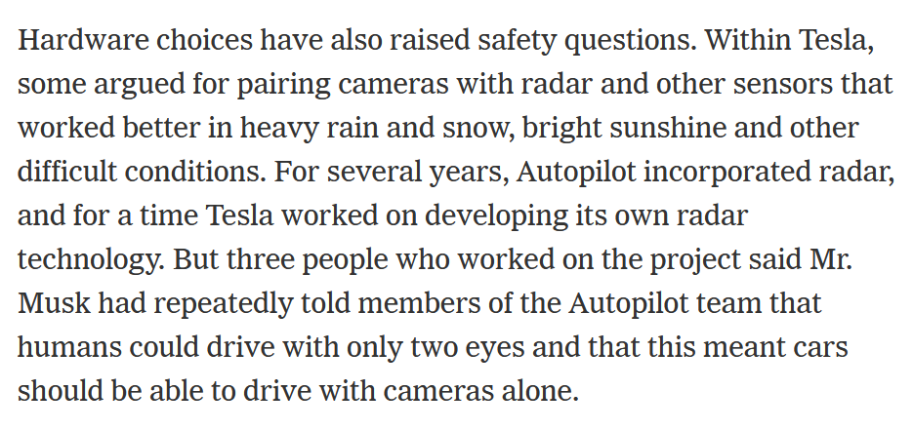

Slide 41
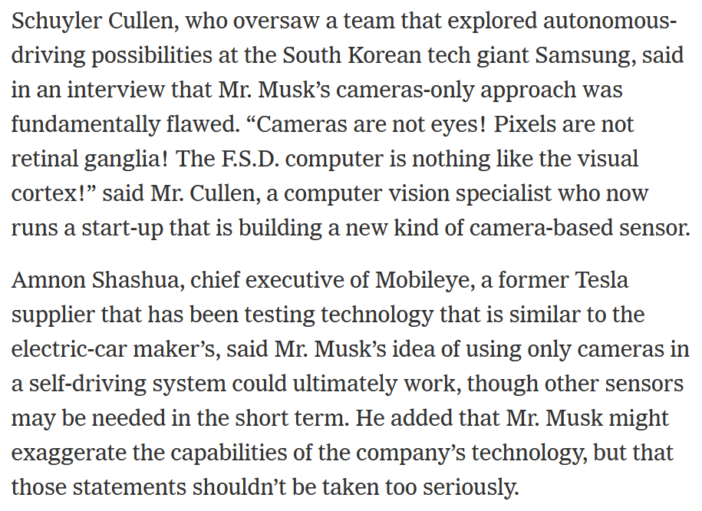

Slide 42
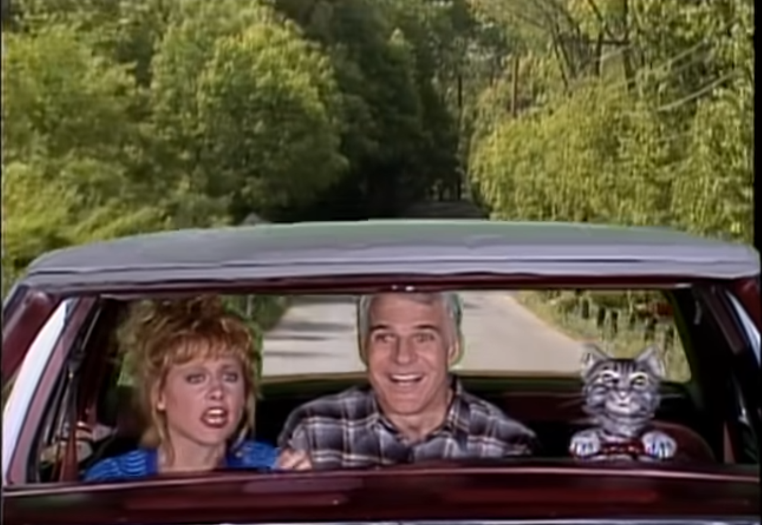
Another driving system with human level eyesight

Slide 43
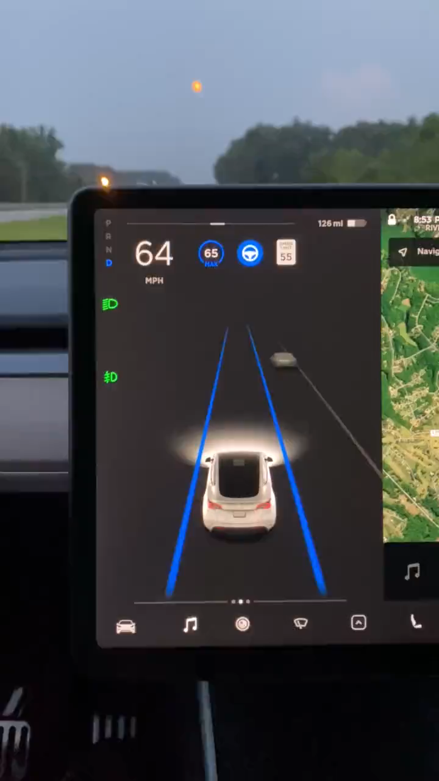
https://twitter.com/JordanTeslaTech/status/1418413307862585344

Slide 44
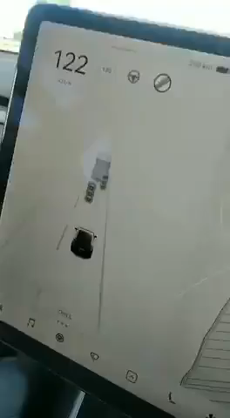
https://www.reddit.com/r/teslamotors/comments/nrs8kf/you_think_ice_cream_truck_stop_signs_are_a_problem/

Slide 45
On the whole, cameras are a reasonable analogy for eyes. They do capture sufficient information for safe driving 99.9% of the time.

Slide 46
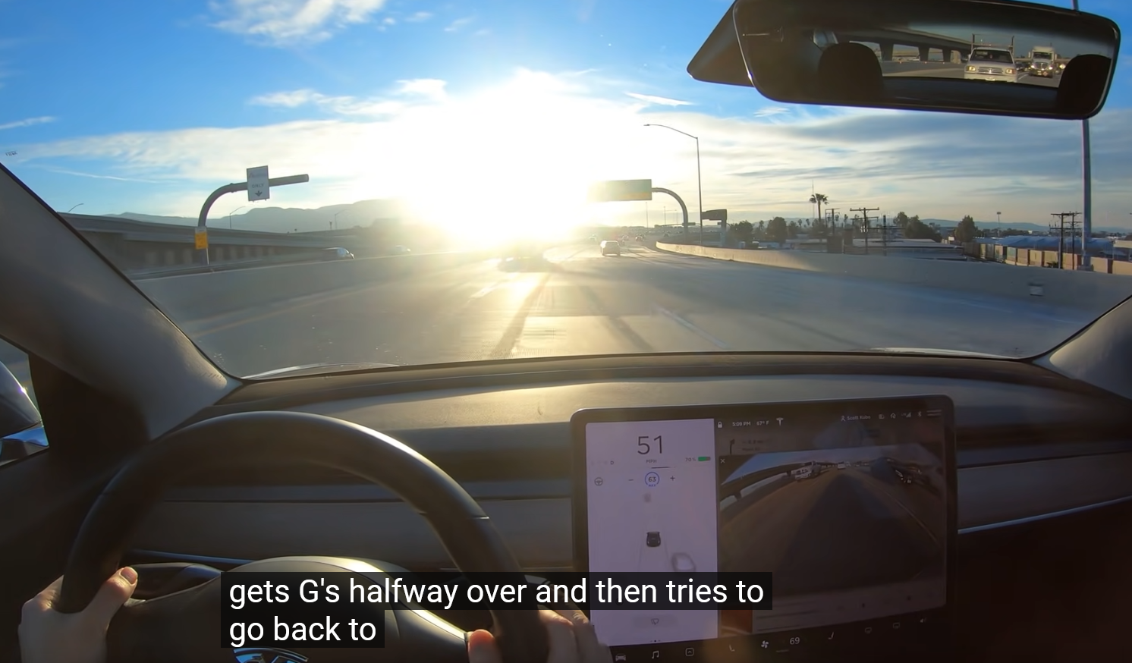
https://www.youtube.com/watch?v=s1eTBMYEs-Y
Notes:
But maybe some cameras don’t have enough dynamic range at the moment

Slide 47
On the whole, cameras are a reasonable analogy for eyes. They do capture sufficient information for safe driving 99.9% of the time.
  Imagine remote controlling a vehicle based on a camera feed.
But the computer vision and machine learning methods that interpret the camera images are not yet a reasonable analogy for the human brain.

Slide 48
Next: Interest points and corners
Slides: Hoiem, Efros, and others

