Slide 1
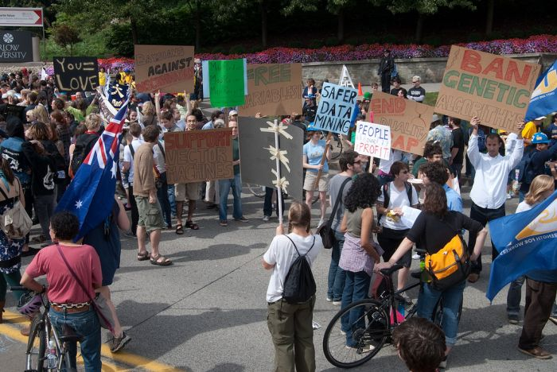
Machine Learning Crash Course
Computer Vision
James Hays
Slides: Isabelle Guyon, Erik Sudderth, Mark Johnson, Derek Hoiem
Photo: CMU Machine Learning Department protests G20

Slide 2
Recap: Multiple Views and Motion
Epipolar geometry
Relates cameras in two positions
Fundamental matrix maps from a point in one image to a line (its epipolar line) in the other
Can solve for F given corresponding points (e.g., interest points)
Stereo depth estimation
Estimate disparity by finding corresponding points along epipolar lines
Depth is inverse to disparity
Motion Estimation
By assuming brightness constancy, truncated Taylor expansion leads to simple and fast patch matching across frames
Assume local motion is coherent
“Aperture problem” is resolved by coarse to fine approach

Slide 3
It is a rare criticism of elite American university students that they do not think big enough. But that is exactly the complaint from some of the largest technology companies and the federal government.
At the heart of this criticism is data. Researchers and workers in fields as diverse as bio-technology, astronomy and computer science will soon find themselves overwhelmed with information.
The next generation of computer scientists has to think in terms of what could be described as Internet scale.
New York Times
Training to Climb an Everest of Digital Data.
By Ashlee Vance.
Published: October 11, 2009

Slide 4
Machine learning: Overview
Core of ML: Making predictions or decisions from Data.
This overview will not go in to depth about the statistical underpinnings of learning methods. We’re looking at ML as a tool.
Take a machine learning course if you want to know more!

Slide 5
Impact of Machine Learning
Machine Learning is arguably the greatest export from computing to other scientific fields.

Slide 6
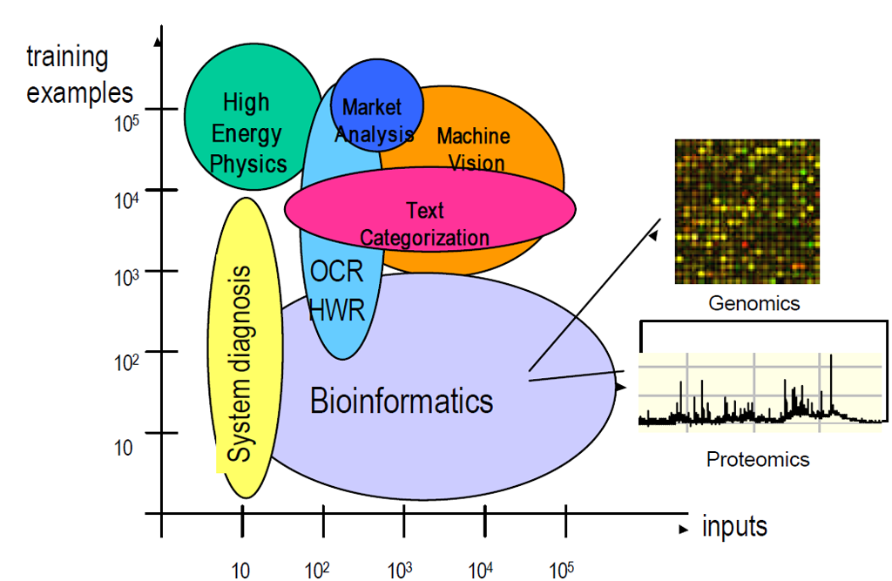
Machine Learning Applications
Slide: Isabelle Guyon

Slide 8
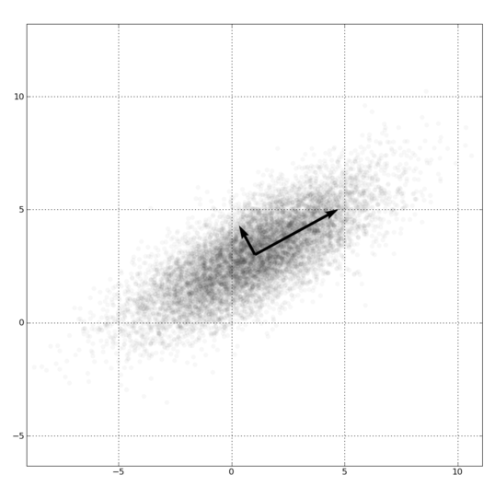
Dimensionality Reduction
PCA, ICA, LLE, Isomap
PCA is the most important technique to know. It takes advantage of correlations in data dimensions to produce the best possible lower dimensional representation based on linear projections (minimizes reconstruction error).
PCA should be used for dimensionality reduction, not for discovering patterns or making predictions. Don't try to assign semantic meaning to the bases.

Slide 10
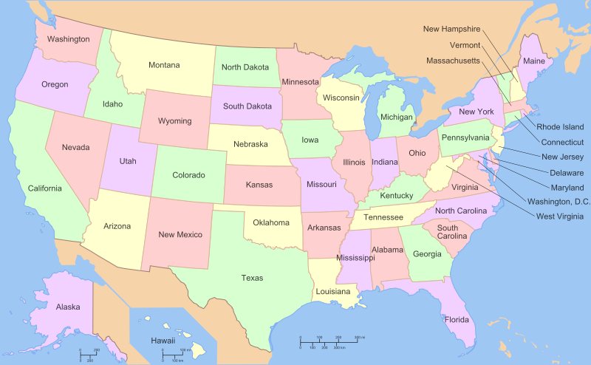

Slide 11
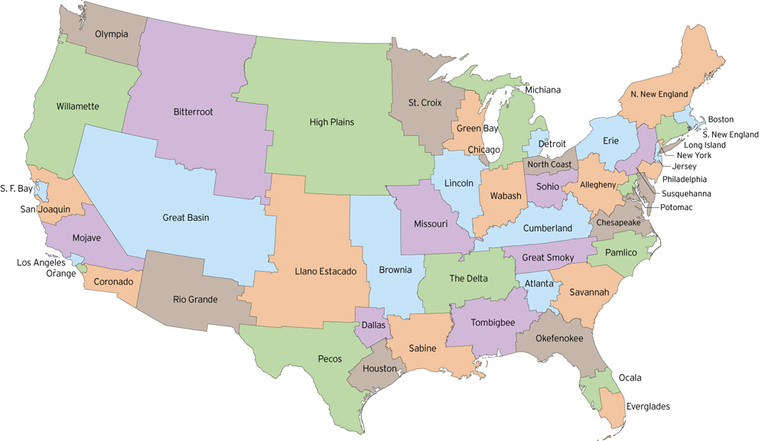
http://fakeisthenewreal.org/reform/
Notes:
~5,617,000 population in each state

Slide 12
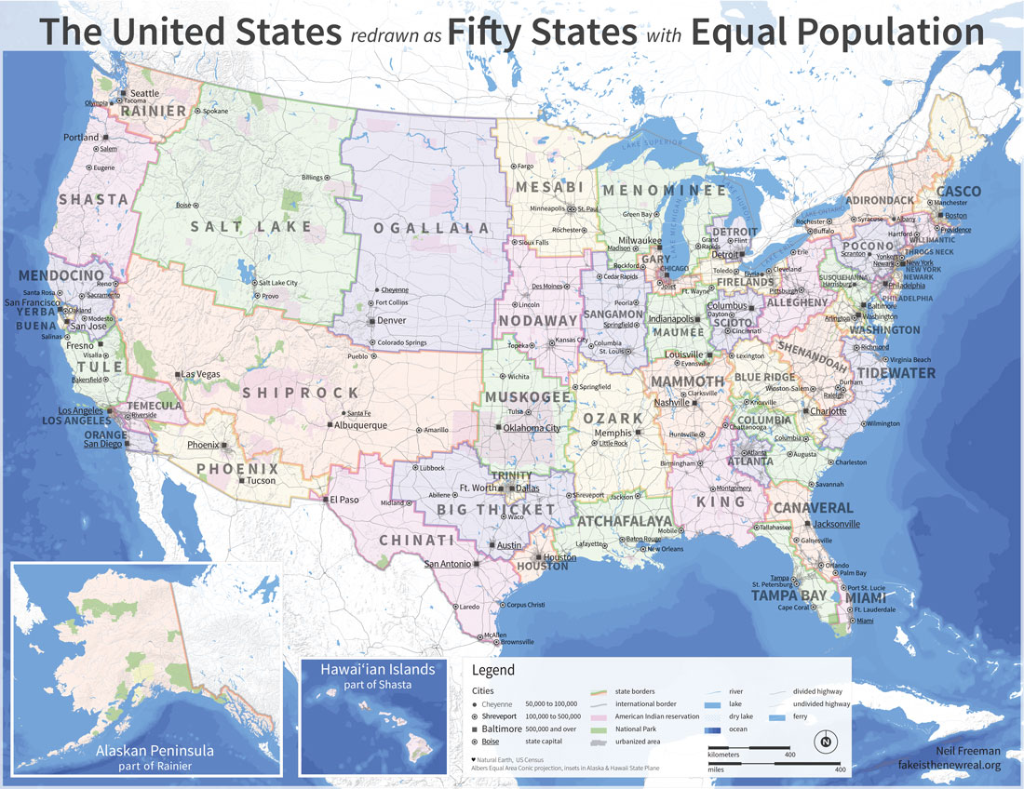
http://fakeisthenewreal.org/reform/
Notes:
~5,617,000 population in each state

Slide 13
Clustering example: image segmentation
Goal: Break up the image into meaningful or perceptually similar regions

Slide 14
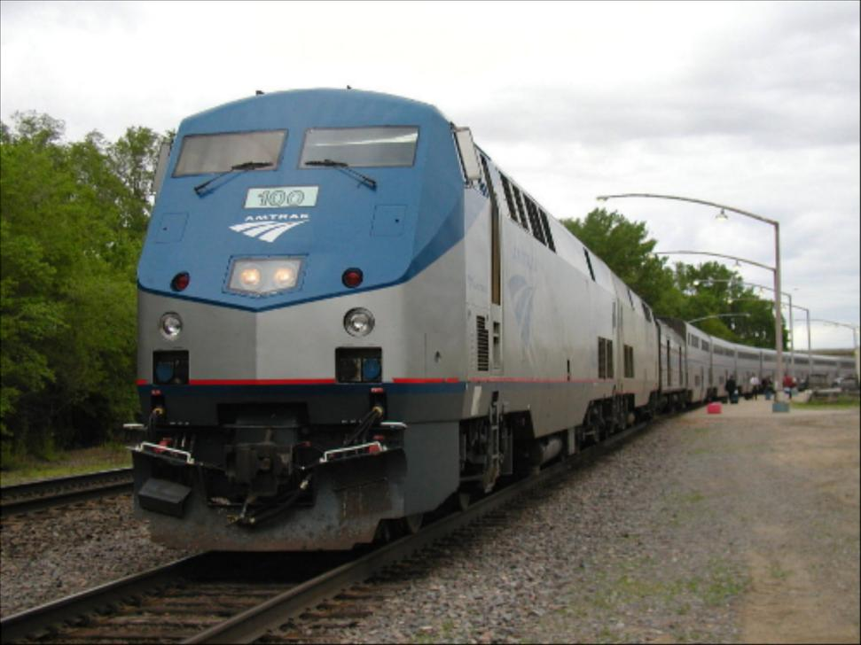
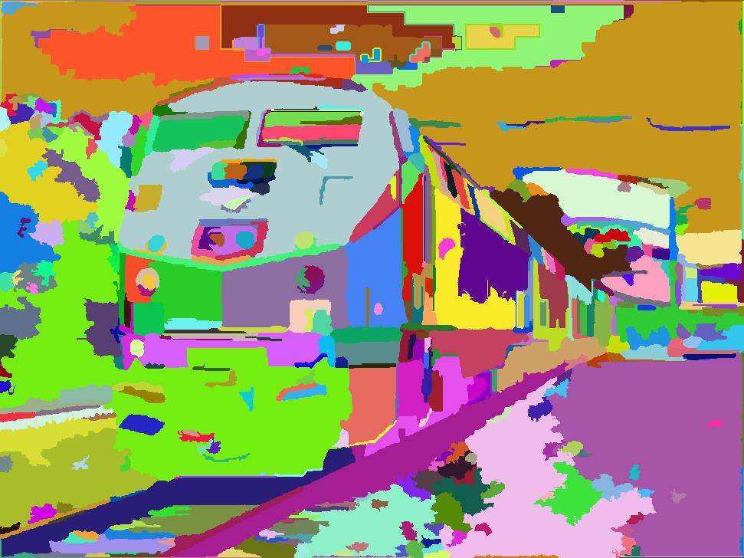
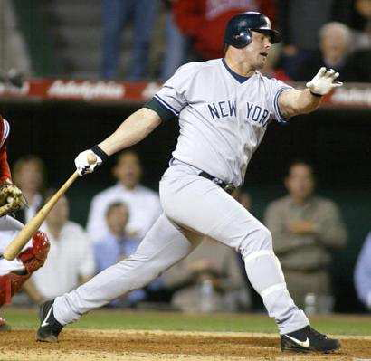
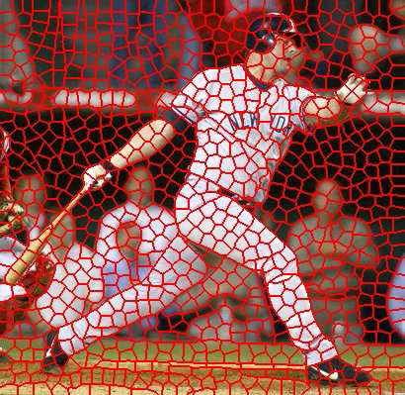
Segmentation for feature support or efficiency
50x50 Patch
50x50 Patch
[Felzenszwalb and Huttenlocher 2004]
[Shi and Malik 2001]
Slide: Derek Hoiem
[Hoiem et al. 2005, Mori 2005]

Slide 15
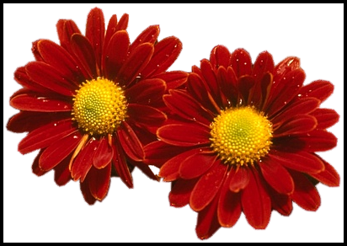
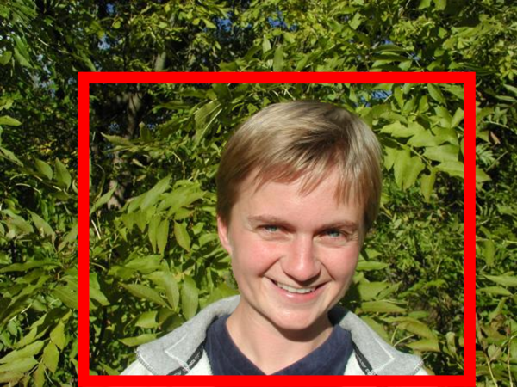
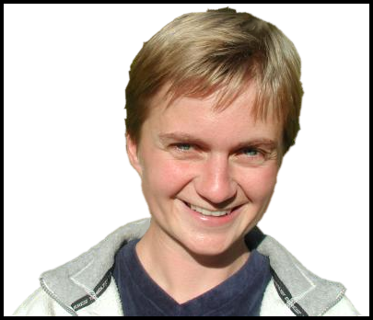
Segmentation as a result
Rother et al. 2004

Slide 16
Types of segmentations
Oversegmentation
Undersegmentation
Multiple Segmentations

Slide 17
Major processes for segmentation
Bottom-up: group tokens with similar features
Top-down: group tokens that likely belong to the same object
[Levin and Weiss 2006]

Slide 18
Clustering: group together similar points and represent them with a single token
Key Challenges:
1) What makes two points/images/patches similar?
2) How do we compute an overall grouping from pairwise similarities?
Slide: Derek Hoiem

Slide 19
Why do we cluster?
Summarizing data
Look at large amounts of data
Patch-based compression or denoising
Represent a large continuous vector with the cluster number
Counting
Histograms of texture, color, SIFT vectors
Segmentation
Separate the image into different regions
Prediction
Images in the same cluster may have the same labels
Slide: Derek Hoiem

Slide 20
How do we cluster?
K-means
Iteratively re-assign points to the nearest cluster center
Agglomerative clustering
Start with each point as its own cluster and iteratively merge the closest clusters
Mean-shift clustering
Estimate modes of pdf
Spectral clustering
Split the nodes in a graph based on assigned links with similarity weights

Slide 21
Clustering for Summarization
Goal: cluster to minimize variance in data given clusters
Preserve information
Cluster center
Data
Whether x_{j} is assigned to c_{i}
Slide: Derek Hoiem

Slide 22
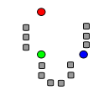
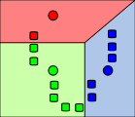
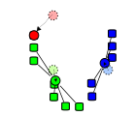
K-means algorithm
1. Randomly select K centers
2. Assign each point to nearest center
3. Compute new center (mean) for each cluster
Illustration: http://en.wikipedia.org/wiki/K-means_clustering

Slide 23
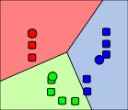
K-means algorithm
1. Randomly select K centers
2. Assign each point to nearest center
Back to 2
3. Compute new center (mean) for each cluster
Illustration: http://en.wikipedia.org/wiki/K-means_clustering

Slide 24
K-means
Initialize cluster centers: c⁰ ; t=0
Assign each point to the closest center
Update cluster centers as the mean of the points
Repeat 2-3 until no points are re-assigned (t=t+1)
Slide: Derek Hoiem

Slide 25
K-means converges to a local minimum

Slide 26
K-means: design choices
Initialization
Randomly select K points as initial cluster center
Or greedily choose K points to minimize residual
Distance measures
Traditionally Euclidean, could be others
Optimization
Will converge to a local minimum
May want to perform multiple restarts

Slide 27
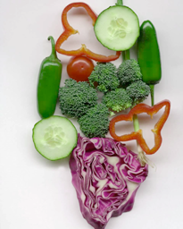
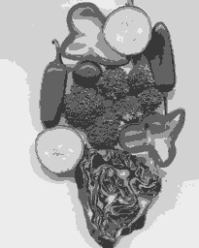
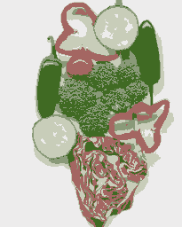
K-means clustering using intensity or color
Image
Clusters on intensity
Clusters on color
Notes:
I gave each pixel the mean intensity or mean color of its cluster --- this is basically just vector quantizing the image intensities/colors. Notice that there is no requirement that clusters be spatially localized and they’re not.

Slide 28
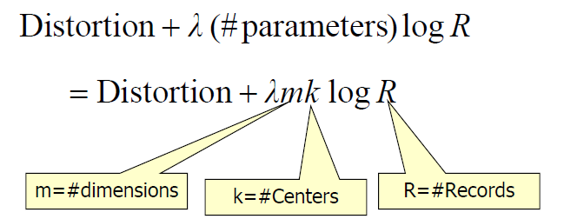
How to choose the number of clusters?
Minimum Description Length (MDL) principal for model comparison
Minimize Schwarz Criterion
also called Bayes Information Criteria (BIC)

Slide 29
How to evaluate clusters?
Generative
How well are points reconstructed from the clusters?
Discriminative
How well do the clusters correspond to labels?
Purity
Note: unsupervised clustering does not aim to be discriminative
Slide: Derek Hoiem

Slide 30
How to choose the number of clusters?
Validation set
Try different numbers of clusters and look at performance
When building dictionaries (discussed later), more clusters typically work better
Slide: Derek Hoiem

Slide 31
K-means demos
General
http://home.dei.polimi.it/matteucc/Clustering/tutorial_html/AppletKM.html
http://www.cs.washington.edu/research/imagedatabase/demo/kmcluster/
Color clustering

Slide 32
K-Means pros and cons
Pros
Finds cluster centers that minimize conditional variance (good representation of data)
Simple and fast*
Easy to implement
Cons
Need to choose K
Sensitive to outliers
Prone to local minima
All clusters have the same parameters (e.g., distance measure is non-adaptive)
*Can be slow: each iteration is O(KNd) for N d-dimensional points
Usage
Rarely used for pixel segmentation

Slide 33
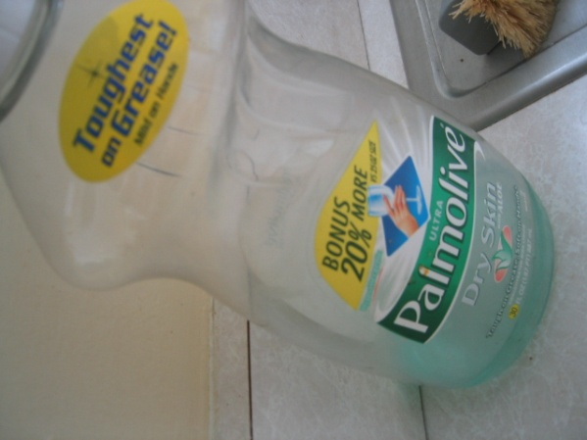
Building Visual Dictionaries
Sample patches from a database
E.g., 128 dimensional SIFT vectors
Cluster the patches
Cluster centers are the dictionary
Assign a codeword (number) to each new patch, according to the nearest cluster

Slide 34
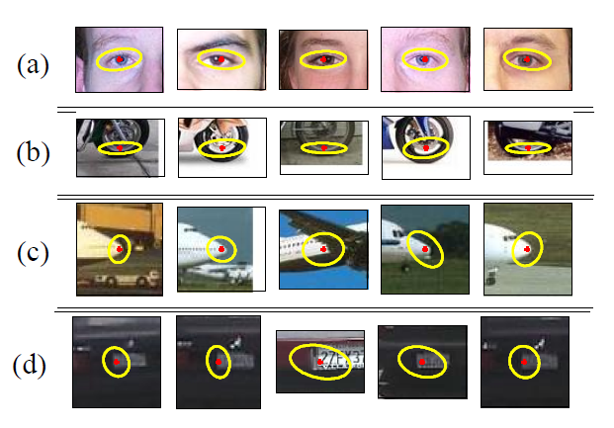
Examples of learned codewords
Most likely codewords for 4 learned “topics”
EM with multinomial (problem 3) to get topics
http://www.robots.ox.ac.uk/~vgg/publications/papers/sivic05b.pdf
Sivic et al. ICCV 2005

Slide 35
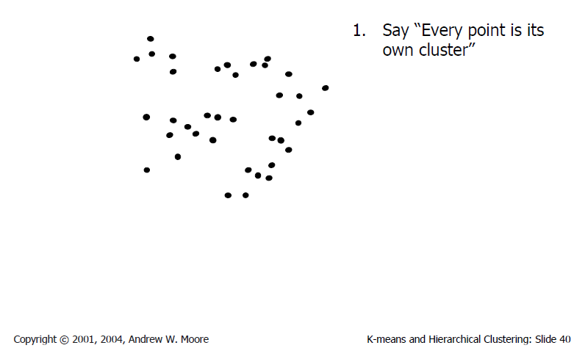
Agglomerative clustering

Slide 36
Agglomerative clustering

Slide 37
Agglomerative clustering

Slide 38
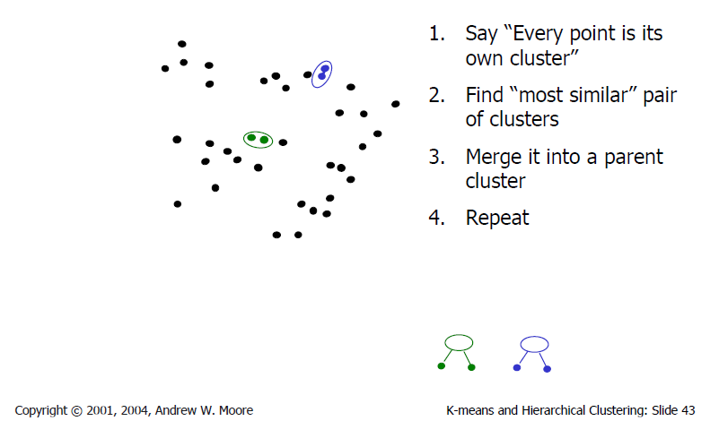
Agglomerative clustering

Slide 39
Agglomerative clustering

Slide 40
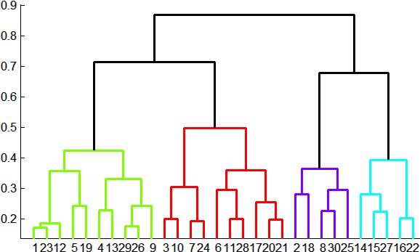
Agglomerative clustering
How to define cluster similarity?
Average distance between points, maximum distance, minimum distance
Distance between means or medoids
How many clusters?
Clustering creates a dendrogram (a tree)
Threshold based on max number of clusters or based on distance between merges
distance

Slide 41
Agglomerative clustering demo
http://home.dei.polimi.it/matteucc/Clustering/tutorial_html/AppletH.html

Slide 42
Conclusions: Agglomerative Clustering
Good
Simple to implement, widespread application
Clusters have adaptive shapes
Provides a hierarchy of clusters
Bad
May have imbalanced clusters
Still have to choose number of clusters or threshold
Need to use an “ultrametric” to get a meaningful hierarchy
Notes:
Ultrametric – stronger requirement than triangle inequality. Distance between two points must be at least a large as the distance of connecting those two points through any intermediate point.

Slide 43
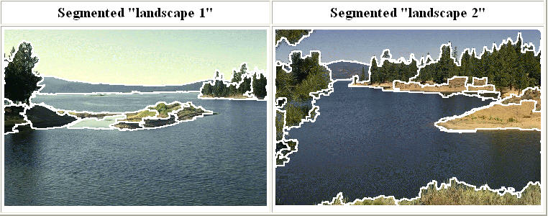
Mean shift segmentation
D. Comaniciu and P. Meer, Mean Shift: A Robust Approach toward Feature Space Analysis, PAMI 2002.
Versatile technique for clustering-based segmentation

Slide 44
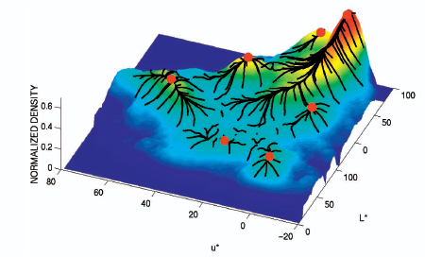
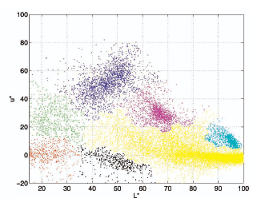
Mean shift algorithm
Try to find modes of this non-parametric density

Slide 45
Kernel density estimation
Kernel density estimation function
Gaussian kernel

Slide 46
Mean shift
Region of
interest
Center of
mass
Mean Shift
vector
Slide by Y. Ukrainitz & B. Sarel

Slide 47
Mean shift
Region of
interest
Center of
mass
Mean Shift
vector
Slide by Y. Ukrainitz & B. Sarel

Slide 48
Mean shift
Region of
interest
Center of
mass
Mean Shift
vector
Slide by Y. Ukrainitz & B. Sarel

Slide 49
Mean shift
Region of
interest
Center of
mass
Mean Shift
vector
Slide by Y. Ukrainitz & B. Sarel

Slide 50
Mean shift
Region of
interest
Center of
mass
Mean Shift
vector
Slide by Y. Ukrainitz & B. Sarel

Slide 51
Mean shift
Region of
interest
Center of
mass
Mean Shift
vector
Slide by Y. Ukrainitz & B. Sarel

Slide 52
Mean shift
Region of
interest
Center of
mass
Slide by Y. Ukrainitz & B. Sarel

Slide 53
Computing the Mean Shift
Simple Mean Shift procedure:
Compute mean shift vector
Translate the Kernel window by m(x)
Slide by Y. Ukrainitz & B. Sarel

Slide 54
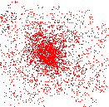
Attraction basin
Attraction basin: the region for which all trajectories lead to the same mode
Cluster: all data points in the attraction basin of a mode
Slide by Y. Ukrainitz & B. Sarel

Slide 55
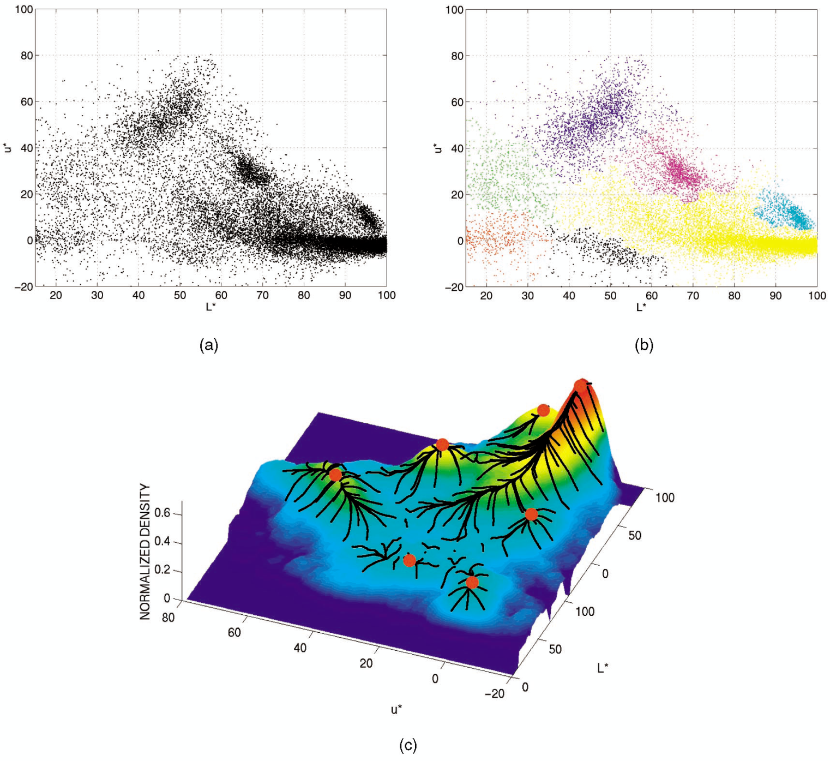
Attraction basin

Slide 56
Mean shift clustering
The mean shift algorithm seeks modes of the given set of points
Choose kernel and bandwidth
For each point:
Center a window on that point
Compute the mean of the data in the search window
Center the search window at the new mean location
Repeat (b,c) until convergence
Assign points that lead to nearby modes to the same cluster

Slide 57
Segmentation by Mean Shift
Compute features for each pixel (color, gradients, texture, etc)
Set kernel size for features K_{f} and position K_{s}
Initialize windows at individual pixel locations
Perform mean shift for each window until convergence
Merge windows that are within width of K_{f} and K_{s}

Slide 58
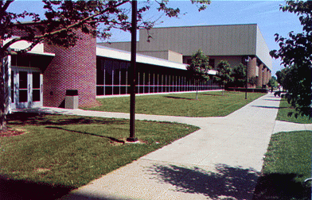
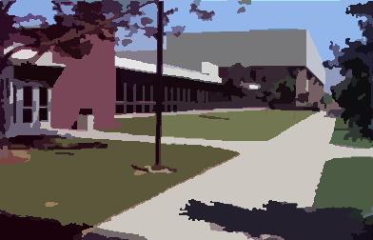
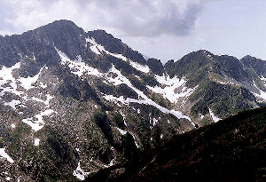
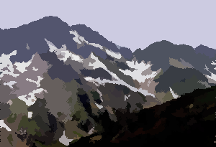
Mean shift segmentation results
Comaniciu and Meer 2002
Notes:
Clustering based on feature (LUV colors), location (x y coordinates), and eliminating small clusters

Slide 59
Comaniciu and Meer 2002

Slide 60
Mean-shift: other issues
Speedups
Binned estimation
Fast search of neighbors
Update each window in each iteration (faster convergence)
Other tricks
Use kNN to determine window sizes adaptively
Lots of theoretical support
D. Comaniciu and P. Meer, Mean Shift: A Robust Approach toward Feature Space Analysis, PAMI 2002.

Slide 61
Mean shift pros and cons
Pros
Good general-practice segmentation
Flexible in number and shape of regions
Robust to outliers
Cons
Have to choose kernel size in advance
Not suitable for high-dimensional features
When to use it
Oversegmentatoin
Multiple segmentations
Tracking, clustering, filtering applications

Slide 62
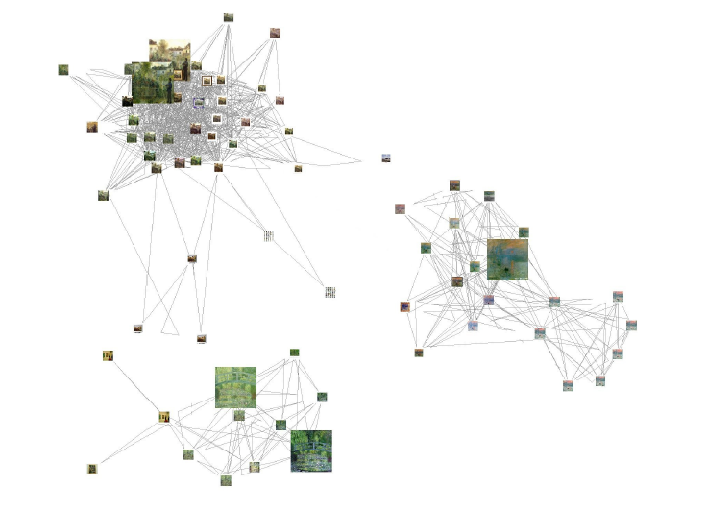
Spectral clustering
Group points based on links in a graph
B
A

Slide 63
Cuts in a graph
B
A
Normalized Cut
a cut penalizes large segments
fix by normalizing for size of segments
volume(A) = sum of costs of all edges that touch A
Source: Seitz

Slide 64
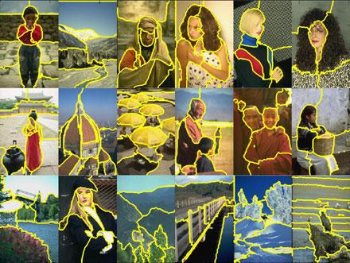
Normalized cuts for segmentation

Slide 65
Visual PageRank
Determining importance by random walk
What’s the probability that you will randomly walk to a given node?
Create adjacency matrix based on visual similarity
Edge weights determine probability of transition
Jing Baluja 2008

Slide 66
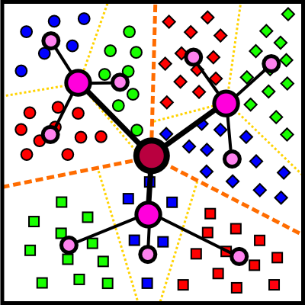
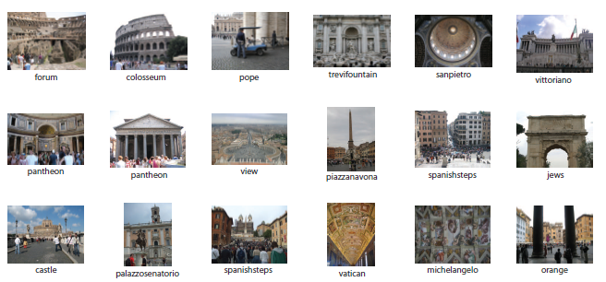
Which algorithm to use?
Quantization/Summarization: K-means
Aims to preserve variance of original data
Can easily assign new point to a cluster
Summary of 20,000 photos of Rome using “greedy k-means”
http://grail.cs.washington.edu/projects/canonview/
Quantization for computing histograms

Slide 67
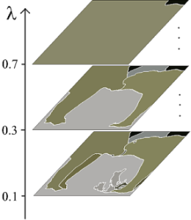
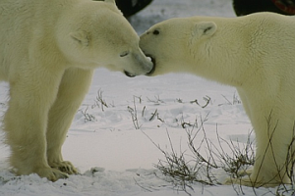
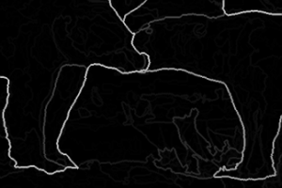
Which algorithm to use?
Image segmentation: agglomerative clustering
More flexible with distance measures (e.g., can be based on boundary prediction)
Adapts better to specific data
Hierarchy can be useful
http://www.cs.berkeley.edu/~arbelaez/UCM.html

Slide 68
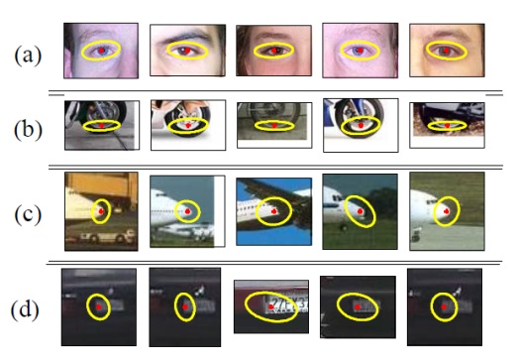
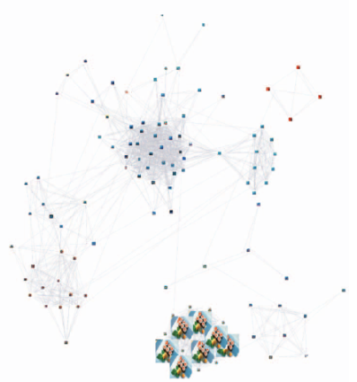
Things to remember
K-means useful for summarization, building dictionaries of patches, general clustering
Agglomerative clustering useful for segmentation, general clustering
Spectral clustering useful for determining relevance, summarization, segmentation

Slide 69
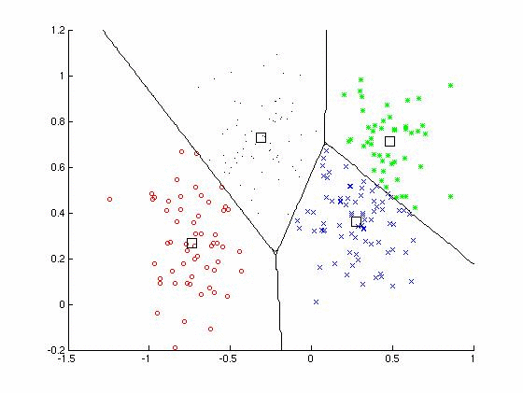
Clustering
Key algorithm
K-means

Slide 71
To be continued

