Slide 1
CS 4803 / 7643: Deep Learning
Topics:
  Generative Adversarial Networks (GANs)
  Closing time
Dhruv Batra
Georgia Tech

Slide 2
Administrativia
Last class today
Project submission
  Due: 12/03, 11:55pm
  Last deliverable in the class
  Can’t use late days
  https://www.cc.gatech.edu/classes/AY2020/cs7643_fall/

Slide 3
Generative Adversarial Networks (GAN)

Slide 4
Types of Learning
Supervised learning
  Learning from a “teacher”
  Training data includes desired outputs
Reinforcement learning
  Learning to act under evaluative feedback (rewards)
Unsupervised learning
  Discover structure in data
  Training data does not include desired outputs

Slide 5
Taxonomy of Generative Models
Direct
GAN
Generative models
Explicit density
Implicit density
Tractable density
Approximate density
Markov Chain
Fully Visible Belief Nets
NADE
MADE
PixelRNN/CNN
Change of variables models (nonlinear ICA)
GSN
Variational
Markov Chain
Variational Autoencoder
Boltzmann Machine
Figure copyright and adapted from Ian Goodfellow, Tutorial on Generative Adversarial Networks, 2017.
Slide Credit: Fei-Fei Li, Justin Johnson, Serena Yeung, CS 231n
Notes:
Refer to goodfellow tutorial which has a good overview of this
Today discuss 3 most popular types of generative models

Slide 6
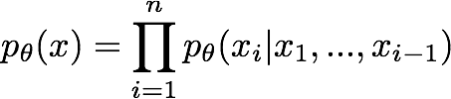

So far...
PixelCNNs define tractable density function, optimize likelihood of training data:
VAEs define intractable density function with latent z:
Cannot optimize directly, derive and optimize lower bound on likelihood instead
Slide Credit: Fei-Fei Li, Justin Johnson, Serena Yeung, CS 231n

Slide 7
So far...
PixelCNNs define tractable density function, optimize likelihood of training data:
VAEs define intractable density function with latent z:
Cannot optimize directly, derive and optimize lower bound on likelihood instead
What if we give up on explicitly modeling density, and just want ability to sample?
Slide Credit: Fei-Fei Li, Justin Johnson, Serena Yeung, CS 231n

Slide 8
So far...
PixelCNNs define tractable density function, optimize likelihood of training data:
VAEs define intractable density function with latent z:
Cannot optimize directly, derive and optimize lower bound on likelihood instead
What if we give up on explicitly modeling density, and just want ability to sample?
GANs: don’t work with any explicit density function!
Slide Credit: Fei-Fei Li, Justin Johnson, Serena Yeung, CS 231n

Slide 9
Generative Adversarial Networks (GANs)
GANs are a combination of the following ideas:
Learning to Sample
  (High-level) Connection to Inverse Transform Sampling
Adversarial Training
“Reparameterization” Trick

Slide 10

Easy Interview Question
I give you u ~ U(0,1)
Use u to produce a sample x ~ Bern($θ$)

Slide 11

Slightly Harder Interview Question
I give you u ~ U(0,1)
Use u to produce a sample x ~ Cat($π$)

Slide 12
Harder Interview Question
I give you u ~ U(0,1)
Use u to produce a sample x ~ F_{X}(x)

Slide 13
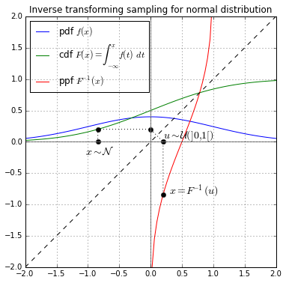
Inverse Transform Sampling

Slide 14
Harder Interview Question
I give you u ~ U(0,1)
Use u to produce a sample x ~ F_{X}(x)

Slide 15
Generative Adversarial Networks
Ian Goodfellow et al., “Generative Adversarial Nets”, NIPS 2014
Problem: Want to sample from complex, high-dimensional training distribution. No direct way to do this!
Solution: Sample from a simple distribution, e.g. random noise. Learn transformation to training distribution.
Q: What can we use to represent this complex transformation?
Slide Credit: Fei-Fei Li, Justin Johnson, Serena Yeung, CS 231n
Notes:
Mapping z to data manifold?
Hard to sample from high dimensional distribution. Take random noise, transform to real distribution

Slide 16
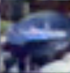
Generative Adversarial Networks
Ian Goodfellow et al., “Generative Adversarial Nets”, NIPS 2014
Problem: Want to sample from complex, high-dimensional training distribution. No direct way to do this!
Solution: Sample from a simple distribution, e.g. random noise. Learn transformation to training distribution.
Q: What can we use to represent this complex transformation?
Output: Sample from training distribution
A: A neural network!
Generator Network
Input: Random noise
z
Slide Credit: Fei-Fei Li, Justin Johnson, Serena Yeung, CS 231n
Notes:
Mapping z to data manifold?
Hard to sample from high dimensional distribution. Take random noise, transform to real distribution

Slide 17
Generative Adversarial Networks (GANs)
GANs are a combination of the following ideas:
Learning to Sample
  Connection to Inverse Transform Sampling
Adversarial Training
“Reparameterization” Trick

Slide 18
Training GANs: Two-player game
Ian Goodfellow et al., “Generative Adversarial Nets”, NIPS 2014
Generator network: try to fool the discriminator by generating real-looking images
Discriminator network: try to distinguish between real and fake images
Slide Credit: Fei-Fei Li, Justin Johnson, Serena Yeung, CS 231n
Notes:
Mapping z to data manifold?

Slide 19





Training GANs: Two-player game
Ian Goodfellow et al., “Generative Adversarial Nets”, NIPS 2014
Generator network: try to fool the discriminator by generating real-looking images
Discriminator network: try to distinguish between real and fake images
Real or Fake
Discriminator Network
Fake Images
(from generator)
Real Images
(from training set)
Generator Network
Random noise
z
Fake and real images copyright Emily Denton et al. 2015. Reproduced with permission.
Slide Credit: Fei-Fei Li, Justin Johnson, Serena Yeung, CS 231n
Notes:
Mapping z to data manifold?

Slide 20
Training GANs: Two-player game
Ian Goodfellow et al., “Generative Adversarial Nets”, NIPS 2014
Generator network: try to fool the discriminator by generating real-looking images
Discriminator network: try to distinguish between real and fake images
Train jointly in minimax game
Minimax objective function:
Slide Credit: Fei-Fei Li, Justin Johnson, Serena Yeung, CS 231n
Notes:
Mapping z to data manifold?

Slide 21
Training GANs: Two-player game
Ian Goodfellow et al., “Generative Adversarial Nets”, NIPS 2014
Generator network: try to fool the discriminator by generating real-looking images
Discriminator network: try to distinguish between real and fake images
Train jointly in minimax game
Minimax objective function:
Discriminator outputs likelihood in (0,1) of real image
Discriminator output for real data x
Discriminator output for generated fake data G(z)
Slide Credit: Fei-Fei Li, Justin Johnson, Serena Yeung, CS 231n
Notes:
Mapping z to data manifold?

Slide 22
Training GANs: Two-player game
Ian Goodfellow et al., “Generative Adversarial Nets”, NIPS 2014
Generator network: try to fool the discriminator by generating real-looking images
Discriminator network: try to distinguish between real and fake images
Train jointly in minimax game
Minimax objective function:
Discriminator outputs likelihood in (0,1) of real image
Discriminator output for real data x
Discriminator output for generated fake data G(z)
Discriminator (θ_{d}) wants to maximize objective such that D(x) is close to 1 (real) and D(G(z)) is close to 0 (fake)
Generator (θ_{g}) wants to minimize objective such that D(G(z)) is close to 1 (discriminator is fooled into thinking generated G(z) is real)
Slide Credit: Fei-Fei Li, Justin Johnson, Serena Yeung, CS 231n
Notes:
Mapping z to data manifold?

Slide 23

Training GANs: Two-player game
Ian Goodfellow et al., “Generative Adversarial Nets”, NIPS 2014
Minimax objective function:
Alternate between:
Gradient ascent on discriminator
2. Gradient descent on generator
Slide Credit: Fei-Fei Li, Justin Johnson, Serena Yeung, CS 231n
Notes:
Mapping z to data manifold?

Slide 24
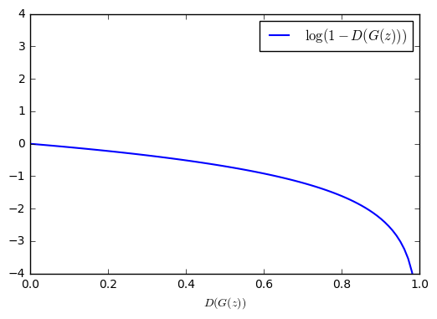
Training GANs: Two-player game
Ian Goodfellow et al., “Generative Adversarial Nets”, NIPS 2014
Minimax objective function:
Gradient signal dominated by region where sample is already good
Alternate between:
Gradient ascent on discriminator
2. Gradient descent on generator
When sample is likely fake, want to learn from it to improve generator. But gradient in this region is relatively flat!
In practice, optimizing this generator objective does not work well!
Slide Credit: Fei-Fei Li, Justin Johnson, Serena Yeung, CS 231n
Notes:
Mapping z to data manifold?

Slide 25
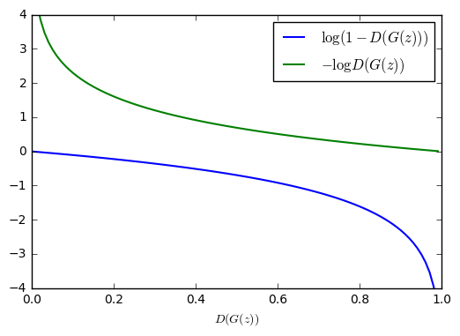

Training GANs: Two-player game
Ian Goodfellow et al., “Generative Adversarial Nets”, NIPS 2014
Minimax objective function:
Alternate between:
Gradient ascent on discriminator
2. Instead: Gradient ascent on generator, different objective
Instead of minimizing likelihood of discriminator being correct, now maximize likelihood of discriminator being wrong.
Same objective of fooling discriminator, but now higher gradient signal for bad samples => works much better! Standard in practice.
High gradient signal
Low gradient signal
Slide Credit: Fei-Fei Li, Justin Johnson, Serena Yeung, CS 231n
Notes:
Mapping z to data manifold?

Slide 26
Training GANs: Two-player game
Ian Goodfellow et al., “Generative Adversarial Nets”, NIPS 2014
Minimax objective function:
Aside: Jointly training two networks is challenging, can be unstable. Choosing objectives with better loss landscapes helps training, is an active area of research.
Alternate between:
Gradient ascent on discriminator
2. Instead: Gradient ascent on generator, different objective
Instead of minimizing likelihood of discriminator being correct, now maximize likelihood of discriminator being wrong.
Same objective of fooling discriminator, but now higher gradient signal for bad samples => works much better! Standard in practice.
High gradient signal
Low gradient signal
Slide Credit: Fei-Fei Li, Justin Johnson, Serena Yeung, CS 231n
Notes:
Mapping z to data manifold?

Slide 27
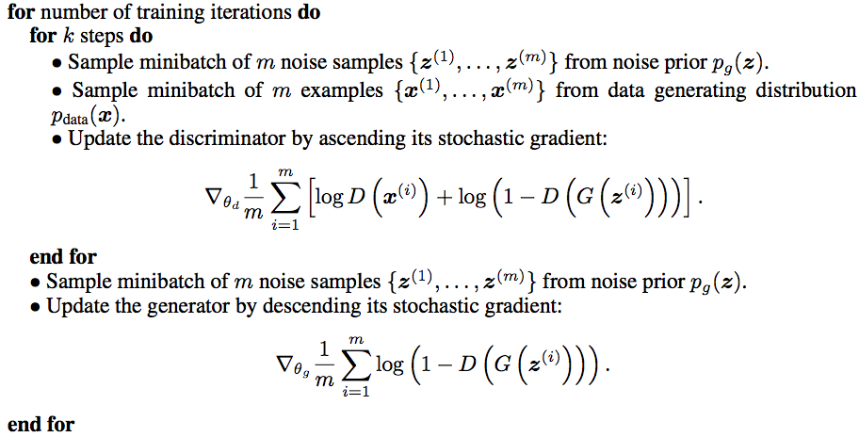
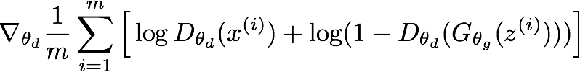
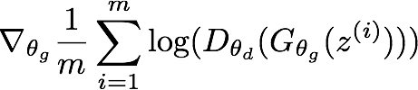
Training GANs: Two-player game
Ian Goodfellow et al., “Generative Adversarial Nets”, NIPS 2014
Putting it together: GAN training algorithm
Slide Credit: Fei-Fei Li, Justin Johnson, Serena Yeung, CS 231n
Notes:
Train discriminator for a bit
Then train generator for a bit

Slide 28
Training GANs: Two-player game
Ian Goodfellow et al., “Generative Adversarial Nets”, NIPS 2014
Putting it together: GAN training algorithm
Some find k=1 more stable, others use k > 1, no best rule.
Recent work (e.g. Wasserstein GAN) alleviates this problem, better stability!
Slide Credit: Fei-Fei Li, Justin Johnson, Serena Yeung, CS 231n
Notes:
Mapping z to data manifold?
**No clear rule. Sometimes train 1 step discriminator, 1 step gen. Some train disc. More

Slide 29
Training GANs: Two-player game
Ian Goodfellow et al., “Generative Adversarial Nets”, NIPS 2014
Generator network: try to fool the discriminator by generating real-looking images
Discriminator network: try to distinguish between real and fake images
Real or Fake
Discriminator Network
Fake Images
(from generator)
Real Images
(from training set)
Generator Network
After training, use generator network to generate new images
Random noise
z
Fake and real images copyright Emily Denton et al. 2015. Reproduced with permission.
Slide Credit: Fei-Fei Li, Justin Johnson, Serena Yeung, CS 231n
Notes:
Mapping z to data manifold?

Slide 30
GANs
Demo
  https://poloclub.github.io/ganlab/

Slide 31
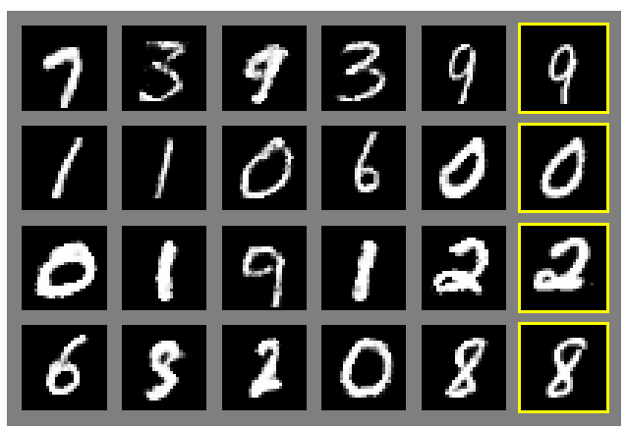
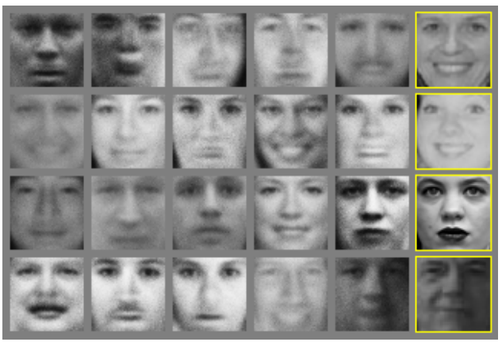
Generative Adversarial Nets
Ian Goodfellow et al., “Generative Adversarial Nets”, NIPS 2014
Generated samples
Nearest neighbor from training set
Figures copyright Ian Goodfellow et al., 2014. Reproduced with permission.
Slide Credit: Fei-Fei Li, Justin Johnson, Serena Yeung, CS 231n
Notes:
Realistic samples, never directly memorizes training set

Slide 32
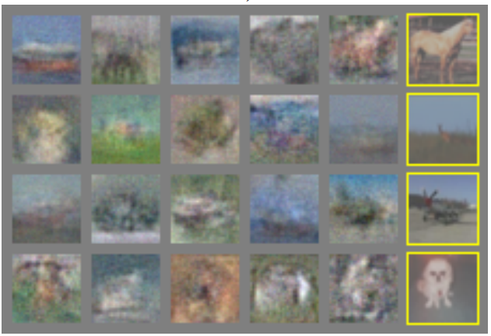
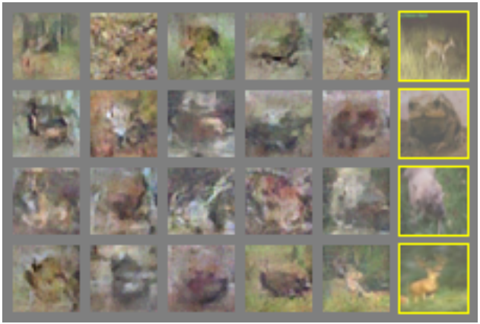
Generative Adversarial Nets
Ian Goodfellow et al., “Generative Adversarial Nets”, NIPS 2014
Generated samples (CIFAR-10)
Nearest neighbor from training set
Figures copyright Ian Goodfellow et al., 2014. Reproduced with permission.
Slide Credit: Fei-Fei Li, Justin Johnson, Serena Yeung, CS 231n
Notes:
Original work from 2014, not such great quality yet

Slide 33
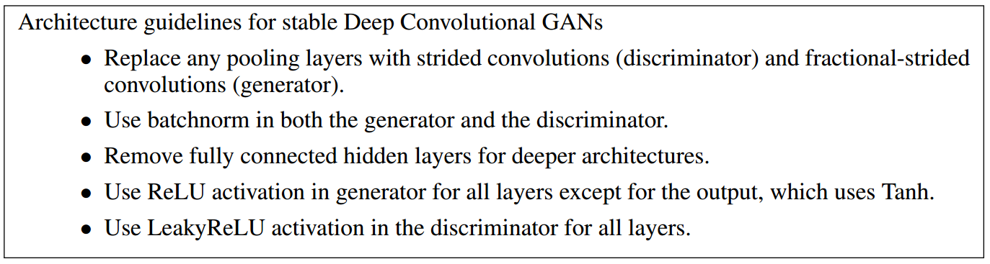
Generative Adversarial Nets: Convolutional Architectures
Generator is an upsampling network with fractionally-strided convolutions
Discriminator is a convolutional network
Radford et al, “Unsupervised Representation Learning with Deep Convolutional Generative Adversarial Networks”, ICLR 2016
Slide Credit: Fei-Fei Li, Justin Johnson, Serena Yeung, CS 231n
Notes:
Since this time, a lot of work on improving GANs.
This work ICLR2016 on adding convolutional architectures to GANs

Slide 34
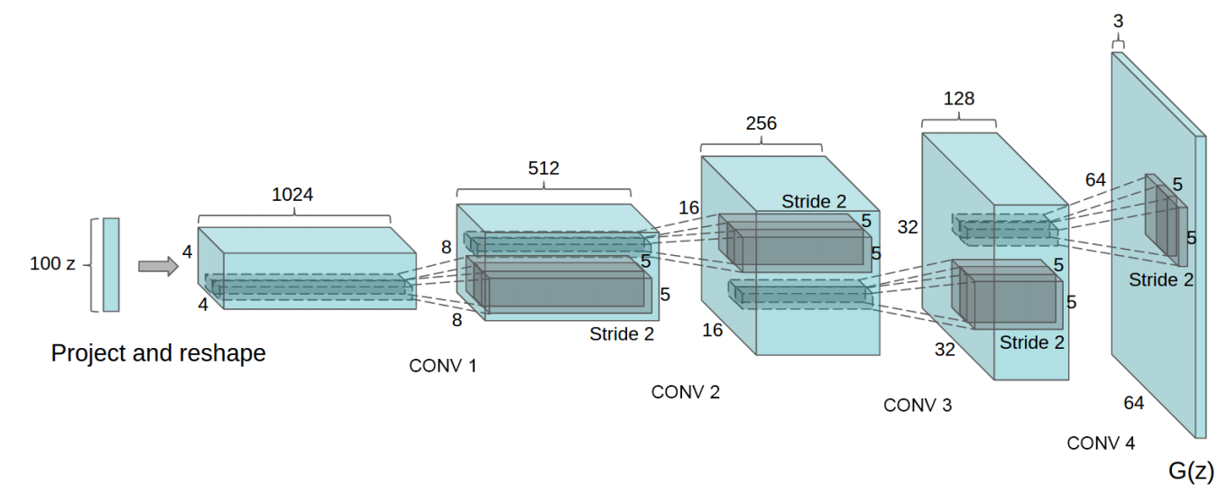
Generative Adversarial Nets: Convolutional Architectures
Generator
Radford et al, “Unsupervised Representation Learning with Deep Convolutional Generative Adversarial Networks”, ICLR 2016
Slide Credit: Fei-Fei Li, Justin Johnson, Serena Yeung, CS 231n

Slide 35
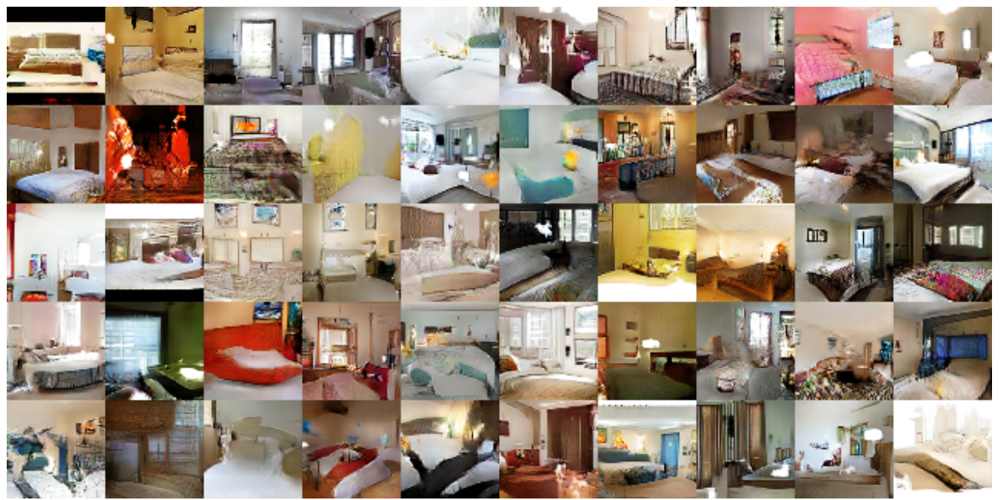
Generative Adversarial Nets: Convolutional Architectures
Samples from the model look much better!
Radford et al,
ICLR 2016
Slide Credit: Fei-Fei Li, Justin Johnson, Serena Yeung, CS 231n

Slide 36
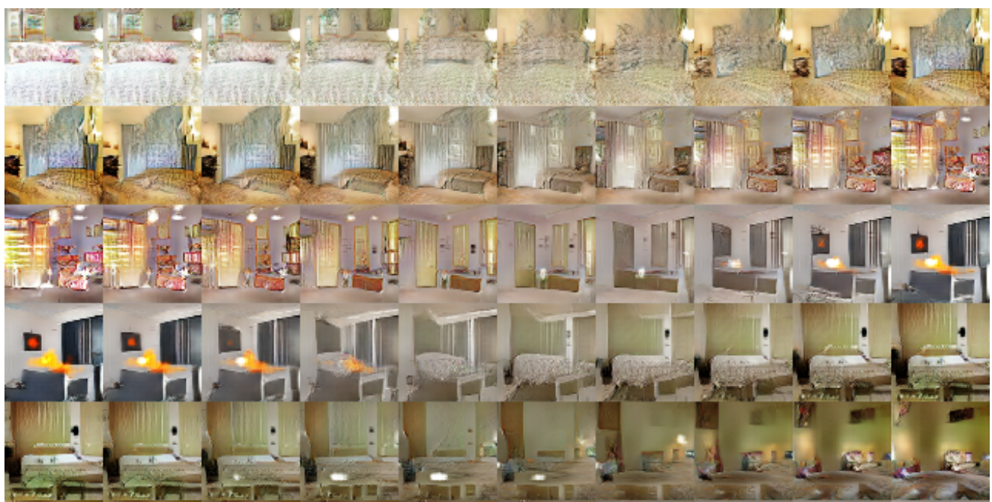
Generative Adversarial Nets: Convolutional Architectures
Interpolating between random
points in latent space
Radford et al,
ICLR 2016
Slide Credit: Fei-Fei Li, Justin Johnson, Serena Yeung, CS 231n
Notes:
Take 2 points of z (2 random vectors), and interpolate between these points

Slide 37
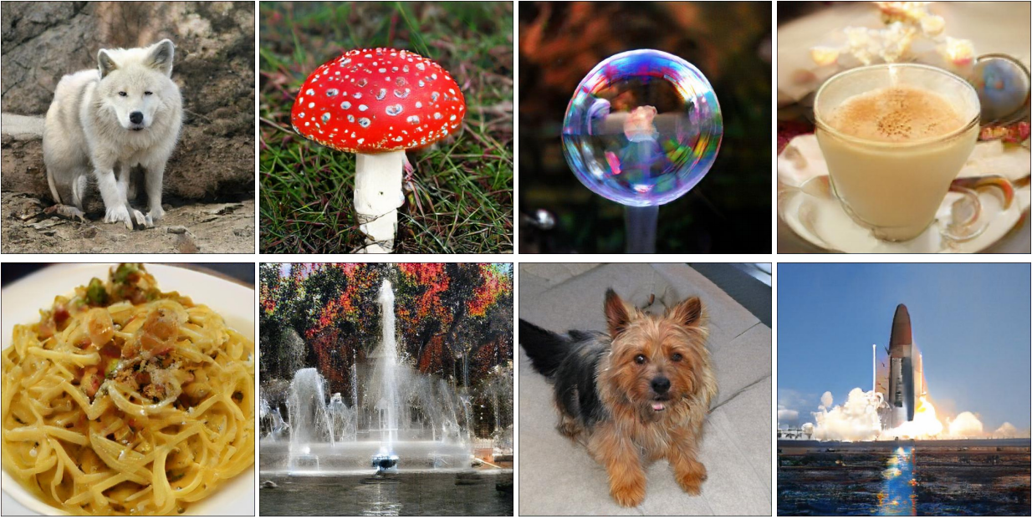
BigGAN
Large Scale GAN Training for High Fidelity Natural Image Synthesis
Andrew Brock, Jeff Donahue, Karen Simonyan https://arxiv.org/abs/1809.11096

Slide 38
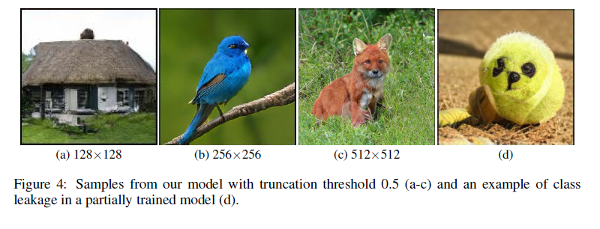
BigGAN
Large Scale GAN Training for High Fidelity Natural Image Synthesis
Andrew Brock, Jeff Donahue, Karen Simonyan https://arxiv.org/abs/1809.11096

Slide 39
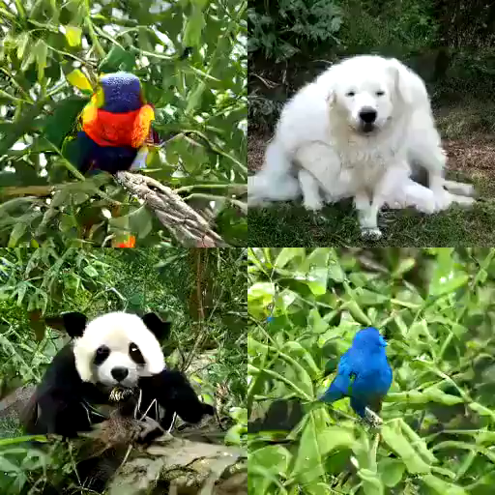
BigGAN
https://gist.github.com/phillipi/d2921f2d4726d7e3cdac7a4780c6050a

Slide 40
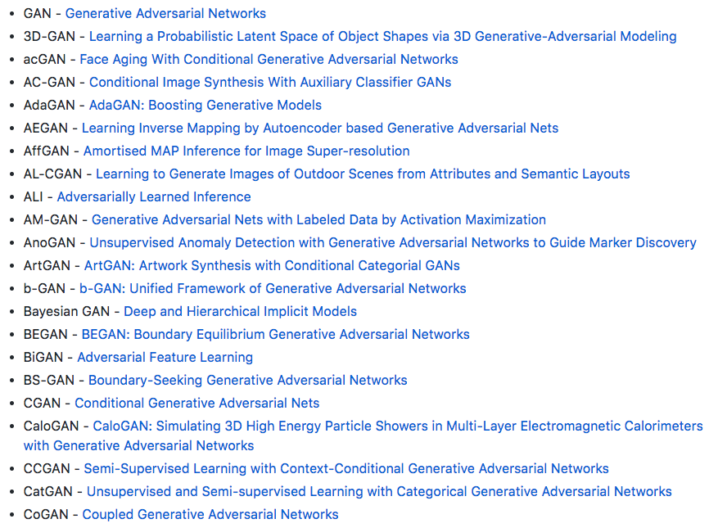
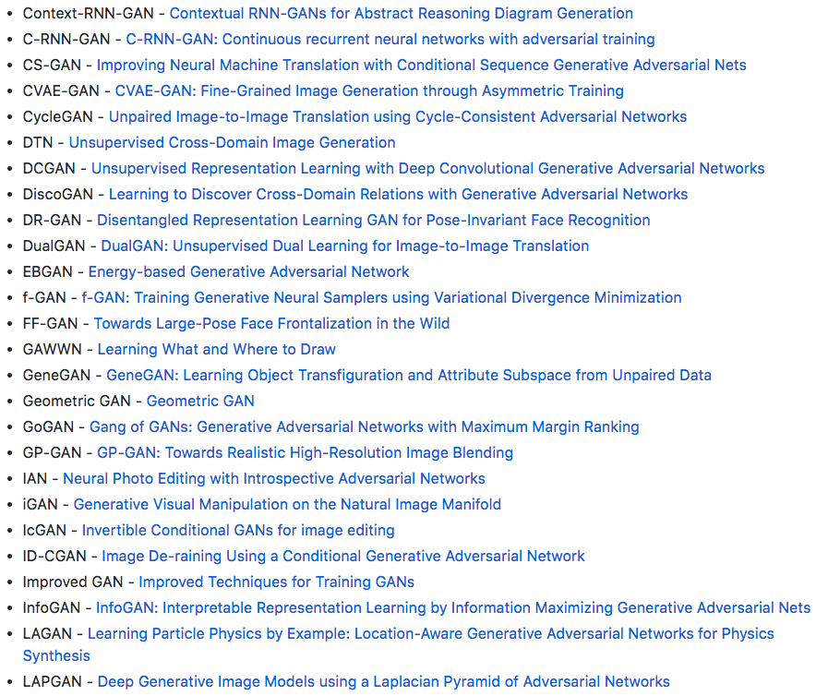
Explosion of GANs
“The GAN Zoo”
“The GAN Zoo”
https://github.com/hindupuravinash/the-gan-zoo
Slide Credit: Fei-Fei Li, Justin Johnson, Serena Yeung, CS 231n

Slide 41
“The GAN Zoo”
Explosion of GANs
See also: https://github.com/soumith/ganhacks for tips and tricks for trainings GANs
https://github.com/hindupuravinash/the-gan-zoo
Slide Credit: Fei-Fei Li, Justin Johnson, Serena Yeung, CS 231n

Slide 42
GANs
Don’t work with an explicit density function
Take game-theoretic approach: learn to generate from training distribution through 2-player game
Pros:
Beautiful, state-of-the-art samples!
Cons:
Trickier / more unstable to train
Can’t solve inference queries such as p(x), p(z|x)
Active areas of research:
Better loss functions, more stable training (Wasserstein GAN, LSGAN, many others)
Conditional GANs, GANs for all kinds of applications
Slide Credit: Fei-Fei Li, Justin Johnson, Serena Yeung, CS 231n

Slide 43
Plan for Today
Generative Adversarial Networks (GANs)
Closing the loop

Slide 44
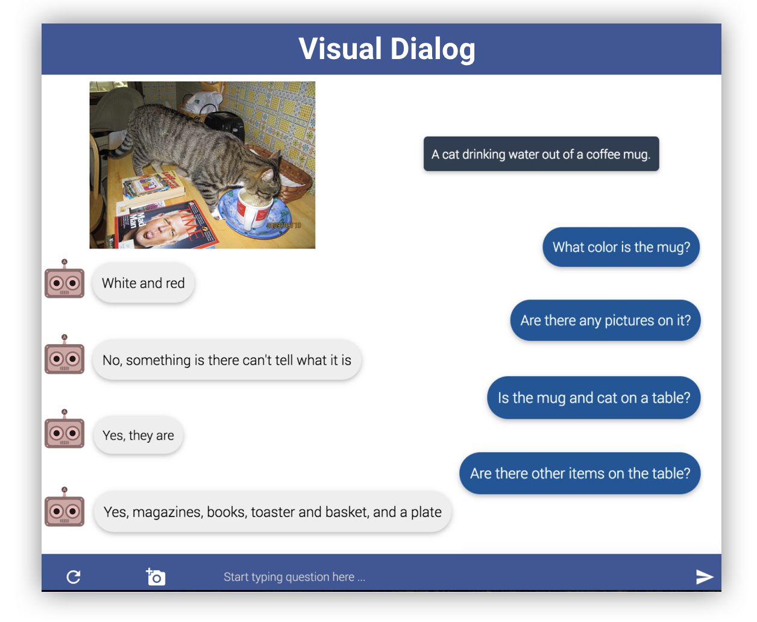

Visual Dialog

Slide 45


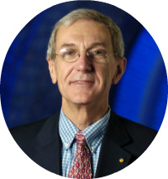

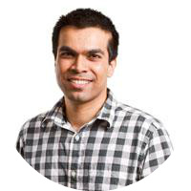
Learning Cooperative Visual Dialog Agents with Deep Reinforcement Learning
[ICCV ‘17]
Abhishek Das*
(Georgia Tech)
Satwik Kottur*
(CMU)
José Moura
(CMU)
Stefan Lee
(Virginia Tech)
Dhruv Batra
(Georgia Tech)

Slide 46

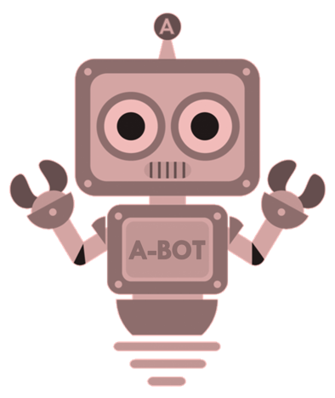
Image Guessing Game
Slide Credit: Abhishek Das

Slide 47

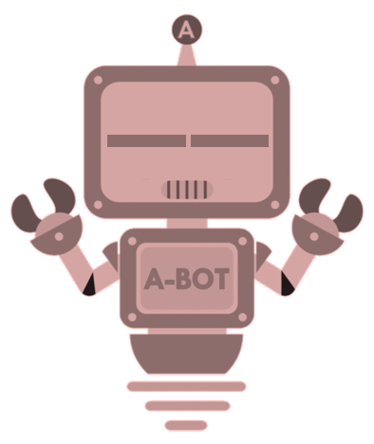
Image Guessing Game
Slide Credit: Abhishek Das

Slide 48
Image Guessing Game
Q-Bot
asks questions
is blindfolded
Slide Credit: Abhishek Das

Slide 49

Image Guessing Game
asks questions
Q-Bot
is blindfolded
Slide Credit: Abhishek Das

Slide 50
Image Guessing Game
asks questions
A-Bot
answers questions
sees an image
Slide Credit: Abhishek Das

Slide 51
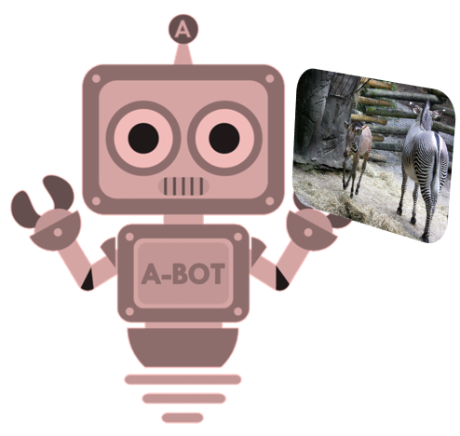
Image Guessing Game
asks questions
answers questions
A-Bot
sees an image
Slide Credit: Abhishek Das

Slide 52
Image Guessing Game
asks questions
Slide Credit: Abhishek Das

Slide 53






Image Guessing Game
asks questions
Slide Credit: Abhishek Das

Slide 54

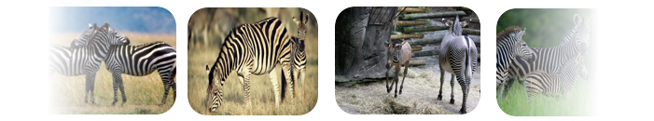
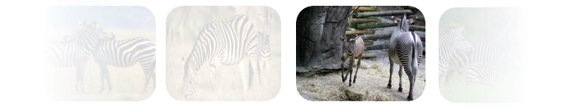
Image Guessing Game
asks questions
Slide Credit: Abhishek Das

Slide 55

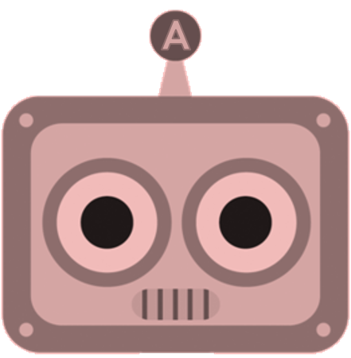
RL for Cooperative Dialog Agents
Agents: (Q-bot, A-bot)
Environment: Image
Action:
  Q-bot: question (symbol sequence)
  A-bot: answer (symbol sequence)
  Q-bot: image regression
State
  Q-bot:
  A-bot:
q_{t}
Any people in the shot?
a_{t}
No, there aren’t any.

Slide 56
RL for Cooperative Dialog Agents
Action:
  Q-bot: question (symbol sequence)
  A-bot: answer (symbol sequence)
  Q-bot: image regression
State
  Q-bot:
  A-bot:
q_{t}
Any people in the shot?
a_{t}
No, there aren’t any.

Slide 57
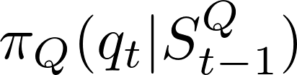

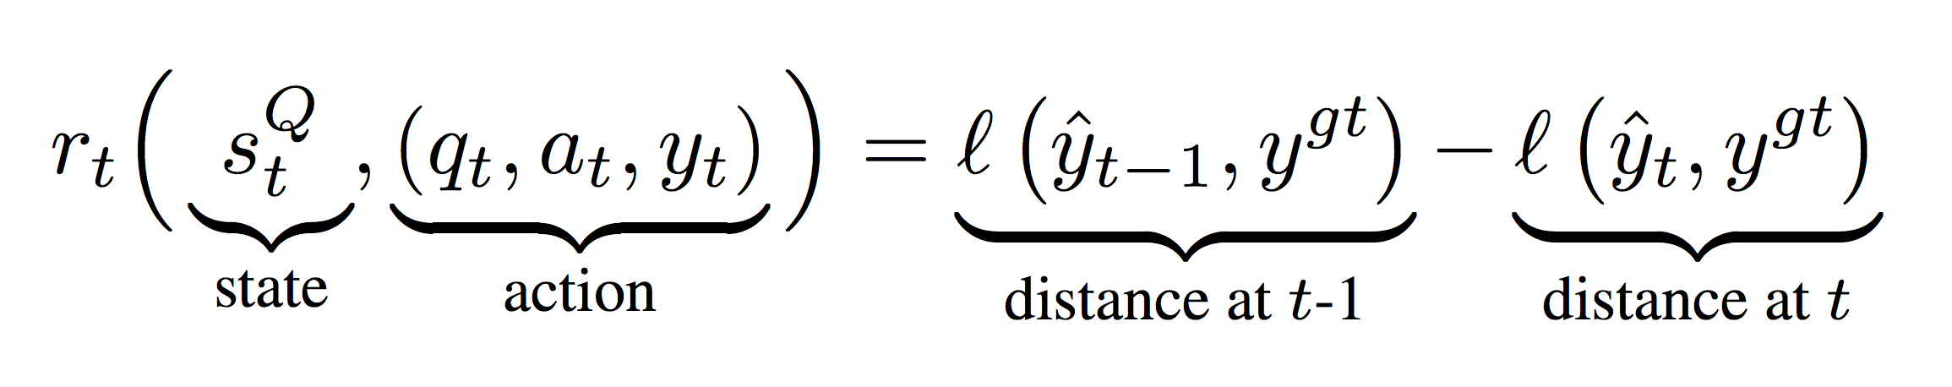
RL for Cooperative Dialog Agents
Action:
  Q-bot: question (symbol sequence)
  A-bot: answer (symbol sequence)
  Q-bot: image regression
State
  Q-bot:
  A-bot:
Policy
Reward
q_{t}
Any people in the shot?
a_{t}
No, there aren’t any.
Q-bot
A-bot

Slide 58
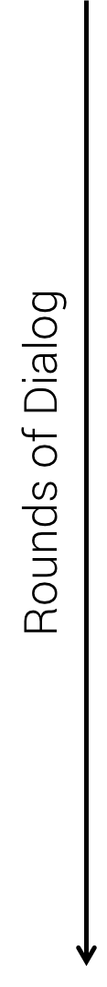
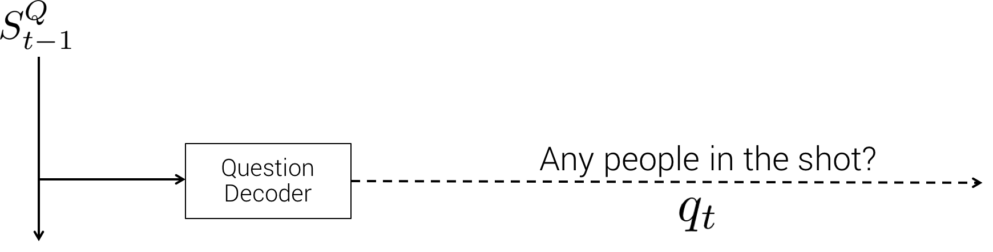
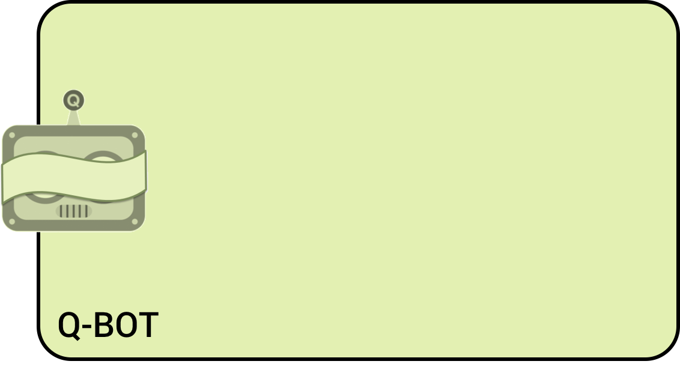
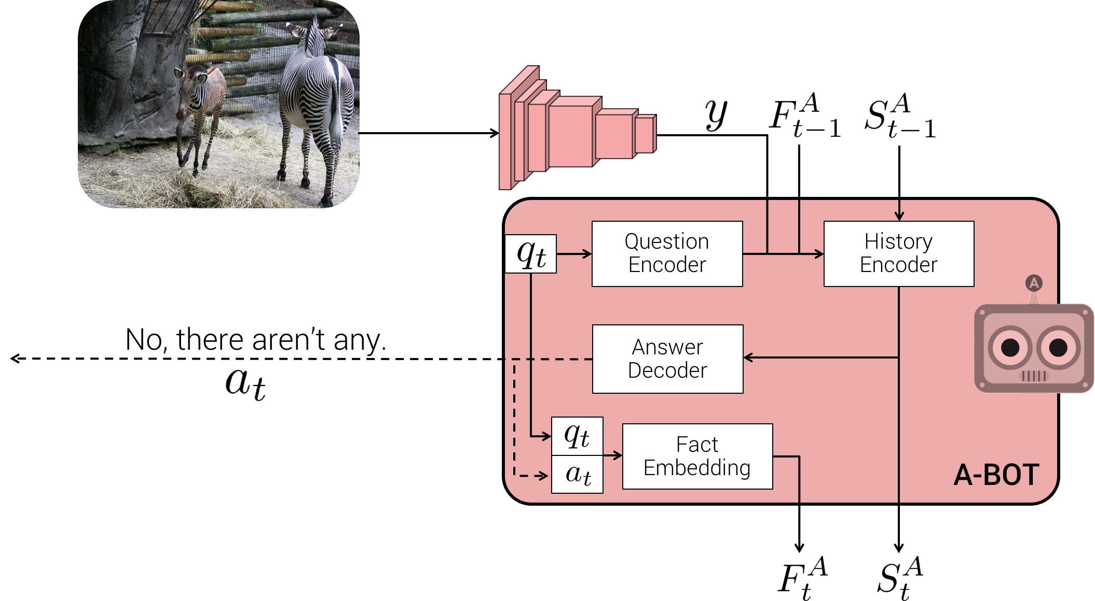
Policy Networks
Q-Bot
A-Bot
A-BOT
Slide Credit: Abhishek Das

Slide 59
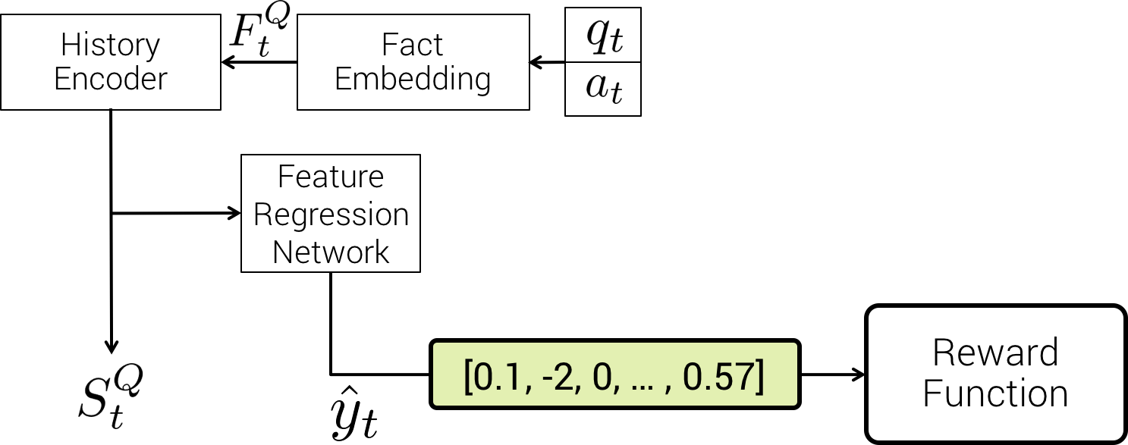
Policy Networks
Q-Bot
A-Bot
Slide Credit: Abhishek Das

Slide 60
Policy Networks
Q-Bot
A-Bot
Slide Credit: Abhishek Das

Slide 61
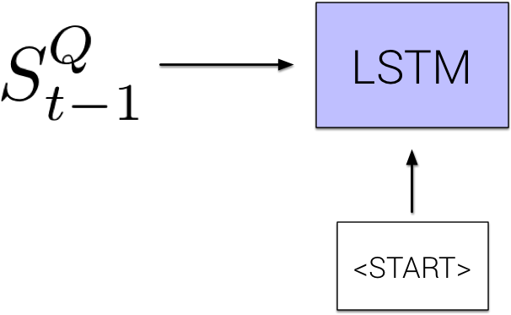
Policy Networks
Q-Bot
A-Bot
Slide Credit: Abhishek Das

Slide 62
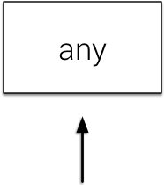
Policy Networks
Q-Bot
A-Bot
Slide Credit: Abhishek Das

Slide 63
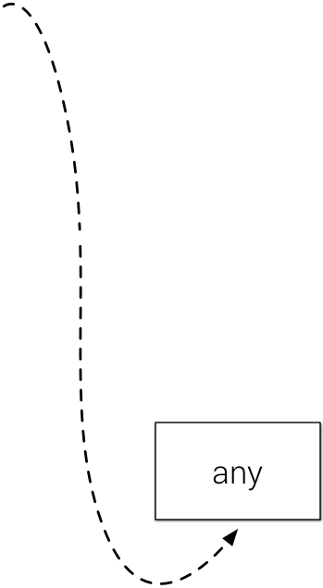
Policy Networks
Q-Bot
A-Bot
Slide Credit: Abhishek Das

Slide 64
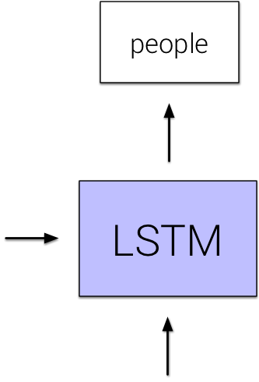
Policy Networks
Q-Bot
A-Bot
Slide Credit: Abhishek Das

Slide 65
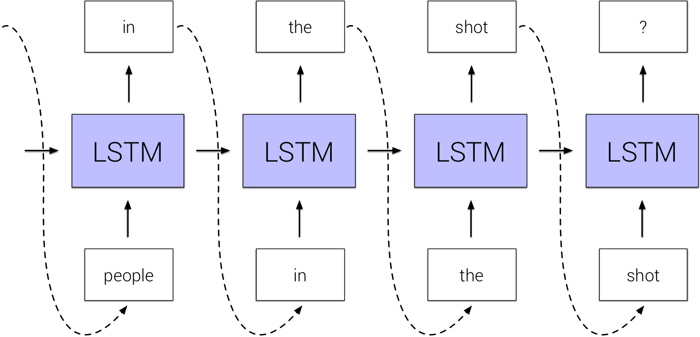
Policy Networks
Q-Bot
A-Bot
Slide Credit: Abhishek Das

Slide 66
Policy Networks
Q-Bot
A-Bot
Slide Credit: Abhishek Das

Slide 67
Policy Networks
Q-Bot
A-Bot
Slide Credit: Abhishek Das

Slide 68
Policy Networks
Q-Bot
A-Bot
VGG-16
Slide Credit: Abhishek Das

Slide 69

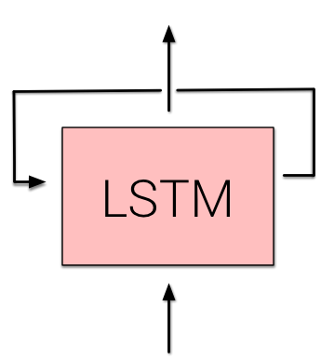

Policy Networks
Q-Bot
A-Bot
Slide Credit: Abhishek Das

Slide 70
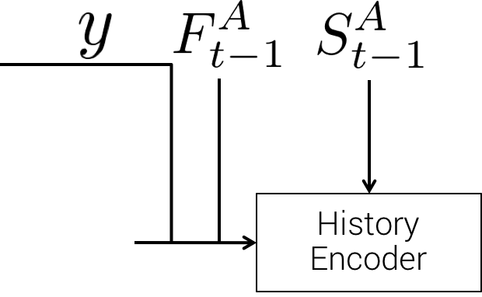
Policy Networks
Q-Bot
A-Bot
Slide Credit: Abhishek Das

Slide 71
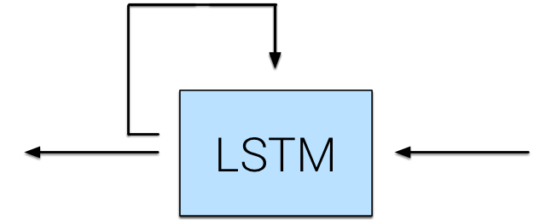

Policy Networks
Q-Bot
Fact
Embedding
A-Bot
Two zebra are walking around their pen at the zoo.
Slide Credit: Abhishek Das

Slide 72

Policy Networks
Q-Bot
Fact
Embedding
A-Bot
Is this zoo?
Yes
Two zebra are walking around their pen at the zoo.
Slide Credit: Abhishek Das

Slide 73

Policy Networks
Q-Bot
Fact
Embedding
A-Bot
How many zebra?
Two
Is this zoo?
Yes
Two zebra are walking around their pen at the zoo.
Slide Credit: Abhishek Das

Slide 74


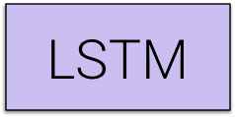


Policy Networks
Q-Bot
History
Encoder
Fact
Embedding
A-Bot
How many zebra?
Two
Is this zoo?
Yes
Two zebra are walking around their pen at the zoo.
Slide Credit: Abhishek Das

Slide 75


Policy Networks
Q-Bot
History
Encoder
Fact
Embedding
A-Bot
How many zebra?
Two
Is this zoo?
Yes
Two zebra are walking around their pen at the zoo.
Slide Credit: Abhishek Das

Slide 76


Policy Networks
Q-Bot
History
Encoder
Fact
Embedding
A-Bot
How many zebra?
Two
Is this zoo?
Yes
Two zebra are walking around their pen at the zoo.
Slide Credit: Abhishek Das

Slide 77
Policy Networks
Q-Bot
A-Bot
Slide Credit: Abhishek Das

Slide 78
Policy Networks
Q-Bot
A-Bot
Slide Credit: Abhishek Das

Slide 79
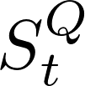
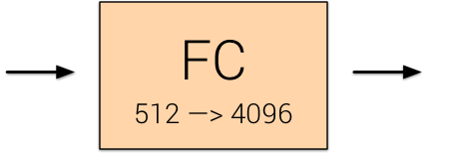

Policy Networks
Q-Bot
A-Bot
Slide Credit: Abhishek Das

Slide 80
Policy Networks
Q-Bot
A-Bot
Slide Credit: Abhishek Das

Slide 81
Policy Gradients
REINFORCE Gradients
Slide Credit: Abhishek Das

Slide 82
Turing Test

Slide 83


SL vs RL
SL Agents
RL Agents

Slide 84
Plan for Today
Generative Adversarial Networks (GANs)
Closing the loop

Slide 85
So what is Deep (Machine) Learning?
A few different ideas:
(Hierarchical) Compositionality
  Cascade of non-linear transformations
  Multiple layers of representations
End-to-End Learning
  Learning (goal-driven) representations
  Learning to feature extraction
Distributed Representations
  No single neuron “encodes” everything
  Groups of neurons work together

Slide 86


Building A Complicated Function
Given a library of simple functions
Idea 2: Compositions
Deep Learning
Grammar models
Scattering transforms…
Compose into a
complicate function
Slide Credit: Marc'Aurelio Ranzato, Yann LeCun

Slide 87
Differentiable Computation Graph
Any DAG of differentialble modules is allowed!
Slide Credit: Marc'Aurelio Ranzato

Slide 88
So what is Deep (Machine) Learning?
A few different ideas:
(Hierarchical) Compositionality
  Cascade of non-linear transformations
  Multiple layers of representations
End-to-End Learning
  Learning (goal-driven) representations
  Learning to feature extraction
Distributed Representations
  No single neuron “encodes” everything
  Groups of neurons work together

Slide 89

“Shallow” vs Deep Learning
“Shallow” models
Deep models
hand-crafted
Feature Extractor
“Simple” Trainable
Classifier
fixed
learned
Trainable
Feature-Transform /
Classifier
Trainable
Feature-Transform /
Classifier
Trainable
Feature-Transform /
Classifier
Learned Internal Representations
Slide Credit: Marc'Aurelio Ranzato, Yann LeCun

Slide 90

Key Computation: Forward-Prop
Slide Credit: Marc'Aurelio Ranzato, Yann LeCun

Slide 91

Key Computation: Back-Prop
Slide Credit: Marc'Aurelio Ranzato, Yann LeCun

Slide 92
So what is Deep (Machine) Learning?
A few different ideas:
(Hierarchical) Compositionality
  Cascade of non-linear transformations
  Multiple layers of representations
End-to-End Learning
  Learning (goal-driven) representations
  Learning to feature extraction
Distributed Representations
  No single neuron “encodes” everything
  Groups of neurons work together

Slide 93

Distributed Representations Toy Example
Can we interpret each dimension?
Slide Credit: Moontae Lee

Slide 94

Power of distributed representations!
Local
Distributed
Slide Credit: Moontae Lee

Slide 95
What is this class about?

Slide 96
What is this class about?
Introduction to Deep Learning
Goal:
  After finishing this class, you should be ready to get started on your first DL research project.
    CNNs
    RNNs
    Deep Reinforcement Learning
    Generative Models (VAEs, GANs)
Target Audience:
  Senior undergrads, MS-ML, and new PhD students

Slide 97
What did we learn?
Background & Basics
    Neural Networks, Backprop, Optimization (SGD)
Module 1: Convolutional Neural Networks (CNNs)
    Architectures, Pre-training, Fine-tuning
    Visualizations, Fooling CNSS, Adversarial examples
    Different tasks: detection CNNs, segmentation CNNs
Module 2: Recurrent Neural Networks (RNNs)
    Difficulty of learning; “Vanilla” RNNs, LSTMs, GRU
    RNNs for Sequence-to-Sequence (machine translation & image captioning, VQA, Visual Dialog)
Module 3: Deep Reinforcement Learning
    Overview, policy gradients
    Optimizing Neural Sequence Models for goal-driven rewards
Module 4: Deep Unsupervised Learning
    Variational Inference
    Variational Auto Encoders (VAEs)
    GANs, Adversarial Learning

Slide 98


Arxiv Fire Hose
PhD Student
Deep Learning papers

Slide 99
Feedback
http://b.gatech.edu/cios

Slide 100
Thanks!
(We hope your future learnings are deep)

