Slide 1
CS 4803 / 7643: Deep Learning
Topics:
  Unsupervised Learning
  Generative Models (PixelRNNs, VAEs)
Dhruv Batra
Georgia Tech

Slide 2
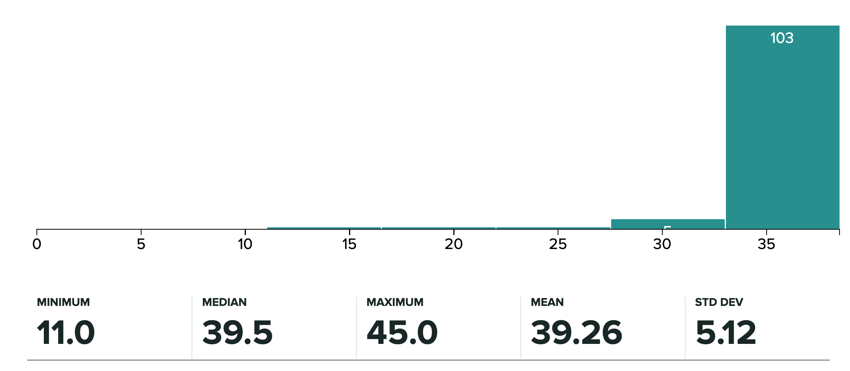
Administrativia
HW4 Grades Released
  Regrade requests close: 11/09, 11:59pm
Grade histogram: 7643
  Max possible: 38.5 (regular credit) + 6.5 (extra credit)

Slide 3
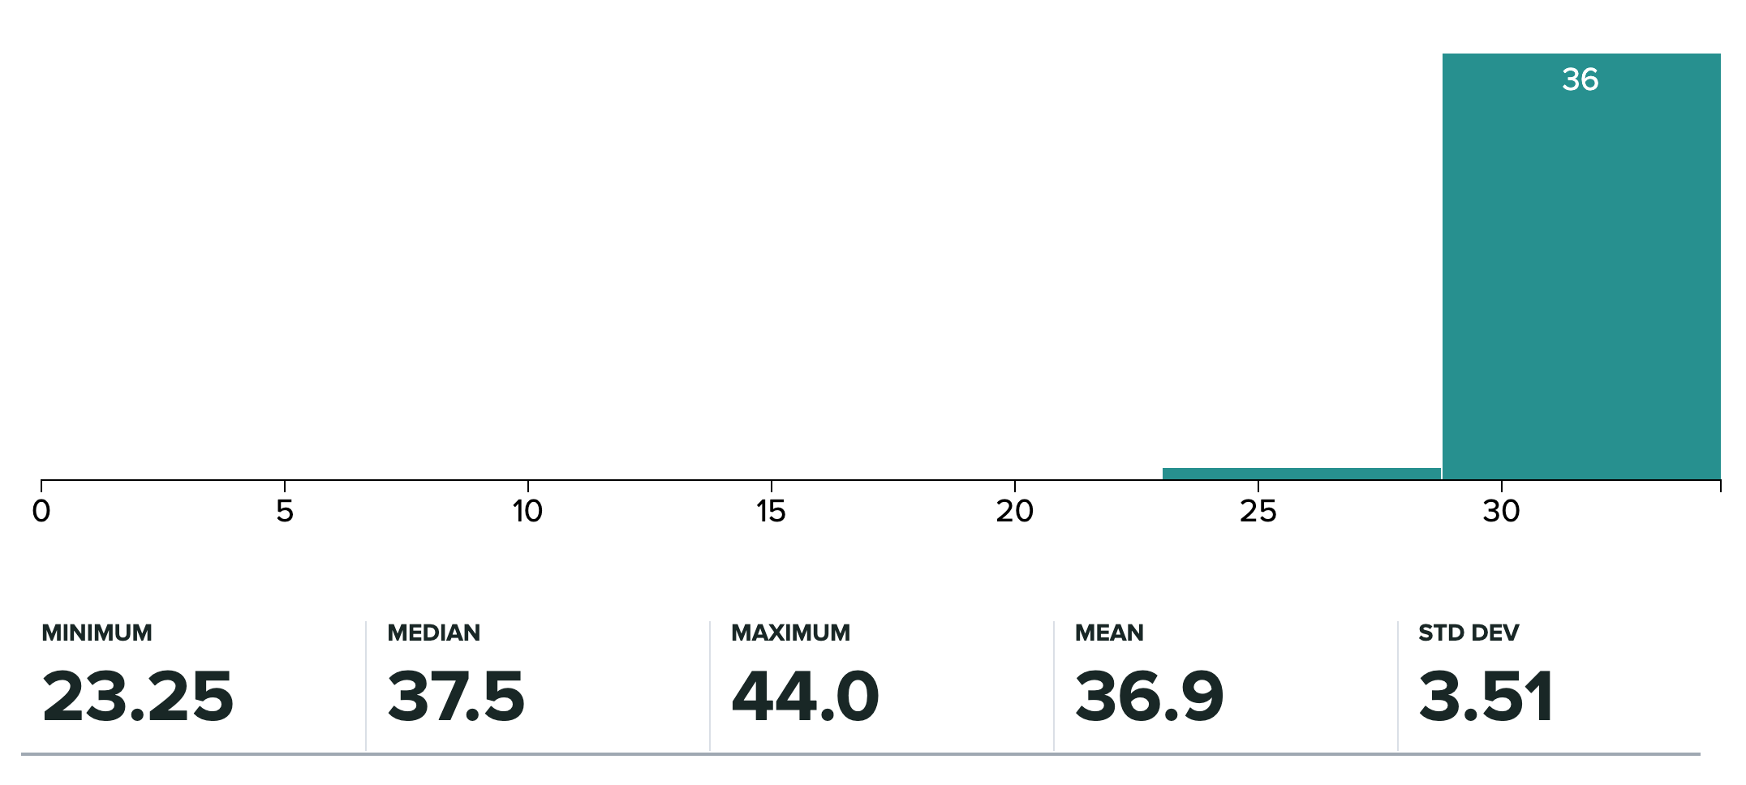
Administrativia
HW3 Grades Released
  Regrade requests close: 11/09, 11:59pm
Grade histogram: 4803
  Max possible: 34.5 (regular) + 10.5 (extra credit)

Slide 4
Administrativia
Project submission instructions
  Due: 11/24, 11:59pm
  Last deliverable in the class
  Can’t use late days
  https://www.cc.gatech.edu/classes/AY2021/cs7643_fall/

Slide 5
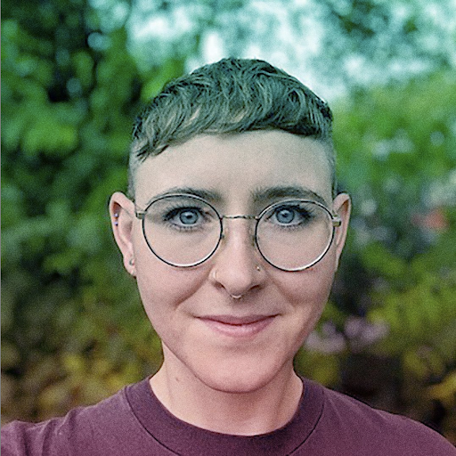
Administrativia
Guest Lecture: Emily Denton (Google AI)
  Next class (11/10)
  Ethics in AI
https://cephaloponderer.com/

Slide 6
Overview
Unsupervised Learning
Generative Models
  PixelRNN and PixelCNN
  Variational Autoencoders (VAE)
  Generative Adversarial Networks (GAN)
Slide Credit: Fei-Fei Li, Justin Johnson, Serena Yeung, CS 231n
Notes:
Unsupervised learning problem
Generative models, type of unsupervised learning
3 types of generative models
PixelRNN and PixelCNN, type of fully visible belief networks

Slide 7
Supervised vs Reinforcement vs Unsupervised Learning
Slide Credit: Fei-Fei Li, Justin Johnson, Serena Yeung, CS 231n
Notes:
In this class so far, have talked about a lot of sup. Learning problems
Data x, y is a label, and label can take many different forms

Slide 8
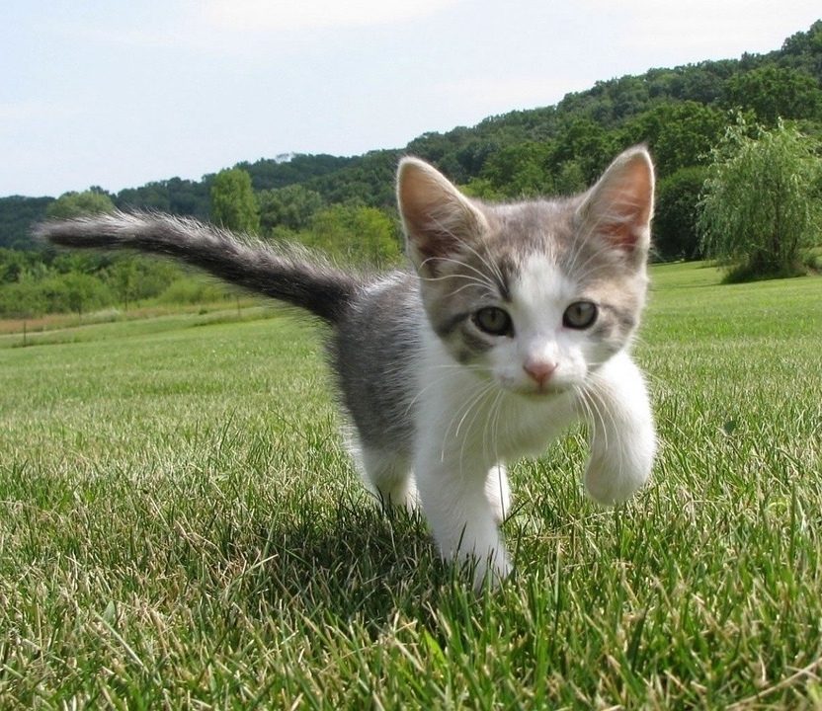
Supervised vs Reinforcement vs Unsupervised Learning
Supervised Learning
Data: (x, y)
x is data, y is label
Goal: Learn a function to map x → y
Examples: Classification, regression, object detection, semantic segmentation, image captioning, etc.
Cat
Classification
This image is CC0 public domain
Slide Credit: Fei-Fei Li, Justin Johnson, Serena Yeung, CS 231n
Notes:
So far talked about SL
Type of problem where have Data X, Labels Y, goals is to learn a function mapping from x to y

Slide 9
Supervised vs Unsupervised Learning
Supervised Learning
Data: (x, y)
x is data, y is label
Goal: Learn a function to map x → y
Examples: Classification, regression, object detection, semantic segmentation, image captioning, etc.
GRASS, CAT, TREE, SKY
Semantic Segmentation
Slide Credit: Fei-Fei Li, Justin Johnson, Serena Yeung, CS 231n

Slide 10

Supervised vs Unsupervised Learning
Supervised Learning
Data: (x, y)
x is data, y is label
Goal: Learn a function to map x → y
Examples: Classification, regression, object detection, semantic segmentation, image captioning, etc.
A cat sitting on a suitcase on the floor
Image captioning
Caption generated using neuraltalk2
Image is CC0 Public domain.
Slide Credit: Fei-Fei Li, Justin Johnson, Serena Yeung, CS 231n

Slide 11
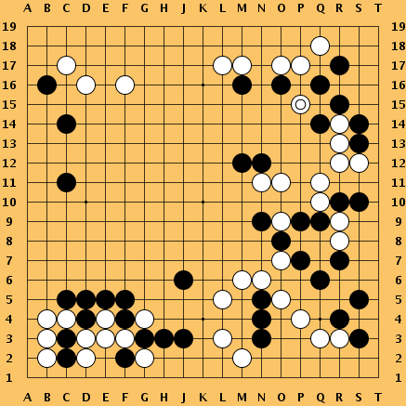
Supervised vs Reinforcement vs Unsupervised Learning
Reinforcement Learning
Given: (e, r)
Environment e, Reward function r (evaluative feedback)
Goal: Maximize expected reward
Examples: Robotic control, video games, board games, etc.
Slide Credit: Fei-Fei Li, Justin Johnson, Serena Yeung, CS 231n
Notes:
So far talked about SL
Type of problem where have Data X, Labels Y, goals is to learn a function mapping from x to y

Slide 12
Supervised vs Reinforcement vs Unsupervised Learning
Unsupervised Learning
Data: x
Just data, no labels!
Goal: Learn some underlying hidden structure of the data
Examples: Clustering, dimensionality reduction, feature learning, density estimation, etc.
Slide Credit: Fei-Fei Li, Justin Johnson, Serena Yeung, CS 231n
Notes:
Unsupervised learning is a type of learning where we have unlabeled training data, and we want to learn some underlying hidden structure of the data

Slide 13
Supervised vs Reinforcement vs Unsupervised Learning
Supervised Learning
Data: (x, y)
x is data, y is label
Goal: Learn a function to map x → y
Examples: Classification, regression, object detection, semantic segmentation, image captioning, etc.
Unsupervised Learning
Data: x
Just data, no labels!
Goal: Learn some underlying hidden structure of the data
Examples: Clustering, dimensionality reduction, feature learning, density estimation, etc.
Slide Credit: Fei-Fei Li, Justin Johnson, Serena Yeung, CS 231n
Notes:
To summarize differences, sup uses labeled data to learn a function mapping from x to y
Unsup uses no labels, tries to learn some underlying hidden structure of the data, whether grouping, axes of variation, underlying density

Slide 14
Supervised vs Reinforcement vs Unsupervised Learning
Supervised Learning
Data: (x, y)
x is data, y is label
Goal: Learn a function to map x → y
Examples: Classification, regression, object detection, semantic segmentation, image captioning, etc.
Unsupervised Learning
Data: x
Just data, no labels!
Goal: Learn some underlying hidden structure of the data
Examples: Clustering, dimensionality reduction, feature learning, density estimation, etc.
Training data is cheap
Holy grail: Solve unsupervised learning
=> understand structure of visual world
Slide Credit: Fei-Fei Li, Justin Johnson, Serena Yeung, CS 231n
Notes:
To summarize differences, sup uses labeled data to learn a function mapping from x to y
Unsup uses no labels, tries to learn some underlying hidden structure of the data, whether grouping, axes of variation, underlying density

Slide 15
Tasks
Supervised Learning
x
Classification
y
Discrete
x
Regression
y
Continuous
Unsupervised Learning
x
Clustering
c
Discrete
x
Dimensionality
Reduction
z
Continuous
x
Density
Estimation
p(x)
On simplex

Slide 16
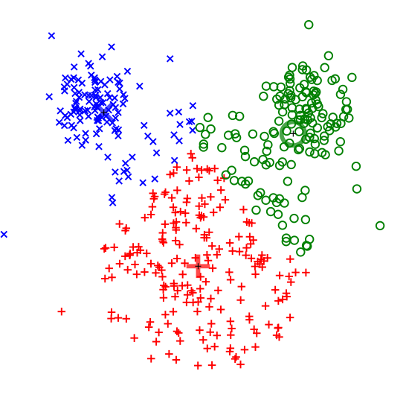
Supervised vs Reinforcement vs Unsupervised Learning
Unsupervised Learning
Data: x
Just data, no labels!
Goal: Learn some underlying hidden structure of the data
Examples: Clustering, dimensionality reduction, feature learning, density estimation, etc.
K-means clustering
This image is CC0 public domain
Slide Credit: Fei-Fei Li, Justin Johnson, Serena Yeung, CS 231n
Notes:
Clustering - find groups within the data that are similar through some metric

Slide 17
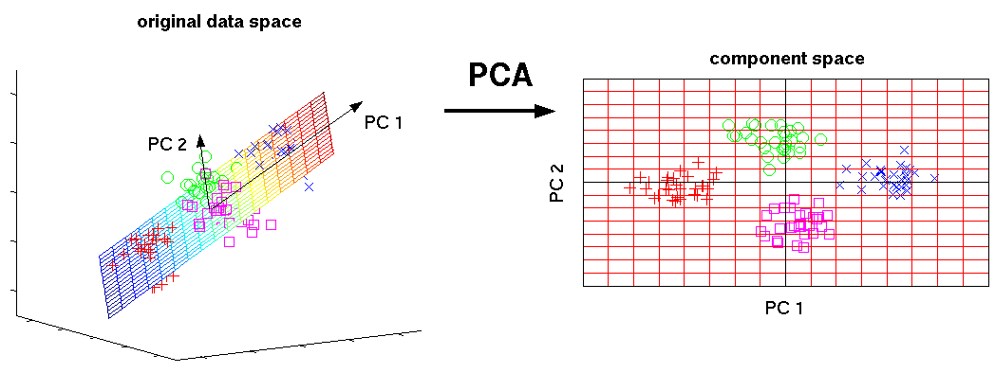
Supervised vs Reinforcement vs Unsupervised Learning
Unsupervised Learning
Data: x
Just data, no labels!
Goal: Learn some underlying hidden structure of the data
Examples: Clustering, dimensionality reduction, feature learning, density estimation, etc.
3-d
2-d
Principal Component Analysis
(Dimensionality reduction)
This image from Matthias Scholz is CC0 public domain
Slide Credit: Fei-Fei Li, Justin Johnson, Serena Yeung, CS 231n
Notes:
Find axes along which the data has most variation, this is part of the underlying structure of the data
Use this to reduce the dimensionality of the data such that the data has significant variation among each remaining dimension
Here is an example, take 3d data, finding 2 axes of variatiation and reducing dimensionality to 2d

Slide 18
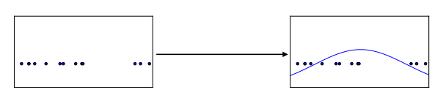
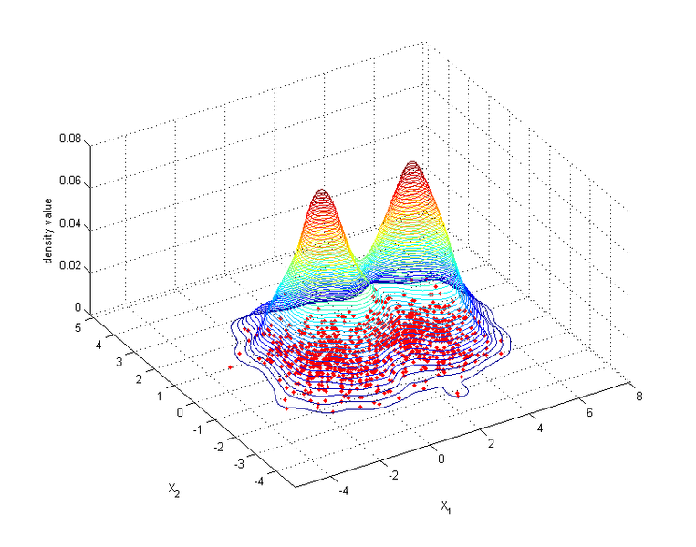
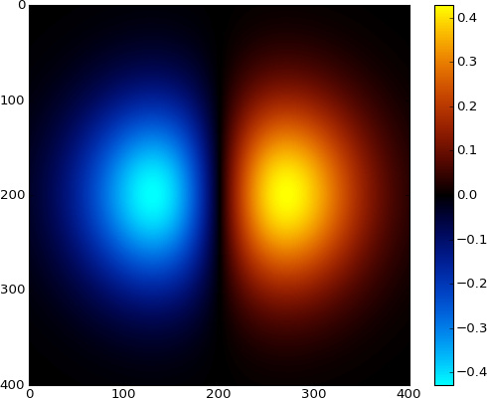
Supervised vs Reinforcement vs Unsupervised Learning
Unsupervised Learning
Data: x
Just data, no labels!
Goal: Learn some underlying hidden structure of the data
Examples: Clustering, dimensionality reduction, feature learning, density estimation, etc.
Figure copyright Ian Goodfellow, 2016. Reproduced with permission.
1-d density estimation
2-d density estimation
2-d density images left and right are CC0 public domain
Slide Credit: Fei-Fei Li, Justin Johnson, Serena Yeung, CS 231n
Notes:
Finally, another example is density estimation, which is estimating the underlying distribution of your data.
For example, in top example, have points in 1-d, and we can try to fit a gaussian to the density
In the bottom example, have 2d data. Again trying to estimate the density, and we model the density to be higher where more points are concentrated

Slide 19
Supervised vs Reinforcement vs Unsupervised Learning
Unsupervised Learning
Data: x
Just data, no labels!
Goal: Learn some underlying hidden structure of the data
Examples: Clustering, dimensionality reduction, feature learning, density estimation, etc.
K-means clustering
This image is CC0 public domain
Slide Credit: Fei-Fei Li, Justin Johnson, Serena Yeung, CS 231n
Notes:
Clustering - find groups within the data that are similar through some metric

Slide 20
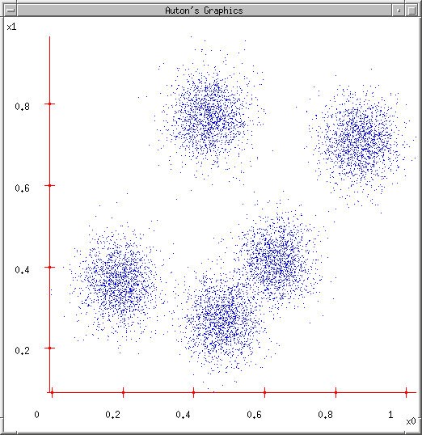
Some Data
Slide Credit: Carlos Guestrin

Slide 21
K-means
Ask user how many clusters they’d like. (e.g. k=5)
Slide Credit: Carlos Guestrin

Slide 22
K-means
Ask user how many clusters they’d like. (e.g. k=5)
Randomly guess k cluster Center locations
Slide Credit: Carlos Guestrin

Slide 23
K-means
Ask user how many clusters they’d like. (e.g. k=5)
Randomly guess k cluster Center locations
Each datapoint finds out which Center it’s closest to. (Thus each Center “owns” a set of datapoints)
Slide Credit: Carlos Guestrin

Slide 24
K-means
Ask user how many clusters they’d like. (e.g. k=5)
Randomly guess k cluster Center locations
Each datapoint finds out which Center it’s closest to.
Each Center finds the centroid of the points it owns
Slide Credit: Carlos Guestrin

Slide 25
K-means
Ask user how many clusters they’d like. (e.g. k=5)
Randomly guess k cluster Center locations
Each datapoint finds out which Center it’s closest to.
Each Center finds the centroid of the points it owns…
…and jumps there
…Repeat until terminated!
Slide Credit: Carlos Guestrin

Slide 26
K-means
Randomly initialize k centers
  μ⁽⁰⁾ = μ₁⁽⁰⁾,…, μ_{k}⁽⁰⁾
Assign:
  Assign each point i∈{1,…n} to nearest center:
Recenter:
  μ_{j} becomes centroid of its points
Slide Credit: Carlos Guestrin

Slide 27
K-means
Demo
  http://stanford.edu/class/ee103/visualizations/kmeans/kmeans.html

Slide 28
What is K-means optimizing?
Objective F(μ,C): function of centers μ and point allocations C:
  1-of-k encoding
Optimal K-means:
  min_{μ}min_{a} F(μ,a)

Slide 29
Coordinate descent algorithms
Want: min_{a} min_{b} F(a,b)
Coordinate descent:
  fix a, minimize b
  fix b, minimize a
  repeat
Converges!!!
  if F is bounded
  to a (often good) local optimum
    as we saw in applet (play with it!)
K-means is a coordinate descent algorithm!
Slide Credit: Carlos Guestrin

Slide 30
K-means as Co-ordinate Descent
Optimize objective function:
Fix μ, optimize a (or C)
Slide Credit: Carlos Guestrin

Slide 31
K-means as Co-ordinate Descent
Optimize objective function:
Fix a (or C), optimize μ
Slide Credit: Carlos Guestrin

Slide 32
Supervised vs Reinforcement vs Unsupervised Learning
Unsupervised Learning
Data: x
Just data, no labels!
Goal: Learn some underlying hidden structure of the data
Examples: Clustering, dimensionality reduction, feature learning, density estimation, etc.
Figure copyright Ian Goodfellow, 2016. Reproduced with permission.
1-d density estimation
2-d density estimation
2-d density images left and right are CC0 public domain
Slide Credit: Fei-Fei Li, Justin Johnson, Serena Yeung, CS 231n
Notes:
Finally, another example is density estimation, which is estimating the underlying distribution of your data.
For example, in top example, have points in 1-d, and we can try to fit a gaussian to the density
In the bottom example, have 2d data. Again trying to estimate the density, and we model the density to be higher where more points are concentrated

Slide 33






Generative Models
Given training data, generate new samples from same distribution
Training data ~ p_{data}(x)
Generated samples ~ p_{model}(x)
Want to learn p_{model}(x) similar to p_{data}(x)
Slide Credit: Fei-Fei Li, Justin Johnson, Serena Yeung, CS 231n
Notes:
Today we’ll focus on generative models, a class of models for unsupervised learning that given training data, tries to generate new samples from the same distribution

Slide 34
Generative Classification vs Discriminative Classification vs
Density Estimation
Generative Classification
  Model p(x, y); estimate p(x|y) and p(y)
  Use Bayes Rule to predict y
  E.g Naïve Bayes
Discriminative Classification
  Estimate p(y|x) directly
  E.g. Logistic Regression
Density Estimation
  Model p(x)
  E.g. VAEs

Slide 35
Generative Models
Given training data, generate new samples from same distribution
Training data ~ p_{data}(x)
Generated samples ~ p_{model}(x)
Want to learn p_{model}(x) similar to p_{data}(x)
Addresses density estimation, a core problem in unsupervised learning
Several flavors:
Explicit density estimation: explicitly define and solve for p_{model}(x)
Implicit density estimation: learn model that can sample from p_{model}(x) w/o explicitly defining it
Slide Credit: Fei-Fei Li, Justin Johnson, Serena Yeung, CS 231n
Notes:
Addresses the problem of density estimation, which is a core problem in unsup learning

Slide 36
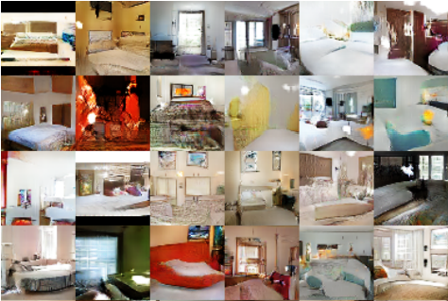
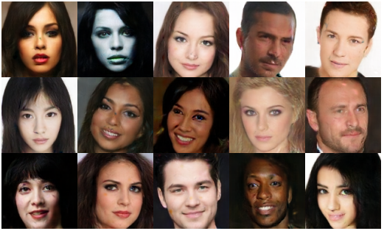
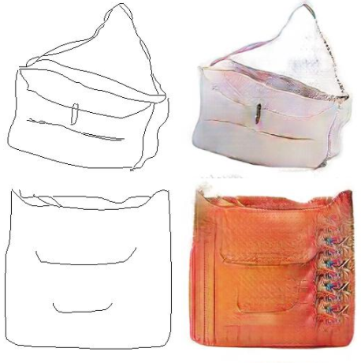
Why Generative Models?
Realistic samples for artwork, super-resolution, colorization, etc.
Generative models of time-series data can be used for simulation and planning (reinforcement learning applications!)
Training generative models can also enable inference of latent representations that can be useful as general features
FIgures from L-R are copyright: (1) Alec Radford et al. 2016; (2) David Berthelot et al. 2017; Phillip Isola et al. 2017. Reproduced with authors permission.
Slide Credit: Fei-Fei Li, Justin Johnson, Serena Yeung, CS 231n

Slide 37
Taxonomy of Generative Models
Direct
GAN
Generative models
Explicit density
Implicit density
Tractable density
Approximate density
Markov Chain
Fully Visible Belief Nets
NADE
MADE
PixelRNN/CNN
Change of variables models (nonlinear ICA)
GSN
Variational
Markov Chain
Variational Autoencoder
Boltzmann Machine
Figure copyright and adapted from Ian Goodfellow, Tutorial on Generative Adversarial Networks, 2017.
Slide Credit: Fei-Fei Li, Justin Johnson, Serena Yeung, CS 231n
Notes:
If we look at types of generative models, can be organized into this taxonomy, where 2 major branches are, as mentioned earlier, explicit density models that explicitly define and solve for the underlying density function, and implicit density models that represent the underlying distribution implicitly through its samples

Slide 38
Taxonomy of Generative Models
Direct
We will discuss 3 most popular types of generative models
GAN
Generative models
Explicit density
Implicit density
Tractable density
Approximate density
Markov Chain
Fully Visible Belief Nets
NADE
MADE
PixelRNN/CNN
Change of variables models (nonlinear ICA)
GSN
Variational
Markov Chain
Variational Autoencoder
Boltzmann Machine
Figure copyright and adapted from Ian Goodfellow, Tutorial on Generative Adversarial Networks, 2017.
Slide Credit: Fei-Fei Li, Justin Johnson, Serena Yeung, CS 231n
Notes:
Refer to goodfellow tutorial which has a good overview of this
Today discuss 3 most popular types of generative models

Slide 39
PixelRNN and PixelCNN

Slide 40

Fully Observable Model
Explicit density model
Use chain rule to decompose likelihood of an image x into product of 1-d distributions:
Likelihood of image x
Probability of i’th pixel value given all previous pixels
Then maximize likelihood of training data
Slide Credit: Fei-Fei Li, Justin Johnson, Serena Yeung, CS 231n
Notes:
Pielrnn and cnn type of fully visible belief network

Slide 41
Fully Observable Model
Explicit density model
Use chain rule to decompose likelihood of an image x into product of 1-d distributions:
Likelihood of image x
Probability of i’th pixel value given all previous pixels
Then maximize likelihood of training data
Complex distribution over pixel values => Express using a neural network!
Slide Credit: Fei-Fei Li, Justin Johnson, Serena Yeung, CS 231n

Slide 42
Fully Observable Model
Explicit density model
Use chain rule to decompose likelihood of an image x into product of 1-d distributions:
Will need to define ordering of “previous pixels”
Likelihood of image x
Probability of i’th pixel value given all previous pixels
Then maximize likelihood of training data
Complex distribution over pixel values => Express using a neural network!
Slide Credit: Fei-Fei Li, Justin Johnson, Serena Yeung, CS 231n

Slide 43
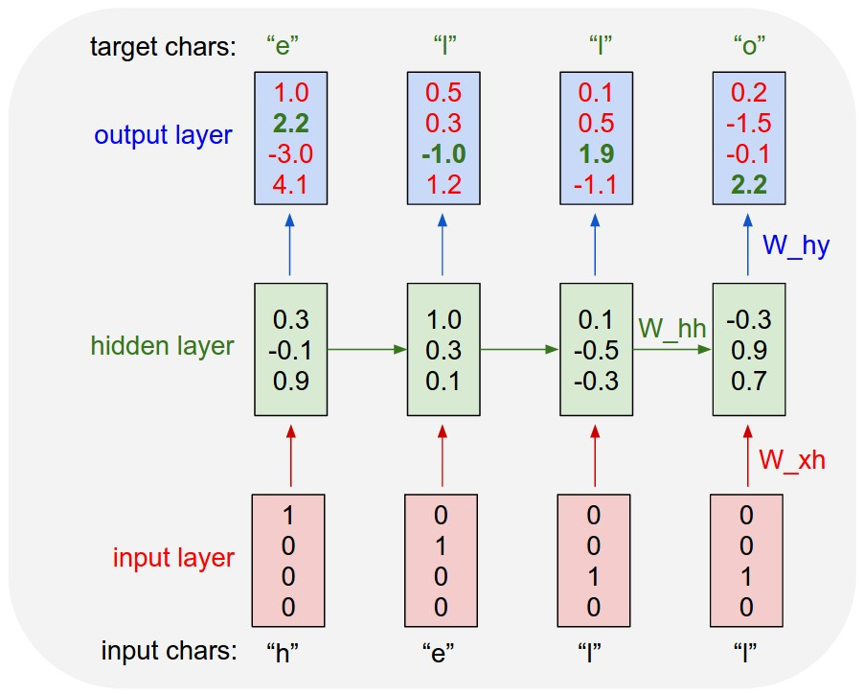
Example: Character-level
Language Model
Vocabulary:
[h,e,l,o]
Example training
sequence:
“hello”
Slide Credit: Fei-Fei Li, Justin Johnson, Serena Yeung, CS 231n

Slide 44
PixelRNN [van der Oord et al. 2016]
Generate image pixels starting from corner
Dependency on previous pixels modeled using an RNN (LSTM)
Slide Credit: Fei-Fei Li, Justin Johnson, Serena Yeung, CS 231n

Slide 45
PixelRNN [van der Oord et al. 2016]
Generate image pixels starting from corner
Dependency on previous pixels modeled using an RNN (LSTM)
Slide Credit: Fei-Fei Li, Justin Johnson, Serena Yeung, CS 231n

Slide 46
PixelRNN [van der Oord et al. 2016]
Generate image pixels starting from corner
Dependency on previous pixels modeled using an RNN (LSTM)
Slide Credit: Fei-Fei Li, Justin Johnson, Serena Yeung, CS 231n

Slide 47
Test Time: Sample / Argmax / Beam Search
Example: Character-level
Language Model
Sampling
Vocabulary:
[h,e,l,o]
At test-time sample characters one at a time, feed back to model
“e”
“l”
“l”
“o”
Sample
.03
.13
.00
.84
.25
.20
.05
.50
.11
.17
.68
.03
.11
.02.08
.79
Softmax
Slide Credit: Fei-Fei Li, Justin Johnson, Serena Yeung, CS 231n

Slide 48
Test Time: Sample / Argmax / Beam Search
Example: Character-level
Language Model
Sampling
Vocabulary:
[h,e,l,o]
At test-time sample characters one at a time, feed back to model
“e”
“l”
“l”
“o”
Sample
.03
.13
.00
.84
.25
.20
.05
.50
.11
.17
.68
.03
.11
.02.08
.79
Softmax
Slide Credit: Fei-Fei Li, Justin Johnson, Serena Yeung, CS 231n

Slide 49
Test Time: Sample / Argmax / Beam Search
Example: Character-level
Language Model
Sampling
Vocabulary:
[h,e,l,o]
At test-time sample characters one at a time, feed back to model
“e”
“l”
“l”
“o”
Sample
.03
.13
.00
.84
.25
.20
.05
.50
.11
.17
.68
.03
.11
.02.08
.79
Softmax
Slide Credit: Fei-Fei Li, Justin Johnson, Serena Yeung, CS 231n

Slide 50
Test Time: Sample / Argmax / Beam Search
Example: Character-level
Language Model
Sampling
Vocabulary:
[h,e,l,o]
At test-time sample characters one at a time, feed back to model
“e”
“l”
“l”
“o”
Sample
.03
.13
.00
.84
.25
.20
.05
.50
.11
.17
.68
.03
.11
.02.08
.79
Softmax
Slide Credit: Fei-Fei Li, Justin Johnson, Serena Yeung, CS 231n

Slide 51
PixelRNN [van der Oord et al. 2016]
Generate image pixels starting from corner
Dependency on previous pixels modeled using an RNN (LSTM)
Drawback: sequential generation is slow!
Slide Credit: Fei-Fei Li, Justin Johnson, Serena Yeung, CS 231n

Slide 52
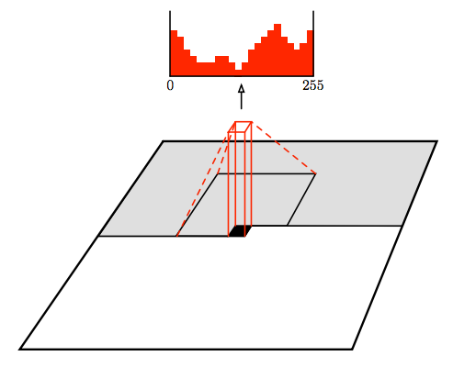
PixelCNN [van der Oord et al. 2016]
Still generate image pixels starting from corner
Dependency on previous pixels now modeled using a CNN over context region
Figure copyright van der Oord et al., 2016. Reproduced with permission.
Slide Credit: Fei-Fei Li, Justin Johnson, Serena Yeung, CS 231n
Notes:
Improves in efficiency over pixelrnn

Slide 54
Masked Convolutions
Apply masks so that a pixel does not see
“future” pixels

Slide 55
PixelCNN [van der Oord et al. 2016]
Softmax loss at each pixel
Still generate image pixels starting from corner
Dependency on previous pixels now modeled using a CNN over context region
Training: maximize likelihood of training images
Figure copyright van der Oord et al., 2016. Reproduced with permission.
Slide Credit: Fei-Fei Li, Justin Johnson, Serena Yeung, CS 231n

Slide 56
PixelCNN [van der Oord et al. 2016]
Still generate image pixels starting from corner
Dependency on previous pixels now modeled using a CNN over context region
Training is faster than PixelRNN
(can parallelize convolutions since context region values known from training images)
Generation must still proceed sequentially
=> still slow
Figure copyright van der Oord et al., 2016. Reproduced with permission.
Slide Credit: Fei-Fei Li, Justin Johnson, Serena Yeung, CS 231n

Slide 57
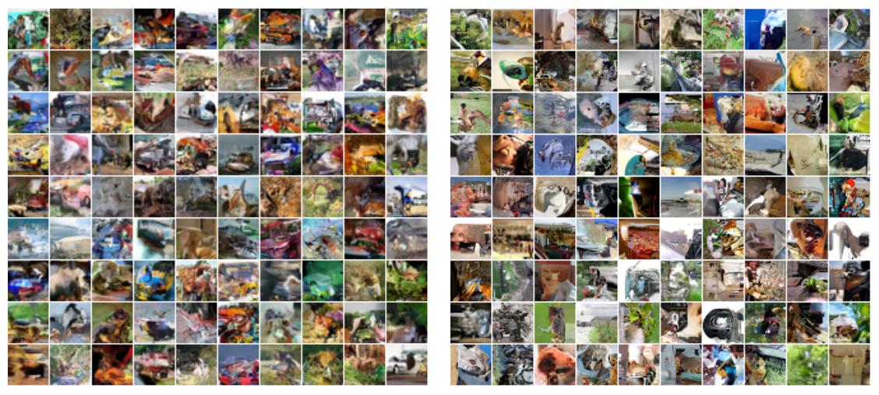
Generation Samples
32x32 CIFAR-10
32x32 ImageNet
Figures copyright Aaron van der Oord et al., 2016. Reproduced with permission.
Slide Credit: Fei-Fei Li, Justin Johnson, Serena Yeung, CS 231n

Slide 58
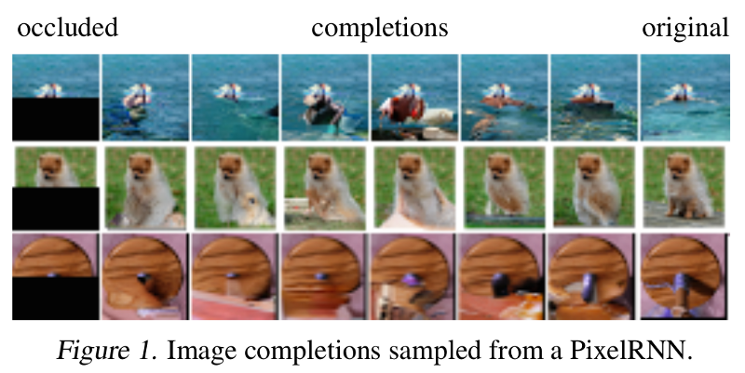
Image Completion

Slide 59
Results from generating sounds
https://deepmind.com/blog/wavenet-generative-model-raw-audio/

Slide 60
PixelRNN and PixelCNN
Pros:
Can explicitly compute likelihood p(x)
Explicit likelihood of training data gives good evaluation metric
Good samples
Con:
Sequential generation => slow
Improving PixelCNN performance
Gated convolutional layers
Short-cut connections
Discretized logistic loss
Multi-scale
Training tricks
Etc…
See
Van der Oord et al. NIPS 2016
Salimans et al. 2017 (PixelCNN++)
Slide Credit: Fei-Fei Li, Justin Johnson, Serena Yeung, CS 231n
Notes:
When is it not computationally tractable?

