Slide 1
A Black-Box Approach for Estimating Utilization of Polled IO Network Functions
Harshit Gupta, Abhigyan Sharma*, Alex Zelezniak*, Minsung Jang*, Umakishore Ramachandran
Georgia Tech, *AT&T Labs Research

Slide 2
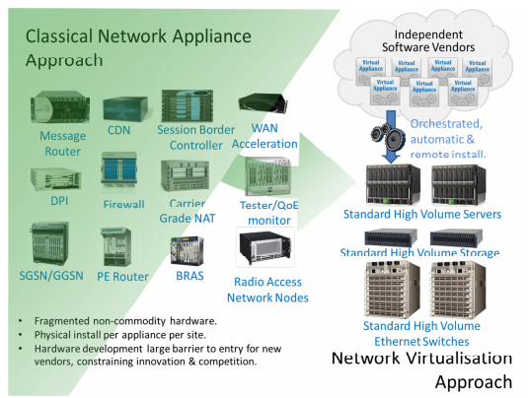
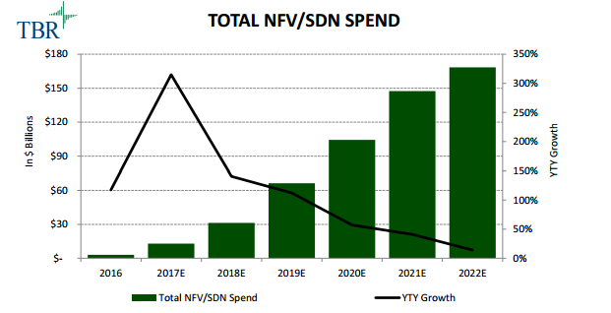
Network Function Virtualization is everywhere !
Enterprises use a plethora of network appliances (middleboxes)
NFV aims to virtualize network processing to run on general-purpose hardware
Source : https://www.telco.com/blog/nfv-and-sdn-market-to-reach-168-billion-by-2022/
Source : https://portal.etsi.org/NFV/NFV_White_Paper.pdf
Notes:
Today’s enterprises employ a plethora of network appliances or middleboxes, like firewalls, deep packet inspection engines, CDNs and many more.
The push towards Network Function Virtualization aims to transform the traditional middleboxes and deploy them as software on general purpose servers, reducing CapEx, OpeEx and easy recovery from failures.
In fact, the spending on NFV and SDN is projected to keep increasing in the future.

Slide 3
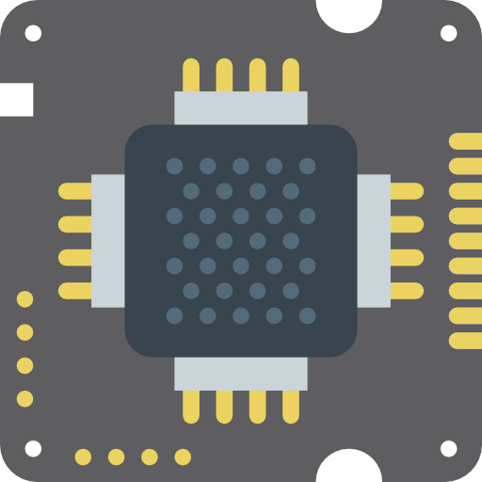
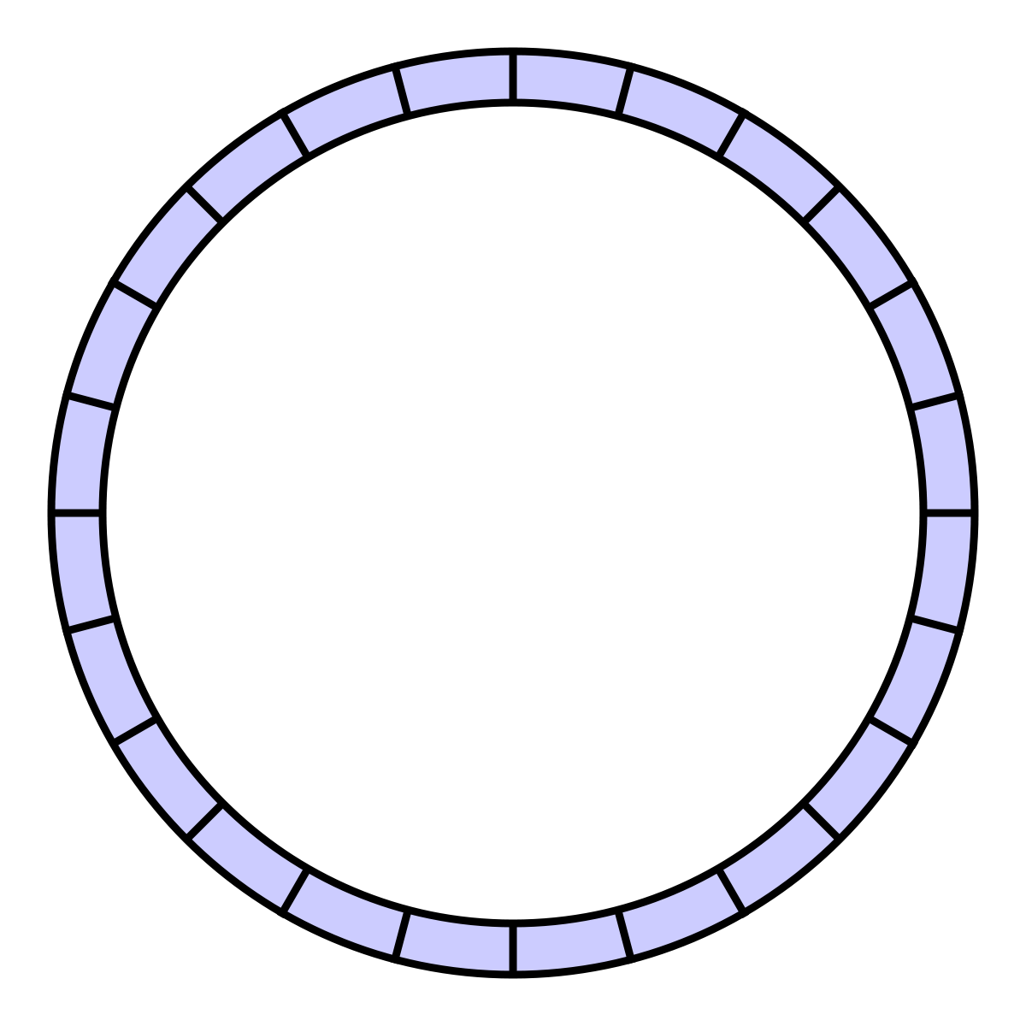
Traditional networking stack is slow !
Interrupt
Kernel Space
User Space
DMA
Application Buffer
Socket recv buffer
Ring buffer
Scheduling Kernel processing via interrupts
Copying packet data
Between ring buffer and TCP socket receive buffer
Between recv buffer and application buffer
Switching between user-mode to kernel-mode
Overheads
Notes:
Traditional network stack of Linux is slow.
When a packet arrives
The NIC DMA controller copies the packet into a ring buffer
An interrupt is sent to the CPU to handle the received packets
The CPU leaves what it is doing and copies the packets from the ring buffer into a socket recv buffer
After TCP/IP processing, the packet payload is copied into the application’s buffer, for the application to use
There are a number of overheads in this process, such as

Slide 4
Poll-mode network IO for fast packet processing
DMA
Poll for packets
Application Processing
Ring buffer
Userspace
Packet DMA from NIC buffer to userspace buffer
Polling for incoming packets (no interrupts)
No kernel processing overheads like context switching, packet copying
Thriving open-source projects (e.g. DPDK, fd.io, Open vSwitch)
Notes:
Poll-mode I/O aims to remove those overheads. The main features are :
DMA’ing packets directly into userspace → thereby avoiding multiple copies
CPU continuously polls the userspace buffer for new packets, instead of waiting for interrupts
Since everything is in userspace, there is no need to switch between kernel and user modes

Slide 5
Poll-mode I/O is everywhere !
Google Maglev
FD.io - The Fast Data Project
Open vSwitch
Contrail vRouter
Notes:
Poll mode IO is used in a large number of projects. Few examples are ….
https://www.linuxjournal.com/content/userspace-networking-dpdk

Slide 6
Util% measurement for NFs essential
For power management
Scaling the CPU frequency to conserve power during low util%
Workload-aware load balancing
Send more flows to light-loaded NF instance
Resource allocation
Add more cores to a heavily loaded NF
Notes:
Utilization refers to the amount of useful work done by an application.
Just like any other application, measuring the utilization of a network function is essential, and can enable a number of use-cases.
The operating frequency of CPU cores running a lightly loaded NF can be reduced to conserve power.
Workload-aware load balancing can be done by sending more flows to an NF instance that is under-utilized.
Likewise, more resources can be dynamically assigned to an NF if its utilization is too high.

Slide 7
Continuous polling makes util% estimation difficult
Tools like top shows cores always at 100% utilization even at zero traffic!
CPU busy time
Pkt process
Empty poll
INSIGHT: Instead of ___________ measure __________________
busy time
total time
pkt process time
total time
Notes:
As discussed before, polled IO NFs continuously poll the ring buffer for incoming packets. Therefore CPU is always at 100% utilization, even when the traffic rate is zero.
Tools like top measure utilization in terms of CPU busy time / total time. Since such NFs are always polling, CPU utilization is always 100%.
We need a metric that reports how much time the NF was busy processing packets, and not including the time that the NF was just polling on an empty ring buffer. This metric would give us the true amount of useful work done by the network function.

Slide 8
Alternatives to CPU% ?
Stats from application
Measures the rate of empty polls
Rate of empty polls high ⇒ fewer packets ⇒ CPU underutilized
Requires instrumenting applications for collecting stats → Difficult for network providers
NIC stats by poll-mode drivers
Few packets in NIC queues ⇒ CPU underutilized
Requires NFs re-compilation with poll-mode driver
Poll-mode drivers vary with NIC speeds, generations & vendors
Need to collect metrics from guest VM → cannot be done externally on the host itself
NO modification to NF VMs
External/host-level monitoring
Notes:
A few alternatives have been proposed in the past to measure utilization for NFs.
We can collect statistics from the application. For example, Trifinov’s adaptive polling mechanism measures the number of times that polling for incoming packets returned zero packets, and uses that information to estimate utilization. However, this approach requires the application to actively supply this information, which would require modification to NF virtual machines. This is not feasible for a network provider like AT&T.
Another approach is to have the NIC driver expose metrics. Niccolini et al modify Click modular router, which is a library for building fast virtualized routers to estimate utilization using NIC queue sizes. This approach requires recompiling the NF application code with the modified driver. The metrics will still need to be collected from the guest VM, hence this approach too requires modification to the NF VM.
Our objective is to come up with an approach that does not require any modification to the NF VMs. All monitoring needs to be done at the host level, without relying on the guest VM that runs the NF application.

Slide 9
Can we learn how the CPU behaves when it is busy processing packets ?
Notes:
We wanted to know whether we can learn how the CPU behaves when it is busy processing packets , versus when it is not ?

Slide 10
Hardware performance counters
Are programmable, per-core CPU registers for counting CPU events
Can count 100s of events, e.g., branch (mis)predictions, cache hit/miss ...
... but only few at a time up to the number of hardware registers
Enable low overhead (tens of cycles) collection of program execution metrics
Are available in any Intel or AMD server CPU
CPU event for branch predictor hits
Number of branch predictor hits
0x005300c4
write
read
0x186 Config register
0xc1 Counter register
Notes:
In order to do so, we explore a feature in recent CPU architectures - Hardware Performance Counters.
These counters are essentially CPU registers that are programmed to count various hardware and software events. Such as branch prediction hits or cache misses.
These counters are available in most Intel and AMD processors
Collection of these metrics incurs very low overhead. It can go as low as few 10s of cycles.
The way this works is that you program a config register to record a certain event, e.g. branch prediction hits and then read the number of that event from the corresponding counter register.

Slide 11
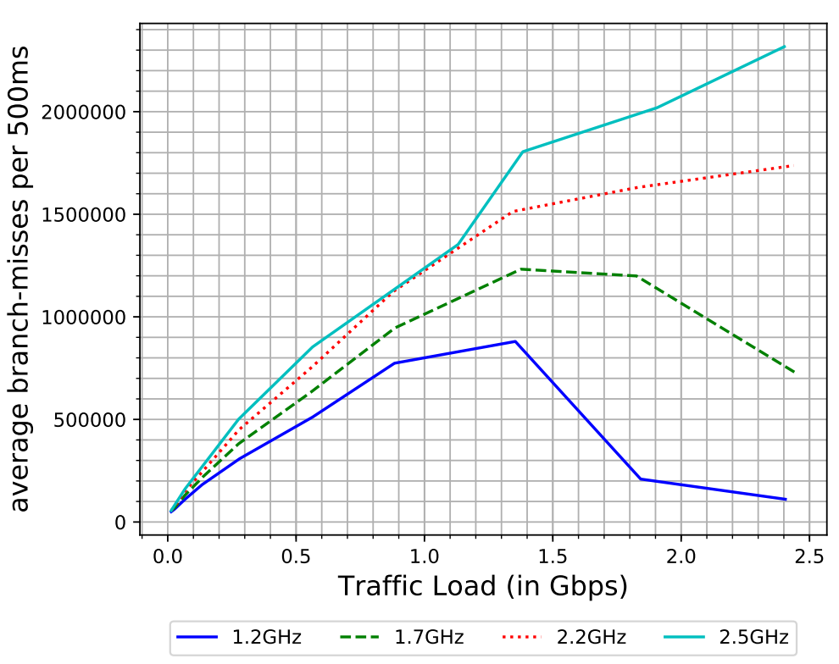
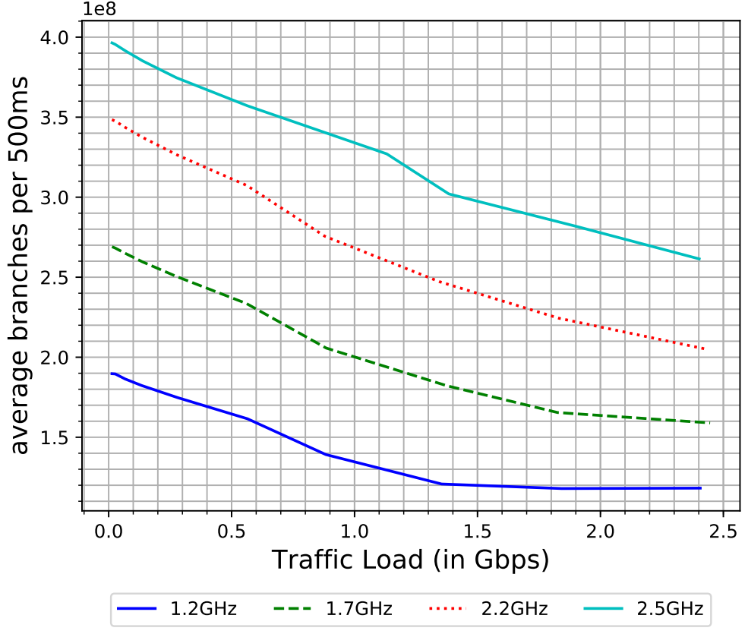
High correlation of counters with load
270 out of 714 CPU events show > 95% correlation with traffic load
Branch prediction misses per 500ms
Branch instructions
Number of events every 500ms Intel Xeon E5. CPU
Notes:
We found good motivation to use counters to count CPU events. Initial experiments showed that the frequency of certain CPU events, like number of branch instructions and branch mispredictions were highly correlated with number of packets processed by the core per second.
In fact, 270 out of 714 events we collected had more than 95% correlation with traffic load. Thus the frequency of these events definitely gives an idea of how busy an NF is in packet processing, unlike opaque metrics like CPU utilization.

Slide 12
Advantages of using CPU events
Require no modification to NF, drivers or cloud infrastructure
Can be sampled with minimal overhead (10s of cycles)
Supported by modern processors

Slide 13
We try to prove that CPU events are good estimators of util%

Slide 14
Challenges of using CPU events for util% estimation
Cannot count arbitrarily large number of CPU events
Performance monitoring counter registers are limited
Which CPU events to monitor ?
There are 700+ CPU events on modern CPUs
How to select the best events ?
Need a robust model for mapping events’ frequency to util%

Slide 15
Main questions explored in this study
Can we select a small number of CPU events whose values can be accurately mapped to an NF’s utilization level?
Is the mapping function robust across variations in workload for the NF?
Can we build a universal mapping function that works across NFs ? Or NF-specific mapping is the best we can do ?
What is the latency of estimating an NF’s utilization using this approach?

Slide 16
Assumptions about the system environment
CPU microarchitecture of servers remains uniform
Same set of CPU events are available
For a multi-core Network Function, all cores perform identical packet processing
Receive Side Scaling is used to split traffic between the multiple cores evenly
Henceforth we focus on single-core NFs
CPU is the bottleneck resource
Not memory or network card

Slide 17
Hardware counter based estimator functions
…
Problem 1 : Choosing right set of events
e₁
e₂
e_{n}
CPU core
u = f_{E} (c1, c2, ...., cn)
Problem 2 : Building accurate and robust mapping function
Let E_ALL be the set of CPU events of whom E = {e1, e2, …, en } is a subset.
Let c1, c2, ... be the counter values collected for events e1, e2, ... at a core.
Let f_{E} be an estimator function that maps counter values to a utilization value u.
Notes:
The estimation of NF utilization is done using an estimator function. An estimation function is defined for a set of CPU events C.
It takes the frequency of the C CPU events on a given core as input and returns the utilization of the NF on that core.
The problem to solve is the selection of the right set of CPU events to use as input (C) and the mapping function, which is essentially a regression analysis problem.

Slide 18
Data-driven estimator selection
Build 3 families of estimator functions f_{E} with|E| = 1, 2, 3 (E ⊆ E_ALL)
Each f_{E} is implemented as a Linear Regression model
Gather counter values for all CPU events in all representative scenarios
Network functions (NFs): Layer-3/Layer-4/Layer-7 functions
Traffic profiles: packet size, packets per flow, bytes per flow
Load: 0%, 10%, …, 100%
Assuming …
Fixed hardware (CPU mode, BIOS settings)
Run-to-completion packet processing
CPU as the bottleneck
Select f_{E} that minimizes average estimation errors |f_{E}(.) - u| on test data

Slide 19
Two kinds of estimator functions
Network Function specific
Local Estimator L_{nC}
Outputs the utilization for a specific network function n
Takes frequency of C CPU events as input
One estimator for all Network Functions
Universal Estimator U_{C}
Outputs the utilization for any network function
Takes frequency of C CPU events as input
Notes:
We start with the notion of Local Estimators that are able to estimate the utilization of a specific network function alone. However, since network functions typically use the same underlying library (DPDK), we also try to explore universal utilization estimators - that are able to estimate the utilization for all network functions.
Both universal and local estimators are based on a set of CPU events. They take the frequency of those CPU events as input and output utilization estimate.

Slide 20
Network functions evaluated
Stateless NF - L3FWD (Layer 3 forwarder)
Matches IP destination to set of entries and forwards packet to the right next-hop IP
Does not maintain per-flow state
We use L3FWD application in DPDK 18.02 release
Stateful NF - L4LB (Layer 4 load balancer)
Multiplexes connections to a backed pool of servers
Creates an entry for each flow - stores the backend server chosen for that flow
We evaluate homegrown load balancer in less that 3K lines-of-code using DPDK library
Compute-intensive NF - DPI (Deep Packet Inspection)
Identifies traffic based on set of rules (layer-3 or layer 4 headers or application layer info)
Maintains per-flow state and performs non-trivial computation on each flow
We use opensource DPI library nDPI and integrate it with a DPDK forwarding application`
Notes:
In order to test whether such estimator functions are feasible and effective, we study 3 classes of network functions. We evaluate a stateless NF, a stateful NFs and a compute intensive NF.

Slide 21
Network functions evaluated
Stateless NF L3FWD (Layer 3 forwarder) Lookup routing table for every packet
Stateful NF L4LB (Layer 4 load balancer) Per-flow state storing backend server
Compute-intensive NF DPI (Deep Packet Inspection) Expensive pattern matching for each flow
Ethernet Header
IP Header
TCP Header
Application Data
Ethernet Trailer
Ethernet Header
IP Header
TCP Header
Application Data
Ethernet Trailer
Ethernet Header
IP Header
TCP Header
Application Data
Ethernet Trailer

Slide 22
Training the estimator functions
Build a set of test profiles T_{n} for each NF n
Each test profile represents a configuration in which NF n will be deployed
Traffic characteristics (e.g. packet sizes, flow lengths)
NF parameters (e.g. routing table size)
For each traffic profile, NF is subjected to a set of loads L ∈[0, 100]
L = 0 ⇒ No traffic
L = 100 ⇒ Traffic volume equal to max throughput of NF n for that traffic profile
L represents the true utilization → percentage of peak load served by NF
Network providers like AT&T know representative test profiles for NFs
Notes:
We model the estimation problem as a regression analysis problem. Building the estimator function requires training the linear regression model.
We generate training data using a set of test profiles for each network function.
Each test profile is a combination of traffic characteristics like packet and flow sizes and NF parameters like routing table size. Each test profile represents a scenario in which the NF will be running.
For each traffic profile, we subject the NF to varying traffic loads, ranging from 0 (meaning no traffic) to 100 (meaning the max throughput the NF can sustain for that traffic profile). While doing so we collect frequencies of all CPU events - thus giving us the training inputs to the estimator functions. The load value (0-100) is the true utilization of the NF and thereby gives the training target.

Slide 23
Util% estimation error of estimators
Build estimators that take C events as input, where C equals
1 CPU event
2 CPU events
3 CPU events
Test estimation error using 3-fold cross validation
Use average Root Mean Squared Error (RMSE) as error metric
Estimators of increasing complexity
Notes:
Now we try to find out the utilization estimation accuracy that we can achieve with CPU events.
We build estimator functions of varying levels of complexity, starting from estimators that take a single event as input, going upto 3 events as input.
We determine estimation error using 3-fold cross validation.
The error metric used is Root Mean Squared Error.

Slide 24
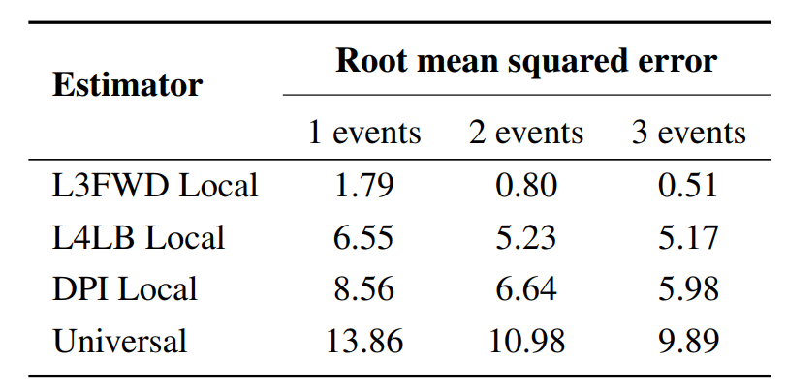
Best estimators (local and universal)
Local estimators have lower error than universal estimators.
It is possible to construct local estimators with modest error.
Notes:
This table shows the error in utilization estimation by the best models of each type for each NF. The errors of universal estimators are also shown.
As we were expecting, the error of universal estimators is higher than local estimators.
We can conclude that it is possible to construct local estimators with modest error.

Slide 25
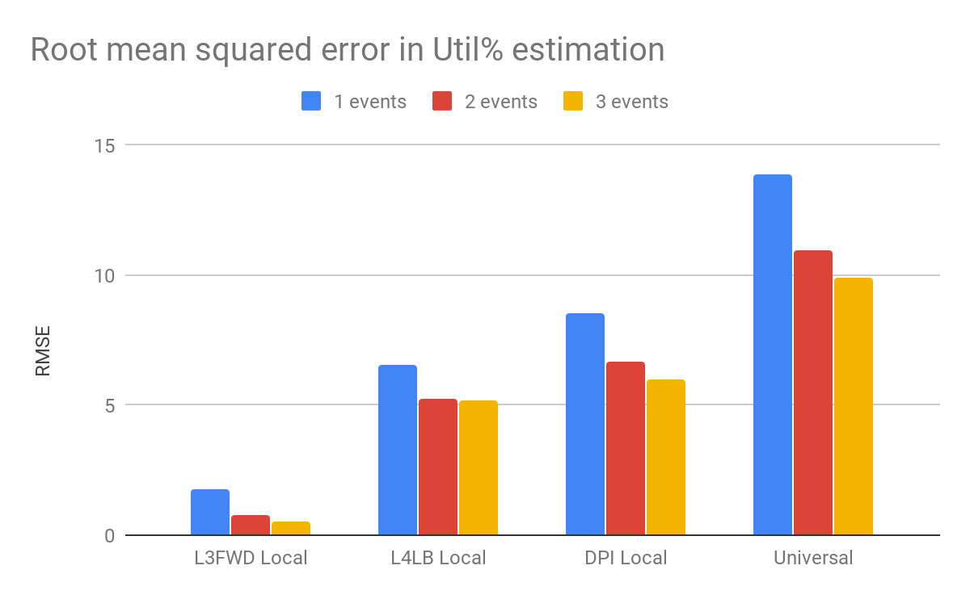
Util% estimation error of estimators
We test both NF-specific estimation and universal estimator functions
Calculate estimation error using 3-fold cross validation
|E|
Local estimators have lower error than universal estimators.
It is possible to construct local estimators with modest error.

Slide 26
Distribution of error with local estimators
Marginal decrease in error when going to 3 events from 2 events is not significant ⇒ adding more events to estimator would not benefit much
Notes:
In fact, there are quite a few estimator functions that are possible with pretty low error. We show a distribution of RMSE of all possible estimator functions.
We can see that using 3 events for util% estimation does not give significant improvement over using 2 events. Hence, for this study we stick with using 2 events for building estimator functions.

Slide 27
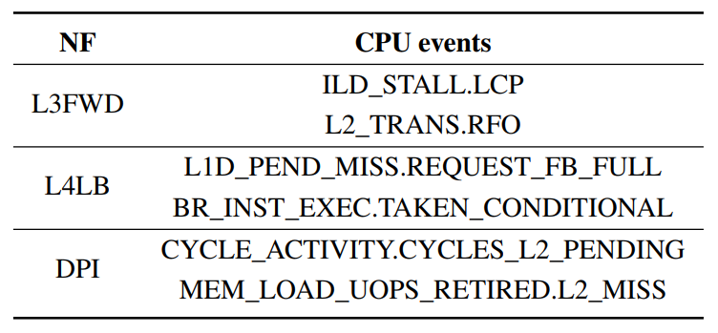
Testing on unseen network traffic profiles
We use the mentioned events to build the local estimator each NF
Util% estimation needs to be fast
How long should we count the events ?
Intuitively the longer we count, the more stable the signal
Counting events for too long hurts responsiveness
Notes:
Now we evaluate how well the best estimators perform on unseen traffic profiles. The events that build the best local estimator for each NF are shown on the right.
One important question we need to answer here, is how long to count the CPU events for before feeding them as input to the estimator function ?
Counting for a longer period will help filter out noise in counting, however counting for too long might hurt responsiveness of the monitoring tool.

Slide 28
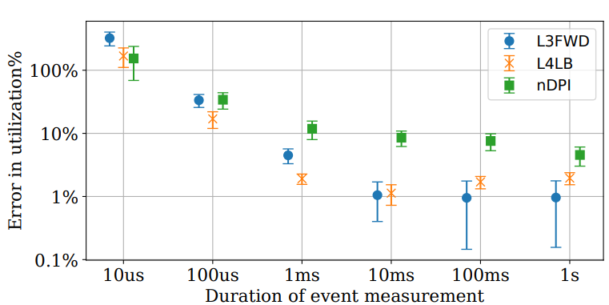
Util% estimation on unseen traffic profiles
Ideal measurement period depends on use-case
Workload placement operate on the order of mins/hrs ⇒ can work with 1s interval
CPU power management needs real-time information ⇒ need ~ 1 ms interval
Notes:
As expected, the error goes down significantly as we increase the period for which events are counted before using the counts to estimate utilization. Counting events for 10 milliseconds provides ample accuracy.
The ideal measurement period depends on the use-case. For example, workload placement use-cases that operator on the order of minutes or hours can work with 1 second of event counting. However, CPU power management by frequency scaling needs to have real-time information. Hence it might prefer counting events for 1 millisecond at the expense of slightly higher error which would need to be handled by designing conservative policies.

Slide 29
Testing on unseen network traffic profiles
We evaluate the best estimators against previously unseen test profiles
We study the variation of error with event counting duration
Util% estimation error decreases with higher event counting duration
Counting for 10 ms provides the best tradeoff between latency and accuracy

Slide 30
Next steps
Build a toolkit for NF util% estimation
Similar to top and htop
Better universal estimators
Using even more CPU events
Non-linear estimation models (e.g. random forest, neural networks)
Test approach on virtualized NFs
Use-cases for a util% estimation tool
Power management of polled NFs Luca Niccolini et al. Building a Power-proportional Software Router. In USENIX ATC, 2012.
Resource allocation, workload placement, load balancing

Slide 31
Points for discussion
Is it worthwhile to develop per-NF or universal util% estimators ?
NF vendors can implement and maintain a common API for reporting util%
Some initial work in DPDK community (https://software.intel.com/en-us/vtune-amplifier-cookbook-core-utilization-in-dpdk-apps)
Accuracy of util% estimators can’t be increased arbitrarily with complex ML
Complex models would increase end-to-end latency
Make util% estimation infeasible for latency-sensitive use-cases (e.g. power management)
Behaviour of estimators dependent on training set
We assume that network provider like AT&T has representative traffic profiles for an NF

Slide 32
Conclusion
Utilization estimation for NFs is difficult with traditional methods
H/w Performance Monitoring Counters provide low-error util% estimation
No modification to NF Virtual Machines required Monitoring done at host level
Approach works for 3 complexity classes of NFs Stateless, Stateful and Compute-intensive

Slide 33
Vision
$ nf-top --core=6 --events=0x005300c4,0x005300c5
--mapping-function=./firewall.map
Network Function utilization
0 %
100 %
70 %
Notes:
Based on the mentioned assumptions, our vision is to build a top-like utility for measuring NF utilization.

Slide 34
Summary
Proposed polled IO utilization estimation based on hardware counters
Works purely at host level for black box NFs
Shows low errors (< 10%) on stateless, stateful and compute-intensive NFs
Future work
Universal estimators (more events, neural network-based estimators)
Additional NFs (virtualized NFs, cross-core packet processing NFs)
Use cases (power management, load balancing, workload placement)

Slide 35
Backup slides

Slide 36
Why not use all CPU events available ?
> 700 CPU events available
A lot of them are not correlated with input traffic ⇒ no useful data
There are limited number of performance monitoring registers on CPUs
Can only count so many events at once
To count 8 events for 2 sec each on 4 registers , we need (8/4)*2secs

