Slide 1


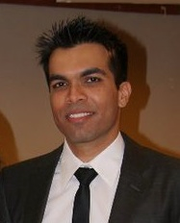


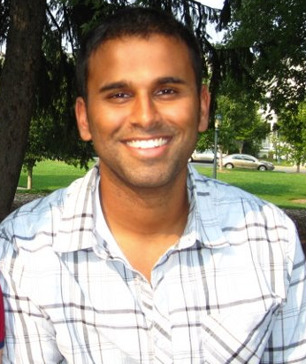
Beyond MAP:
Making Multiple Predictions: Diversity, DPPs and more.
Dhruv Batra
Virginia Tech
Alex Kulesza
Univ. of Michigan
Dennis Park
UC Irvine
Deva Ramanan
UC Irvine

Slide 2
Schedule
Time | Topic | Presenter
9:00 – 9:30 | Opening Remarks + Need for Multiple Diverse Solutions | Dhruv
9:30 – 10:15 | Multiple Solutions via M-Best MAP | Dennis
10:15 – 10:45 | Coffee Break
10:45 – 11:30 | Multiple Solutions via Diverse M-Best | Dhruv
12:00 – 1:30 | Lunch

Slide 3
Schedule
Time | Topic | Presenter
9:00 – 9:30 | Opening Remarks + Need for Multiple Diverse Solutions | Dhruv
9:30 – 10:15 | Multiple Solutions via M-Best MAP | Dennis
10:15 – 10:45 | Coffee Break
10:45 – 11:30 | Multiple Solutions via Diverse M-Best | Dhruv
12:00 – 1:30 | Lunch
1:30 – 2:00 | Multiple Solutions via Sampling | Deva
2:00 – 3:15 | Multiple Solutions via DPPs | Alex
3:15 – 3:45 | Coffee Break
3:45 – 4:30 | DPPs (Continued) | Alex
4:30 – 5:00 | Closing Remarks + What can we do with diverse solutions? | Dhruv
1. Please interrupt & ask questions!
2. All slides available online.

Slide 4


Local Ambiguity
slide credit: Fei-Fei Li, Rob Fergus & Antonio Torralba

Slide 5
Graphical Models to the Rescue!
y₁
y₂
MAP
Inference
…
Person
x_{n}
Table
Plate
Most Likely Assignment
Notes:
The visual perception problem have a lot of local ambiguity. If I ask you to recognize this patch, you probably won’t be able to.
Graphical models are useful tools that allow us to model all variables of interest, write down local beliefs in terms of node & edge energies, and then use these to make a global prediction by jointly minimizing this energy function, also called MAP inference.

Slide 6

Vision in 2000s

Slide 7
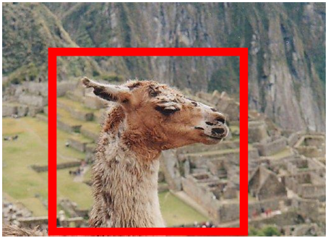

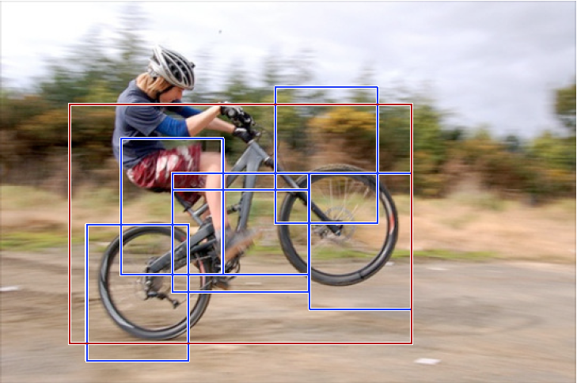
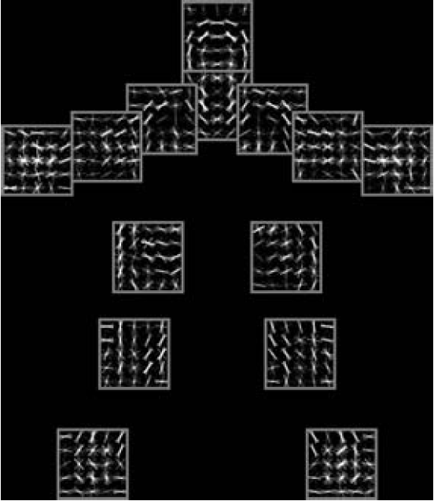
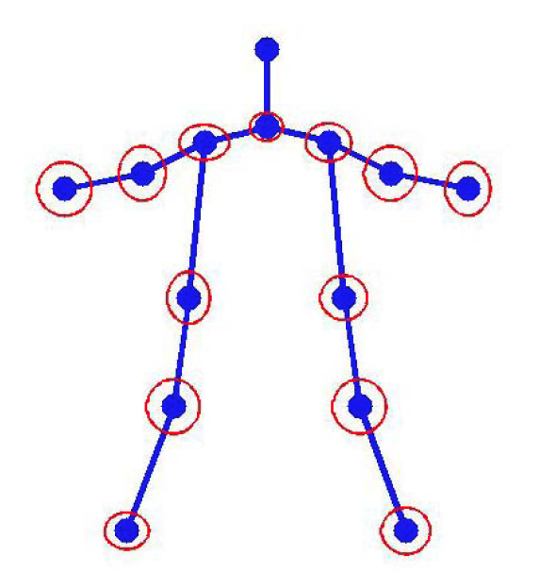
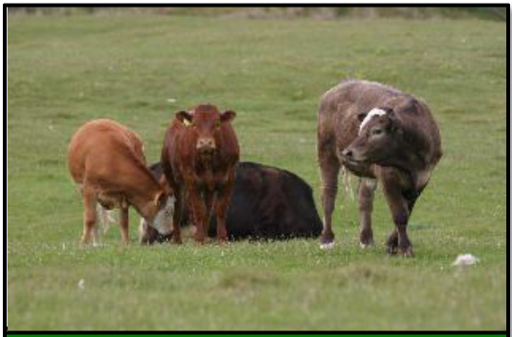
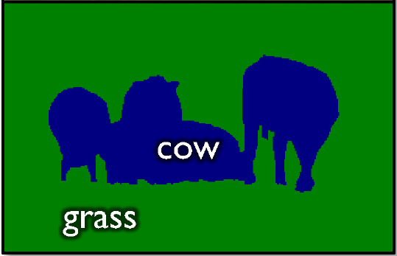
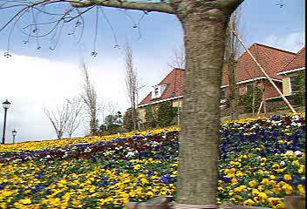
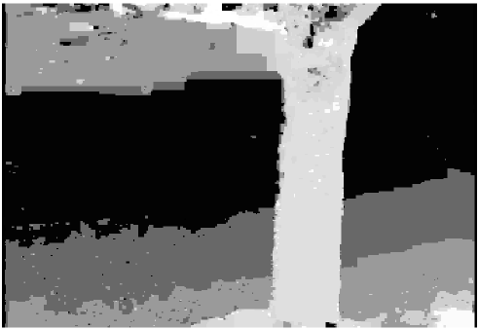
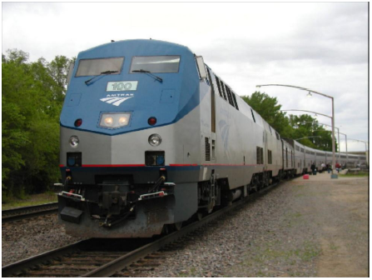
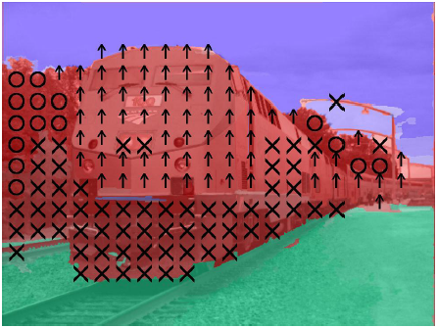
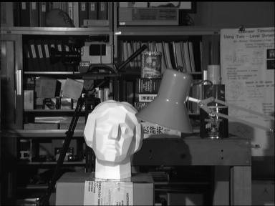
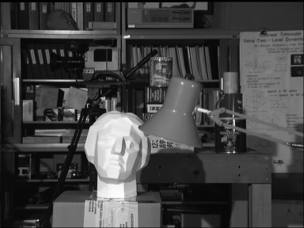



Graphical Models in Vision
Segmentation
Object Recognition / Pose Estimation
Motion Flow
Geometric Labelling
Stereo
Denoising
Left image
Right image
Disparity map

Slide 8
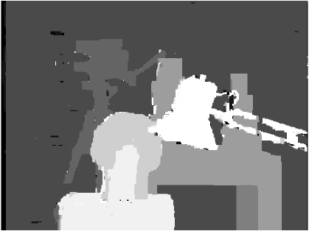

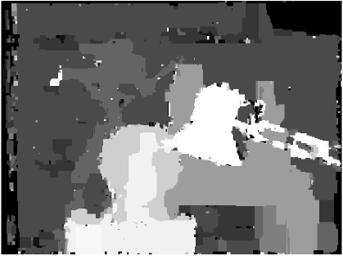
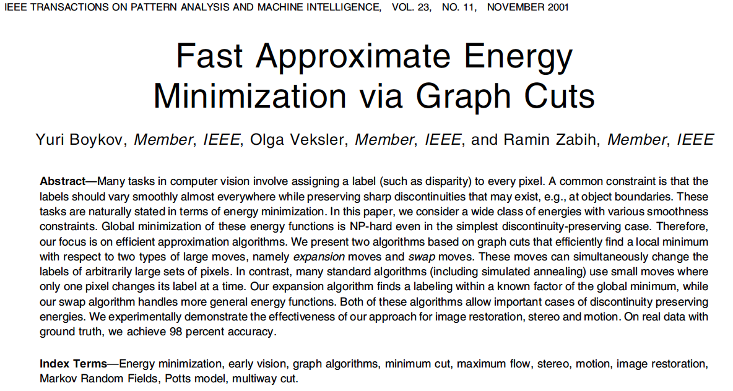
Alpha-Expansion
Simulated Annealing

Slide 9
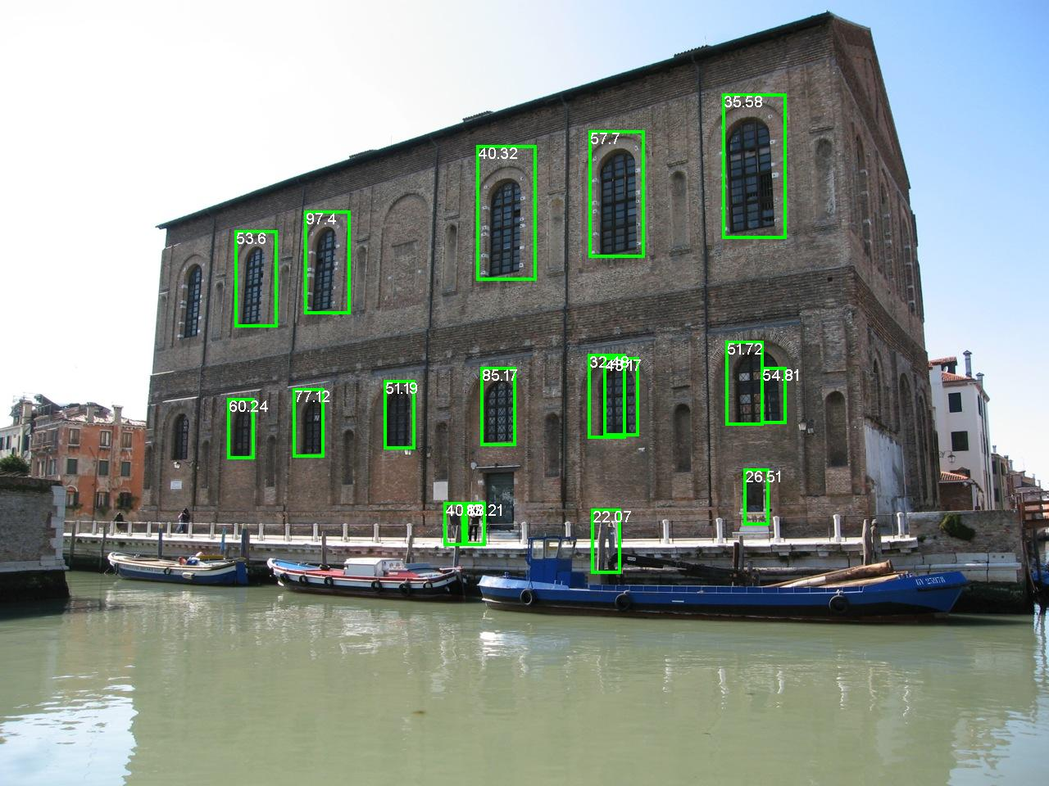
Dollar et al., BMVC 2009

Slide 10


Slide 11

Problems
Model-Class is Wrong!
-- Approximation Error
  Human Body ≠ Tree
Figure Courtesy: [Yang & Ramanan ICCV ‘11]
Notes:
Unfortunately, we often run into a number of problems with MAP.
Most often, our model is simply wrong. So even if we predict the most probable state from our model, it could be very far from ground-truth.
For example, a tree model assumes that we walk around like this, with our limbs always un-occluded.

Slide 12
Problems
Model-Class is Wrong!
Not Enough Training Data!
-- Approximation Error
-- Estimation Error
Notes:
Even if your model is rich enough, you may not have enough training data to learn the correct parameters.

Slide 13



Problems
Model-Class is Wrong!
Not Enough Training Data!
MAP is NP-Hard
-- Approximation Error
-- Estimation Error
-- Optimization Error
Notes:
Even if you have enough training data, actually computing MAP may be NP-hard.

Slide 14


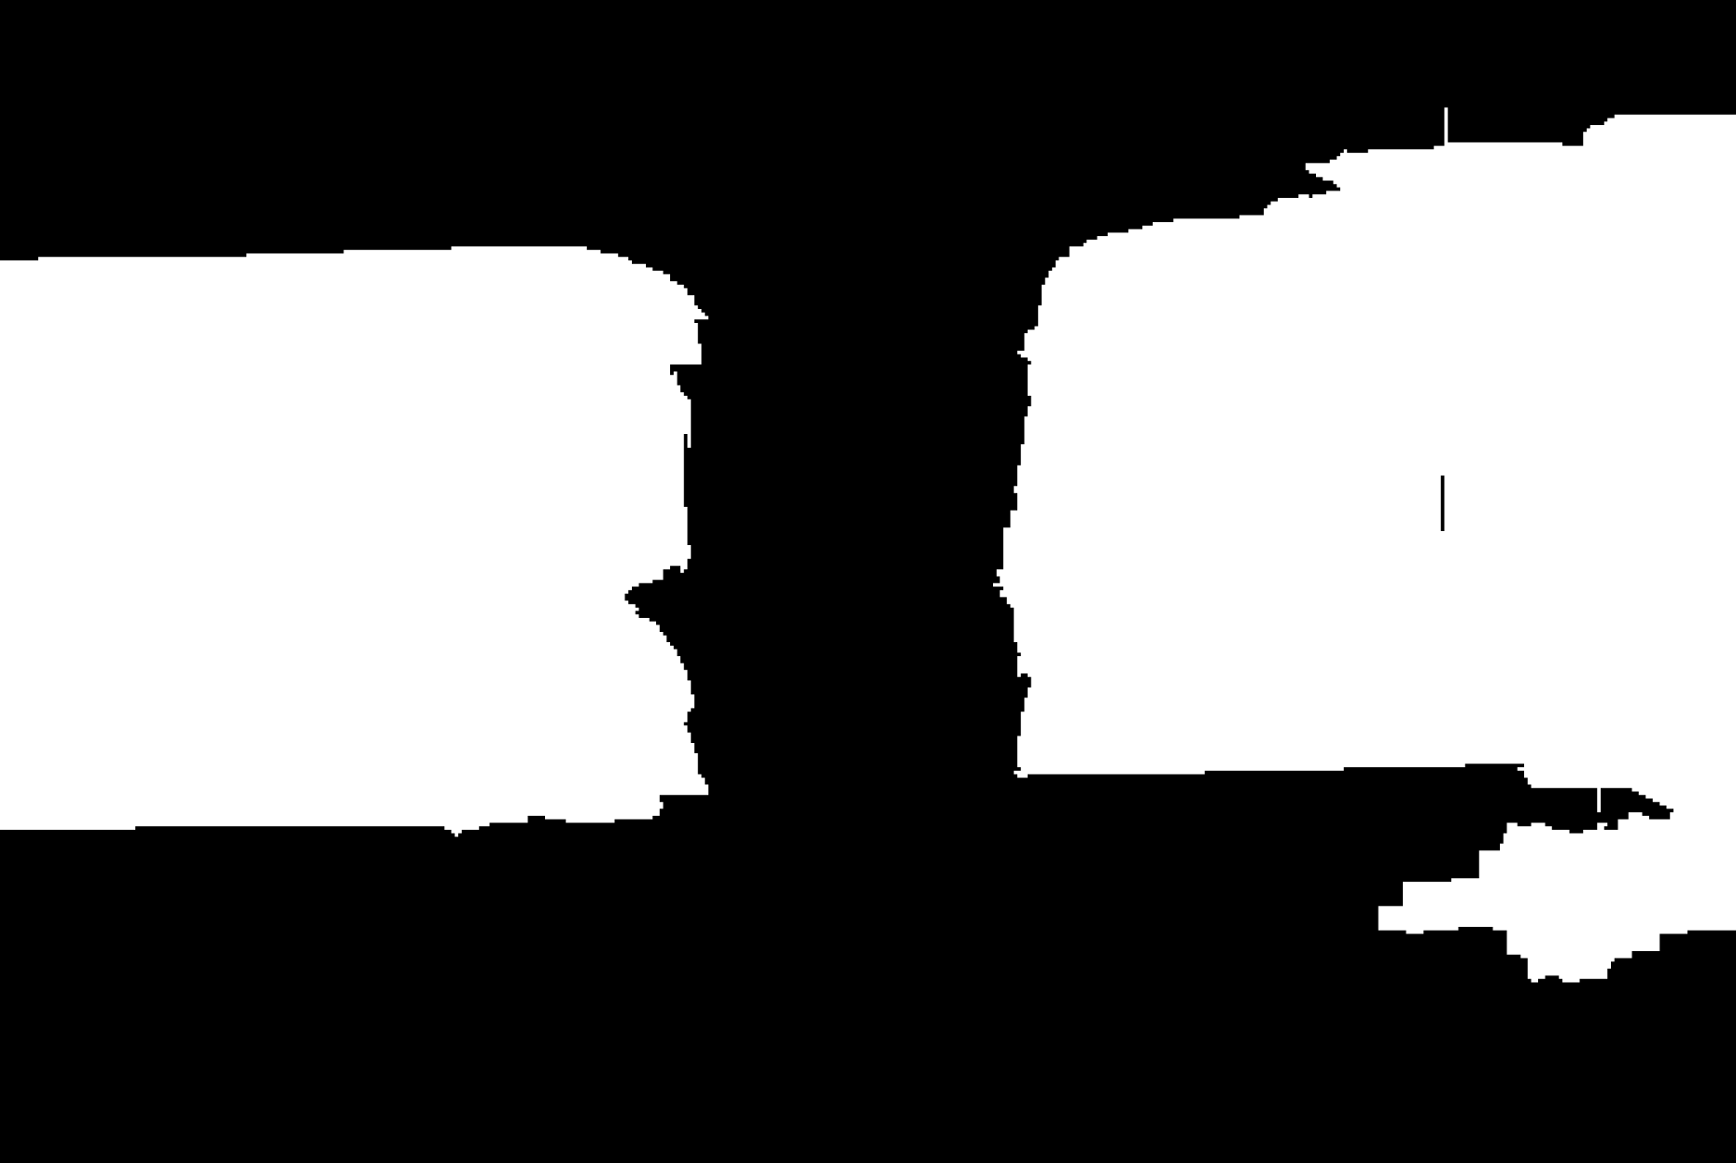

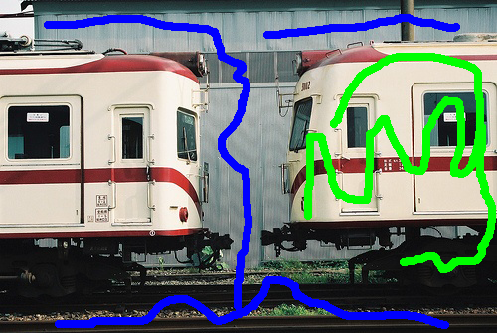
Biggest Problem
Model-Class is Wrong!
Not Enough Training Data!
MAP is NP-Hard
Inherent Ambiguity
-- Approximation Error
-- Estimation Error
-- Optimization Error
-- Bayes Error
?
?
Rotating clockwise /
anti-clockwise?
Old Lady looking left /
Young woman looking away?
One instance /
Two instances?
Notes:
Even if you can compute MAP, there may simply be multiple acceptable answers.
For example, this woman could be rotating left or rotating right.
This could be a young woman looking away or an old lady looking left.
When we have a user-in-the-loop, different users may expect different outputs from the same input.

Slide 15
Problems
Model-Class is Wrong!
Single Prediction = Uncertainty Mismanagement
Not Enough Training Data!
MAP is NP-Hard
Inherent Ambiguity
-- Approximation Error
-- Estimation Error
-- Optimization Error
Make Multiple Predictions!
-- Bayes Error
Notes:
So where does that leave us?
When your model is wrong, your data is insufficient, you can’t compute the optimal MAP and you’re not sure which answer the user wanted anyway, making a single best prediction is simply inadequate. What we need to do is to make multiple plausible predictions!

Slide 16

Multiple Predictions
(Diverse) M-Best MAP
Dhruv
10:45 – 11:30
Dennis
9:30 – 10:15
Flerova et al., 2011
Fromer et al., 2009
Yanover et al., 2003

Slide 17
Multiple Predictions
x
x
x
x
x
x
x
x
x
x
x
x
x
Sampling
Deva
1:30 – 2:00-pm
Porway & Zhu, 2011
TU & Zhu, 2002
Rich History
Notes:
So how can we make multiple predictions.
Well, it’s a probabilistic model. We could sample from the distribution. Unfortunately, sampling is rather wasteful since we observe the same modes of the distribution over and over again. And if there is a low-probability mode, we will have to wait a long time to observe a sample from it.

Slide 18
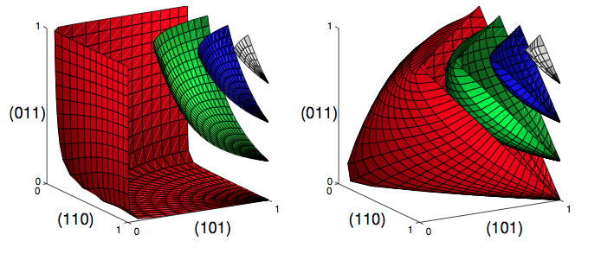
Multiple Predictions
Determinental
Point Process
Alex
2:00 – 3:15
3:45 – 4:30
Build a new model over sets that prefers diverse set

Slide 19
Multiple Predictions
Sampling
(Diverse) M-Best MAP
Determinental
Point Process
Alex
2:00 – 3:15
3:45 – 4:30
Porway & Zhu, 2011
TU & Zhu, 2002
Rich History
Flerova et al., 2011
Fromer et al., 2009
Yanover et al., 2003
Build a new model over sets that prefers diverse set

Slide 20
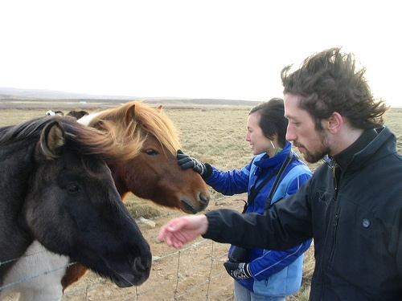

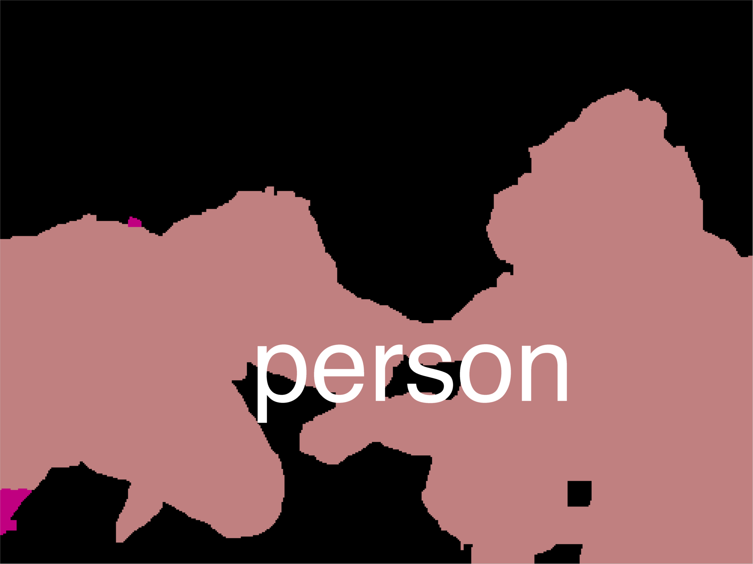
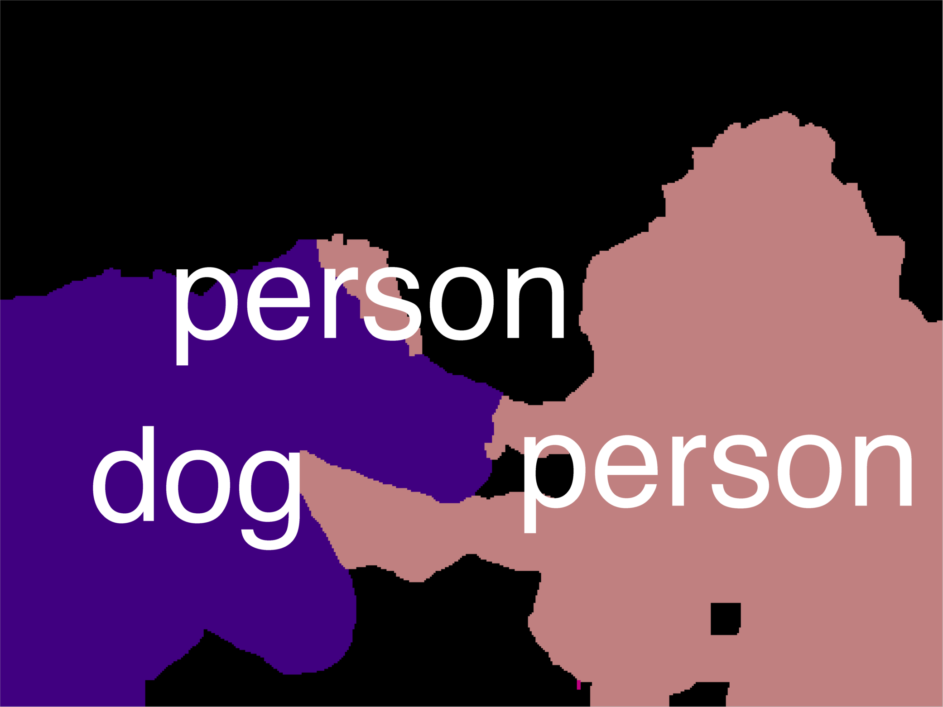
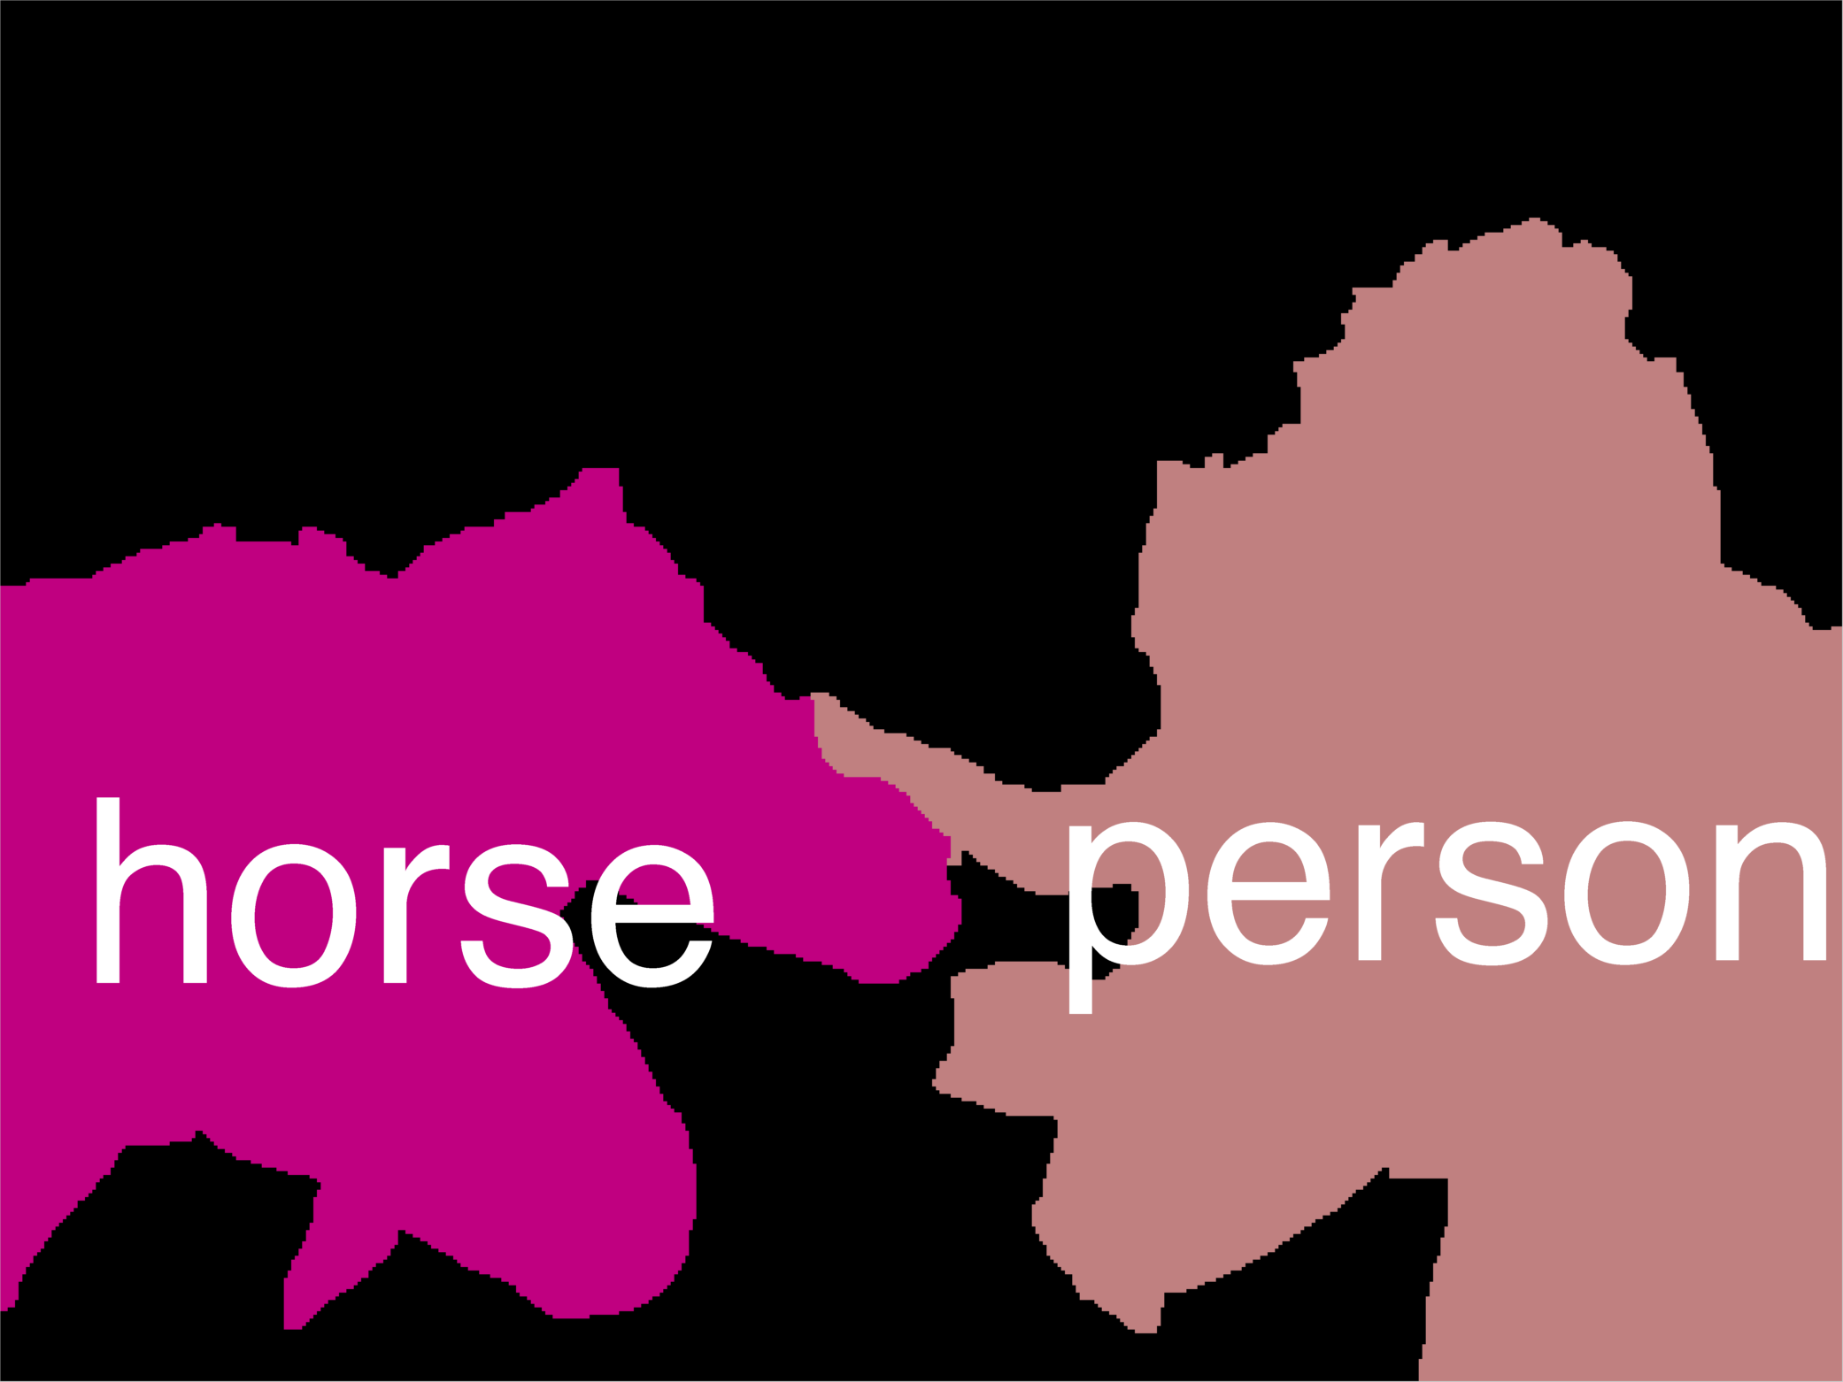
Multiple Predictions
Sampling
(Diverse) M-Best MAP
Determinental
Point Process
Porway & Zhu, 2011
TU & Zhu, 2002
Rich History
Flerova et al., 2011
Fromer et al., 2009
Yanover et al., 2003
Build a new model over sets that prefers diverse set

Slide 21
Schedule
Time | Topic | Presenter
9:00 – 9:30 | Opening Remarks + Need for Multiple Diverse Solutions | Dhruv
9:30 – 10:15 | Multiple Solutions via M-Best MAP | Dennis
10:15 – 10:45 | Coffee Break
10:45 – 11:30 | Multiple Solutions via Diverse M-Best | Dhruv
12:00 – 1:30 | Lunch
1:30 – 2:00 | Multiple Solutions via Sampling | Deva
2:00 – 3:15 | Multiple Solutions via DPPs | Alex
3:15 – 3:45 | Coffee Break
3:45 – 4:30 | DPPs (Continued) | Alex
4:30 – 5:00 | Closing Remarks + What can we do with diverse solutions? | Dhruv
All slides available online.

Slide 22
Notation and
Review of CRFs

Slide 23
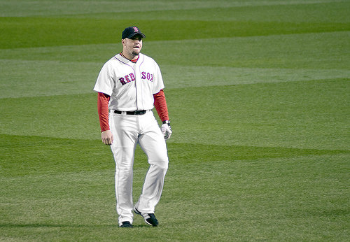
Conditional Random Fields
X₁
Discrete random variables
Factorized Model
X₂
1 1 10 0
10
0
kx1
…
10
X_{i}
X_{n}
10
0
10
kxk
Node Energies / Local Costs
Edge Energies /
Distributed Prior

Slide 24
MAP Inference
In general NP-hard [Shimony ‘94]
Approximate Inference
Heuristics: Loopy BP [Pearl, ‘88]
Greedy: α-Expansion [Boykov ’01, Komodakis ‘05]
LP Relaxations: [Schlesinger ‘76, Wainwright ’05, Sontag ’08, Batra ‘10]
QP/SDP Relaxations: [Ravikumar ’06, Kumar ‘09]

Slide 25
MAP Integer Program
kx1
Notes:
Let me begin by writing the MAP problem, which involves minimizing an energy composed of node terms & edge terms.
Instead of each variable being an integer between 1 and k, we will represent them as indicator vectors of length k.

Slide 26
MAP Integer Program
1
0
0
0
kx1
Notes:
So this is xi = 1.

Slide 27
MAP Integer Program
0
1
0
0
kx1
Notes:
So this is xi = 2.

Slide 28
MAP Integer Program
0
0
1
0
kx1
Notes:
This is xi = 3.

Slide 29
MAP Integer Program
0
0
0
1
kx1
Notes:
And this is xi = 4.

Slide 30
MAP Integer Program
0
0
0
1
kx1
k²x1
Notes:
We can do the same thing at edges, where the indicator vector is of length k^2

Slide 31
MAP Integer Program
0
0
0
1
kx1
k²x1
Notes:
So this is the Linear Integer program whose solution in the MAP state.

Slide 32
MAP Integer Program
Graphcuts, BP, Expansion, etc
Notes:
We typically solve this with algorithms like graph-cuts, BP, alpha-expansion. Etc.

Slide 33

MAP Integer Program
LP view
Graphcuts, BP, Expansion, etc
MAP

Slide 34
Schedule
Time | Topic | Presenter
9:00 – 9:30 | Opening Remarks + Need for Multiple Diverse Solutions | Dhruv
9:30 – 10:15 | Multiple Solutions via M-Best MAP | Dennis
10:15 – 10:45 | Coffee Break
10:45 – 11:30 | Multiple Solutions via Diverse M-Best | Dhruv
12:00 – 1:30 | Lunch
1:30 – 2:00 | Multiple Solutions via Sampling | Deva
2:00 – 3:15 | Multiple Solutions via DPPs | Alex
3:15 – 3:45 | Coffee Break
3:45 – 4:30 | DPPs (Continued) | Alex
4:30 – 5:00 | Closing Remarks + What can we do with diverse solutions? | Dhruv
All slides available online.

