Slide 1
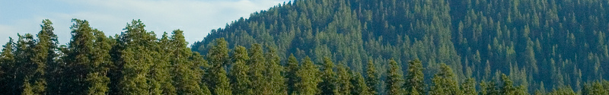

Diverse M-Best Solutions in
Markov Random Fields
Dhruv Batra
Virginia Tech
Joint work with:
Students: Payman Yadollahpour (TTIC), Abner Guzman-Rivera (UIUC)
Colleagues: Chris Dyer (CMU), Greg Shakhnarovich (TTIC),
Pushmeet Kohli (MSRC), Kevin Gimpel (TTIC)

Slide 2
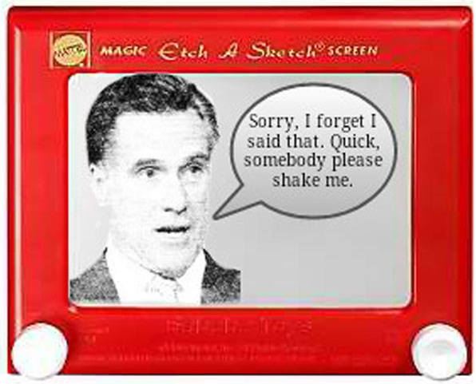

Slide 3
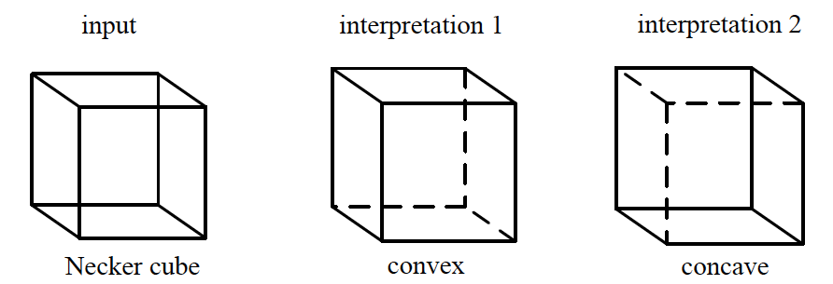
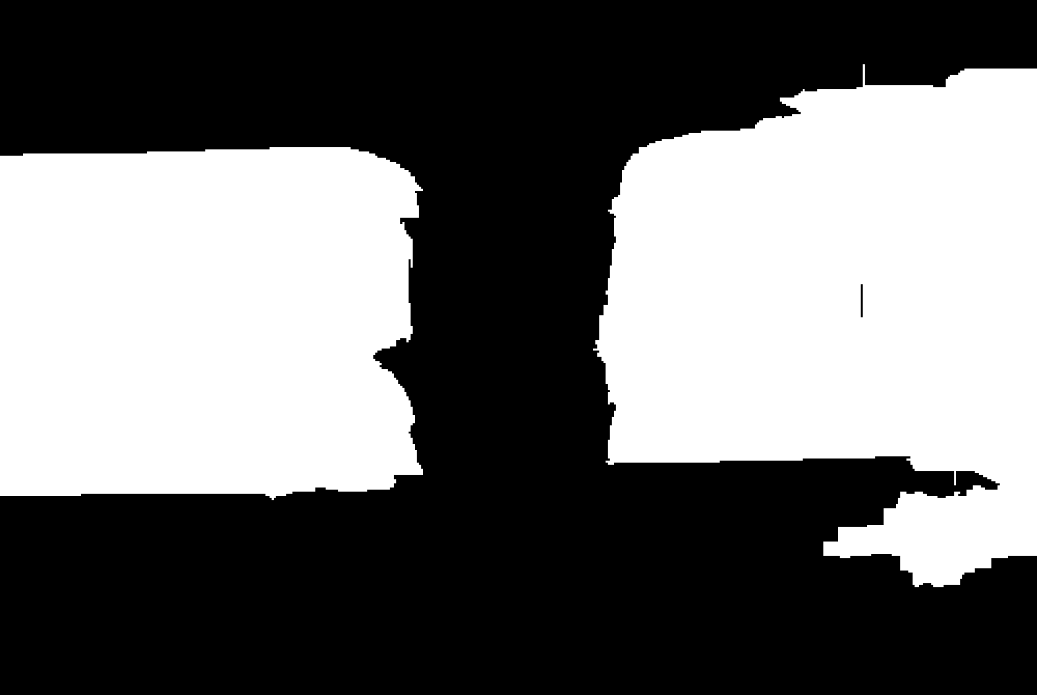
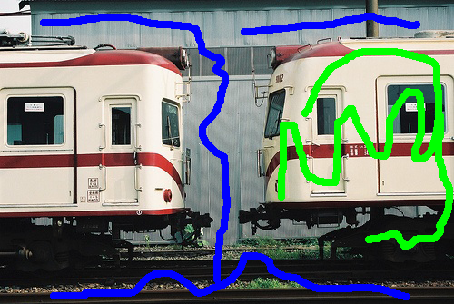
Ambiguity Ambiguity Ambiguity
?
?
One instance /
Two instances?

Slide 4
Problems with MAP
Model-Class is Wrong!
Single Prediction = Uncertainty Mismanagement
Not Enough Training Data!
MAP is NP-Hard
Inherent Ambiguity
-- Approximation Error
-- Estimation Error
-- Optimization Error
Make Multiple Predictions!
-- Bayes Error
Notes:
So where does that leave us?
When your model is wrong, your data is insufficient, you can’t compute the optimal MAP and you’re not sure which answer the user wanted anyway, making a single best prediction is simply inadequate. What we need to do is to make multiple plausible predictions!

Slide 5


Multiple Predictions
x
x
x
x
x
x
x
x
x
x
x
x
x
Sampling
Porway & Zhu, 2011
TU & Zhu, 2002
Rich History
Notes:
So how can we make multiple predictions.
Well, it’s a probabilistic model. We could sample from the distribution. Unfortunately, sampling is rather wasteful since we observe the same modes of the distribution over and over again. And if there is a low-probability mode, we will have to wait a long time to observe a sample from it.

Slide 6
Multiple Predictions
✓
Sampling
M-Best MAP
Ideally:
M-Best Modes
Porway & Zhu, 2011
TU & Zhu, 2002
Rich History
Flerova et al., 2011
Fromer et al., 2009
Yanover et al., 2003
Notes:
We could ask for the top M most probably states from the model, called the M Best MAPs. Unfortunately, these solutions are typically minor perturbations of each other.
What we’d like to extract are the top M /modes/ of this distribution, i.e. solve the M-Best Mode problem.
However, there are technical challenges because this is a discrete distribution, and we have to deal with combinatorial optimization.

Slide 7
Multiple Predictions
✓
Our work: Diverse M-Best in MRFs [ECCV ‘12]
Sampling
M-Best MAP
Don’t hope for diversity. Explicitly encode it.
Not guaranteed to be modes.
Ideally:
M-Best Modes
Porway & Zhu, 2011
TU & Zhu, 2002
Rich History
Flerova et al., 2011
Fromer et al., 2009
Yanover et al., 2003
Notes:
In this paper we present an algorithm to find a set of diverse M-Best solutions from discrete probabilistic models.
We elevate diversity to a first-class citizen by explicitly encoding it into our approach, rather than post-processing for diversity.
Our solutions are not guaranteed to be modes, but are often very useful for applications.

Slide 8
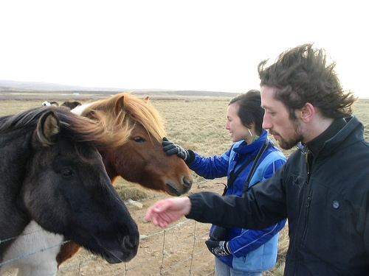
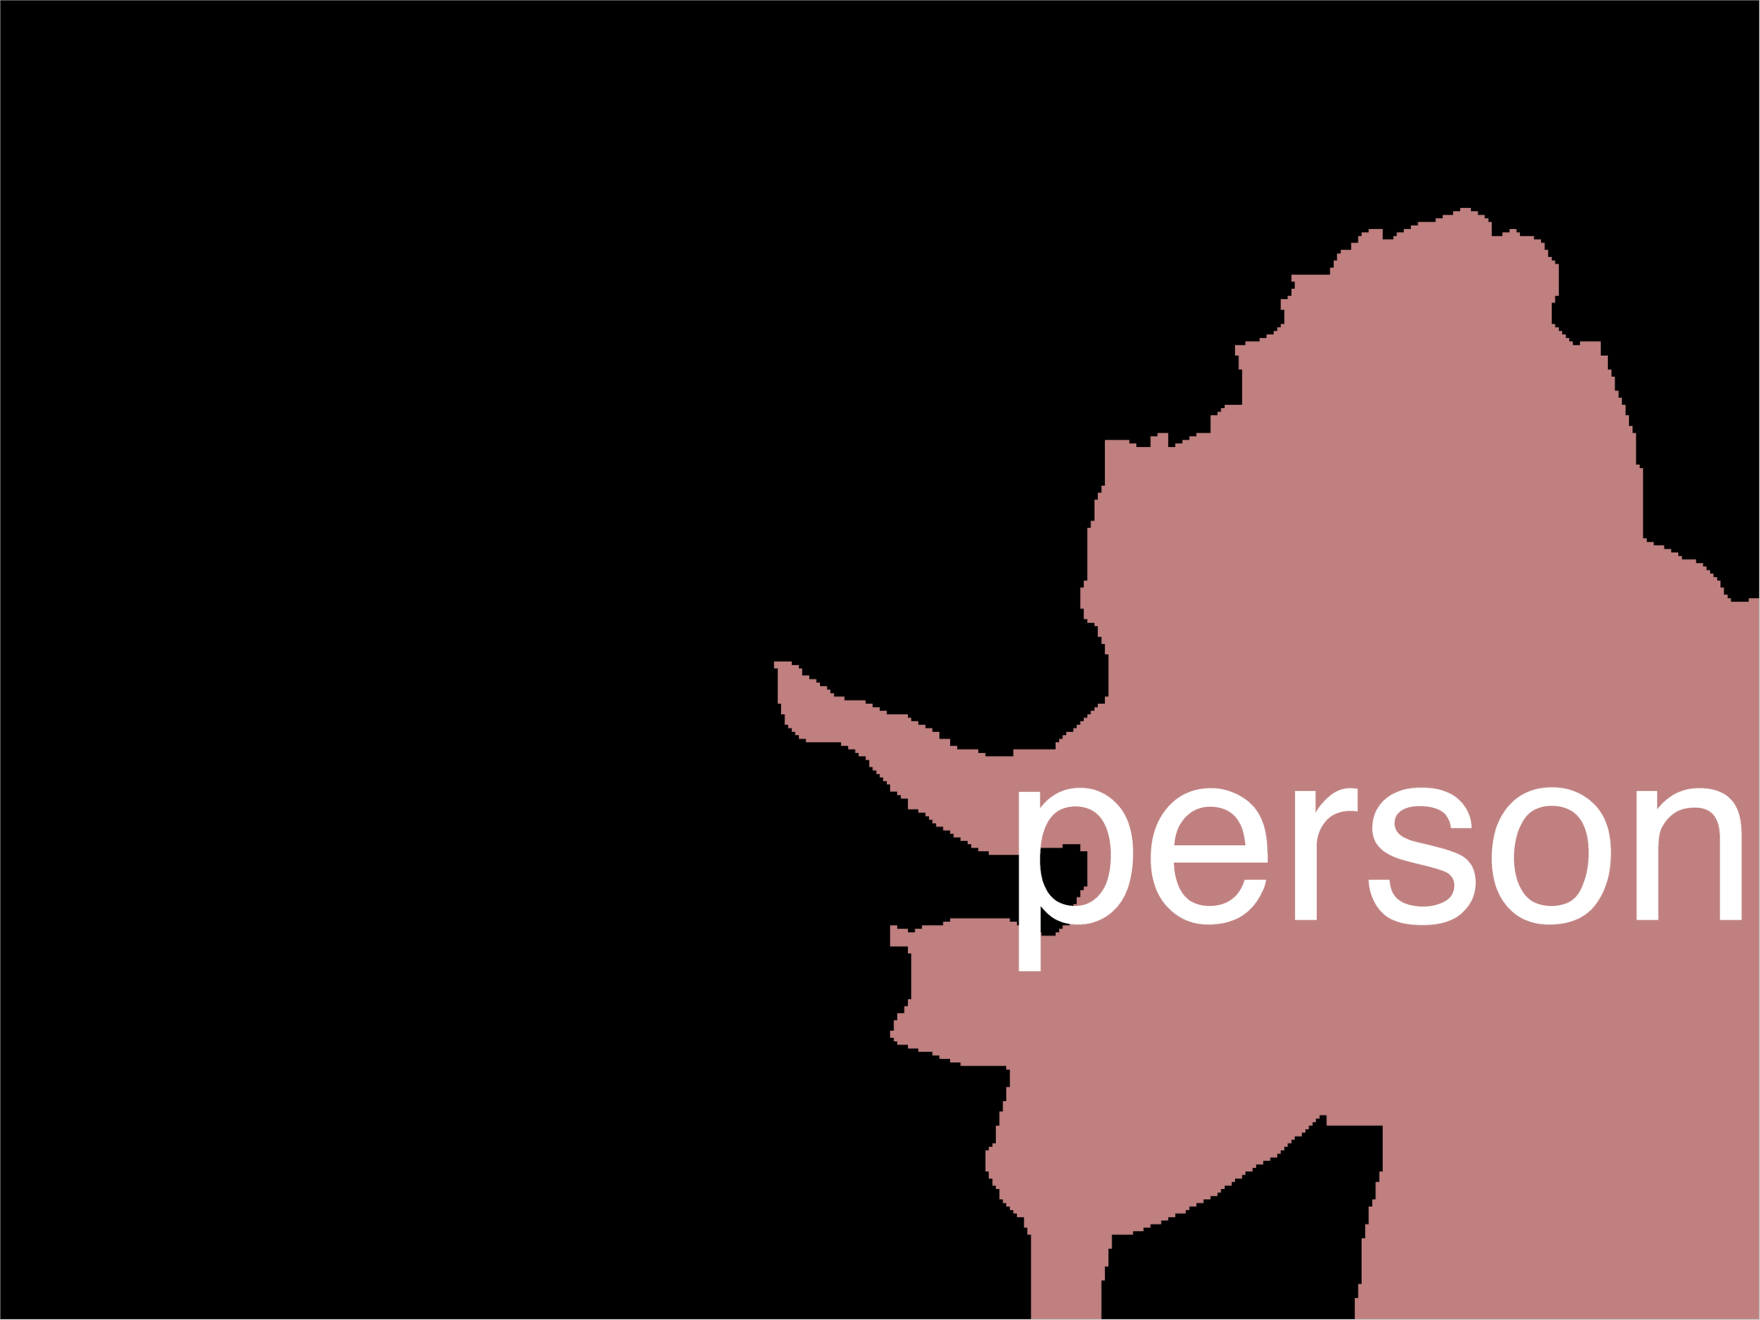
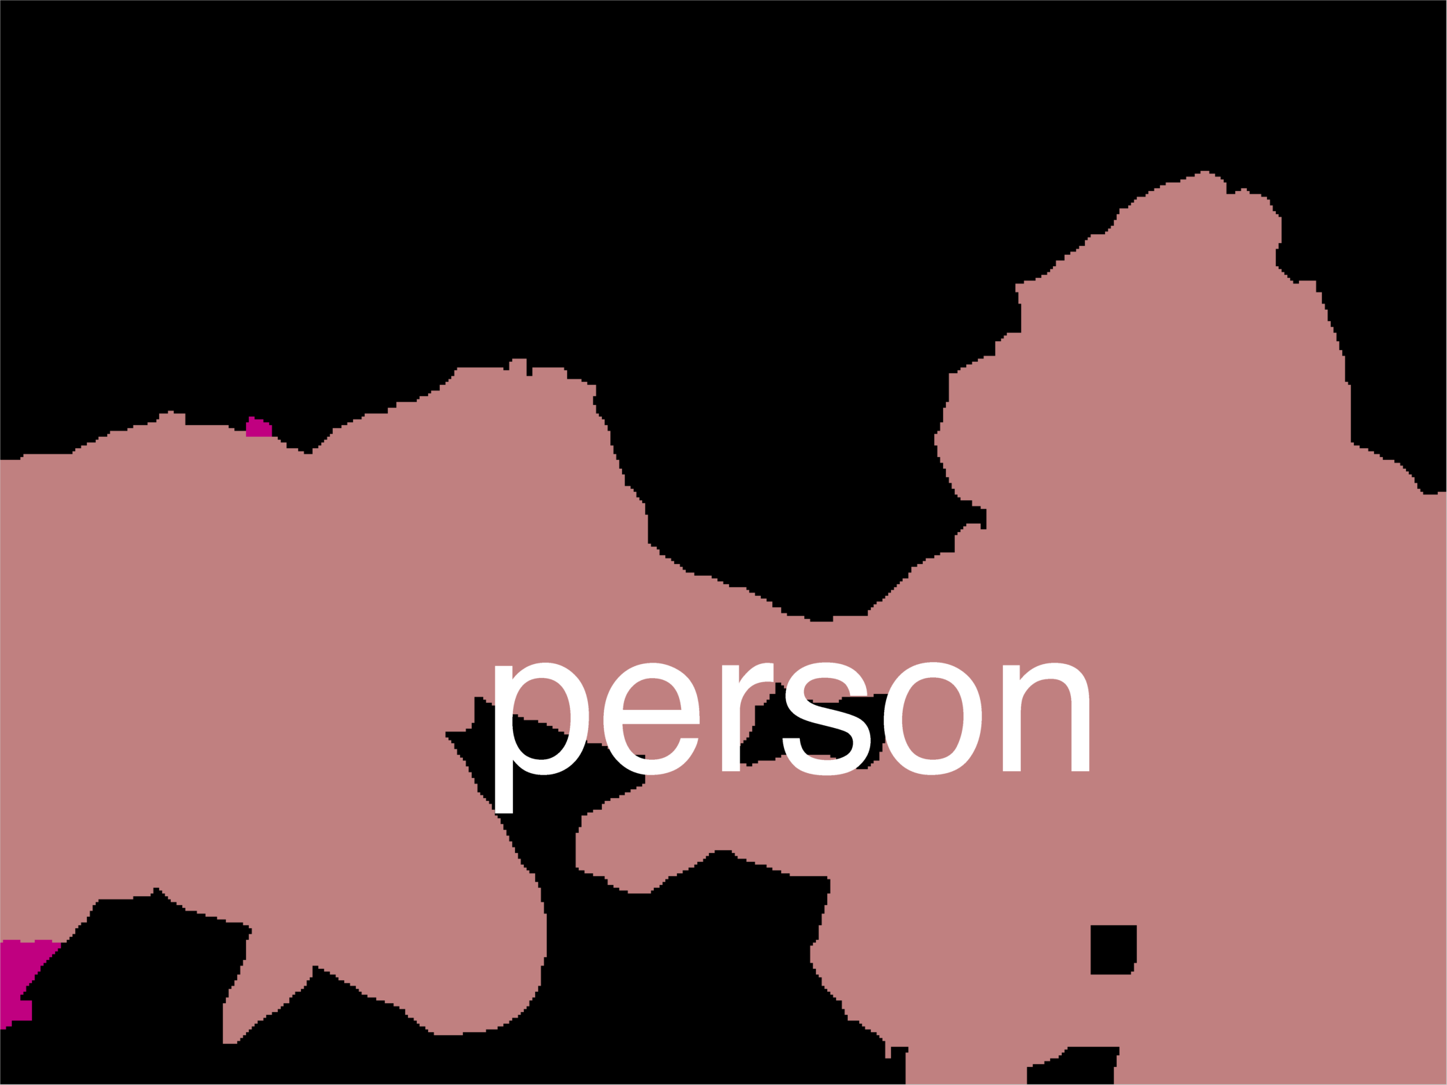
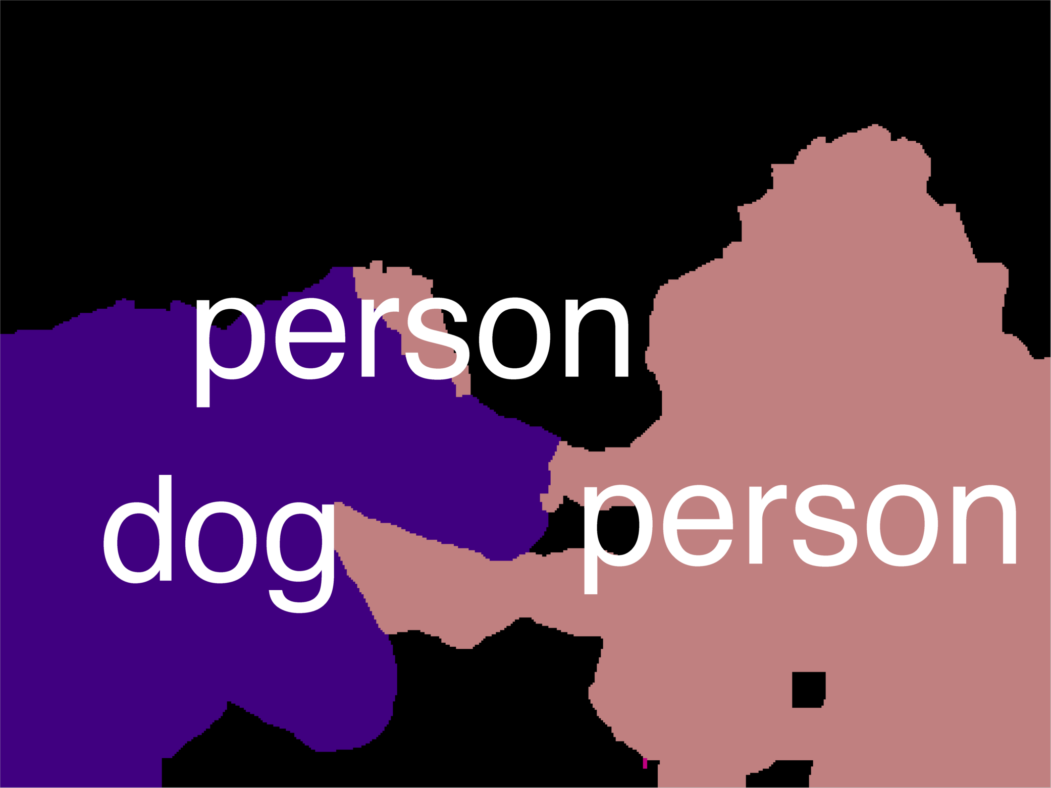
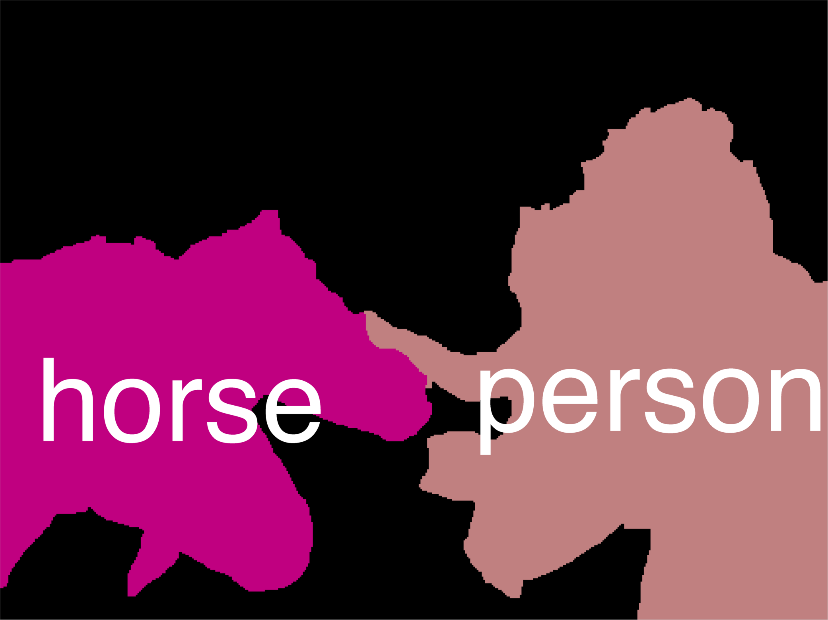
Example Result

Slide 9
Example Result
Discriminative Re-ranking of Diverse Segmentation
[Yadollahpour et al., CVPR13, Wednesday Poster]

Slide 10
MAP Integer Program
kx1
Notes:
Let me begin by writing the MAP problem, which involves minimizing an energy composed of node terms & edge terms.
Instead of each variable being an integer between 1 and k, we will represent them as indicator vectors of length k.

Slide 11
MAP Integer Program
1
0
0
0
kx1
Notes:
So this is xi = 1.

Slide 12
MAP Integer Program
0
1
0
0
kx1
Notes:
So this is xi = 2.

Slide 13
MAP Integer Program
0
0
1
0
kx1
Notes:
This is xi = 3.

Slide 14
MAP Integer Program
0
0
0
1
kx1
Notes:
And this is xi = 4.

Slide 15
MAP Integer Program
0
0
0
1
kx1
k²x1
Notes:
We can do the same thing at edges, where the indicator vector is of length k^2

Slide 16
MAP Integer Program
0
0
0
1
kx1
k²x1
Notes:
So this is the Linear Integer program whose solution in the MAP state.

Slide 17
MAP Integer Program
Graphcuts, BP, Expansion, etc
Notes:
We typically solve this with algorithms like graph-cuts, BP, alpha-expansion. Etc.

Slide 18
Diverse 2nd-Best
Diversity
MAP
Notes:
So now, how can we find a diverse 2nd best solution?
We present a fairly general formulation, that simply adds this inequality to the problem. There is task-specific diversity function Delta that measures the dissimilarity or distance between two full configurations, and we force the 2nd best solution to be at least k distance away from MAP.

Slide 19
Diverse M-Best
Notes:
The extension from 2nd best to M best is fairly straightforward. We simply add more inequalities incrementally to further restrict the search space.

Slide 20
Diverse 2nd-Best
Q1: How do we solve DivMBest?
Q2: What kind of diversity functions are allowed?
Q3: How much diversity?
Notes:
In order to keep things simple, I’ll focus on the 2nd best problem in this talk and everything I describe will naturally extend to the M-Best case.
Now, given this general formulation, there are a few different questions we can ask.
In this talk, I will answer the first question, partially answer the second, and not answer the third. I encourage you to see the paper for details.
So let’s look at the first question.

Slide 21
Diverse 2nd-Best
Diversity-Augmented Score
Primal
Dualize
Notes:
We do not solve this problem in the “Primal” form. Instead, we dualize the diversity constraint, ie add it as a penalty to the objective. So whenever we find a solution that is less than k distance away, we pay a penalty of lambda.
This is known as the Lagrangian relaxation. It has an interesting interpretation as the diversity augmented energy, which involves finding low-energy high-diversity solutions.
The Lagrangian function is known to provide a concave lower-bound to the Primal solution; and the tightest lower-bound can be found by maximizing this function.
There are several ways to solve this Lagrangian dual problem.
We can use 1) supergradient ascent 2) binary search or 3) grid search.
For our experiments, we use grid search over lambda, which is suboptimal but the fastest.

Slide 22
Diverse 2nd-Best
Lagrangian Relaxation
Diversity-Augmented Score
Dual
Subgradient Descent
Concave (Non-smooth)
Upper-Bound on Div2Best Score
Div2Best score

Slide 23
Diverse 2nd-Best
Lagrangian Relaxation
Many ways to solve:
Diversity-Augmented Energy
Subgradient Ascent. Optimal. Slow.
2. Binary Search. Optimal for M=2. Faster.
3. Grid-search on lambda. Sub-optimal. Fastest.
Dualize

Slide 24
Theorem Statement
Theorem [Batra et al ’12]: Lagrangian Dual corresponds to solving the Relaxed Primal:
    Based on result from [Geoffrion ‘74]
Dual
Relaxed Primal

Slide 25

Effect of Lagrangian Relaxation

Slide 26
Effect of Lagrangian Relaxation

Slide 27
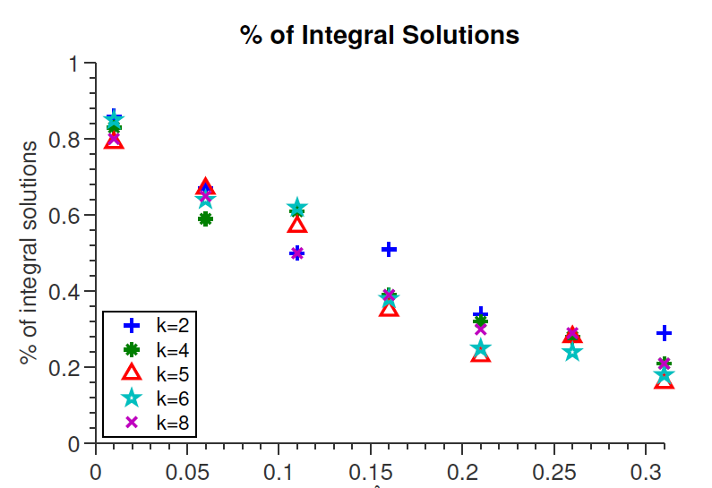
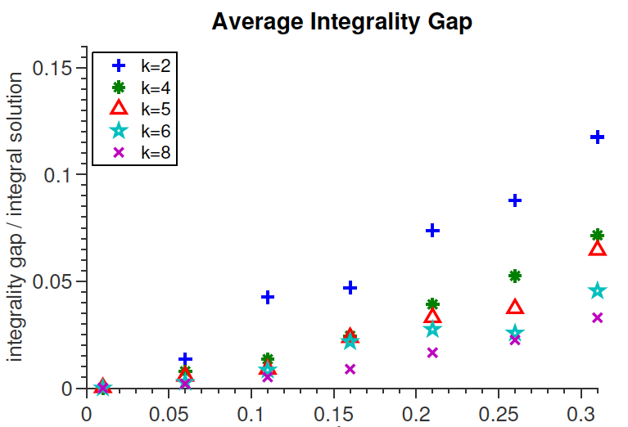
Effect of Lagrangian Relaxation
[Mezuman et al. UAI13]
Pairwise Potential Strength
Pairwise Potential Strength

Slide 28
Diverse 2nd-Best
Q1: How do we solve DivMBest?
Q2: What kind of diversity functions are allowed?
Q3: How much diversity?
Notes:
So now let’s look at how we measure diversity.

Slide 29
Diversity
[Special Case] 0-1 Diversity M-Best MAP
  [Yanover NIPS03; Fromer NIPS09; Flerova Soft11]
[Special Case] Max Diversity [Park & Ramanan ICCV11]
Hamming Diversity
Cardinality Diversity
Any Diversity
Notes:
Our formulation allows several kinds of diversity functions.
With a 0-1 diversity, we get the special case of M-Best MAP.
With a max-diversity, we get the formulation of Park & Ramanan from last year.
We can use hamming diversity, cardinality diversity, basically any diversity function that allows efficient inference with diversity-augmented-energy.
In this talk, I am going to describe the simplest diversity – Hamming diversity; and details of the others can be found in the paper.

Slide 30
Hamming Diversity
0
1
0
0
0
1
0
0
0 1 0 0
1 0 0 0
Notes:
Hamming Diversity can be expressed with a sum of dot-products of indicator vectors.
If the vectors are the same, their dot-product is 1, and if they are different, their dot-product is 0. Thus this sum counts the no. of variables that have the same label as MAP.

Slide 31
Hamming Diversity
Diversity Augmented Inference:
Notes:
Hamming Diversity has the property that it factorizes with the node energies, so we can think of diversity augmented score as having perturbed node energies, that absorb the previous solutions vectors.

Slide 32
Hamming Diversity
Diversity Augmented Inference:
Unchanged.
Can still use graph-cuts!
Simply edit node-terms. Reuse MAP machinery!
Notes:
This can be implemented with these 4 lines of pseudo-code. Simply write a for loop over the variables, increment the unary costs of the labels seen in MAP and run MAP again.
That’s it!
Thus we can reuse all the existing MAP machinery.
Another interesting thing is that we did not modify the edge energies, so there was some structure in the edge terms, it is preserved. For instance, if they were submodular, they continue to be submodular and we can use graph-cuts for the second best problem.

Slide 33
Diverse 2nd-Best
Q1: How do we solve DivMBest?
Q2: What kind of diversity functions are allowed?
Q3: How much diversity?
Notes:
So now let’s look at how we measure diversity.

Slide 34
How Much Diversity?
Empirical Solution: Cross-Val for
More Efficient: Cross-Val for

Slide 35
Experiments
3 Applications
  Interactive Segmentation: Hamming, Cardinality (in paper)
  Pose Estimation: Hamming
  Semantic Segmentation: Hamming
Baselines:
  M-Best MAP (No Diversity)
  Confidence-Based Perturbation (No Optimization)
Notes:
Let me show some results.
We test DivMBest on 3 applications: interactive segmentation, pose estimation and semantic segmentation.
We compare against two baselines: M-Best MAP that has no notion of diversity; and a Confidence-based baseline that produces the changes confused variables to achieve the same level of diversity as our solutions, but has no optimization.
I will report results using two metric – Oracle accuracies, ie the accuracy of the best solution in a set of M.
And Re-ranked accuracies, ie accuracies achieved by an automatic algorithm that picks one of these M.

Slide 36


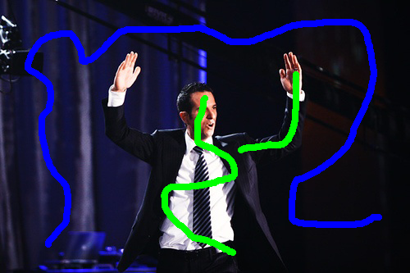



Interactive Segmentation
Setup
  Model: Color/Texture + Potts Grid CRF
  Inference: Graph-cuts
  Dataset: 50 train/val/test images
Image + Scribbles
MAP
2nd Best MAP
Diverse 2nd Best
1-2 Nodes Flipped
100-500 Nodes Flipped
Notes:
The first experiment is interactive segmentation, where a user provides scribbles on images and we use graph-cuts for inference.
This is the second-best solution without diversity. We can see that it is nearly identical to MAP with a few nodes flipped.
This is the second-best solutions with diversity. We can see that these solutions are significantly different. In one case, we found another instance of the object, and in another, we completed a thin long structure.

Slide 37
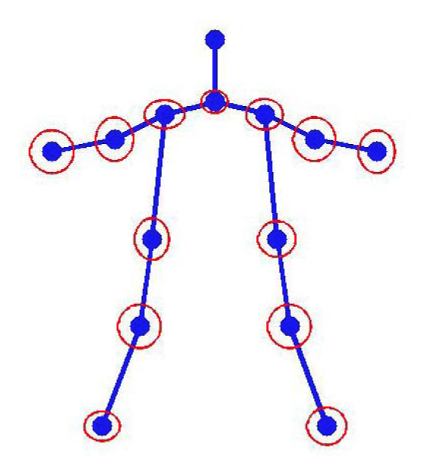
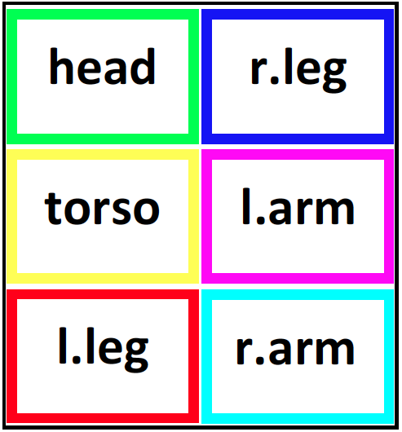
Pose Tracking
Setup
  Model: Mixture of Parts from [Park & Ramanan, ICCV ‘11]
  Inference: Dynamic Programming
  Dataset: 4 videos, 585 frames
Image Credit: [Yang & Ramanan, ICCV ‘11]
Notes:
Next, we applied our approach to pose-tracking in videos.
We replicated the setup of Park & Ramanan who use a mixture of parts tree model. Exact inference can be performed by dynamic programming.

Slide 38
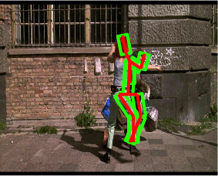
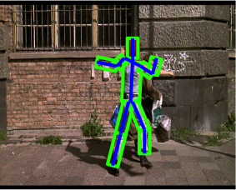


Slide 39
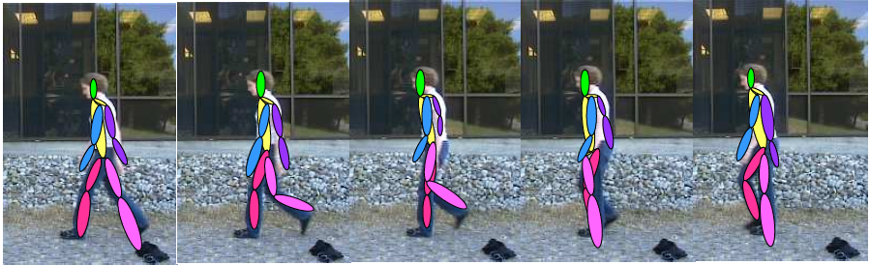
Pose Tracking
Chain CRF with M states at each time
M Best
Solutions
Image Credit: [Yang & Ramanan, ICCV ‘11]
Notes:
We compute M solutions in each frame of the video, and then choose a smooth trajectory using the Viterbi algorithm.

Slide 40
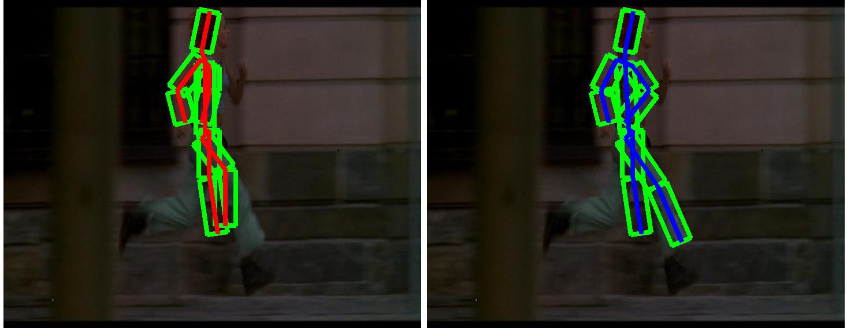
Pose Tracking
MAP
DivMBest + Viterbi
Notes:
Here, on the left, I am showing you the MAP pose on each frame. We can see that is quite noisy and jumps around, while the DivMBest solution is smooth.

Slide 41
Pose Tracking
Better
DivMBest (Re-ranked)
13% Gain
Same Features
Same Model
[Park & Ramanan, ICCV ‘11] (Re-ranked)
PCP Accuracy
Confidence-based Perturbation (Re-ranked)
#Solutions / Frame
Notes:
Here are quantitative results. On the x axis are the no. of solutions per frame. On the Y axis is PCP accuracy of the trajectory.
The confidence based baseline does not benefit from multiple solutions.
This is the result from Park & Ramanan. And this is our approach.
We can see that we get an improvement of 13 PCP points with the same model and exactly the same features, just a different way of computing multiple solutions.

Slide 42
Machine Translation
Input:
Die Regierung will die Folter von “Hexen” unterbinden und gab eine Broschüre heraus
MAP Translation:
The government wants the torture of ‘witch’ and gave out a booklet

Slide 43
Machine Translation
Input:
Die Regierung will die Folter von “Hexen” unterbinden und gab eine Broschüre heraus
5-Best Translations:
The government wants the torture of ‘witch’ and gave out a booklet
The government wants the torture of “witch” and gave out a booklet
The government wants the torture of ‘witch’ and gave out a brochure
The government wants the torture of ‘witch’ and gave out a leaflet
The government wants the torture of “witch” and gave out a brochure

Slide 44
Machine Translation
Input:
Die Regierung will die Folter von “Hexen” unterbinden und gab eine Broschüre heraus
Diverse 5-Best Translations:
The government wants the torture of ‘witch’ and gave out a booklet
The government wants to stop torture of “witch” and issued a leaflet issued
The government wants to “stop the torture of” witches and gave out a brochure
The government intends to the torture of “witchcraft” and were issued a leaflet
The government is the torture of “witches” stamp out and gave a brochure

Slide 45
Machine Translation
Input:
Die Regierung will die Folter von “Hexen” unterbinden und gab eine Broschüre heraus
Diverse 5-Best Translations:
The government wants the torture of ‘witch’ and gave out a booklet
The government wants to stop torture of “witch” and issued a leaflet issued
The government wants to “stop the torture of” witches and gave out a brochure
The government intends to the torture of “witchcraft” and were issued a leaflet
The government is the torture of “witches” stamp out and gave a brochure
Correct Translation:
The government wants to limit the torture of “witches,” a brochure was released

