Slide 1
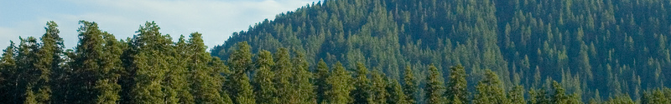

Closing Remarks:
What can we do with multiple diverse solutions?
Dhruv Batra
Virginia Tech

Slide 2
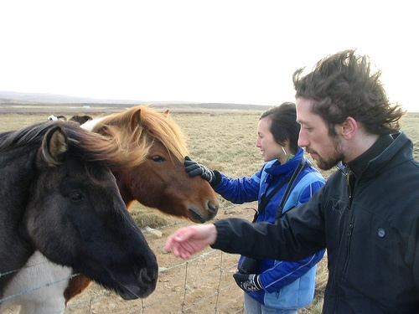
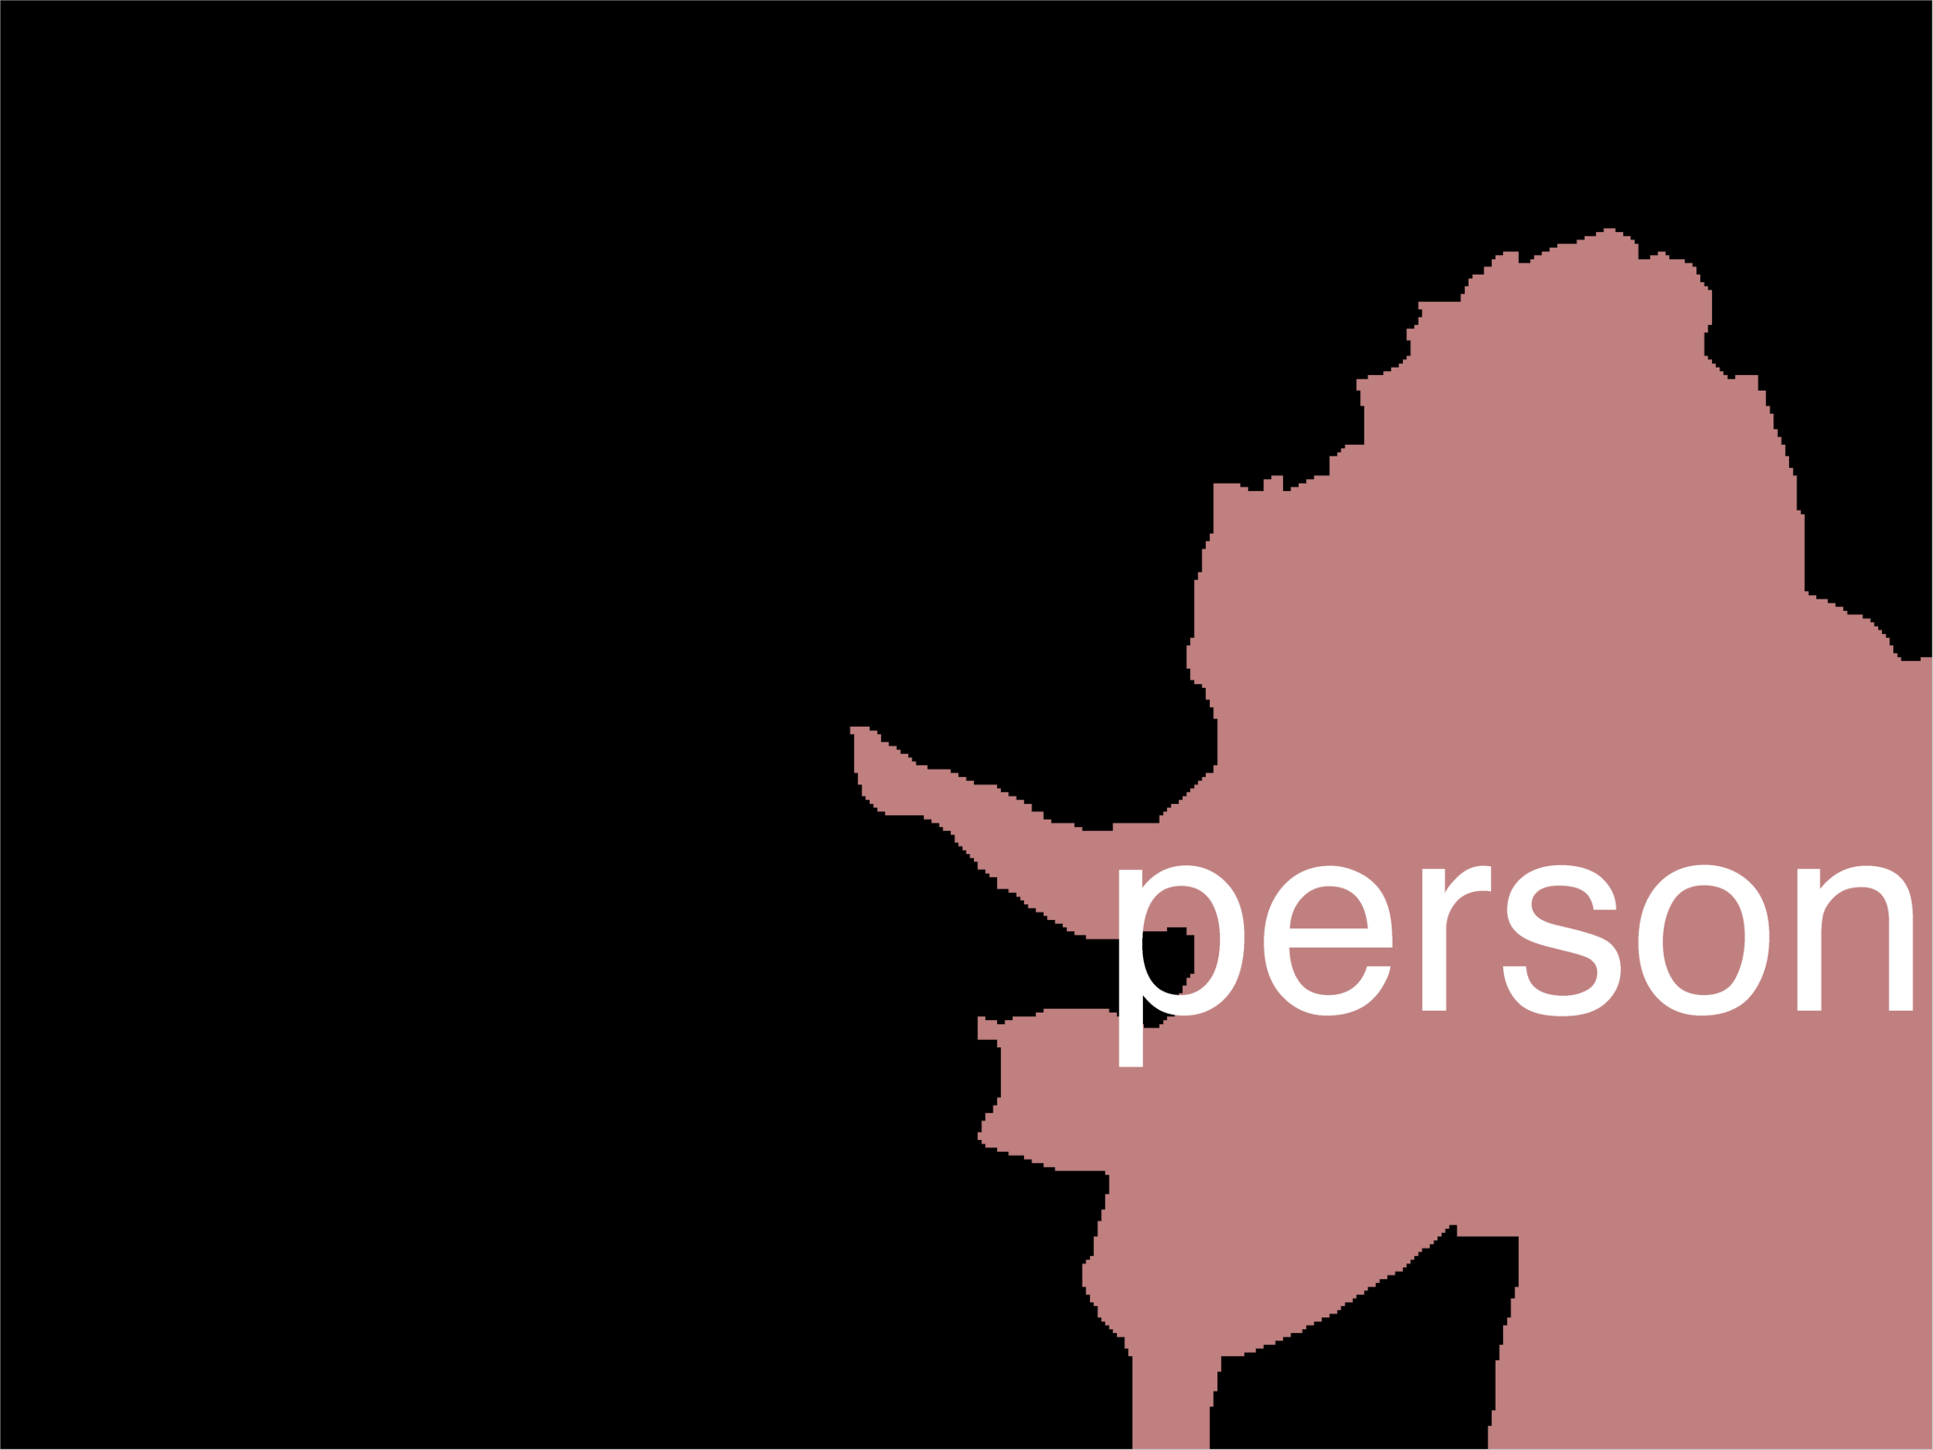
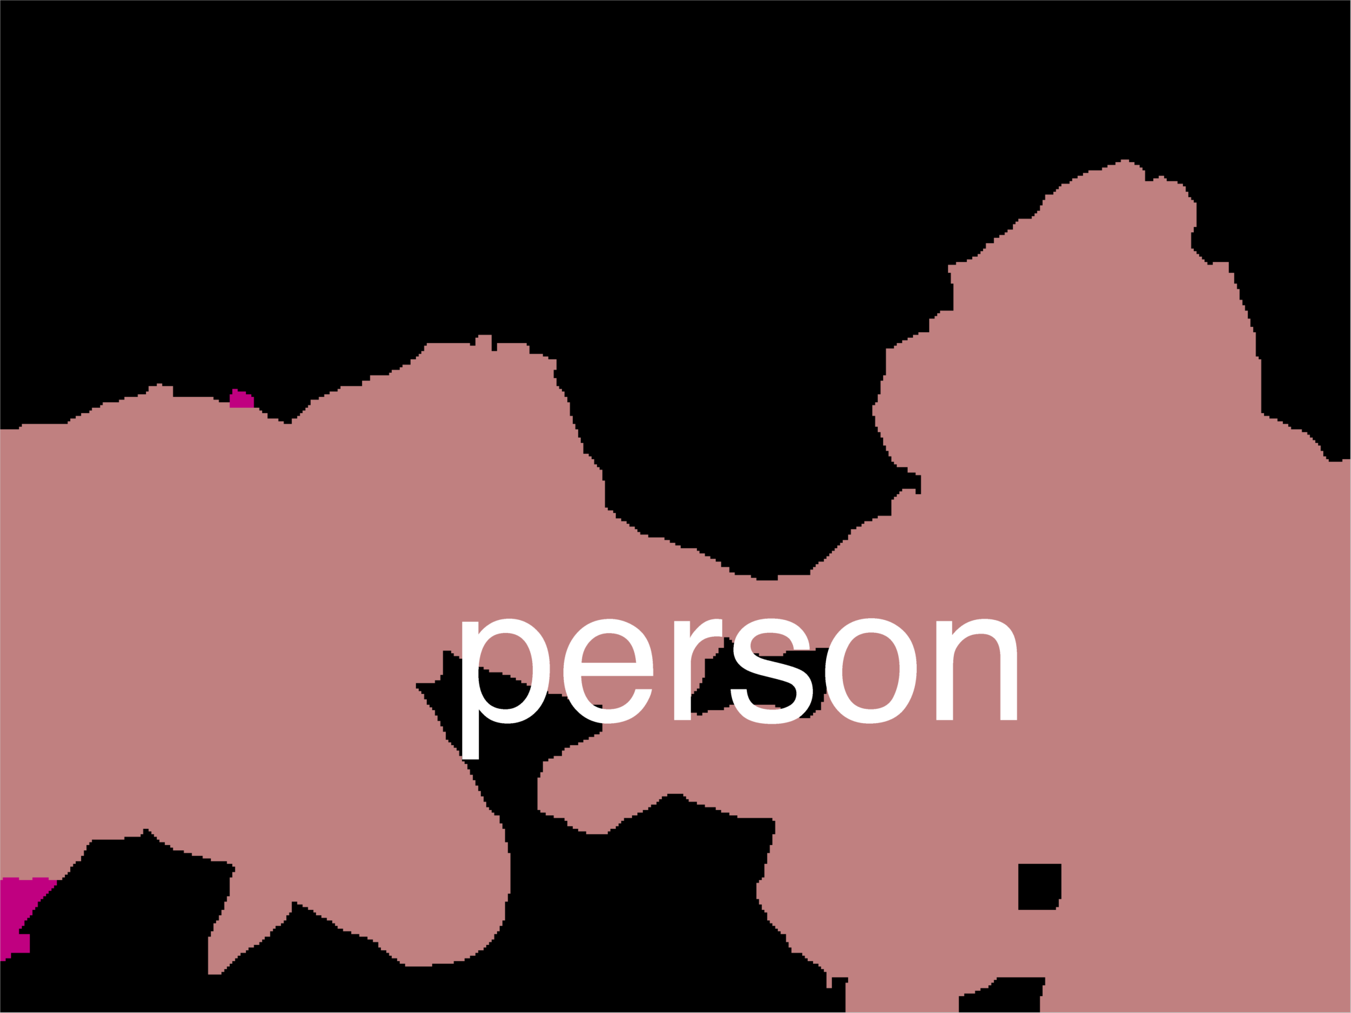
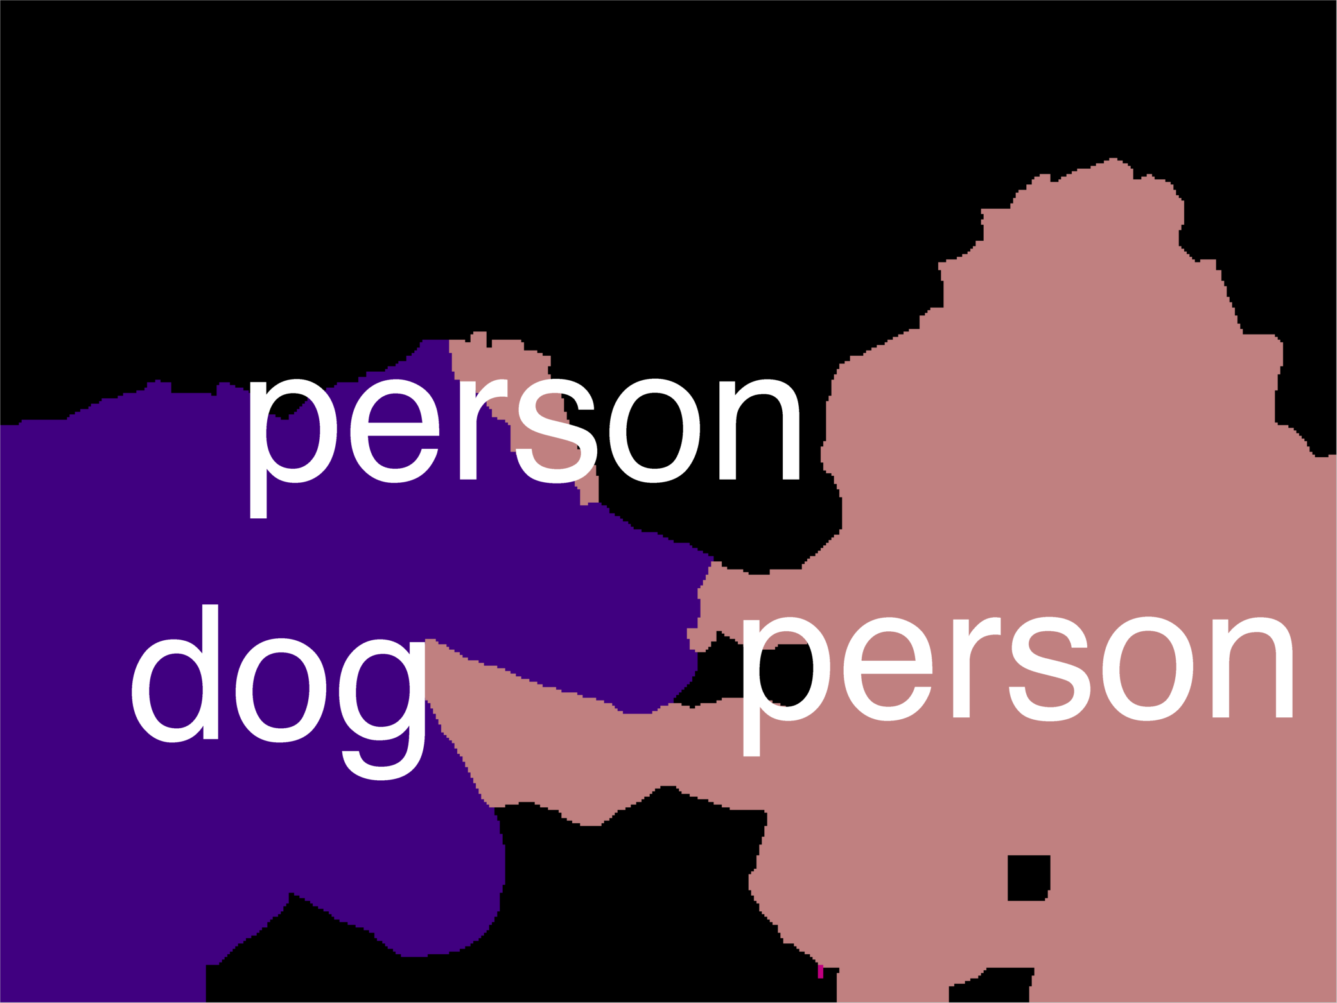
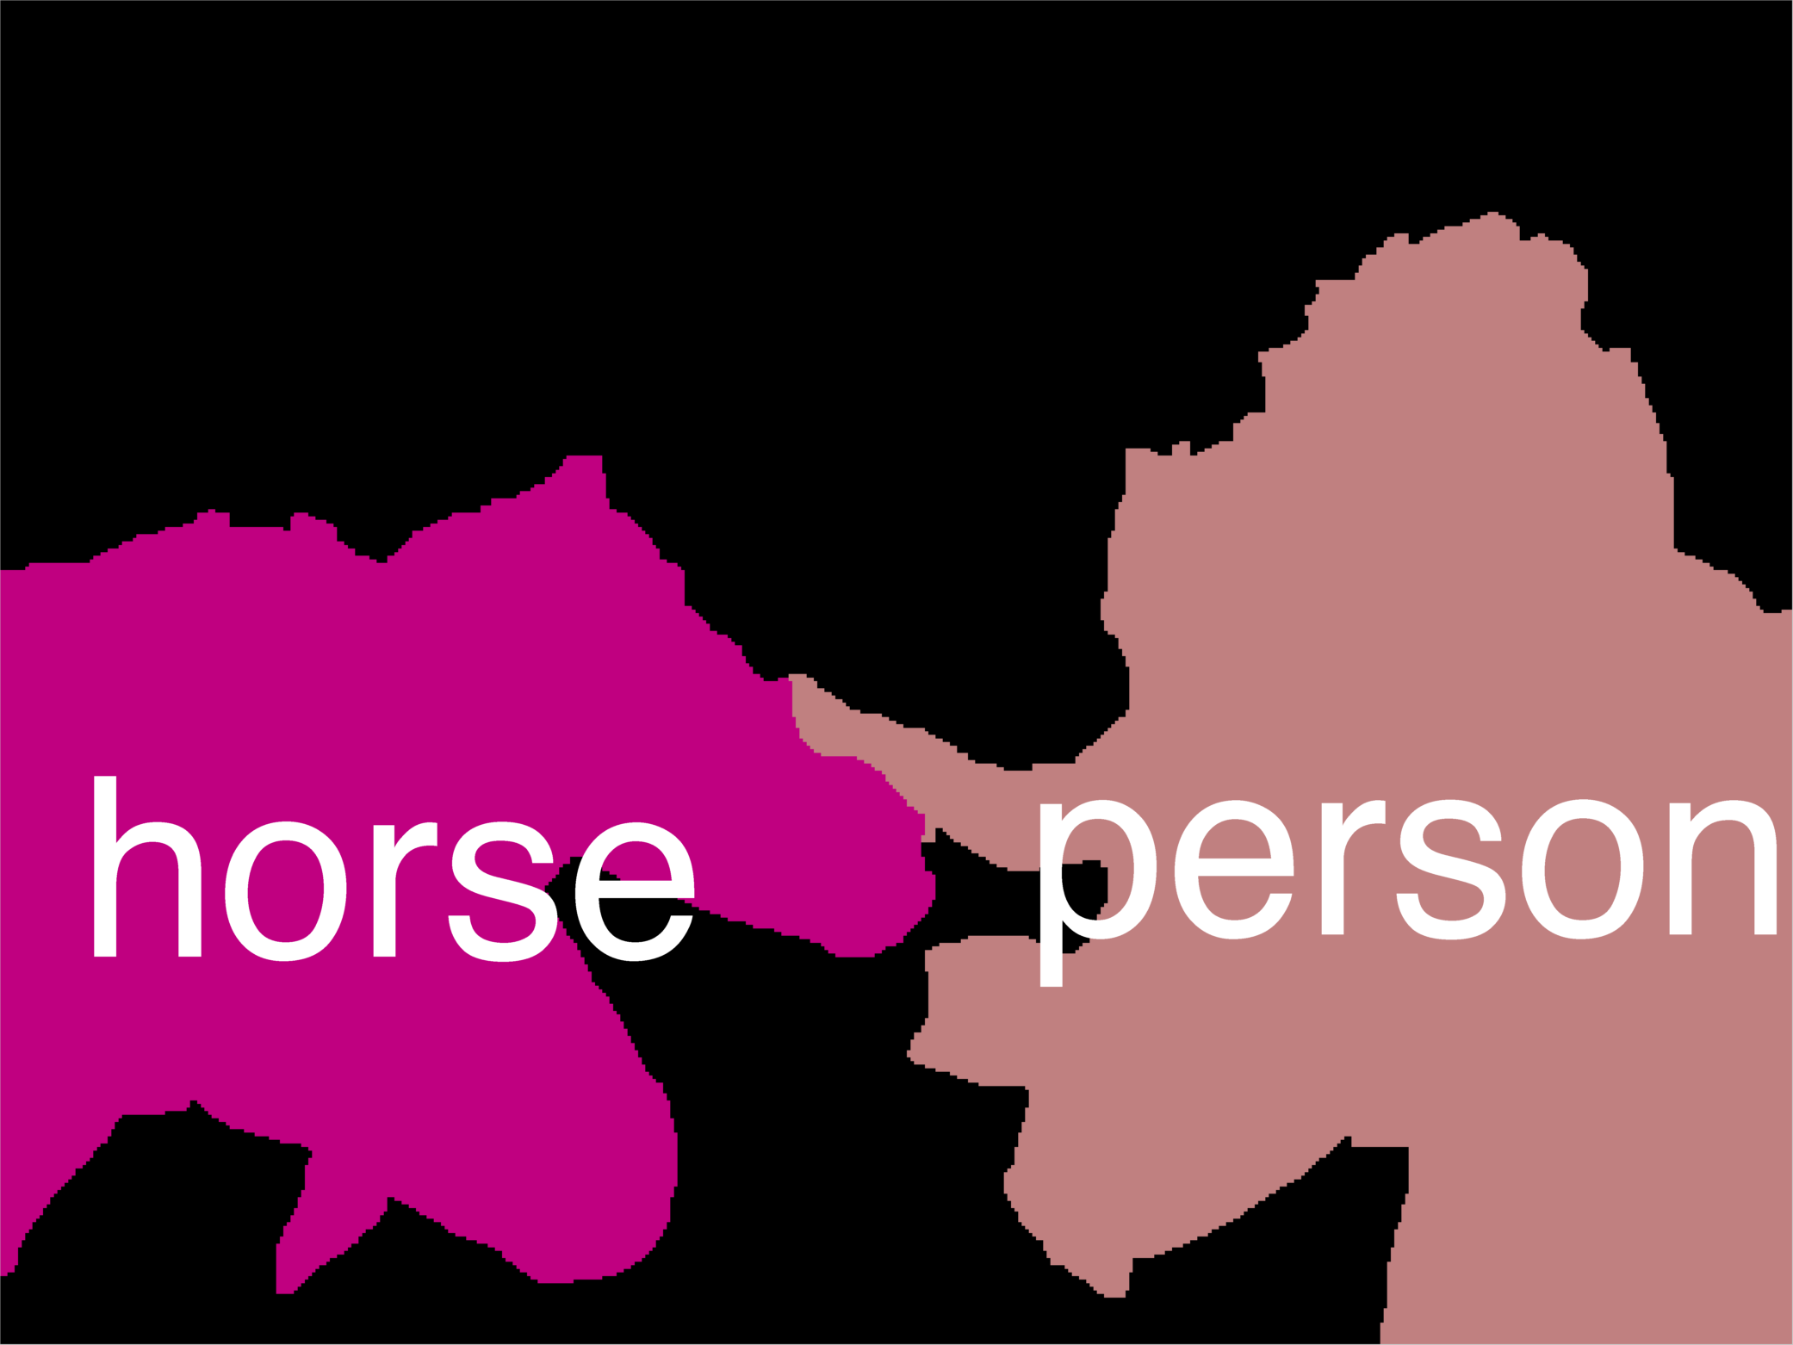
Example Result
Now what?

Slide 3
Your Options
Nothing
  User in the loop
(Approximate) Min Bayes Risk
  Use solutions to estimate the distribution and optimize Bayes Risk
Re-ranking
  Pick a good solution from the list
Increasing Side Information

Slide 4
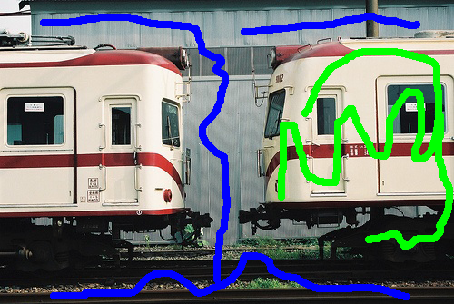
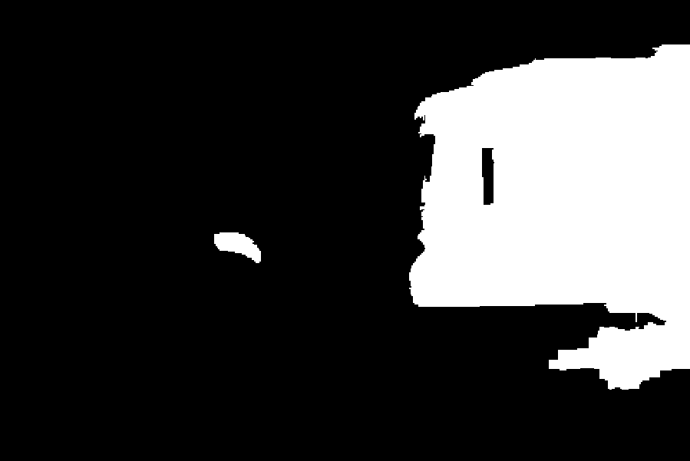

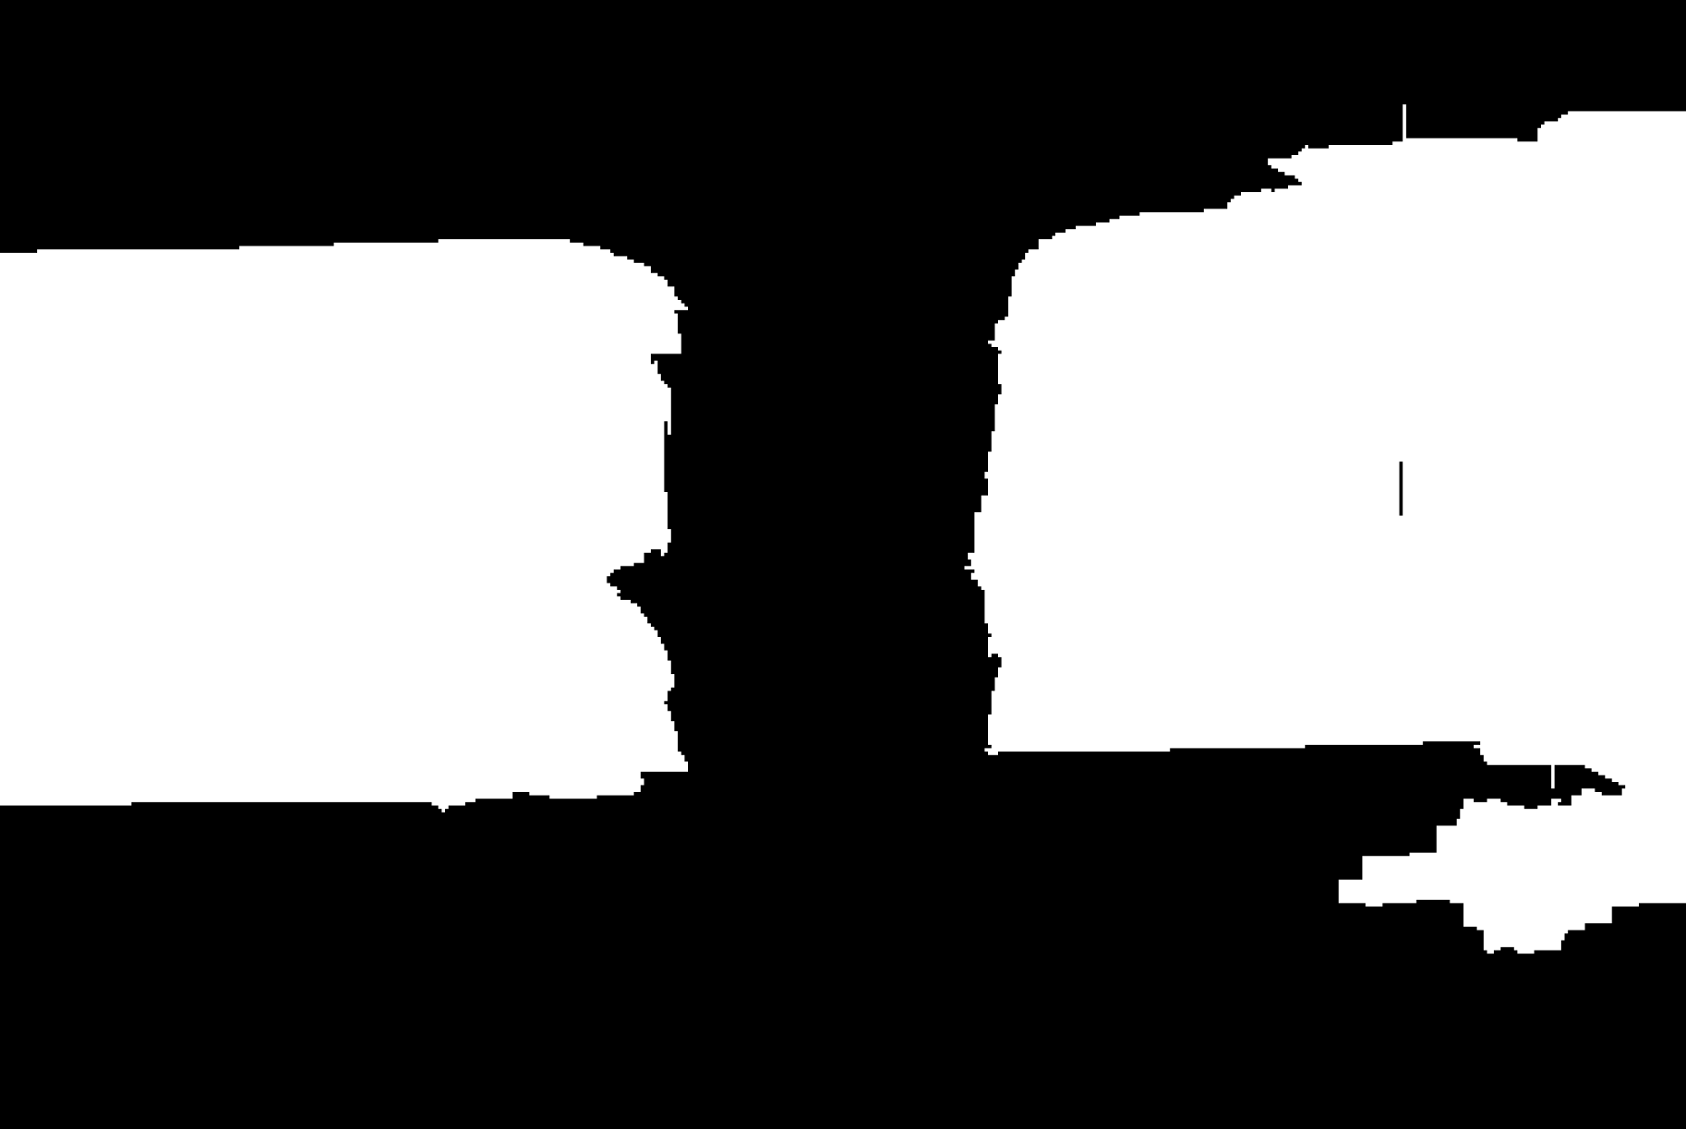
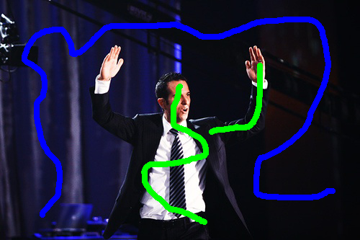

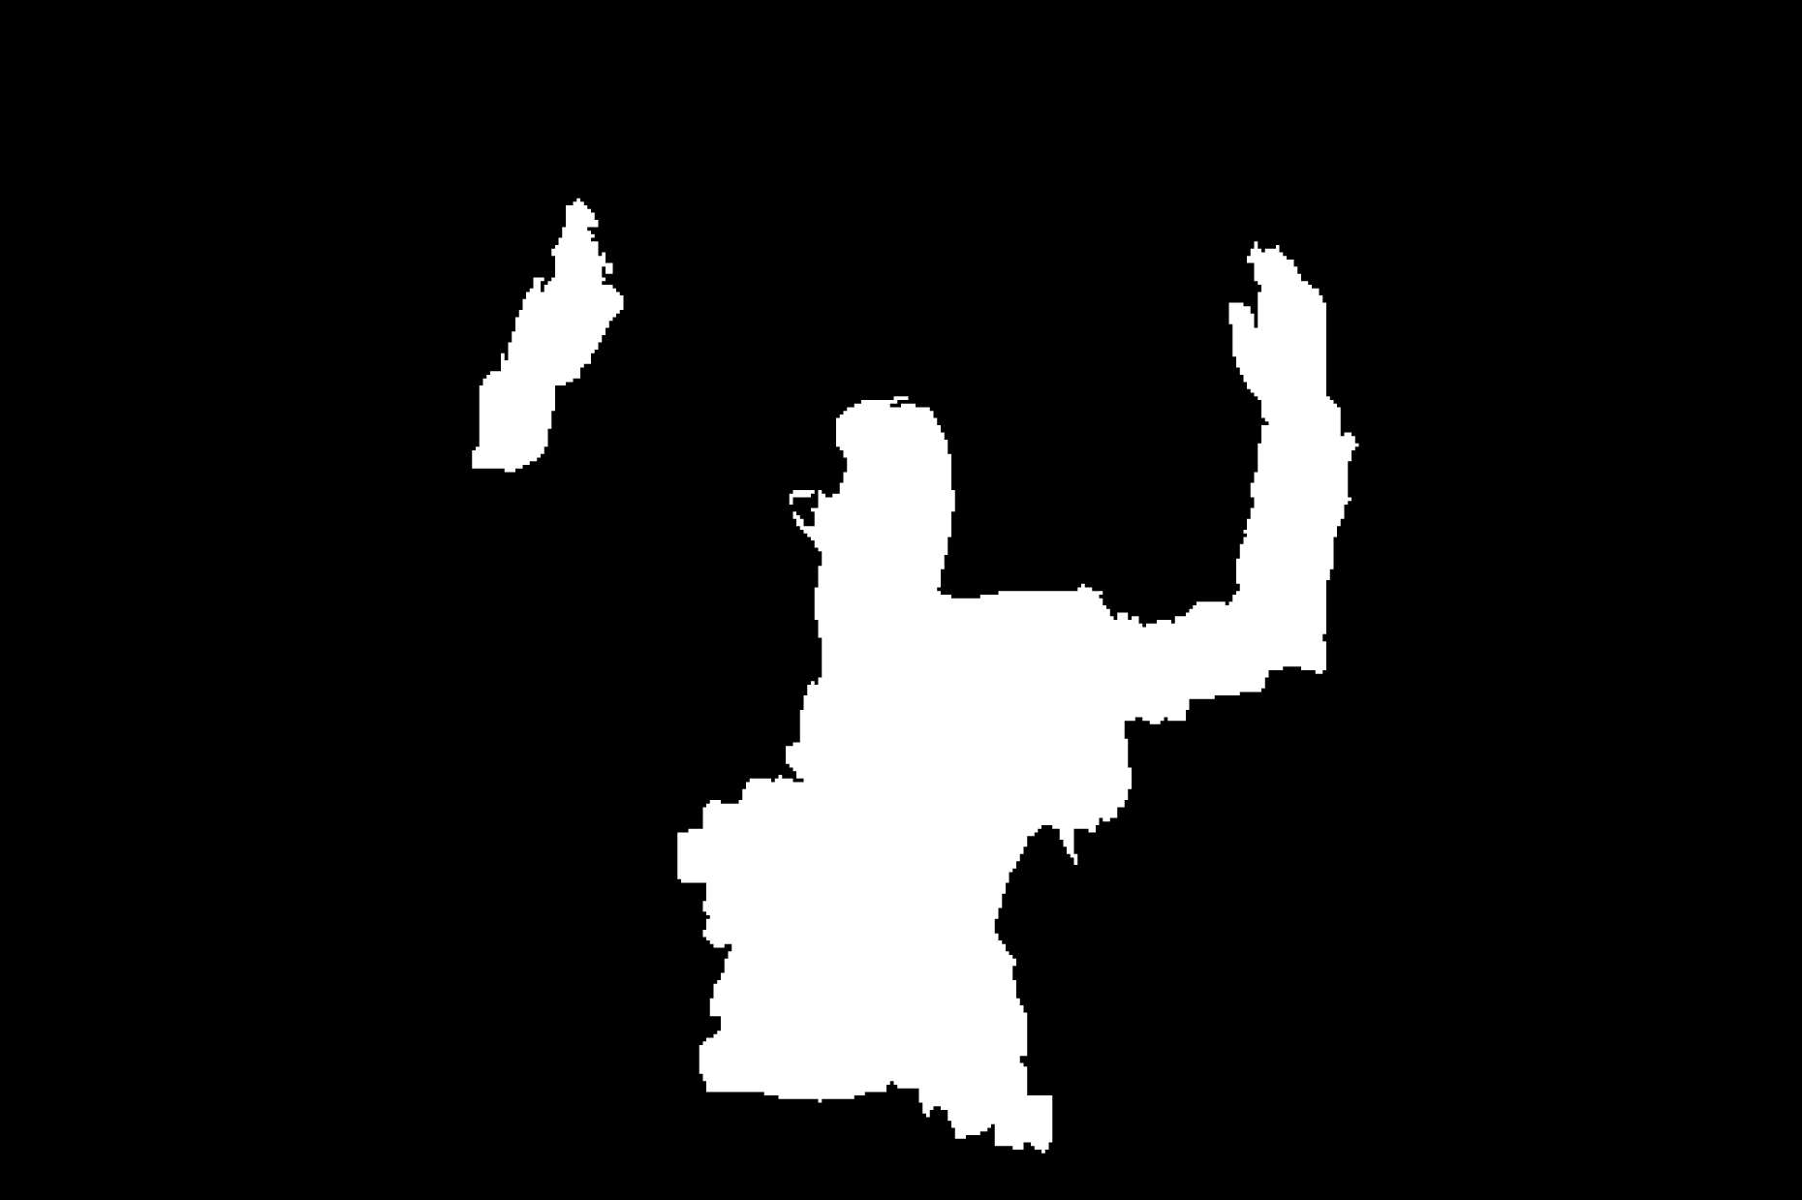

Interactive Segmentation
Setup
  Model: Color/Texture + Potts Grid CRF
  Inference: Graph-cuts
  Dataset: 50 train/val/test images
Image + Scribbles
MAP
2nd Best MAP
Diverse 2nd Best
1-2 Nodes Flipped
100-500 Nodes Flipped
Notes:
The first experiment is interactive segmentation, where a user provides scribbles on images and we use graph-cuts for inference.
This is the second-best solution without diversity. We can see that it is nearly identical to MAP with a few nodes flipped.
This is the second-best solutions with diversity. We can see that these solutions are significantly different. In one case, we found another instance of the object, and in another, we completed a thin long structure.

Slide 5
Interactive Segmentation
Better
+3.62%
+1.61%
Segmentation Accuracy
+0.05%
(Oracle)
(Oracle)
(Oracle)
M=6
Notes:
Quantitatively, here is the how well MAP performs on our dataset.
And these are the oracle accuracy for different methods. We can see that DivMBest outperforms both baselines.

Slide 6
Your Options
Nothing
  User in the loop
(Approximate) Min Bayes Risk
  Use solutions to estimate the distribution and optimize Bayes Risk
Re-ranking
  Pick a good solution from the list

Slide 7

Statistics 101
Loss
  PCP, Pascal Loss, etc
“True” Distribution
Expected Loss:
Min Bayes Risk

Slide 8
Structured Output Problems
Min Bayes Risk
Two Problems
Approximate MBR:
Intractable
Intractable

Slide 9
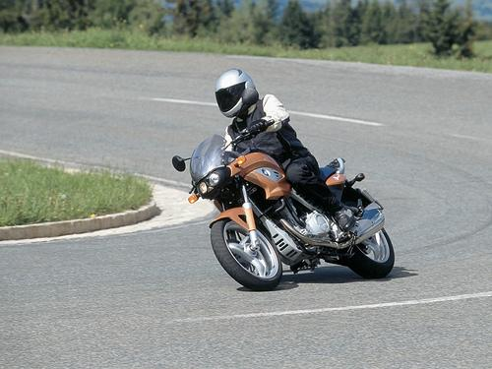
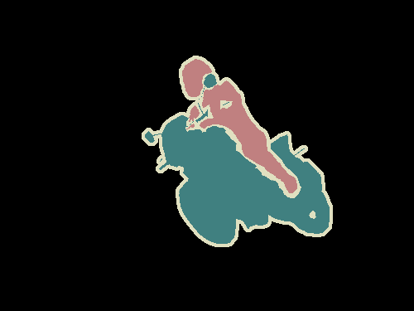
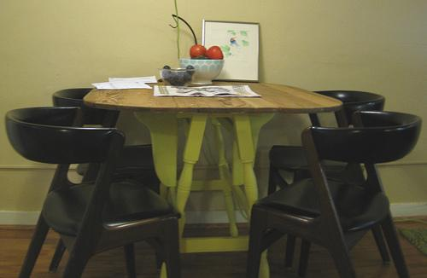

Semantic Segmentation
Setup
  Models:
    Hierarchical CRF [Ladicky et al. ECCV ’10, ICCV ‘09]
    Second-Order Pooling [Carreira ECCV ‘12]
  Inference:
    Alpha-expansion
    Greedy
  Dataset: Pascal Segmentation Challenge (VOC 2012)
    20 categories + background; ~1500 train/val/test images
Notes:
Finally, we applied DivMBest to Semantic Segmentation on the PASCAL 2010 dataset.
We use the model of Ladicky et al., where approximate inference is performed with alpha-expansion.

Slide 10
Large-Margin Re-ranking

Slide 11
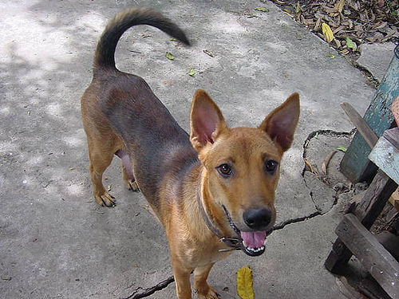

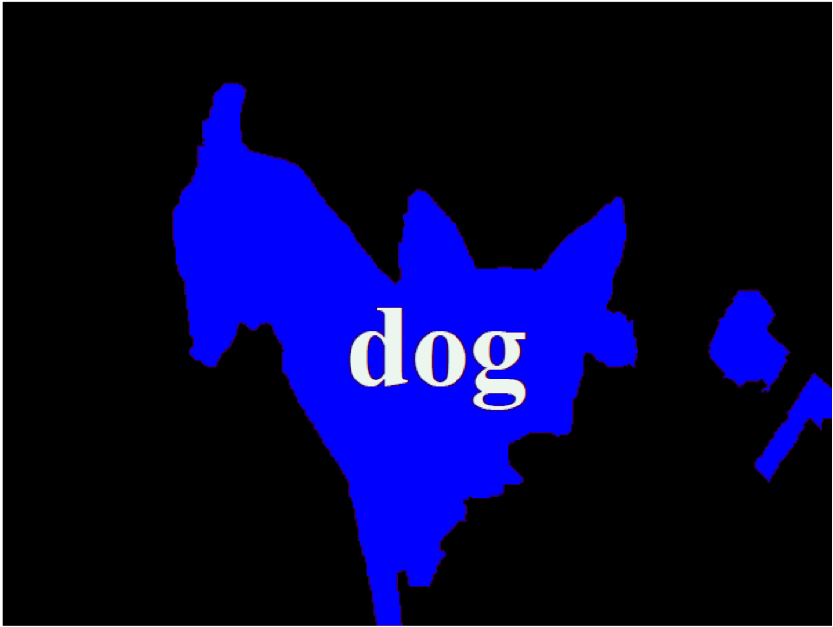
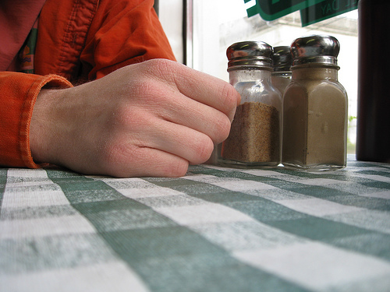
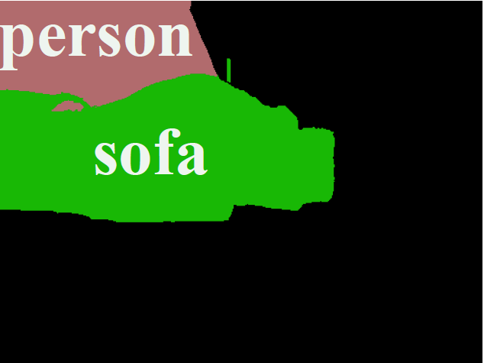
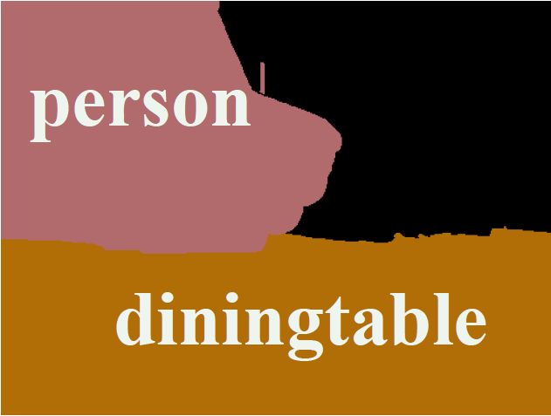
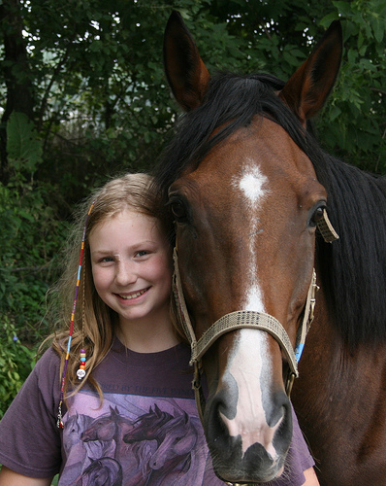
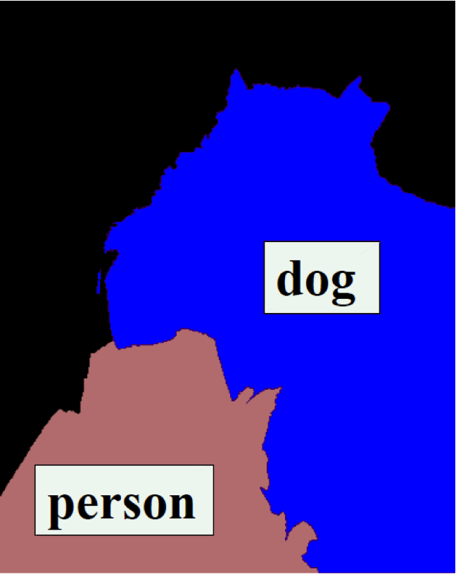
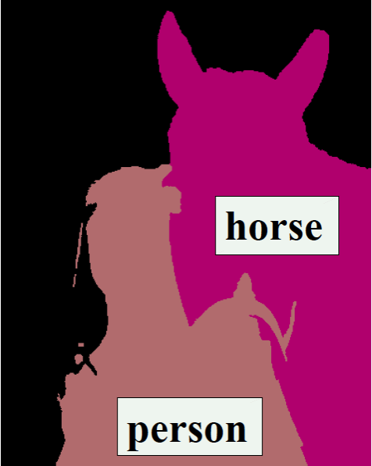
Semantic Segmentation
Input
MAP
Best of 10-Div
Notes:
Here are some example results.
We can see that for the first image, the MAP solution is wrong.
But if we compute 10 diverse solutions, one of them does in fact have the correct answer.

Slide 12
Semantic Segmentation
Better
DivMBest (Oracle)
15%-gain possible
Same Features
Same Model
PACAL Accuracy
MBR
MAP
[State-of-art circa 2012]
Rand (Re-rank)
#Solutions / Image

Slide 13
Your Options
Nothing
  User in the loop
(Approximate) Min Bayes Risk
  Use solutions to estimate the distribution and optimize Bayes Risk
Re-ranking
  Pick a good solution from the list

Slide 14
Large-Margin Re-ranking

Slide 15
Large-Margin Re-ranking

Slide 16
Large-Margin Re-ranking

Slide 17
Large-Margin Re-ranking
Discriminative Re-ranking of Diverse Segmentation
[Yadollahpour et al., CVPR13, Wednesday Poster]

Slide 18
Semantic Segmentation
Better
DivMBest (Oracle)
PACAL Accuracy
DivMBest (Re-ranked) [Y.B.S., CVPR ‘13]
MBR
MAP
[State-of-art circa 2012]
Rand (Re-rank)
#Solutions / Image

Slide 19
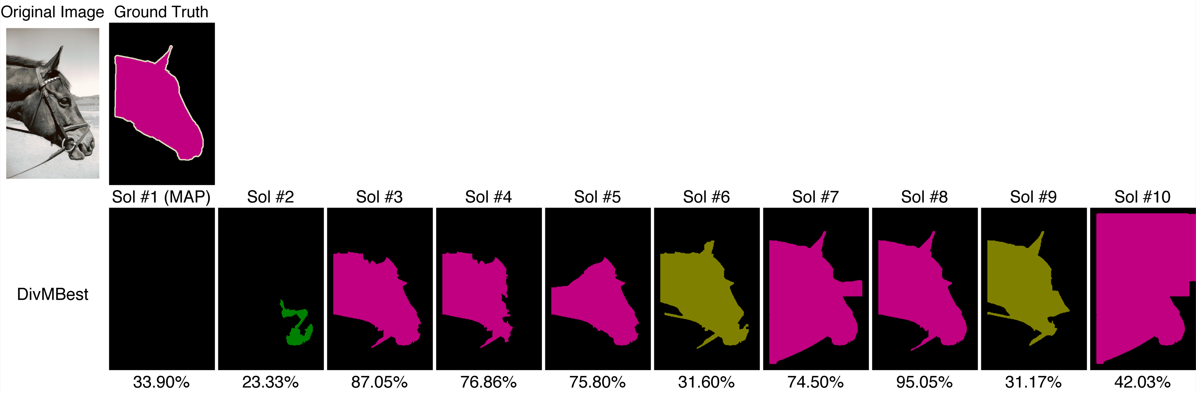
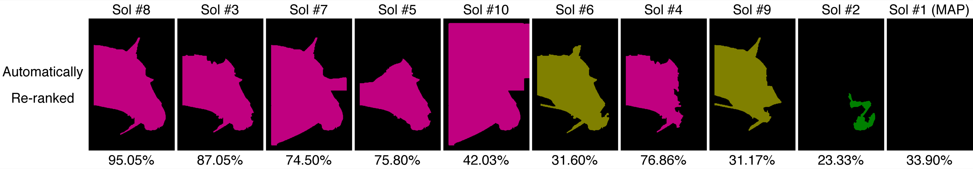
Qualitative Results: Success

Slide 20
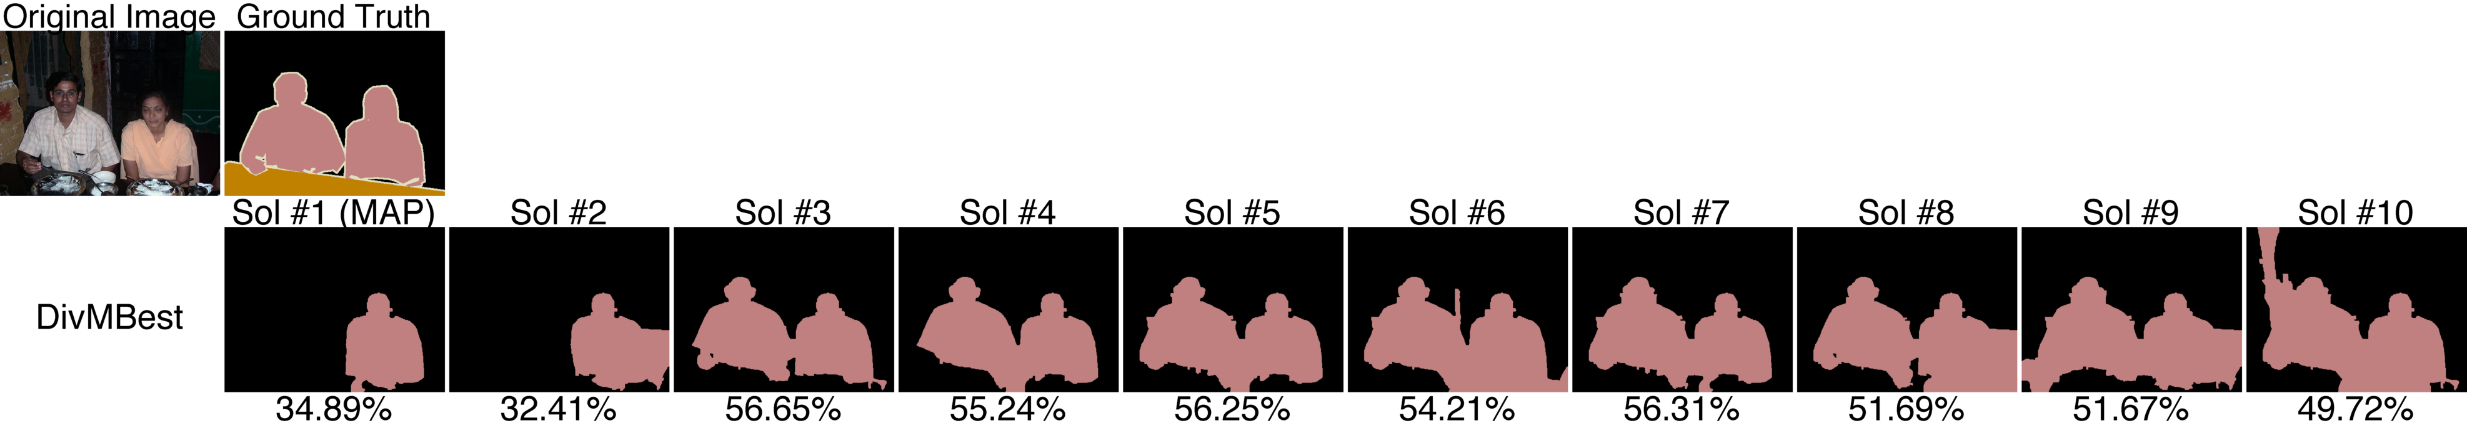
Qualitative Results: Success

Slide 21
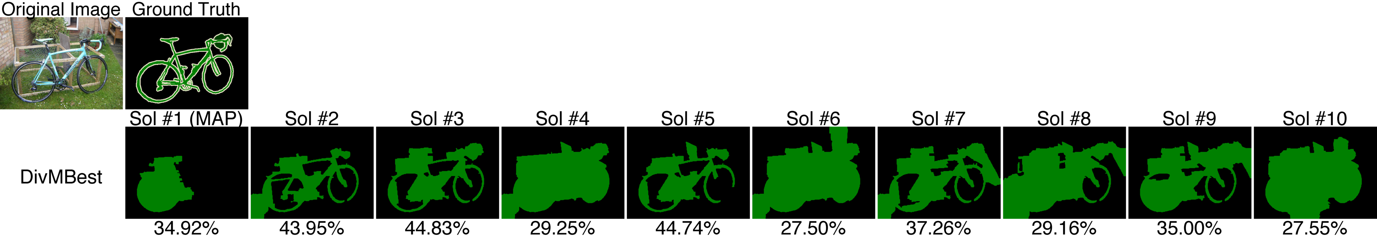
Qualitative Results: Success

Slide 22
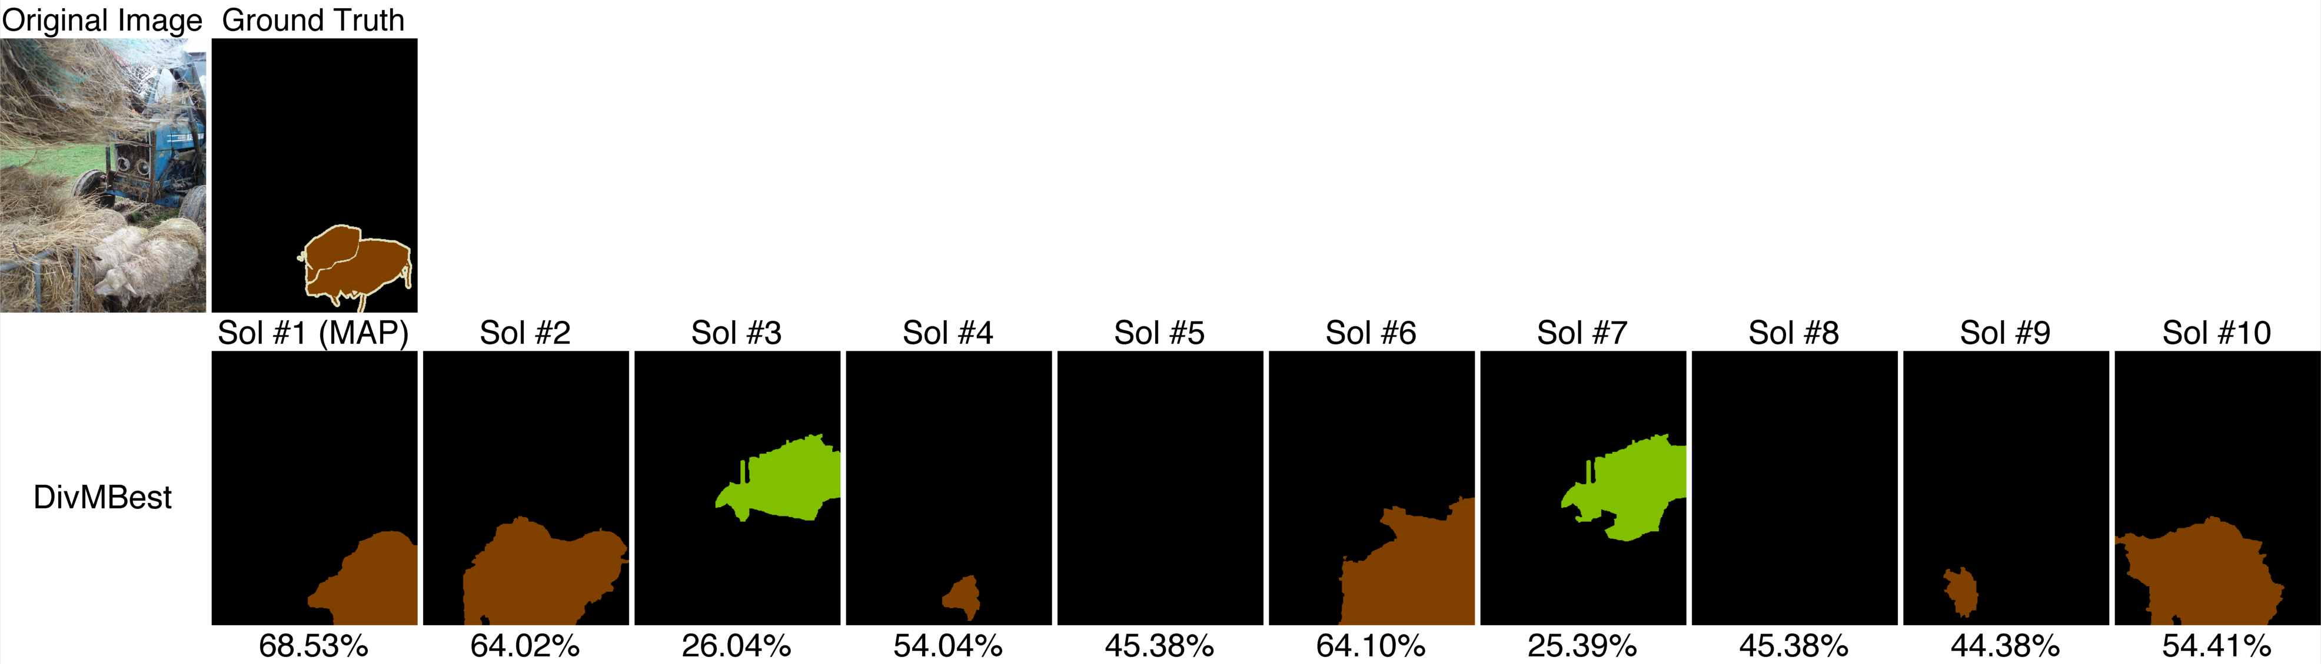
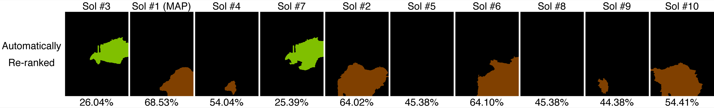
Qualitative Results: Failures

Slide 23
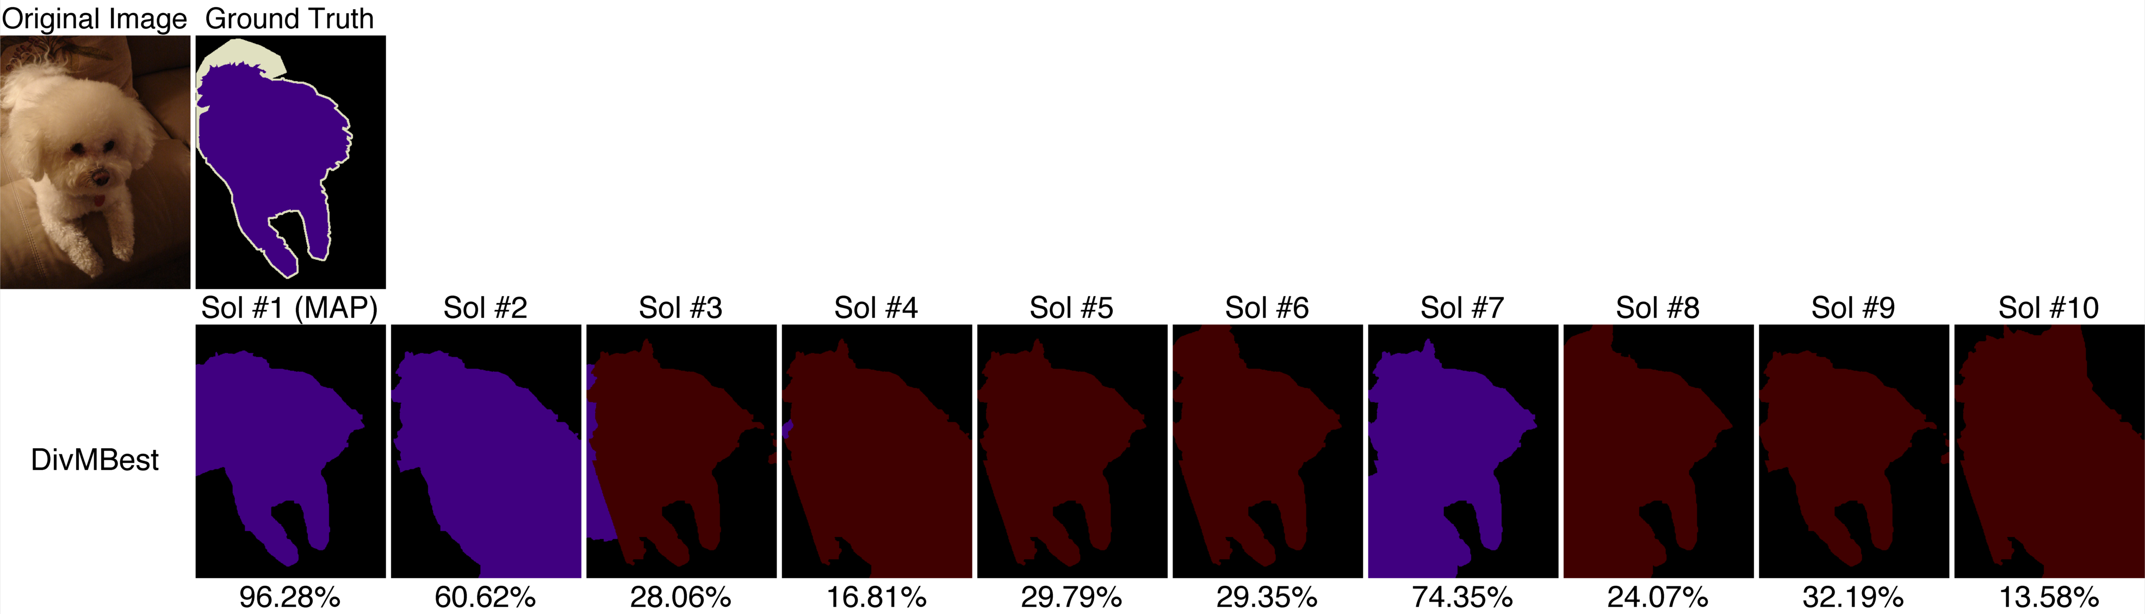
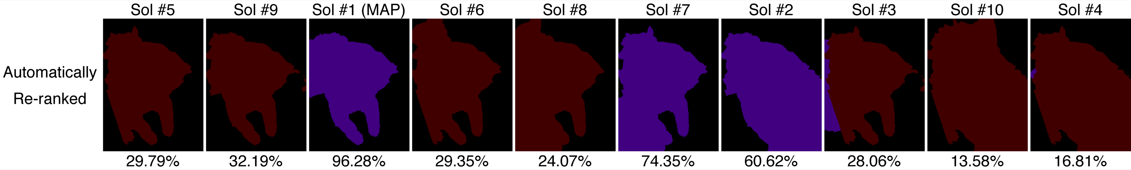
Qualitative Results: Failures

Slide 24
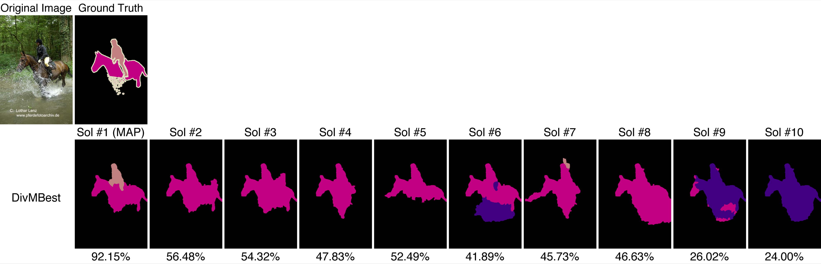
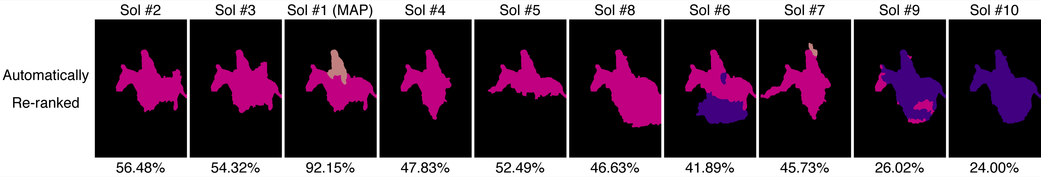
Qualitative Results: Failures

Slide 25
Summary
All models are wrong
Some beliefs are useful
Diverse Multiple Solutions
  A way to get useful beliefs out.
DivMBest + Reranking
  Big impact possible on many applications!
Notes:
In summary, not matter what the problem, all models are wrong, but some of their beliefs might be useful.
Our proposed algorithm give you a wait to exploit these beliefs by producing diverse M-Best solutions in discrete models.
It’s an efficient algorithm that re-uses existing MAP machinery.
And we believe there is a big impact possible on many applications.

Slide 26
Summary
What does my model believe?
Posterior Summary

Slide 27
Thanks!

