Slide 1
The M-Best Mode Problem
Dhruv Batra
Research Assistant Professor
TTI-Chicago
Joint work with:
Abner Guzman-Rivera (UIUC), Greg Shakhnarovich (TTIC), Payman Yadollahpour (TTIC).

Slide 2


Local Ambiguity
slide credit: Fei-Fei Li, Rob Fergus & Antonio Torralba

Slide 3
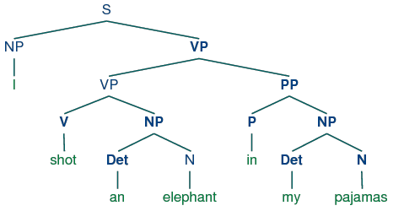
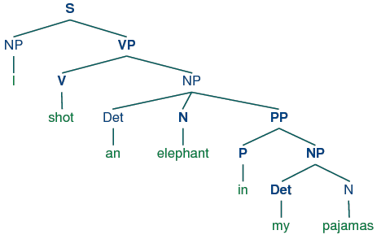
Local Ambiguity
“While hunting in Africa, I shot an elephant in my pajamas.
How an elephant got into my pajamas, I’ll never know!”
  Groucho Marx (1930)

Slide 4
Output-Space Explosion
k Classes
Exponentially Many Classes
+1, -1
all graph-labelings

Slide 5
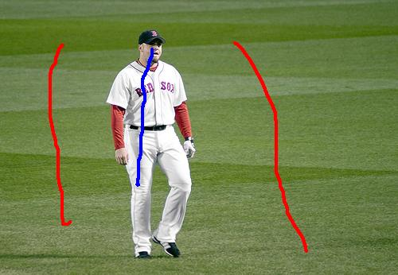

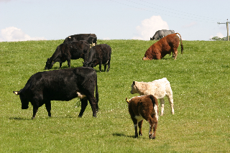
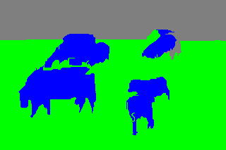
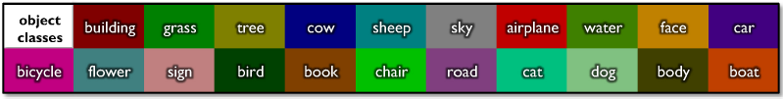
Structured Output
Segmentation
  [Batra et al. CVPR ‘10, IJCV ’11]
  [Batra et al. CVPR ’08], [Batra ICML ‘11, CVPR ‘11]
(#Labels)^{#Pixels}
sky
cow
grass

Slide 6
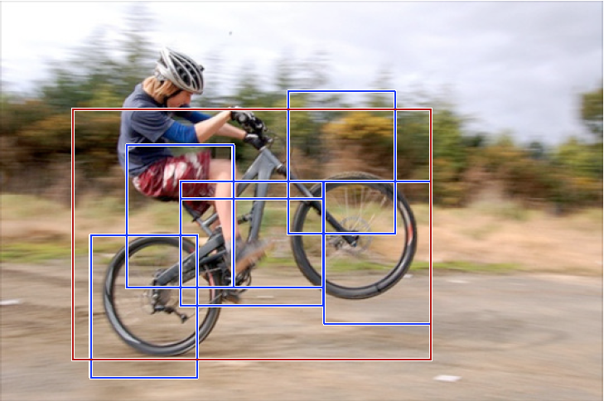
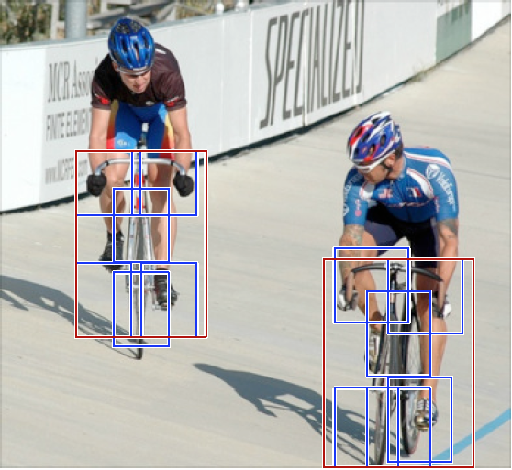
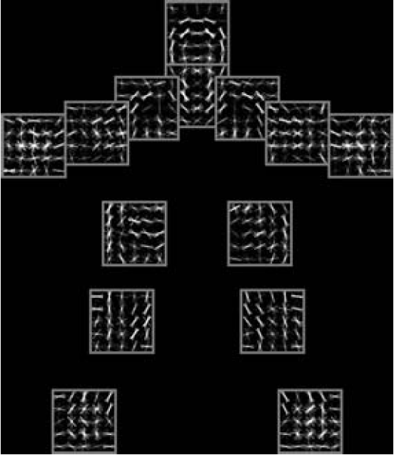
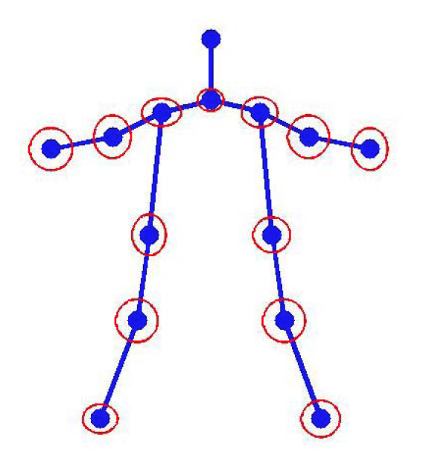
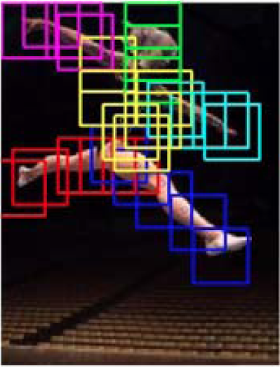
Structured Output
Object Detection: parts-based models
  [Felzenszwalb et al. PAMI ‘10], [Yang and Ramanan, ICCV ‘11]
(#Pixels)^{#Parts}

Slide 7
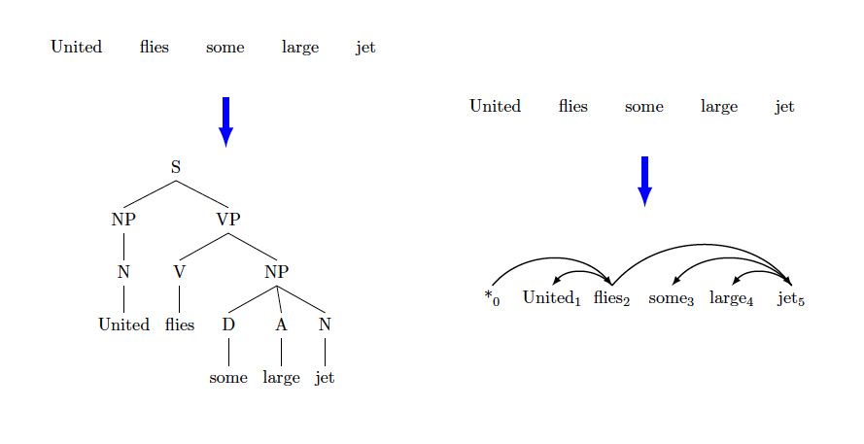
Structured Output
Dependency parsing
|Sentence-Length|^{|Sentence-length|-2}
Figure courtesy Rush & Collins NIPS11

Slide 8
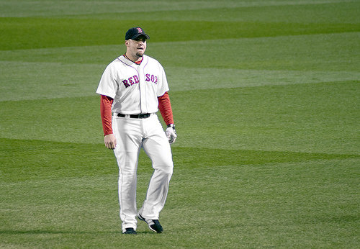


Conditional Random Fields
X₁
Discrete random variables
Factored-Exponential Model
X₂
1 1 10 0
10
0
kx1
…
10
X_{i}
X_{n}
10
0
10
kxk
Node Energies / Local Costs
Edge Energies /
Distributed Prior

Slide 9


MAP Inference
In general NP-hard [Shimony ‘94]
Approximate Inference
Heuristics: Loopy BP [Pearl, ‘88]
Greedy: α-Expansion [Boykov ’01, Komodakis ‘05]
LP Relaxations: [Schlesinger ‘76, Wainwright ’05, Sontag ’08, Batra ‘10]
QP/SDP Relaxations: [Ravikumar ’06, Kumar ‘09]

Slide 10
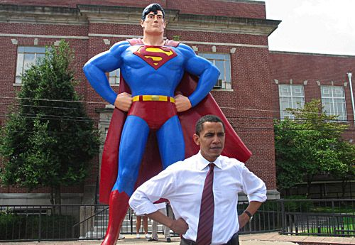
MAP Inference
In general NP-hard [Shimony ‘94]
Approximate Inference
Heuristics: Loopy BP [Pearl, ‘88]
Greedy: α-Expansion [Boykov ’01, Komodakis ‘05]
LP Relaxations: [Schlesinger ‘76, Wainwright ’05, Sontag ’08, Batra ‘10]
QP/SDP Relaxations: [Ravikumar ’06, Kumar ‘09]
This is a job for Optimization Man

Slide 11

I have a new Fancy Approximate Inference Alg.
Worship Me!

Slide 12

MAP ≠ Ground-truth
Large-scale studies
  “the global OPT does not solve many of the problems in the BP or Graph Cuts solutions.”
    [Meltzer, Yanover, Weiss ICCV05]
  “the ground truth has substantially lower score [than MAP]”
    [Szeliski et al. PAMI08]
Implication: Models are inaccurate.
Ground-Truth

Slide 13

Possible Solution
Ask for more than MAP!
M-Best MAP Problem
✓
Flerova et al., 2011
Rollon et al., 2011
Fromer et al., 2009
Yanover et al., 2003
Nilsson,1998
Seroussi et al., 1994
Lawler, 1972
Better Problem:
M-Best Modes

Slide 14
Formulation
Over-Complete Representation
1
0
0
0
0
1
0
0
1
1
0
0
0
0
0
0
Inconsistent
kx1
1000000000000000
0100000000000000
k²x1

Slide 15


Formulation
Score = Dot Product
kx1
k²x1

Slide 16

Formulation
MAP Integer Program
Black-Box

Slide 17

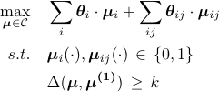
Formulation
2nd-Best Mode
MAP
2nd-Mode
MAP

Slide 18

Approach
Diversity-Augmented Score
2nd-Best Mode
Lagrangian Relaxation
  Convergence & other guarantees
  Large class of Delta-functions allowed
  See paper for details
Primal
Dualize
Dual
Binary Search in 1-D
Subgradient Descent in N-D
Convex (Non-smooth)
Upper-Bound on Primal-OPT
Primal-OPT

Slide 19
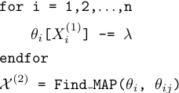



Dot-Product Dissimilarity
Diversity Augmented Inference:
For integral solution, equivalent to Hamming!
0
1
0
0
Simply edit node-terms. Reuse MAP machinery!

Slide 20
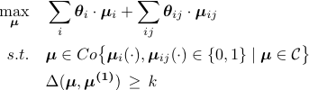
Theorem Statement
Theorem [Batra et al ’12]: Lagrangian Dual corresponds to solving the Relaxed Primal:
    Based on result from [Geoffrion ‘74]
Dual
Relaxed Primal

Slide 21
How Much Diversity?
Empirical Solution: Cross-Val for
More Efficient: Cross-Val for

Slide 22
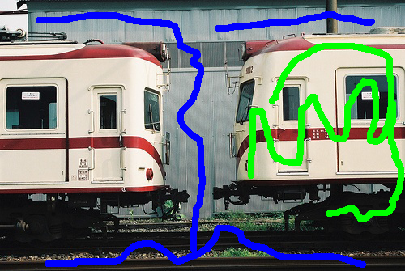


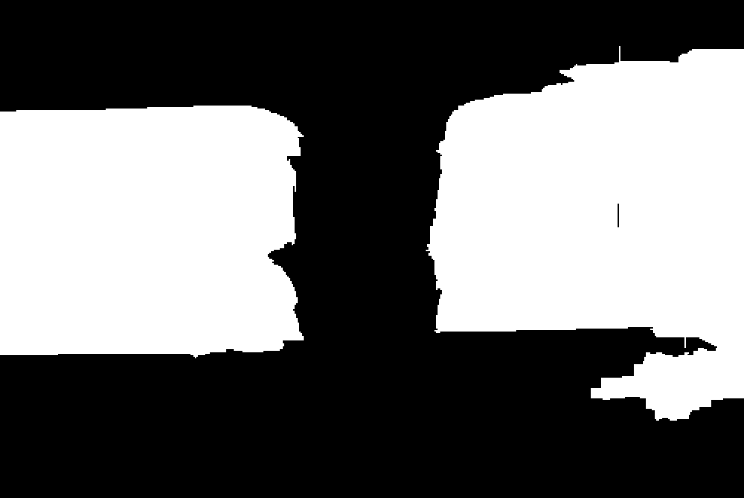
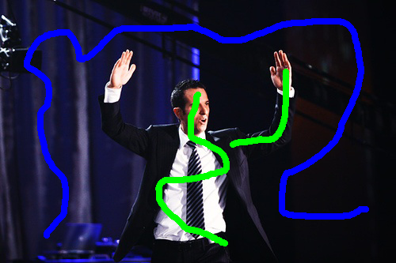



Experiment #1
Interactive Segmentation
  Model from [Batra et al. CVPR’10]
Image + Scribbles
MAP
2nd Best MAP
2nd Best Mode

Slide 23
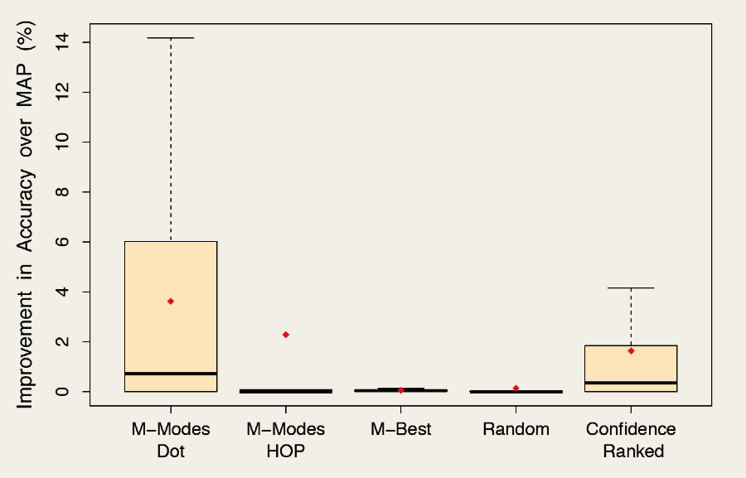
Experiment #1
Better
MAP

Slide 24
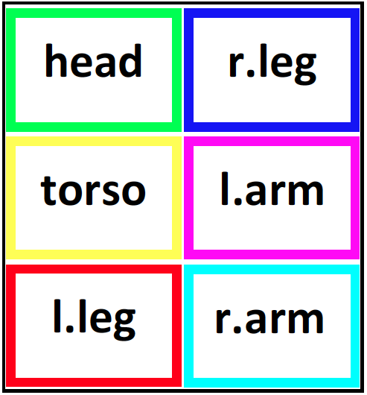
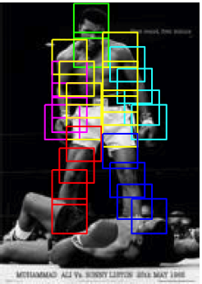
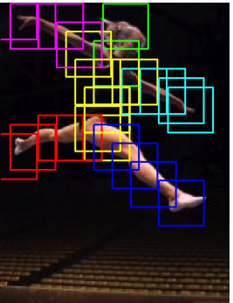
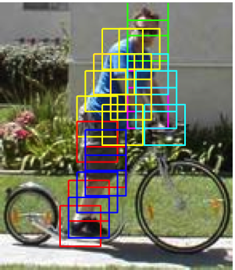
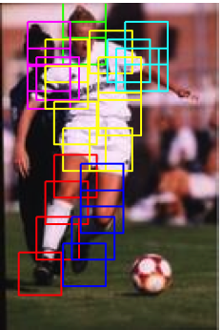
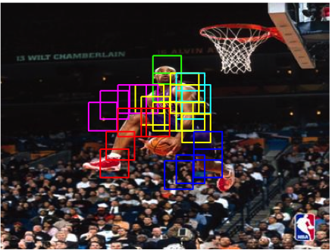
Experiment #2
Pose Estimation

Slide 25
Experiment #2
Mixture of Parts Model
  Model from [Yang, Ramanan, ICCV ‘11]
    Tree of Parts
    Histogram of Oriented Gradient (HOG) Features

Slide 26
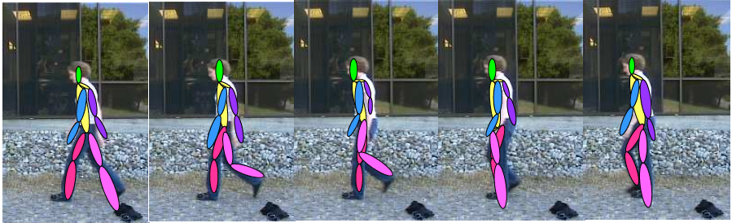
Experiment #2
Pose Tracking w/ Chain CRF
M-Modes

Slide 27
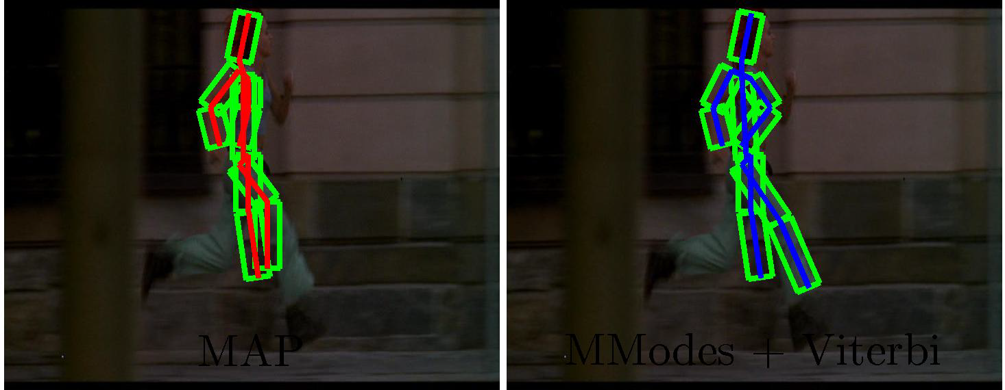
Experiment #2
MAP
M-Modes + Viterbi

Slide 28
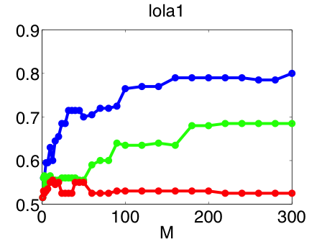
Experiment #2
Better
M-Modes
25% Better
Baseline #1
Accuracy
Baseline #2
#Modes / Frame

Slide 29
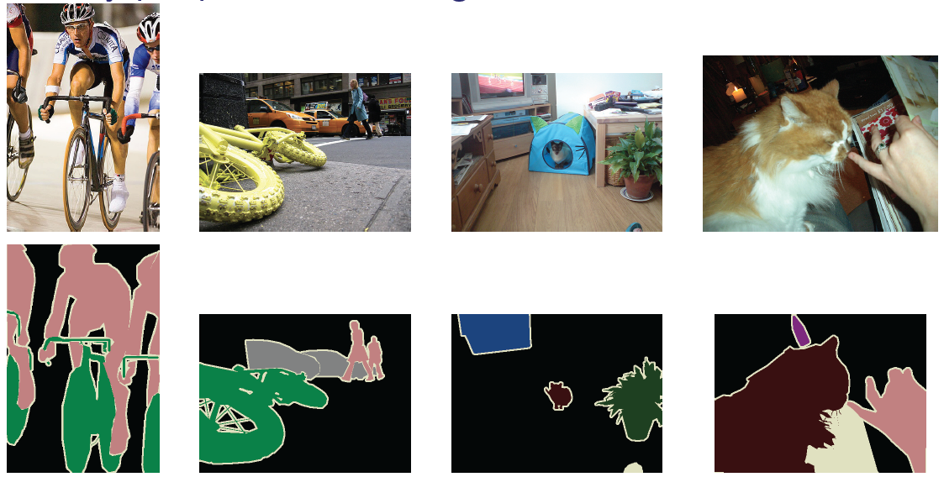
Experiment #3
Pascal Segmentation Challenge
  20 categories + background
  Competitive international challenge (2007-2012)

Slide 30
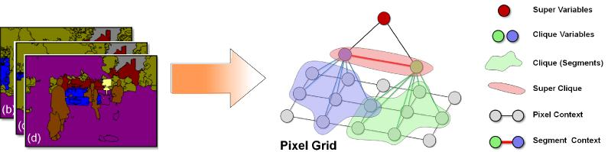
Experiment #3
Hierarchical CRF model
  [Ladicky et al. ECCV ‘10, BMVC ’10, ICCV ‘09]
    Pixel potential: textons, color, HOG
    Pairwise potentials between pixels: Potts
    Segment potentials: histogram of pixel features
    Pairwise potentials between segments

Slide 31

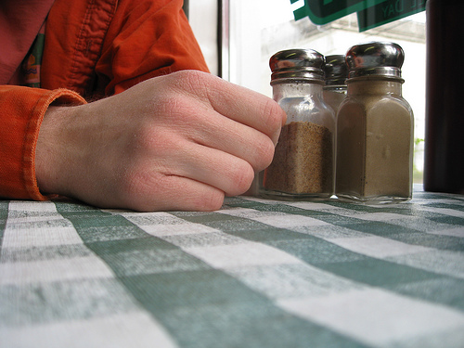
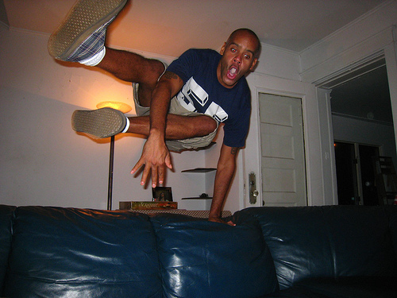
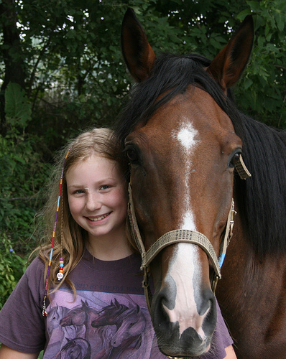
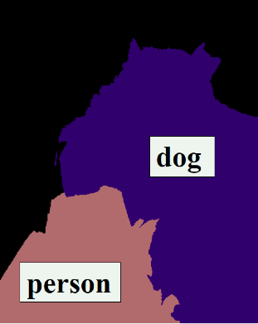

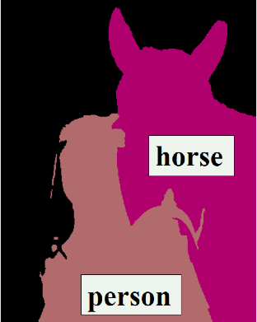

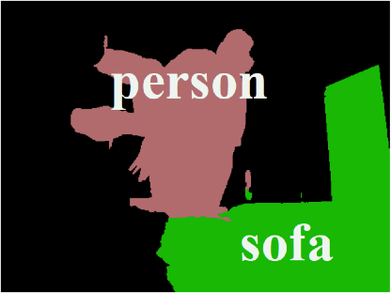
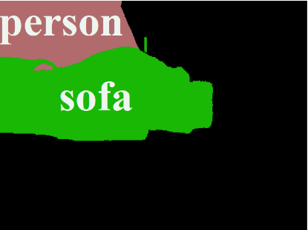


Examples: Test Set
Input
MAP
Best Mode

Slide 32
Experiment #3
Better
M-Modes
Accuracy
State of the art
Baseline
MAP
#Modes / Image

Slide 33


Future Directions
M-Best Modes
  More applications
    Object Detection, Medical Segmentation
  Cascaded Models with Modes passed on
  General Trick for Combinatorial Structures
Top M
Top M
Step 1
Step 2
Step 3
hypotheses
hypotheses

Slide 34
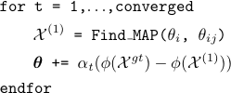
Future Directions
M-Best Modes
  Improved Learning with Modes
  Posterior Summaries with Modes

Slide 35
Take-Away Message (Part #1)
Think about YOUR problem.
Are you or a loved one, tired of a single solution?
If yes, then M-Modes might be right for you!*
* M-Modes is not suited for everyone. People with perfect models, and love of continuous variables should not use M-Modes. Consult your local optimization expert before starting M-Modes.
Please do not drive or operate heavy machinery while on M-Modes.

Slide 36



Thank You!
M-Best Modes
Payman Yadollahpour
(TTIC)
Abner Guzman-Rivera
(UIUC)
Greg Shakhnarovich
(TTIC)

Slide 38
Local Ambiguity
[Smyth et al., 1994]
slide credit: Andrew Gallagher

Slide 39
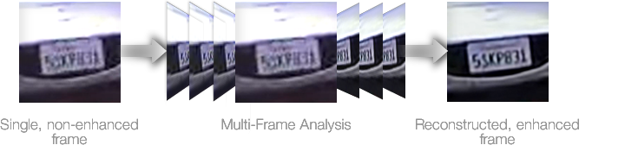

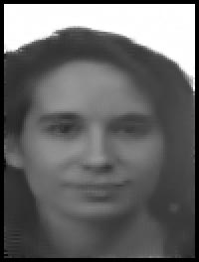
Structured Output
Super-Resolution
  [Baker, Kanade, PAMI ‘02], [Freeman et al, IJCV ‘00]
|Patch-Dictionary|^{#Patches}

Slide 40
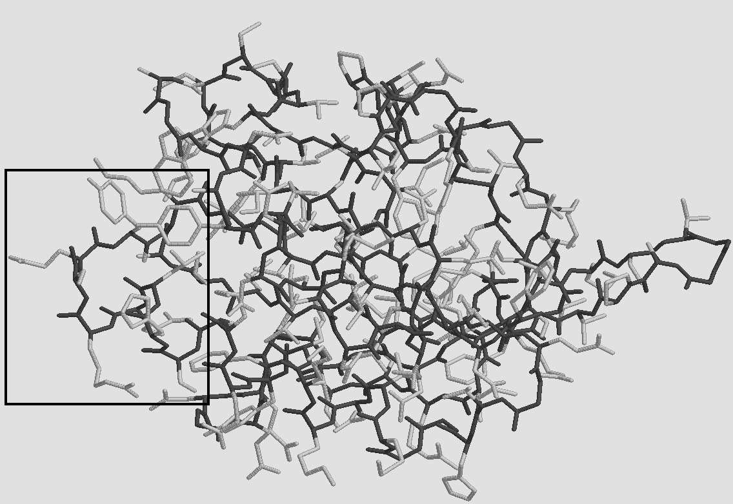
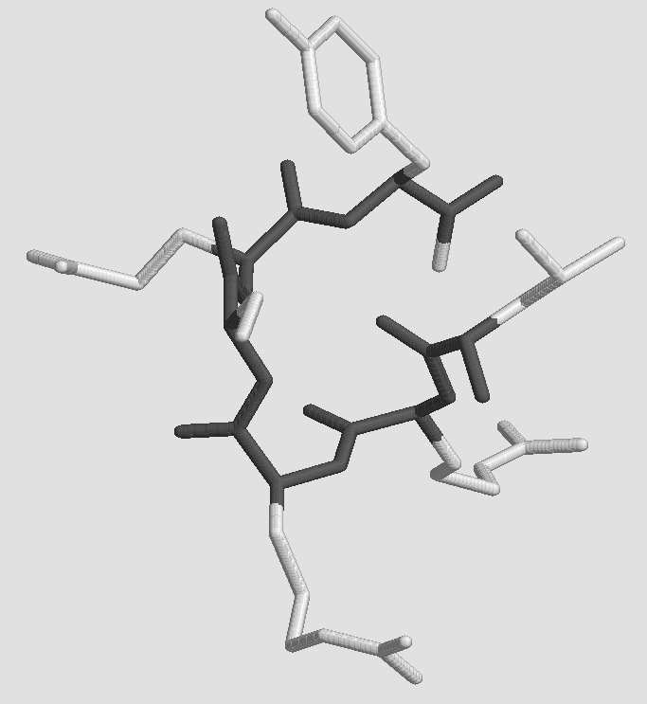
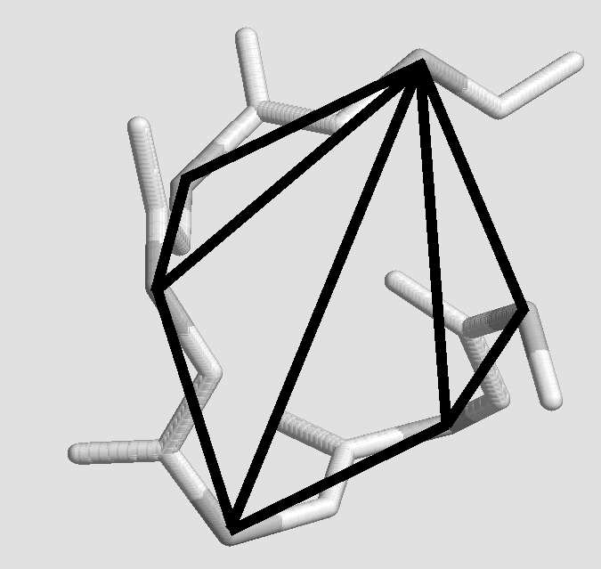
Structured Output
Protein Side-Chain Prediction
(#Angles)^{#Sites}
Figure courtesy Yanover & Weiss NIPS02

Slide 41
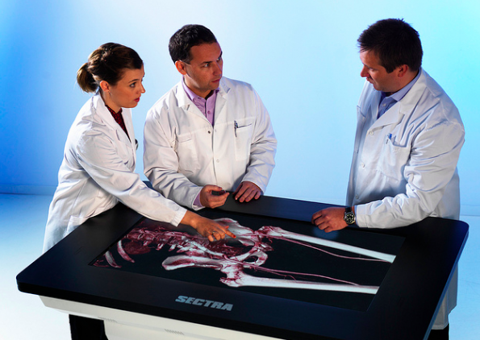
Applications
What can we do with multiple solutions?
  More choices for “human/expert in the loop”

Slide 42
Applications
What can we do with multiple solutions?
  More choices for “human/expert in the loop”
  Input to next system in cascade
Step 1
Top M
Step 2
Top M
Step 3
hypotheses
hypotheses

Slide 43
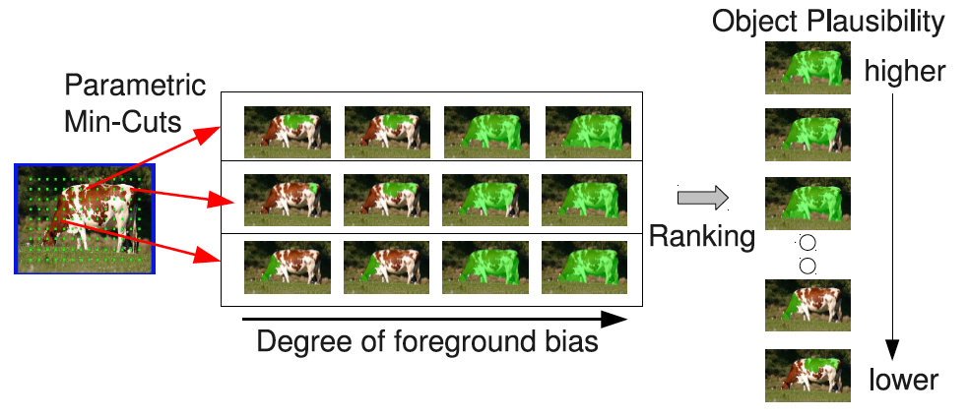
Applications
What can we do with multiple solutions?
  More choices for “human in the loop”
  Rank solutions
~10,000
[Carreira and Sminchisescu, CVPR10]
State-of-art segmentation on PASCAL Challenge 2011

Slide 44

Dissimilarity
A number of special cases
  0-1 Dissimilarity M-Best MAP
Large class of Delta-functions allowed
  Hamming distance
  Higher-Order Dissimilarity

Slide 45


Higher-Order Dissimilarity
Cardinality Potential
Efficient Inference
  Cardinality [Tarlow ‘10]
  Lower Linear envelop [Kohli ‘10]
  Pattern Potentials [Rother ‘10]

Slide 46
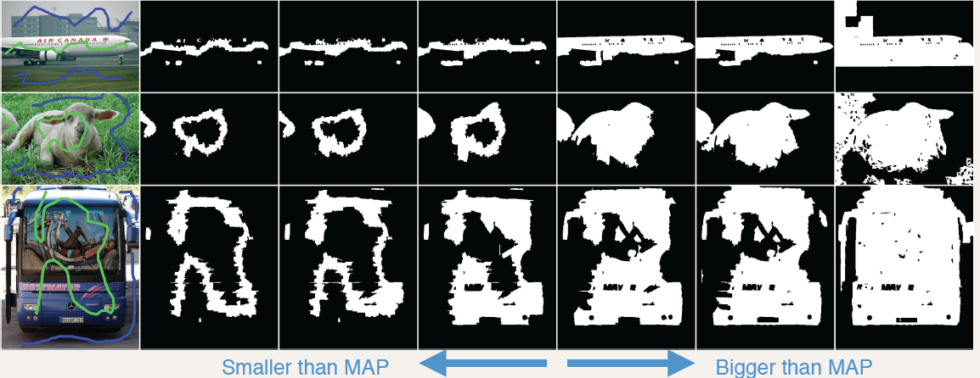
Example Results

Slide 47
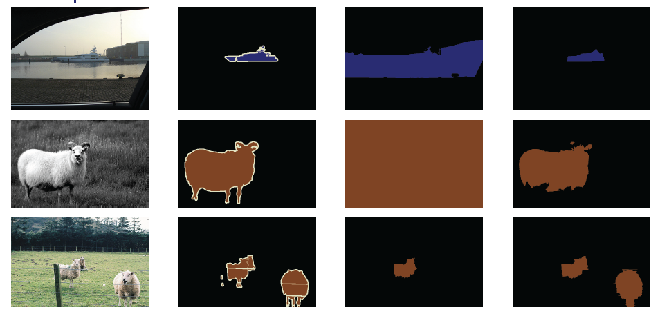
Examples: Validation Set
Input
Ground-Truth
MAP
Best Mode

Slide 48
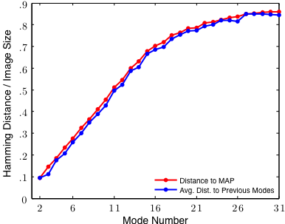
Experiment #3

Slide 49


Experiment #3

