Slide 1

PetTrack: Tracking Pet Location and Activity Indoors
Neeraj Alavala², Haige Chen¹, Rishabh Singhal¹, Ashutosh Dhekne¹
Georgia Institute of Technology
Microsoft
Notes:
Good afternoon. My name is Haige Chen. I will present our work, PetTrack: Tracking Pet Location and Activity Indoors. I would like to acknowledge the other authors, Neeraj Alavala who was previously at Georgia Institute of Technology and now at Microsoft, and Rishabh Singhal and Ashutosh Dhekne from Georgia Tech.

Slide 2

# of pet-owning households in US
Total pet industry expenditure in US
according to American Pet Product Association
90.5 million
109.6 billion
Notes:
(Millions) of families in the US have pets in their household. That number has increased during the pandemic to (). Nowadays, with people going back to office and travelling much more frequently, our pet friends are often left at home alone.

Slide 3
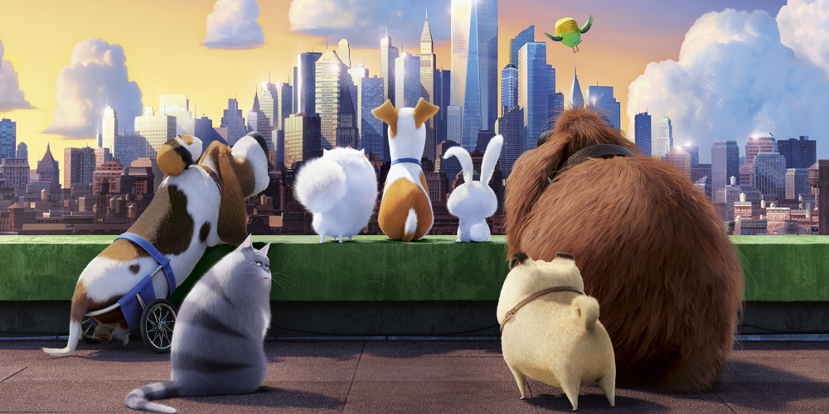
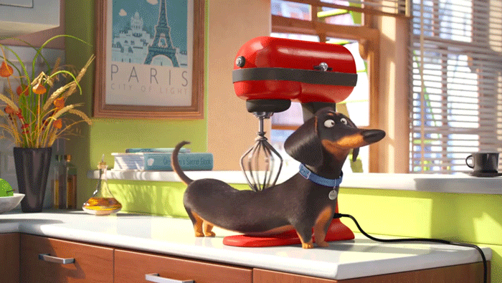
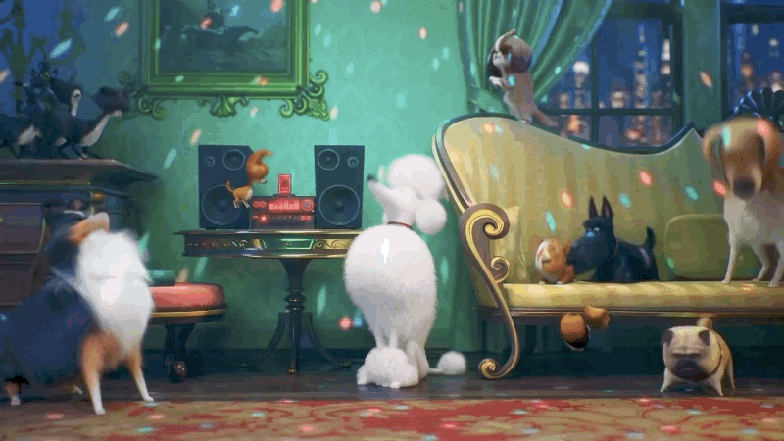
“The Secret Life of Pets”

Slide 4
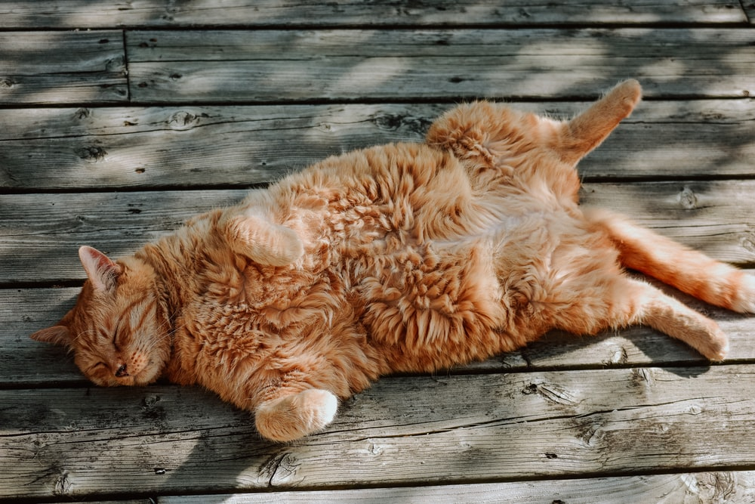
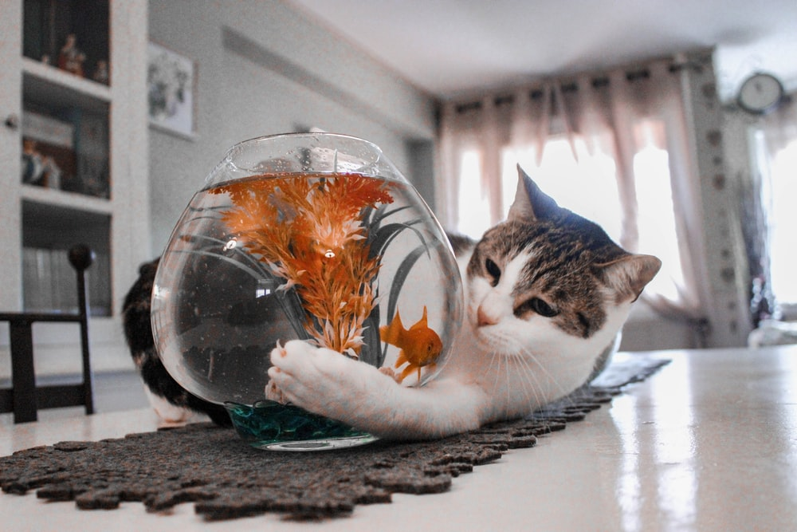
Does my cat sleep all day long, or does it play and exercise?

Slide 5
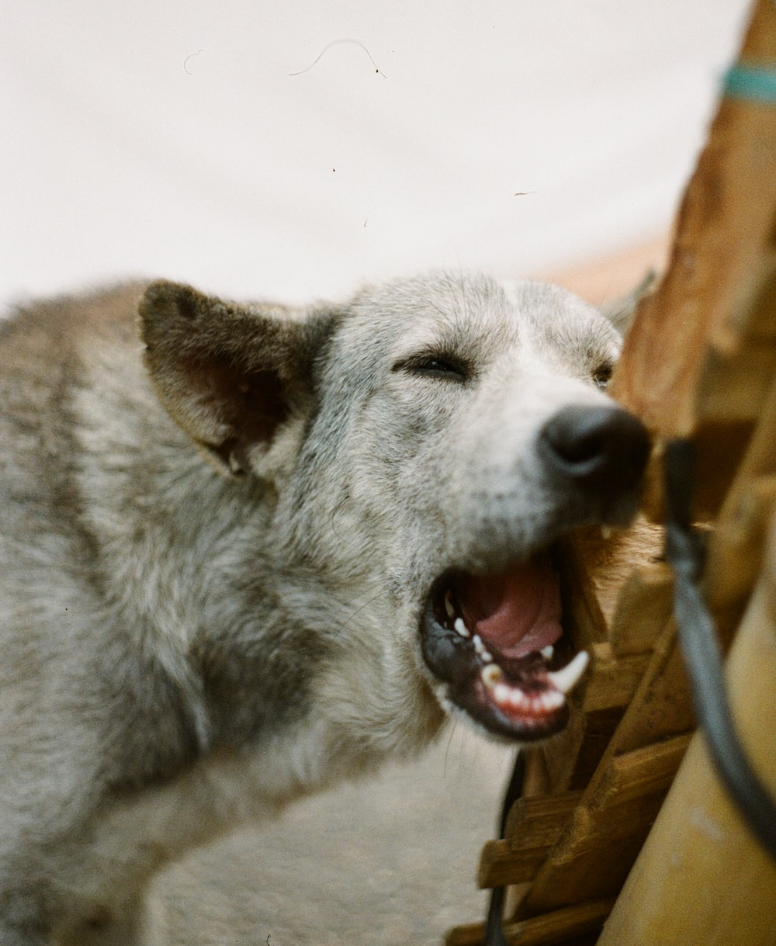
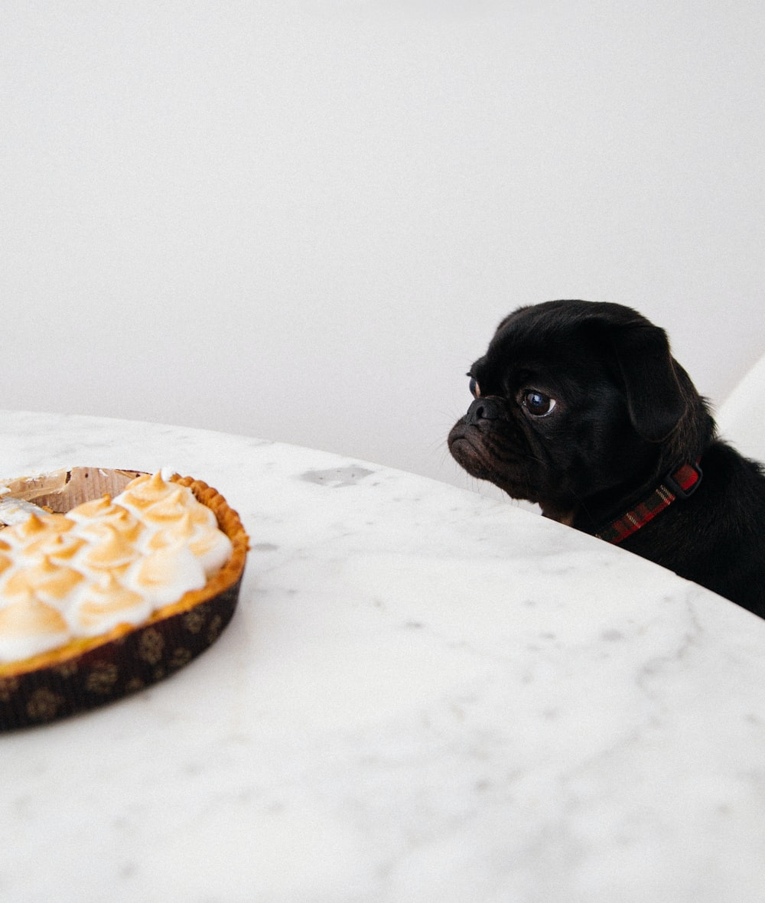
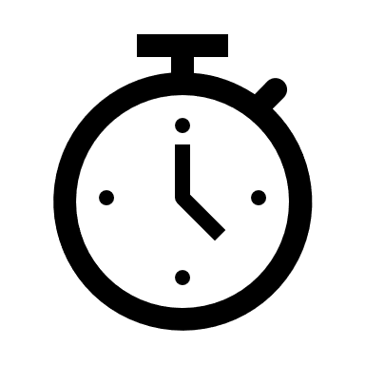
Did they do something they are not supposed to do?

Slide 6
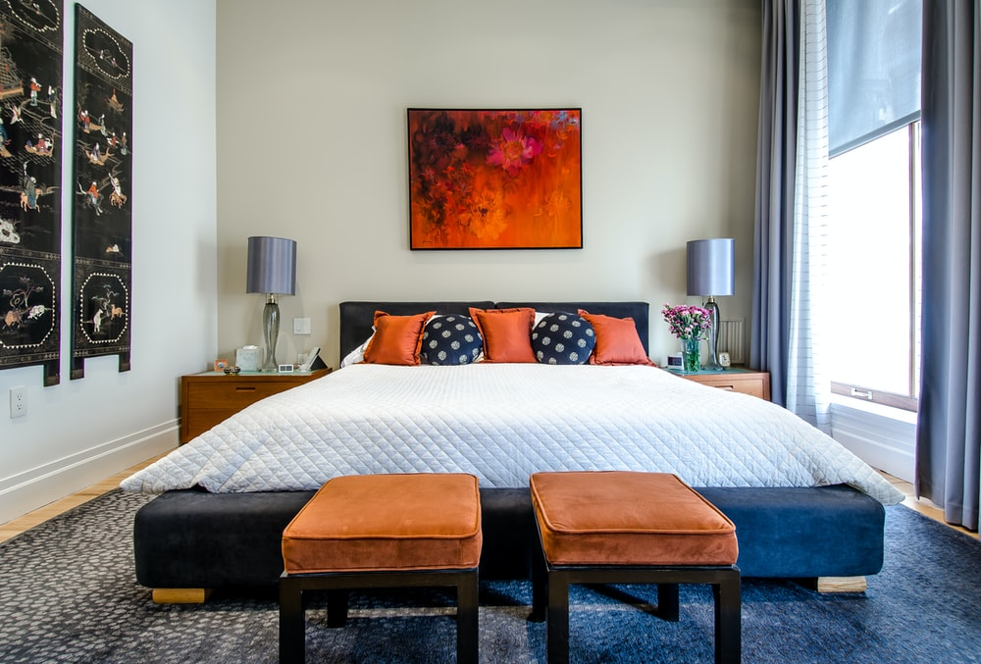
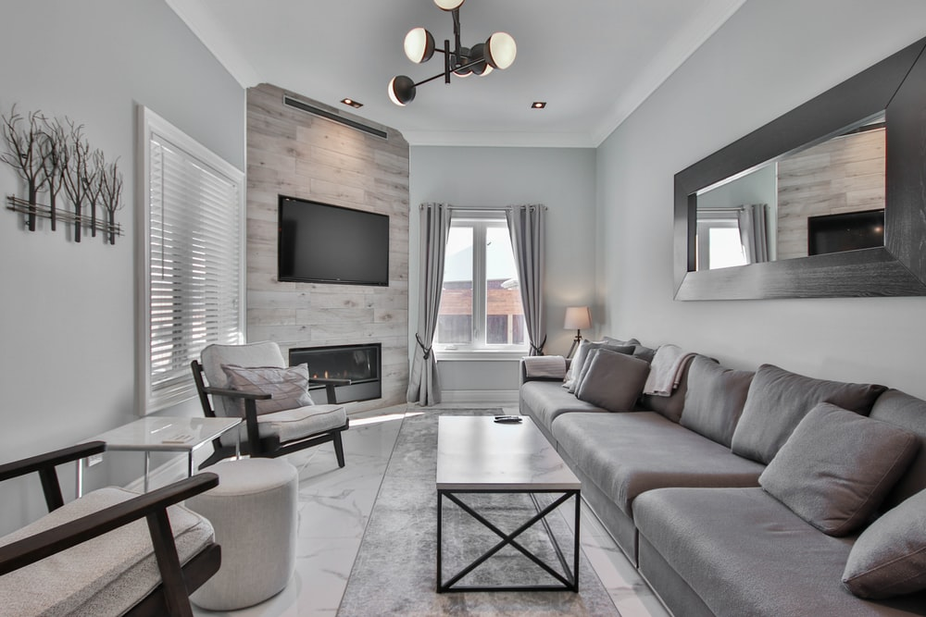
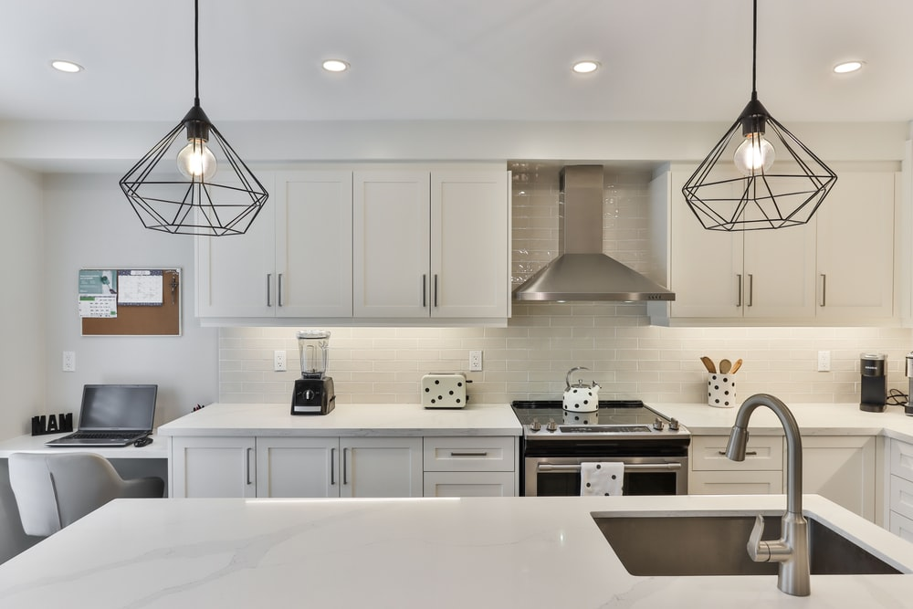
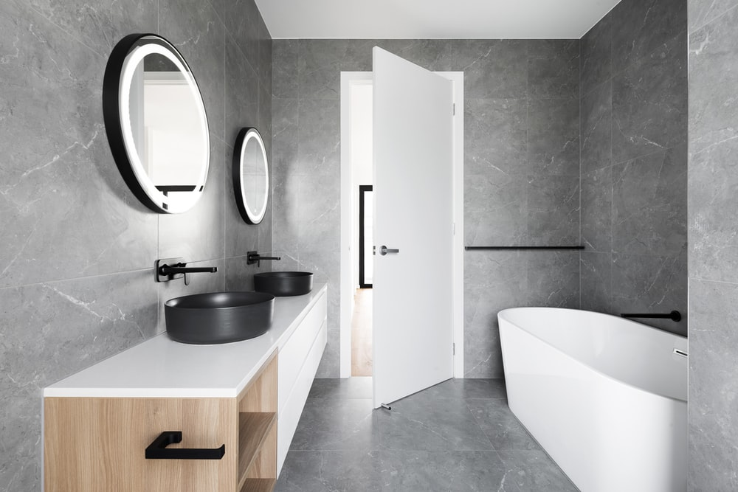
Which room does my dog spend the most time in?

Slide 7
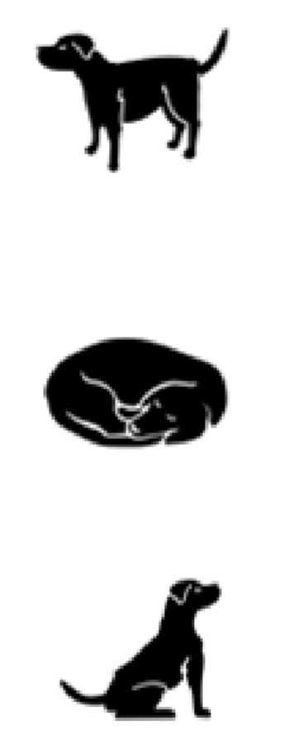
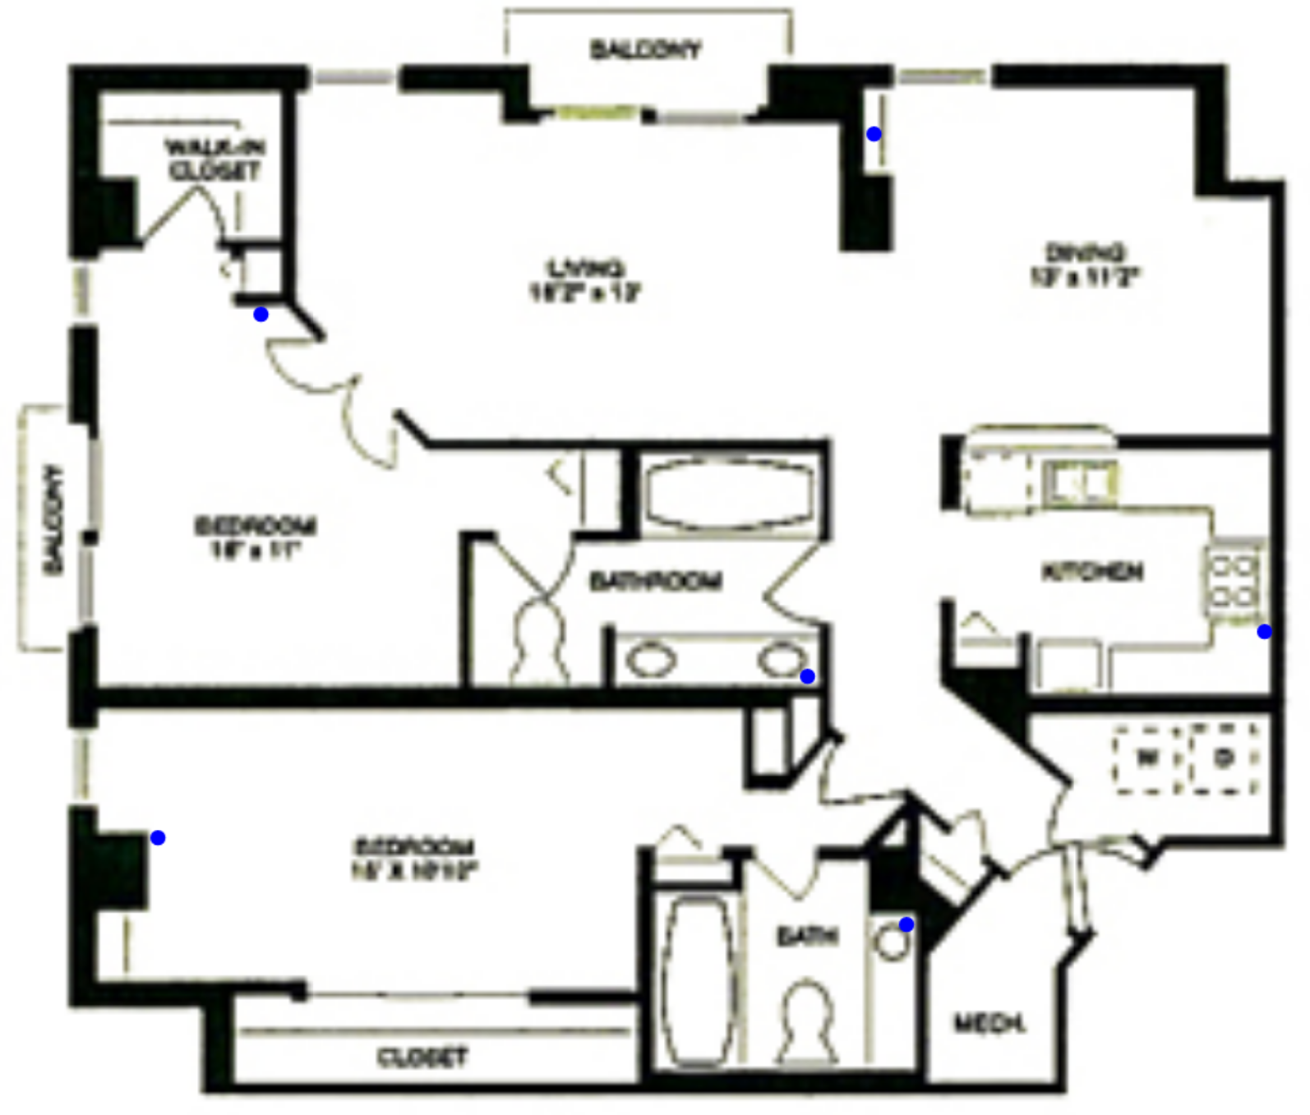
To answer these questions…
???
???
Location
Pose

Slide 8
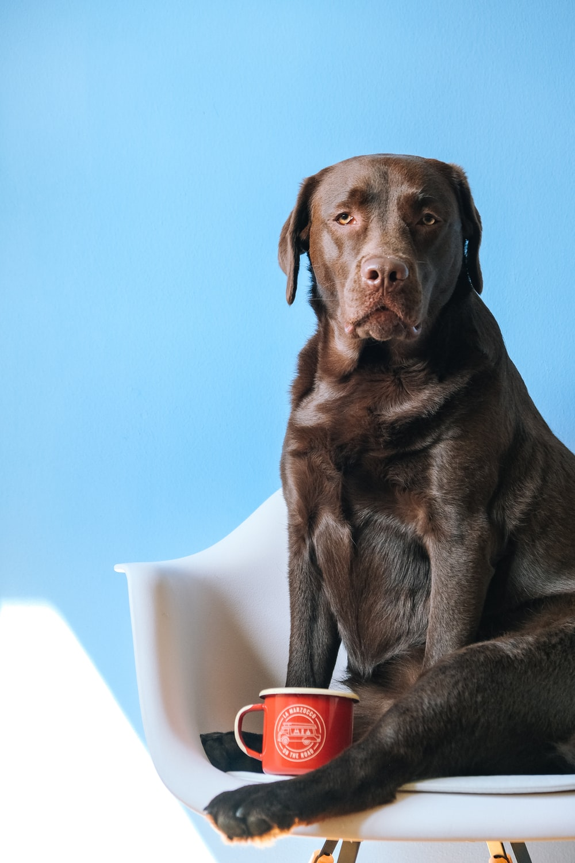
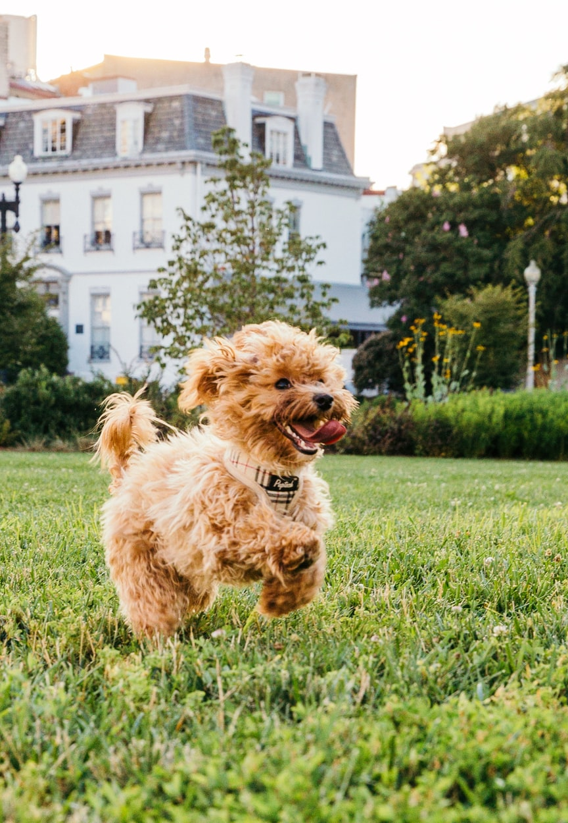
Other potential inferences:
Emotional State
Health State
Emergencies

Slide 9
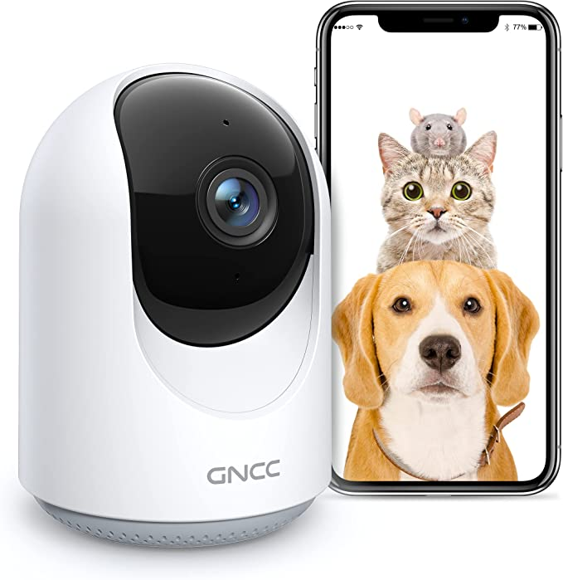
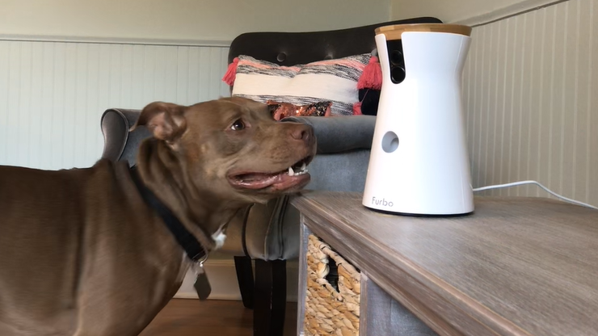
Problems with pet cameras
Object occlusion
Privacy intrusive
Data intensive
Computationally complex

Slide 10
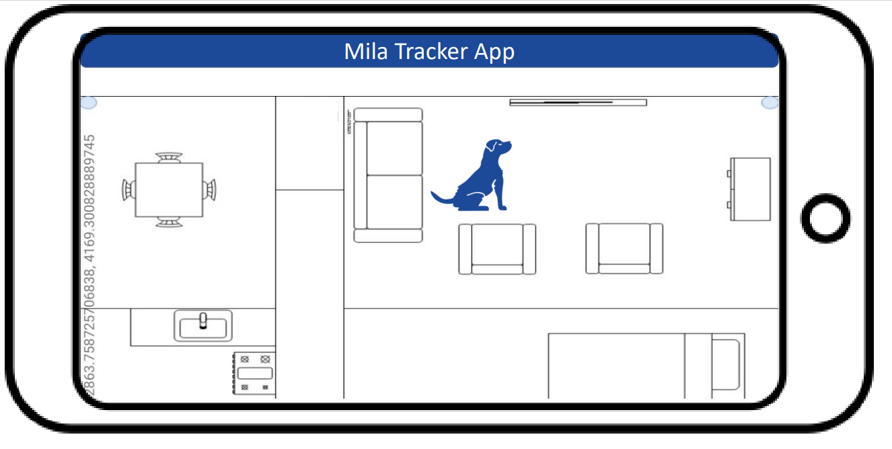
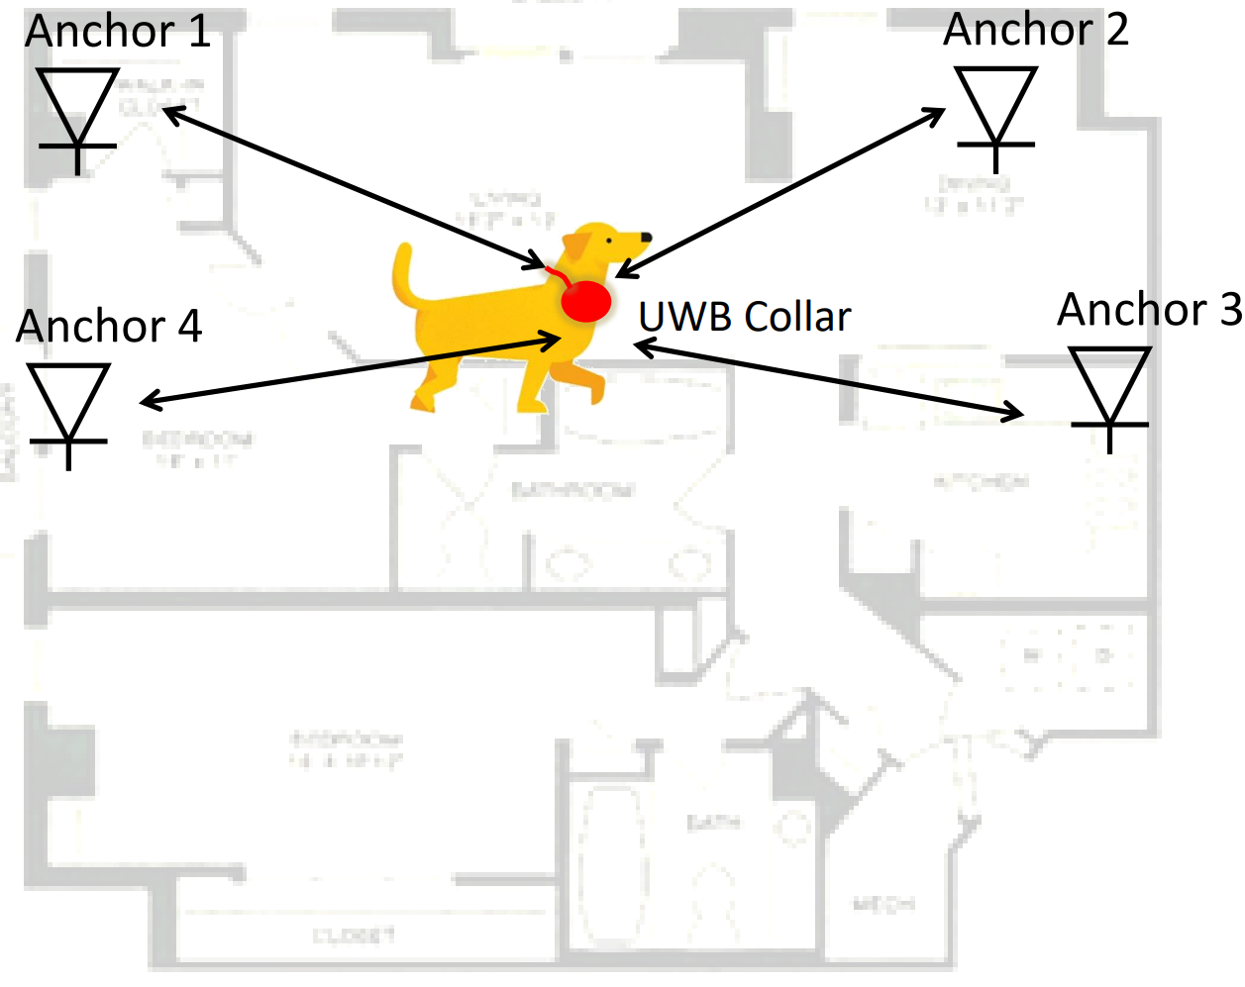


PetTrack Overview
UWB radio+IMU
UWB Anchors
Collect and process IMU and UWB data, and post pose and location to cloud
Listener
(x, y)
Pose

Slide 11



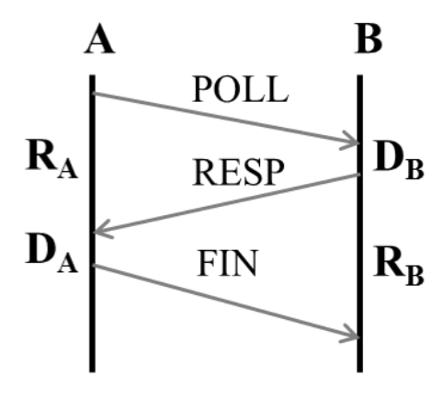
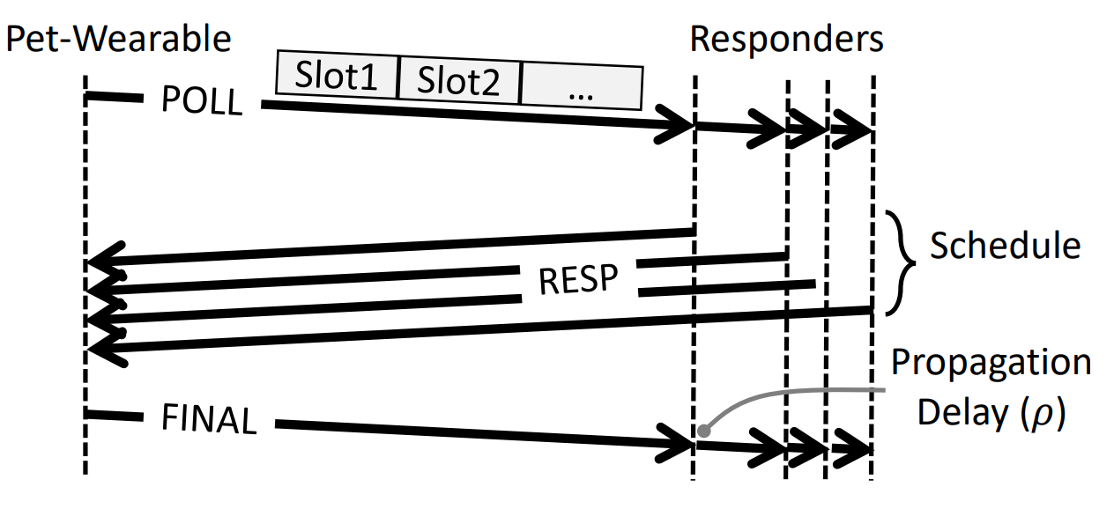
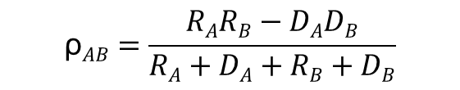
UWB Localization
Why UWB?
Large bandwidth enables precise measurement of time-of-arrival (ToA).
Good at distinguishing multipaths.
Good signal penetration through walls.
Protocol
Pipelined Two-way Ranging
mmWave
$$\text{ρ}AB=\frac{RARB−DADB}{RA+DA+RB+DB}$$

Slide 12
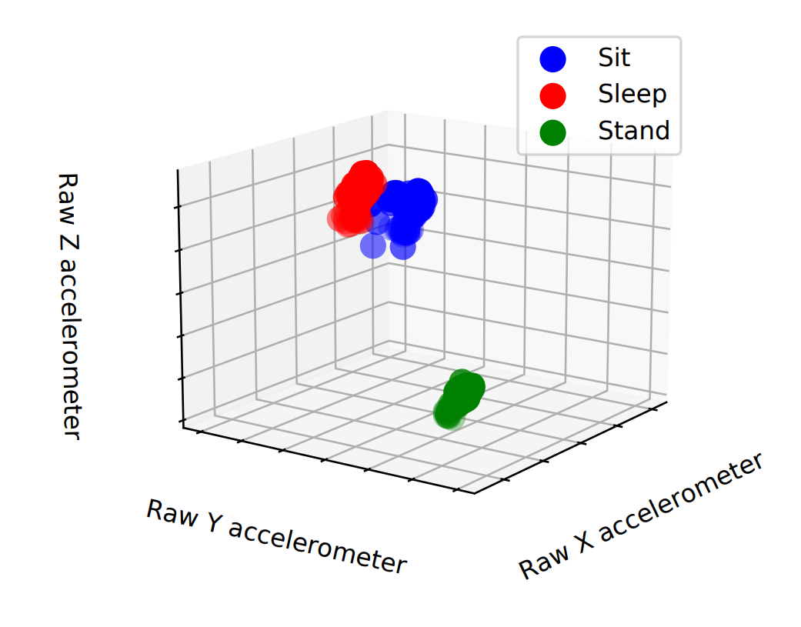
IMU based activity classification
Observation:
  Unique accelerometer signatures of poses
KNN pose classification
7.85
2.47
1.43
7.68
2.55
1.40
7.70
……
TS | 0.02 | 0.04 | 0.06
Ax | 7.85 | 7.68 | 7.70
Ay | 2.47 | 2.55 | 2.45
Az | 1.43 | 1.40 | 1.51
Filter out transitions
Vectorization
…
Windowed Raw Samples
KNN
Pose

Slide 13
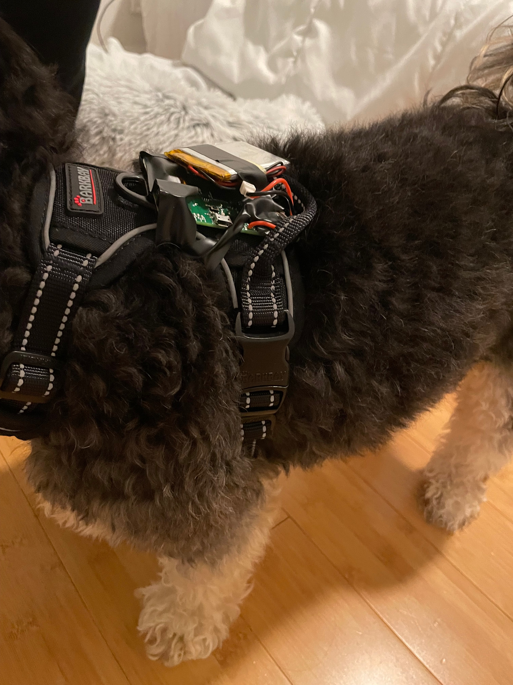
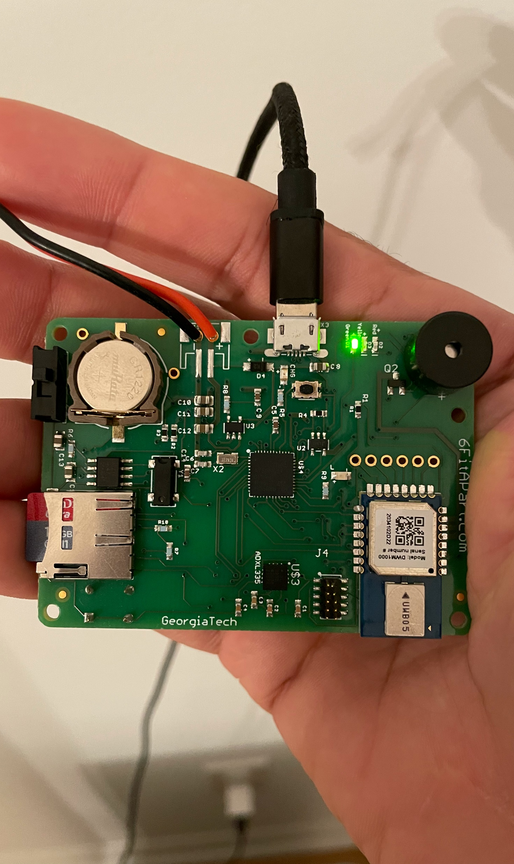
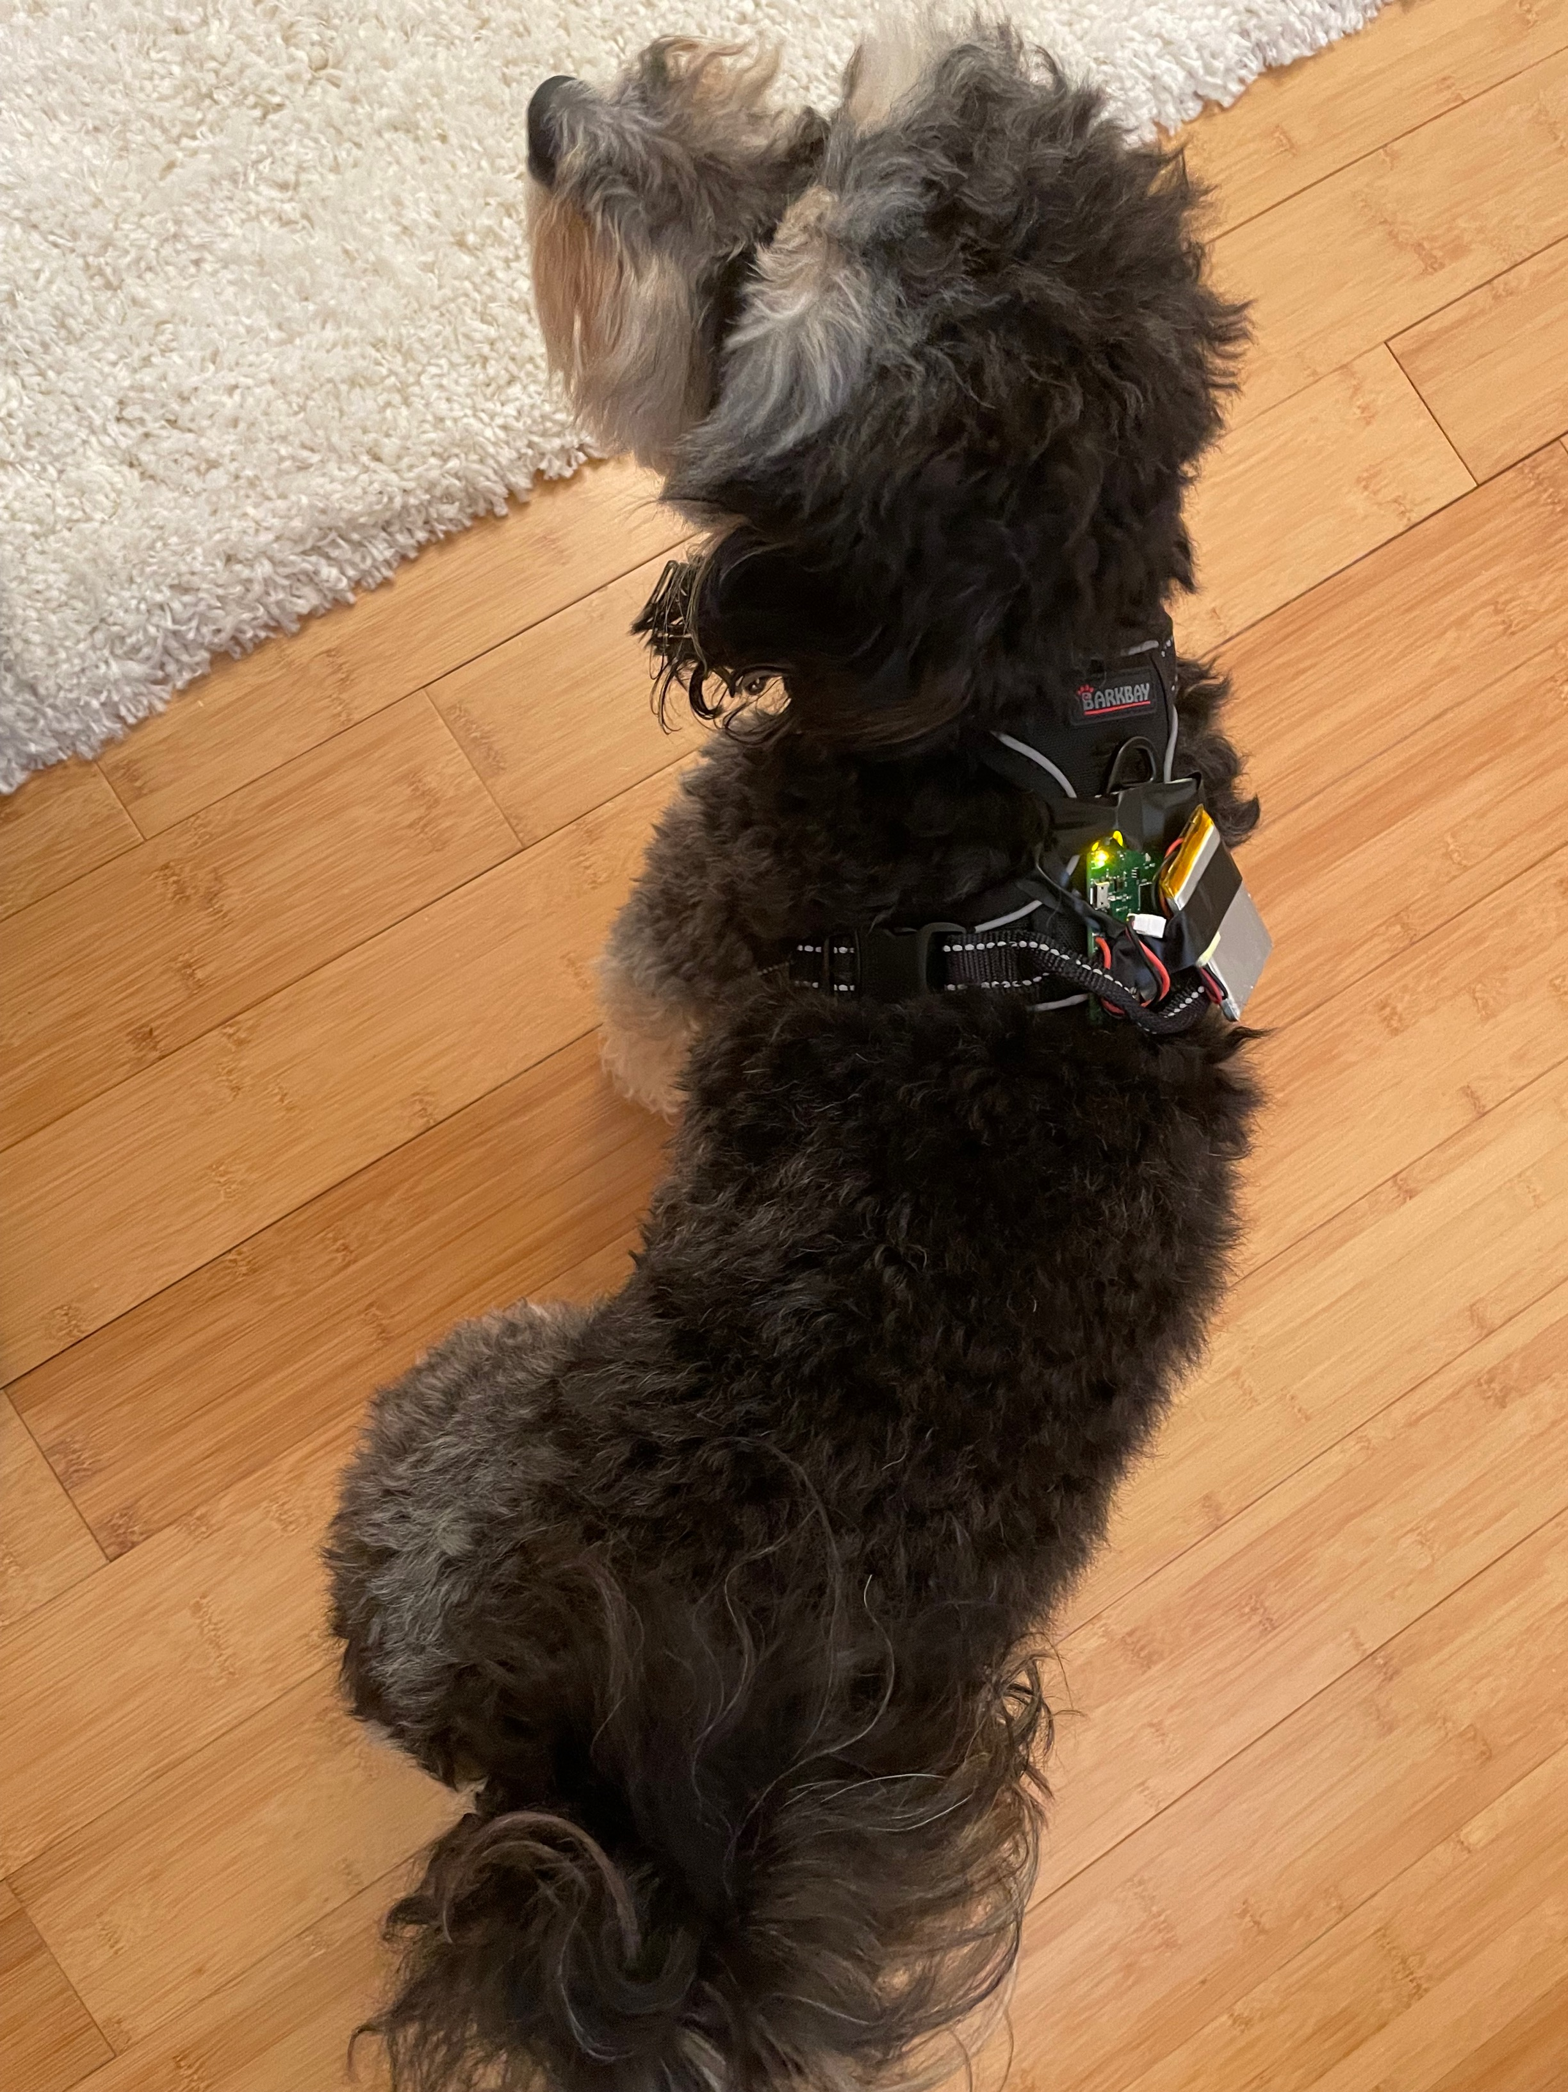
Wearable design
Sensor placement:
  Comfort
  Localization accuracy
  Pose classification accuracy
Hardware considerations
  Form factor
  Power
RTC Battery
Buzz
SDCard
Acc
UWB
Pet-Wearable
Animal experimentation approved by IACUC and IRB

Slide 14
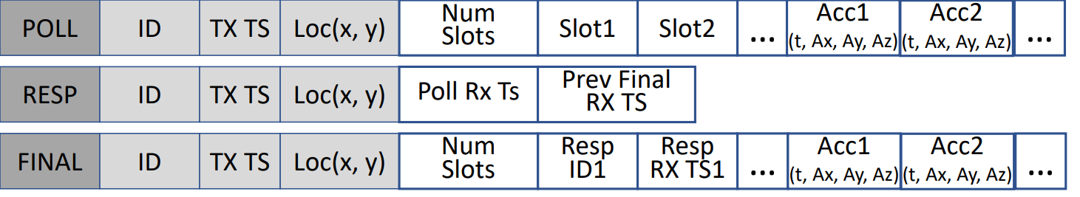
Listener
Pet wearable device is resource restricted.
UWB and accelerometer data should be exported to external device for processing and communication with Cloud
Customized TWR message

Slide 15
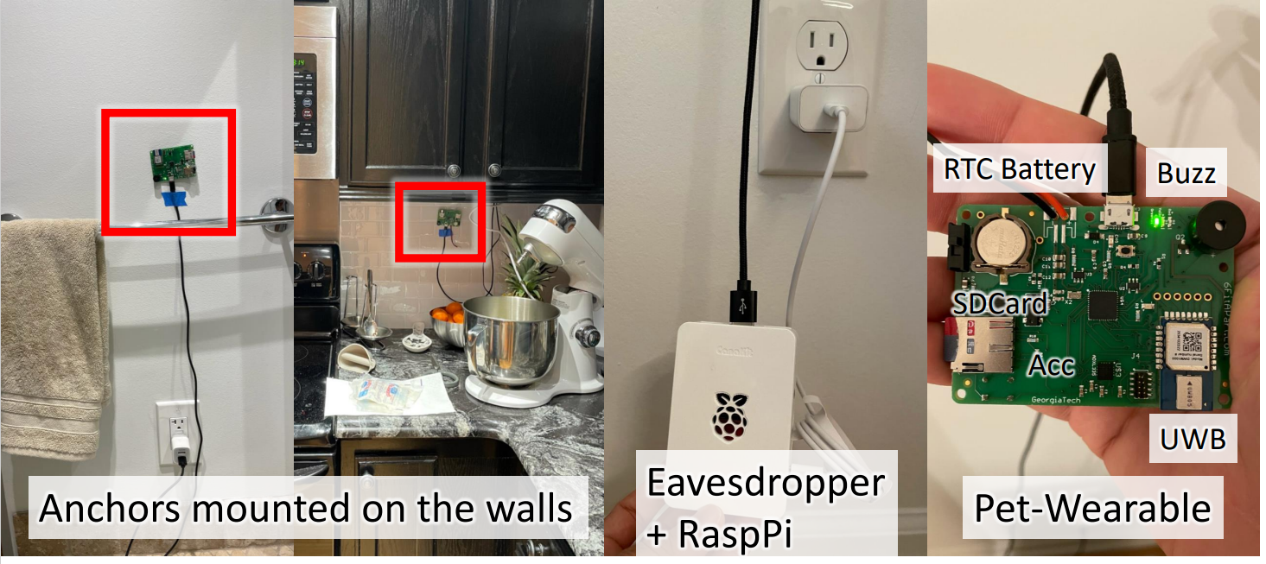
Implementation

Slide 16
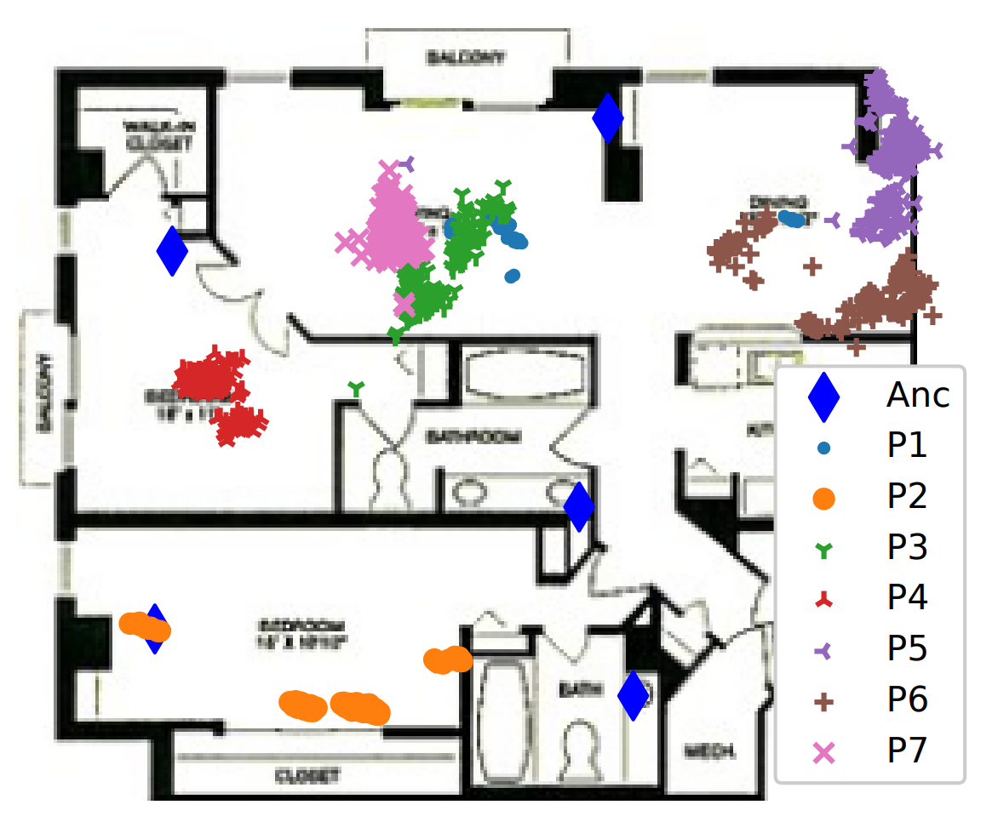
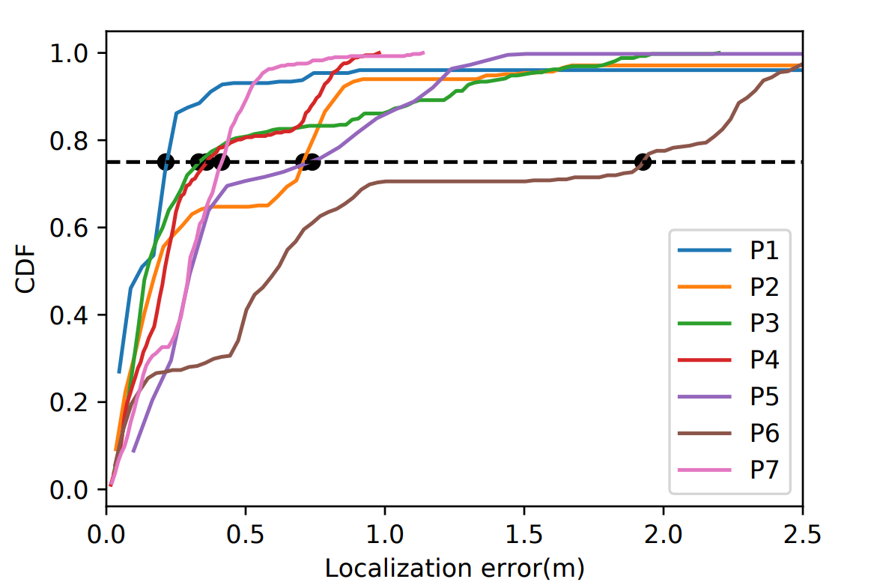
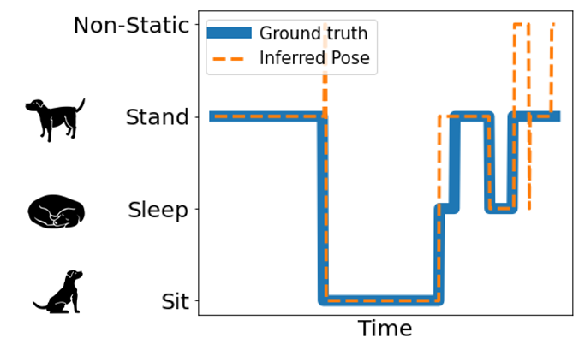
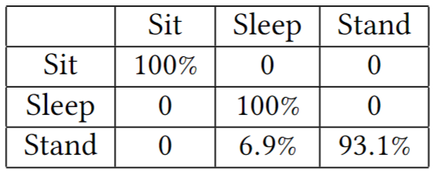
Results
Localization result at 7 static locations
Classification Accuracy
Static: 98.6%
Freely moving: 88.4%
KNN Pose Classification Confusion Matrix

Slide 17
Future works
Improve localization accuracy
Recognition of more static poses and motions
More in depth inferences, such as health, and psychology.
Facilitating pet training

