Slide 1

A Metric for Quantifying UWB Ranging Error Due to Clock Drifts
Haige Chen, Ashutosh Dhekne
Georgia Institute of Technology
Notes:
Good afternoon. My name is Haige Chen. I will present our work, PetTrack: Tracking Pet Location and Activity Indoors. I would like to acknowledge the other authors, Neeraj Alavala who was previously at Georgia Institute of Technology and now at Microsoft, and Rishabh Singhal and Ashutosh Dhekne from Georgia Tech.

Slide 2

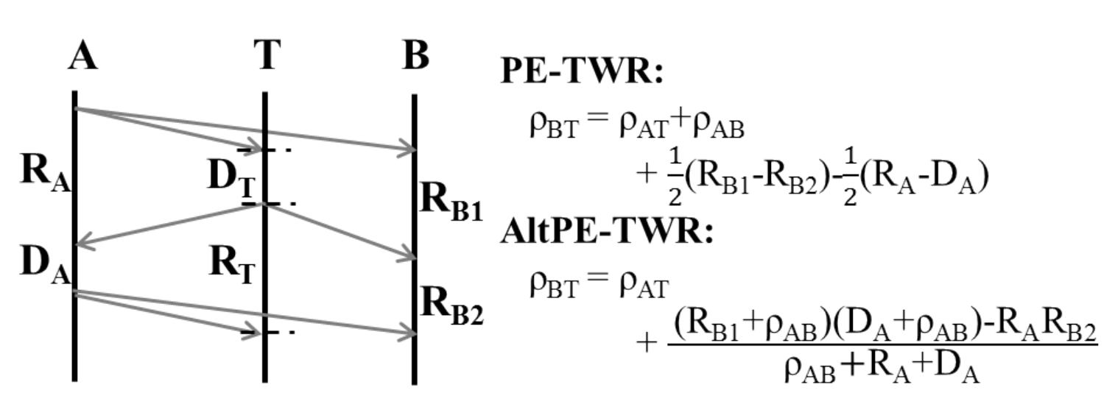
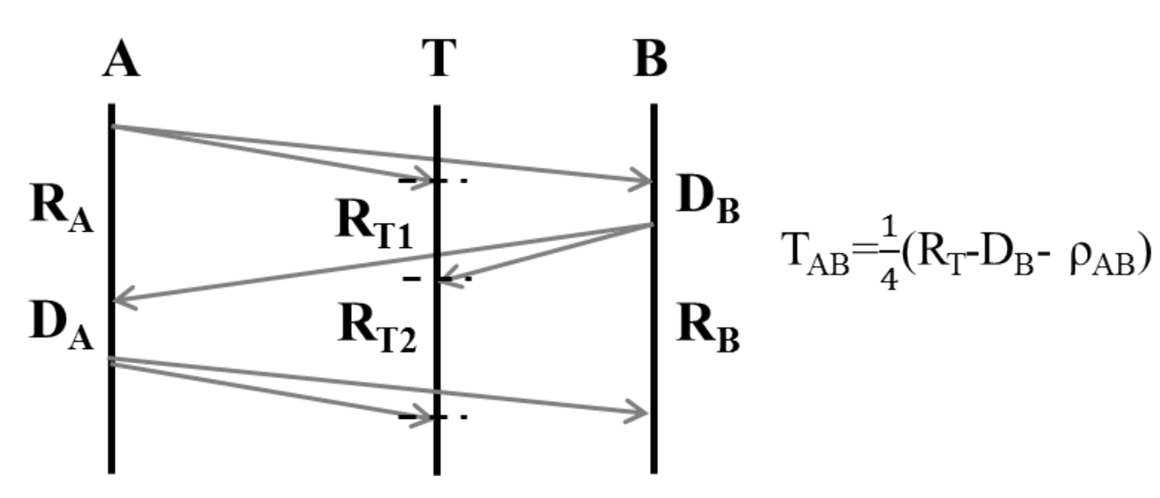
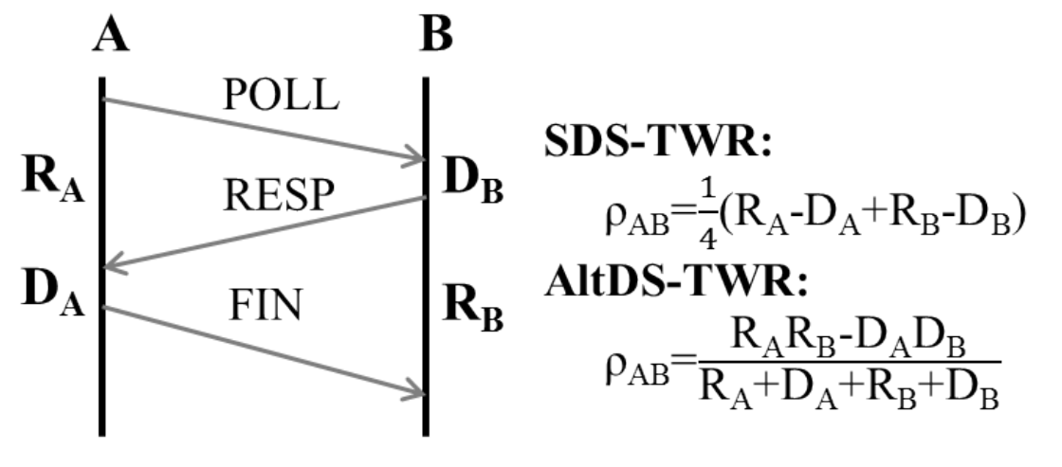
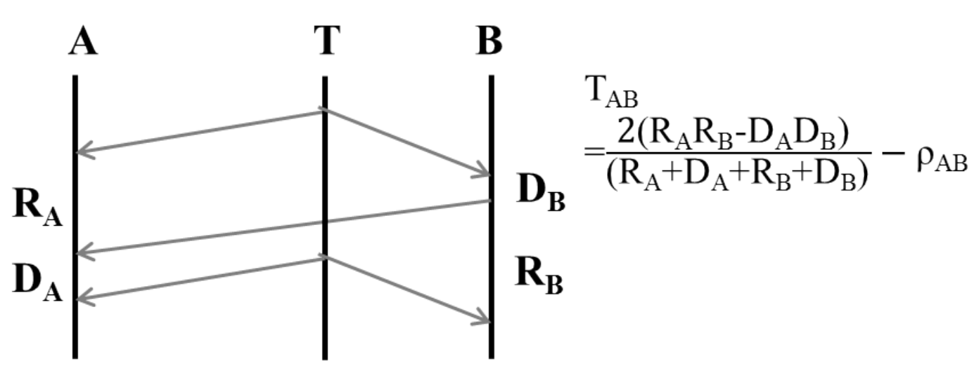
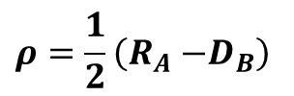
Ranging
A B
R_{A}
D_{B}
$$ρ=\frac{1}{2}\left(R_{A}{−D}_{B}\right)$$

Slide 3
How to choose which one to use?
How to compare one another?
Ranging
A B
R_{A}
D_{B}
$$ρ=\frac{1}{2}\left(R_{A}{−D}_{B}\right)$$

Slide 4
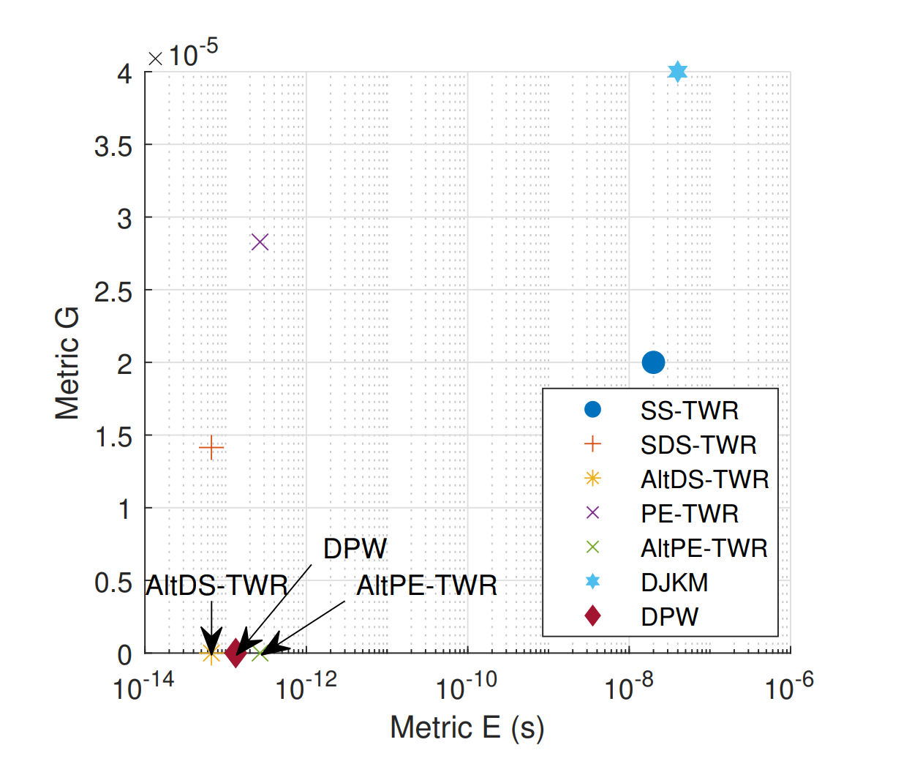
Ranging
A B
R_{A}
D_{B}
$$ρ=\frac{1}{2}\left(R_{A}{−D}_{B}\right)$$

Slide 5
Less desirable
Ranging
More desirable
A B
R_{A}
D_{B}
$$ρ=\frac{1}{2}\left(R_{A}{−D}_{B}\right)$$

Slide 6
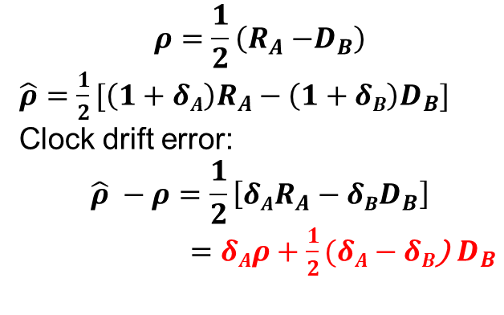
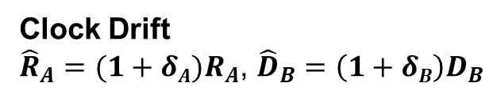
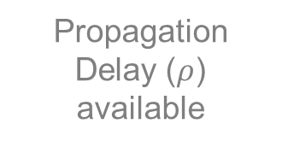


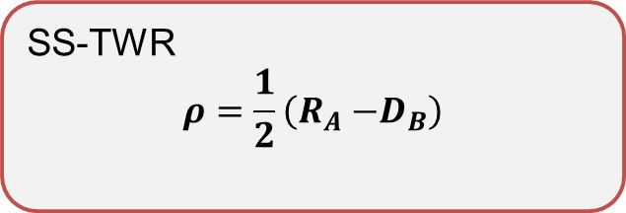
Ranging Primer
SS-TWR
$$ρ=\frac{1}{2}\left(R_{A}{−D}_{B}\right)$$
A
B
T_{A1}
POLL
$$R_{A}=T_{A2}−T_{A1}$$
T_{B1}
R_{A}
D_{B}
RESP
T_{B2}
T_{A2}
$$D_{B}=T_{B2}−T_{B1}$$
Propagation Delay ($ρ$) available
Clock Drift
${\hat{R}}_{A}=(1+δA)R_{A}$, ${\hat{D}}_{B}=\left(1+δB\right)D_{B}$
10⁻⁵
10⁻⁹
10⁻⁵
10⁻³

Slide 7
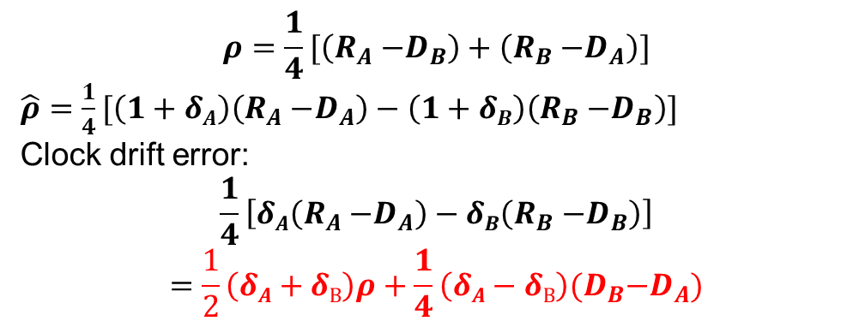


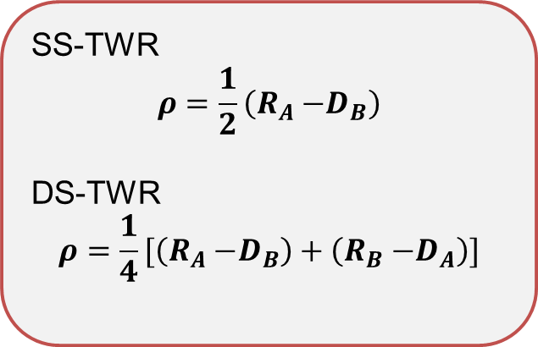
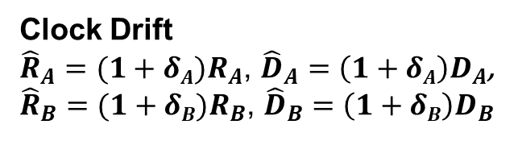
Ranging Primer
SS-TWR
$$ρ=\frac{1}{2}\left(R_{A}{−D}_{B}\right)$$
DS-TWR
$$ρ=\frac{1}{4}[\left(R_{A}{−D}_{B}\right)+\left(R_{B}{−D}_{A}\right)]$$
A
B
T_{A1}
POLL
$$R_{A}=T_{A2}−T_{A1}$$
T_{B1}
$$R_{B}=T_{B3}−T_{B2}$$
R_{A}
D_{B}
RESP
T_{B2}
T_{A2}
$$D_{B}=T_{B2}−T_{B1}$$
D_{A}
R_{B}
$$D_{A}=T_{A3}−T_{A2}$$
T_{A3}
FINAL
T_{B3}
Propagation Delay ($ρ$) available
Clock Drift
${\hat{R}}_{A}=(1+δA)R_{A}$, ${\hat{D}}_{A}=\left(1+δA\right)D_{A}$,
${\hat{R}}_{B}=(1+δB)R_{B}$, ${\hat{D}}_{B}=\left(1+δB\right)D_{B}$
10⁻⁵
10⁻⁹
10⁻⁵
10⁻³

Slide 8
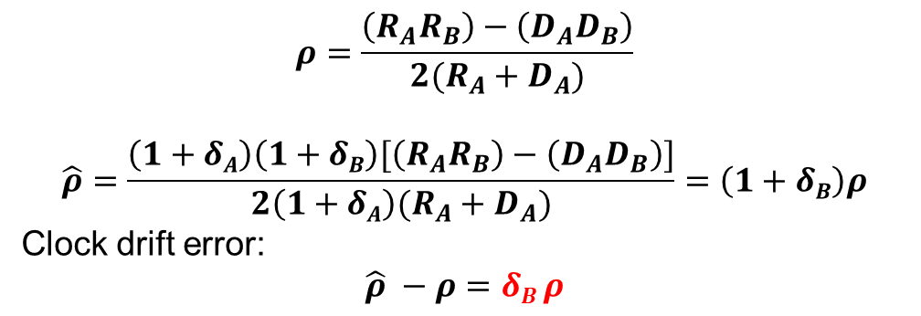
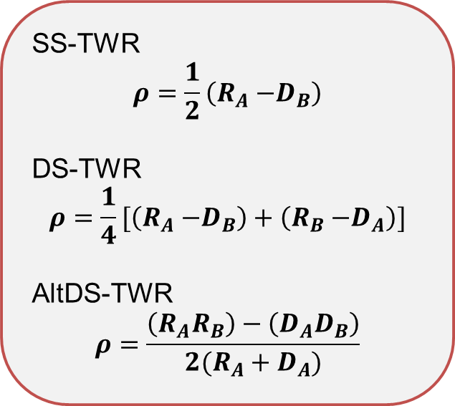
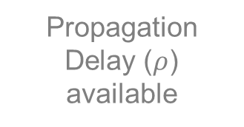
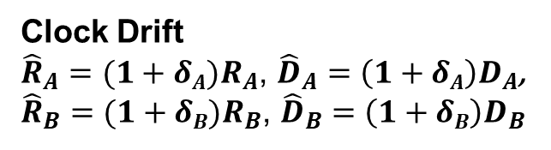
Ranging Primer
SS-TWR
$$ρ=\frac{1}{2}\left(R_{A}{−D}_{B}\right)$$
DS-TWR
$$ρ=\frac{1}{4}[\left(R_{A}{−D}_{B}\right)+\left(R_{B}{−D}_{A}\right)]$$
AltDS-TWR
$$ρ=\frac{\left(R_{A}R_{B}\right)−\left(D_{A}D_{B}\right)}{2(R_{A}+D_{A})}$$
A
B
T_{A1}
POLL
T_{B1}
$$R_{A}=T_{A2}−T_{A1}$$
R_{A}
D_{B}
$$R_{B}=T_{B3}−T_{B2}$$
RESP
T_{B2}
T_{A2}
$$D_{B}=T_{B2}−T_{B1}$$
D_{A}
R_{B}
T_{A3}
FINAL
$$D_{A}=T_{A3}−T_{A2}$$
T_{B3}
Propagation Delay ($ρ$) available
Clock Drift
${\hat{R}}_{A}=(1+δA)R_{A}$, ${\hat{D}}_{A}=\left(1+δA\right)D_{A}$,
${\hat{R}}_{B}=(1+δB)R_{B}$, ${\hat{D}}_{B}=\left(1+δB\right)D_{B}$
10⁻⁵
10⁻⁹

Slide 9
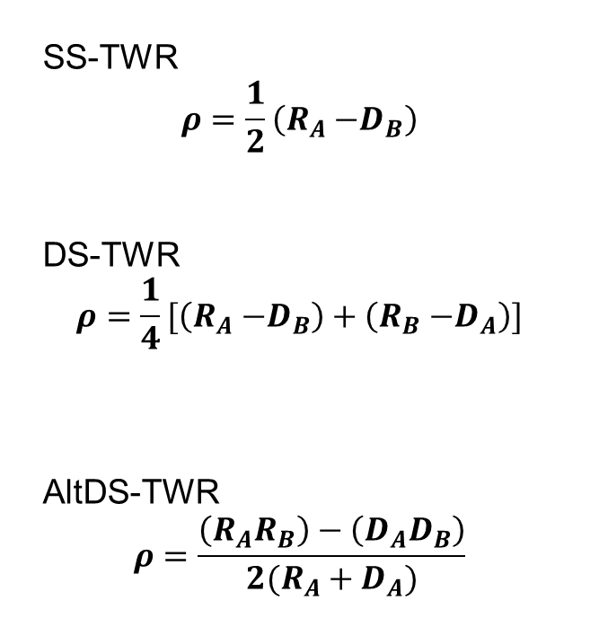
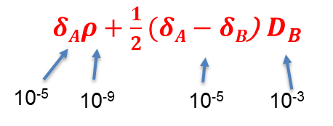
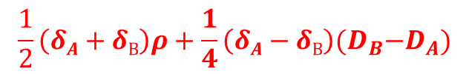
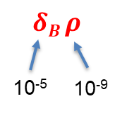
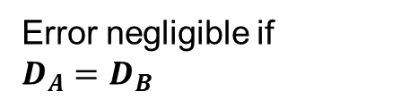
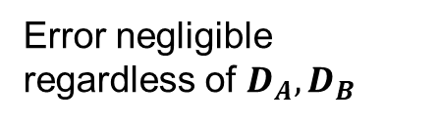
Error on the scale of meters
Error negligible if $D_{A}{=D}_{B}$
10⁻⁵
10⁻⁹
10⁻⁵
10⁻³
Error negligible regardless of $D_{A}{,D}_{B}$
Observation:
DS-TWR, AltDS-TWR > SS-TWR: they can achieve better minimum clock drift error.
AltDS-TWR > DS-TWR: robust under any conditions; allows more flexibility

Slide 10
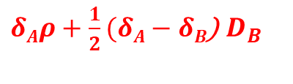

$δAρ+\frac{1}{2}(δA−δB$) $D_{B}$
Error on the scale of meters
10⁻⁵
10⁻⁹
10⁻⁵
10⁻³
How to quantify minimum clock drift error and robustness?
$$\frac{1}{2}\left(δA+δB\right)ρ+\frac{1}{4}\left(δA−δB\right)(D_{B}{−D}_{A})$$
Error negligible if $D_{A}{=D}_{B}$
10⁻⁵
10⁻⁹
10⁻⁵
10⁻³
$$δB ρ$$
Error negligible regardless of $D_{A}{,D}_{B}$
10⁻⁵
10⁻⁹
Observation:
DS-TWR, AltDS-TWR > SS-TWR: they can achieve better minimum clock drift error.
AltDS-TWR > DS-TWR: robust under any conditions; allows more flexibility

Slide 11
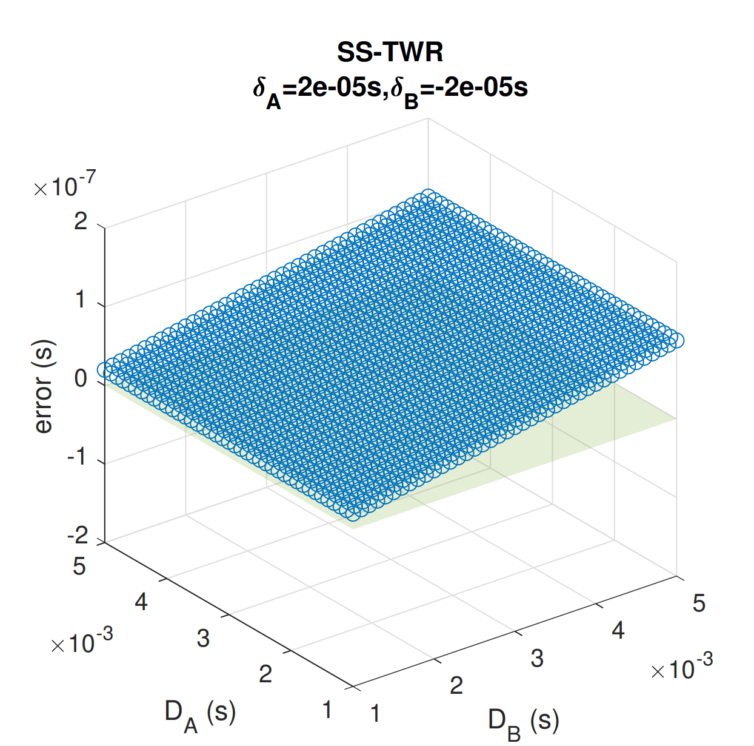
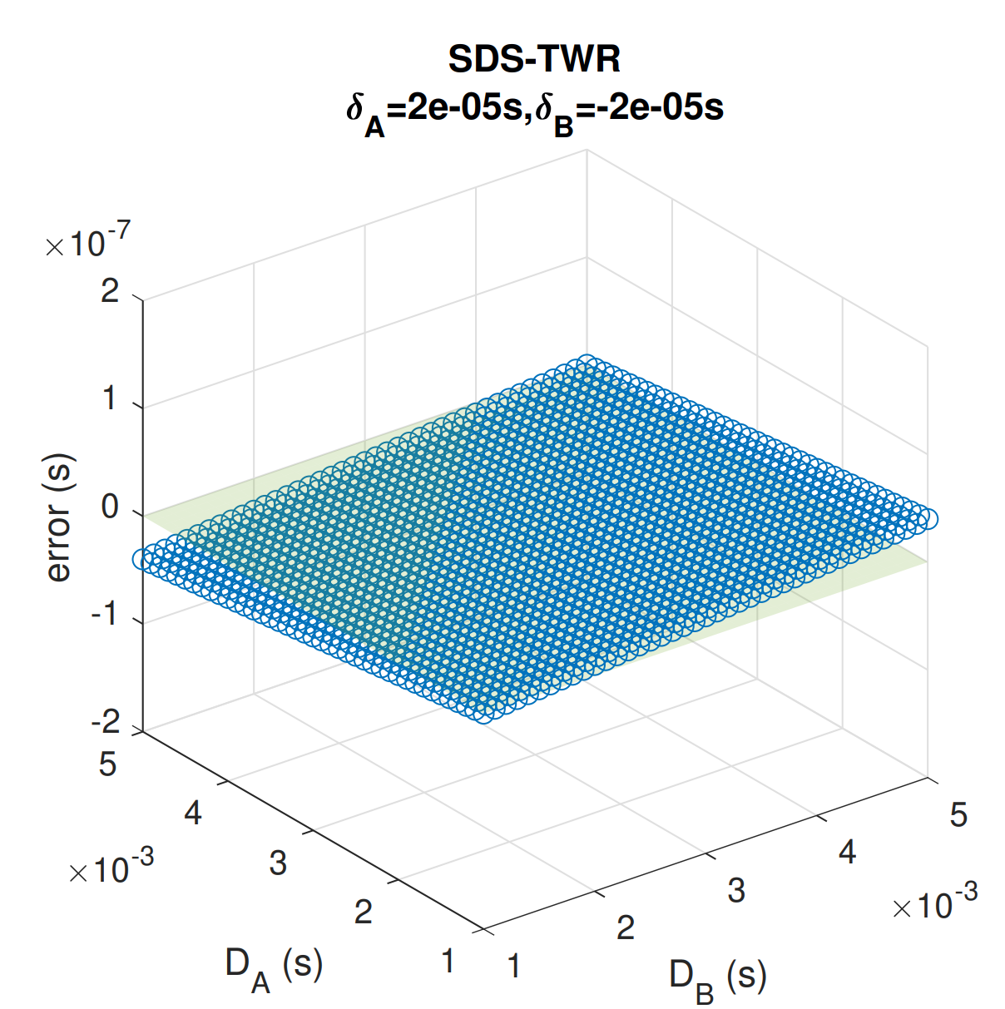
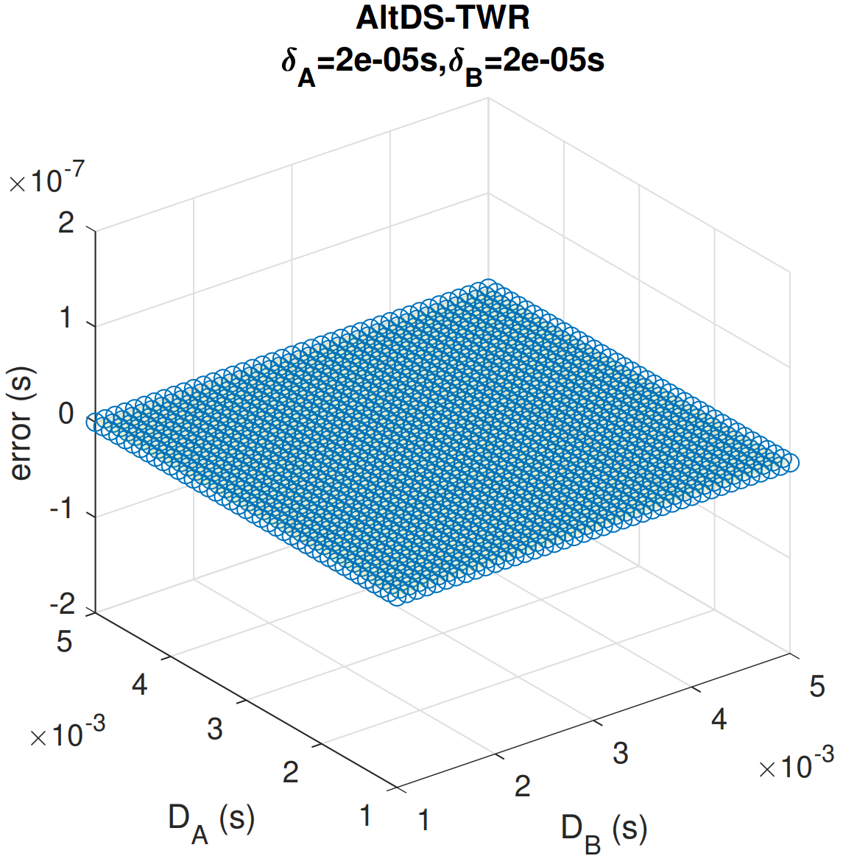
Numerical simulation
E
G
Minimum value represents minimum error
Gradient represents dependency on system parameters

Slide 12
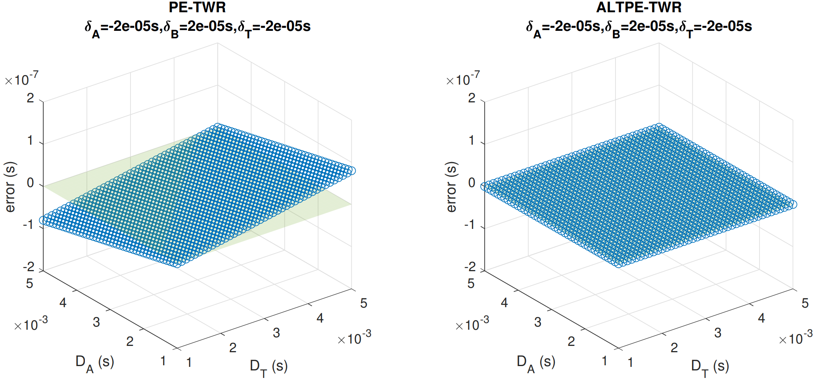
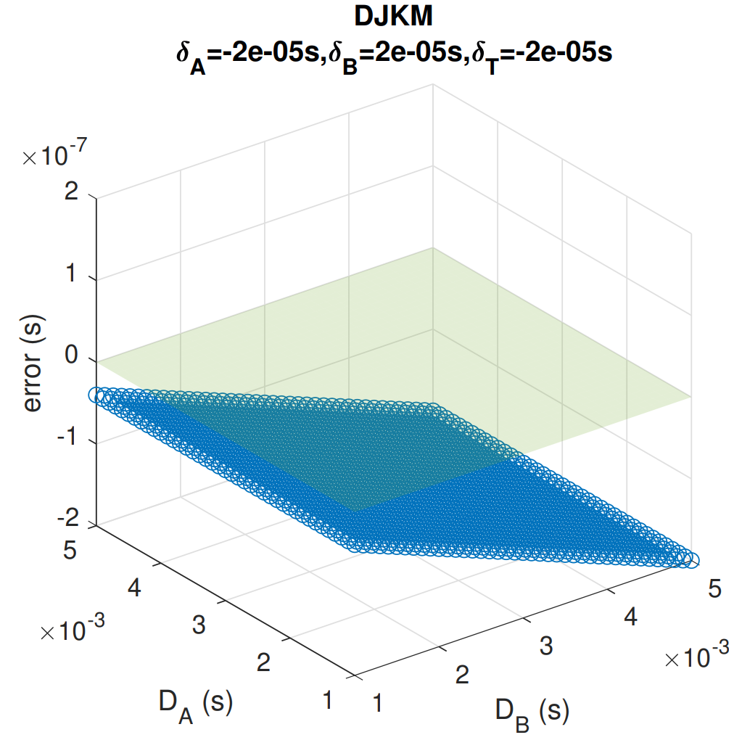
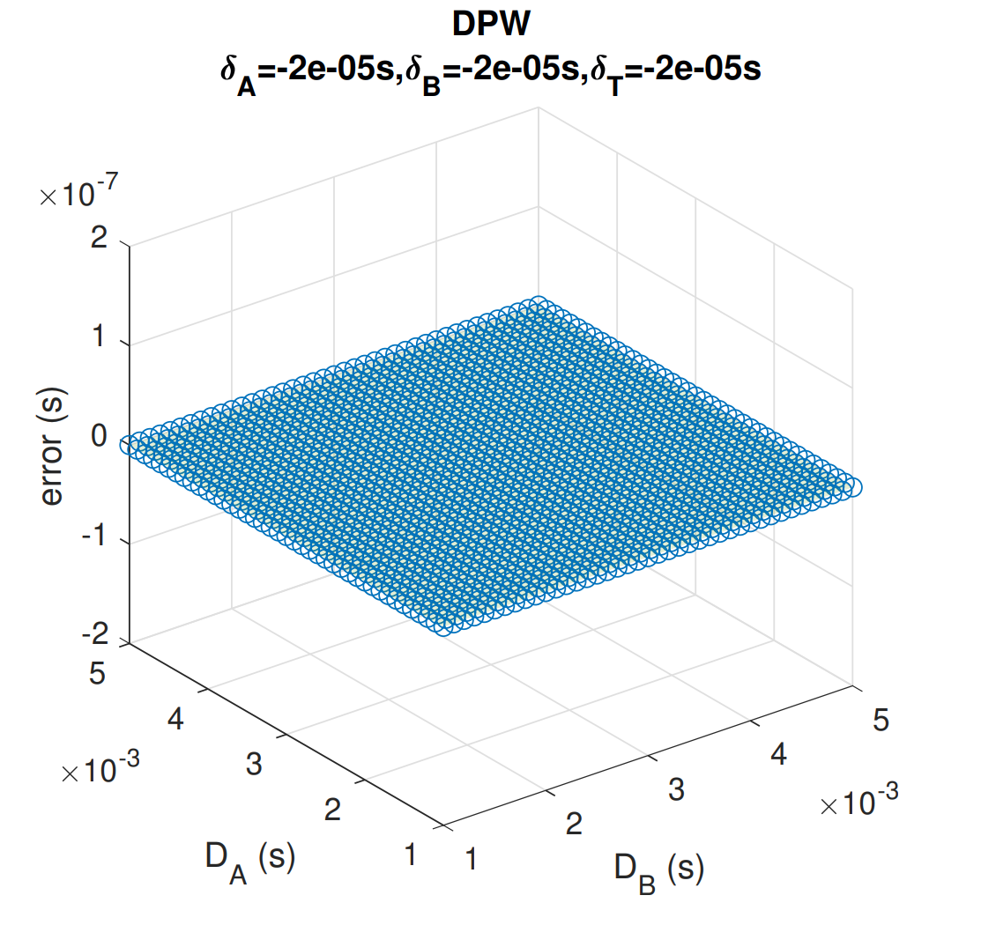
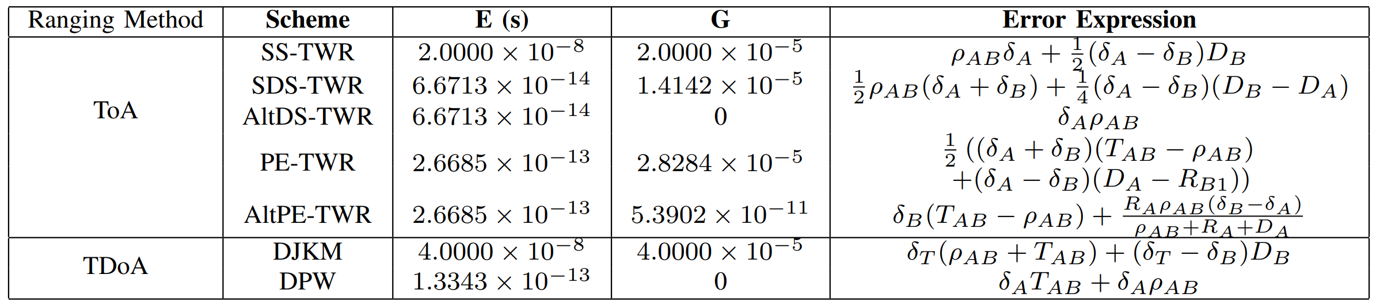

Slide 13
High Dependency on System Parameter
Low Dependency on System Parameter
Low Min Error
High Min Error

Slide 14
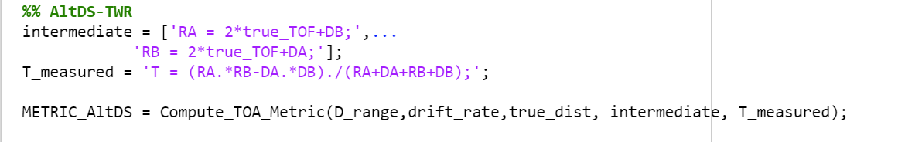
Open-source Matlab Tool

Slide 15
Use Cases
Analysing future ranging schemes
Choosing the right ranging protocol
Choosing the right parameters
Fusion of multiple protocols

Slide 17
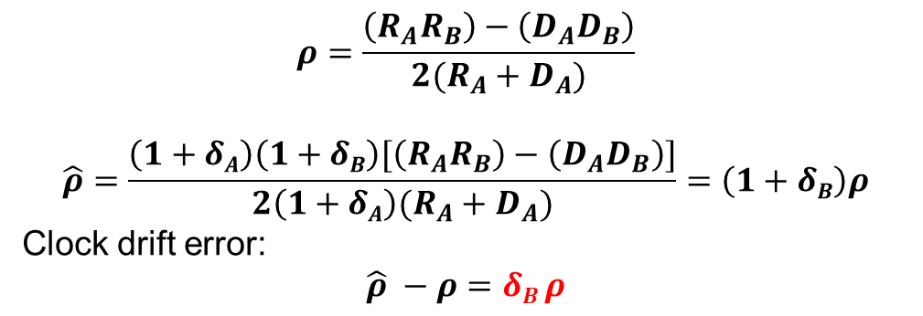
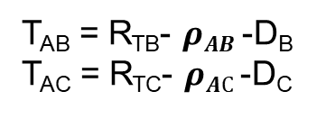
$$ρ=\frac{\left(R_{A}R_{B}\right)−\left(D_{A}D_{B}\right)}{2(R_{A}+D_{A})}$$
$$\hat{ρ}=\frac{\left(1+δA\right)\left(1+δB\right)[\left(R_{A}R_{B}\right)−\left(D_{A}D_{B}\right)]}{2\left(1+δA\right)(R_{A}+D_{A})}=\left(1+δB\right)ρ$$
Clock drift error:
$$\hat{ρ} −ρ=δB ρ$$
A B C T
T_{AB} = R_{TB}- $ρAB$-D_{B}
T_{AC} = R_{TC}- $ρAC$-D_{C}
D_{B}
D_{c}
R_{TB}
R_{TC}

Slide 18
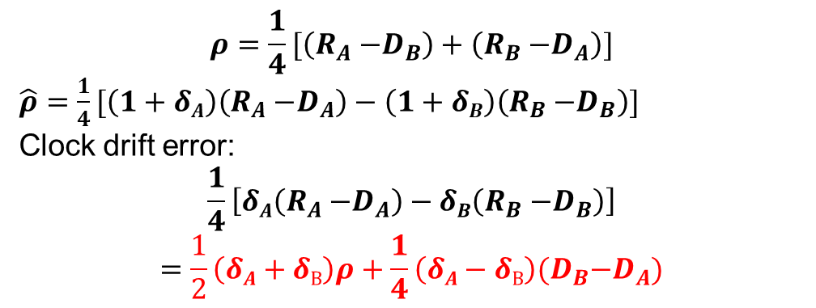


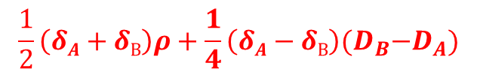
$$ρ=\frac{1}{4}[\left(R_{A}{−D}_{B}\right)+\left(R_{B}{−D}_{A}\right)]$$
$\hat{ρ}=$ $\frac{1}{4}[\left(1+δA\right)\left(R_{A}{−D}_{A}\right)−\left(1+δB\right)\left(R_{B}{−D}_{B}\right)]$
Clock drift error:
$$\frac{1}{4}\left[δA\left(R_{A}{−D}_{A}\right)−δB\left(R_{B}{−D}_{B}\right)\right]$$
$$=\frac{1}{2}\left(δA+δB\right)ρ+\frac{1}{4}\left(δA−δB\right)(D_{B}{−D}_{A})$$
$$\frac{1}{2}\left(δA+δB\right)ρ+\frac{1}{4}\left(δA−δB\right)(D_{B}{−D}_{A})$$
$δAρ+\frac{1}{2}(δA−δB$) $D_{B}$
10⁻⁵
10⁻⁹
10⁻⁵
10⁻³
$$ρ=\frac{1}{2}\left(R_{A}{−D}_{B}\right)$$
$\hat{ρ}=$ $\frac{1}{2}[\left(1+δA\right)R_{A}−\left(1+δB\right)D_{B}]$
Clock drift error:
$$\hat{ρ} −ρ=\frac{1}{2}\left[δAR_{A}−δBD_{B}\right]$$
$=δAρ+\frac{1}{2}(δA−δB$) $D_{B}$
$$δB ρ$$
10⁻⁵
10⁻⁹

