Slide 1



PnPLoc: UWB Based Plug & Play Indoor Localization
Haige Chen, Ashutosh Dhekne
Georgia Institute of Technology

Slide 2



Slide 3


Slide 4


Slide 5


Slide 6
Convenient
Building Managers
Building Pedestrians

Slide 7
Convenient
Building Managers
Building Pedestrians
Ease of Deployment
Accurate
Dynamic Infrastructure
Privacy Preserving
Large Coverage
Scalable

Slide 8
Problems with passive TDoA schemes
Synchronization backbone
Wireless Synchronization
Sensitive to clock drift error
Cost and communication overhead
Scalability
Specialty nodes makes large-scale deployment hard
Concurrent Ranging
reference anchor
Synchronization Free
schedule

Slide 9
Convenient
Fundamental changes needed to the underlying ranging protocol
Building Managers
Building Occupants
Ease of Deployment
Ease of Deployment
Large Coverage
Ease of Deployment
Ease of Deployment
Ease of Deployment
Ease of Deployment

Slide 10

Active Anchors
Passive Clients

Slide 11
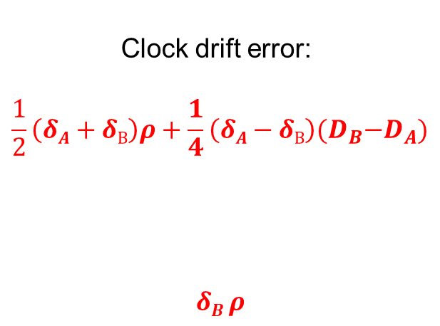
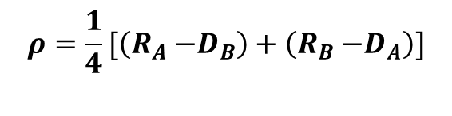
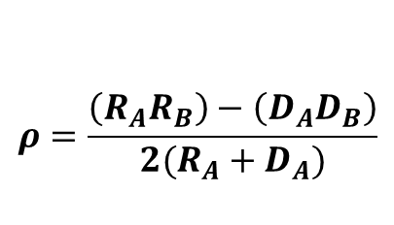

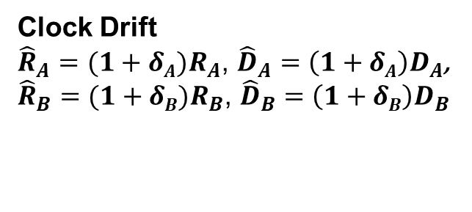
Two-way Ranging (TWR) Refresher
A
B
T_{A1}
POLL
T_{B1}
R_{A}
D_{B}
RESP
T_{B2}
T_{A2}
D_{A}
R_{B}
T_{A3}
FINAL
10⁻⁵
10⁻⁹
10⁻⁵
10⁻³
T_{B3}
Propagation Delay ($ρ$) available
10⁻⁵
10⁻⁹
Clock Drift
${\hat{R}}_{A}=(1+δA)R_{A}$, ${\hat{D}}_{A}=\left(1+δA\right)D_{A}$,
${\hat{R}}_{B}=(1+δB)R_{B}$, ${\hat{D}}_{B}=\left(1+δB\right)D_{B}$
A better ranging protocol should null the clock drift error regardless of system configuration.

Slide 12
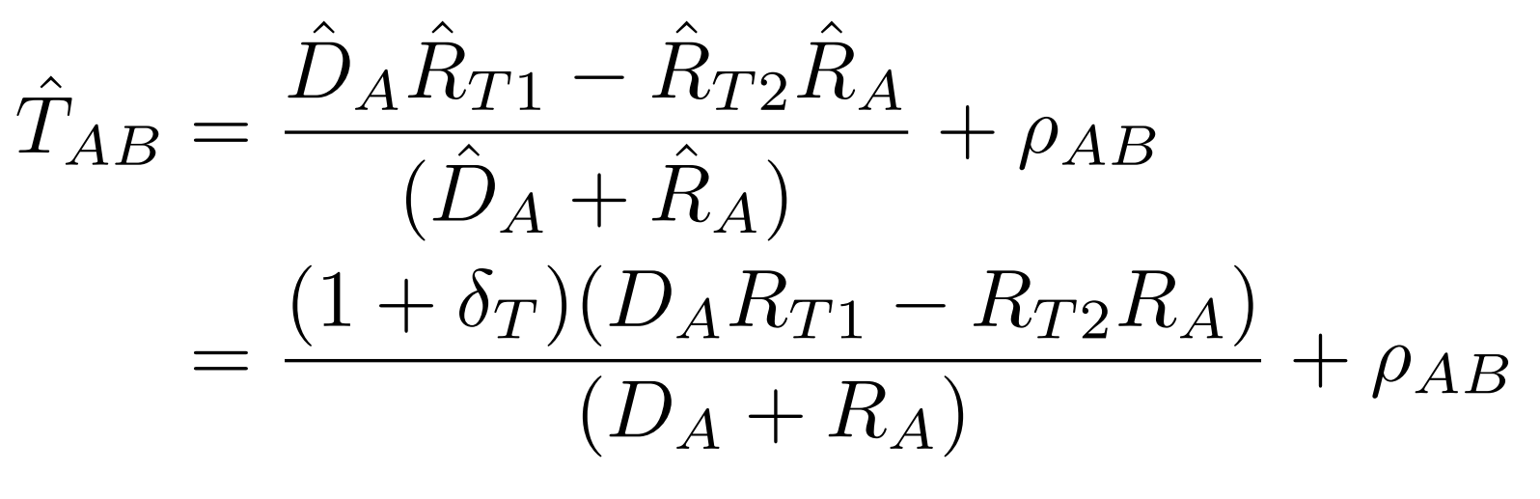
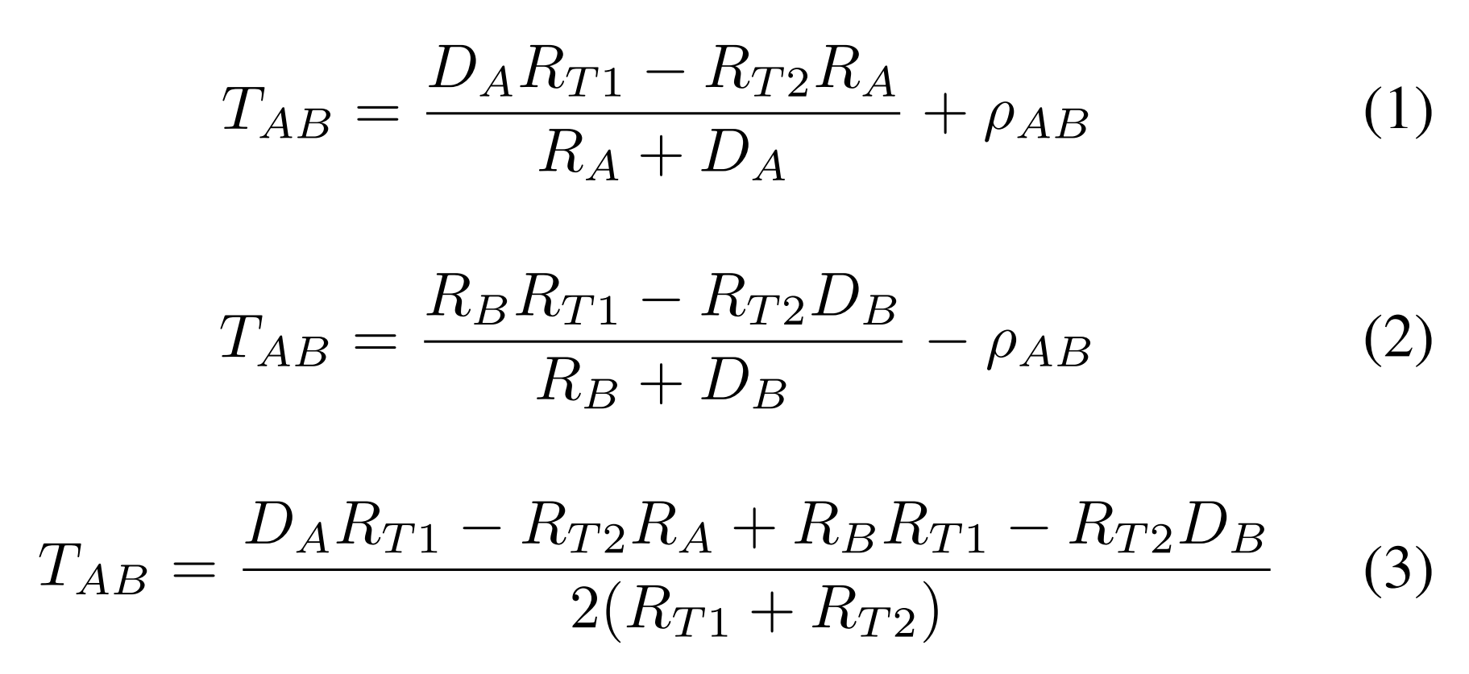
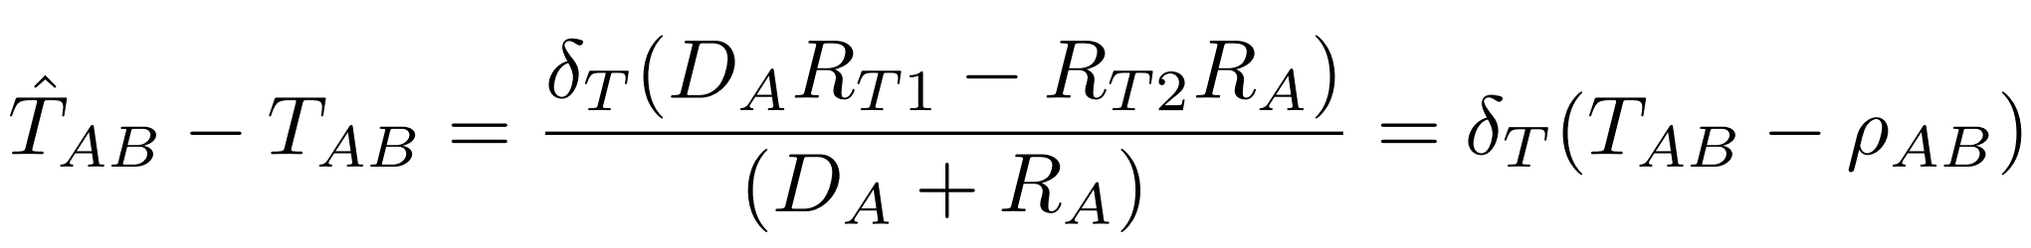
PnPLoc-TDoA
Clock drift analysis
Initiator (A)
Responder (B)
Tag (T)
t₀
Overheard
POLL
t₁
t₂
R_{A}
D_{B}
R_{T1}
t₄
RESP
t₃
t₅
D_{A}
R_{B}
t₆
R_{T2}
FINAL
t₈
t₇
Clock drift error
10⁻⁵
10⁻⁹

Slide 13
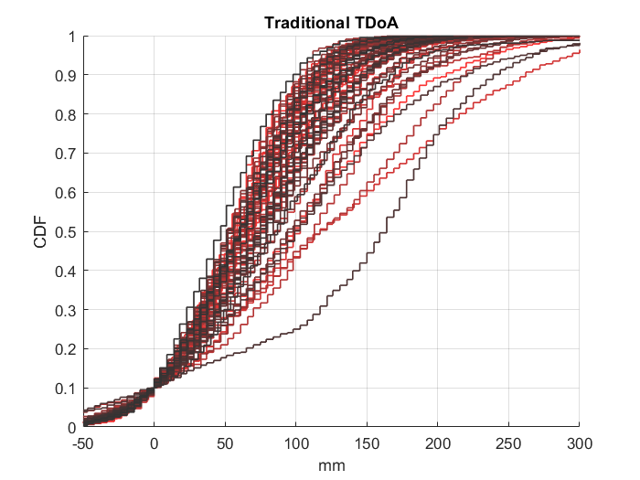
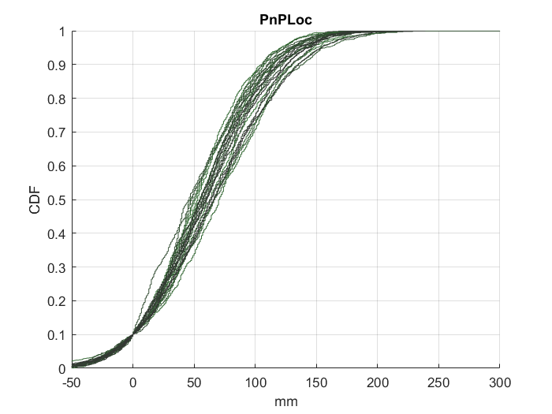
PnPLoc-TDoA
High variability
in individual TDoAs
Clock drift analysis
All individual TDoAs have almost the same behavior
Initiator (A)
Responder (B)
Tag (T)
t₀
Overheard
POLL
t₁
t₂
R_{A}
D_{B}
R_{T1}
t₄
RESP
t₃
t₅
D_{A}
R_{B}
t₆
R_{T2}
FINAL
t₈
t₇
Clock drift error
TDoA* with Clock Drift Compensation
Our Formulation with no Clock Drift Compensation required
*A robot self-localization system using one-way ultra-wideband communication (A. Ledergerber, et al., 2015)

Slide 14
Active Anchors
Passive Clients
Scalable
Accurate
Privacy preserving

Slide 15
Active Anchors
Passive Clients
Easy deployment
Dynamic infrastructure
Large coverage
?
Scalable
Accurate
Privacy preserving

Slide 16
Dilution-of-Precision
A₃ – A₁
A₂ – A₁
A₁
Tag’s location
A₃
A₂
A₂ – A₃

Slide 17
Dilution-of-Precision
Anchor Geometry determines localization precision.
A₃ – A₁
A₂ – A₁
A₁
Tag’s location
A₃
A₂
A₂ – A₃

Slide 18
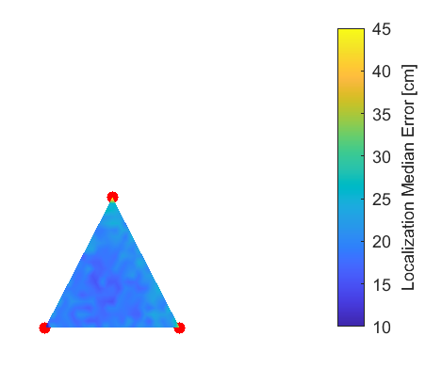
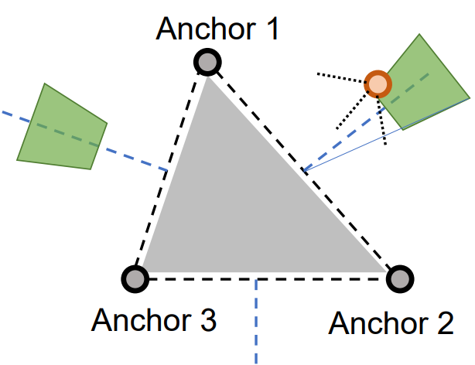
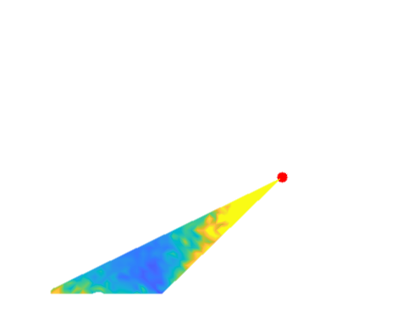
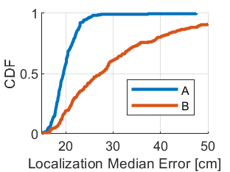
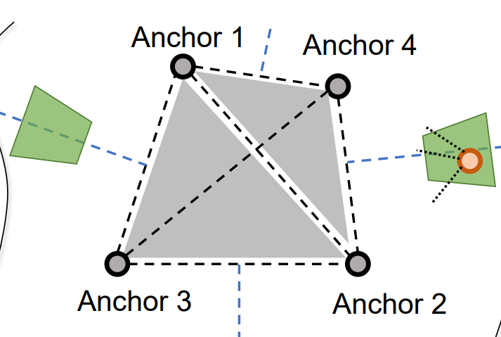
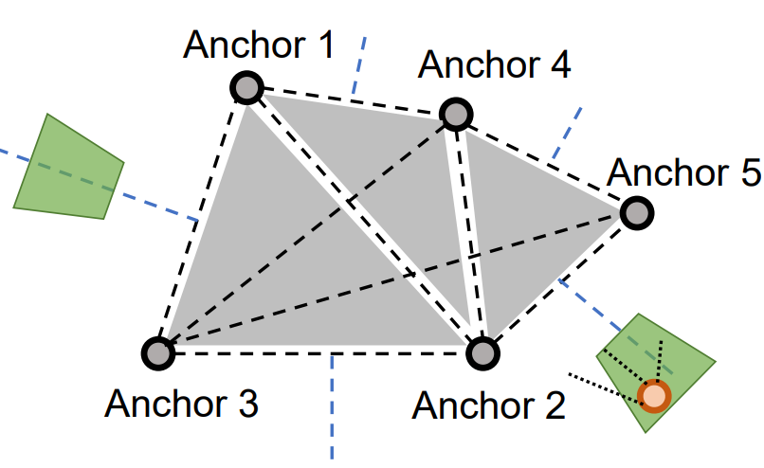
Anchor deployment
Heuristic: anchors in equilateral triangles have lower tag localization error
New Anchor placement region
A
B
T3: Worst-case signal strength
T1: Deviation from bisection line
T2: Minimum Distance
Bisection line
Anchor 1
Anchor 2

Slide 19
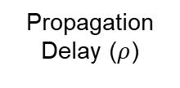
Anchor Messaging
Initiator
Responders
POLL
Slot1
Slot2
…
TDMA
Schedule
RESP
Propagation Delay ($ρ$)
FINAL
POLL
ID
TX TS
Loc(x, y)
Num
Slots
Slot1
Slot2
…
Contention Slot 1
Contention Slot 2
…
RESP
ID
TX TS
Loc(x, y)
Poll Rx Ts
Prev Final RX TS
FINAL
ID
TX TS
Loc(x, y)
Next Init ID
Num
Slots
Resp ID1
Resp RX TS1
Resp ID1
Resp RX TS1
…

Slide 20
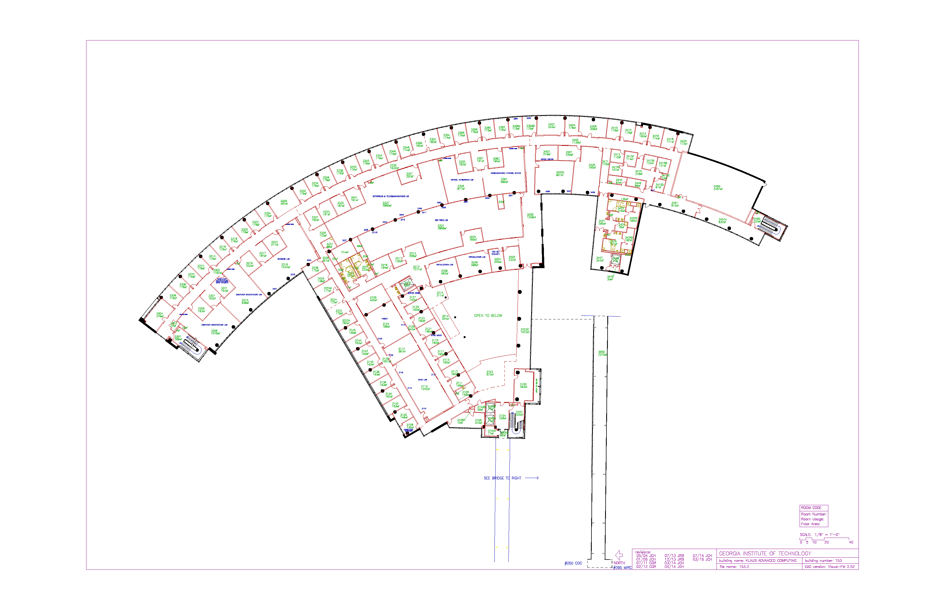


Initiator
Responders
POLL
Slot1
Slot2
…
Anchor Messaging
TDMA
Schedule
Active Anchors
RESP
Passive Clients
FINAL
Propagation Delay ($ρ$)
Anchor Deployment
Easy deployment
Dynamic infrastructure
Large coverage
Anchors
Scalable
Accurate
Privacy preserving

Slide 21


Poor link quality
Poor anchor geometry

Slide 22

Initiator
Responders
POLL
Slot1
Slot2
…
Anchor Messaging
TDMA
Schedule
Active Anchors
RESP
Passive Clients
FINAL
Propagation Delay ($ρ$)
Anchor Deployment
Easy deployment
Dynamic infrastructure
Large coverage
Anchors
Anchor Selection & Filtering
Scalable
Accurate
Privacy preserving
Anchor Geometry
?
?
?
?
Occlusions

Slide 23
Anchor ID | DDoA | RX Power
2 | 2134 mm | -91 dBm
1 | 8740 mm | -78 dBm
3 | 10967 mm | -100 dBm
4 | 12893 mm | -85 dBm
7 | 21738 mm | -105 dBm
2
0
4
7
Filter out anchor 7
3
1
Anchor combinations | (2,1,3,4) | (2,1,3) | (2,1,4) | (1,3,4) | …
Location result | [23564, 4876] mm | [22784, 4988] mm | [23770, 4912] mm | [25076, 4876] mm
GDoP | 0.8 | 1.1 | 0.9 | 1.9
Poor link quality
Poor anchor geometry
Check GDoP

Slide 24
Initiator
Responders
POLL
Slot1
Slot2
…
Anchor Messaging
TDMA
Schedule
Active Anchors
RESP
Passive Clients
FINAL
Propagation Delay ($ρ$)
Anchor Deployment
Easy deployment
Dynamic infrastructure
Large coverage
Anchors
Anchor Selection & Filtering
Scalable
Accurate
Privacy preserving
Anchor Geometry
?
?
?
?
Accuracy
Occlusions

Slide 25
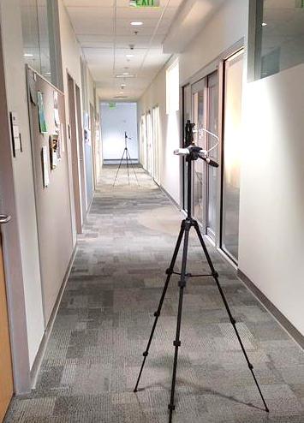
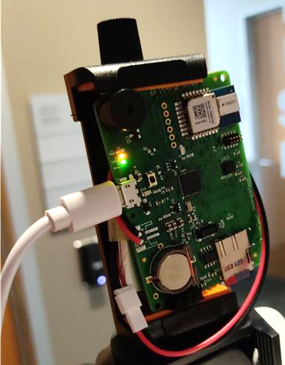
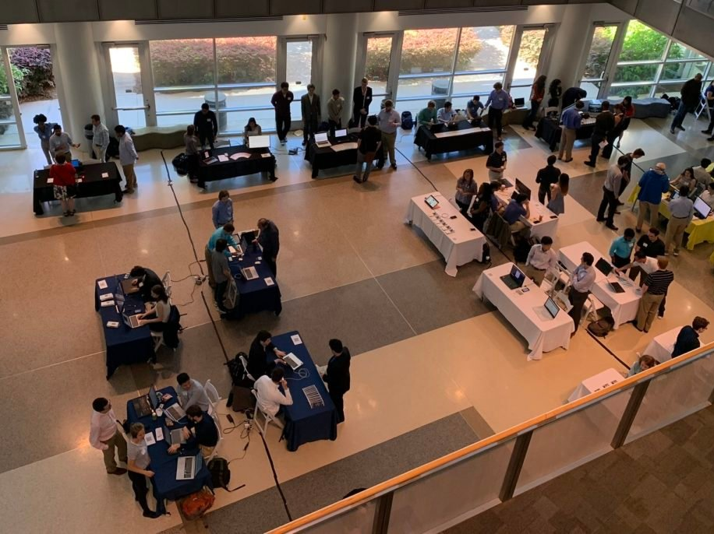


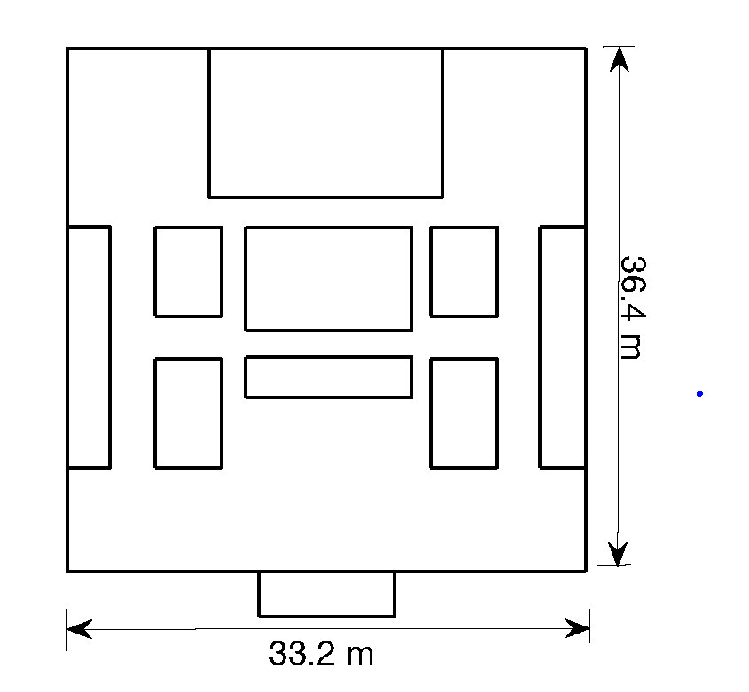
Evaluation
DW1000
3 test environments (open atrium, library, research building)
Atrium(A) 695 m²
Library (L)1208 m²
Advanced Computing Building (K) 2241 m²

Slide 26
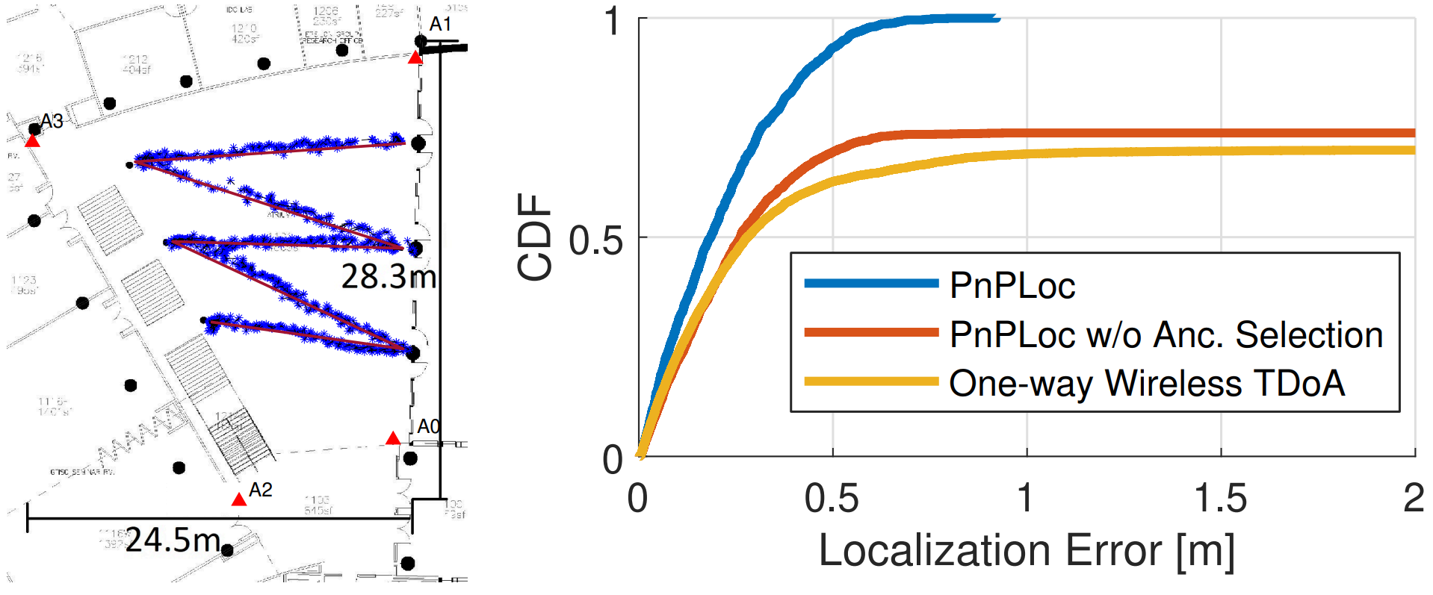
Evaluation
Comparison with
A robot self-localization system using one-way ultra-wideband communication (A. Ledergerber, et al., 2015)
Atrium

Slide 27
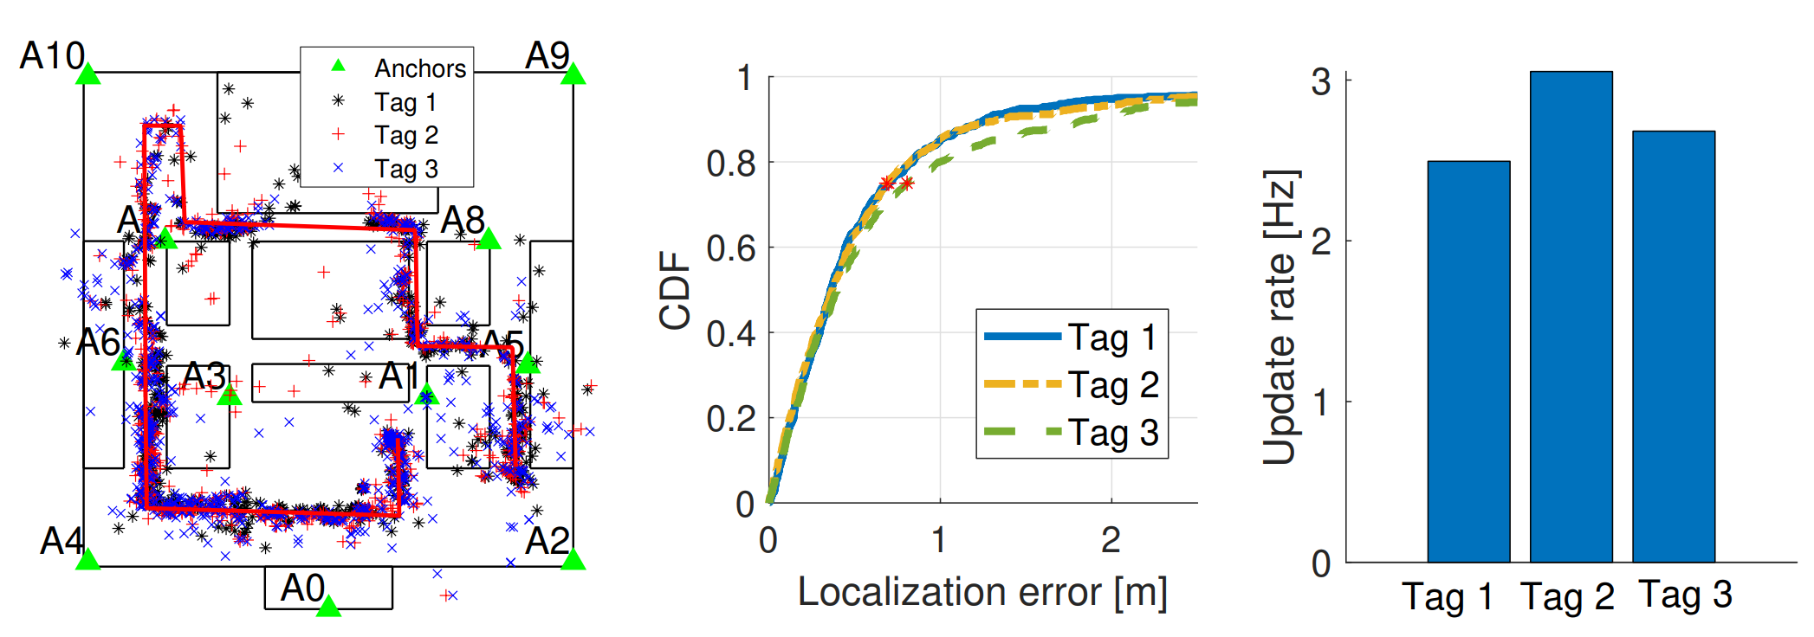
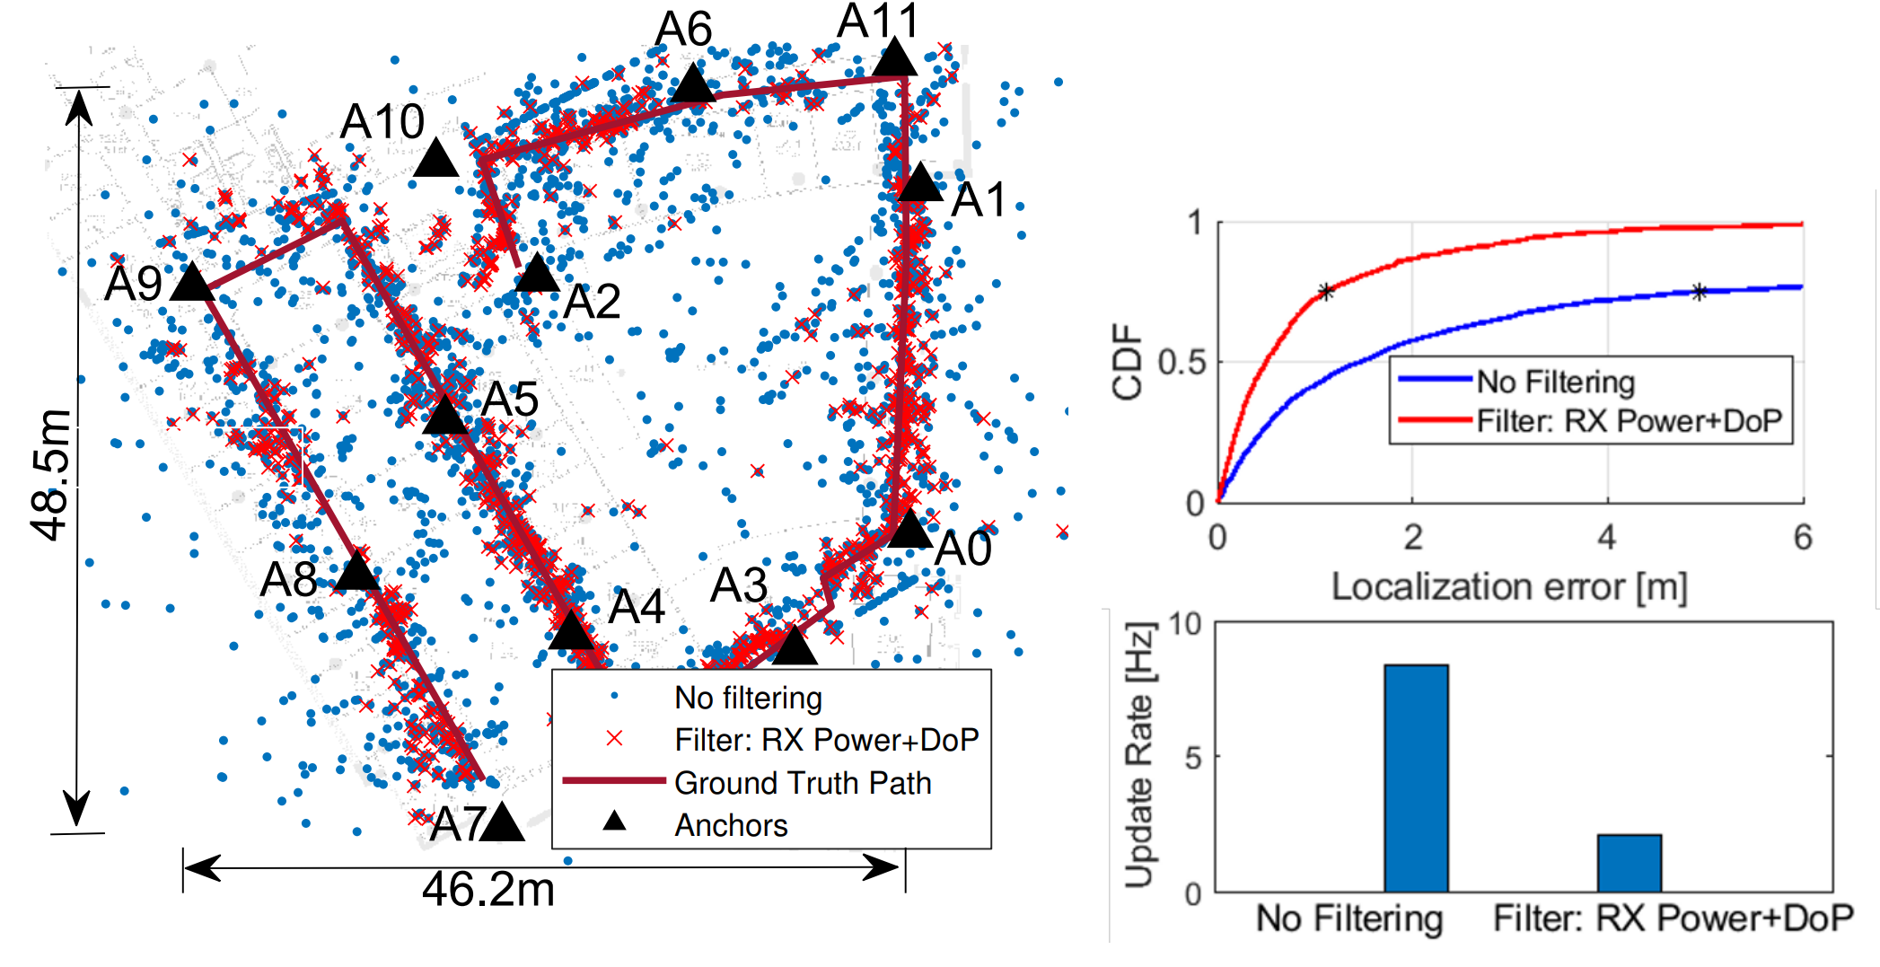
Evaluation
36.4 m
Library
33.2 m
Advanced Computing Building

Slide 28
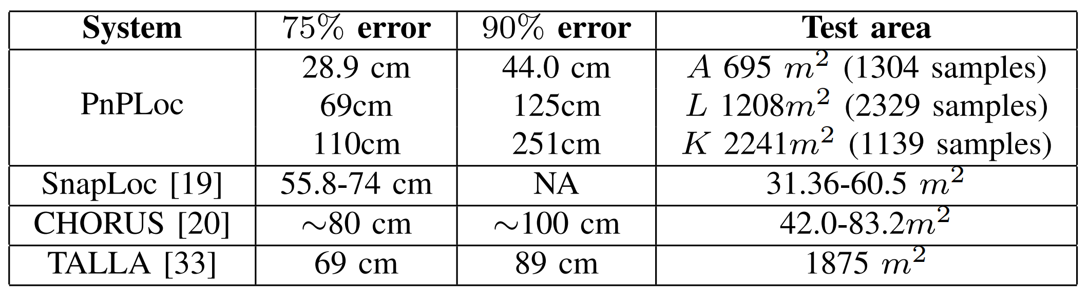
Comparison with State-of-Art

Slide 29


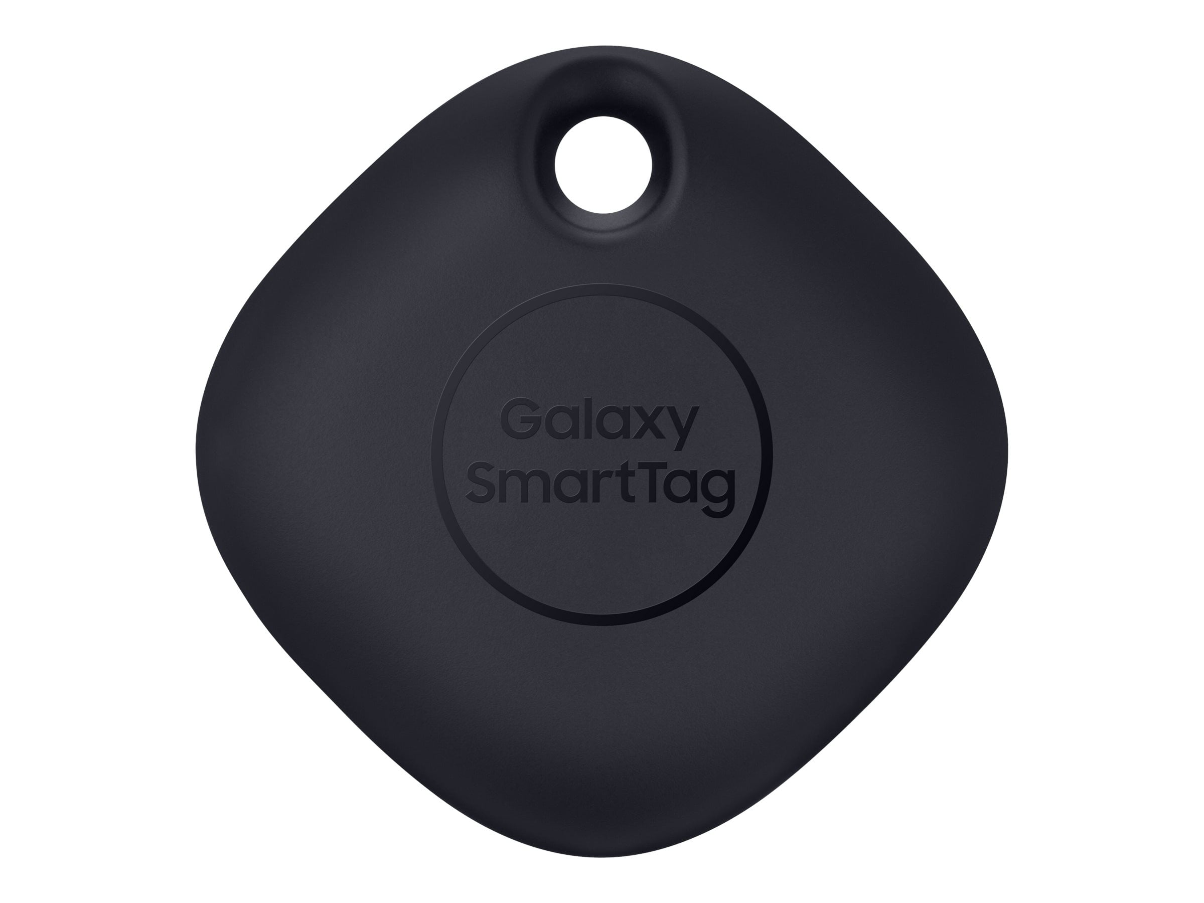

Future works
(x₁,y₁)
(x₂,y₂)
(x₅,y₅)
(x₃,y₃)
(x₄,y₄)
NLOS mitigation/correction
Auto-labeling of anchor locations
Co-existence with other UWB technologies
Standardization and commercialization

Slide 30
Thank you

Slide 31
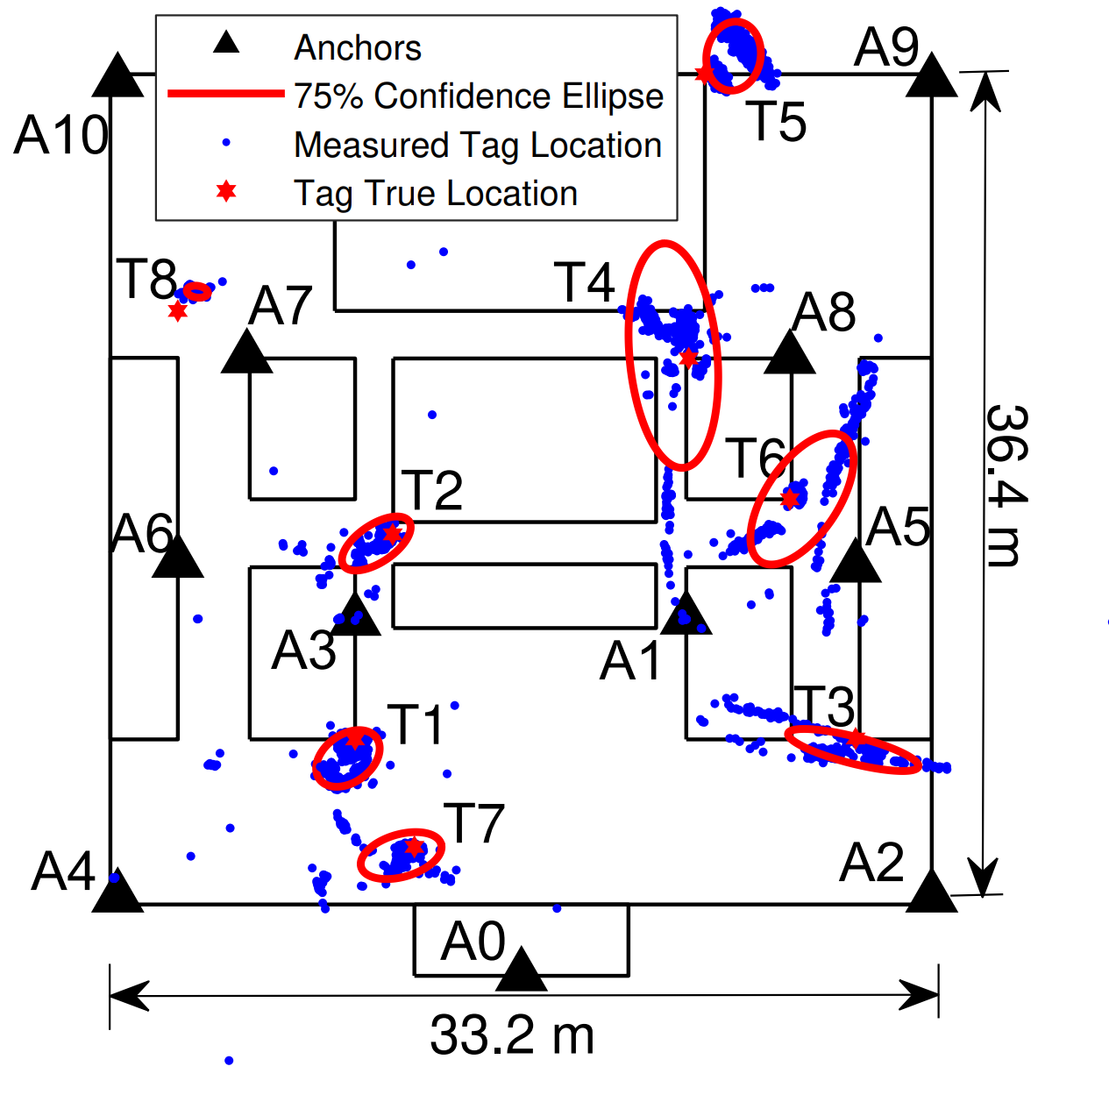
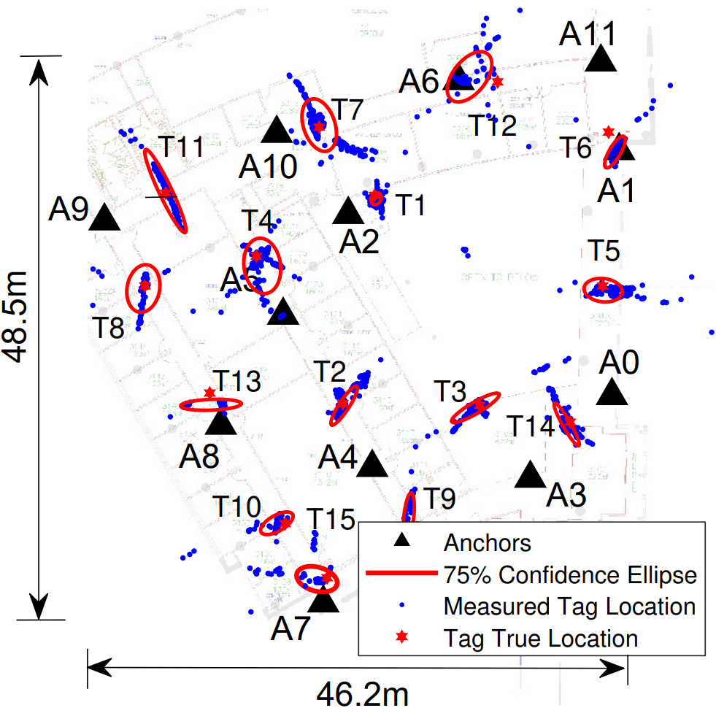
Evaluation

Slide 32
PnPLoc Overview
Initiator
Responders
Slot1
Slot2
…
POLL
Anchor Messaging
TDMA
Schedule
Active Anchors
RESP
Passive Clients
FINAL
Propagation Delay ($ρ$)
Anchor Deployment
Easy deployment
Dynamic infrastructure
Large coverage
Anchors
Anchor Selection & Filtering
Scalability
Privacy preserving
Anchor Geometry
?
?
?
?
Accuracy
Occlusions

Slide 33
Dilution-of-Precision
A₃ – A₁
A₂ – A₁
A₁
Anchor Geometry Affects Localization Precision
What does it entail?
Tag’s location
A₃
A₂
A₂ – A₃
Anchor Deployment
Anchor Selection

Slide 34
Anchor Selection + Filtering
Anchor ID | DDoA | RX Power
2 | 2134 mm | -91 dBm
1 | 10967 mm | -78 dBm
3 | 8740 mm | -100 dBm
4 | 5189 mm | -85 dBm
7 | 12428 mm | -105 dBm
Poor link
Poor anchor geometry
Filter out anchor 7
Anchor combinations | (2,1,3,4) | (2,1,3) | (2,1,4) | (1,3,4) | …
Location result | [23564, 4876] mm | [22784, 4988] mm | [23770, 4912] mm | [25076, 4876] mm
GDoP | 0.8 | 1.1 | 0.9 | 1.9

Slide 35
Problems with passive TDoA schemes
Synchronization backbone
Wireless Synchronization
Sensitive to clock drift error
Cost overhead
Communication overhead
Scalability
Specialty nodes makes large-scale deployment hard
Concurrent Ranging
reference anchor
Synchronization Free
schedule

Slide 36
Problems with passive TDoA schemes
Synchronization backbone
Wireless Synchronization
Sensitive to clock drift error
Cost overhead
Communication overhead
Scalability
Specialty nodes makes large-scale deployment hard
Concurrent Ranging
reference anchor
Synchronization Free
schedule

Slide 37
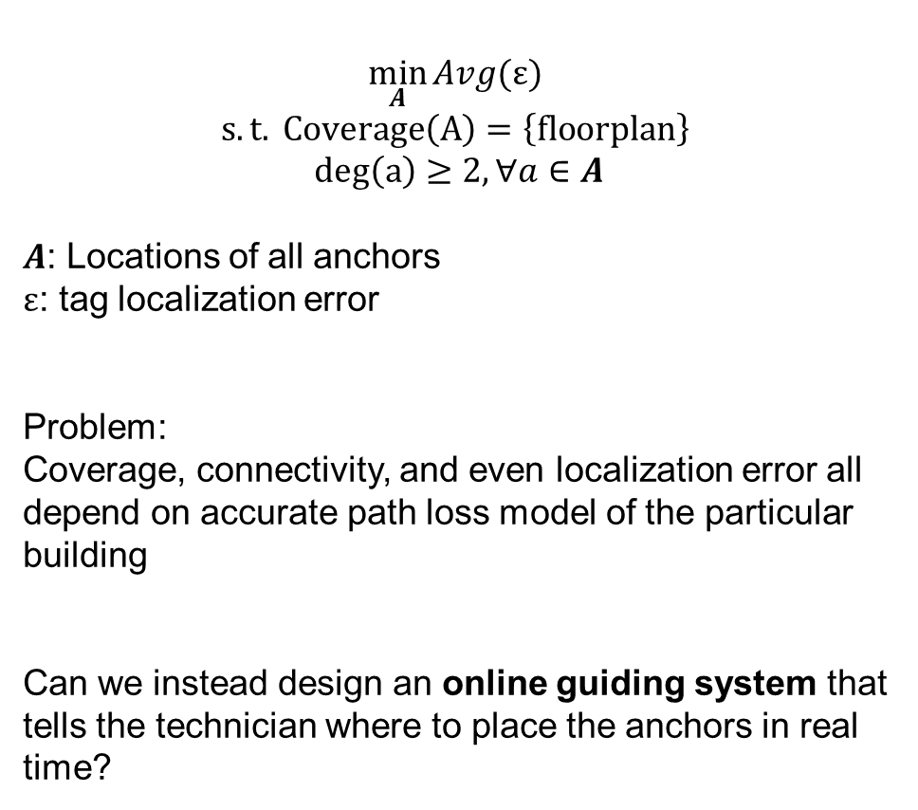
Anchor Deployment
$$\min_{A}{Avg(ε)}$$
$$s.t. Coverage\left(A\right)=\left\{floorplan\right\}$$
$$deg\left(a\right)≥2, ∀a∈A$$
$A$: Locations of all anchors
$ε$: tag localization error
Problem:
Coverage, connectivity, and even localization error all depend on accurate path loss model of the particular building
Can we instead design an online guiding system that tells the technician where to place the anchors in real time?

Slide 38
Clock drift error:
$$\frac{1}{2}\left(δA+δB\right)ρ+\frac{1}{4}\left(δA−δB\right)(D_{B}{−D}_{A})$$
$$δB ρ$$
$$ρ=\frac{1}{4}[\left(R_{A}{−D}_{B}\right)+\left(R_{B}{−D}_{A}\right)]$$
$$ρ=\frac{\left(R_{A}R_{B}\right)−\left(D_{A}D_{B}\right)}{2(R_{A}+D_{A})}$$

Slide 39
Dilution-of-Precision
Anchor Geometry also determines localization precision.

Slide 40








Anyone (without expertise) can deploy the system in any place, and provide localization service to any person in the space.

