Slide 1
Privacy vs. Awareness: Relieving the Tension between Older Adults and Adult Children When Sharing In-home Activity Data
Jiachen Li, Bingrui Zong, Tingyu Cheng, Yunzhi Li
Elizabeth Mynatt, Ashutosh Dhekne

Slide 2
56 million people aged 65 and over lived in the United States
The majority of older adults live in the community instead of nursing home or elder living facilities
90% of seniors express their willingness to stay in their own homes and community as they age
Notes:
As we all know, older adults is a large and growing populations, and the majority of them are and prefer to stay in their own homes instead of nursing homes and living facilities.
This leads us to a concept that receives significant attention in research—aging in place.

Slide 3
Aging in place
“ The ability to live in one’s own home and community safely, independently, and comfortably, regardless of age, income, or ability level. [1]”
[1] Centers for Disease Control, Prevention, et al. 2013. Public health terms for planners and planning terms for public health professionals.
Notes:
As researchers, our aim is to assist older adults in successfully aging in place. However, numerous challenges exist, and one of the primary concerns stems from their adult children.

Slide 4
“I don’t want to be monitored!”
“Are my parents safe?”
power dynamics
?
Older adult
Adult children
Privacy vs. Awareness
Notes:
Many adult children, especially those who don't live with their parents, always have this question in mind: "Are my parents safe?" Some of them think, what about installing a monitor camera at my parents home?
The issue here is quite evident – no one like to be monitored. So many of them still end up using the traditional way: a phone call to check if everything’s okay, which does not meet all their needs, such as getting an immediate notice after their parents slip. As we can see this situation creates a tension between both parties involved.
In our research, we aim to examine the tradeoff between privacy and awareness, seeking a solution that can ease this tension.

Slide 5
Research questions
Tradeoffs surrounding privacy and awareness
Detailed design insights
Technology probe: iFloor
Notes:
To summarize, our approach involves two main steps. First, we aim to understand the tradeoffs involved. Then, we plan to dive deeper into the practical design insights using a technology probe we've developed called "iFloor."

Slide 6
14
13
High-level takeaways
Interview & Focus group
Elderly
Children
Initial design insights
Designer Workshop
5
Designers
Researchers
iFloor
System development
5
5
Final design insights
User testing
Elderly
Children
Notes:
We used an iterative design approach in our study
we began by conducting interviews and focus group sessions with 14 older adults and 13 adult children to gather some high-level takeaways.
Using these takeaways as a foundation, we organized a designer workshop involving 5 designers to generate initial design insights.
From those ideas, our team created iFloor as a concrete embodiment of these insights.
Next, we conducted user testing with 5 older adults and 5 children to see if iFloor effectively balanced the tradeoffs between privacy and awareness. (We compared it with abstract art and video recording, which we considered as two extremes on the privacy and awareness spectrum.)
Using the results from this testing, we made further refinements to our final design insights.

Slide 7
High-level takeaways - Needs and Concerns
Movement and Daily activities are important
14 daily activities
crucial, private, casual, customized
Only showing necessary information and avoiding any video data
Notes:
Now, let's dive into our insights. During our sessions with both older adults and their children, we explored their needs and concerns.
First of all, we discovered that movement and daily activities are two important categories for both groups, even older adults themselves agreed on that.
However, we also recognized that various daily activities come with different levels of importance and privacy considerations. To quantify this, we conducted a survey during our user research sessions, asking both parties to rate the importance and privacy levels of 14 different daily activities. This allowed us to categorize these activities into four distinct groups: crucial, private, casual, and customized.

Slide 8
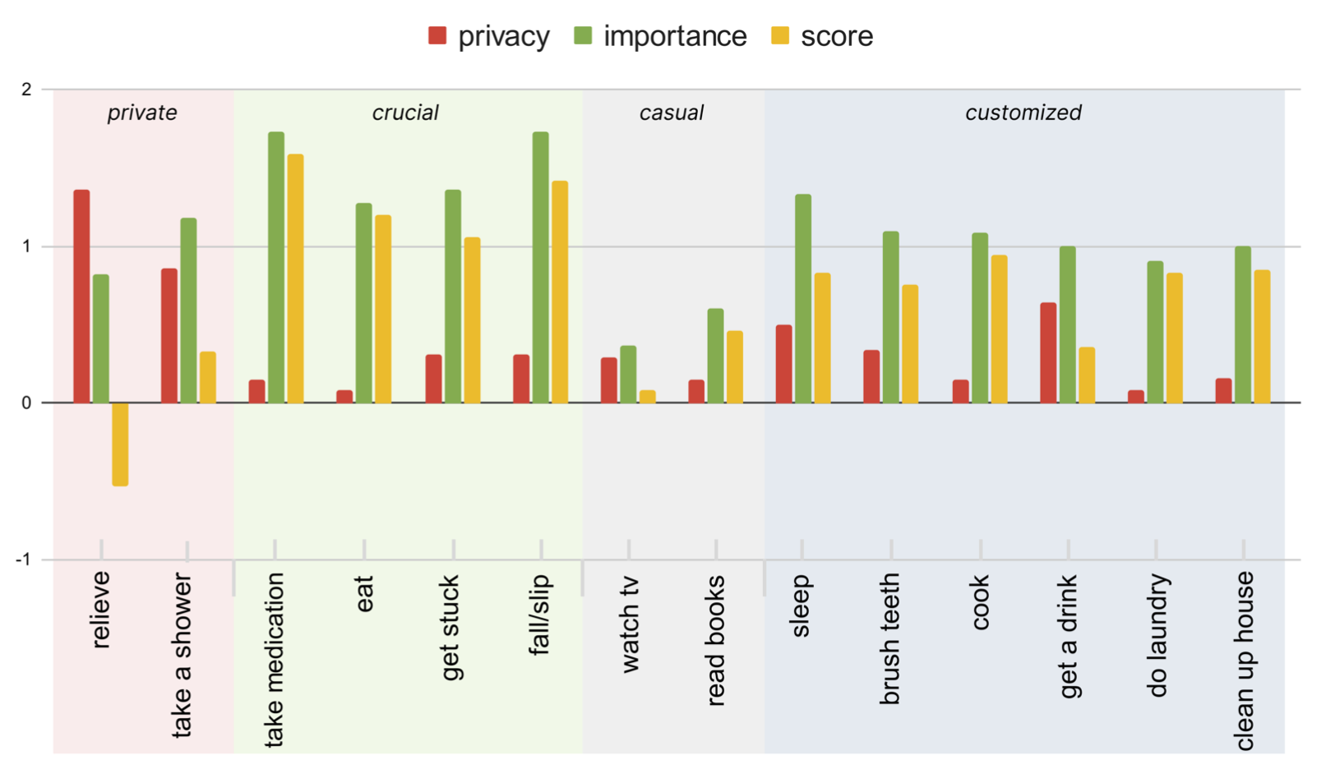
Notes:
Animation! Now, let's take a look at the 4 categories. Starting with the leftmost one, the private activities, they were rated as significantly private for older adults, such as relieving. There could be a potential tension here such as taking a shower also has relatively high importance, however, to respect the privacy of older adults, as long as an activity is considered very private by them, we categorize it as a private activity.
Moving on to crucial activities, these are quite straightforward: they have a very high importance level but a low privacy level, which makes their deviation higher than 1, such as taking medication.
Now, the gray category, casual activities, have very low values in both privacy and importance, which means they are generally not that important.
Lastly, we have the customized activities, which don't neatly fit into the private, crucial, or casual categories. They typically have a high standard deviation among all participants, suggesting that these activities are important but need to be customized according to each user's preference.

Slide 9
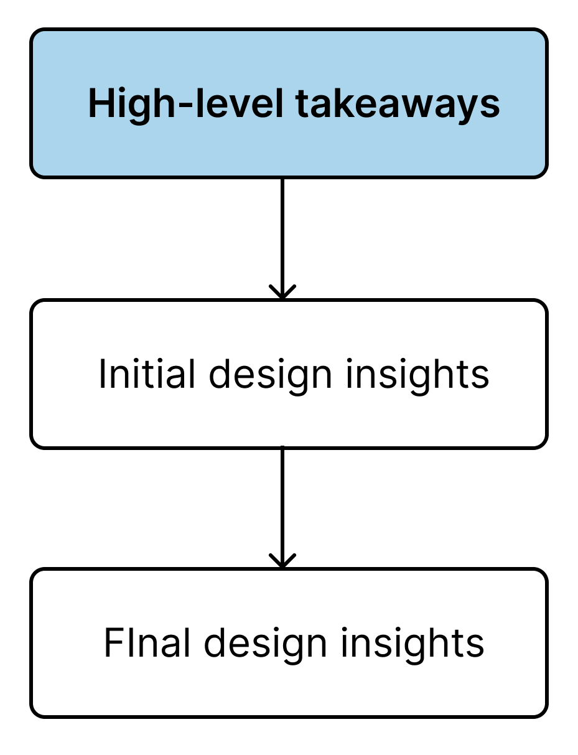
4 Goals [2]
Support low-level awareness
Trends over time
Respecting privacy concerns
Reduce complexity
[2] Elizabeth D Mynatt, Jim Rowan, Sarah Craighill, and Annie Jacobs. 2001. Digital family portraits: supporting peace of mind for extended family members. In Proceedings of the SIGCHI conference on Human factors in computing systems. 333–340.
Notes:
So now when we summarize our first version of the high-level takeaways, we start from these four goals that were initially drawn from existing literature.

Slide 10
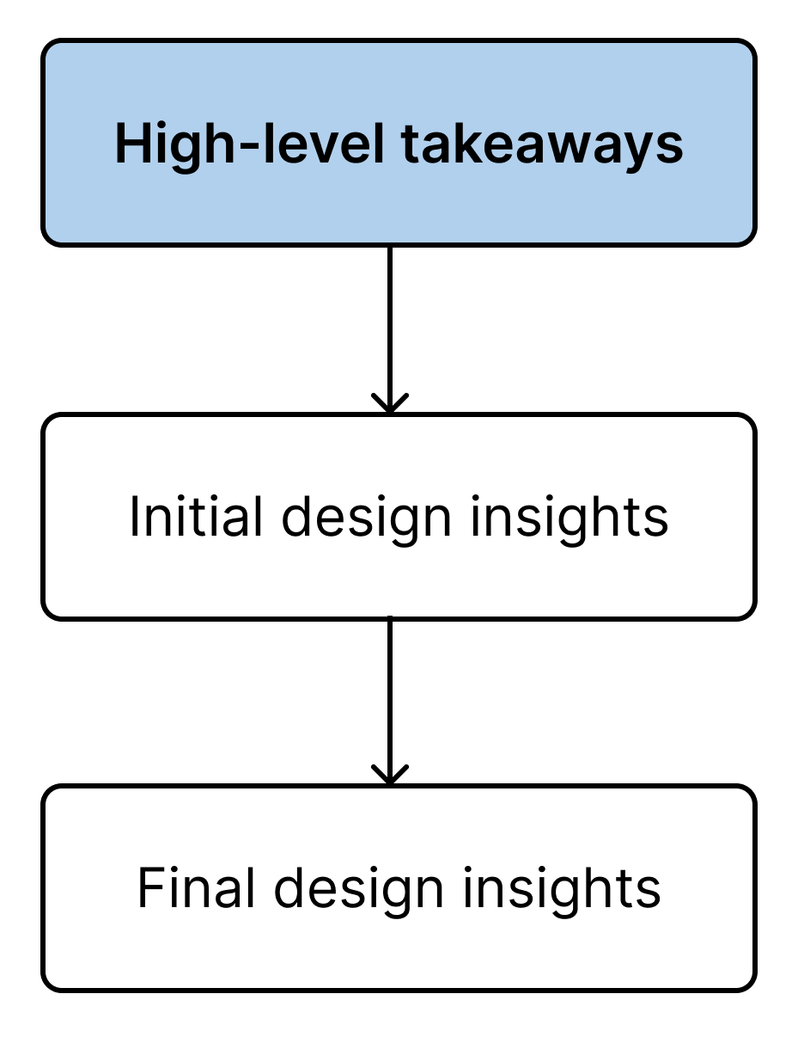
4 Goals [2]
High-level Takeaways
Movement and daily activities
Support low-level awareness
Trends over time
Respecting privacy concerns
Crucial and customized activities
Reduce complexity
Private and casual activities
Visual information
[2] Elizabeth D Mynatt, Jim Rowan, Sarah Craighill, and Annie Jacobs. 2001. Digital family portraits: supporting peace of mind for extended family members. In Proceedings of the SIGCHI conference on Human factors in computing systems. 333–340.
Notes:
So now when we summarize our first version of the high-level takeaways, we start from these four goals that were initially drawn from existing literature.
We've further refined these goals based on the insights I've just discussed as the high-level takeaways.
We should report movement and daily activities, especially for those that are crucial or customized. We shouldn’t share any private and casual activities, and we should avoid capturing any visual information.

Slide 11
High-level Takeaways
Support low-level awareness
Trends over time
Respecting privacy concerns
Reduce complexity
Notes:
We've further refined these goals based on the insights I've just discussed as the high-level takeaways.
We should report movement and daily activities, especially for those that are crucial or customized. We shouldn’t share any private and casual activities, and we should avoid capturing any visual information.

Slide 12
High-level Takeaways
Support low-level awareness
Movement and daily activities
Trends over time
Respecting privacy concerns
Crucial and customized activities
Private and casual activities
Visual information
Reduce complexity
Notes:
We've further refined these goals based on the insights I've just discussed as the high-level takeaways.
We should report movement and daily activities, especially for those that are crucial or customized. We shouldn’t share any private and casual activities, and we should avoid capturing any visual information.

Slide 13
Designer workshop
Presentation
1-hour Prototyping
Group Discussion
Scenario
Personas
Storyboards
Notes:
Now that we've got a grasp of what information to share, it's equally important to consider how we share it because that can significantly influence people's perception of that information. To tackle this aspect, we organized a designer workshop to translate our high-level takeaways into practical design insights.
In the workshop, we began by presenting the high-level takeaways we got in the earlier sessions to the designers using scenarios, personas, and storyboards. Each designer was then given an hour to individually craft a prototype based on these insights. Following this, we held a group discussion to explore and evaluate each designer's unique ideas and approaches.

Slide 14
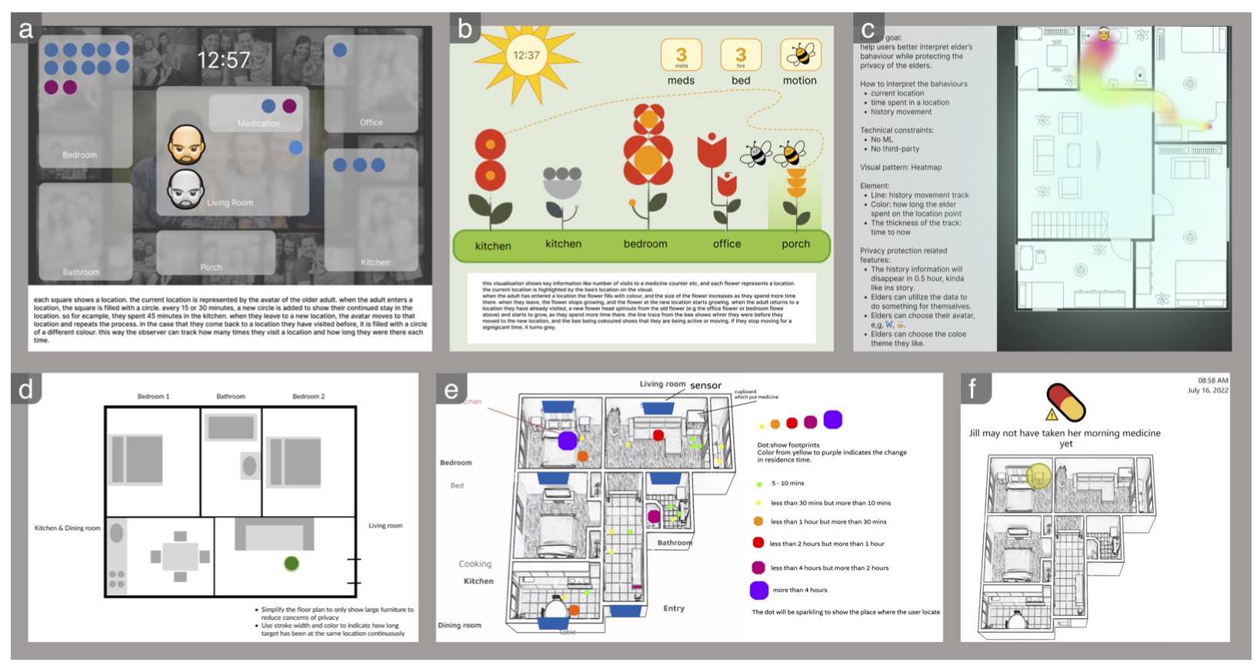
Notes:
These are the six ideas from our designers, we won’t go deeper in this presentation, but please check our paper if you are interested in. One thing to note is that a floorplan based design dominate, which becomes the basis of our iFloor design.

Slide 15
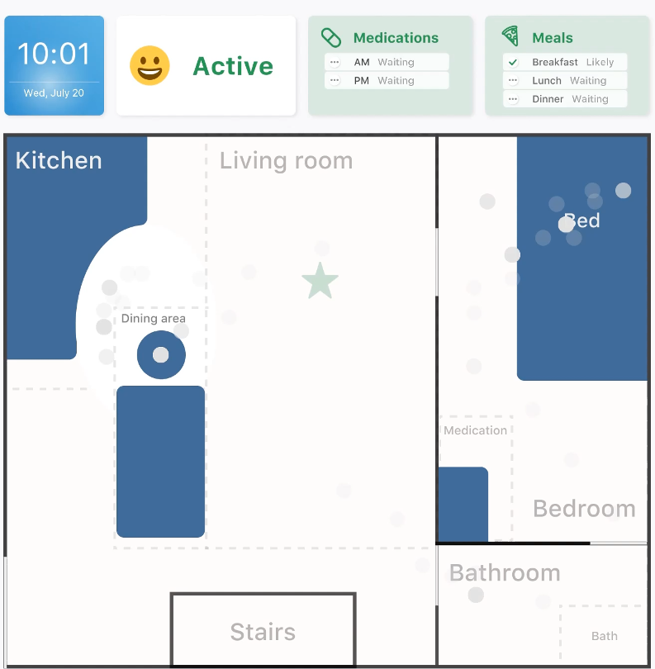
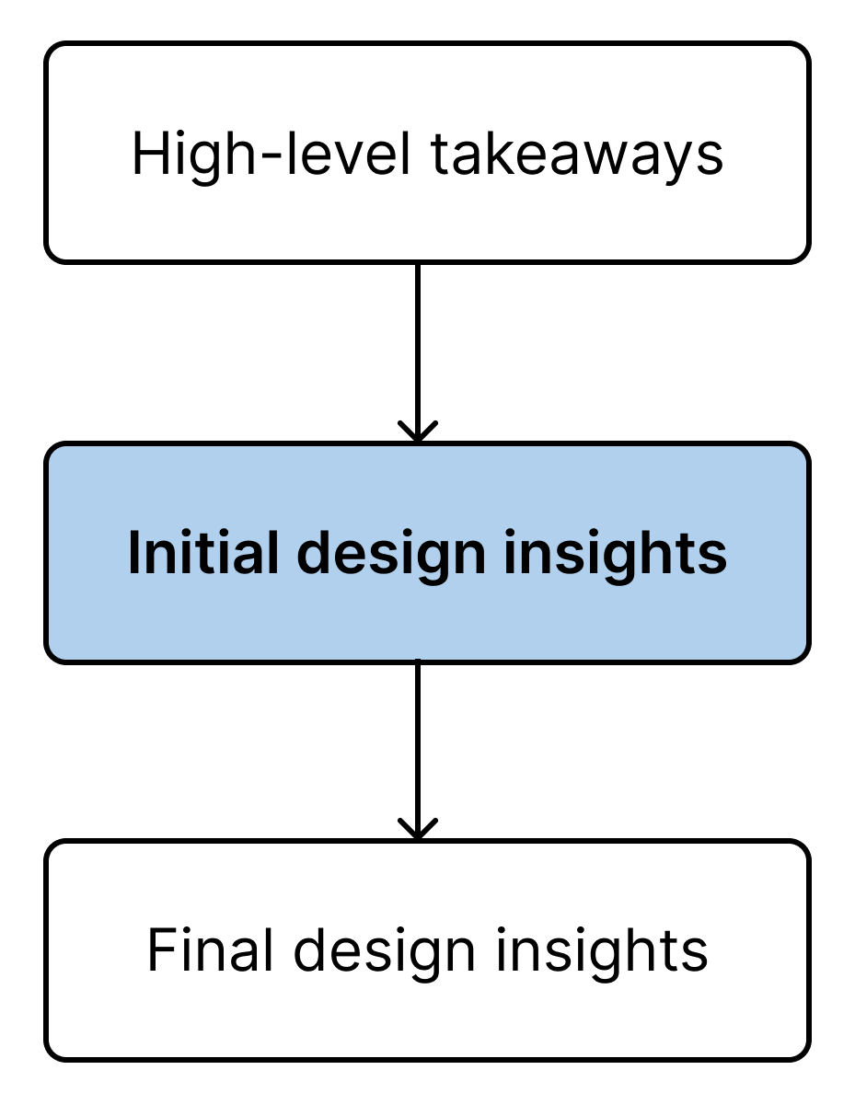
High-level takeaways
Initial design insights
Support low-level awareness
Particular areas
Avatar has different stages
Movement and daily activities
Highlight important status/activities
Trends over time
Visual cues -> time spent in an area
Respecting privacy concerns
Crucial and customized activities
No private and casual activities
Activity panels
No visual information
Only vague necessary furniture
Reduce complexity
Ambient historical data
Notes:
After the designer workshop, we have some interesting ideas and findings to refine our list. So again, these are the previous high-level takeaways
This is the refined version. I know these are a lot, but let’s go through each of them using our final design, iFloor, which is a visualization that the researchers designed based on all these detailed insights.
On the right is iFloor, a visualization that's based on the indoor location of older adults.

Slide 16
High-level takeaways
Support low-level awareness
Movement and daily activities
Trends over time
Respecting privacy concerns
Crucial and customized activities
No private and casual activities
No visual information
Reduce complexity
Notes:
This is the refined version. I know these are a lot, but let’s go through each of them using our final design, iFloor, which is a visualization that the researchers designed based on all these detailed insights.

Slide 17
Initial design insights
Particular areas
Avatar has different stages
Highlight important status/activities
Visual cues -> time spent in an area
Activity panels
Only vague necessary furniture
Ambient historical data
Notes:
The main part of it shows a simplified floor plan of their home, specific areas such as medication were highlighted.
Only essential furniture items are included and are represent in a vague manner to safeguard the privacy of older adults.

Slide 18
Initial design insights
Particular areas
Avatar has different stages
Highlight important status/activities
Visual cues -> time spent in an area
Activity panels
Only vague necessary furniture
Ambient historical data
Notes:
On top of the floor plan, there’s a panel highlighting older adult’s status and important activities.

Slide 19
Initial design insights
Particular areas
Avatar has different stages
Highlight important status/activities
Visual cues -> time spent in an area
Activity panels
Only vague necessary furniture
Ambient historical data
Notes:
You might also notice some gray dots scattered across the map; these represent the person's historical movements.

Slide 20
Initial design insights
Support low-level awareness
Movement and daily activities
Particular areas
Avatar has different stages
Highlight important status/accidents/activities
Trends over time
Visual cues -> time spent in an area
Respecting privacy concerns
Crucial and customized activities
Activity panels
No private and casual activities
Only vague necessary furnitures
No visual information
Reduce complexity
Ambient historical data
Notes:
This is the refined version. I know these are a lot, but let’s go through each of them using our final design, iFloor, which is a visualization that the researchers designed based on all these detailed insights.

Slide 21
Initial design insights
Support low-level awareness
Movement and daily activities
Particular areas
Avatar has different stages
Highlight important status/accidents/activities
Trends over time
Visual cues -> time spent in an area
Respecting privacy concerns
Crucial and customized activities
Activity panels
No private and casual activities
Only vague necessary furnitures
No visual information
Reduce complexity
Ambient historical data
Notes:
On the right is iFloor, a visualization that's based on the indoor location of older adults. The main part of it shows a simplified floor plan of their home, specific areas such as medication were highlighted.
Only essential furniture items are included and are represent in a vague manner to safeguard the privacy of older adults.

Slide 22
Initial design insights
Support low-level awareness
Movement and daily activities
Particular areas
Avatar has different stages
Highlight important status/accidents/activity
Trends over time
Visual cues -> time spent in an area
Respecting privacy concerns
Crucial and customized activities
Activity panels
No private and casual activities
Only vague necessary furnitures
No visual information
Reduce complexity
Ambient historical data
Notes:
On top of the floor plan, there’s a panel highlighting older adult’s status and important activities.

Slide 23
Initial design insights
Support low-level awareness
Movement and daily activities
Particular areas
Avatar has different stages
Highlight important status/accidents/activities
Trends over time
Visual cues -> time spent in an area
Respecting privacy concerns
Crucial and customized activities
Activity panels
No private and casual activities
Only vague necessary furnitures
No visual information
Reduce complexity
Ambient historical data
Notes:
You might also notice some gray dots scattered across the map; these represent the person's historical movements.

Slide 24
User Testing - iFloor on the tradeoff spectrum
Travelogue [3]
iFloor
video
abstract
detailed
Day-in-fast- forward testing (30x) in a mock-up room
Location -> Visualization (iFloor)
[3] Yunzhi Li, Tingyu Cheng, and Ashutosh Dhekne. 2022. Travelogue: Representing Indoor Trajectories as Informative Art. In Extended Abstracts of the 2022 CHI Conference on Human Factors in Computing Systems (New Orleans, LA, USA) (CHI EA ’22). Association for Computing Machinery, New York, NY, USA, Article 387, 7 pages. https://doi.org/10. 1145/3491101.3519834
Notes:
Now that we have our iFloor prototype, which embodies our design insights, our next step was to test and see how well it balances the tradeoff between privacy and awareness. To do this, we conducted a user testing, comparing iFloor with two other formats.
The first format is called "Travelogue," which is a prototype created by Li et al. in previous research. On top of the black background, the light gray geographics are generated based on the locations one has visited. We view it as an abstract version of iFloor.
The second format we used is video recording, which provides very detailed information but raises potential privacy concerns. To create these visualizations, we simulated a 30 speed day in fast-forward testing scenario in a studio-like mock-up room to mimic the 14 possible daily activities in a 24-hour period. We captured data based on how the visualization was designed, primarily tracking the locations of researchers to create these representations.

Slide 25
User Testing - iFloor on the tradeoff spectrum
we show them..
Short fragment video of an activity
Snapshot at a certain time
we ask them..
Correctness
What is Jasmine doing right now?
Usefulness
Do you think it’s useful to get this video/visualization?
Comfort level
Will you feel comfortable sharing this to your children?
Notes:
Following the data collection, we ended up with three 30-speed video clips for the three different visualizations. When we presented these visualizations to the older adults, we did it in two ways: by showing a short video clip of an activity and by displaying a snapshot, which is essentially an image of iFloor at a specific moment.
The questions we asked during the testing fell into three categories: correctness, usefulness, and comfort level. If you're interested in a more detailed breakdown, you can find it in the paper.

Slide 26
Correctness
Notes:
Let's talk about correctness first. When it comes to raw video, it had the highest correctness rate, with adult children correctly interpreting the activities 100% of the time. iFloor also performed quite well, with a good level of correctness.
However, when it comes to the abstract art, even after we explained it in detail, none of the adult children were able to successfully interpret any of the three activities presented. The only activity some of them could figure out was sleeping, which was relatively easier to identify as it showed a single pattern of no movement on the screen.

Slide 27
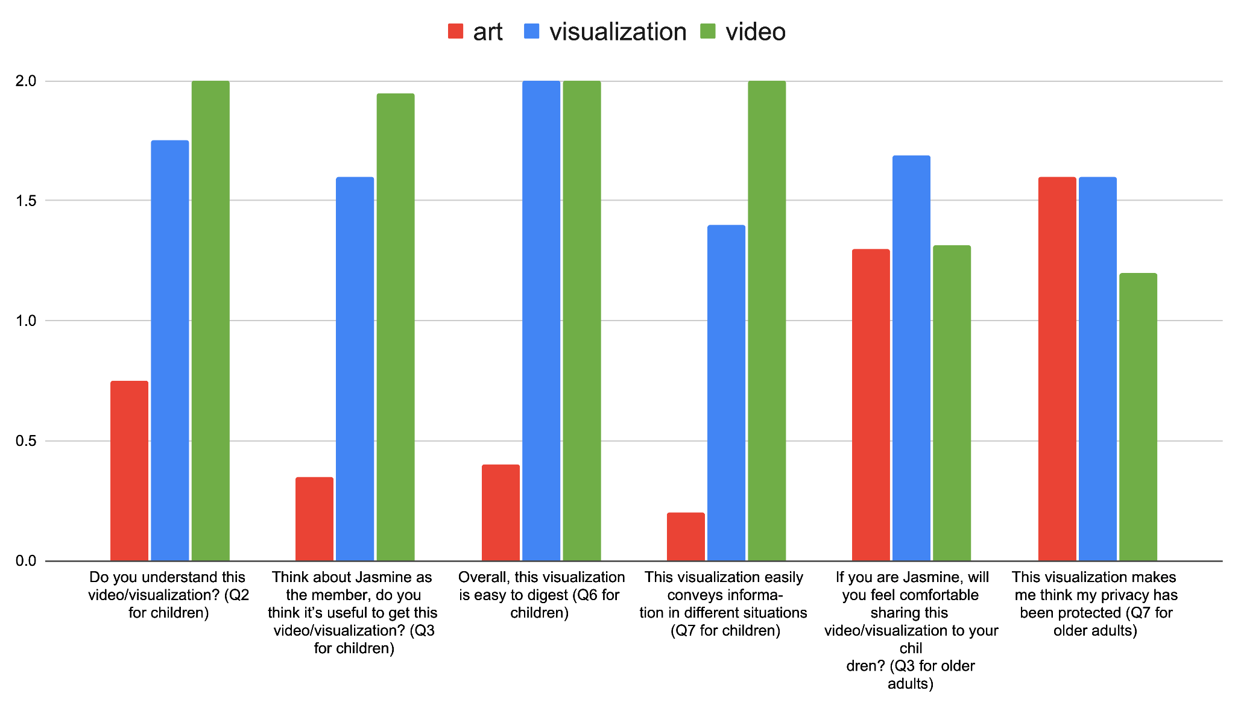
Usefulness
Comfort level
Notes:
Regarding the usefulness. as you can see, the trends are consistent. Video which is green, remains the highest-rated format, visualization, blue is quite good, and the abstract art, red fares poorly in terms of perceived usefulness.
When it comes to the comfort level, represented in the two rows on the right side, video turns out to be the least comfortable format for older adults. On the other hand, iFloor is the most comfortable option for them. Interestingly, the abstract art isn't as comfortable for older adults to share with their children as we initially thought it might be.

Slide 28
?
More concrete -> More accurate and useful?
Generally correct.
More abstract -> More privacy preserved?
Not really!
?
Notes:
Generally, more concrete leads to more accurate and useful. However, does being more abstract leads to more privacy preserved? Not really.

Slide 29
?
Why abstract art is NOT the most privacy-preserved method?
Distrust in technology
Different level of tech literacy between older adults and children
Cognitive impairment - > Declined learning ability
Privacy ≠ Data privacy/security
Perception of Privacy!
Notes:
In our follow-up interviews, we discussed these findings with our participants to understand why these outcomes occurred. It became clear that even though explained it very well, older adults didn't grasp their meanings. This lack of understanding made them feel suspicious.
Imagine someone tells you that certain information won't violate your privacy, but you simply can't comprehend it. Would you feel comfortable sharing it with others? This concern gets even more pronounced when there's a disparity in tech literacy between you and the people you're sharing with. In our case, older adults worried that their more tech-savvy children might interpret more information than they could, leading them to hesitate sharing until they fully understood.
This issue is particularly significant in the older adult population, as many of them have some level of cognitive impairment, which can hinder their ability to learn new things. Even as time goes on and they become more familiar with the system, they still might not be able to understand it. So, we can't simply rely on time to solve this challenge.
We recognized that privacy is not just data privacy or security, but the perception of privacy

Slide 30
Discussion
Awareness ≠ Safety alerts
Disagreement regarding the level of autonomy of the elderly
More trust in raw data resources
Notes:
Let's explore some additional points from our paper.
When we consider the aspect of awareness, we often think about practical matters like receiving safety alerts. However, this isn't always the primary concern, especially when older adults still maintain a high level of autonomy. As my advisor Beth pointed out in her paper from years ago, sometimes what children seek is simply peace of mind. Even in the absence of safety alerts, they might just want to check in on how their parents are doing.
Now, discussing the level of autonomy, it's a crucial factor in the tension between the two parties, particularly when they have different perspectives. Older adults may believe they're perfectly fine, while their children worry about potential accidents. As designers, we should recognize that easing this tension isn't solely about comparing quantitative results from questions. It's more about fostering communication and reaching an agreement that satisfies both parties.
Another valuable insight is that adult children's trust in the system largely depends on how well they understand how it works. For example, when one participant learned that our judgments about daily activities were based on location information, she became more inclined to look for relevant historical location data and determine whether her mother was taking her medication independently, rather than relying solely on the summarized data we provided. This highlights the importance of respecting people's thought processes and understanding of the system.

Slide 31
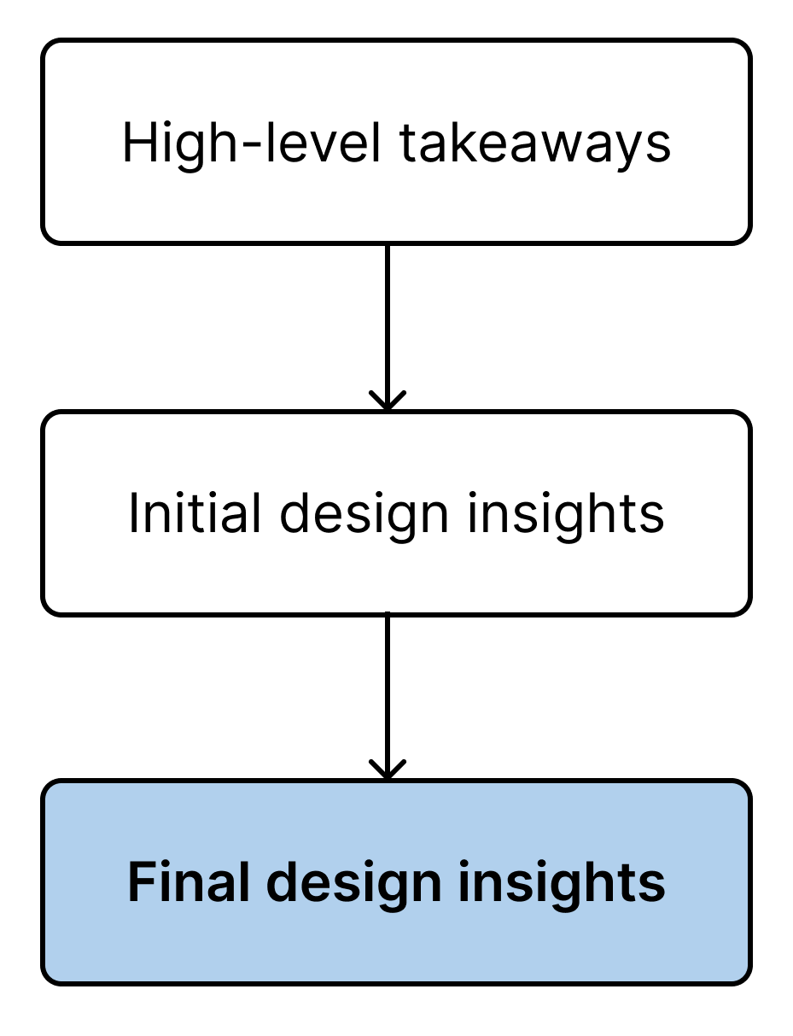
Initial design insights
Final design insights
Support low-level awareness
Movement and daily activities
Particular areas
Avatar has different stages
Highlight important status/accidents/activities
Trends over time
Visual cues -> time spent in an area
Respecting privacy concerns
Learning curve for non tech-savvy
Crucial and customized activities
Design for Trust
Activity panels
No private and casual activities
Align with original data resources
Only vague necessary furnitures
No visual information
A basic level of trust & understanding as the basis
Reduce complexity
Ambient historical data
Notes:
Finally, here’s our initial design insights.
The first 3 do not change
We added one point to the fourth goal, and added a fifth goal, design for trust

Slide 32
Final design insights
Support low-level awareness
Trends over time
Respecting privacy concerns
Reduce complexity
Ambient historical data
Notes:
The first 3 do not change

Slide 33
Final design insights
Support low-level awareness
Trends over time
Respecting privacy concerns
Reduce complexity
Ambient historical data
Learning curve for non tech-savvy
Design for Trust
Align with original data resources
A basic level of trust & understanding as the basis
Notes:
We added one point to the fourth goal, and added a fifth goal, design for trust

Slide 34
(1) The design should convey relevant information about a person’s daily life to support low-level awareness of that person’s well-being.
(a) Movement and daily activities (crucial and customized)
(i) Particular areas should be created inside one room to highlight important activities (e.g.medication area).
(ii) Avatar should have different visual effects to represent the person’s real-time safety status.
(iii) Important status/accidents/activities should be highlighted with evident and dynamic changes.
(2) The design should depict trends over time or the different categories of information represented.
(a) Use visual cues (e.g. color, size) to represent the time someone spends in certain areas.
(3) The visualization should provide a qualitative view respecting privacy concerns.
(a) Information of crucial and customized activities should be provided in a qualitative view.
(i) Provide activity panels for crucial and customized activities
(b) Information of private and casual activities should not be displayed.
(i) Only include necessary furniture and make them vague.
(c) No camera-based information should be captured and delivered.
(4) Reduce the display’s complexity.
(a) History data is important, but make it ambient.
(b) The learning curve of the qualitative view should be considered during the design process, especially for tech-unsavvy users.
(5) Design for trust.
(a) Display more information that is aligned with the original data resources to promote trust.
(b) Provide enough information and explanation to make sure the user has a basic understanding of the graphics.
(c) Keep in mind that a certain level of trust is the basis for users to share information without worrying about privacy issues.

Slide 35
Summary
Privacy vs. Awareness tradeoff between older adults and their children when sharing in-home activities information
Interviews and focus group sections + Designer workshop + User testing
iFloor successfully balances the tradeoffs
Abstract ≠ Comfortable to share with others -> Perception of privacy & Design for trust
Notes:
In summary, we delved into the tradeoffs between privacy and awareness in the context of older adults and their children sharing in-home activity data. We conducted a series of iterative user design and research sessions, which led us to create iFloor. We then tested it with users and distilled a set of valuable design insights, which is our main contribution.
We believe that iFloor strikes a balance by offering adequate information while safeguarding seniors' privacy.
It's crucial to note that making the visualization abstract doesn't necessarily make people feel comfortable sharing their data, and we should include the level of trust and the perception of privacy into our design considerations.

Slide 36
Limitations
Data collection in lab
What if even indoor location is not okay?
Female (80%) outnumber other gender identities
Notes:
Our paper does have a few limitations worth mentioning. Firstly, we collected and generated data in a controlled lab setting. In real-life situations, the behavior of older adults and researchers can vary, and the hardware sensing data may not be as accurate or pristine as what we obtained in the lab.
Additionally, it's important to note that all our participants are 100% comfortable to share their indoor location information with their children, which formed the basis of our design. However, there might be older adults, particularly those with higher autonomy, who may be reluctant to share even their location within their own homes. In such cases, we would need to develop an alternative set of design principles.
Another limitation is that there is an imbalance between the number of female and other gender identity participants. However, it's worth acknowledging that in real-life caregiving situations, female caregivers do tend to outnumber individuals of other gender identities.

Slide 37
Khoury College Faculty Hiring - NEU Tenure Track and Research Active Teaching Faculty
Resilient and Trustworthy Systems: Databases, Systems, Security and Privacy, Trustworthy AI, Quantum
Next Generation Software: PL; Scalable Software; AI-assisted Programming
Robotics and Foundations of AI: Foundations of ML, NLP, Computer Vision, Robotics
Human-Centered AI and Embodied Intelligence: HCI, XR/AR/VR, Human-in-the-loop AI
AI for Personal, Public, and Population Health: Digital Health, AI for health, Longitudinal and behavioral health
Computer Science and Law: Data governance and privacy, Crypto and Law, Regulations and Generative AI
Digital Civics: HCC, CSCW, ubicomp, visual analytics, smart cities, information ethics, public good tech
Targeted support for post-doctoral researchers and early-career and senior faculty Hiring at Boston, San Jose, Mills/Oakland, Seattle and Arlington campuses
Notes:
Before the Q&A, I would like to introduce this wonderful opportunity on behalf of my advisor, Dean Beth. Khoury college at Northeastern University is hiring post-doc and faculties in different areas. Please definitely check it out if you are on the job market.

Slide 38
Support low-level awareness
Thank You :)
Movement and daily activities
Particular areas
Avatar has different stages
@JasmineJiachenL
Highlight important status/accidents/activities
Trends over time
Visual cues -> time spent in an area
Respecting privacy concerns
Crucial and customized activities
Activity panels
No private and casual activities
Only vague necessary furniture
No visual information
Reduce complexity
Ambient historical data
Learning curve for non tech-savvy
Design for Trust
Align with original data resources
A basic level of trust & understanding as the basis
Notes:
I will leave it here, and please feel free to ask any questions, thanks!
ADL activities of daily livings: bathing, dressing, toileting, transferring (getting in and out of bed or chair), eating, and continence.
Instrumental activities of daily living (IADLs): activities that allow an individual to live independently in a community. Although not necessary for functional living, the ability to perform IADLs can significantly improve the quality of life. The major domains of IADLs include cooking, cleaning, transportation, laundry, and managing finances.

Slide 39
Thank you :)

