Slide 1
ClairvoyantEdge: Prescient Prefetching of On-demand Video at the Edge of the Network
Manasvini Sethuraman, Anirudh Sarma, Adwait Bauskar, Ashutosh Dhekne, Kishore Ramachandran
College of Computing
Georgia Institute of Technology
Notes:
1-13
14-25
26-42
43-50
Good morning everyone. My name is Manasvini. Today Anirudh and I will be presenting our system, ClairvoyantEdge, which we built for on-demand video delivery at the edge, in collaboration with our colleague Adwait and advisors Dr. Ashutosh Dhekne and Dr. Umakishore Ramachandran. Without further ado, let's get started.

Slide 2
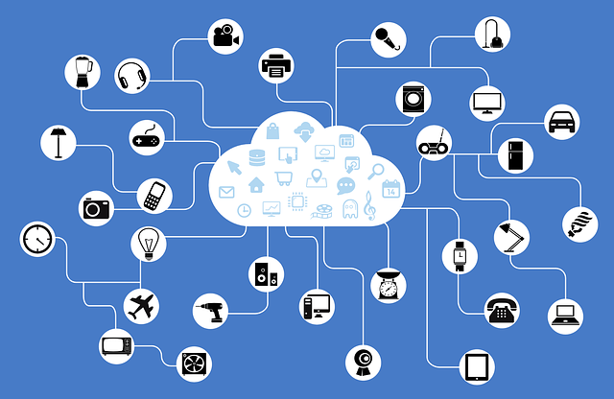


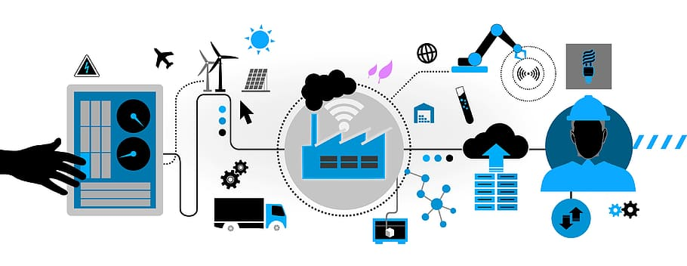

Introduction
5G is touted as an enabler for a variety of new applications
Notes:
5G today is touted as an enabler for a variety of cutting edge applications such as iot, augmented reality, collaborative AR, smart cities and so on. All of these applications have requirements of low latency, high bandwidth, and the need to be "real time".

Slide 3
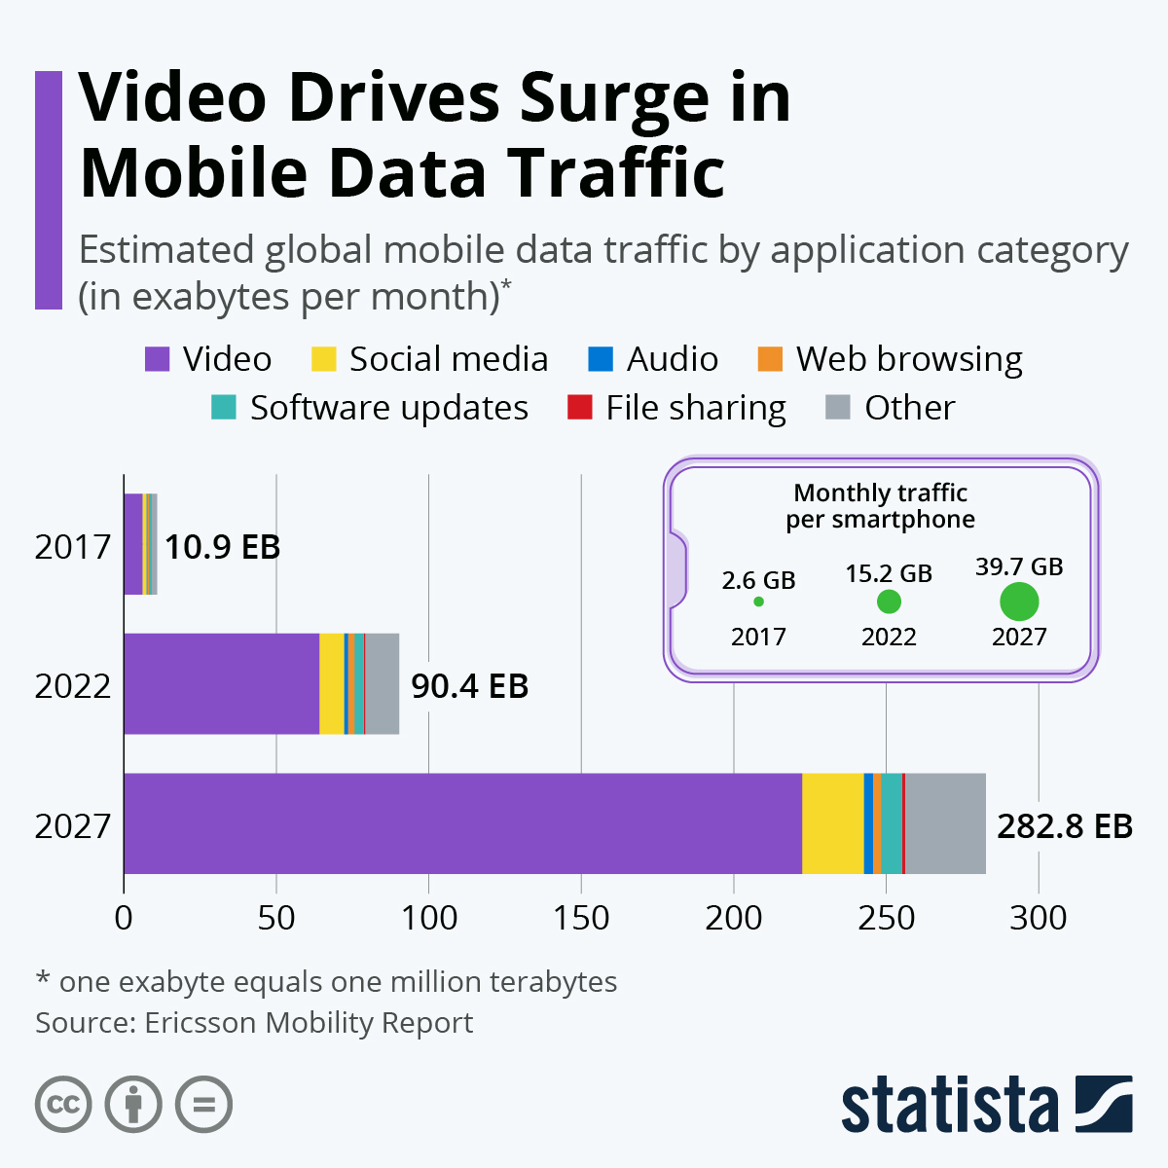
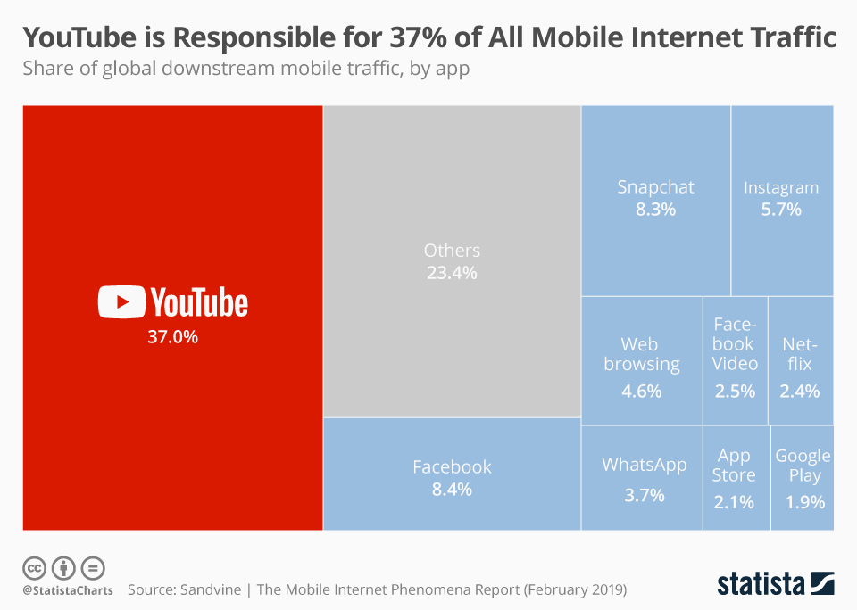
Introduction
Mobile data traffic is estimated to be 90 Exabytes [1]
YouTube accounts for 37% of all mobile internet traffic [2]
[1] https://www.statista.com/chart/27664/mobile-data-traffic-by-application-category/
[2] https://www.statista.com/chart/17321/global-downstream-mobile-traffic-by-app/
Notes:
However, when we look at the breakdown of application traffic on mobile networks, an outsize portion is constituted by just on-demand video viewing, from applications like Youtube, Netflix and so on.
Comments:
- Include 67% stat

Slide 4

Introduction
Emerging applications have high bandwidth, low latency requirements
The mobile landscape is currently populated by on-demand video
Reality of
application
landscape
New emergent applications
Rethinking of content delivery needed to accommodate new applications
Notes:
So there is a disconnect between the promised vision of 5G and the ground reality. If static videos are eating up all the available bandwidth, how do we accommodate these new applications?

Slide 5
Research Question
Can we build on the existing edge infrastructure to create a system that can deliver on-demand video data to end-users who are on the move without consuming the last mile mobile data bandwidth?
Notes:
So, we ask the question:

Slide 6
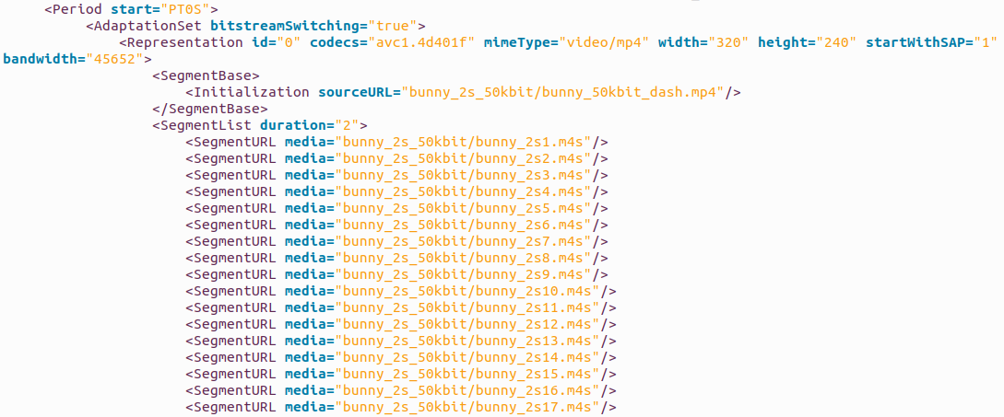

Key Insight 1 – Sequential media
On-demand video data is sequential
  Each video has an associated manifest file (e.g., DASH) which contains information about the segments which make up the video
  Contains metadata about the video (e.g., size of segment, duration)
Video
Manifest
`
Video Playback
Notes:
We draw inspiration from three key insights. The first is that on-demand video is sequential. Each video is broken down into segments and stored in the CDN or origin server. When a user's device is playing a video, it fetches a few segments corresponding to the next 10-20 seconds of the video. Each video conveniently has a manifest file describing the number of segments, the duration, size and other metadata information.
Notes:
Possibly mention dash
Reduce size of manifest
Show a video reel with an arrow (moves left to right)
In manifest (arrow moves top to down)

Slide 7
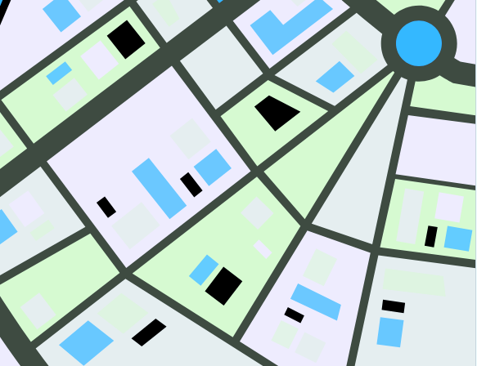


Key Insight 2 – Known user trajectories
The user's travel route can be obtained (with their permission) from a map application (e.g., Google Maps, Waze etc.)
Notes:
Our second insight is that the user's travel route is known. THe user makes use of some application like Google Maps to navigate to their destination.
Notes:
- Make the car big and emphasized

Slide 8
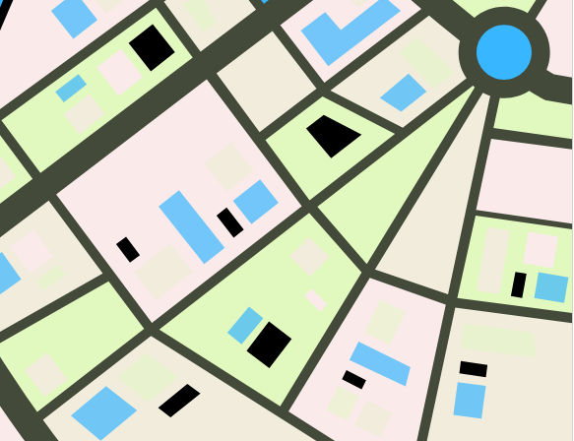
Key Insight 3 – High throughput Physical layer
60 GHz unlicensed mmWave links have significantly high throughput (> 1 Gbps)
Short range allows for spatial reuse
Can be collocated with existing edge infrastructure
Notes:
Thirdly, unlicensed mmWave links operating in the 60GHz band have extremely high throughput and short range. If we can collocate these mmWave antennas with existing edge/MEC infrastructure, then we can deliver upto 1Gbps speed when the user is in the vicinity of the edge node, without actually using cellular data. We might ask, ok since we're looking at unlicenced spectrum, why not WiFi? As we can see from the figure, mmWave throughput far exceeds WiFi throughput, up to a distance of 30 m from the antenna.
Notes:
Say mmwave has significantly high throughput. And tahatThere’s a tradeoff. High throughput but short range
Fix animations for mmwave towers

Slide 9







Solution: ClairvoyantEdge
Distributed Edge-Cloud System which enables
Proactive distribution of sequential media across edge nodes.
Last-mile delivery through mmWave antennas
Fall back on Cellular
CDN
Edge
Notes:
ClairvoyantEdge is a distributed cloud-edge system offloads last mile delivery of on-demand videos for users on the move, to edge nodes equipped with 60 GHz mmWave antennas
Takes user's travel route and video as input, and prefetches segments of the video to the edge nodes lying on the user's path
Delivers segments to user devices through mmWave antennas when the user approaches the edge node
Falls back to mobile data when edge nodes are not available to download segments for a user
Building on these three insights, we propose our system, ClairvoyantEdge, which, given the route information and the video request from user, then delivers on-demand video to end user over unlicensed mmWave links.

Slide 10

Network Model
Cloud
Cellular (4G/5G)
User
Edge
mmWave
User
Edge
Edge
Fiber
Cloud
Edge
WAN/Backhaul
Notes:
Before we get into the design of our system, I first want to clarify the network model that we assume. A moving user communicates with the cloud servers for receiving videos through mobile data
Users communicate with edge nodes over unlicensed mmWave
Edge nodes are connected through fiber with each other
Edge nodes are connected to the cloud server through the internet backbone
Notes:
Use the same symbols here in the previous slide
Just use Backhaul not WAN
Direct links (fiber) (direct connections between edge nodes)
Change icon for mmwave
Use tower to indicate cellular

Slide 11
Solution in a Nutshell
User makes a request for a video
Provides their planned trajectory to the cloud server
CDN
Edge
Edge
Edge
Notes:
With that, let's now dive into how the system works. Let's assume that the user wants to watch a video
The video ID and the user's trajectory are passed on to the clairvoyant cloud server which then computes the edge nodes on the user's path. It also retrieves the video's metadata consisting of the segment level breakdown of the video

Slide 12
Solution in a Nutshell
Cloud server locates the edge nodes on the user's route
Instructs the edge node to prefetch video segments before the user's expected arrival
CDN
<1,2,3,4,5,6,7,8 >
Edge
Edge
Edge
Notes:
Clairvoyant cloud server then sends the user's expected arrival time, and the segment metadata to first edge node on the user's trajectory

Slide 13

Solution in a Nutshell
Edge nodes accepts the assignments if it estimates that it will complete the prefetching before the user's expected arrival
<1,2,3 >
CDN
Edge
Edge
Edge
Notes:
The edge node finds that it has bandwidth to schedule the downloads for the first three segments before the user's arrival and reports its claim over the three segments to the clairvoyant cloud server.

Slide 14
Solution in a Nutshell
Cloud server assigns next set of segments to the subsequent edge node
The first edge node in the meantime begins prefetching the segments
CDN
<4, 5,6,7,8 >
Edge
Edge
Edge
Notes:
Clairvoyant's cloud server then proceeds to the next edge node, with the user's arrival time at this new edge node, as well as the remaing unclaimed segments.

Slide 15


Solution in a Nutshell
The second edge node is unable to accept the request
  Depends on link capacity
  Pending segments to be prefetched
CDN
<1,2,3 >
Edge
Edge
Edge
Notes:
The edge node however, notices that it does not have any bandwidth to download more segments before the user arrive, and therefore rejects the request.

Slide 16
Solution in a Nutshell
Cloud server assigns next set of segments to the subsequent edge node
The first edge node in the meantime begins downloading the segments
CDN
<4, 5,6,7,8 >
<1,2,3 >
Edge
Edge
Edge
Notes:
Clairvoyant's cloud server then proceeds to the next edge node, with the user's arrival time at this new edge node, as well as the remaing unclaimed segments.

Slide 17
Solution in a Nutshell
Cloud server tries to get as many segments assigned as possible
  User's arrival time and their expected offset in the video is calculated by the cloud server
CDN
<6,7,8 >
<1,2,3 >
Edge
Edge
Edge
Notes:
The clairvoyant cloud server notices that by the time the user arrives at the final edge node, they would be downloading segments 1,2 and 3 from the first edge node, and segments 4 and 5 over mobile data, because there was no other edge node available to service their request. So only segments 6,7 and 8 are sent to the subsequent edge node.

Slide 18
Solution in a Nutshell
As user approaches the first edge node, it has finished prefetching the segments
The third edge node accepted the remaining segments for prefetching
CDN
<6,7,8 >
Edge
Edge
Edge
Notes:
THe edge node claimes the last three segments. Note that by this time, the user is also making progress along their route, and nearing the first edge node. The first egde nod by now, has finished downloading segments 1,2 and 3 and is ready for the user's arrival.

Slide 19
Solution in a Nutshell
User gets segments 1,2, and 3 from the first edge node when they are within range of the edge node
CDN
<6,7,8 >
Edge
Edge
Edge
<>
Notes:
The user arrives at edge node 1. Downloads 3 segments over mmWave and is on their way

Slide 20

Solution in a Nutshell
Second edge node does not have any segments for the user and is hence skipped
CDN
Edge
Edge
Edge
<1,2,3 >
Notes:
The second edge node does not have any segments for the user. So the user gets segments 4 and 5 over LTE mobile data. The third edge node in the meantime finishes downloading its segments in anticipation of the user's arrival
Notes:
Show segments downloaded from cloud
Connect antennas to edge nodes
Terminology:
Cloud to edge is “prefetch”
Edge to car is “delivery”
use

Slide 21
Solution in a Nutshell
User gets final few segments from the third edge node
All segment fetches are complete
CDN
Edge
Edge
Edge
<1,2,3,4,5>
Notes:
The user moves close to the third egde node, gets the last three segments and is done!

Slide 22
Comparison
CDN
CDN
Notes:
Dispel the thought that the new infra is incremental (not cost prohibitive). Make this explicit in the next.

Slide 23
Video fetching over
cellular infrastructure
CDN
Video fetching over ClairvoyantEdge
CDN
Notes:
Dispel the thought that the new infra is incremental (not cost prohibitive). Make this explicit in the next.

Slide 24
Is ClarivoyantEdge feasible?
Notes:
So now we know how the system works in a nutshell. Before we move on to the architecture, we want to clarify what clairvoyant edge is and is not, and if it is feasible with today's technology.
Telecom providers already opportunistically use unlicensed WiFi for last mile delivery to save on mobile data usage
60 GHz mmWave will provide similar capabilities
We propose to augment existing last mile delivery with 60 GHz mmWave antennas
We do not propose to overhaul existing CDN architecture
We prefetch content to edge nodes equipped with mmWave antennas
Where to prefetch from: Origin servers or CDNs
With this, I will hand it over to Anirudh to go over the system architecture
Note:
Add a before/after picture for the solution before this slide
Use Q/A based method presenting the slide
Is it unreasonable to have out of band channels
Do we need dramatic changes in the CDN architecture
We can do the above in before/after picture

Slide 25
ClarivoyantEdge is feasible!
Out-of-band 60GHz channel
  Telecom providers already opportunistically use unlicensed WiFi for last mile delivery to save on mobile data usage
  60 GHz mmWave will provide similar capabilities
Dispersed edge infrastructure
  Telecom providers are already densely deploying RAN for 5G
  Antenna cost ~$200
We DO NOT need dramatic changes to CDN architecture
  We propose to augment existing last mile delivery with 60 GHz mmWave antennas
  We do not propose to overhaul existing CDN architecture
  Netflix already hosts boxes with content at the edge for broadband networks
Notes:
So now we know how the system works in a nutshell. Before we move on to the architecture, we want to clarify what clairvoyant edge is and is not, and if it is feasible with today's technology.
Telecom providers already opportunistically use unlicensed WiFi for last mile delivery to save on mobile data usage
60 GHz mmWave will provide similar capabilities
We propose to augment existing last mile delivery with 60 GHz mmWave antennas
We do not propose to overhaul existing CDN architecture
We prefetch content to edge nodes equipped with mmWave antennas
Where to prefetch from: Origin servers or CDNs
With this, I will hand it over to Anirudh to go over the system architecture
Note:
Add a before/after picture for the solution before this slide
Use Q/A based method presenting the slide
Is it unreasonable to have out of band channels
Do we need dramatic changes in the CDN architecture
We can do the above in before/after picture

Slide 26
System Architecture
Control Plane
  Centralized
  Manage metadata for the system
  Issue prefetch requests to edge node
Data Plane
  Video segments prefetched by edge nodes
  Horizontal sharing among Edge nodes
  Segment delivery to users
Notes:
Thanks manasvini,
There are 2 distinct components in ClairvoyantEdge.
The first is the Control Plane which is centralized in the cloud. It manages the metadata and is the entity responsible for issuing prefetch requests to the edge nodes.
The second is the data plane consists of mechanisms for data transfers between different actors, including prefetching by the edge nodes, horizontal sharing across the nodes and the segment delivery to users over mmwave

Slide 27
System Architecture
Control Plane
  Centralized
  Manage metadata for the system
  Issue prefetch requests to edge node
Data Plane
  Video segments prefetched by edge nodes
  Horizontal sharing among Edge nodes
  Segment delivery to users
Notes:
In the interest of time I’ll give you a birds eye view of the control plane but I refer you to the paper which extensively covers the system architecture

Slide 28
System Architecture: Control Plane
CDN
Edge
Edge
Edge
Notes:
Okay, so from a few slides ago, we saw a user requests a video along with its trajectory

Slide 29
System Architecture: Control Plane
Metadata Store
Segment sources
Cloud Orchestrator
segment | source
s1 | e1
... | ...
v1
Video metadata
video | segments
v1 | s1, s2, s3
... | ...
Edge node locations
Edge node | location
e1 | <lat,long>
... | ...
CDN
Edge
Edge
Edge
Notes:
This request is received at a server in cloud referred to as Cloud Orchestrator or CO for short. It consults the metadata store which consists of useful data structures for request processing.

Slide 30
System Architecture: Control Plane
Metadata Store
Segment sources
Cloud Orchestrator
segment | source
s1 | e1
... | ...
v1
Video metadata
video | segments
v1 | s1, s2, s3
... | ...
Edge node locations
Edge node | location
e1 | <lat,long>
... | ...
CDN
Edge
Edge
Edge
Notes:
For a trajectory, the CO finds nearest edge nodes on the route

Slide 31
System Architecture: Control Plane
Metadata Store
Segment sources
Cloud Orchestrator
segment | source
s1 | e1
... | ...
v1
Video metadata
video | segments
v1 | s1, s2, s3
... | ...
Edge node locations
Edge node | location
e1 | <lat,long>
... | ...
CDN
Edge
Edge
Edge
31
Notes:
Simultaneously, The CO finds the segments that must be distributed across edge nodes.

Slide 32
System Architecture: Control Plane
Metadata Store
Segment sources
Cloud Orchestrator
segment | source
s1 | e1
... | ...
v1
Video metadata
video | segments
v1 | s1, s2, s3
... | ...
Edge node locations
Edge node | location
e1 | <lat,long>
... | ...
CDN
Edge
Edge
Edge
Notes:
And then finds the sources of the segments so that the edge nodes know where to prefetch the segments from..

Slide 33
System Architecture: Control Plane
Edge Node
Cloud Orchestrator
Prefetch queue
s2
s3
Prefetch segments
Cached Video segments
segments
s1
...
CDN
<1,2,3,4,5,6,7,8 >
Edge
Edge
Edge
Notes:
The CO prepares a schedule and instructs the edge node to prefetch the desired segments which the edge node enqueues for download unless it isn’t already cached.

Slide 34
System Architecture: Control Plane
Cloud Orchestrator
Edge Node 1
Schedule
Edge Node 2
Edge Node 3
CDN
<1,2,3,4,5,6,7,8 >
Edge
Edge
Edge
Notes:
The CO obtains the commitments from the candidate set of edge nodes and the prepared schedule can finally be returned to the user for delivery over mmwave

Slide 35
System Architecture: Control Plane
CDN
Edge
Edge
Edge
<>
Notes:
The user can now use this schedule for the necessary delivery over the edge nodes

Slide 36
Evaluations
Part 1 – Field experiments:
  mmWave behavior in the real-world
Part 2 – System capacity study using synthetic data
  Micro-benchmarks for ClairvoyantEdge knobs
Part 3 – Evaluating on real world data
  Expected gains in the real-world
Notes:
Next, we conducted a 3-part evaluation
The 1st part consisted of field experiments to characterize mmwave throughput
Part 2 was a system capacity study using synthetic data
And finally in Part 3, we evaluate the system with Real world data
Old text
-----------
Part 1
Field experiments with mmWave antennas to characterize spatial throughput profile.
Part 2
Studying sensitivity ClairvoyantEdge to intrinsic and extrinsic factors using synthetic data
User arrival rate
Edge node positioning
mmWave capacity to support concurrent users
Leveraging horizontal connectivity between edge nodes
Effect of delayed vs early prefetching
Uncertainties in user's travel route due to deviations from planned route and delays
Part 3
Evaluation of ClairvoyantEdge on real-world travel patterns
Last mile data delivery over unlicensed mmWave
Savings in backhaul internet bandwidth due to content reuse at the edge
Add slide for field experiments

Slide 37
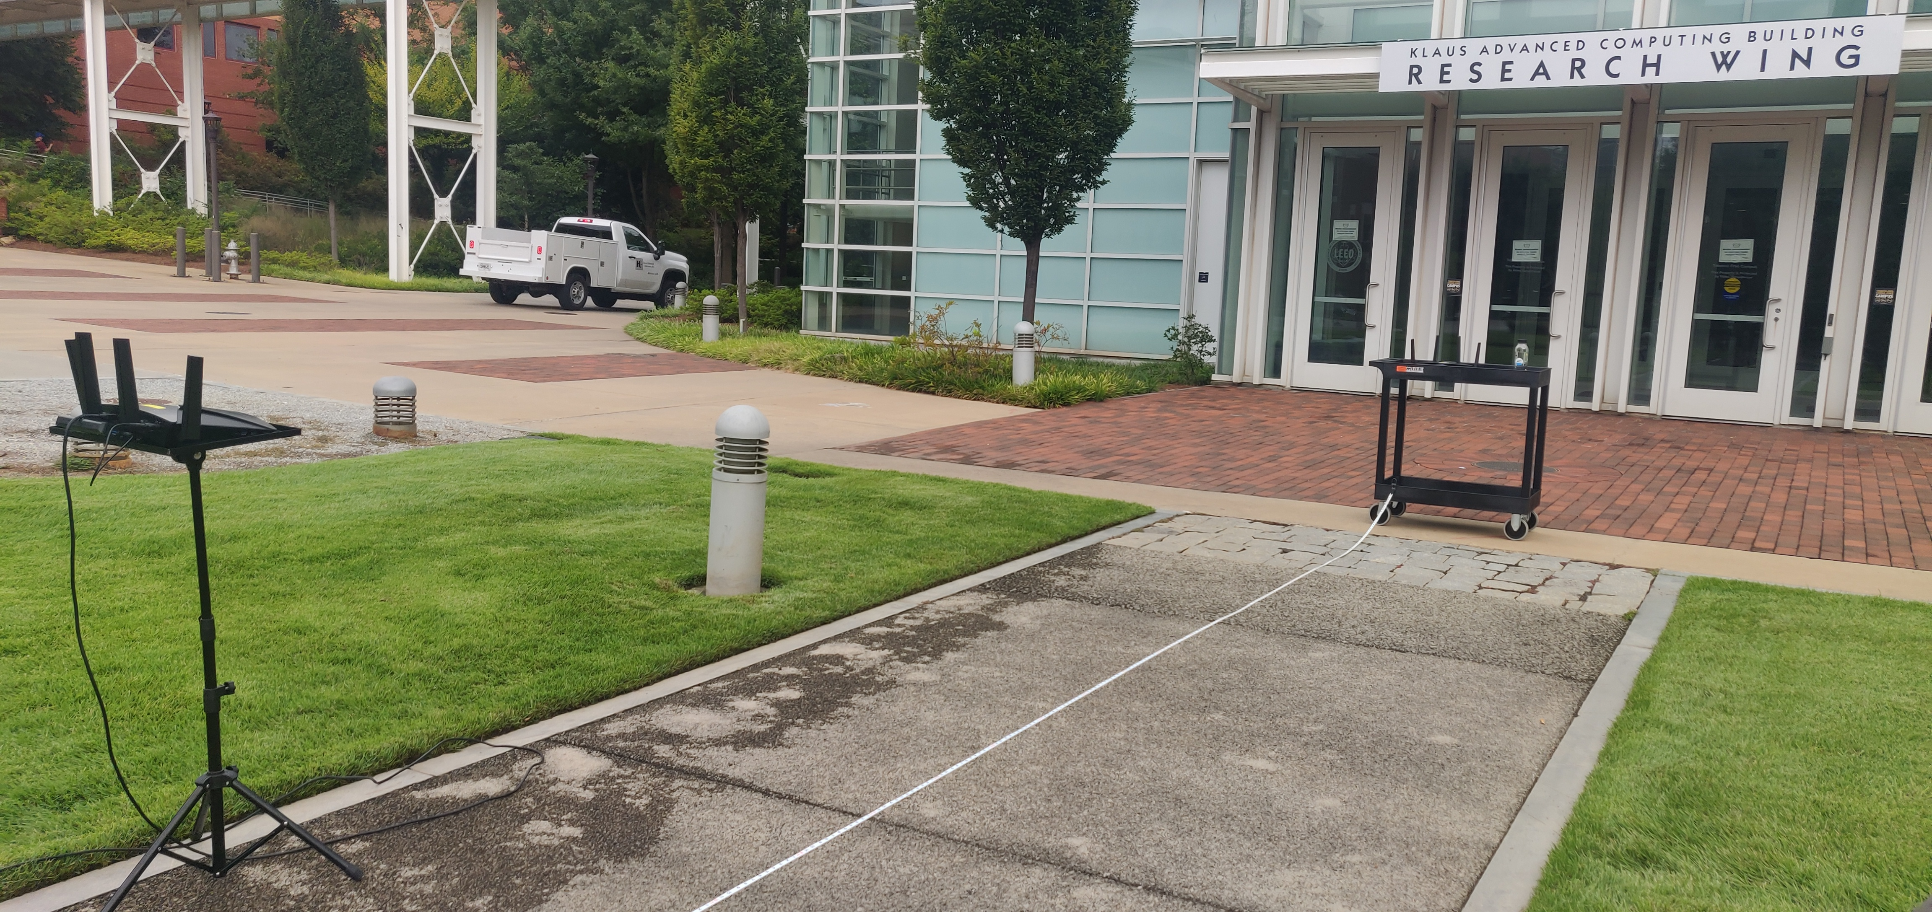
Part 1 – Field Experiments
Notes:
Here’s a snapshot from one of our field experiments where we use mmwave hardware to characterize throughput over distance.
This is visualized on the plot on the right.
These trials were used to model mmWave bandwidth experienced by users in our evaluations.

Slide 38
Part 1 – Field Experiments
Notes:
Here’s a snapshot from one of our field experiments where we use mmwave hardware to characterize throughput over distance.
This is visualized on the plot on the right.
These trials were used to model mmWave bandwidth experienced by users in our evaluations.

Slide 39


Evaluation setup: Infrastructure
Cloud Orchestrator
Edge
16 GB RAM
8 Cores
4 GB RAM
2 Cores
Notes:
For the next 2 parts, the setup were as follows -
We use an Ubuntu host machine equipped with 16 GB RAM and 8 cores for the CO
The edge components run on a ubuntu host as well, but with 4GB RAM and 2 cores
The users are emulated as a multithreaded go application. This emulator application utilizes the mmWave throughput model we derived from our field experiments to emulate the bandwidth experienced by users.
Old
-----
Add icons for cloud, edge and user
Go logo
Cloud Server
Ubuntu 20.04, 16 GB RAM/ 8 vCPUs
Edge Node
Ubuntu 20.04, 4 GB RAM/ 2 vCPUs
Inter-edge connectivity through bridged LAN
User devices
Emulated via multithreaded Go program
mmWave throughput simulated through values obtained from field measurements

Slide 40
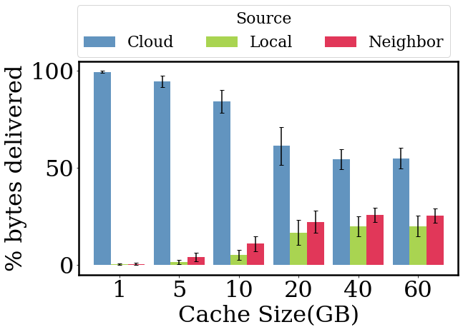
Evaluation: Saving backhaul bandwidth
Reliance on cloud for prefetching content decreases as local storage size increases
Edge nodes can reuse content they prefetch to deliver segments to multiple users requesting the same data
Notes:
No need to explain every bar
Preamble
punchline

Slide 41
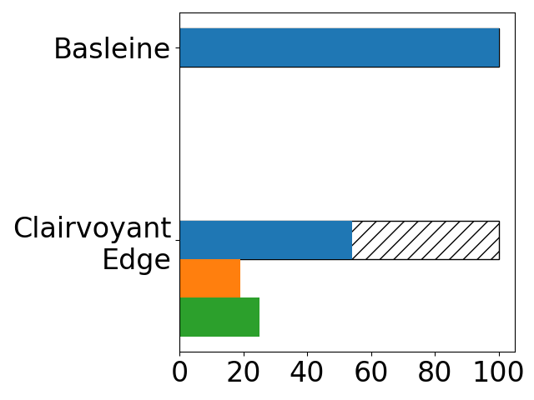
Evaluation: Saving backhaul bandwidth
Cloud
Setup:
10 Edge nodes
Poisson arrivals on edge nodes
Baseline
% Bytes Prefetched
Notes:
In our system capacity study, we make use of just 10 edge nodes and use poisson arrivals for users arriving at the edge nodes.

Slide 42
Evaluation: Saving backhaul bandwidth
Cloud
Baseline
~ 50 % reduction in backhaul traffic
% Bytes Prefetched
Notes:
We see a 50 % reduction in % of bytes transferred from the cloud where in the baseline all data is prefetched over the backhaul!

Slide 43
Evaluation: Saving backhaul bandwidth
Cloud
Baseline
Local
Edge
% Bytes Prefetched
Notes:
These gains come from the reuse of the segments either in the edge local cache or from neighbor edge nodes via the horizontal sharing links which avoid traversing the backhaul

Slide 44
Evaluation: Real World Last mile delivery over mmWave
Dataset: Mobility Traces SF Taxis (https://data.world/crawdad/mobility-traces-sf-taxis)
  mobility traces of taxi cabs in San Francisco, USA
  GPS coordinates of approximately 500 taxis
  collected over 30 days in the San Francisco Bay Area
SFCAB mobility trace to emulate users in SF
  Model cab routes as user trajectories
Traffic lights as mmWave delivery sites (around 20)
Videos sampled from a Zipfian distribution
Notes:
We next look at the delivery experienced by users over mmwave.
For this we show the evaluations on a real-world dataset
We make use of SFCAB mobility trace. This trace contains various cab routes in the form of timestamped coordinates in the city of San Francisco .
We model these cab routes as user trajectories our evaluations.
Then we select traffic lights (20 in total) to represent our edge nodes with mmwave antennae.
---
Elaborate SFCAB trace.

Slide 45
Evaluation: Real World Last mile delivery over mmWave
SFCAB mobility trace to emulate users in SF
Traffic lights as mmWave delivery sites (around 20)
Videos sampled from a Zipfian distribution
(At least) # edge encountered | Average % delivery from Edge
2 | 19.23
4 | 45.83
Just 20 mmWave enabled edge nodes,
covering just 0.12% of total area (46mi²),
achieve 19% video data delivery!
Notes:
We find that as long as users encounter at least 2 edge nodes, on average it can get around 19% of its delivery from edge.
In fact, if we strengthen the constraint by ensuring users encounter at least 4 nodes, the mean delivery % increases to 45%!
These results showcase that it is not necessary to have dense deployments and horizontal sharing & local edge cache reuse allow for a reasonable last mile delivery in the city of SF with just 20 nodes.
---
Mention number of mmwave links in the squaremile

Slide 46
Summary
Offload last mile delivery of on-demand videos for users on the move to edge nodes
Edge nodes equipped with 60 GHz mmWave antennas
Delivers segments to user devices through mmWave antennas
10-30% reduction in last mile mobile bandwidth usage
50% of segments fetched by edge nodes reused
CDN
Edge
Notes:
Change picture
Mention back of the envelop calculation of costs to showcase it’s not cost prohibitive.

Slide 47
Summary – Enabling on-demand data delivery over edge
CDN
Edge
3 Key Insights
Sequential on-demand video
Known user trajectory
High throughput, short range physical layer (mmWave)
ClairvoyantEdge
Distributed edge-cloud system
Proactive distribution of video data across edge
Last mile delivery via mmWave
Fallback on Cellular
Results
With just 20 nodes, we gain
~50% reduction in backhaul usage
20-40% reduction in cellular bandwidth usage
Notes:
I’ll wrap up our talk with this last slide which gives you the main takeaways –
1. The problem we tried to solve is to enable on-demand data delivery over edge.
The 3 key insights that led us to designing Clairvoyant Edge were sequential on-demand video, known user trajectories and the availability of high throughput short range physical layer (mmWave)
2. With these insights, we were able to develop ClairvoyantEdge which is a distributed edge-cloud system which performs on-demand proactive distribution of video data across edge nodes and enables last mile delivery to the users via mmWave with a fallback option of downloading the video from Cellular
3. And finally, we saw ClairvoyantEdge allows us to offset 50% of backhaul traffic and 20% reduction in cellular bandwidth usage as long as users encounter at least 2 users with just 20 mmwave equipped nodes

Slide 48
Future Work
Leveraging trends in user behavior based on geographical preferences for prefetching content
Optimal placement of edge nodes
Edge infrastructure for real time delivery

Slide 49
Questions?
CDN
Edge
3 Key Insights
Sequential on-demand video
Known user trajectory
High throughput, short range physical layer (mmWave)
ClairvoyantEdge
Distributed edge-cloud system
Proactive distribution of video data across edge
Last mile delivery via mmWave
Fallback on Cellular
Results
With just 20 nodes, we gain
~50% reduction in backhaul usage
20-40% reduction in cellular bandwidth usage
Notes:
Thank you for listening to the talk and we’re happy to take any questions

Slide 50
Questions?

