Slide 1
UnSpoof: Distance Spoofing-Evident Localization using UWB
Haige Chen
Ashutosh Dhekne
Notes:
3min + 10min + 10min + 25min + 5min

Slide 2
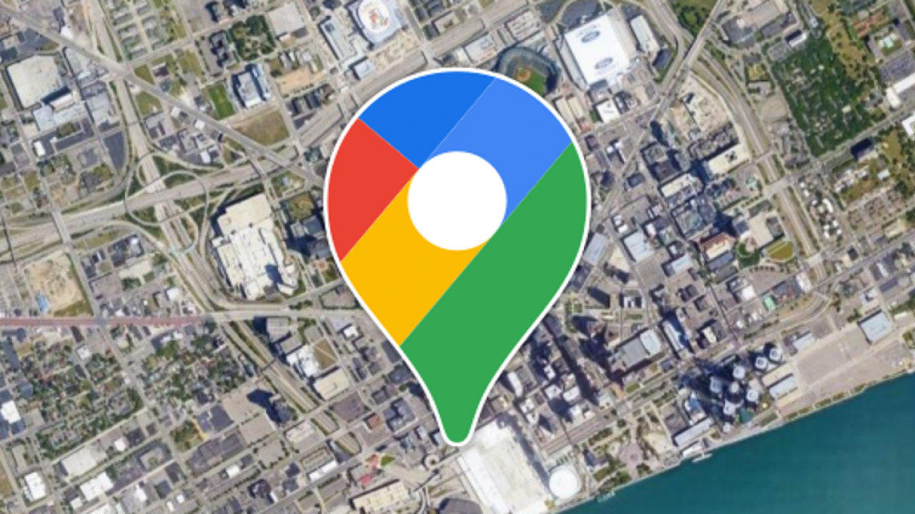
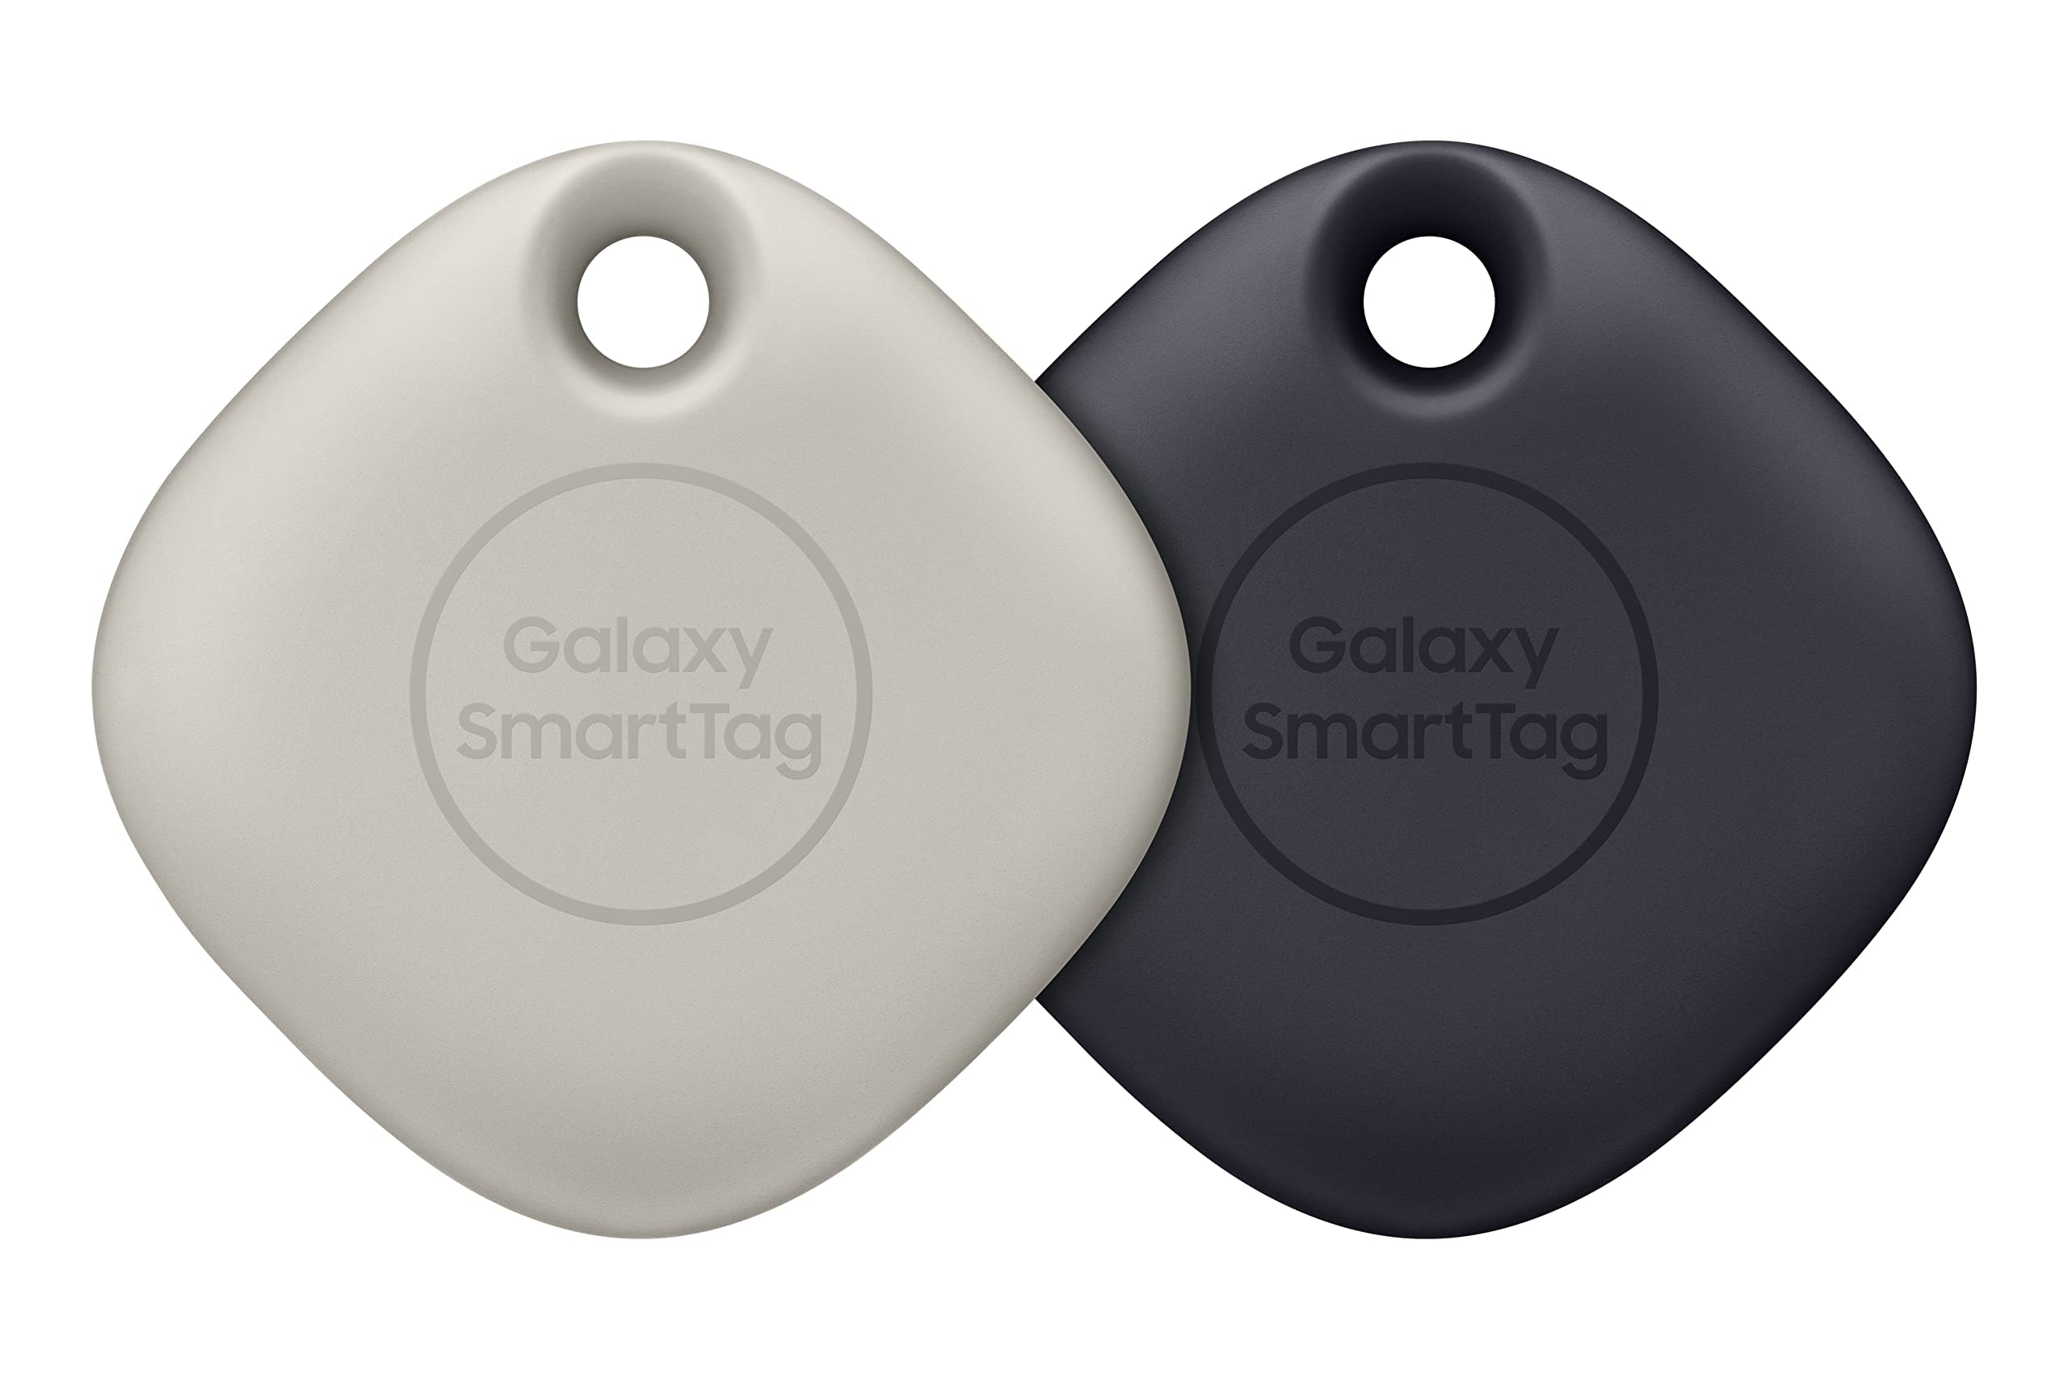
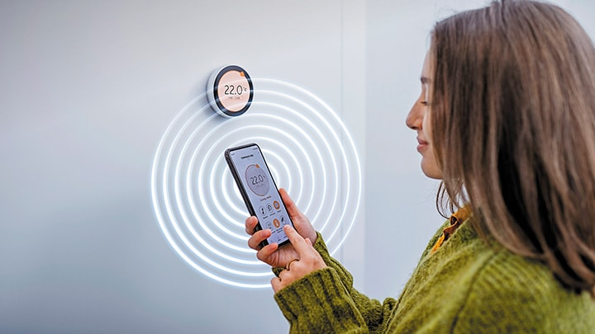
Convenience and Efficiency
Security and Proof
… and more?

Slide 3
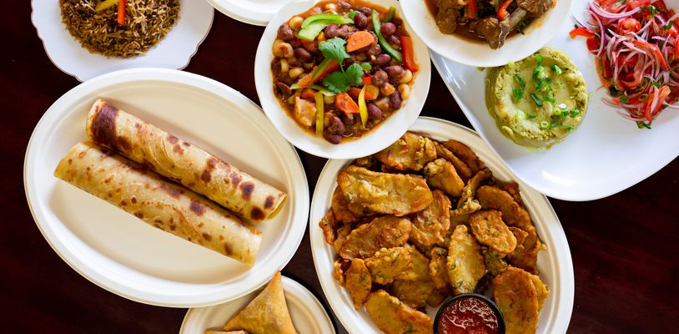
Trusted Restaurant Reviews

Slide 4
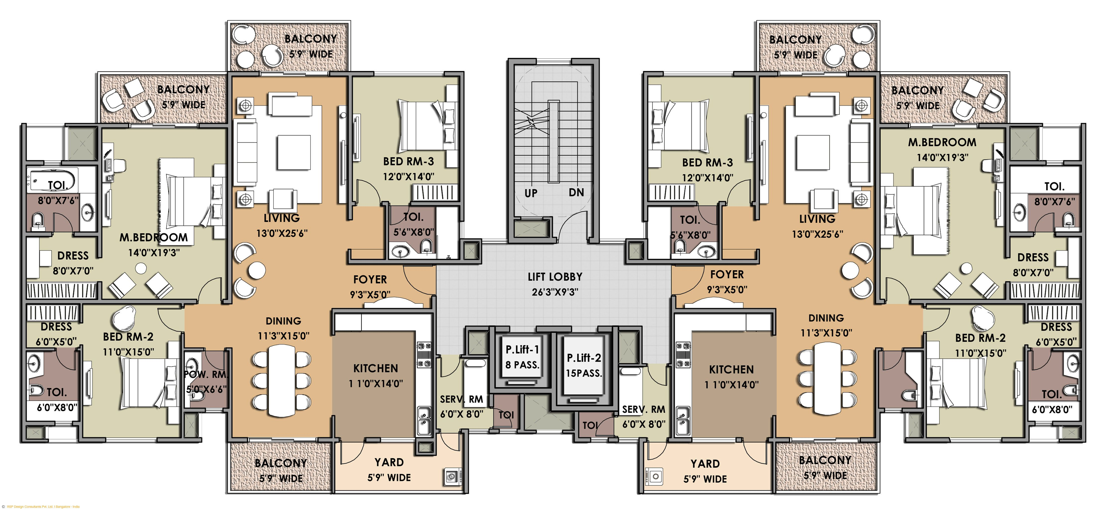
Proof of Delivery
Delivery Room

Slide 5
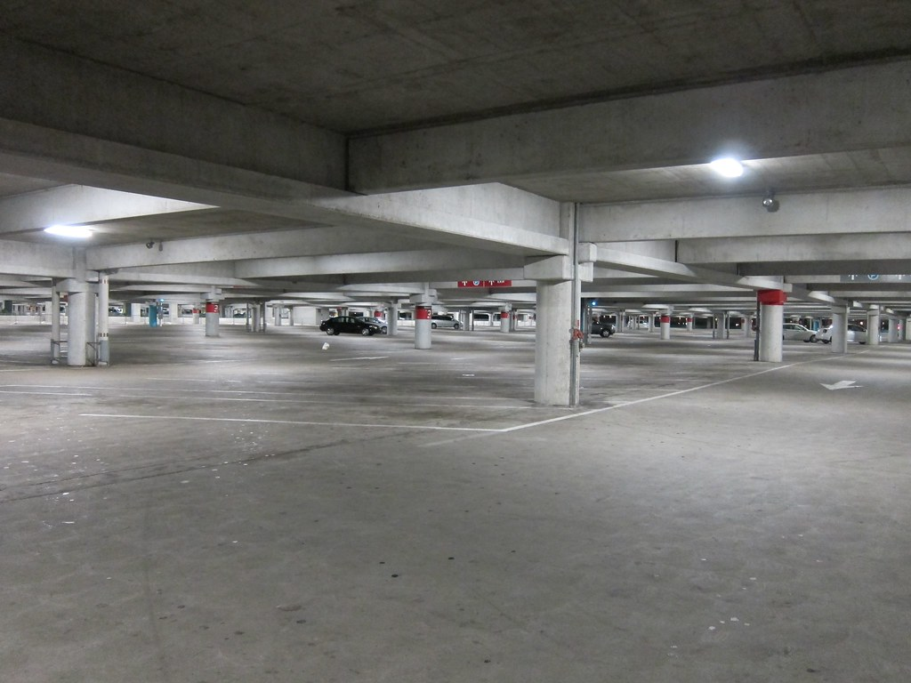
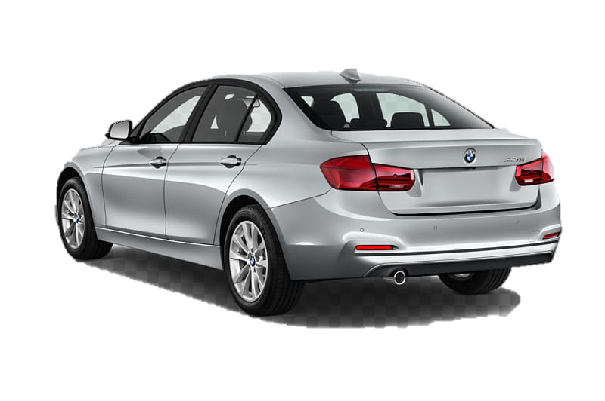
Proof of Car Return to Designated Slot
Assigned Slot

Slide 6
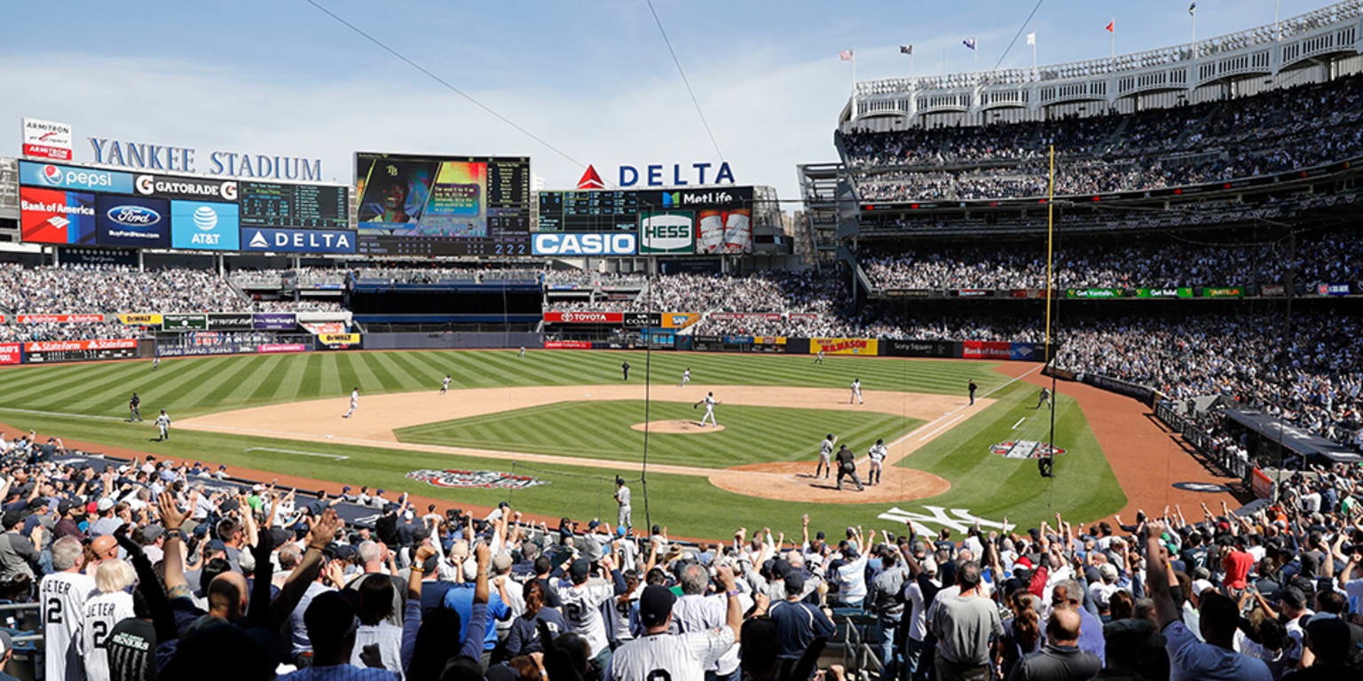
Location Based Access to Content
https://img.mlbstatic.com/mlb-images/image/private/t_2x1/t_w1536/mlb/vyeexwed6rerpzixzyir.jpg

Slide 7
Localization as Proof
Region of Interest
Access denied, or
Presence unverified
Access granted, or
Presence verified
The client has an incentive to lie about its own location

Slide 8
Internal Attacks against TWR
Src ID
Dst ID
R_{T}
D_{T}
Tag
Anchor
POLL
T₀
T₁
Tag controls reporting timings
R_{T}
RESP
D_{A}
T₂
$$ρ=\frac{\left(R_{T}R_{A}\right)−\left(D_{T}D_{A}\right)}{2(R_{A}+D_{A})}$$
T₃
D_{T}
FINAL
R_{A}
T₄
T₅
LAN/MAN Standards Committee. (2020). IEEE Standard for Low-Rate Wireless Networks. Amendment 1: Enhanced Ultra Wideband (UWB) Physical Layers (PHYs) and Associated Ranging Techniques ( IEEE Std 802.15.4z ) (Vol. 2020).
Propagation Delay ($ρ$) available

Slide 9
Internal Attacks against TWR
Tag
Anchor
POLL
T₀
T₁
$$ρ_{AT}=\frac{\left(R_{T}R_{A}\right)−\left(D_{T}D_{A}\right)}{2(R_{A}+D_{A})}$$
R_{T}
RESP
D_{A}
T₂
T₃
D_{T}
FINAL
R_{A}
T₄
Propagation Delay ($ρ$) available
T₅

Slide 10
Internal Attacks against TWR: Distance Enlargement
Tag
Anchor
POLL
T₀
↑
↓
T₁
$$ρ_{AT}=\frac{\left(R_{T}R_{A}\right)−\left(D_{T}D_{A}\right)}{2(R_{A}+D_{A})}$$
↑
RESP
D_{A}
R_{T}
T₂
T₃
R_{A}
D_{T}
FINAL
T₄
Propagation Delay ($ρ$) available
T₅

Slide 11
Internal Attacks against TWR
Tag
Anchor
POLL
T₀
T₁
$$ρ_{AT}=\frac{\left(R_{T}R_{A}\right)−\left(D_{T}D_{A}\right)}{2(R_{A}+D_{A})}$$
R_{T}
RESP
D_{A}
T₂
T₃
D_{T}
FINAL
R_{A}
T₄
Propagation Delay ($ρ$) available
T₅

Slide 12
Internal Attacks against TWR: Distance Reduction
Tag
Anchor
POLL
T₀
↓
↑
T₁
$$ρ_{AT}=\frac{\left(R_{T}R_{A}\right)−\left(D_{T}D_{A}\right)}{2(R_{A}+D_{A})}$$
↓
R_{T}
RESP
D_{A}
T₂
T₃
D_{T}
FINAL
R_{A}
T₄
Propagation Delay ($ρ$) available
T₅

Slide 13
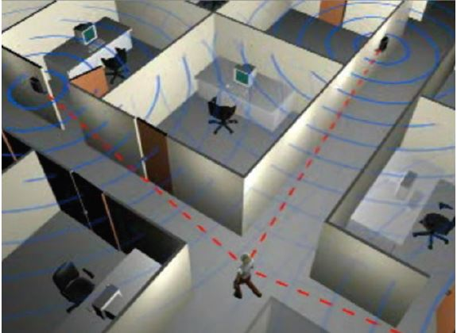
So what if the timings are wrong?
Distance shortening, and distance expansion, both become possible
I was sitting at my desk all the time!
Yes, I had delivered the package!

Slide 14
So what if the timings are wrong?
Distance shortening, and distance expansion, both become possible
I was sitting at my desk all the time!
Yes, I had delivered the package!
UnSpoof prevents this attack.

Slide 15
Passive ranging
Passive ranging
Range Spoofing
Active TWR
Passive ranging
Passive ranging
1. UnSpoof-Passive Ranging
2. Spoofing Detection
TDoA
Range Spoofing
TDoA
TDoA
TDoA
3. UnSpoof-TDoA: Apprehension of Rogue Tag

Slide 16
UnSpoof Passive Ranging
Formulations Inspire by [1]
Passive ranging
Active Anchors
Passive ranging
Passive Clients
Active TWR
Passive ranging
Passive ranging
[1] H. Chen and A. Dhekne, "PnPLoc: UWB Based Plug & Play Indoor Localization," 2022 IEEE 12th International Conference on Indoor Positioning and Indoor Navigation (IPIN), Beijing, China, 2022, pp. 1-8, doi: 10.1109/IPIN54987.2022.9918119.

Slide 17
UnSpoof Passive Ranging
Active Anchor
(A)
Passive Anchor (B)
Tag
(T)
B
Passive ranging
t₀
Overheard
POLL
t₂
t₁
R_{T}
D_{A}
R_{B1}
Active TWR
t₄
RESP
t₃
t₅
T
D_{T}
R_{A}
t₆
R_{B2}
A
FINAL
t₈
t₇
$$ρBT=ρAB−\frac{\left(DTR_{B1}\right)−\left(RB2RT\right)+(R_{A}R_{B1})−\left(RB2D_{A}\right)}{2(R_{B1}+R_{B2})}$$

Slide 18
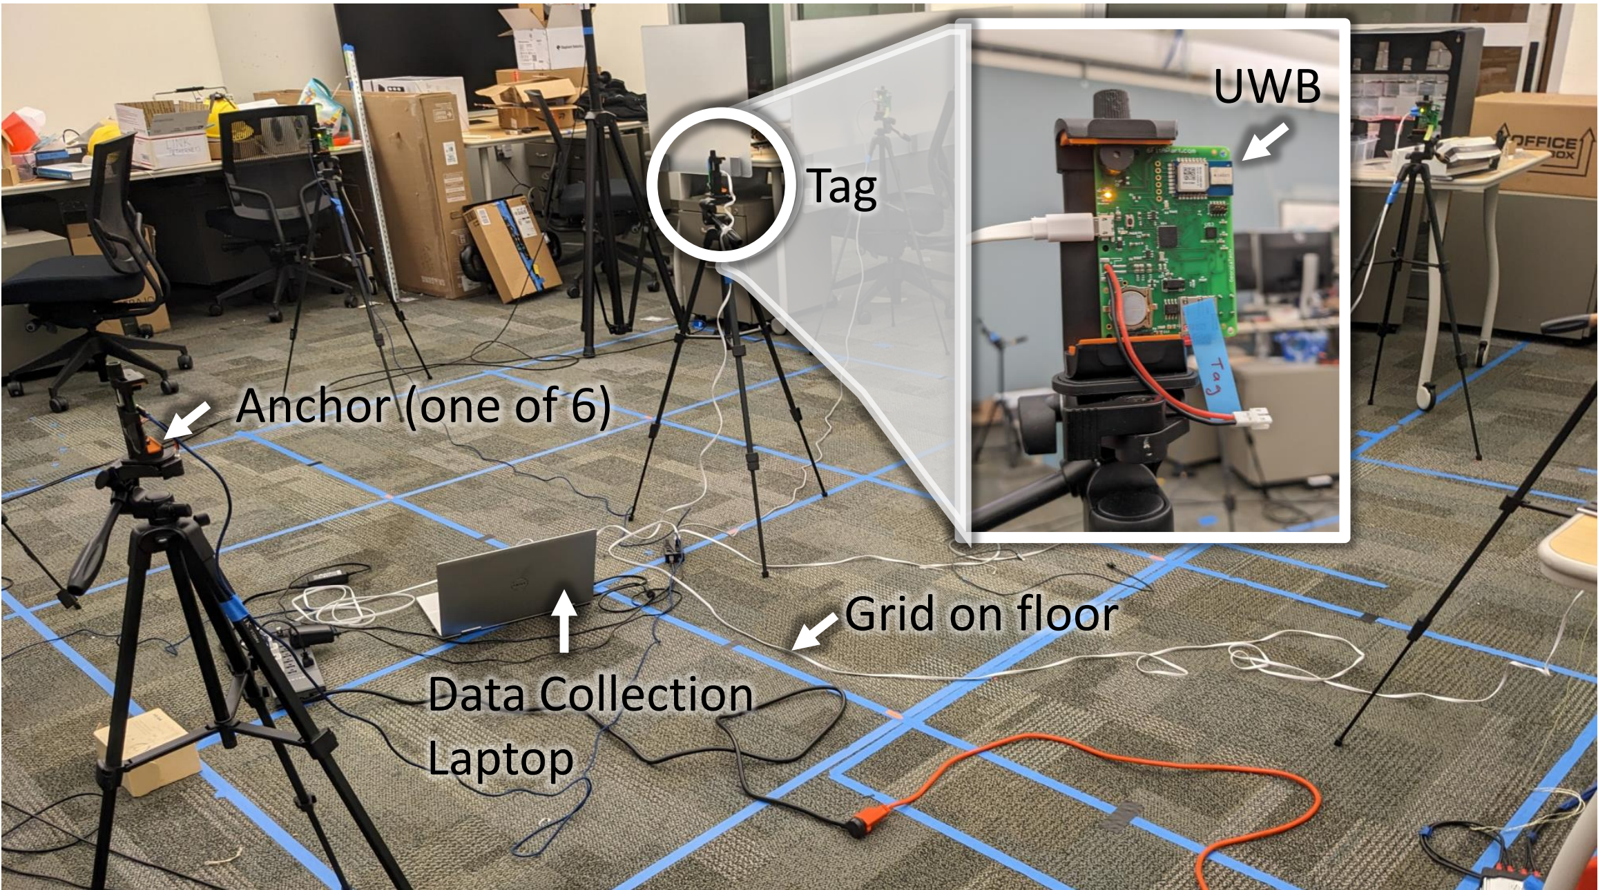
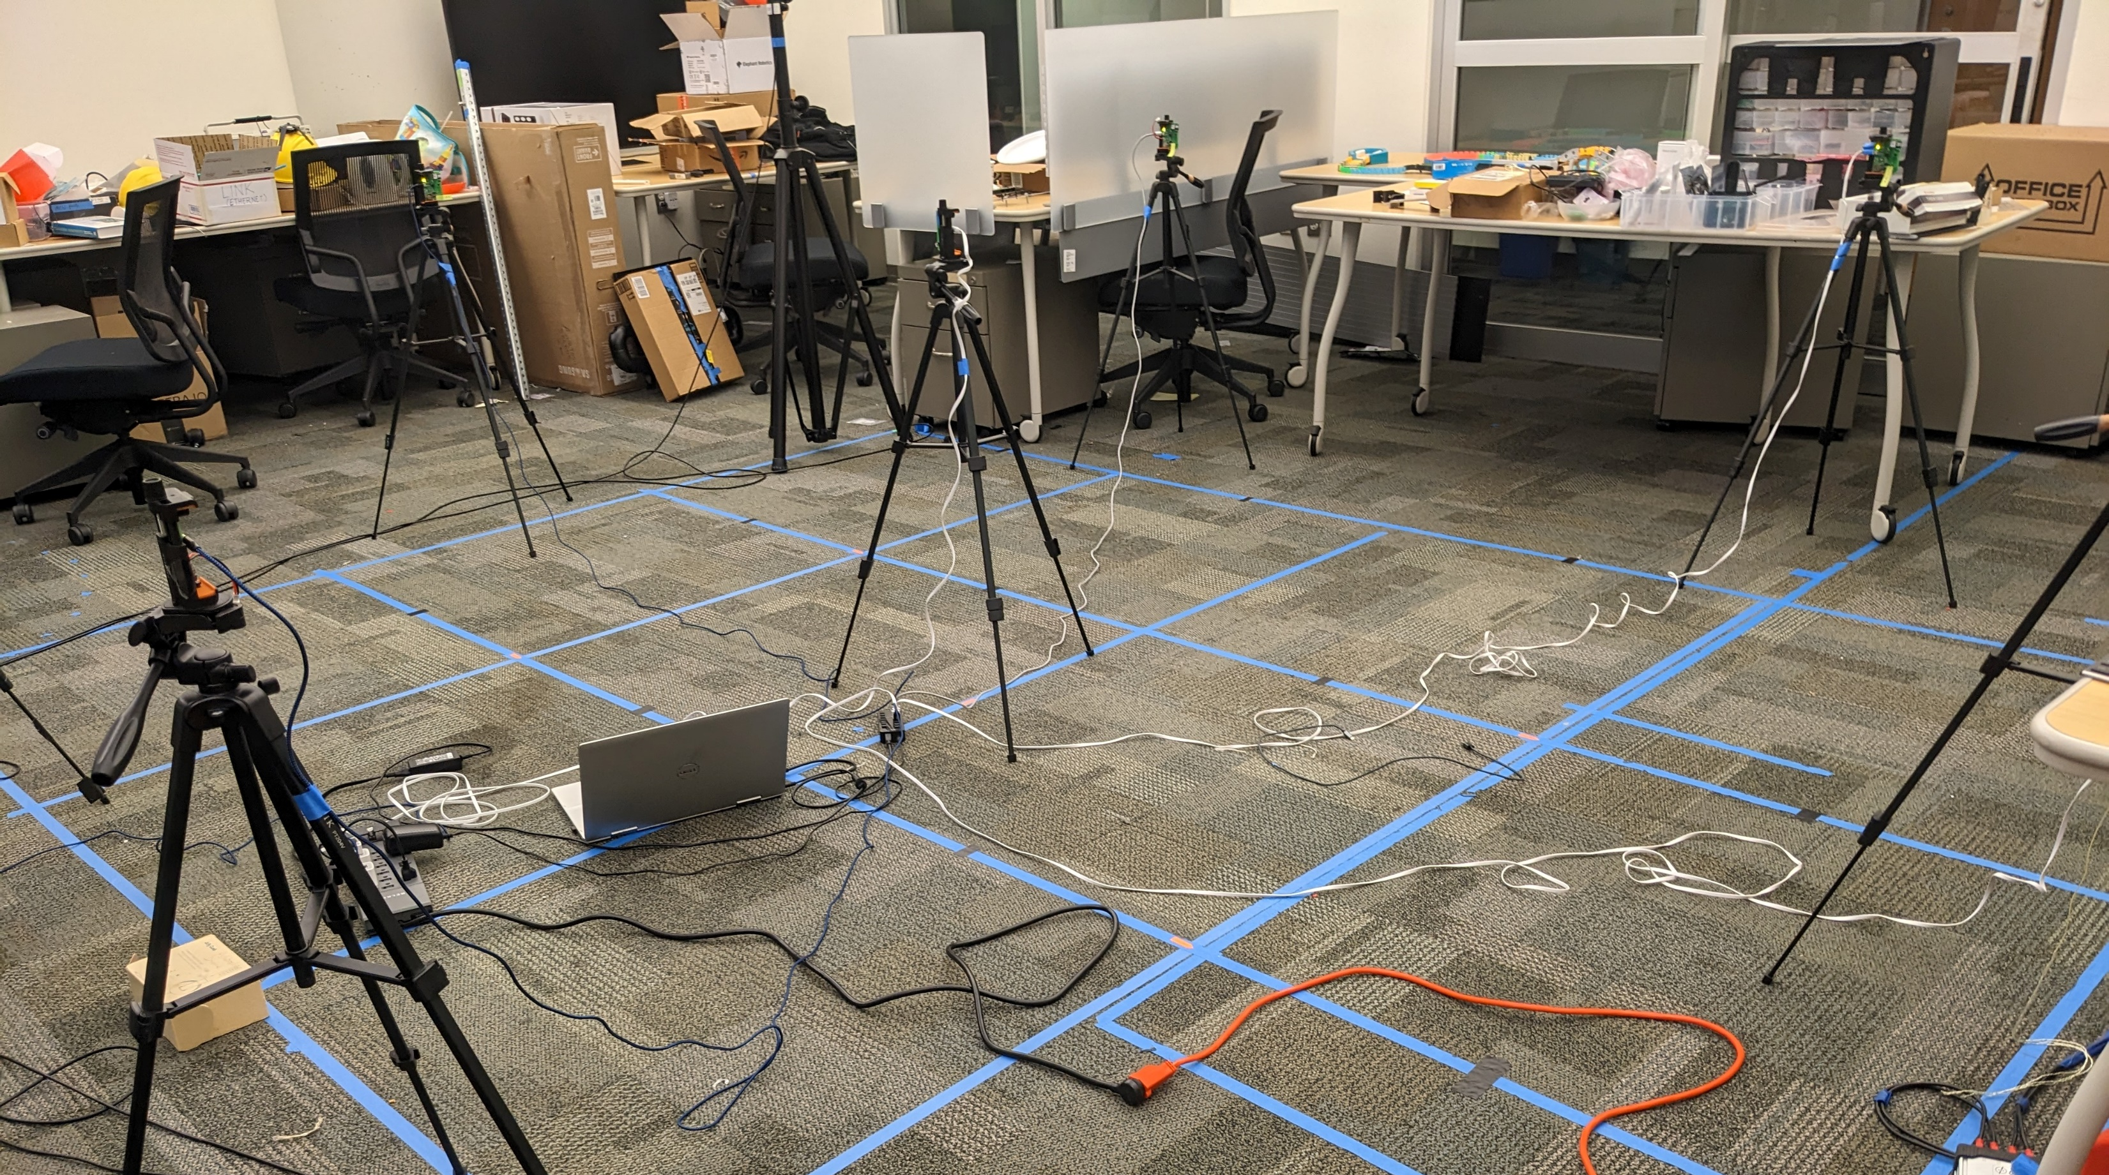
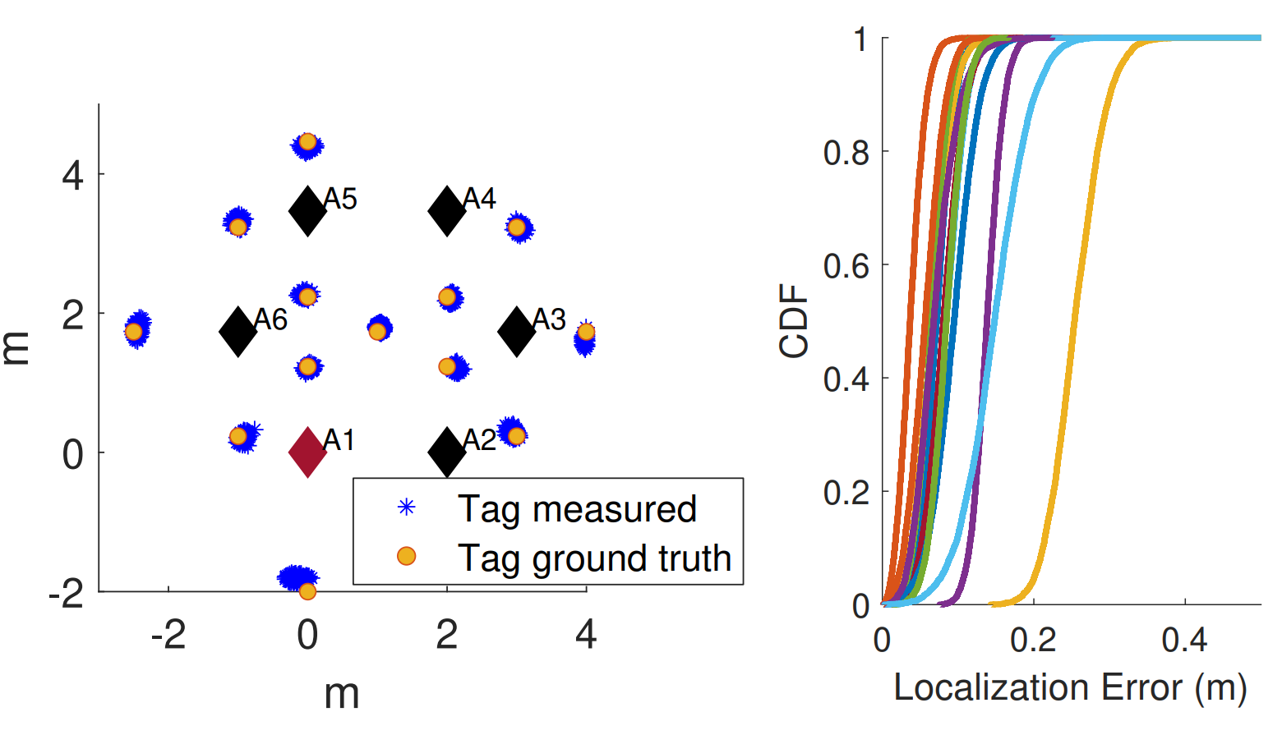
How well can we localize an honest tag?
UnSpoof-Passive Ranging

Slide 19
How well can we localize an honest tag?
UnSpoof-Passive Ranging

Slide 20
How well can we localize an honest tag?
UnSpoof-Passive Ranging

Slide 21
Spoofing Detection
Active Anchor
(A)
Passive Anchor (B)
Tag
(T)
t₀
Overheard
POLL
t₂
t₁
R_{T}
D_{A}
R_{B1}
t₄
RESP
t₃
t₅
D_{T}
R_{A}
t₆
R_{B2}
FINAL
t₈
t₇
$$ρAT=\frac{\left(R_{T}R_{A}\right)−\left(D_{T}D_{A}\right)}{2(R_{A}+D_{A})}$$
TWR
$$ρBT=ρAB−\frac{\left(DTR_{B1}\right)−\left(RB2RT\right)+(R_{A}R_{B1})−\left(RB2D_{A}\right)}{2(R_{B1}+R_{B2})}$$
UnSpoof Passive Ranging

Slide 22
Spoofing Detection: Distance Enlargement
Active Anchor
(A)
Passive Anchor (B)
Tag
(T)
t₀
Overheard
POLL
t₂
t₁
R_{T}
D_{A}
R_{B1}
t₄
RESP
t₃
t₅
R_{A}
D_{T}
R_{B2}
t₆
FINAL
t₈
t₇
↑
↓
$$ρAT=\frac{\left(R_{T}R_{A}\right)−\left(D_{T}D_{A}\right)}{2(R_{A}+D_{A})}$$
TWR
↑
↓
↑
$$ρBT=ρAB−\frac{\left(DTR_{B1}\right)−\left(RB2RT\right)+(R_{A}R_{B1})−\left(RB2D_{A}\right)}{2(R_{B1}+R_{B2})}$$
UnSpoof Passive Ranging
↑

Slide 23
Spoofing Detection
Active Anchor
(A)
Passive Anchor (B)
Tag
(T)
t₀
Overheard
POLL
t₂
t₁
R_{T}
D_{A}
R_{B1}
t₄
RESP
t₃
t₅
D_{T}
R_{A}
t₆
R_{B2}
FINAL
t₈
t₇
$$ρAT=\frac{\left(R_{T}R_{A}\right)−\left(D_{T}D_{A}\right)}{2(R_{A}+D_{A})}$$
TWR
$$ρBT=ρAB−\frac{\left(DTR_{B1}\right)−\left(RB2RT\right)+(R_{A}R_{B1})−\left(RB2D_{A}\right)}{2(R_{B1}+R_{B2})}$$
UnSpoof Passive Ranging

Slide 24
Spoofing Detection: Distance Reduction
Active Anchor
(A)
Passive Anchor (B)
Tag
(T)
t₀
Overheard
POLL
t₂
t₁
R_{T}
D_{A}
R_{B1}
t₄
RESP
t₃
t₅
D_{T}
R_{A}
t₆
R_{B2}
FINAL
t₈
t₇
↓
↑
$$ρAT=\frac{\left(R_{T}R_{A}\right)−\left(D_{T}D_{A}\right)}{2(R_{A}+D_{A})}$$
TWR
↓
↑
↓
$$ρBT=ρAB−\frac{\left(DTR_{B1}\right)−\left(RB2RT\right)+(R_{A}R_{B1})−\left(RB2D_{A}\right)}{2(R_{B1}+R_{B2})}$$
UnSpoof Passive Ranging
↓

Slide 25
Spoofing Detection
Active Anchor
(A)
Passive Anchor (B)
Active Anchor
(A)
Tag
(T)
Tag
(T)
t₀
Overheard
Overheard
Distance Reduction
t₀
Distance Enlargement
POLL
t₂
POLL
t₁
t₁
R_{T}
D_{A}
R_{T}
In case of Distance Reduction
R_{B1}
D_{A}
t₄
RESP
t₄
RESP
t₃
t₅
t₃
D_{T}
R_{A}
D_{T}
R_{A}
t₆
R_{B2}
t₆
FINAL
t₈
FINAL
t₇
t₇
↓
↑
↓
$$ρAT=\frac{\left(R_{T}R_{A}\right)−\left(D_{T}D_{A}\right)}{2(R_{A}+D_{A})}$$
TWR
↓
TWR
↓
↑
↓
The range circles do not intersect.
$$ρBT=ρAB−\frac{\left(DTR_{B1}\right)−\left(RB2RT\right)+(RARB1)−\left(RB2D_{A}\right)}{2(R_{B1}+RB2)}$$
UnSpoof Passive Ranging
↓

Slide 26
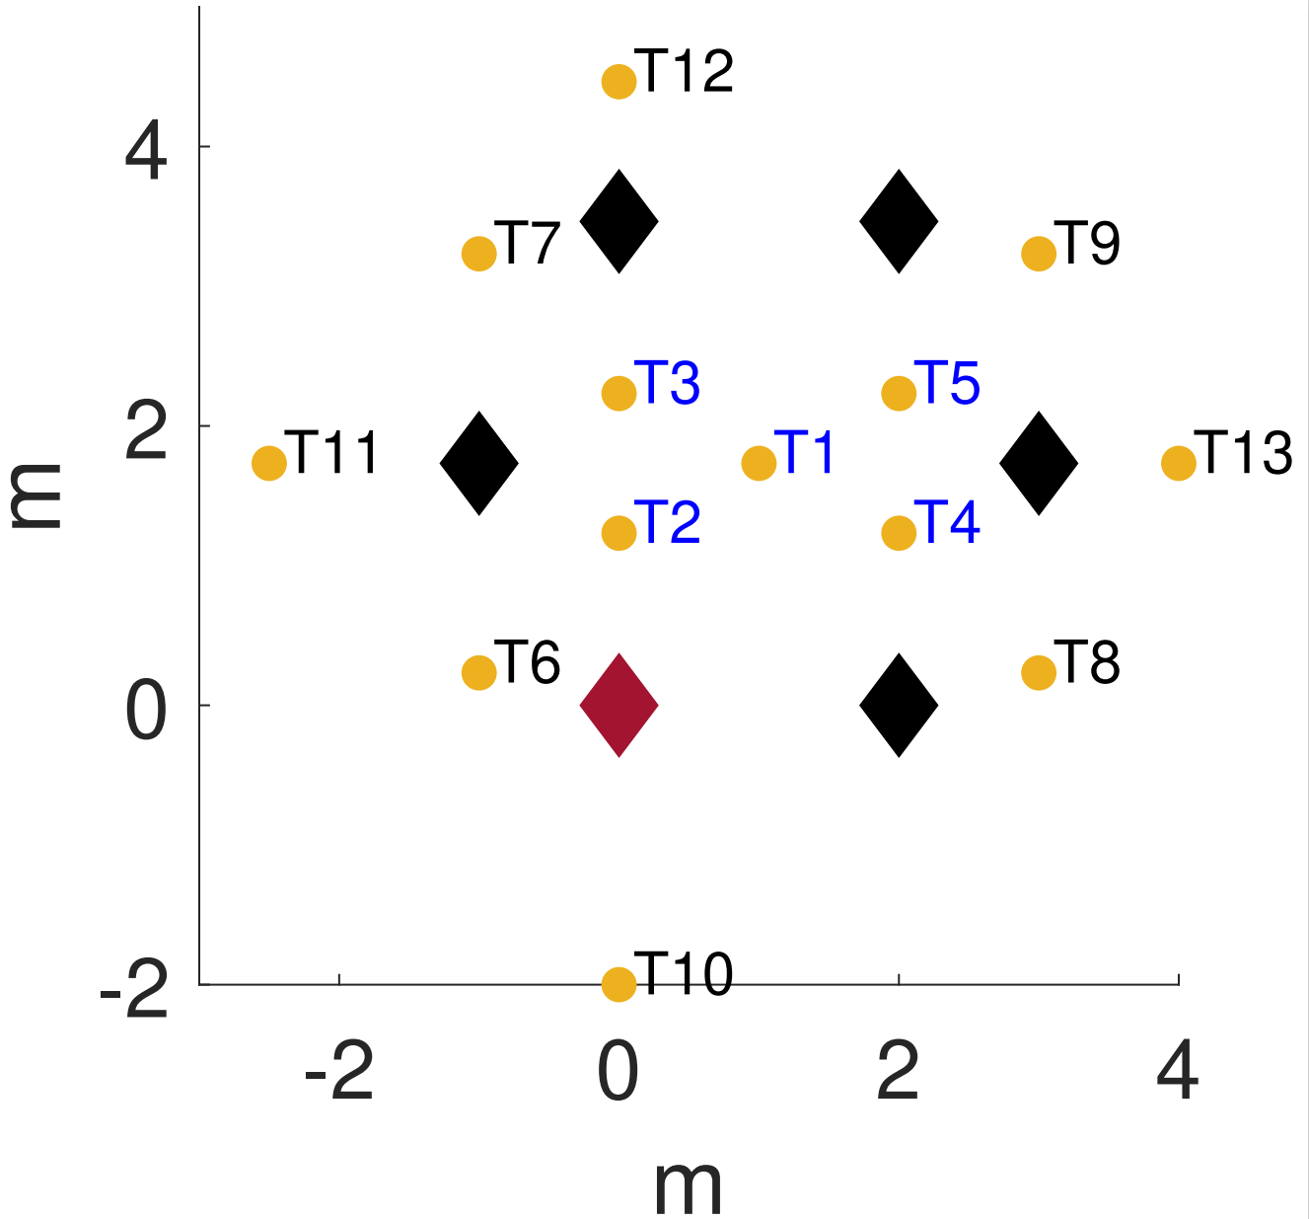
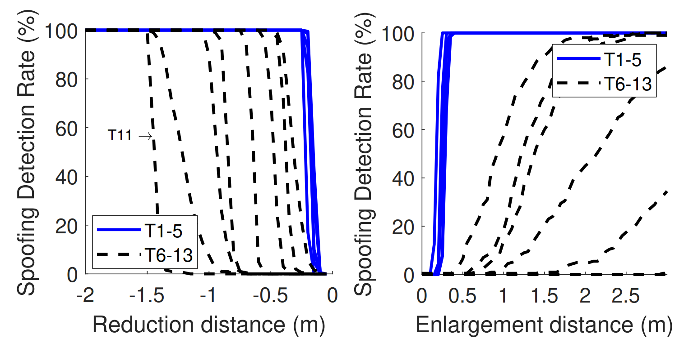
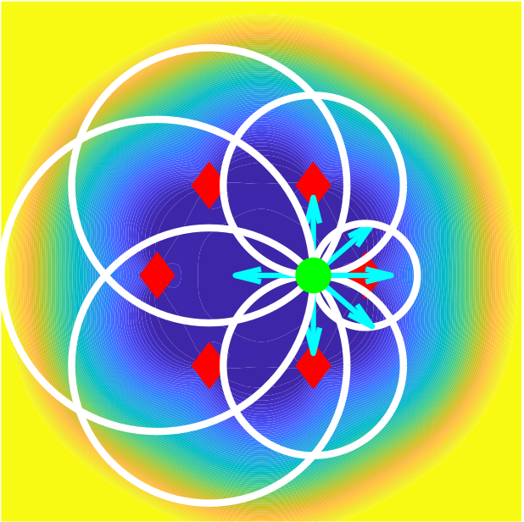
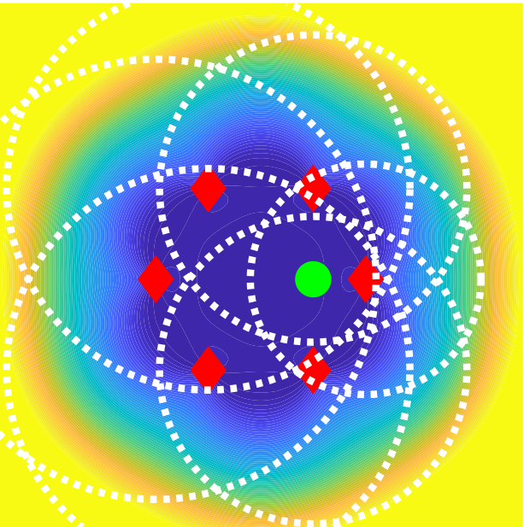
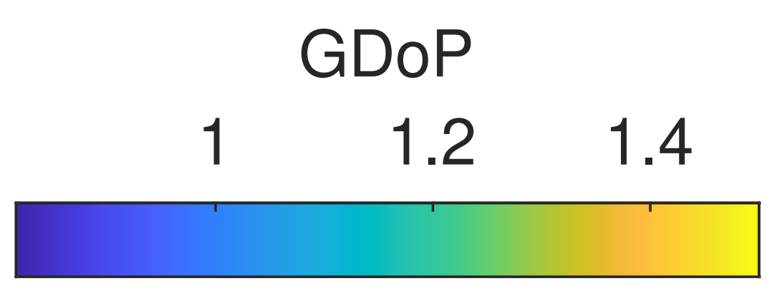
How well can we detect spoofing?
1.5m
Inside Convex Hull

Slide 27
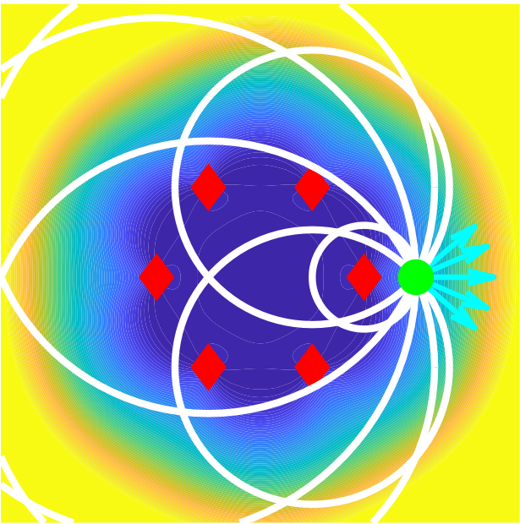
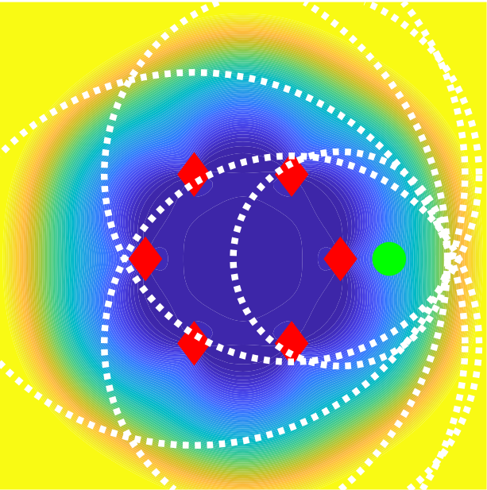
How well can we detect spoofing?
1.5m
Inside Convex Hull
Outside Convex Hull

Slide 28
Is it possible to
localize and catch the attacker?

Slide 29
UnSpoof TDoA
Passive TDoA
Passive TDoA
Active TWR
Passive TDoA
Passive TDoA

Slide 30
UnSpoof TDoA
Active Anchor
(A)
Passive Anchor (B)
Tag
(T)
B
Passive TDoA
t₀
Overheard
POLL
t₂
t₁
R_{T}
D_{A}
R_{B1}
Active TWR
t₄
RESP
t₃
t₅
T
D_{T}
R_{A}
t₆
R_{B2}
A
FINAL
t₈
t₇
$$TAB=ρBT−ρAT$$
$=ρAB−\frac{ (R_{A}R_{B1})−\left(RB2D_{A}\right)}{(R_{A}+D_{A})}$

Slide 31
UnSpoof TDoA
The UnSpoof-TDoA formulation
No spoofing possible by the tag
No synchronization needed between anchors
No clock drift compensation needed
Active Anchor
(A)
Passive Anchor (B)
Tag
(T)
B
Passive TDoA
t₀
Overheard
POLL
t₂
t₁
R_{T}
D_{A}
R_{B1}
Active TWR
t₄
RESP
t₃
t₅
T
D_{T}
R_{A}
t₆
R_{B2}
A
FINAL
t₈
t₇
$$TAB=ρBT−ρAT$$
$=ρAB−\frac{ (R_{A}R_{B1})−\left(RB2D_{A}\right)}{(R_{A}+D_{A})}$

Slide 32
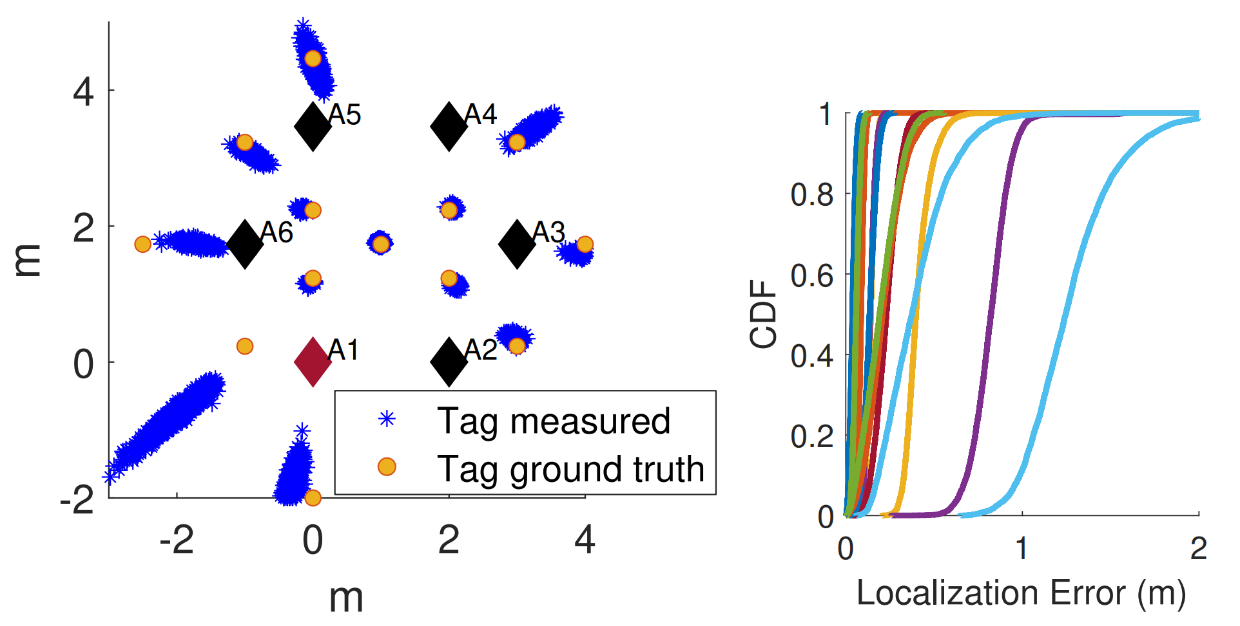
How well can we track the Rogue Tag?
UnSpoof-TDoA

Slide 33
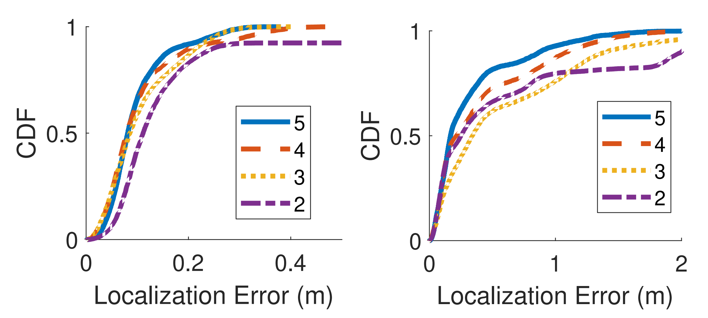
Localization Error vs Number of Passive Anchors
UnSpoof-Passive Ranging
UnSpoof-TDoA

Slide 34
Conclusion
UnSpoof enables
Determining tag location by infrastructure with only one TWR if other anchors are overhearing the messages
Making it almost impossible to spoof distance inside anchors’ convex hull
Catching the rogue tag regardless of spoofing

