Slide 1


Slide 2


Slide 3
Class Today
Project 1 is out
Read Szeliski 2.1, especially 2.1.5
More about projections
Light, color, biological vision

Slide 4
Projection: world coordinates→image coordinates
.
.
.
3
f
5
y
-2
z
v’
?
.
Camera Center (0, 0, 0)
u’
If X = 2, Y = 3,
Z = 5, and f = 2
What are U and V?
Notes:
Being a little loose about coordinates vs lengths
u and v prime because they are in the same coordinate system as x, y, and z but in later slides u and v will be –u’ and –v’ because they are in their own coordinate system which is mirrored

Slide 5
Earth as an example

Slide 6

ISS timelapse. 400 kilometers from Earth

Slide 7
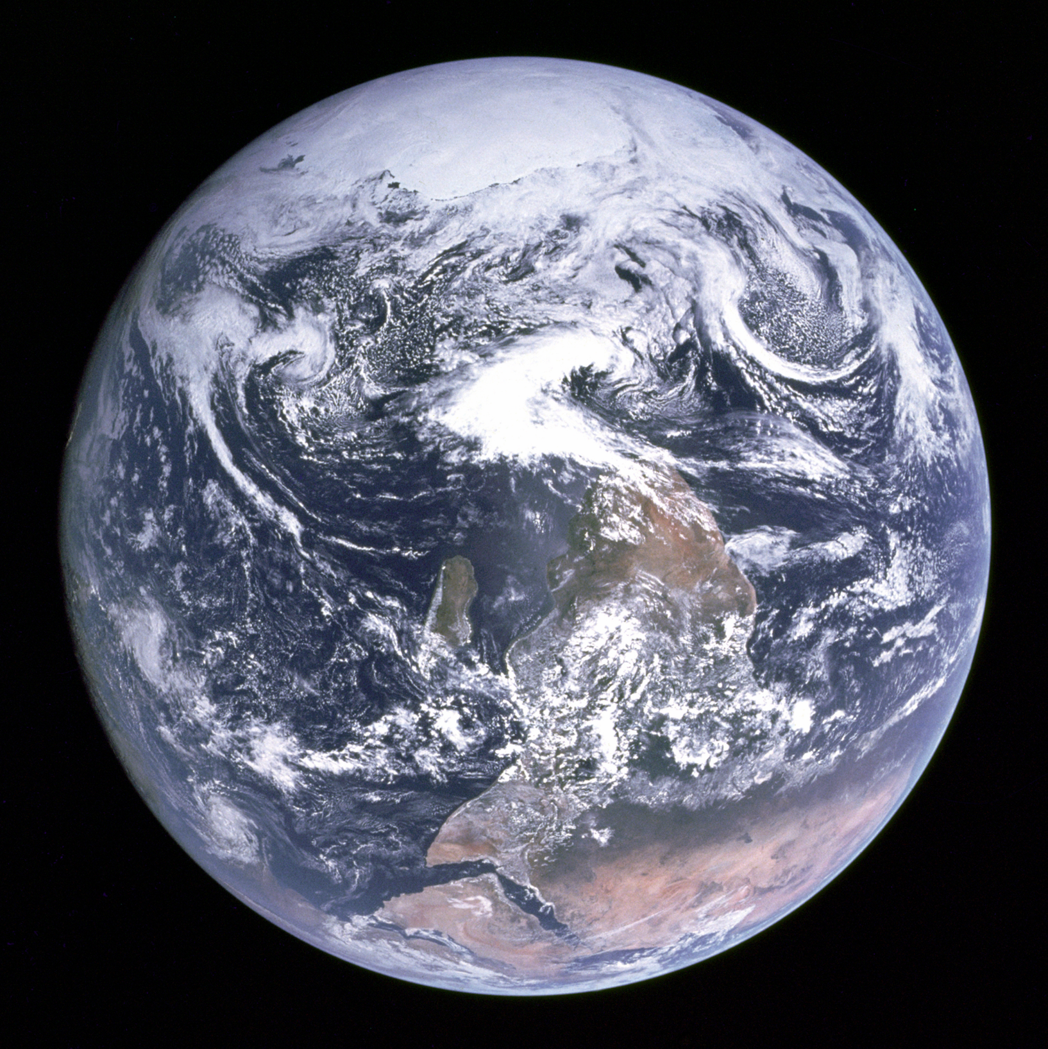
“The Blue Marble”, taken on December 7, 1972, by the crew of the Apollo 17 spacecraft, at a distance of about 45,000 kilometers
Notes:
45k is very near geostationary orbit (42,164 km)

Slide 8
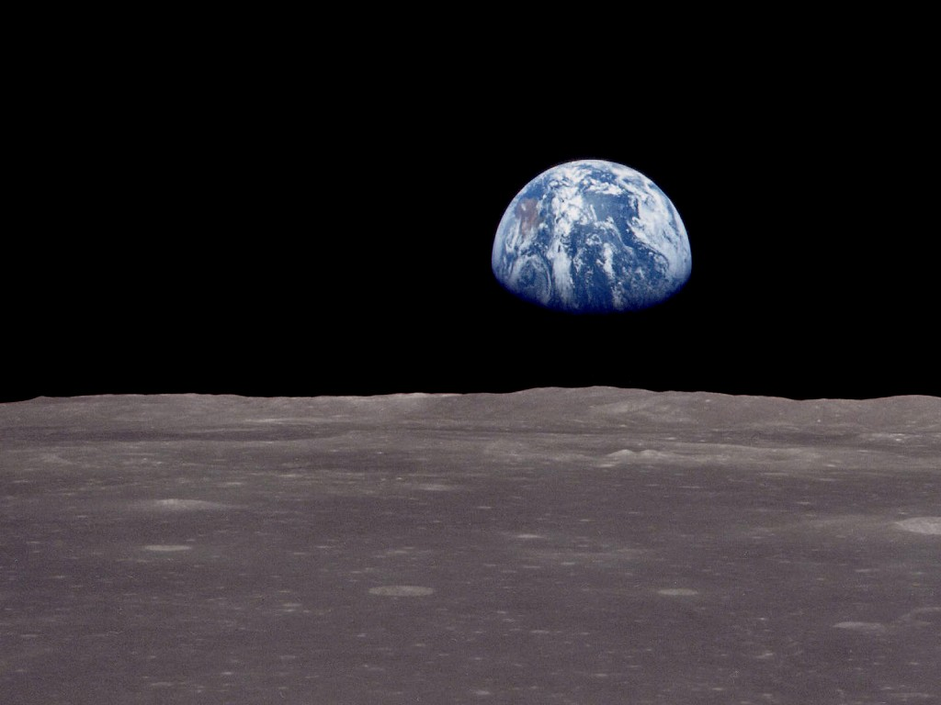

Slide 9
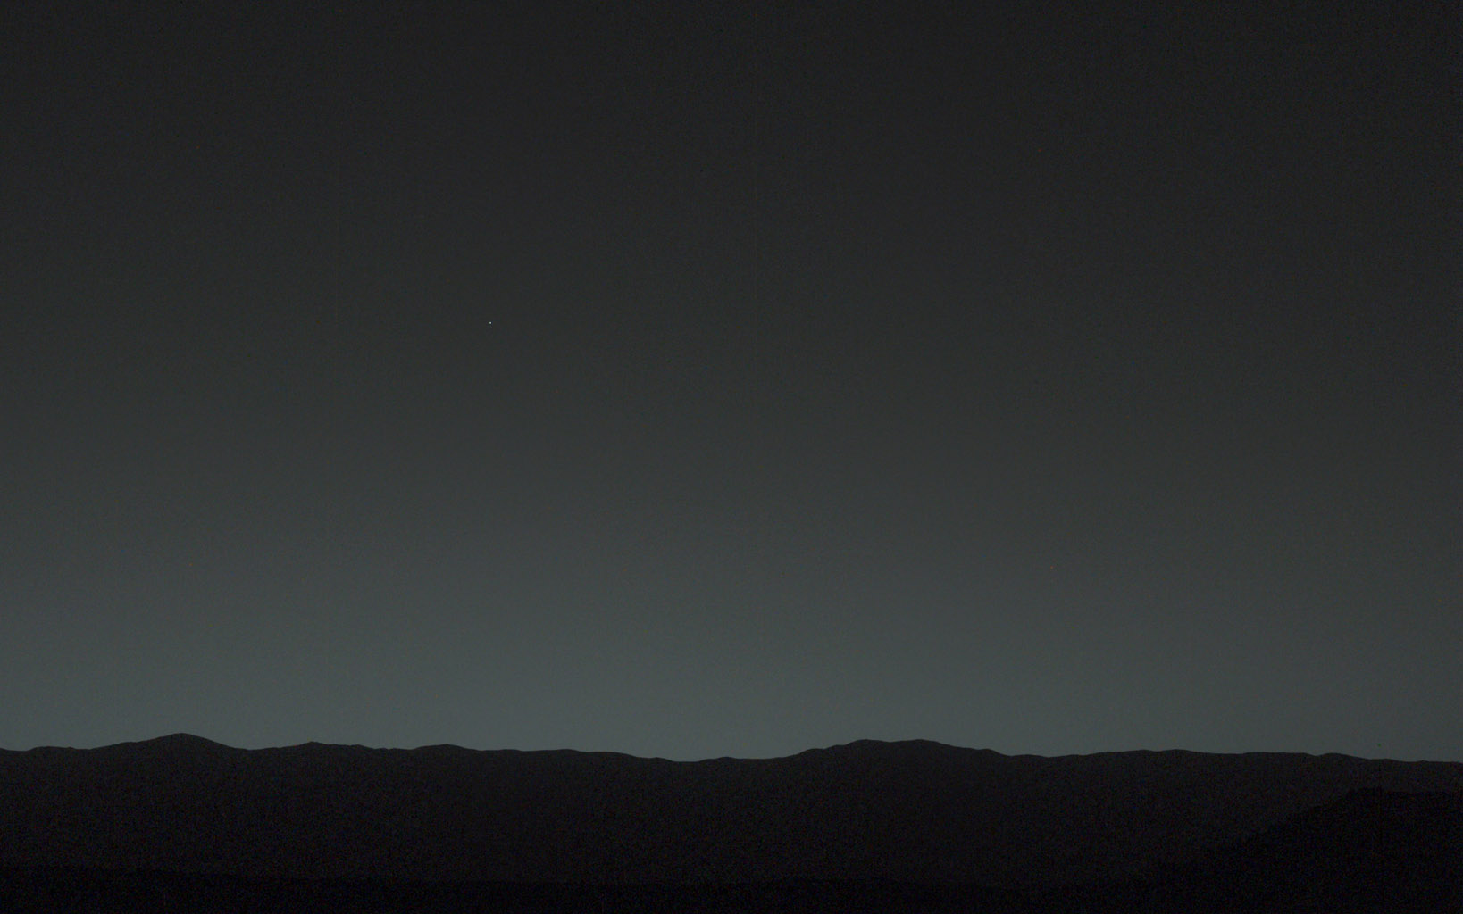
Earth from Curiosity Rover, 2014, 160 million kilometers from Earth

Slide 10
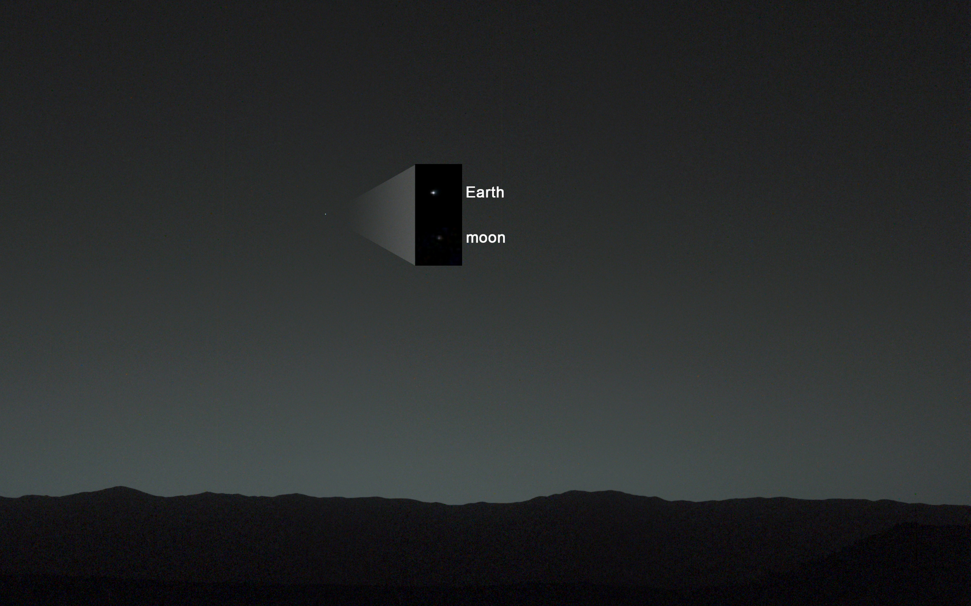
Earth from Curiosity Rover, 2014, 160 million kilometers from Earth

Slide 11
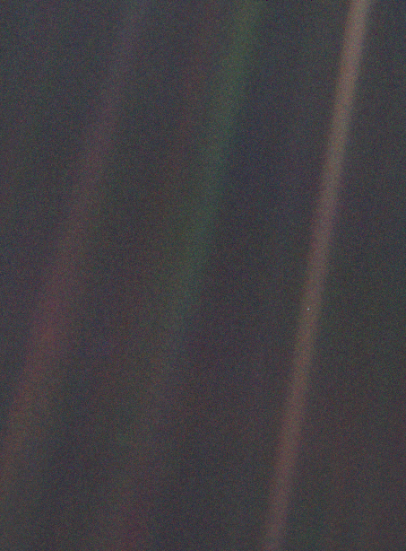
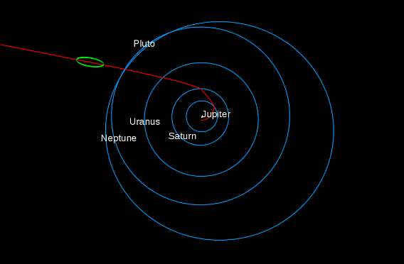
Consider again that dot. That's here. That's home. That's us. On it everyone you love, everyone you know, everyone you ever heard of, every human being who ever was, lived out their lives. The aggregate of our joy and suffering, thousands of confident religions, ideologies, and economic doctrines, every hunter and forager, every hero and coward, every creator and destroyer of civilization, every king and peasant, every young couple in love, every mother and father, hopeful child, inventor and explorer, every teacher of morals, every corrupt politician, every "superstar," every "supreme leader," every saint and sinner in the history of our species lived there – on a mote of dust suspended in a sunbeam.
Carl Sagan
“Pale Blue Dot” from Voyager 1, February 14, 1990, 6 billion kilometers from Earth

Slide 12
Projection: world coordinates→image coordinates
.
Optical Center (u₀, v₀)
.
.
f
Z
Y
.
v
Camera Center (t_{x}, t_{y}, t_{z})
u
How do we handle the general case?

Slide 13
Interlude: why does this matter?

Slide 14
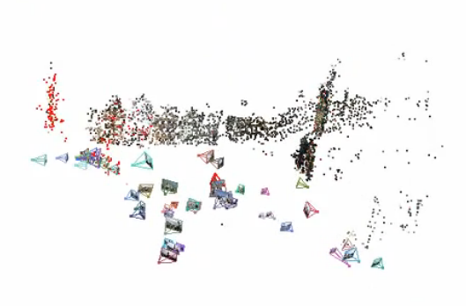
Relating multiple views

Slide 15
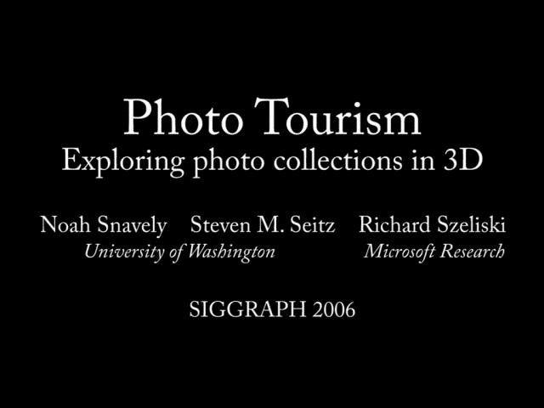

Slide 16
Projection: world coordinates→image coordinates
.
Optical Center (u₀, v₀)
.
.
f
Z
Y
.
v
Camera Center (t_{x}, t_{y}, t_{z})
u
How do we handle the general case?

Slide 17




Homogeneous coordinates
Conversion
Converting to homogeneous coordinates
homogeneous image
coordinates
homogeneous scene
coordinates
Converting from homogeneous coordinates
Notes:
Append coordinate with value 1; proportional coordinate system

Slide 18
Homogeneous coordinates
Invariant to scaling
Point in Cartesian is ray in Homogeneous
Homogeneous Coordinates
Cartesian Coordinates
Notes:
Q: Suppose we have a point in Cartesian coordinates. What is that in homogeneous coordinates? A: a ray

Slide 19
Basic geometry in homogeneous coordinates
Line equation: ax + by + c = 0
Append 1 to pixel coordinate to get homogeneous coordinate
Line given by cross product of two points
Intersection of two lines given by cross product of the lines

Slide 20
Another problem solved by homogeneous coordinates
Intersection of parallel lines
  Cartesian: (Inf, Inf)
  Homogeneous: (1, 1, 0)
  Cartesian: (Inf, Inf)
Homogeneous: (1, 2, 0)
Notes:
Parallel lines intersect at different infinities

Slide 21

Projection matrix
Slide Credit: Savarese
R,t
j_{w}
X
k_{w}
O_{w}
x
i_{w}
x: Image Coordinates: (u,v,1)
K: Intrinsic Matrix (3x3)
R: Rotation (3x3)
t: Translation (3x1)
X: World Coordinates: (X,Y,Z,1)
Notes:
We can use homogeneous coordinates to write camera matrix in linear form.

Slide 22
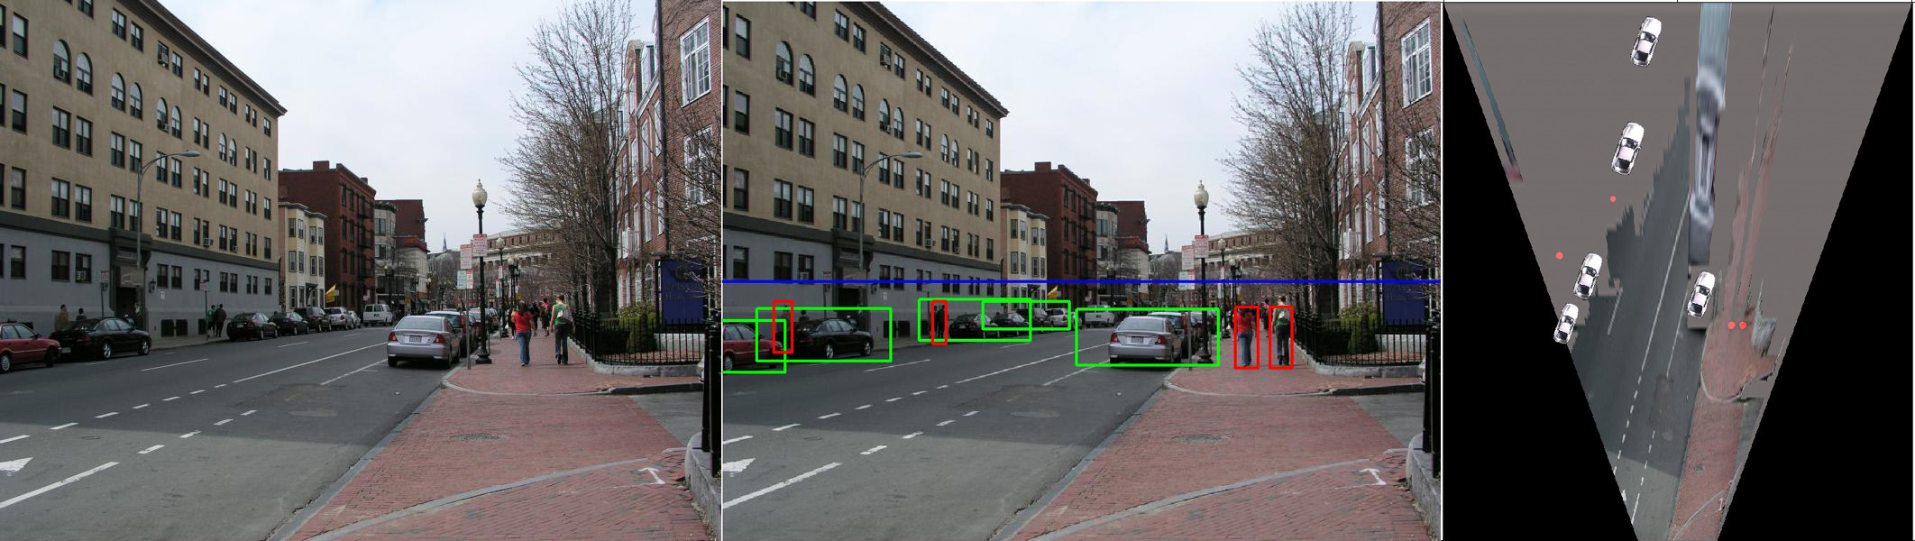
Object Recognition (CVPR 2006)

Slide 23
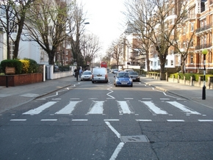
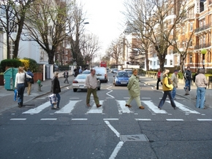
Inserting photographed objects into images (SIGGRAPH 2007)
Original
Created

Slide 24
Pinhole Camera Model
x: Image Coordinates: (u,v,1)
K: Intrinsic Matrix (3x3)
R: Rotation (3x3)
t: Translation (3x1)
X: World Coordinates: (X,Y,Z,1)

Slide 25
Projection matrix
X
x
Intrinsic Assumptions
Unit aspect ratio
Optical center at (0,0)
No skew
Extrinsic Assumptions
No rotation
Camera at (0,0,0)
K
Slide Credit: Savarese
Notes:
Work through equations for u and v on board

Slide 26
Remove assumption: known optical center
Intrinsic Assumptions
Unit aspect ratio
No skew
Extrinsic Assumptions
No rotation
Camera at (0,0,0)

Slide 27
Remove assumption: square pixels
Intrinsic Assumptions
No skew
Extrinsic Assumptions
No rotation
Camera at (0,0,0)

Slide 28
Remove assumption: non-skewed pixels
Intrinsic Assumptions
Extrinsic Assumptions
No rotation
Camera at (0,0,0)
Note: different books use different notation for parameters

Slide 29
Oriented and Translated Camera
R
j_{w}
X
t
k_{w}
O_{w}
x
i_{w}

Slide 30
Allow camera translation
Intrinsic Assumptions
Extrinsic Assumptions
No rotation

Slide 31
3D Rotation of Points
Slide Credit: Saverese
Rotation around the coordinate axes, counter-clockwise:
p’
γ
y
p
z

Slide 32
Allow camera rotation

Slide 33
Degrees of freedom
5
6
Notes:
How many known points are needed to estimate this?

Slide 34
Vanishing Point = Projection from Infinity

Slide 35
Orthographic Projection
Special case of perspective projection
  Distance from the COP to the image plane is infinite
  Also called “parallel projection”
  What’s the projection matrix?
Image
World
Slide by Steve Seitz

Slide 36
Scaled Orthographic Projection
Special case of perspective projection
  Object dimensions are small compared to distance to camera
  Also called “weak perspective”
  What’s the projection matrix?
Image
World
Slide by Steve Seitz

Slide 37
Field of View (Zoom, focal length)

Slide 38
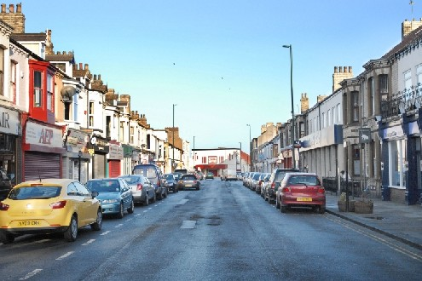
Suppose we have two 3D cubes on the ground facing the viewer, one near, one far.
What would they look like in perspective?
What would they look like in weak perspective?
Photo credit: GazetteLive.co.uk

Slide 39
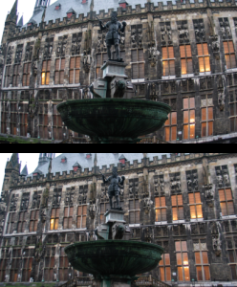
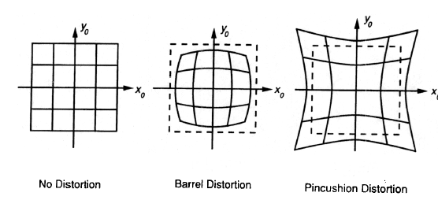
Beyond Pinholes: Radial Distortion
Corrected Barrel Distortion
Image from Martin Habbecke

Slide 40


Things to remember
Vertical vanishing
point
(at infinity)
Vanishing points and vanishing lines
Pinhole camera model and camera projection matrix
Homogeneous coordinates
Vanishing
line
Vanishing
point
Vanishing
point

Slide 41
Reminder: read your book
Lectures have assigned readings
Szeliski 2.1 and especially 2.1.5 cover the geometry of image formation

Slide 42


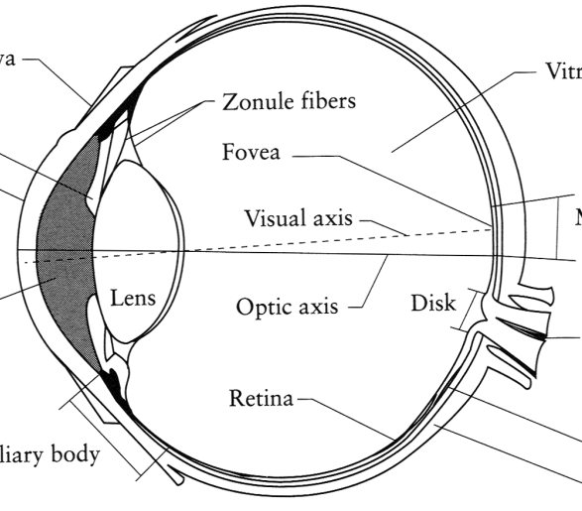
Image Formation
Digital Camera
Film
The Eye

Slide 43
A photon’s life choices
Absorption
Diffusion
Reflection
Transparency
Refraction
Fluorescence
Subsurface scattering
Phosphorescence
Interreflection
light source
λ
?

Slide 44
A photon’s life choices
Absorption
Diffusion
Reflection
Transparency
Refraction
Fluorescence
Subsurface scattering
Phosphorescence
Interreflection
light source
λ

Slide 45
A photon’s life choices
Absorption
Diffuse Reflection
Reflection
Transparency
Refraction
Fluorescence
Subsurface scattering
Phosphorescence
Interreflection
light source
λ

Slide 46
A photon’s life choices
Absorption
Diffusion
Specular Reflection
Transparency
Refraction
Fluorescence
Subsurface scattering
Phosphorescence
Interreflection
light source
λ

Slide 47
A photon’s life choices
Absorption
Diffusion
Reflection
Transparency
Refraction
Fluorescence
Subsurface scattering
Phosphorescence
Interreflection
light source
λ

Slide 48
A photon’s life choices
Absorption
Diffusion
Reflection
Transparency
Refraction
Fluorescence
Subsurface scattering
Phosphorescence
Interreflection
light source
λ

Slide 49
A photon’s life choices
Absorption
Diffusion
Reflection
Transparency
Refraction
Fluorescence
Subsurface scattering
Phosphorescence
Interreflection
light source
λ₁
λ₂

Slide 50
A photon’s life choices
Absorption
Diffusion
Reflection
Transparency
Refraction
Fluorescence
Subsurface scattering
Phosphorescence
Interreflection
light source
λ

Slide 51
A photon’s life choices
Absorption
Diffusion
Reflection
Transparency
Refraction
Fluorescence
Subsurface scattering
Phosphorescence
Interreflection
light source
t=1
t=n

Slide 52
A photon’s life choices
Absorption
Diffusion
Reflection
Transparency
Refraction
Fluorescence
Subsurface scattering
Phosphorescence
Interreflection
light source
λ
(Specular Interreflection)

Slide 53
Lambertian Reflectance
In computer vision, surfaces are often assumed to be ideal diffuse reflectors with no dependence on viewing direction.

Slide 54

Digital camera
A digital camera replaces film with a sensor array
  Each cell in the array is light-sensitive diode that converts photons to electrons
  Two common types
    Charge Coupled Device (CCD)
    CMOS
  http://electronics.howstuffworks.com/digital-camera.htm
Slide by Steve Seitz

Slide 55
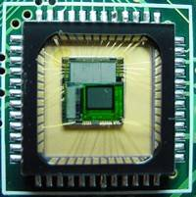
Sensor Array
CMOS sensor

Slide 56
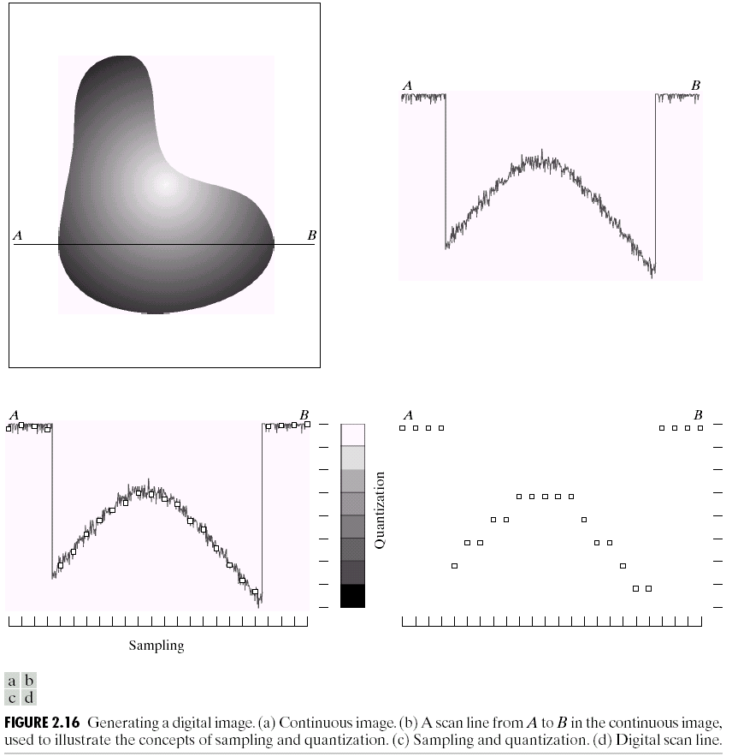
Sampling and Quantization

Slide 57
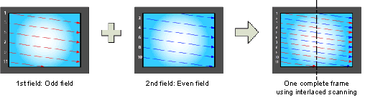
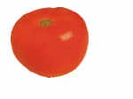
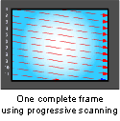
Interlace vs. progressive scan
http://www.axis.com/products/video/camera/progressive_scan.htm
Slide by Steve Seitz

Slide 58
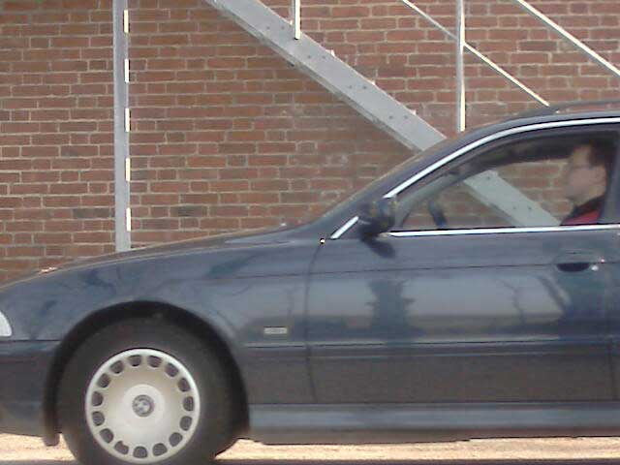
Progressive scan
http://www.axis.com/products/video/camera/progressive_scan.htm
Slide by Steve Seitz

Slide 59
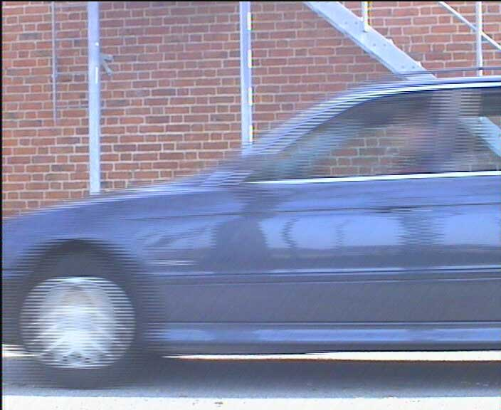
Interlace
http://www.axis.com/products/video/camera/progressive_scan.htm
Slide by Steve Seitz

Slide 60
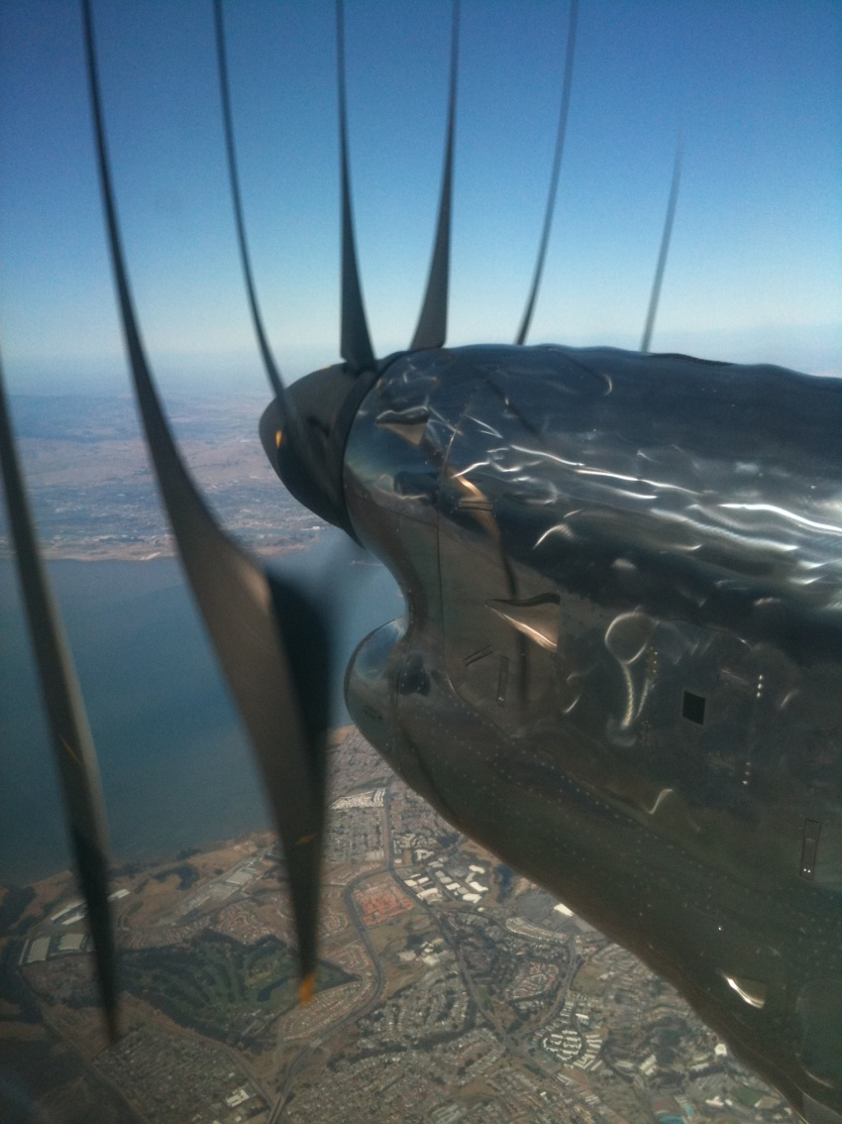
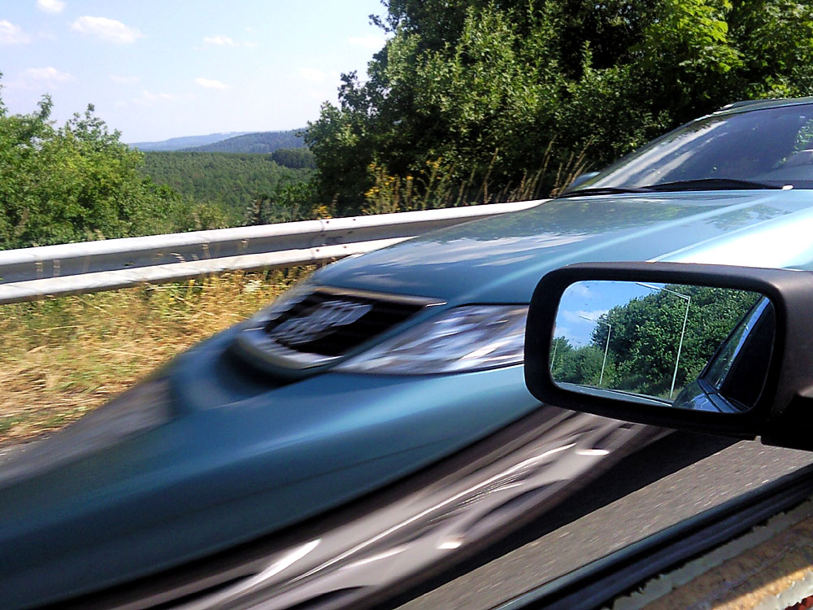
Rolling Shutter
Notes:
http://en.wikipedia.org/wiki/Rolling_shutter
Even DSLRs have this problem.

