Slide 1
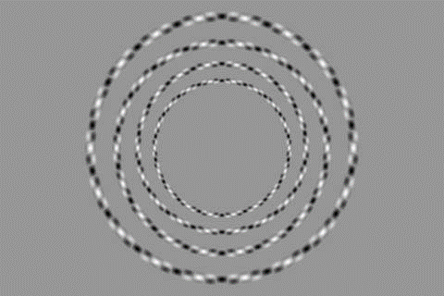

Slide 2
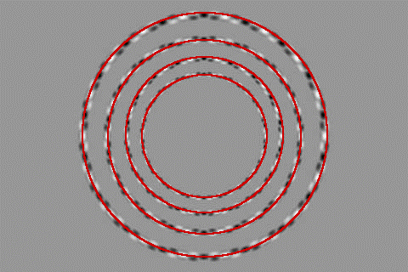

Slide 3
Recap: edge detection
Source: D. Lowe, L. Fei-Fei

Slide 4
Canny edge detector
Filter image with x, y derivatives of Gaussian
Find magnitude and orientation of gradient
Non-maximum suppression:
Thin multi-pixel wide “ridges” down to single pixel width
Thresholding and linking (hysteresis):
Define two thresholds: low and high
Use the high threshold to start edge curves and the low threshold to continue them
MATLAB: edge(image, ‘canny’)
Source: D. Lowe, L. Fei-Fei

Slide 5
Hysteresis thresholding
Check that maximum value of gradient value is sufficiently large
drop-outs? use hysteresis
use a high threshold to start edge curves and a low threshold to continue them.
Source: S. Seitz

Slide 6
To be continued
How do we know that one edge detector is better than another?

Slide 7
Interest Points and Corners
Read Szeliski 4.1
Computer Vision
James Hays
Slides from Rick Szeliski, Svetlana Lazebnik, Derek Hoiem and Grauman&Leibe 2008 AAAI Tutorial

Slide 8
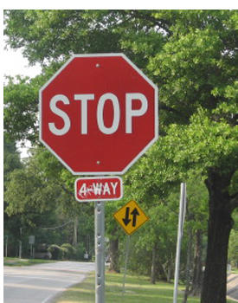
Correspondence across views
Correspondence: matching points, patches, edges, or regions across images
≈

Slide 9
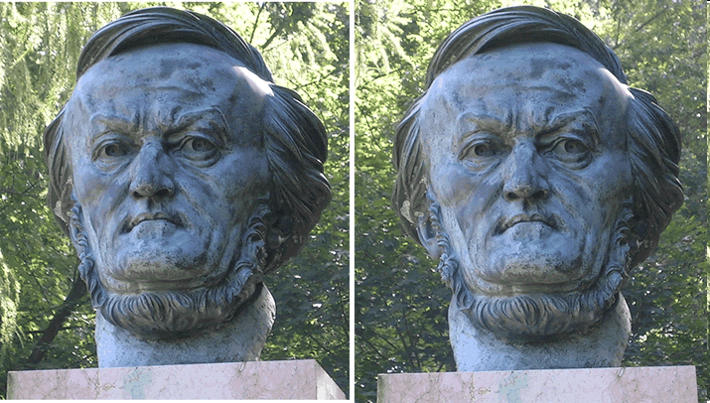
Example: estimating “fundamental matrix” that corresponds two views
Slide from Silvio Savarese

Slide 10
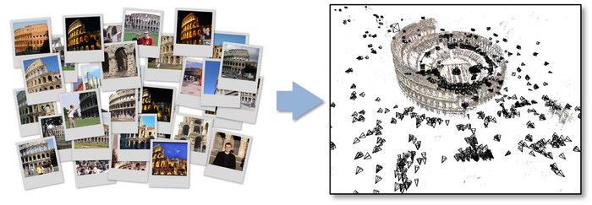
Example: structure from motion

Slide 11
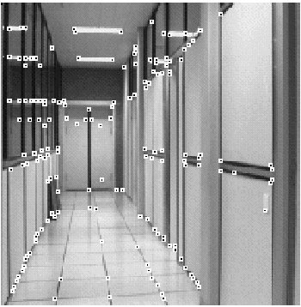
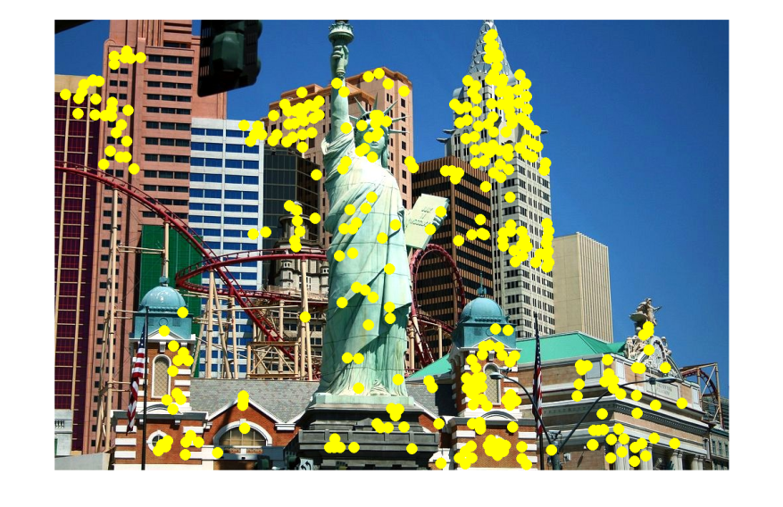
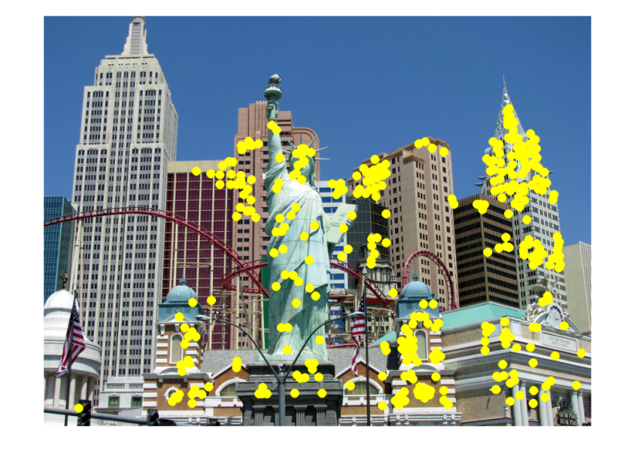
Applications
Feature points are used for:
Image alignment
3D reconstruction
Motion tracking
Robot navigation
Indexing and database retrieval
Object recognition

Slide 12
This class: interest points and local features
Note: “interest points” = “keypoints”, also sometimes called “features”

Slide 13
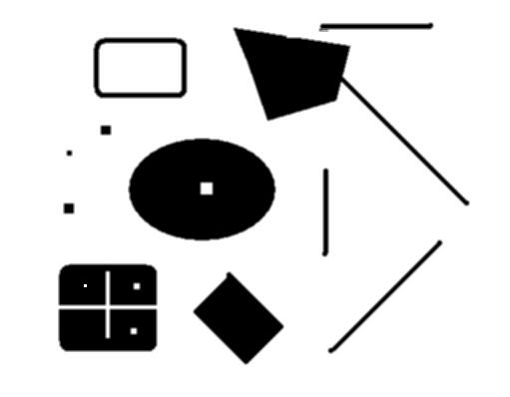
This class: interest points
original
Suppose you have to click on some point, go away and come back after I deform the image, and click on the same points again.
Which points would you choose?
deformed

Slide 14
Overview of Keypoint Matching
1. Find a set of distinctive key- points
A₁
B₃
2. Define a region around each keypoint
A₂
A₃
B₁
B₂
3. Compute a local descriptor from the normalized region
4. Match local descriptors

Slide 15
Goals for Keypoints
Detect points that are repeatable and distinctive

Slide 16
Invariant Local Features
Image content is transformed into local feature coordinates that are invariant to translation, rotation, scale, and other imaging parameters
Features Descriptors

Slide 17
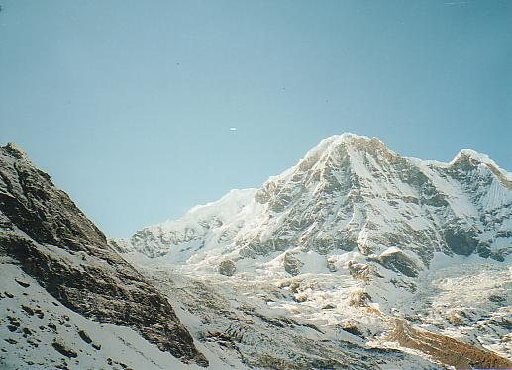
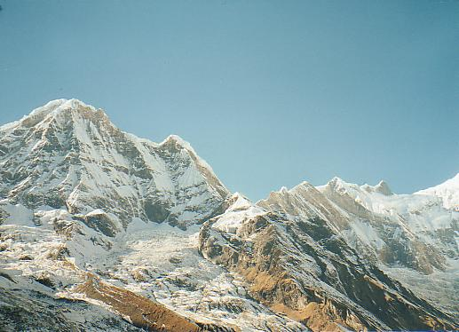
Why extract features?
Motivation: panorama stitching
We have two images – how do we combine them?

Slide 18
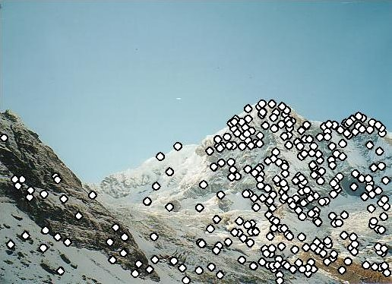
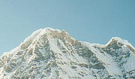
Local features: main components
Detection: Identify the interest points
Description: Extract vector feature descriptor surrounding each interest point.
Matching: Determine correspondence between descriptors in two views
Kristen Grauman

Slide 19
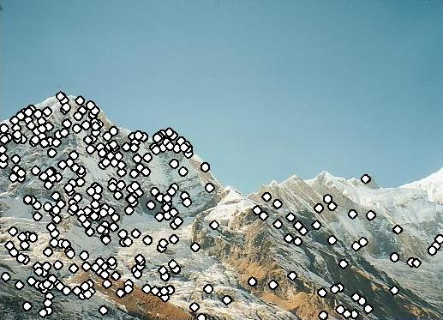
Characteristics of good features
Repeatability
The same feature can be found in several images despite geometric and photometric transformations
Saliency
Each feature is distinctive
Compactness and efficiency
Many fewer features than image pixels
Locality
A feature occupies a relatively small area of the image; robust to clutter and occlusion

Slide 20
Goal: interest operator repeatability
We want to detect (at least some of) the same points in both images.
Yet we have to be able to run the detection procedure independently per image.
No chance to find true matches!
Kristen Grauman
Notes:
20

Slide 21
Goal: descriptor distinctiveness
We want to be able to reliably determine which point goes with which.
Must provide some invariance to geometric and photometric differences between the two views.
?
Kristen Grauman

Slide 22
Local features: main components
Detection: Identify the interest points
Description:Extract vector feature descriptor surrounding each interest point.
Matching: Determine correspondence between descriptors in two views

Slide 23
Many Existing Detectors Available
Hessian & Harris [Beaudet ‘78], [Harris ‘88]
Laplacian, DoG [Lindeberg ‘98], [Lowe 1999]
Harris-/Hessian-Laplace [Mikolajczyk & Schmid ‘01]
Harris-/Hessian-Affine [Mikolajczyk & Schmid ‘04]
EBR and IBR [Tuytelaars & Van Gool ‘04]
MSER [Matas ‘02]
Salient Regions [Kadir & Brady ‘01]
Others…

Slide 24
Corner Detection: Basic Idea
We should easily recognize the point by looking through a small window
Shifting a window in any direction should give a large change in intensity
“flat” region: no change in all directions
“edge”: no change along the edge direction
“corner”: significant change in all directions
Source: A. Efros

Slide 25
Finding Corners
Key property: in the region around a corner, image gradient has two or more dominant directions
Corners are repeatable and distinctive
C.Harris and M.Stephens. "A Combined Corner and Edge Detector.“ Proceedings of the 4th Alvey Vision Conference: pages 147--151.

Slide 26
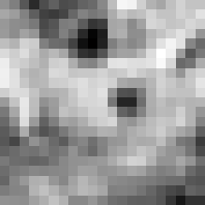
Corner Detection: Mathematics
Change in appearance of window w(x,y)
for the shift [u,v]:
I(x, y)
E(u, v)
E(3,2)
w(x, y)

Slide 27
Corner Detection: Mathematics
Change in appearance of window w(x,y)
for the shift [u,v]:
I(x, y)
E(u, v)
E(0,0)
w(x, y)

Slide 28
Corner Detection: Mathematics
Change in appearance of window w(x,y)
for the shift [u,v]:
Window function
Shifted intensity
Intensity
Window function w(x,y) =
or
1 in window, 0 outside
Gaussian
Source: R. Szeliski

Slide 29
Corner Detection: Mathematics
Change in appearance of window w(x,y)
for the shift [u,v]:
We want to find out how this function behaves for small shifts
E(u, v)

Slide 30
Corner Detection: Mathematics
Change in appearance of window w(x,y)
for the shift [u,v]:
We want to find out how this function behaves for small shifts
But this is very slow to compute naively.
O(window_width² * shift_range² * image_width²)
O( 11² * 11² * 600² ) = 5.2 billion of these
14.6 thousand per pixel in your image

Slide 31
Corner Detection: Mathematics
Change in appearance of window w(x,y)
for the shift [u,v]:
We want to find out how this function behaves for small shifts
Recall Taylor series expansion. A function f can be approximated at point a as

Slide 32
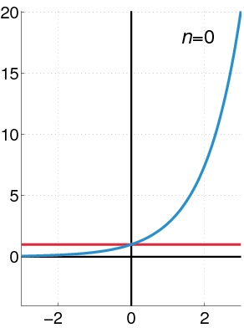
Recall: Taylor series expansion
A function f can be approximated as
Approximation of f(x) = e^{x} centered at f(0)

Slide 33
Corner Detection: Mathematics
Change in appearance of window w(x,y)
for the shift [u,v]:
We want to find out how this function behaves for small shifts
Local quadratic approximation of E(u,v) in the neighborhood of (0,0) is given by the second-order Taylor expansion:
Notes:
Technically a Maclaurin expansion, a special case of Taylor expansion centered at 0.
What is the point? Well, now we’re just extrapolating local measurements instead of doing 10s of thousands of computations.

Slide 34
Corner Detection: Mathematics
Local quadratic approximation of E(u,v) in the neighborhood of (0,0) is given by the second-order Taylor expansion:
E(u, v)
Always 0
First derivative is 0
Notes:
Technically a Maclaurin expansion, a special case of Taylor expansion centered at 0.

Slide 35
Corner Detection: Mathematics
Second-order Taylor expansion of E(u,v) about (0,0):

Slide 36
Corner Detection: Mathematics
Second-order Taylor expansion of E(u,v) about (0,0):

Slide 37
Corner Detection: Mathematics
Second-order Taylor expansion of E(u,v) about (0,0):

Slide 38
Corner Detection: Mathematics
The quadratic approximation simplifies to
where M is a second moment matrix computed from image derivatives:
M

Slide 39
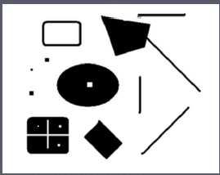
Corners as distinctive interest points
2 x 2 matrix of image derivatives (averaged in neighborhood of a point).
Notation:

Slide 40
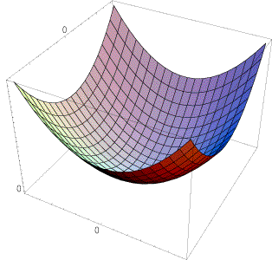
Interpreting the second moment matrix
The surface E(u,v) is locally approximated by a quadratic form. Let’s try to understand its shape.

Slide 41
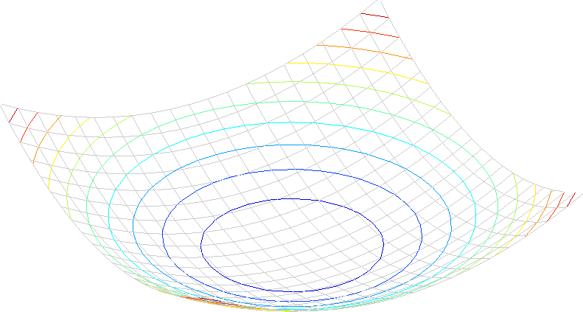
Interpreting the second moment matrix
Consider a horizontal “slice” of E(u, v):
This is the equation of an ellipse.

Slide 42
Interpreting the second moment matrix
First, consider the axis-aligned case (gradients are either horizontal or vertical)
If either λ is close to 0, then this is not a corner, so look for locations where both are large.

Slide 43
Interpreting the second moment matrix
Consider a horizontal “slice” of E(u, v):
This is the equation of an ellipse.
Diagonalization of M:
The axis lengths of the ellipse are determined by the eigenvalues and the orientation is determined by R
direction of the fastest change
direction of the slowest change
(λ_{max})^{-1/2}
(λ_{min})^{-1/2}

Slide 44
Visualization of second moment matrices

Slide 45
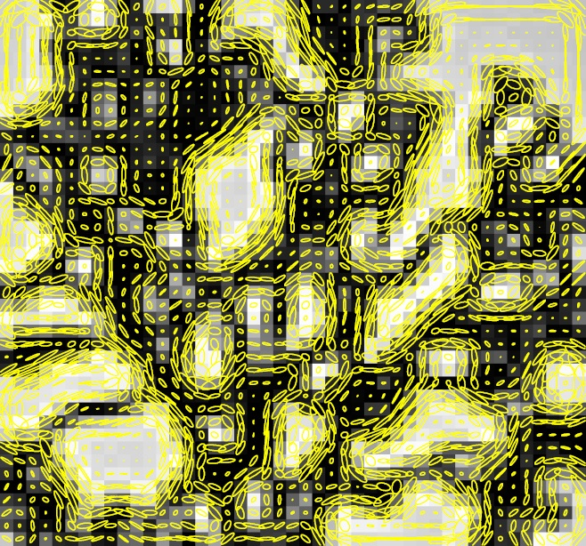
Visualization of second moment matrices

Slide 46
Interpreting the eigenvalues
Classification of image points using eigenvalues of M:
λ₂
“Edge” λ₂ >> λ₁
“Corner” λ₁ and λ₂ are large, λ₁ ~ λ₂; E increases in all directions
λ₁ and λ₂ are small; E is almost constant in all directions
“Flat” region
“Edge” λ₁ >> λ₂
λ₁

Slide 47
Corner response function
α: constant (0.04 to 0.06)
“Edge” R < 0
“Corner” R > 0
|R| small
“Flat” region
“Edge” R < 0

Slide 48
Harris corner detector
Compute M matrix for each image window to get their cornerness scores.
Find points whose surrounding window gave large corner response (f> threshold)
Take the points of local maxima, i.e., perform non-maximum suppression
C.Harris and M.Stephens. “A Combined Corner and Edge Detector.” Proceedings of the 4th Alvey Vision Conference: pages 147—151, 1988.
Notes:
48

Slide 49
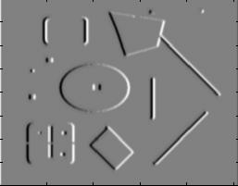
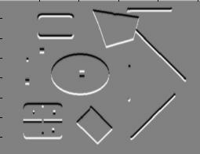
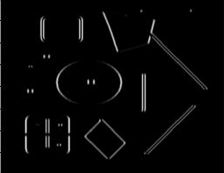
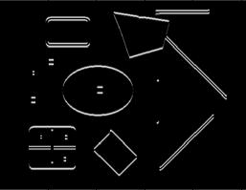
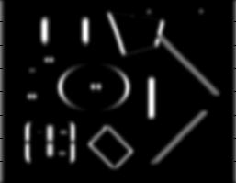
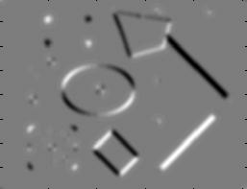
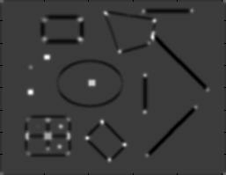
Harris Detector [Harris88]
Second moment matrix
1. Image derivatives
I_{x}
I_{y}
(optionally, blur first)
I_{x}²
I_{y}²
I_{x}I_{y}
2. Square of derivatives
3. Gaussian filter g(σ_{I})
g(I_{x}²)
g(I_{y}²)
g(I_{x}I_{y})
4. Cornerness function – both eigenvalues are strong
5. Non-maxima suppression
har

Slide 50
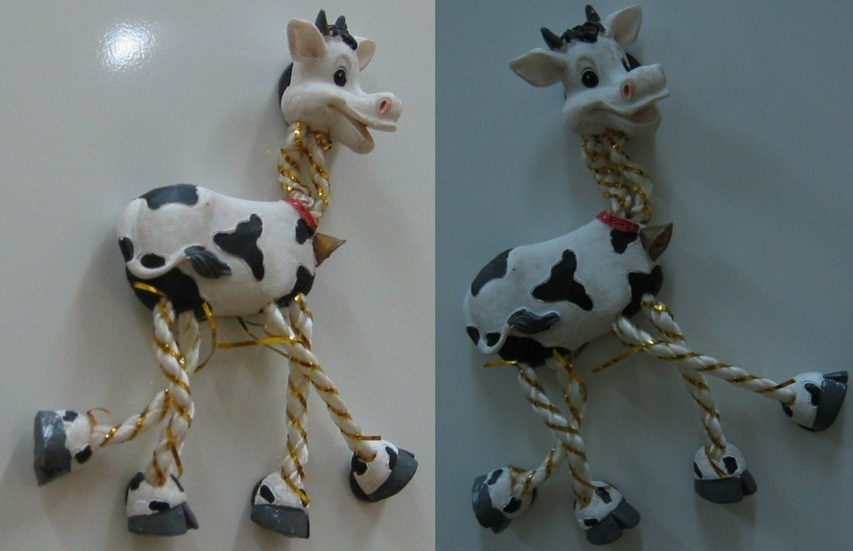
Harris Detector: Steps

Slide 51
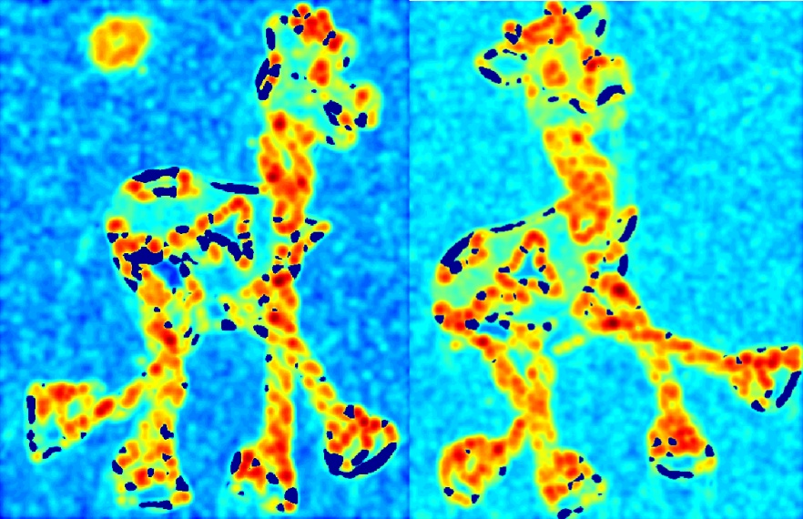
Harris Detector: Steps
Compute corner response R

Slide 52
Harris Detector: Steps
Find points with large corner response: R>threshold

Slide 53
Harris Detector: Steps
Take only the points of local maxima of R

Slide 54
Harris Detector: Steps

Slide 55
Invariance and covariance
We want corner locations to be invariant to photometric transformations and covariant to geometric transformations
Invariance: image is transformed and corner locations do not change
Covariance: if we have two transformed versions of the same image, features should be detected in corresponding locations

Slide 56
Affine intensity change
I → a I + b
Only derivatives are used => invariance to intensity shift I → I + b
Intensity scaling: I → a I
R
R
threshold
x (image coordinate)
x (image coordinate)
Partially invariant to affine intensity change

Slide 57
Image translation
Derivatives and window function are shift-invariant
Corner location is covariant w.r.t. translation

Slide 58
Image rotation
Second moment ellipse rotates but its shape (i.e. eigenvalues) remains the same
Corner location is covariant w.r.t. rotation

Slide 59
Scaling
Corner
All points will be classified as edges
Corner location is not covariant to scaling!

