Slide 1
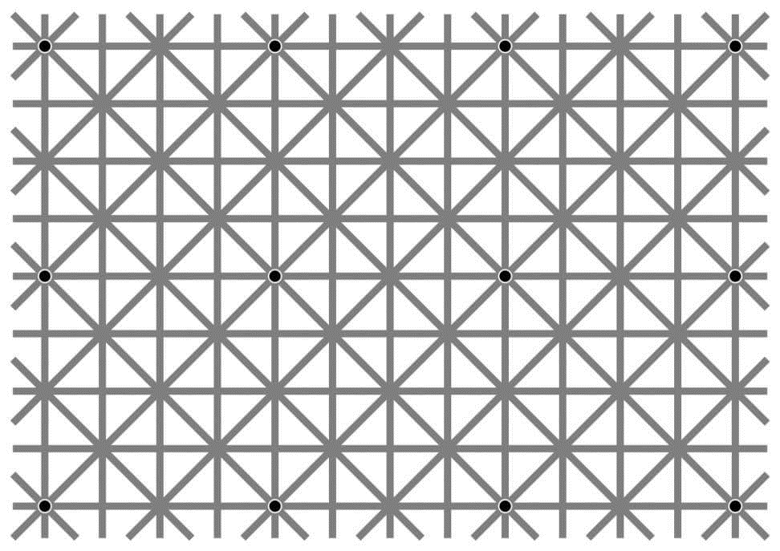
Ninio, J. and Stevens, K. A. (2000) Variations on the Hermann grid: an extinction illusion. Perception, 29, 1209-1217.

Slide 2
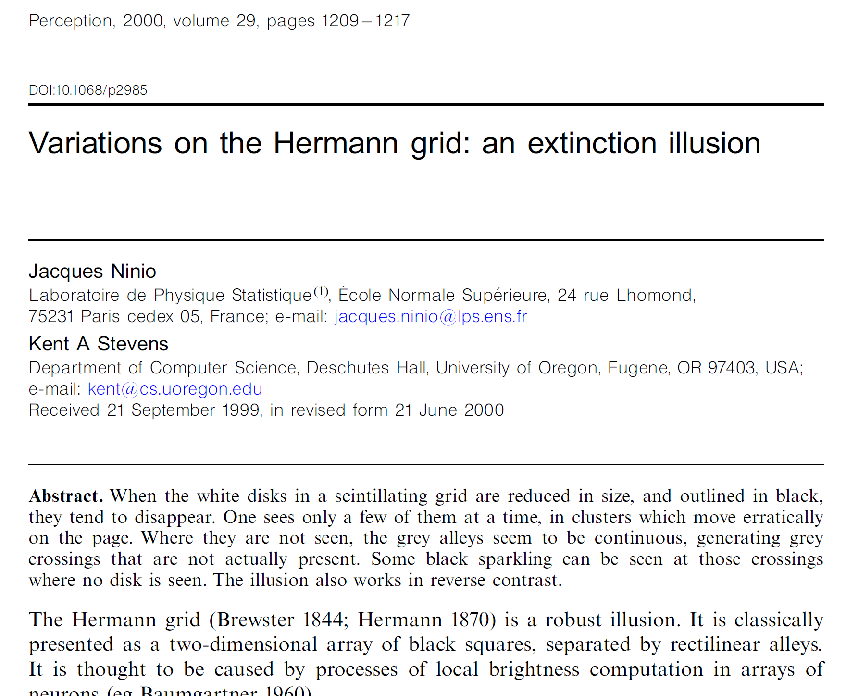

Slide 3
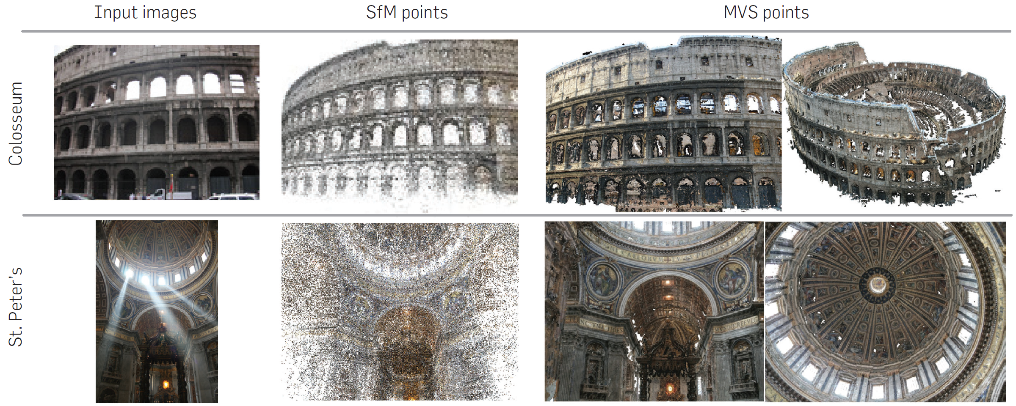
Sparse to Dense Correspodence
Building Rome in a Day
By Sameer Agarwal, Yasutaka Furukawa, Noah Snavely, Ian Simon, Brian Curless, Steven M. Seitz, Richard Szeliski
Communications of the ACM, Vol. 54 No. 10, Pages 105-112

Slide 4
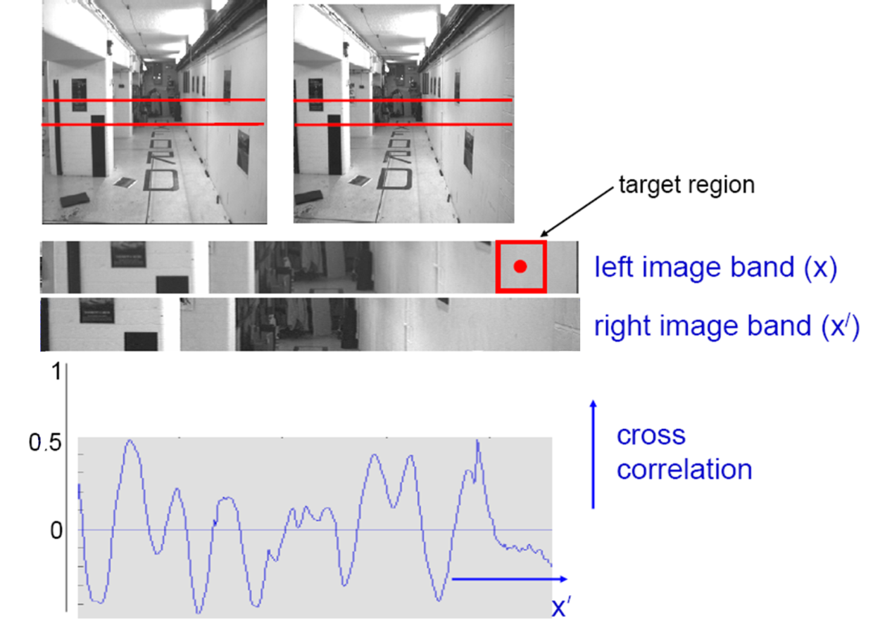
Correlation-based window matching
???
Textureless regions are non-distinct; high ambiguity for matches.
Notes:
We get this corrleation.
[a] And where the peak is located is hard to tell.
How could we fix that? Well…

Slide 5


Stereo matching as energy minimization
I₁
I₂
D
W₁(i )
W₂(i+D(i ))
D(i )
Energy functions of this form can be minimized using graph cuts
  Y. Boykov, O. Veksler, and R. Zabih, Fast Approximate Energy Minimization via Graph Cuts, PAMI 2001
Source: Steve Seitz

Slide 6

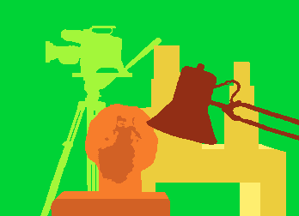
Better results…
Graph cut method
  Boykov et al., Fast Approximate Energy Minimization via Graph Cuts,
  International Conference on Computer Vision, September 1999.
Ground truth
    For the latest and greatest: http://www.middlebury.edu/stereo/

Slide 7
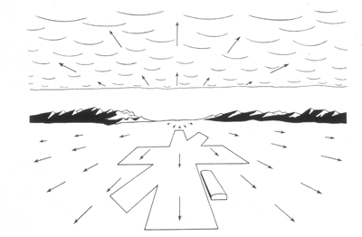
Computer Vision
Motion and Optical Flow
Many slides adapted from S. Seitz, R. Szeliski, M. Pollefeys, K. Grauman and others…

Slide 8
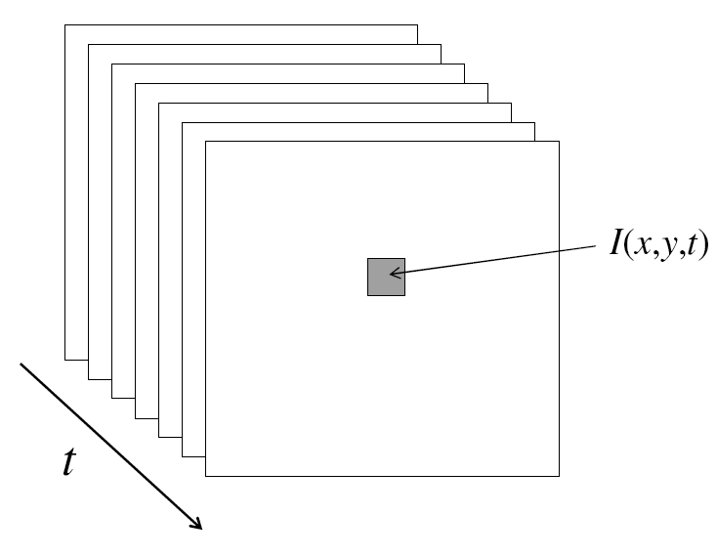
Video
A video is a sequence of frames captured over time
Now our image data is a function of space
(x, y) and time (t)

Slide 9
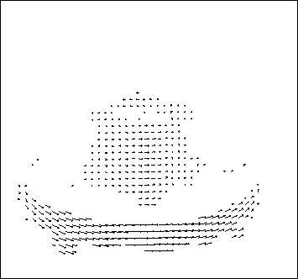
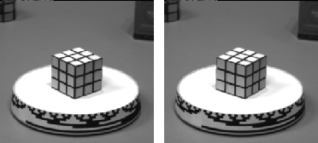
Motion estimation: Optical flow
Optic flow is the apparent motion of objects or surfaces
Will start by estimating motion of each pixel separately
Then will consider motion of entire image

Slide 10
Problem definition: optical flow
How to estimate pixel motion from image I(x,y,t) to I(x,y,t+1) ?
  Solve pixel correspondence problem
    given a pixel in I(x,y,t), look for nearby pixels of the same color in I(x,y,t+1)
Key assumptions
  color constancy: a point in I(x,y, looks the same in I(x,y,t+1)
    For grayscale images, this is brightness constancy
  small motion: points do not move very far
This is called the optical flow problem

Slide 11


Optical flow constraints (grayscale images)
Let’s look at these constraints more closely
  brightness constancy constraint (equation)
  small motion: (u and v are less than 1 pixel, or smooth) Taylor series expansion of I:
Notes:
A: H(x,y) = I(x+u, y+v)

Slide 12
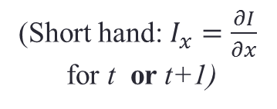
Optical flow equation
Combining these two equations
(Short hand: $I_{x}=\frac{∂I}{∂x}$
for t or t+1)

Slide 13
Optical flow equation
Combining these two equations
(Short hand: $I_{x}=\frac{∂I}{∂x}$
for t or t+1)

Slide 14
Optical flow equation
Combining these two equations
(Short hand: $I_{x}=\frac{∂I}{∂x}$
for t or t+1)
In the limit as u and v go to zero, this becomes exact
  Brightness constancy constraint equation

Slide 15
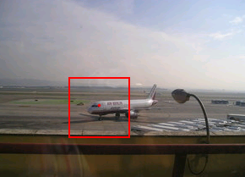
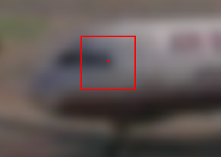
How does this make sense?
  Brightness constancy constraint equation
What do the static image gradients have to do with motion estimation?

Slide 16
The brightness constancy constraint
Can we use this equation to recover image motion (u,v) at each pixel?
or
How many equations and unknowns per pixel?
  One equation (this is a scalar equation!), two unknowns (u,v)
The component of the motion perpendicular to the gradient (i.e., parallel to the edge) cannot be measured
  If (u, v) satisfies the equation,
  so does (u+u’, v+v’ ) if
gradient
(u,v)
(u’,v’)
(u+u’,v+v’)
edge
Notes:
A: u and v are unknown, 1 equation

Slide 17
Aperture problem

Slide 18
Aperture problem

Slide 19
Aperture problem

Slide 20
Apparently an aperture problem

Slide 21

The barber pole illusion
http://en.wikipedia.org/wiki/Barberpole_illusion

Slide 22


The barber pole illusion
http://en.wikipedia.org/wiki/Barberpole_illusion

Slide 23
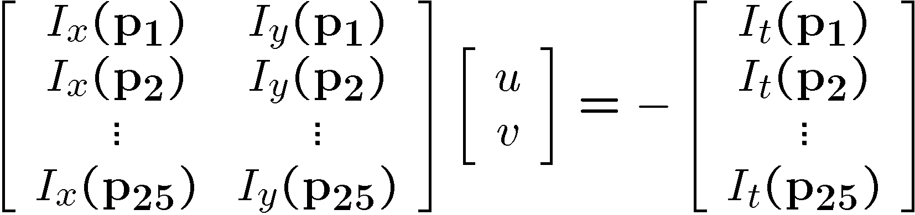
Solving the ambiguity…
B. Lucas and T. Kanade. An iterative image registration technique with an application to stereo vision. In Proceedings of the International Joint Conference on Artificial Intelligence, pp. 674–679, 1981.
How to get more equations for a pixel?
Spatial coherence constraint
Assume the pixel’s neighbors have the same (u,v)
  If we use a 5x5 window, that gives us 25 equations per pixel

Slide 24




Solving the ambiguity…
Least squares problem:

Slide 25

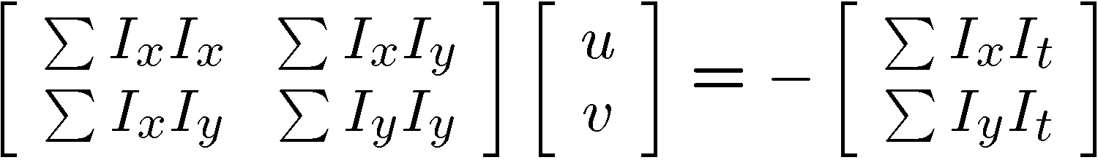


Matching patches across images
Overconstrained linear system
Least squares solution for d given by
  The summations are over all pixels in the K x K window

Slide 26


Conditions for solvability
  Optimal (u, v) satisfies Lucas-Kanade equation
When is this solvable? I.e., what are good points to track?
  A^{T}A should be invertible
  A^{T}A should not be too small due to noise
    eigenvalues λ₁ and λ ₂ of A^{T}A should not be too small
  A^{T}A should be well-conditioned
    λ ₁/ λ ₂ should not be too large (λ ₁ = larger eigenvalue)
Does this remind you of anything?
Criteria for Harris corner detector
Notes:
http://en.wikipedia.org/wiki/Invertible_matrix

Slide 27
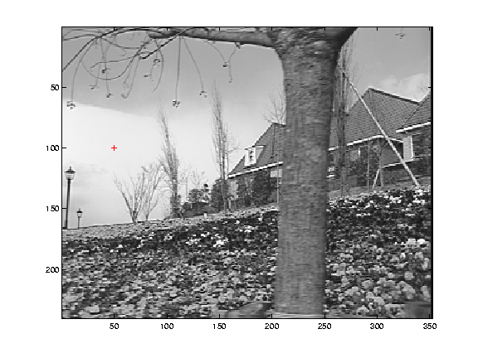
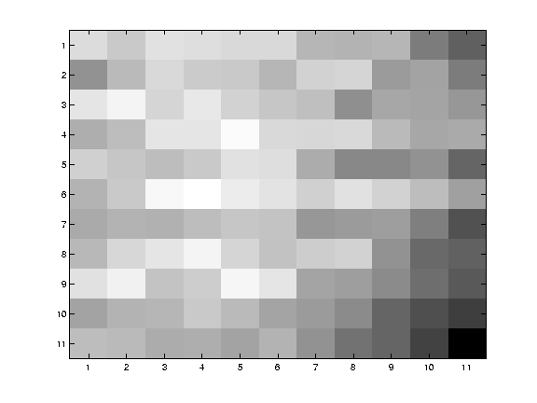
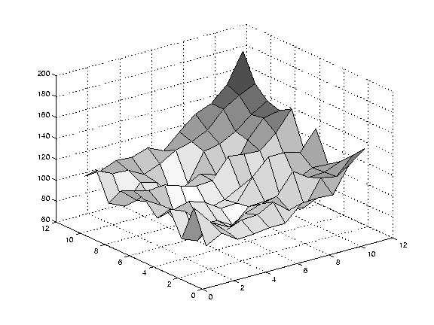
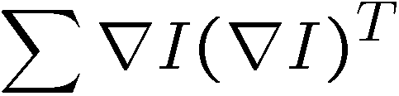
Low texture region
gradients have small magnitude
small λ₁, small λ₂
Notes:
Can’t estimate motion here…nothing you can see moving.

Slide 28
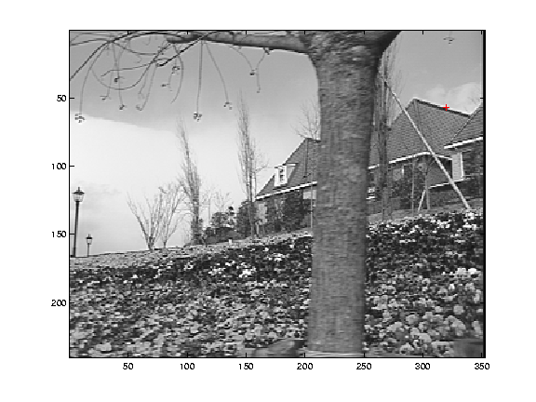
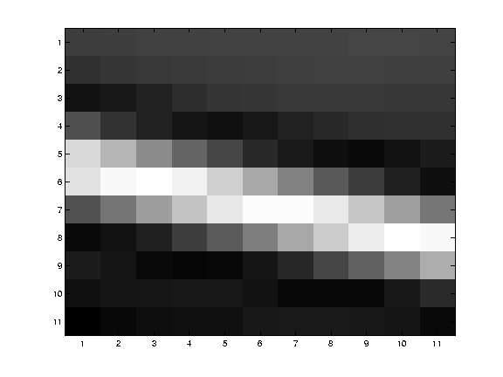
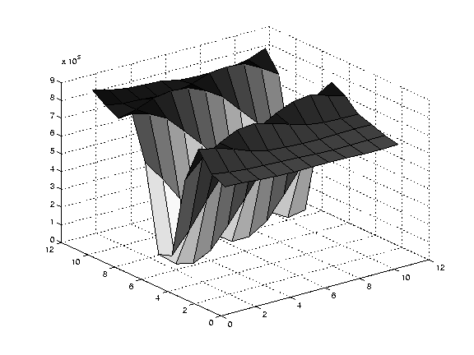
Edge
large gradients, all the same
large λ₁, small λ₂
Notes:
On an edge you can estimate motion perpendicular to the edge but not along it.

Slide 29
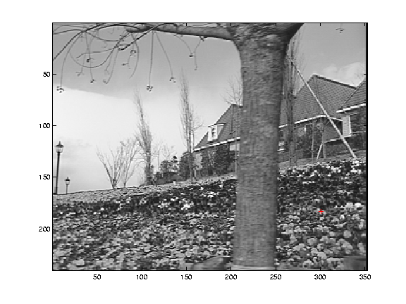
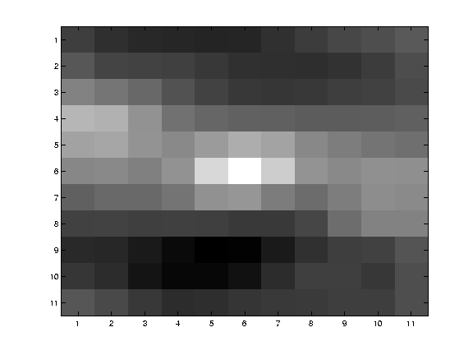
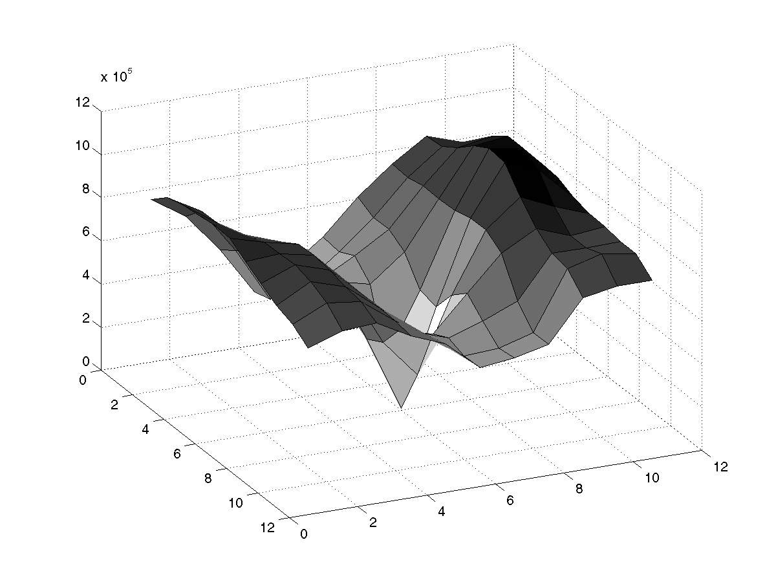
High textured region
gradients are different, large magnitudes
large λ₁, large λ₂
Notes:
But on nice textured regions motion is well estimated because the gradient varies over the window.

Slide 30
The aperture problem resolved
Actual motion

Slide 31
The aperture problem resolved
Perceived motion

Slide 32
Errors in Lucas-Kanade
A point does not move like its neighbors
  Motion segmentation
Brightness constancy does not hold
  Do exhaustive neighborhood search with normalized correlation - tracking features – maybe SIFT – more later….
The motion is large (larger than a pixel)
  Not-linear: Iterative refinement
  Local minima: coarse-to-fine estimation

Slide 33
Not tangent: Iterative Refinement
Iterative Lukas-Kanade Algorithm
  Estimate velocity at each pixel by solving Lucas-Kanade equations
  Warp I_{t} towards I_{t+1} using the estimated flow field
    - use image warping techniques
  Repeat until convergence

Slide 34
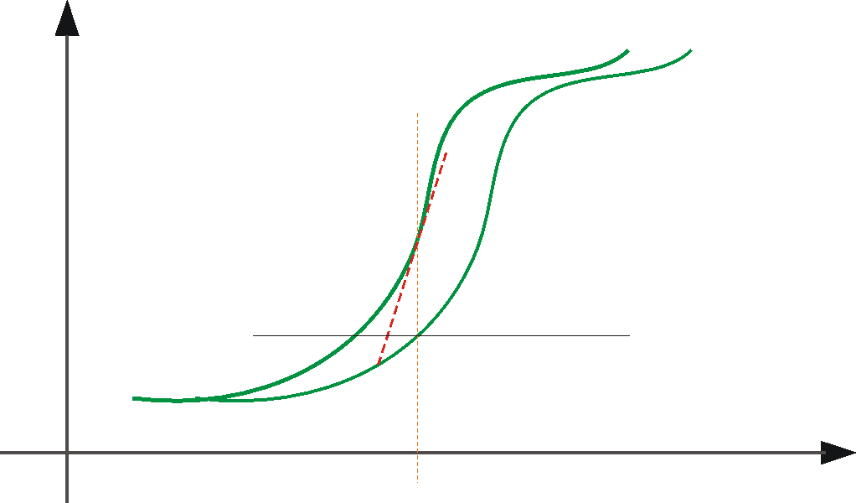





Optical Flow: Iterative Estimation
estimate update
Initial guess:
Estimate:
x₀
x
(using d for displacement here instead of u)

Slide 35
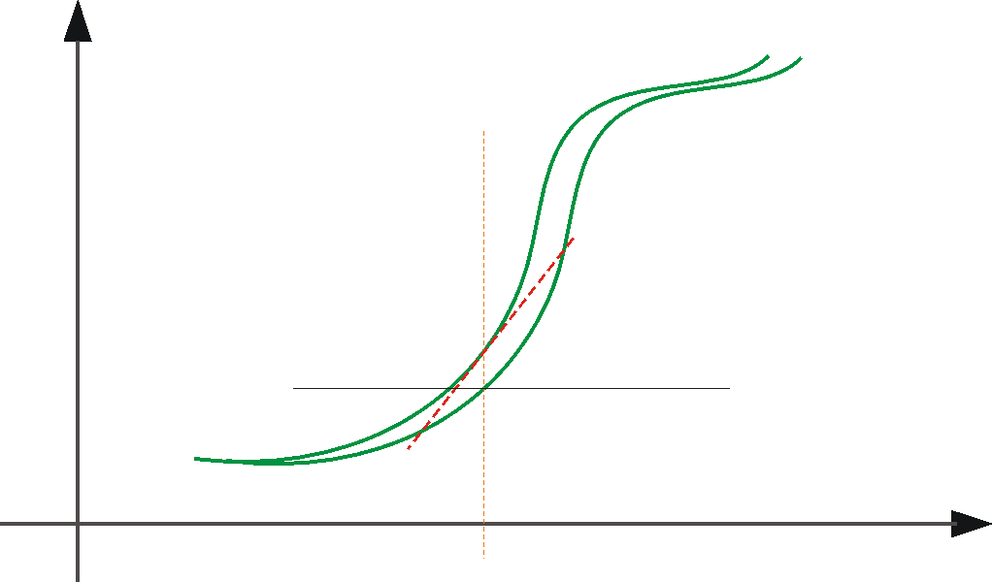



Optical Flow: Iterative Estimation
estimate update
Initial guess:
Estimate:
x₀
x

Slide 36
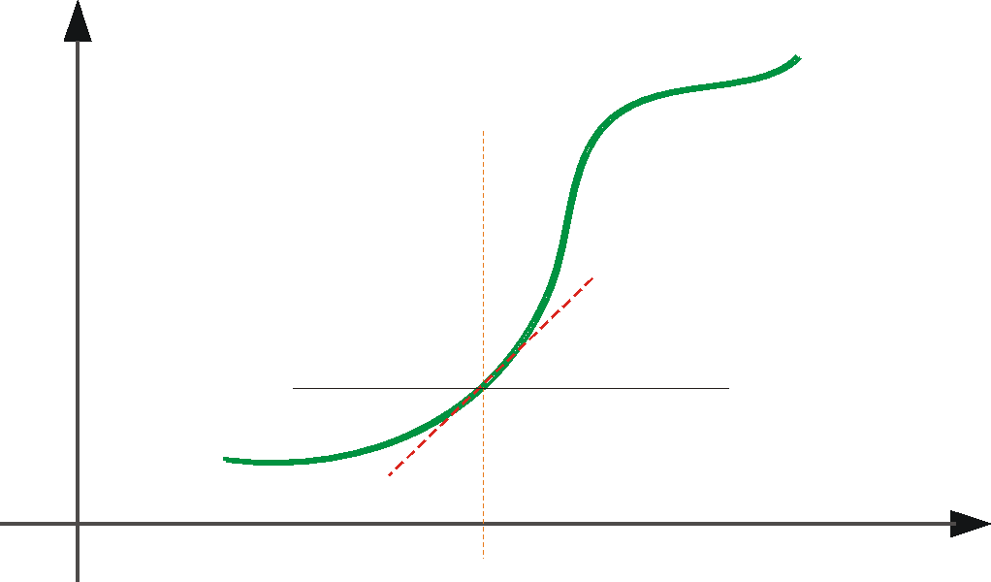



Optical Flow: Iterative Estimation
estimate update
Initial guess:
Estimate:
Initial guess:
Estimate:
x₀
x

Slide 37
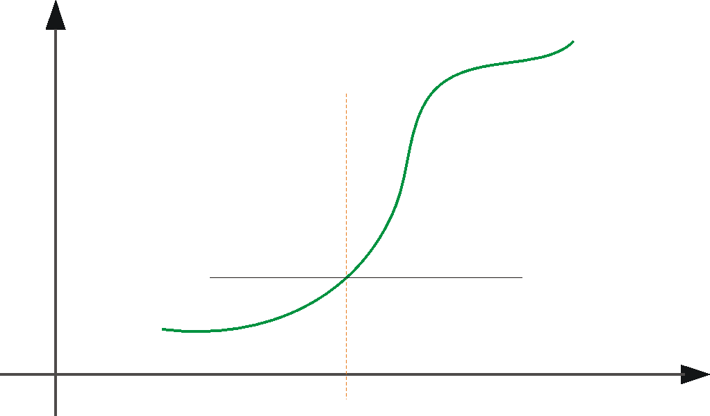

Optical Flow: Iterative Estimation
x₀
x

Slide 38
Optical Flow: Iterative Estimation
Some Implementation Issues:
  Warping is not easy (ensure that errors in warping are smaller than the estimate refinement) – but it is in MATLAB!
  Often useful to low-pass filter the images before motion estimation (for better derivative estimation, and linear approximations to image intensity)

Slide 39
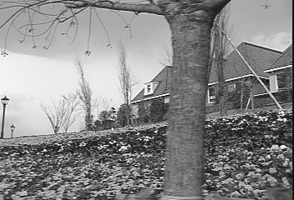
Revisiting the small motion assumption
Is this motion small enough?
  Probably not—it’s much larger than one pixel
  How might we solve this problem?

Slide 40


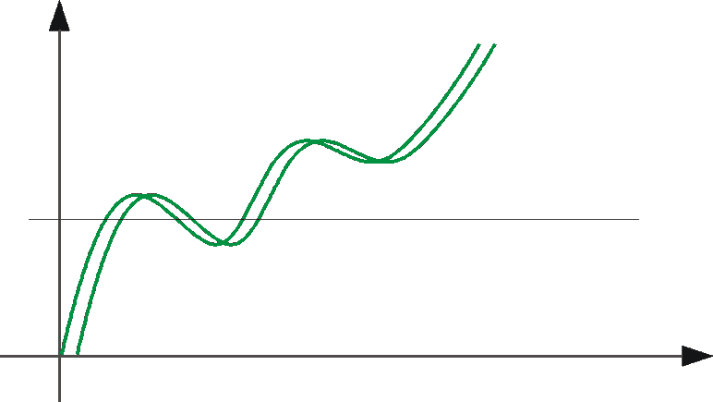
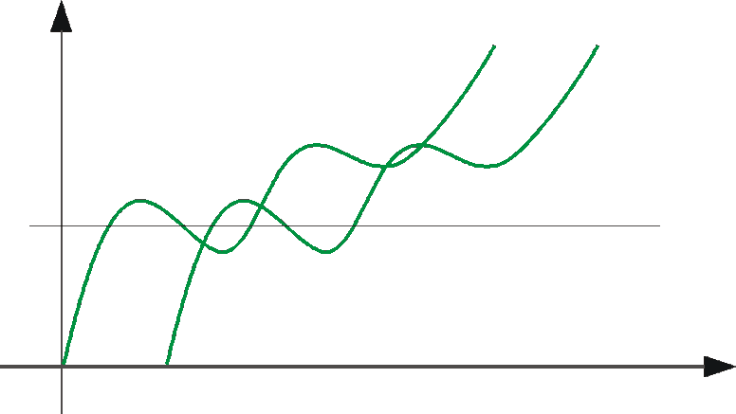
Optical Flow: Aliasing
Temporal aliasing causes ambiguities in optical flow because images can have many pixels with the same intensity.
I.e., how do we know which ‘correspondence’ is correct?
actual shift
estimated shift
nearest match is correct (no aliasing)
nearest match is incorrect (aliasing)
To overcome aliasing: coarse-to-fine estimation.

Slide 41
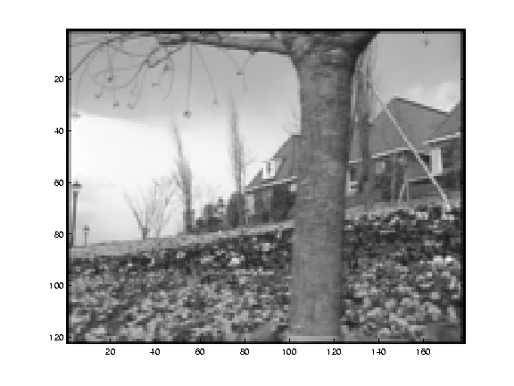
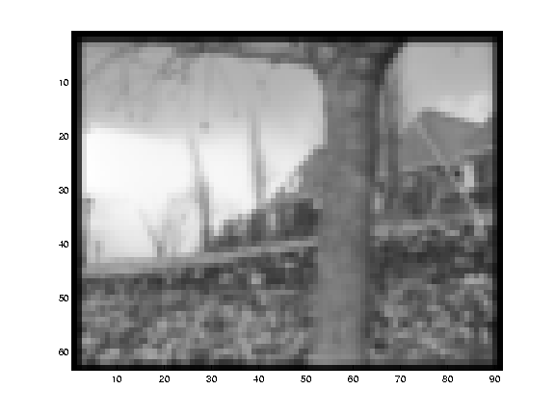
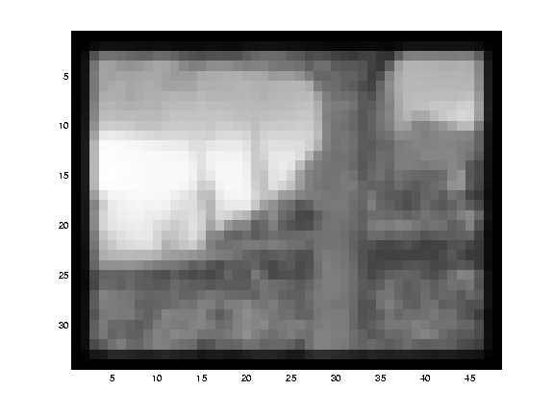
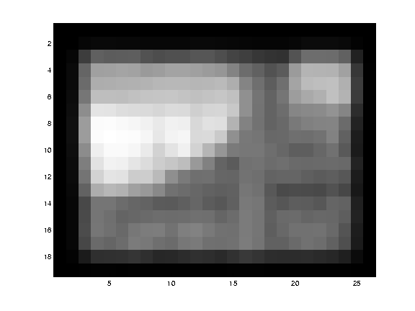
Reduce the resolution!

Slide 42
Coarse-to-fine optical flow estimation
u=1.25 pixels
u=2.5 pixels
u=5 pixels
image 1
u=10 pixels
image 2
image 1
image 2
Gaussian pyramid of image 1
Gaussian pyramid of image 2

Slide 43
Coarse-to-fine optical flow estimation
run iterative L-K
warp & upsample
run iterative L-K
.
.
.
image J
image I
image 1
image 2
Gaussian pyramid of image 1
Gaussian pyramid of image 2

Slide 44
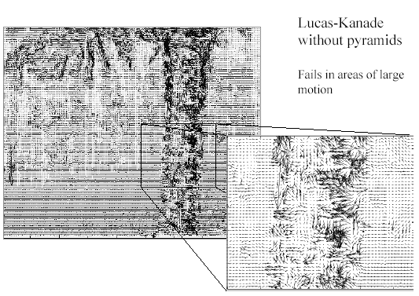
Optical Flow Results
* From Khurram Hassan-Shafique CAP5415 Computer Vision 2003

Slide 45
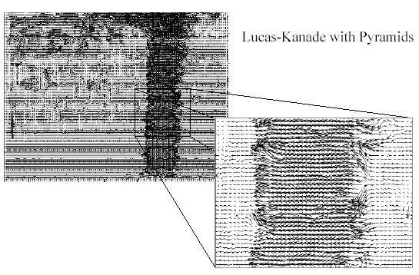
Optical Flow Results
* From Khurram Hassan-Shafique CAP5415 Computer Vision 2003

Slide 46
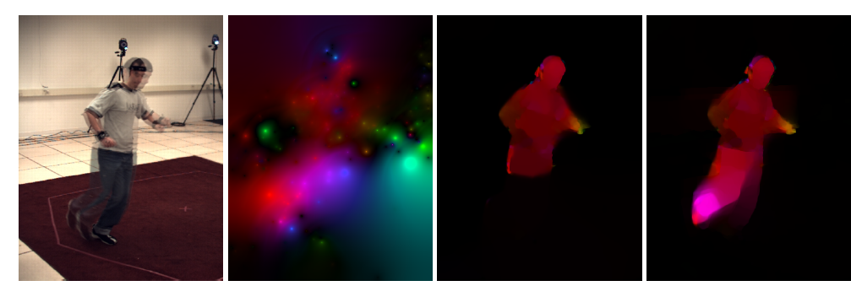
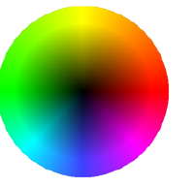
State-of-the-art optical flow, 2009
Start with something similar to Lucas-Kanade
+ gradient constancy
+ energy minimization with smoothing term
+ region matching
+ keypoint matching (long-range)
Region-based
+Pixel-based
+Keypoint-based
Large displacement optical flow, Brox et al., CVPR 2009

Slide 47
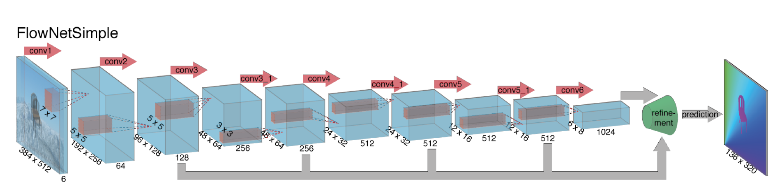
State-of-the-art optical flow, 2015
Deep convolutional network which accepts a pair of input frames and upsamples the estimated flow back to input resolution. Very fast because of deep network, near the state-of-the-art in terms of end-point-error.
Fischer et al. 2015. https://arxiv.org/abs/1504.06852
Notes:
Optical flow as supervised learning

Slide 48
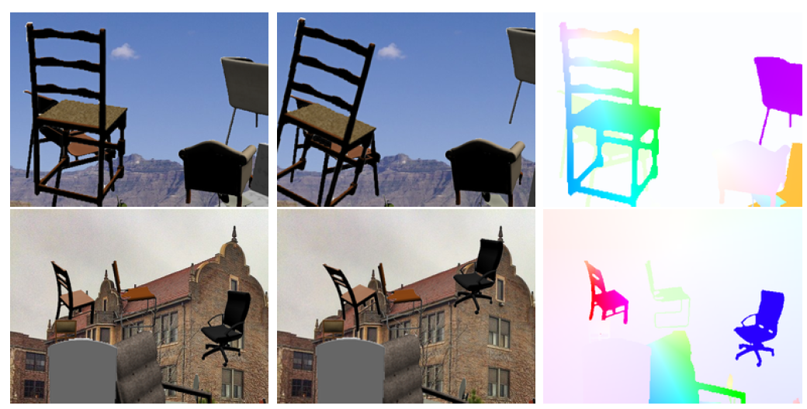
Deep optical flow, 2015
Synthetic Training data
Fischer et al. 2015. https://arxiv.org/abs/1504.06852

Slide 49
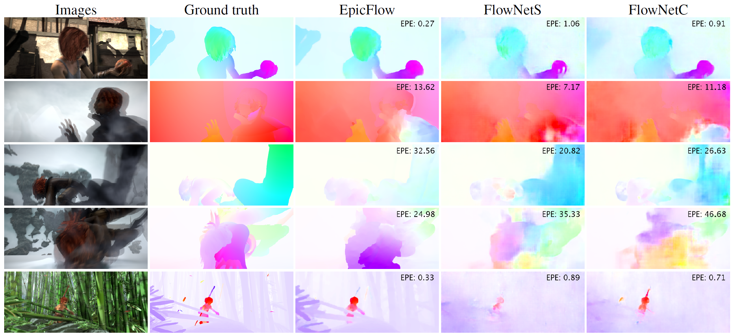
Deep optical flow, 2015
Results on Sintel
Fischer et al. 2015. https://arxiv.org/abs/1504.06852

Slide 50
Optical flow
Definition: optical flow is the apparent motion of brightness patterns in the image
Ideally, optical flow would be the same as the motion field
Have to be careful: apparent motion can be caused by lighting changes without any actual motion
  Think of a uniform rotating sphere under fixed lighting vs. a stationary sphere under moving illumination

