Slide 1
Object Detection Wrapup

Slide 2
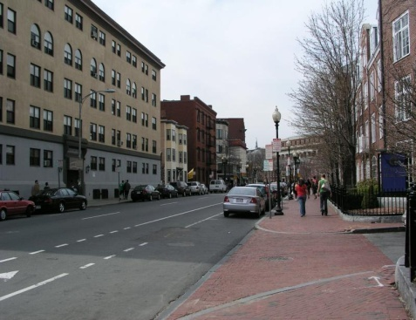
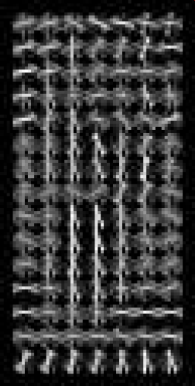
Things to remember
Sliding window for search
Features based on differences of intensity (gradient, wavelet, etc.)
Excellent results require careful feature design
Boosting for feature selection
Integral images, cascade for speed
Bootstrapping to deal with many, many negative examples
Stage 1
H₁(x) > t₁?
Yes
Stage 2
H₂(x) > t₂?
…
Stage N
H_{N}(x) > t_{N}?
Yes
Pass
Examples
No
No
No
Reject
Reject
Reject

Slide 3
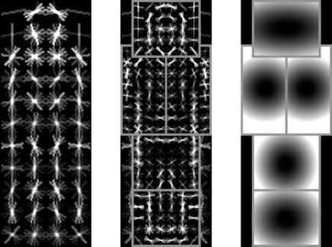
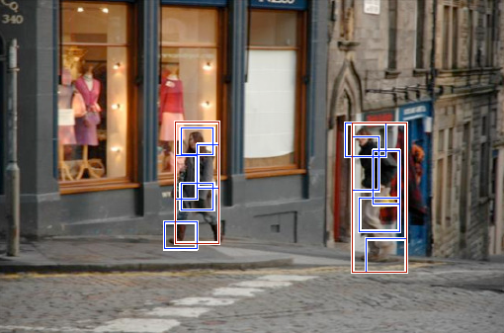
Discriminative part-based models
Root filter
Part filters
Deformation weights
P. Felzenszwalb, R. Girshick, D. McAllester, D. Ramanan, Object Detection with Discriminatively Trained Part Based Models, PAMI 32(9), 2010

Slide 4
Car model
Component 1
Component 2

Slide 5
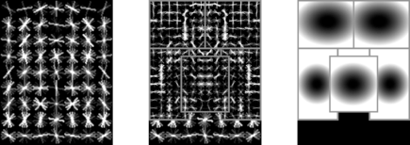
Person model

Slide 6
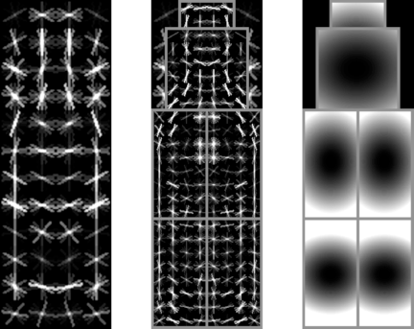
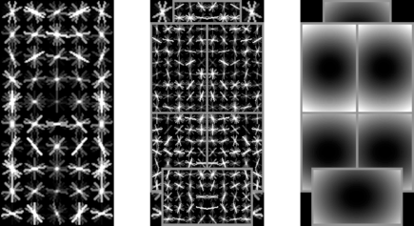
Bottle model

Slide 7
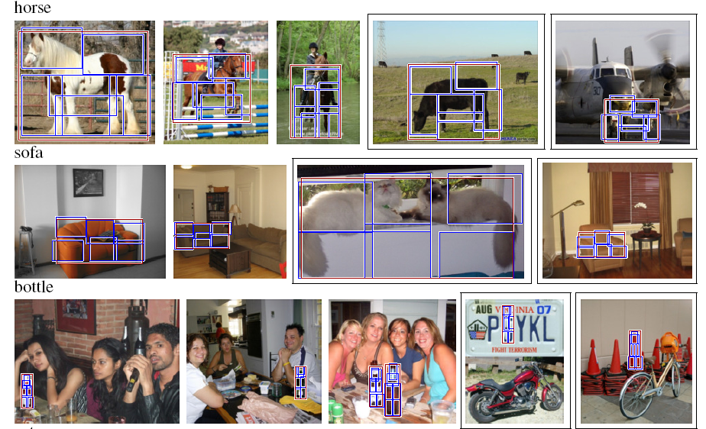
More detections

Slide 8
Twenty object categories (aeroplane to TV/monitor)
Three challenges:
Classification challenge (is there an X in this image?)
Detection challenge (draw a box around every X)
Segmentation challenge
Slides from Noah Snavely

Slide 13
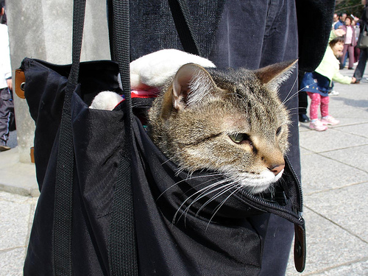
is
is there a cat?

Slide 17
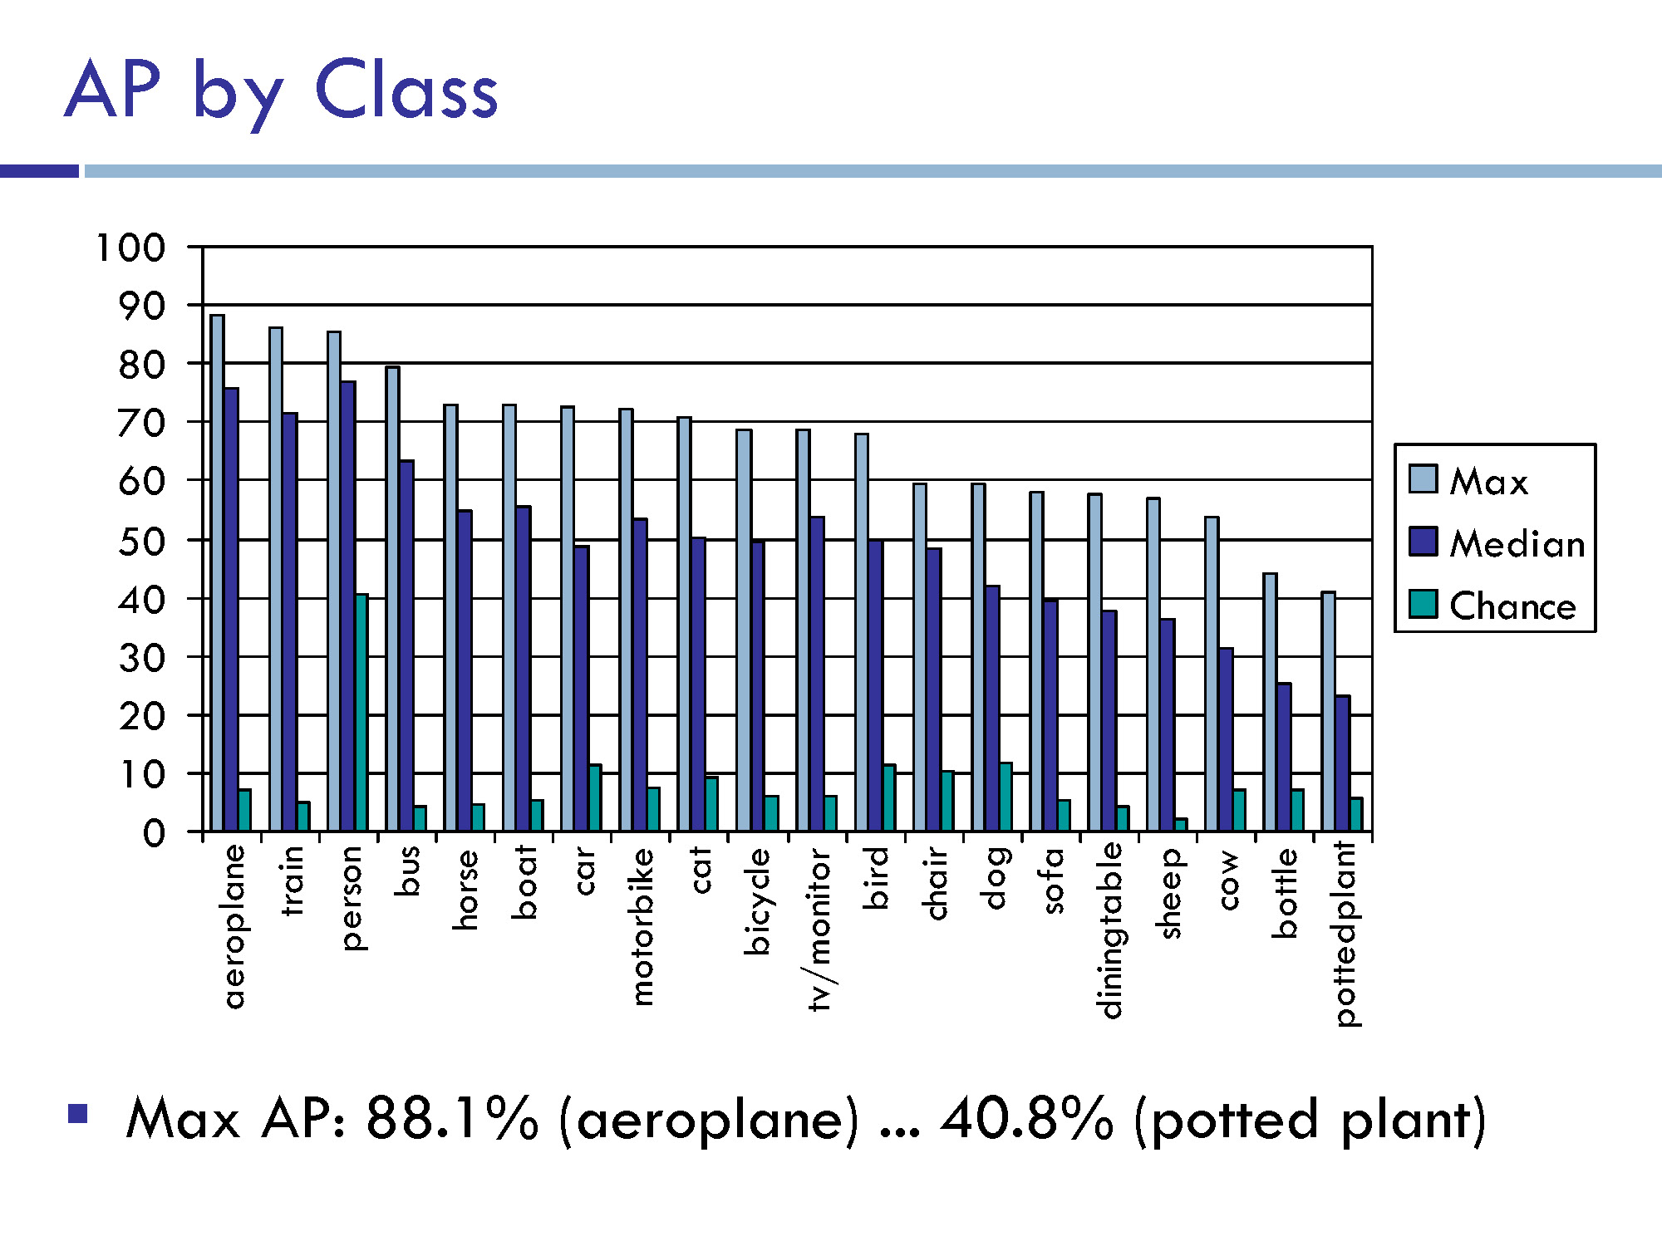

Slide 22
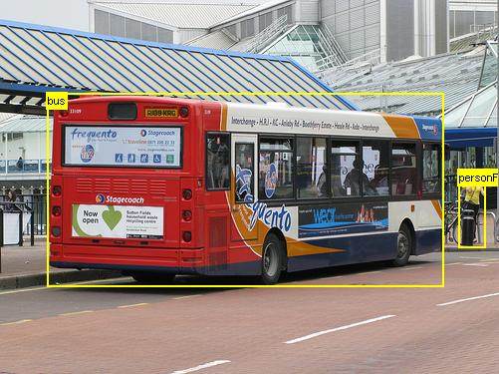

Slide 24
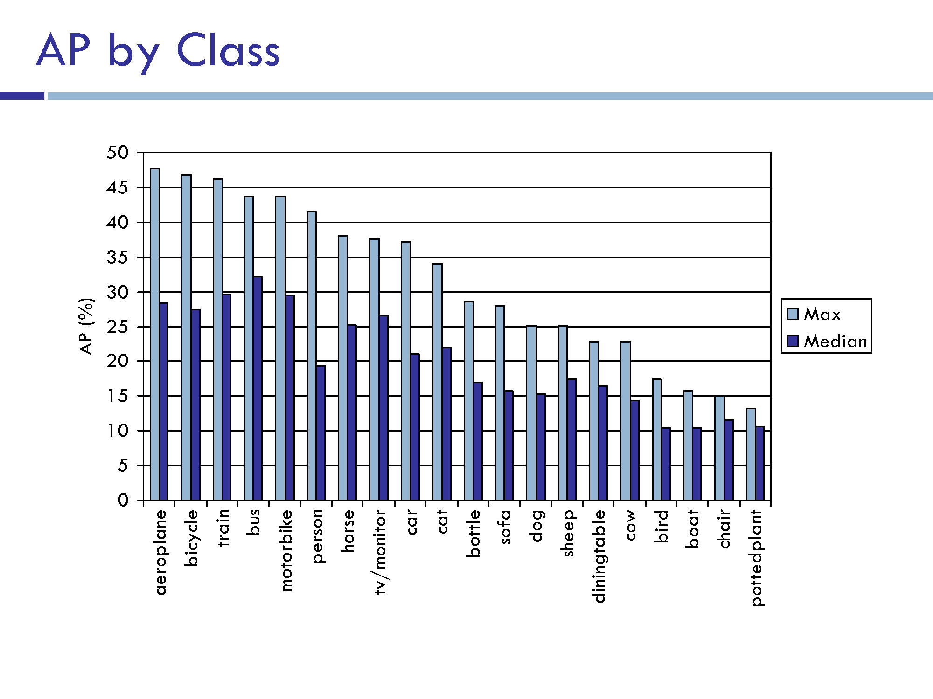
Chance essentially 0

Slide 34
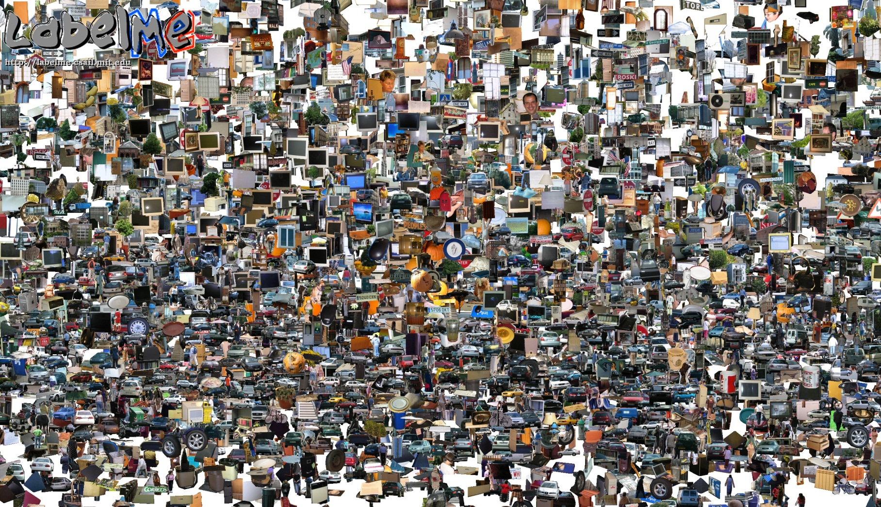
Opportunities of Scale
Computer Vision
James Hays
Many slides from James Hays, Alyosha Efros, and Derek Hoiem
Graphic from Antonio Torralba

Slide 35
Computer Vision so far
The geometry of image formation
Ancient / Renaissance
Signal processing / Convolution
1800, but really the 50’s and 60’s
Hand-designed Features for recognition, either instance-level or categorical
1999 (SIFT), 2003 (Video Google), 2005 (Dalal-Triggs), 2006 (spatial pyramid)
Learning from Data
1991 (EigenFaces) but late 90’s to now especially
Notes:
Omitting tracking / Multiview

Slide 36
What has changed in the last decade?
The Internet
Crowdsourcing
Learning representations from the data these sources provide (deep learning)

Slide 37
Opportunities of Scale: Data-driven methods
Scene completion (Today’s class)
Im2gps

Slide 38
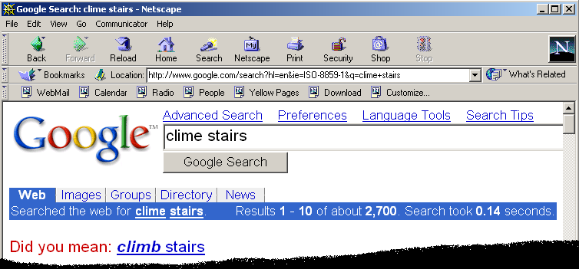
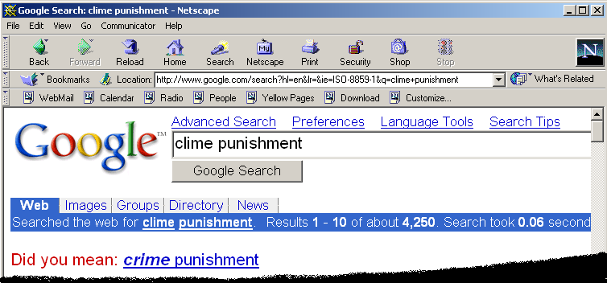
Google and massive data-driven algorithms
A.I. for the postmodern world:
all questions have already been answered…many times, in many ways
Google is dumb, the “intelligence” is in the data

Slide 41
Google Translate
http://ackuna.com/badtranslator
Notes:
http://translationparty.com/#9988025
http://ackuna.com/badtranslator

Slide 42
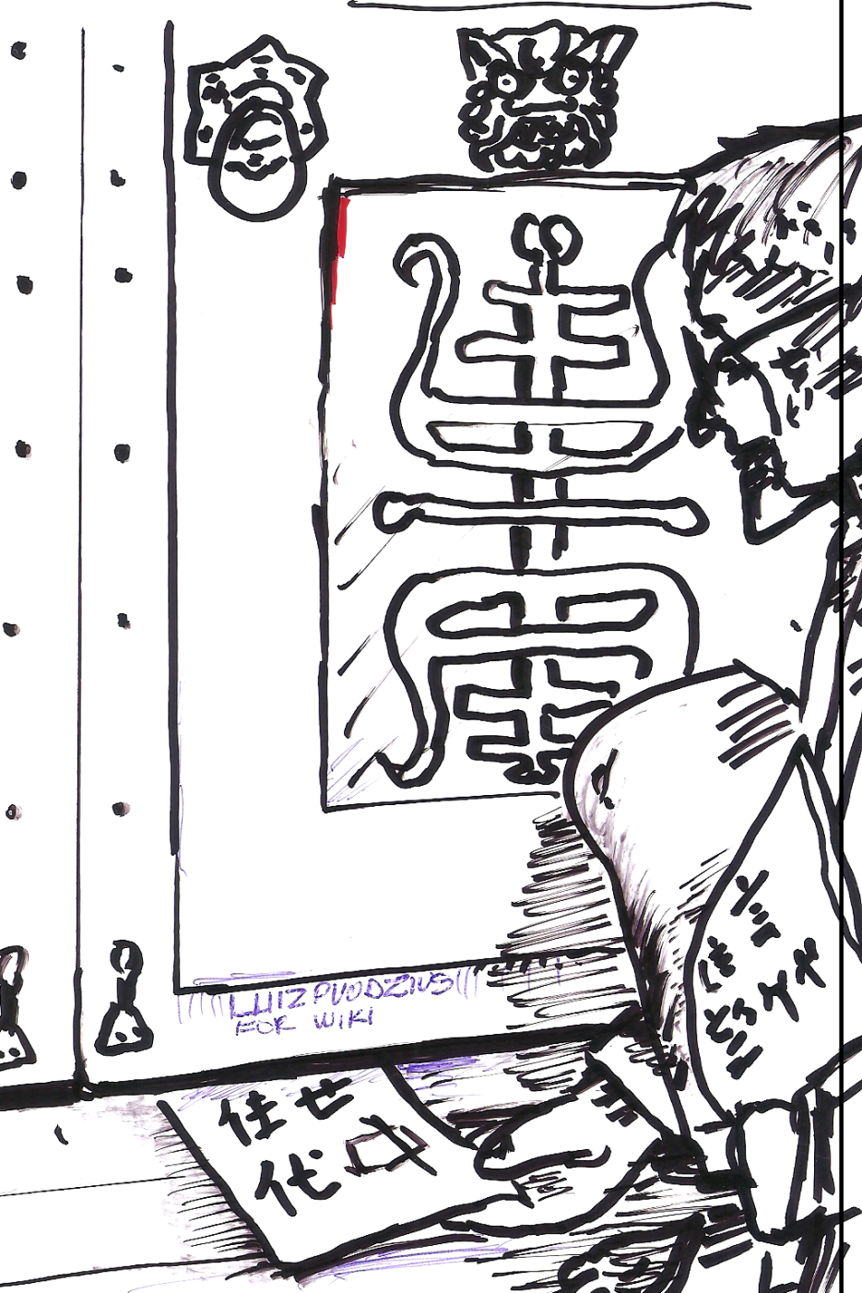
Chinese Room, John Searle (1980)
If a machine can convincingly simulate an intelligent conversation, does it necessarily understand? In the experiment, Searle imagines himself in a room, acting as a computer by manually executing a program that convincingly simulates the behavior of a native Chinese speaker.
Most of the discussion consists of attempts to refute it. "The overwhelming majority," notes BBS editor Stevan Harnad,“ still think that the Chinese Room Argument is dead wrong." The sheer volume of the literature that has grown up around it inspired Pat Hayes to quip that the field of cognitive science ought to be redefined as "the ongoing research program of showing Searle's Chinese Room Argument to be false.
Notes:
The experiment is the centerpiece of Searle's Chinese Room Argument which holds that a program cannot give a computer a "mind" or "understanding", regardless of how intelligently it may make it behave. He concludes that "programs are neither constitutive of nor sufficient for minds." "I can have any formal program you like, but I still understand nothing."
Searle “according to strong AI, . . . the appropriately programmed computer really is a mind, in the sense that computers given the right programs can be literally said to understand and have other cognitive states.”

Slide 44
Big Idea
Do we need computer vision systems to have strong AI-like reasoning about our world?
What if invariance / generalization isn’t actually the core difficulty of computer vision?
What if we can perform high level reasoning with brute-force, data-driven algorithms?

Slide 45
Image Completion Example
[Hays and Efros. Scene Completion Using Millions of Photographs. SIGGRAPH 2007 and CACM October 2008.]
http://graphics.cs.cmu.edu/projects/scene-completion/

Slide 46
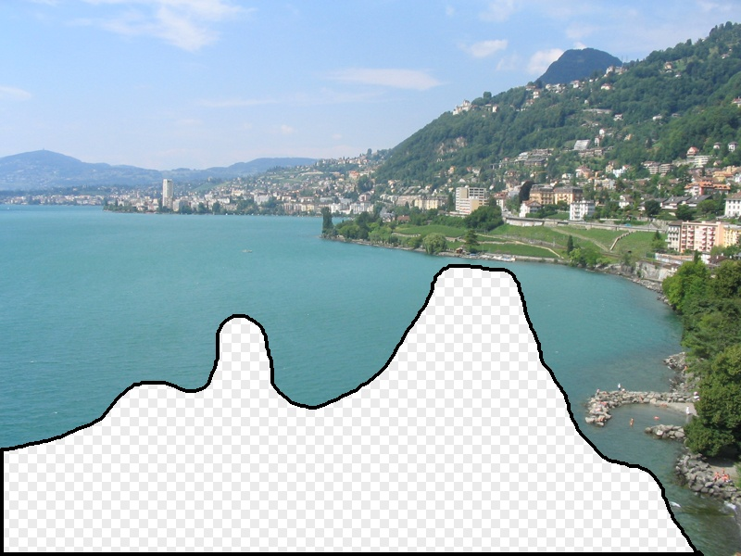
What should the missing region contain?
Notes:
46
What should go here and why?

Slide 47
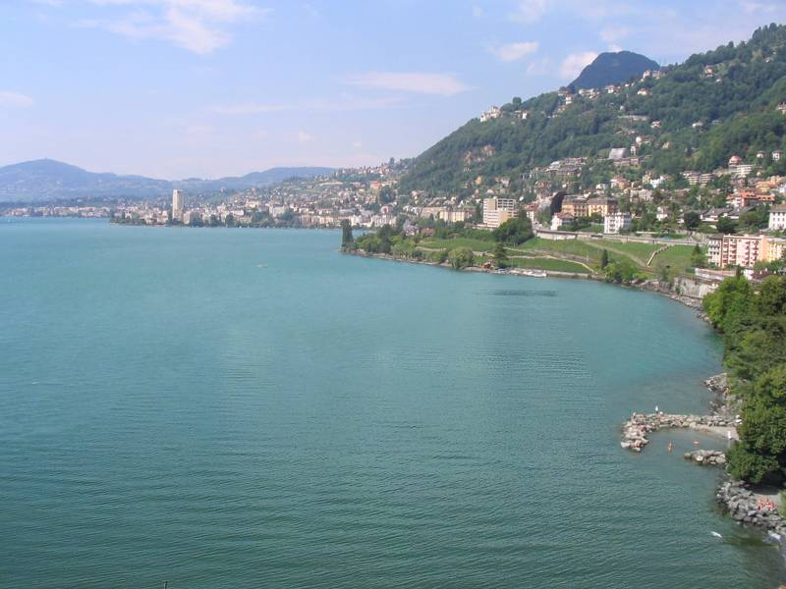

Slide 48
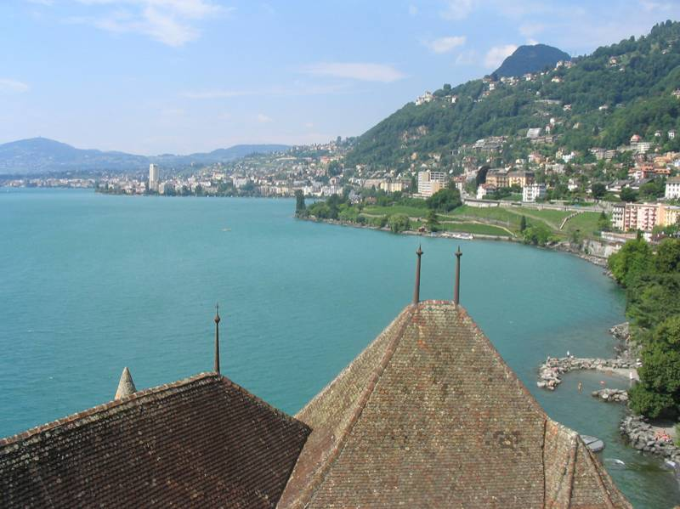
Notes:
48
Introduce gist.

Slide 49
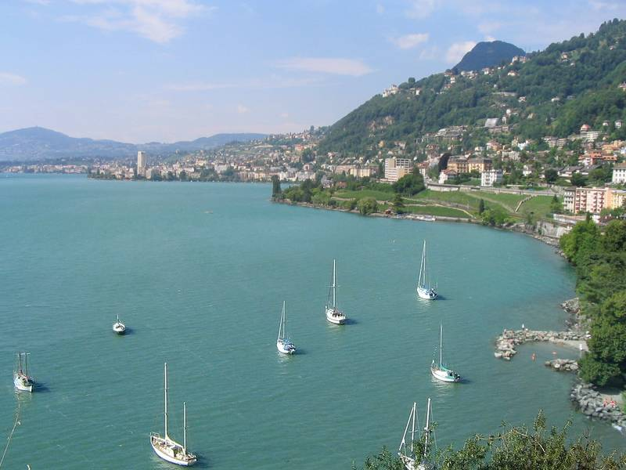

Slide 50
Which is the original?
(a)
(c)
(b)

Slide 51
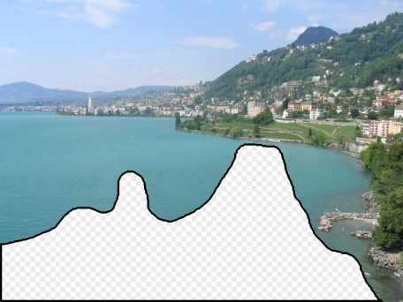
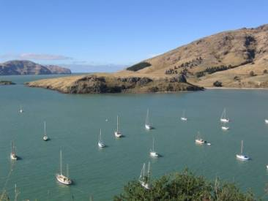
How it works
Find a similar image from a large dataset
Blend a region from that image into the hole
Dataset

Slide 52
General Principal
Huge Dataset
Images
image
matching
Info from Most Similar Images
Input Image
Associated Info
Hopefully, If you have enough images, the dataset will contain very similar images that you can find with simple matching methods.

Slide 53
How many images is enough?

Slide 54
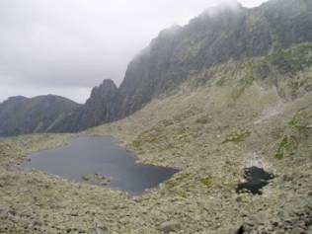
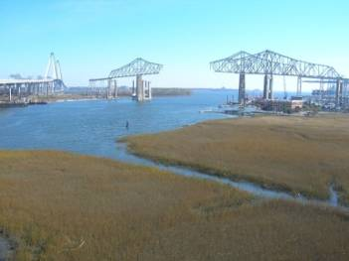
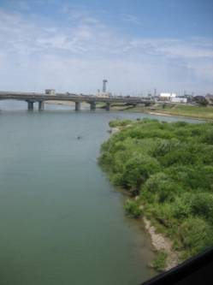
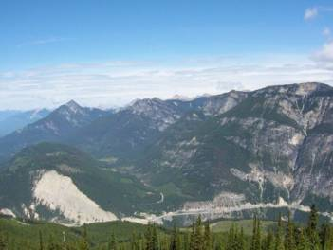
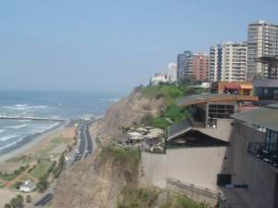
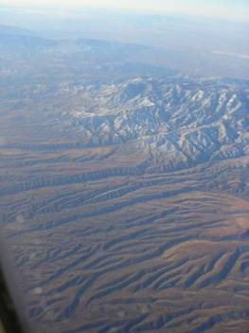
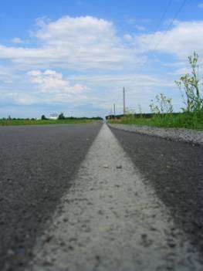
Nearest neighbors from a collection of 20 thousand images
Notes:
54

Slide 55
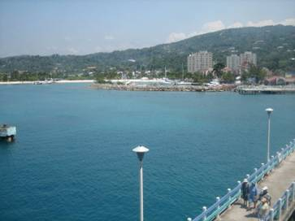
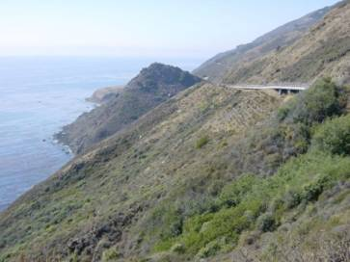
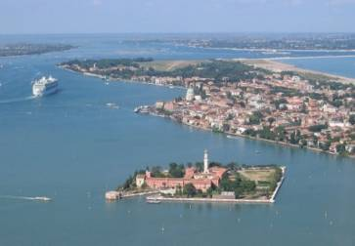
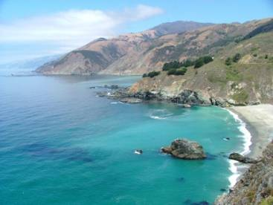
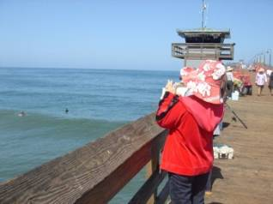
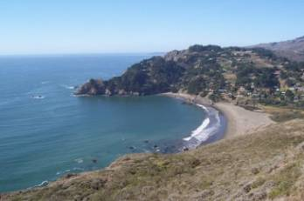
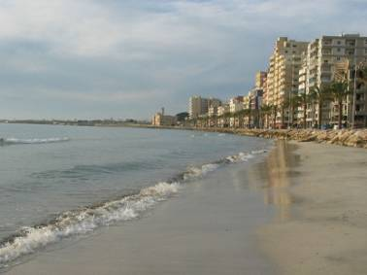
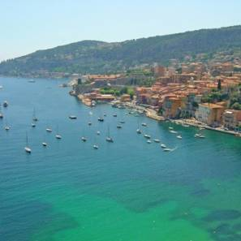
Nearest neighbors from a collection of 2 million images
Notes:
55

Slide 56
Image Data on the Internet
Flickr (as of Sept. 19th, 2010)
5 billion photographs
100+ million geotagged images
Facebook (as of 2009)
15 billion
http://royal.pingdom.com/2010/01/22/internet-2009-in-numbers/

Slide 57
Image Data on the Internet
Flickr (as of Nov 2013)
10 billion photographs
100+ million geotagged images
3.5 million a day
Facebook (as of Sept 2013)
250 billion+
300 million a day
Instagram
55 million a day

Slide 58
Image completion: how it works
[Hays and Efros. Scene Completion Using Millions of Photographs. SIGGRAPH 2007 and CACM October 2008.]

Slide 59
The Algorithm
Notes:
59
Introduce gist.

Slide 60
Scene Matching
Notes:
60
Introduce gist.

Slide 61
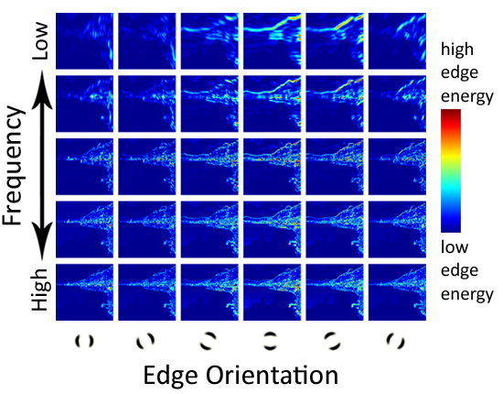
Scene Descriptor
Notes:
Edge energy is just the magnitude of directional derivatives of image intensity.
61

Slide 62
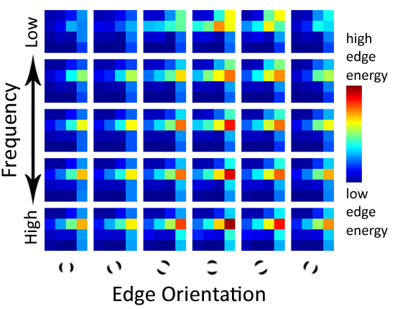
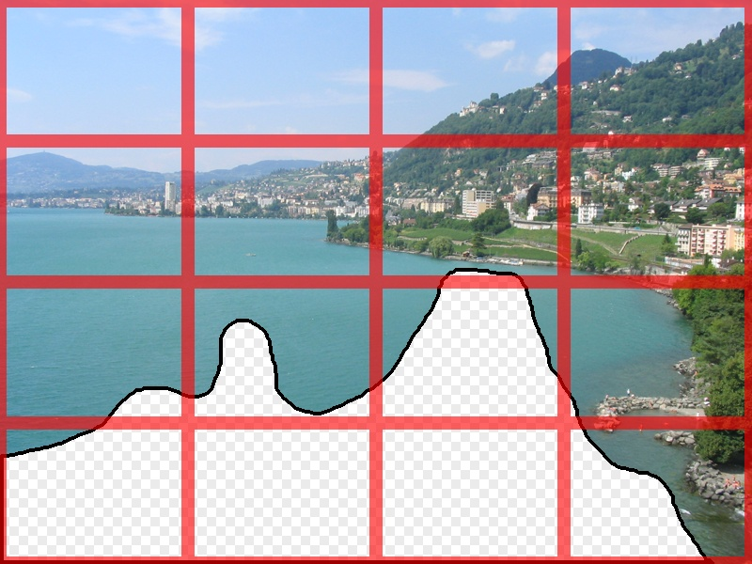
Scene Descriptor
Scene Gist Descriptor (Oliva and Torralba 2001)

Slide 63
Scene Descriptor
+
Scene Gist Descriptor (Oliva and Torralba 2001)

Slide 64
2 Million Flickr Images
Notes:
64
Now we take our gist (and mask and color image) and find it’s L2 nearest neighbors in the database of 2.3 million images, and here they are

Slide 65
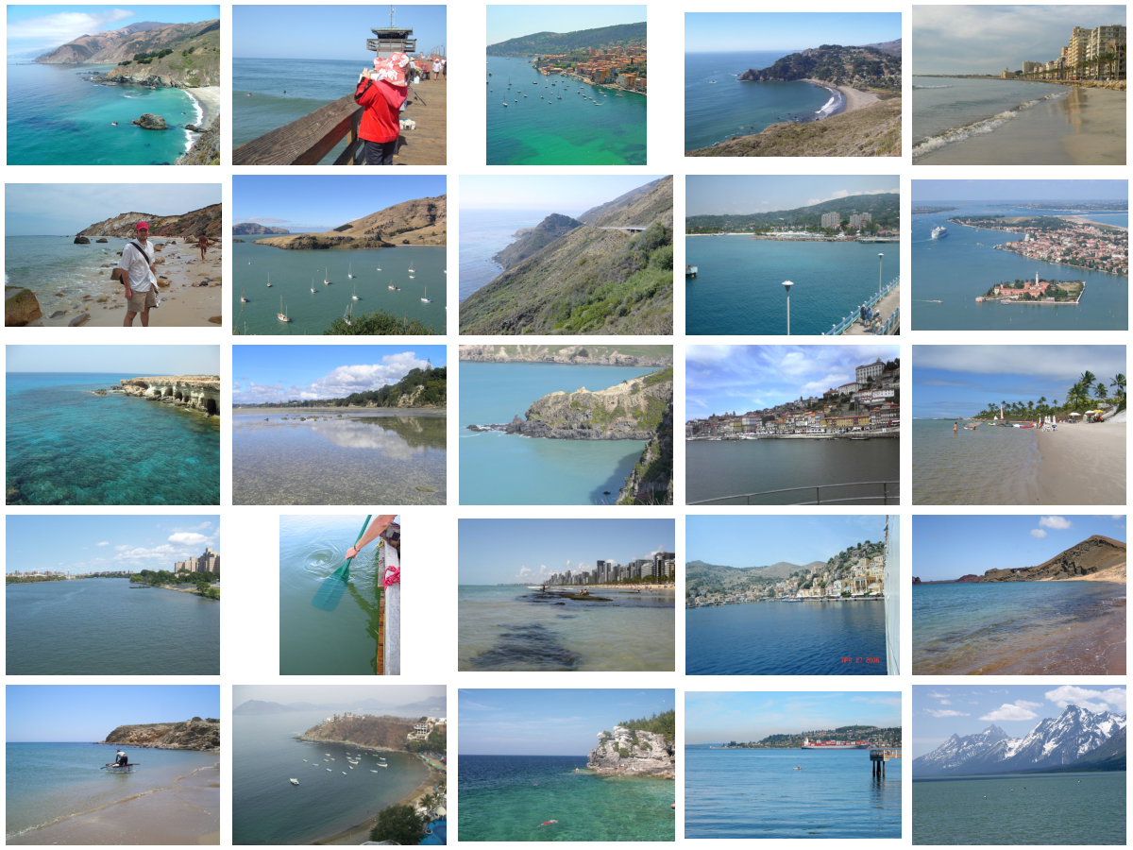
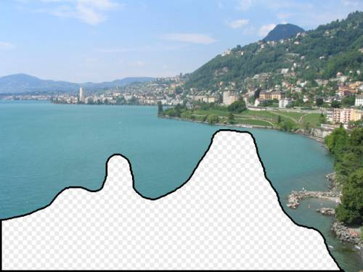
… 200 total
Notes:
65

Slide 66
Context Matching

Slide 67
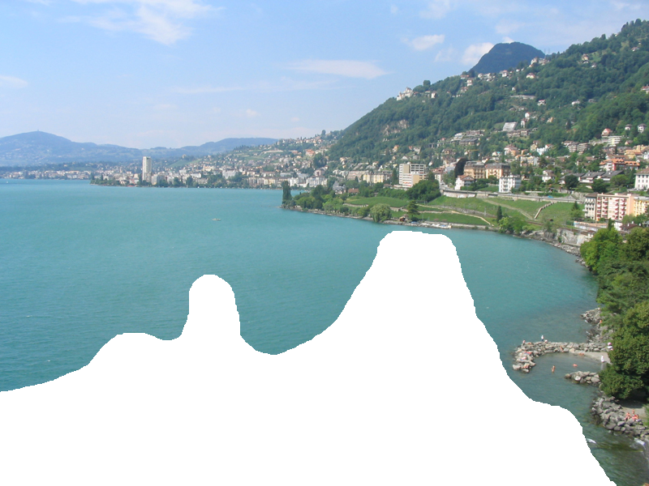
Graph cut + Poisson blending

Slide 68
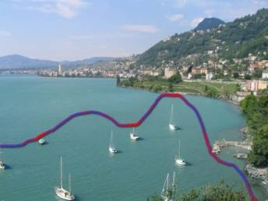
Result Ranking
We assign each of the 200 results a score which is the sum of:
The scene matching distance
The context matching distance (color + texture)
The graph cut cost
Notes:
68
Johnson et al. used the graph cut cost to sort results for users in Semantic Photo Synthesis

Slide 70
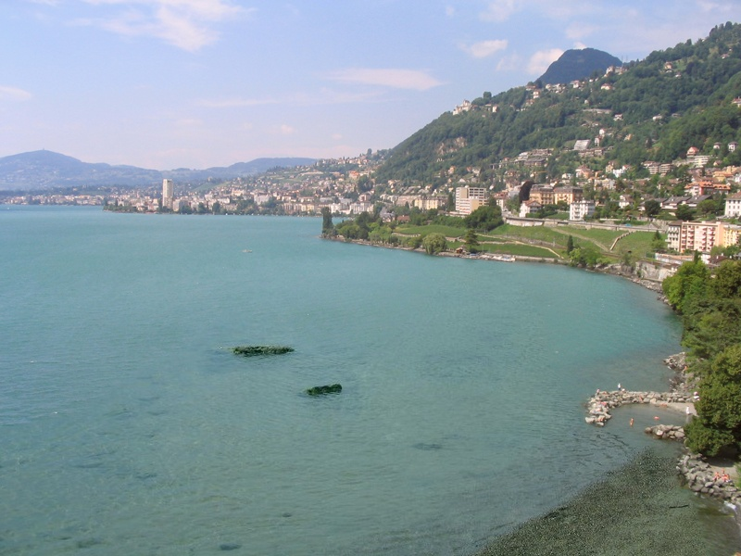

Slide 71
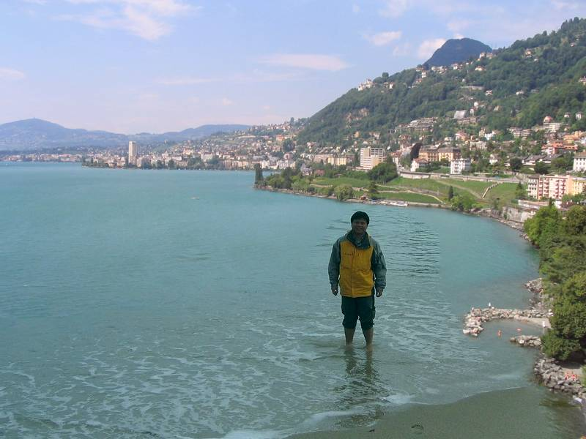

Slide 73
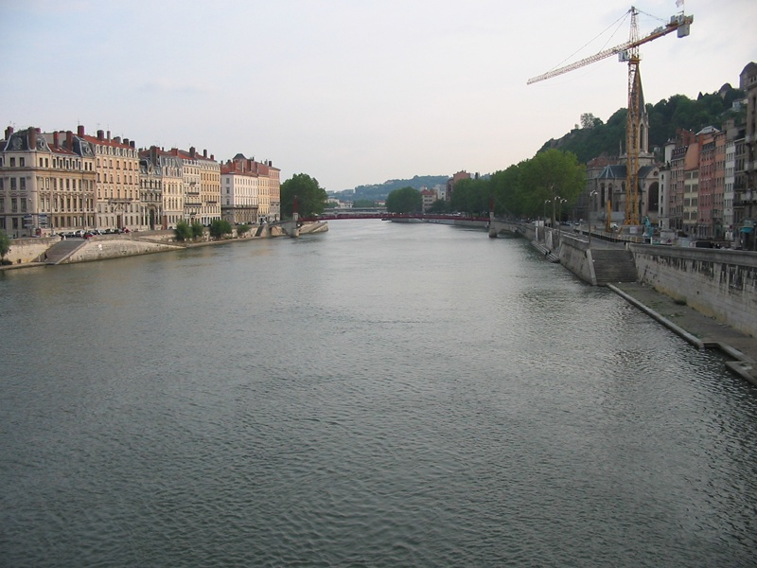
Notes:
73

Slide 74
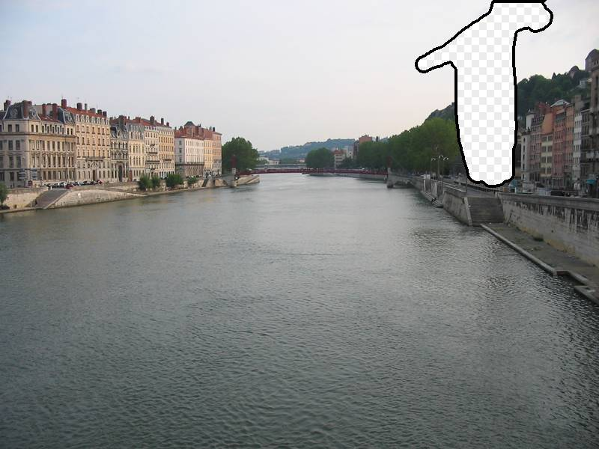
Notes:
74

Slide 75
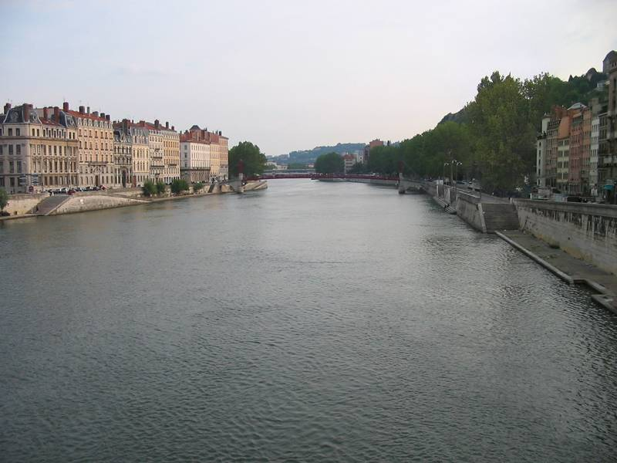
Notes:
75

Slide 76
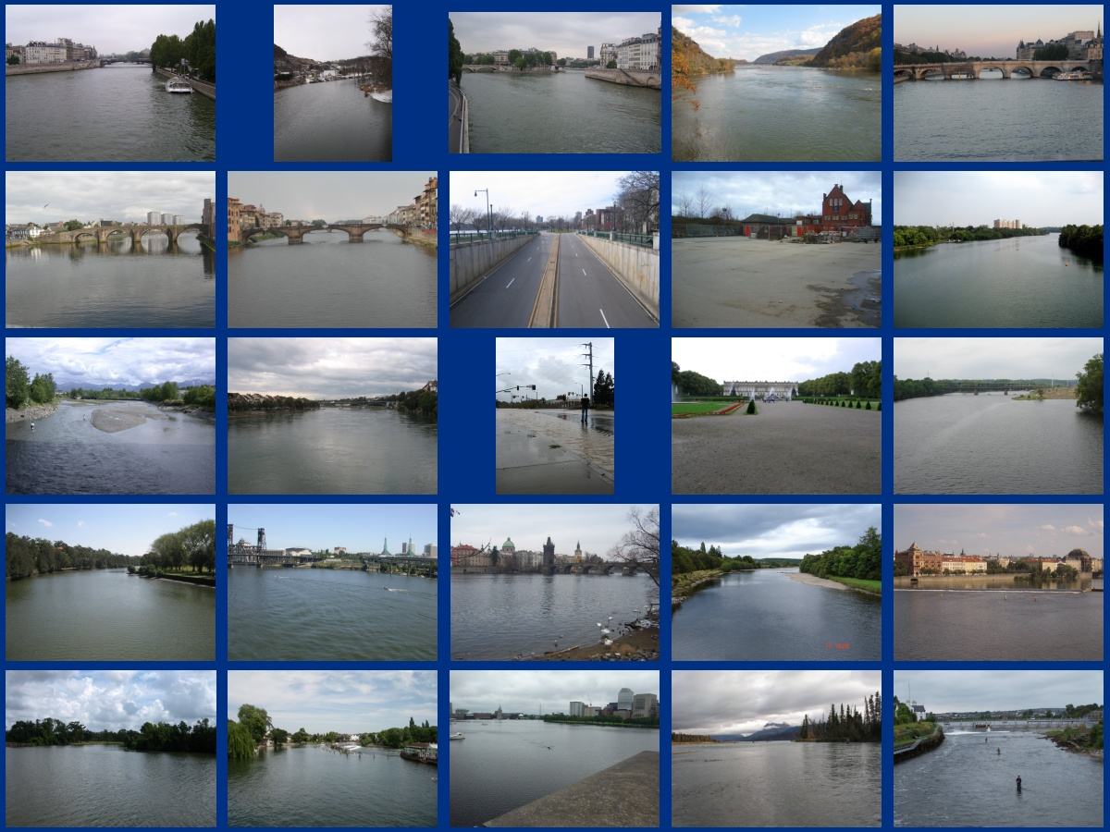
… 200 scene matches
Notes:
76

Slide 77
Notes:
77
Not actually the same scene, even though they’re startlingly similar

Slide 82
Which is the original?

Slide 84
Notes:
84

Slide 85
Notes:
85
Can justify broader use of image completion here

Slide 86
Diffusion Result
Notes:
86

Slide 87
Efros and Leung result
Notes:
87
Efros and leung result

Slide 88
Scene Completion Result

