Slide 1
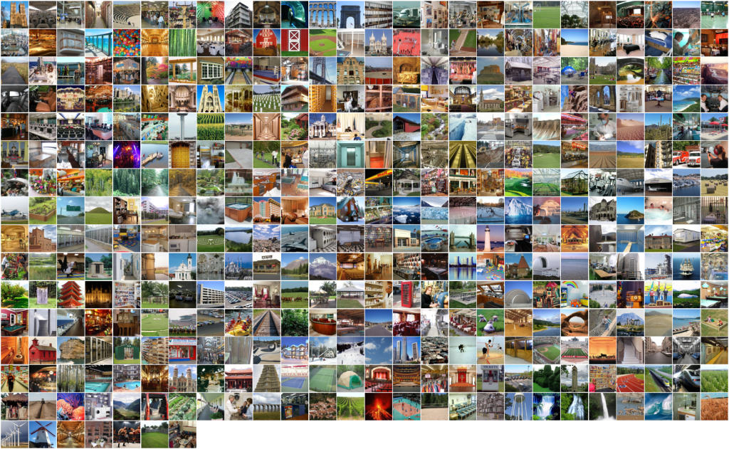
Large-scale category recognition
and
Advanced feature encoding
Computer Vision
James Hays

Slide 2
Why do good recognition systems go bad?
E.g. Why isn’t our Bag of Words classifier at 90% instead of 70%?
Training Data
  Huge issue, but not necessarily a variable you can manipulate.
Representation
  Are the local features themselves lossy?
  What about feature quantization? That’s VERY lossy.
Learning method
  Probably not such a big issue, unless you’re learning the representation (e.g. deep learning).

Slide 3
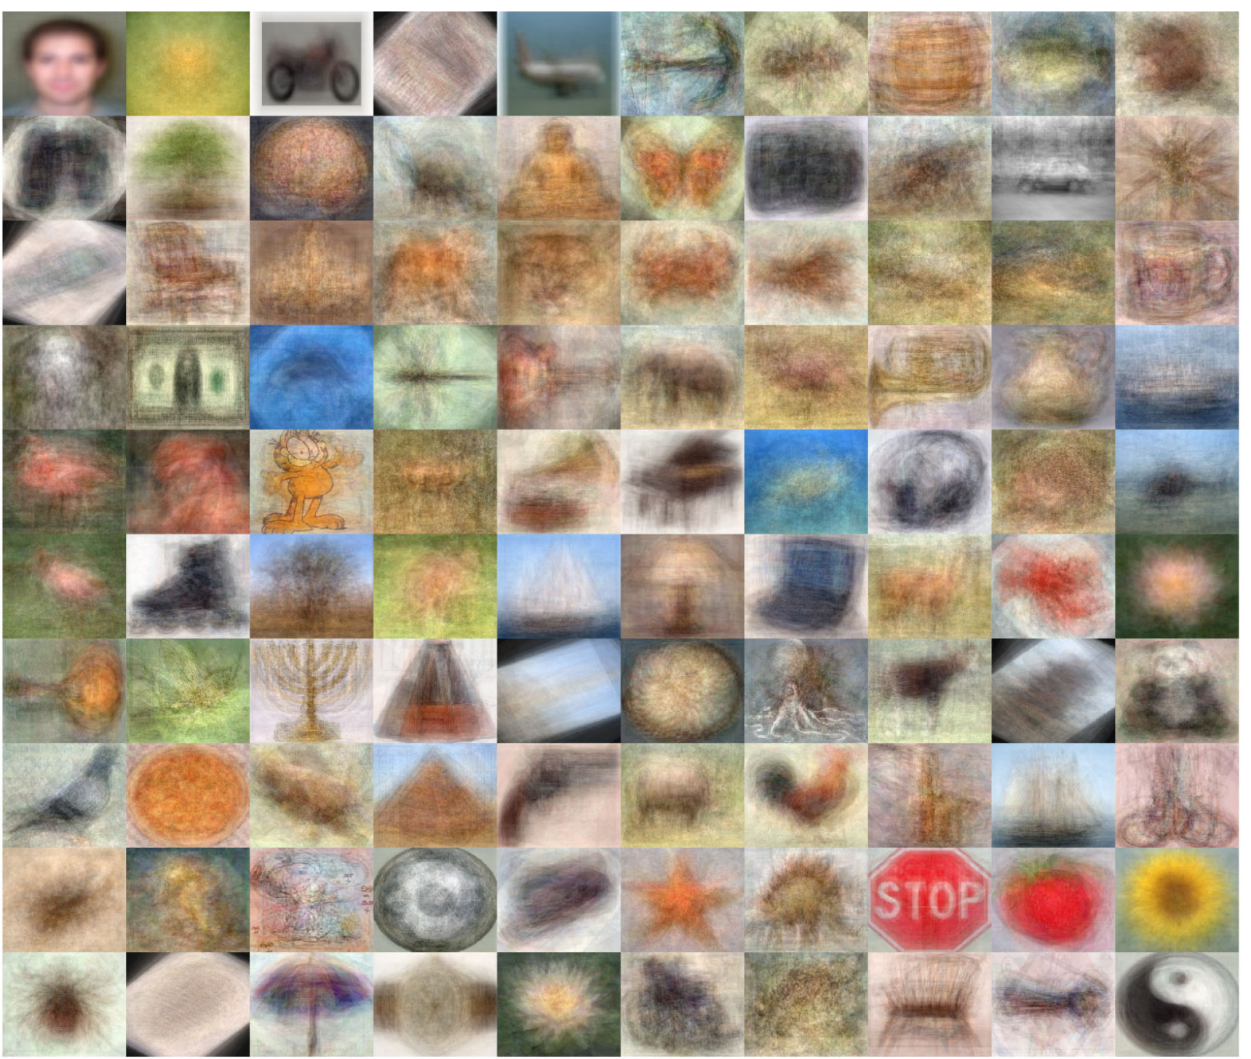
CalTech 101 - 2004

Slide 4
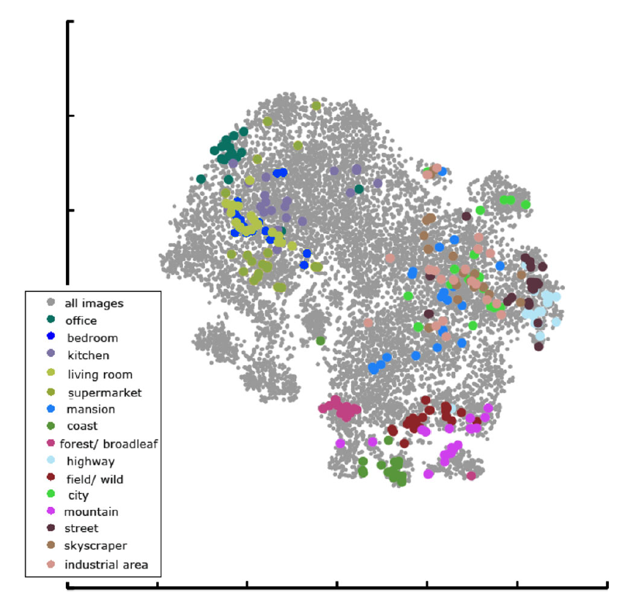
The SUN Attribute Database: Beyond Categories for Deeper Scene Understanding.
Genevieve Patterson, Chen Xu, Hang Su, and James Hays.
International Journal of Computer Vision. vol. 108:1-2, 2014. Pp 59-81.

Slide 5
SUN Database: Large-scale Scene Categorization and Detection
Jianxiong Xiao, James Hays†, Krista A. Ehinger, Aude Oliva, Antonio Torralba
Massachusetts Institute of Technology
† Brown University
Notes:
presented at VSS 2010

Slide 6
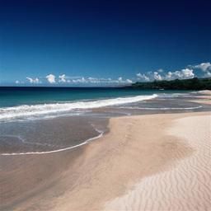
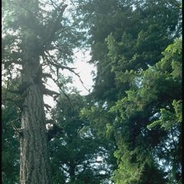
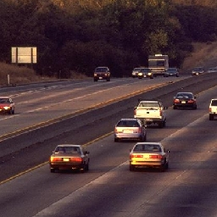
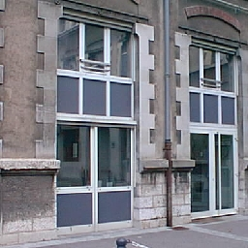
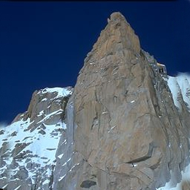
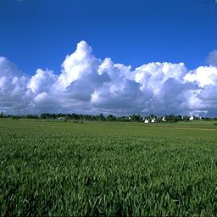
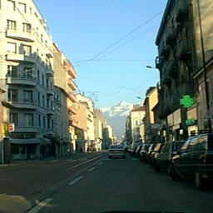
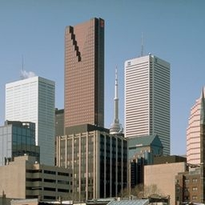
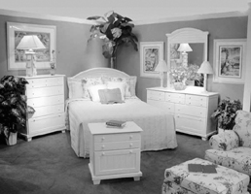
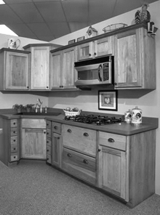
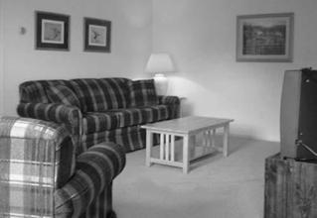
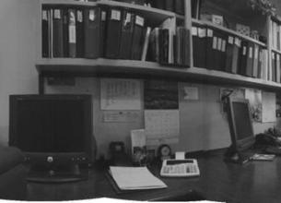
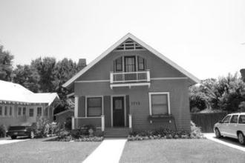
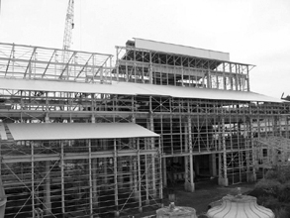
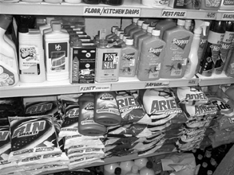
Scene Categorization
Oliva and Torralba, 2001
Coast
Forest
Highway
Inside City
Mountain
Open Country
Street
Tall Building
Fei Fei and Perona, 2005
+
Bedroom
Kitchen
Living Room
Office
Suburb
Lazebnik, Schmid, and Ponce, 2006
+
15 Scene Database
Industrial
Store
Notes:
Scene categorization is an important task for humans and computers. The task is – given a picture, identify the place that it depicts. Scene categorization lets us know the function of our environment and provides context for deeper image understanding.
This slide shows the incrementally built 15 scene database which is the standard scene recognition benchmark in the computer vision community. It has enabled significant progress in computational scene understanding. But it is very small. Clearly there are many additional scene categories that are relevant for human and computer vision.
Instead of just collecting a larger database, we would like to collect all scene categories. So, how many scene categories are there?
But there are issues –
- It is small
- Some categories are not very diverse (Suburb)
- Alternatively, some categories probably encompass many distinct visual scenes (Open Country, Industrial)
- The combined coverage of these categories leaves out much of our visual experience (e.g. our current scene category -- Ballroom).
- (Probably won’t mention) categories have undesirable, confounding low-level biases (e.g. aspect ratios, “Office” is all cylindrical panoramas not real photos).
This is so 1990's, where you build a dataset by taking pictures yourself (office and suburb) or sampling from standard photo collection (Corel). We have the Internet now, let's build a diverse scene database that actually represents the visual diversity of our world.

Slide 7
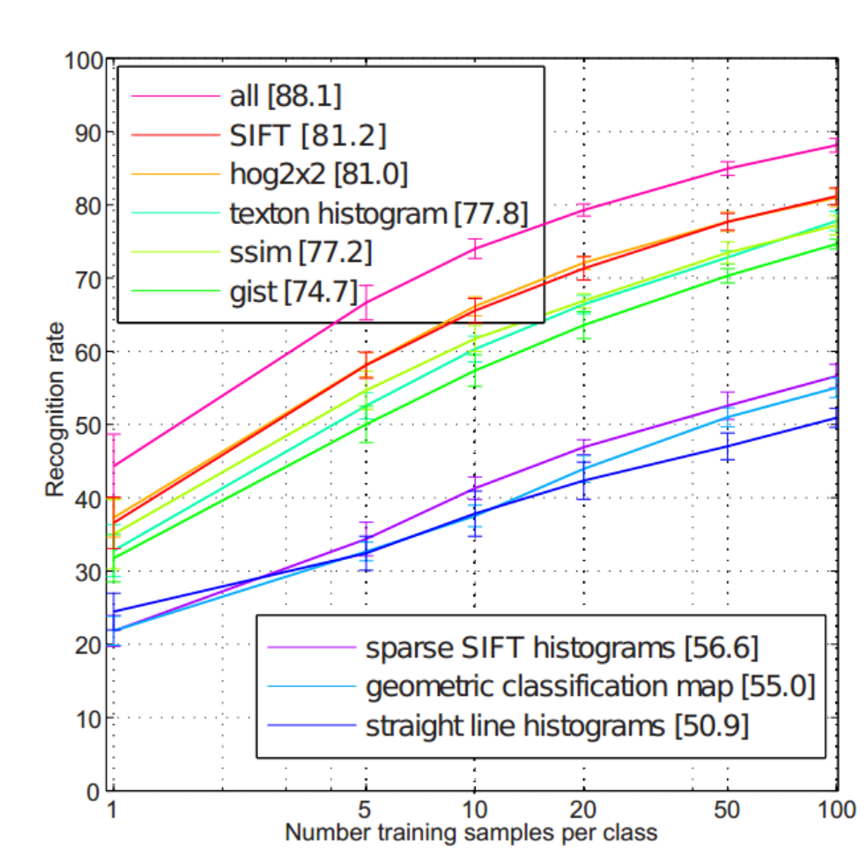
15 Scene Recognition Rate

Slide 8
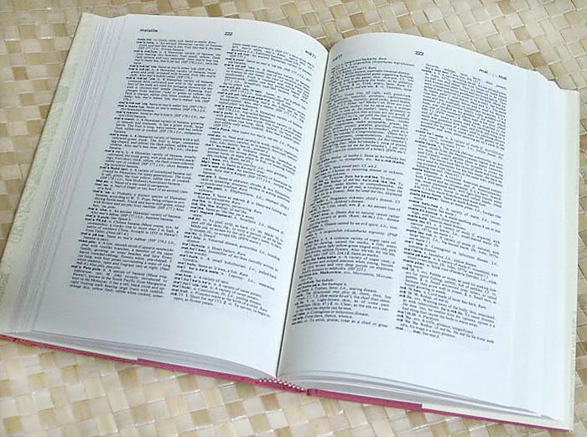

How many object categories are there?
~10,000 to 30,000
Biederman 1987
Notes:
In the domain of object recognition, there have been some attempts to estimate the total number of visual object categories. For instance, Biederman arrived at one such estimate using dictionary counting. So we decided to do the same thing for scene categories. We took a dictionary and counted them all “places” which have a distinct visual identity.
So, just to get a sense of this task, let’s look through some of the places you find in a dictionary…

Slide 9
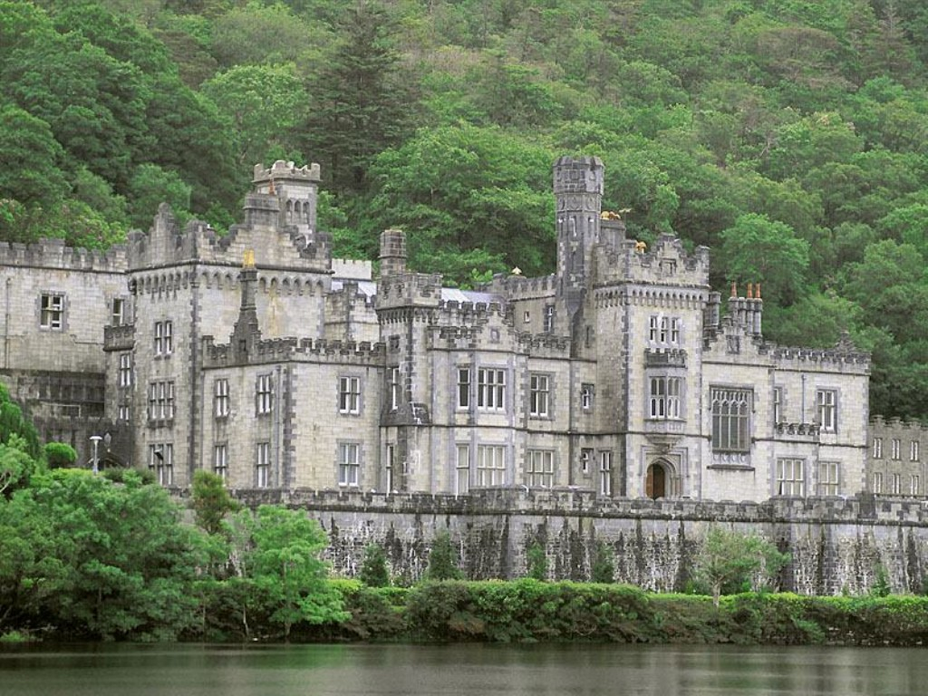
abbey

Slide 10
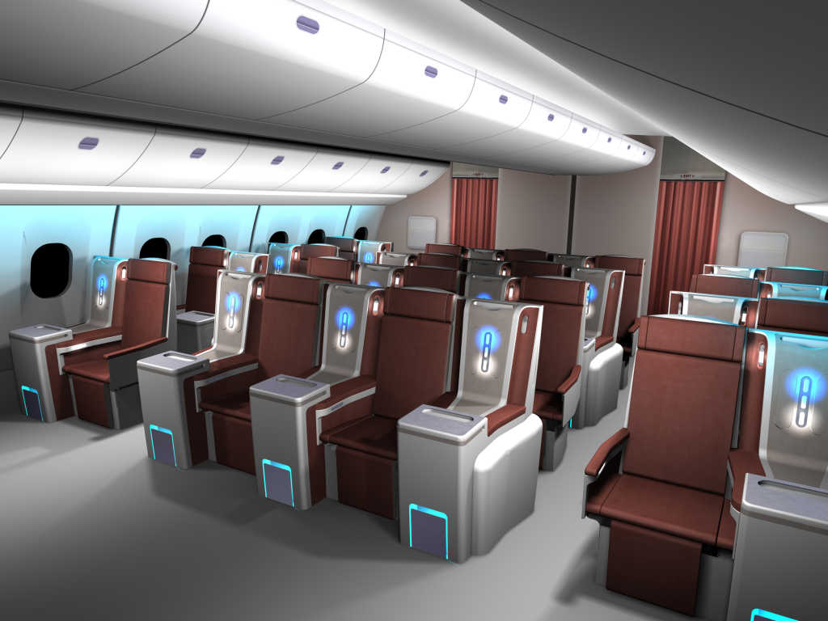
airplane cabin

Slide 11
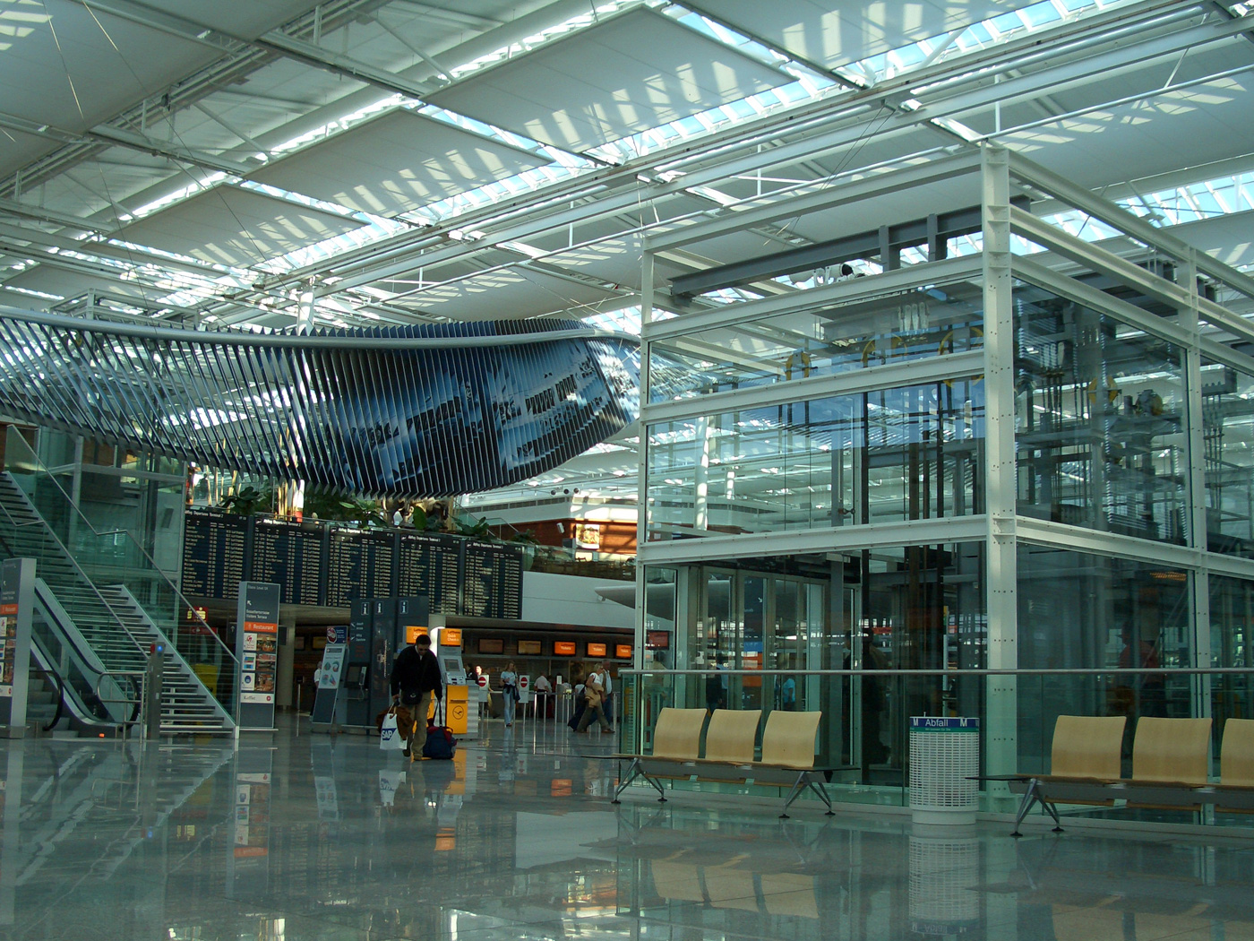
airport terminal

Slide 12
…

Slide 13
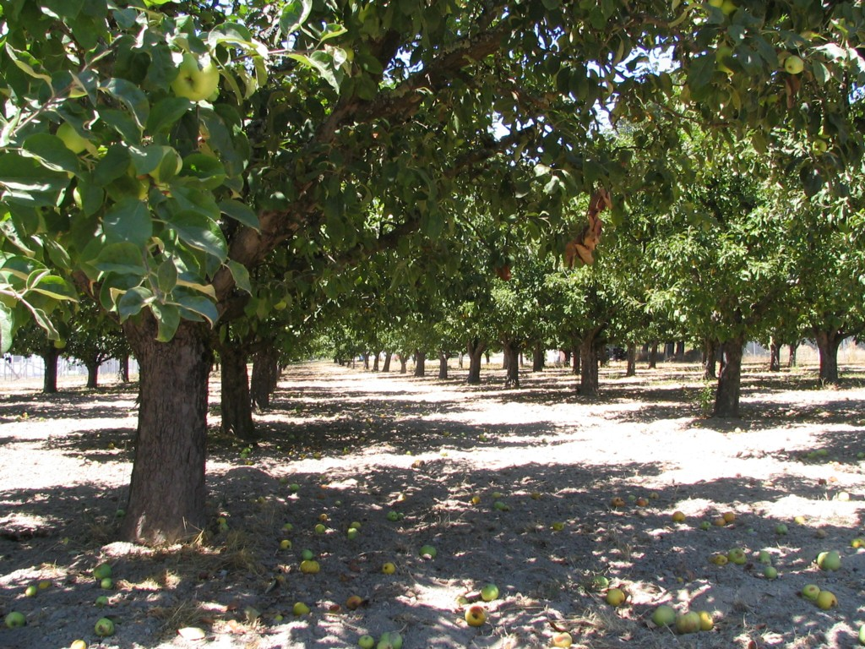
apple orchard
Notes:
orchard

Slide 14
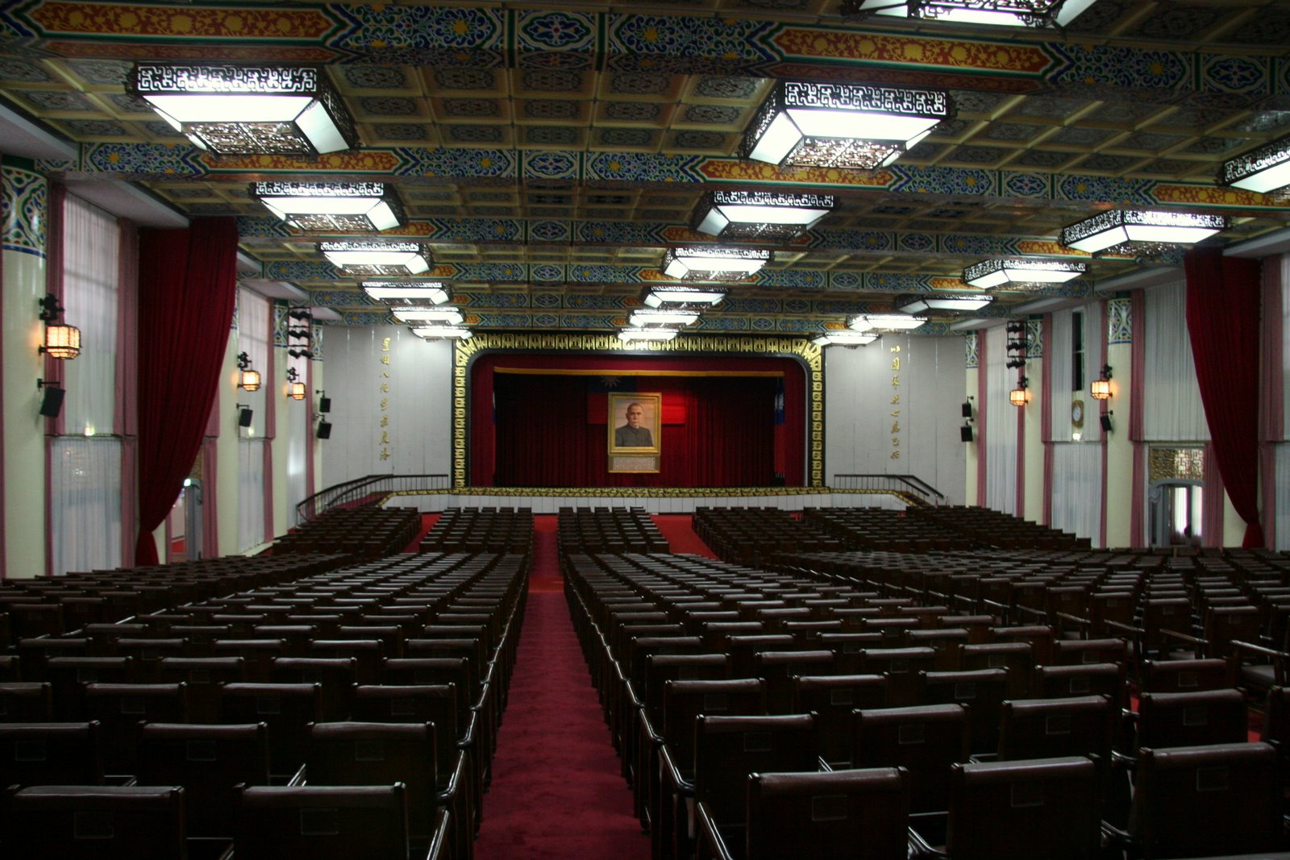
assembly hall
Notes:
Assembly hall

Slide 15
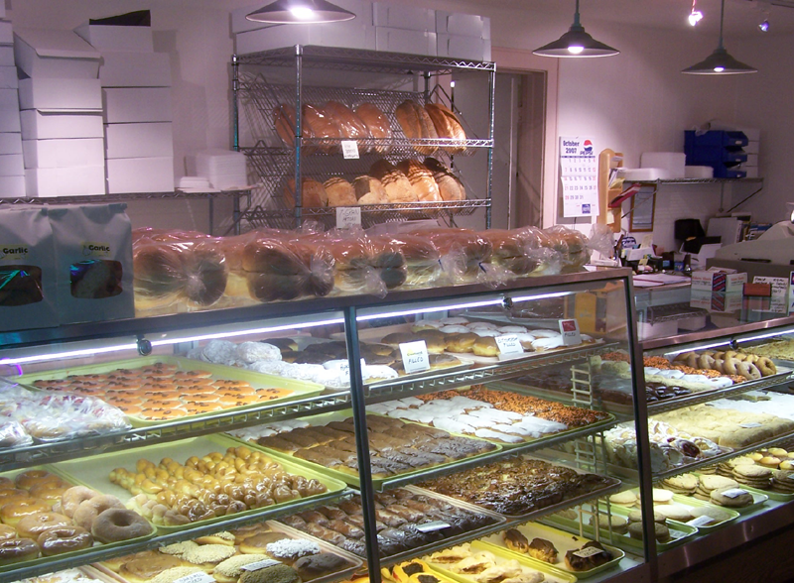
bakery

Slide 16
…

Slide 17
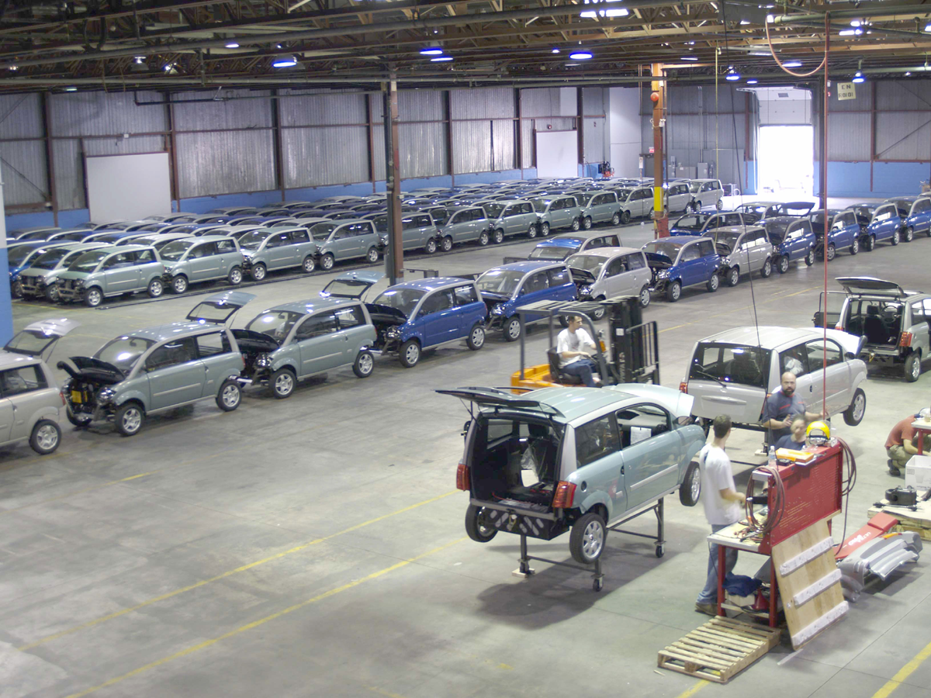
car factory
Notes:
Auto factory

Slide 18
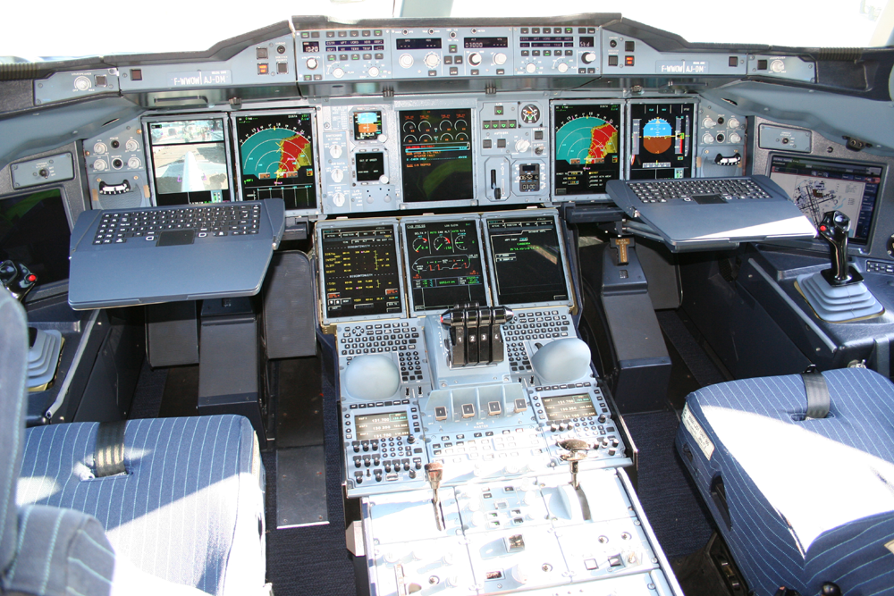
cockpit

Slide 19
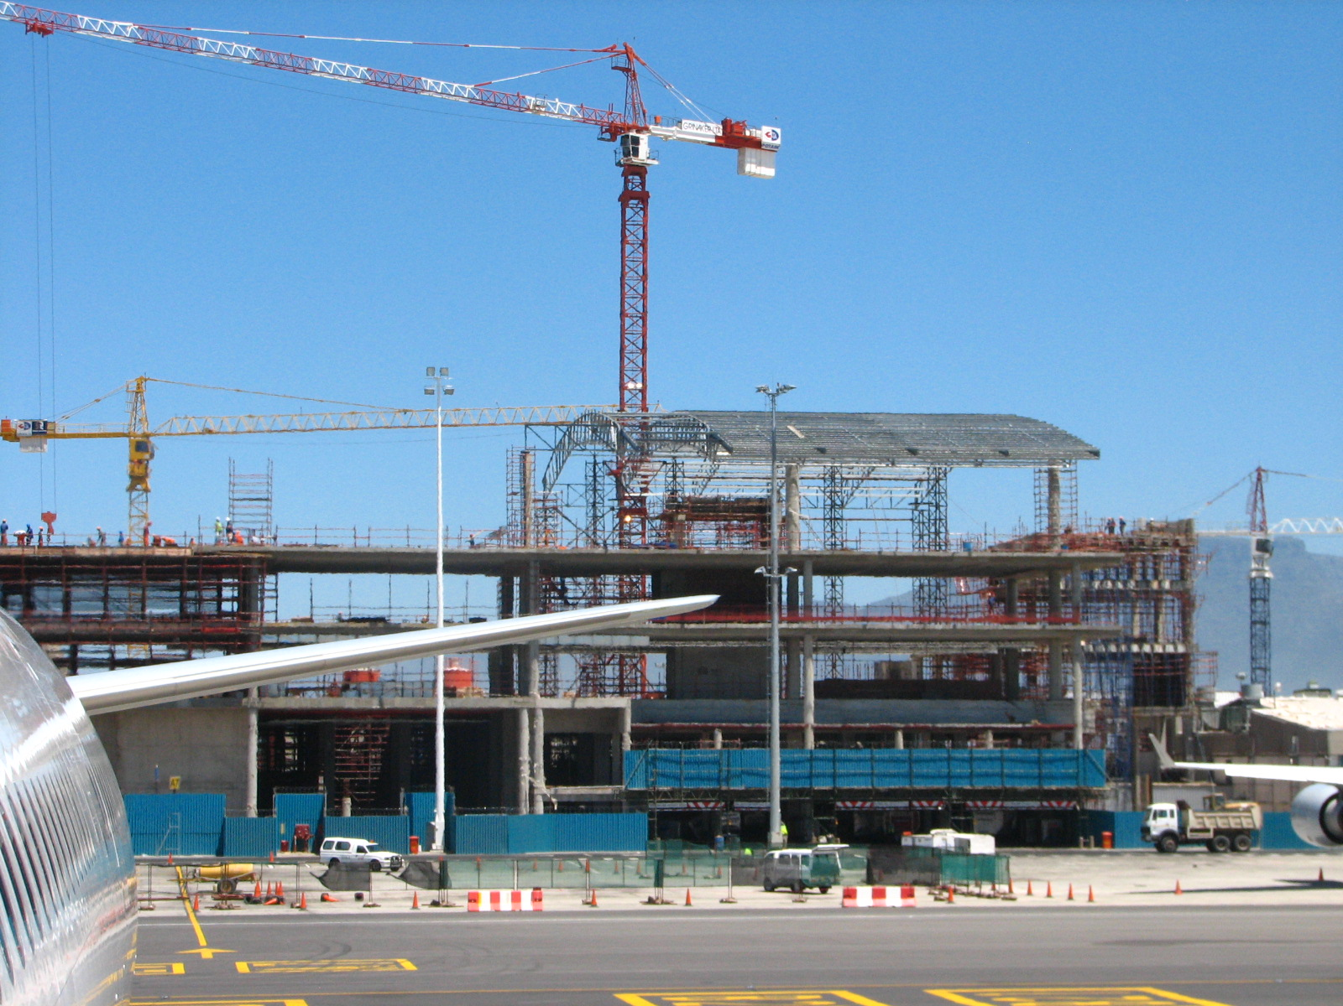
construction site

Slide 20
…

Slide 21
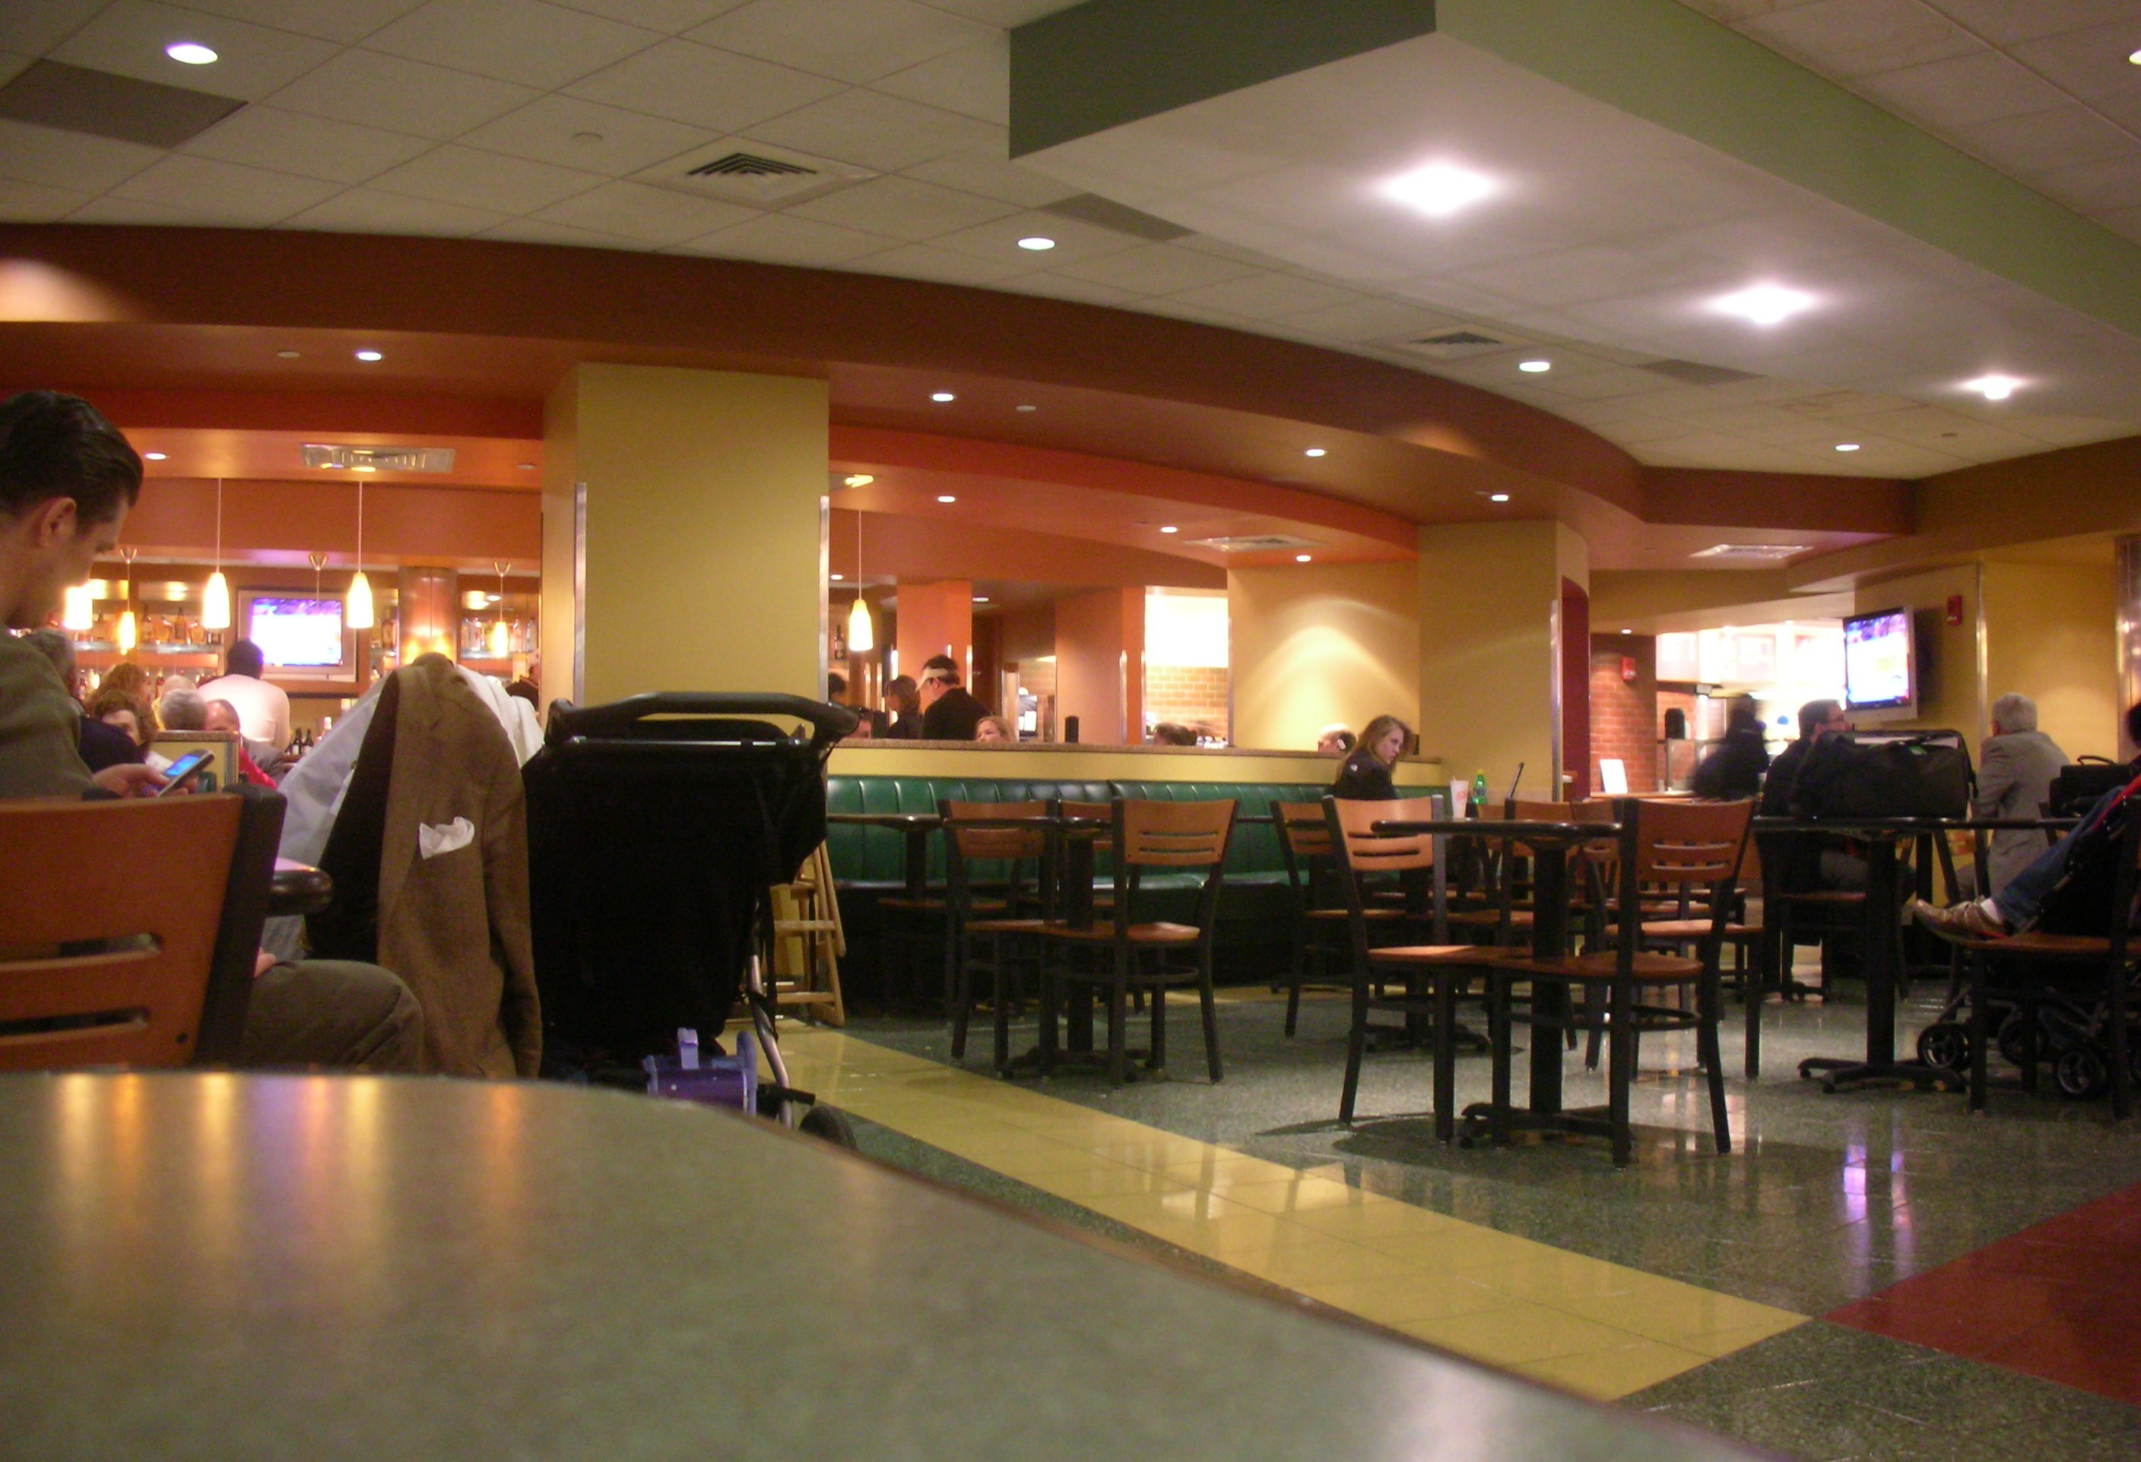
food court

Slide 22
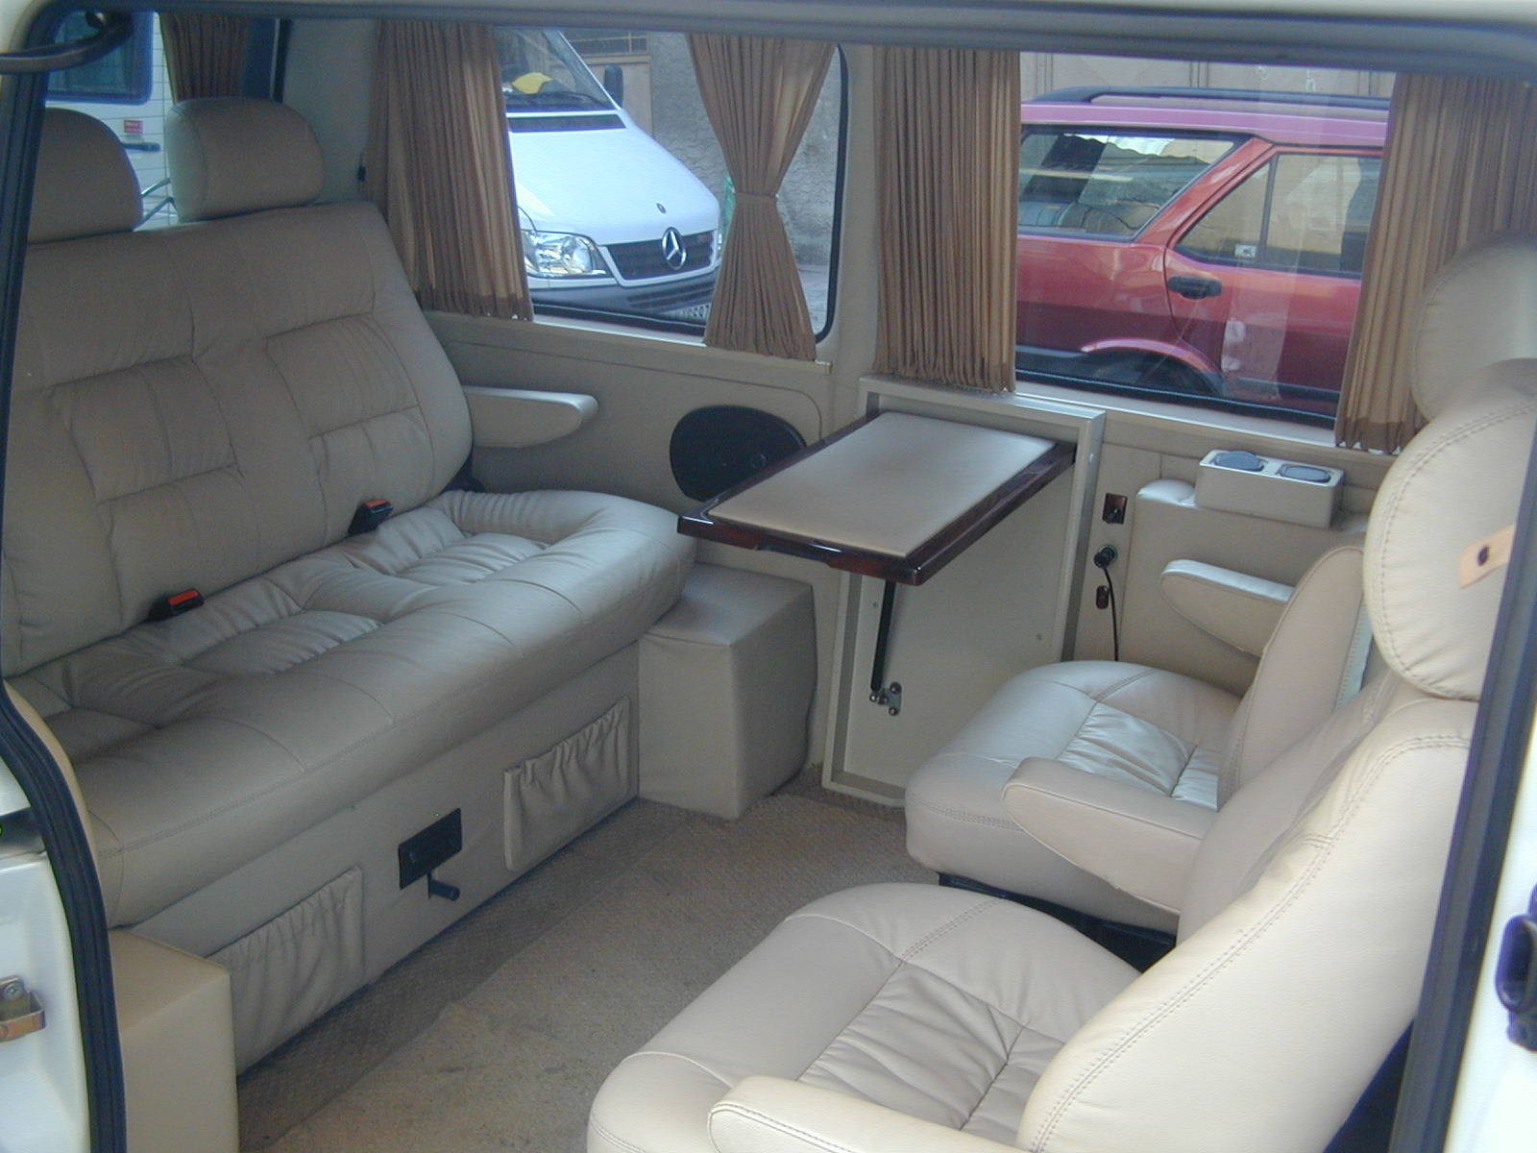
interior car

Slide 23

lounge

Slide 24
…

Slide 25
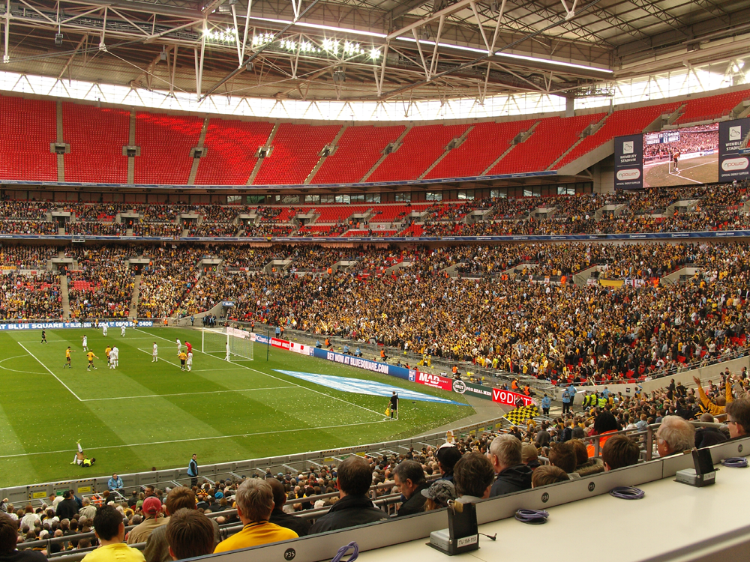
stadium
Notes:
Anechoic chamber

Slide 26
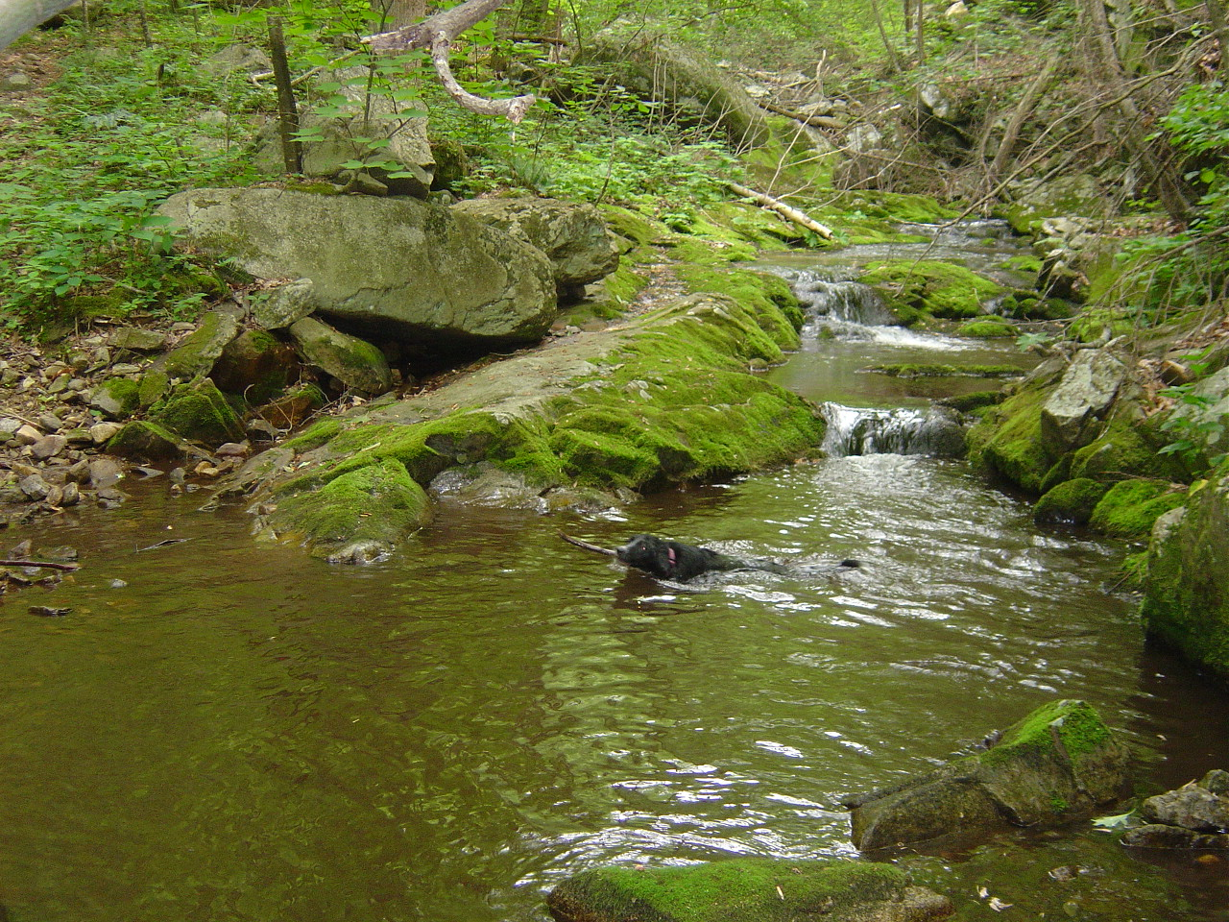
stream

Slide 27
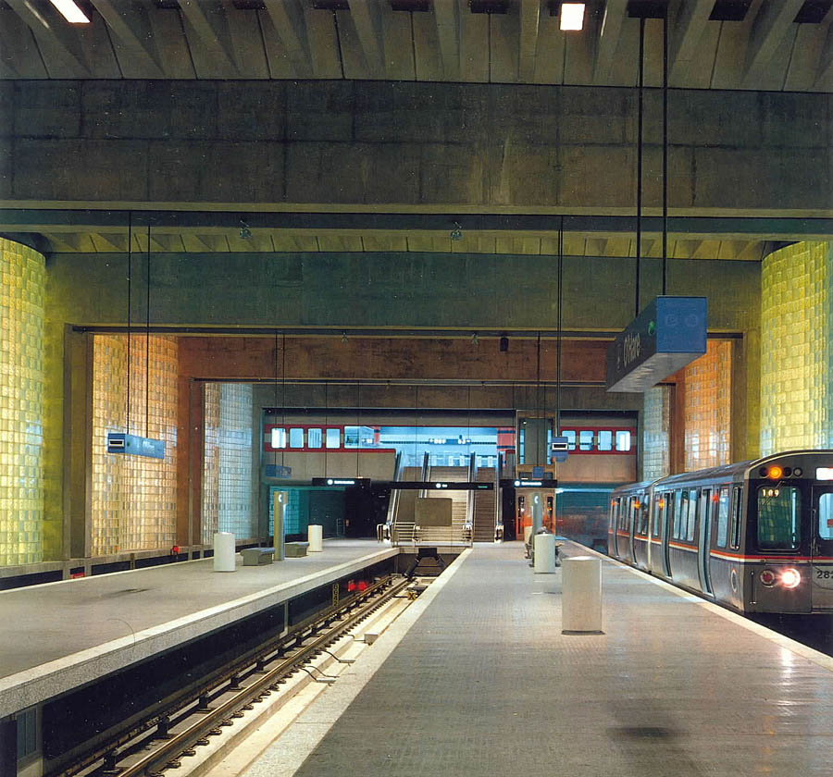
train station
Notes:
Train station

Slide 28
…

Slide 29
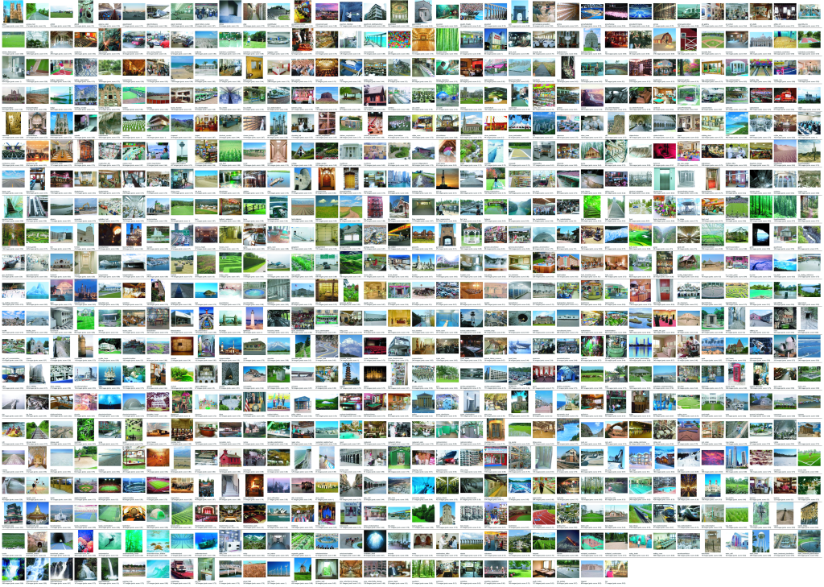
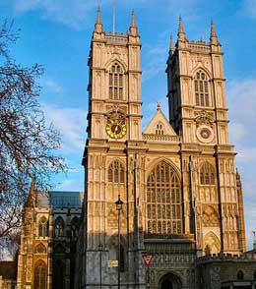
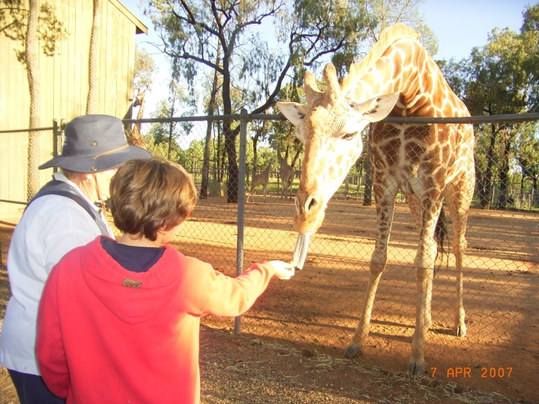
Notes:
899 categories from Abbey to Zoo
For each of those categories we perform keyword searches on the Internet to find candidate scenes, and manually filter each category according to strict guidelines (e.g. what distinguishes a pasture and a corral). We end up with 130, 519 images.
It turns out that, even with an Internet worth of imagery, some categories are sparsely sampled. For all the experiments in this talk, we used only the 397 well-sampled categories with at least 100 unique images.

Slide 30
397 Well-sampled Categories
Notes:
Which still leaves us with a very diverse set of scenes. We lost very rarely encountered scenes like Airlock, Launchpad, and Ossuary. [osh-oo-er-ee].
The first question we want to address is whether people can actually discriminate these scenes. So, we want to run a 397 alternative forced choice task... that’s pretty difficult. But fortunately there are some very hard workers on Mechanical Turk…

Slide 31
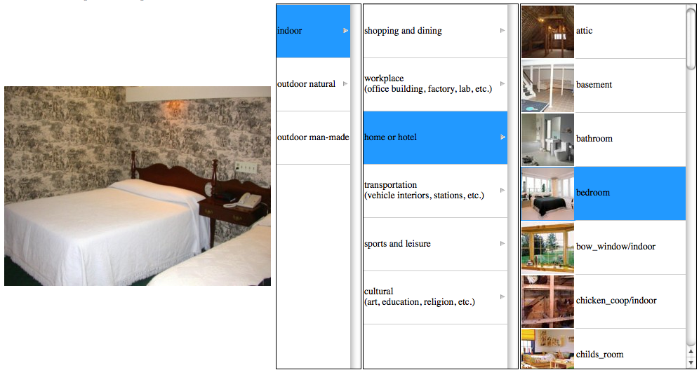
Evaluating Human Scene Classification
?
“Good worker”
Accuracy
98% 90% 68%
Notes:
We present workers with a test case from our database. To help them classify the scene without requiring prior knowledge of our taxonomy, we provide an over-complete hierarchy to browse through. At the leaf level we show a visual example each category.
For each scene category we measure human accuracy on 20 test images, for a total of 397*20 = ~8000 trials
We filter out workers who didn’t do enough experiments or didn’t achieve 95% accuracy at the first level of the hierarchy. Note that the hierarchy here was just an organizational tool. See Krista’s poster for details about a more rigorously constructed hierarchy.
So, how do we actually arrive at this 68% accuracy? [transition]
We only use American participants to help avoid vocabulary confusion. Median working time 23 seconds per HIT.

Slide 32
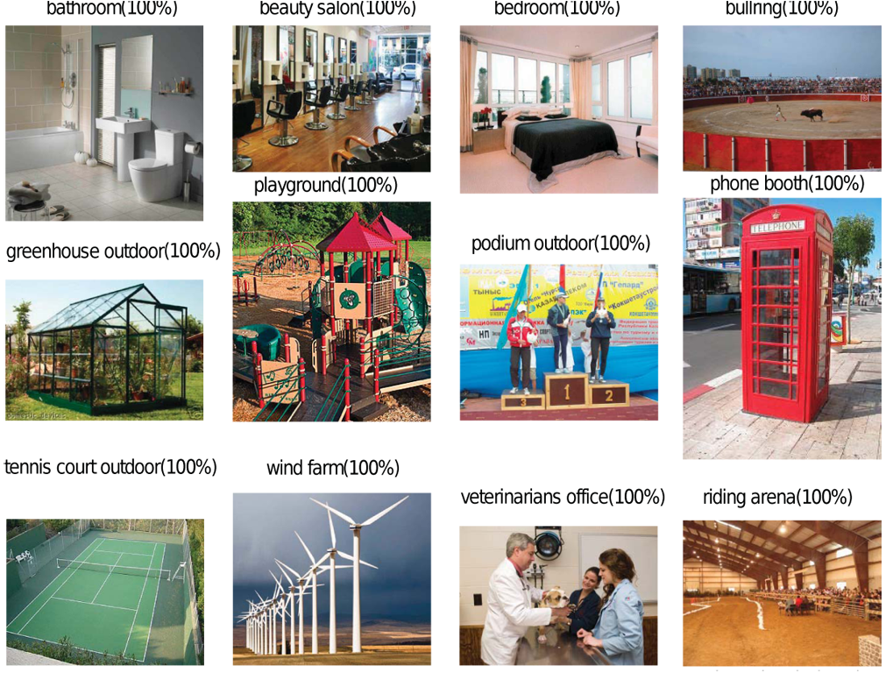
Notes:
First, here is a subset of the categories which participants labeled with perfect accuracy.

Slide 33
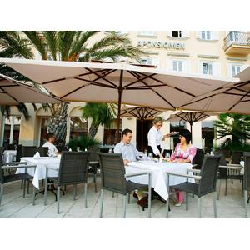
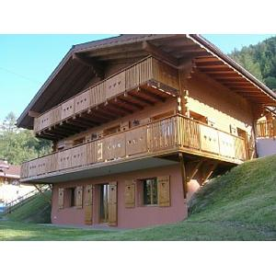
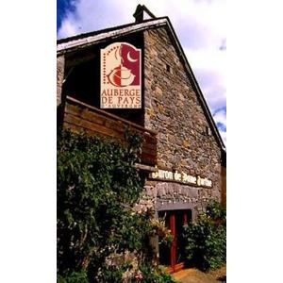
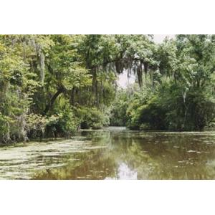
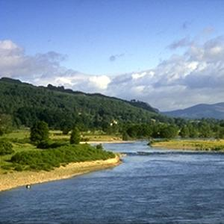

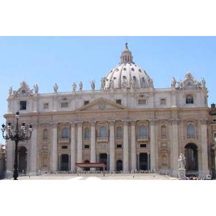
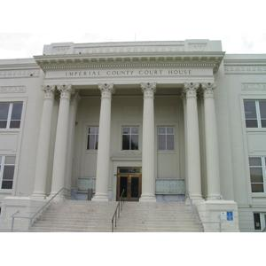
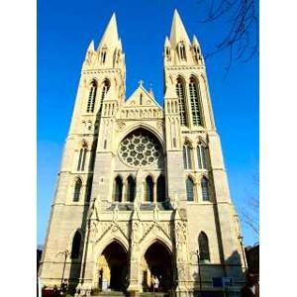
Scene category
Most confusing categories
Inn (0%)
Restaurant patio (44%)
Chalet (19%)
River (67%)
Coast (8%)
Bayou (0%)
Basilica (0%)
Cathedral(29%)
Courthouse (21%)
Notes:
On the other hand, here is a sample of categories where participants were always wrong. For each of these low accuracy categories, here are the two most confusing categories – the incorrect labels that participants most often chose.
Regarding the mistakes that humans make, for example with Bayou, it may be the case that workers didn’t know our scene taxonomy well enough so they thought that “river” was the most specific label. Or it may be the case that they really didn’t have the visual training to distinguish rivers from bayou. Or it could be that there is semantic and visual overlap and they are really ambiguous.

Slide 34
Conclusion: humans can do it
The SUN database is reasonably consistent and differentiable -- even with a huge number of very specific categories, humans get it right 2/3rds of the time with no training.
We also have a good benchmark for computational methods.
How do we classify scenes?

Slide 35
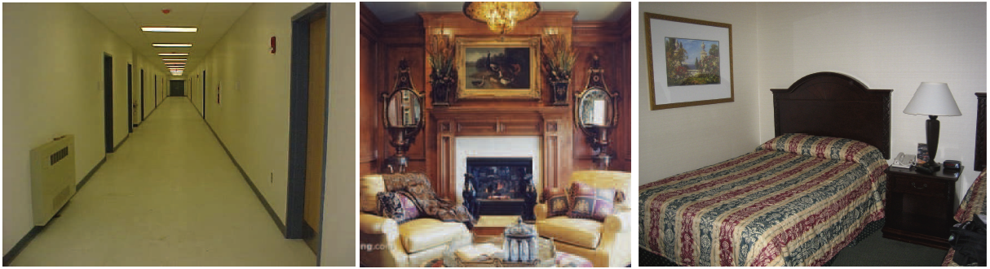
How do we classify scenes?
Ceiling
Ceiling
Lamp
wall
Light
painting
Door
Door
Painting
mirror
Door
mirror
Wall
Door
Wall
Door
wall
wall
Lamp
phone
Fireplace
Bed
alarm
armchair
armchair
Floor
Side-table
Coffee table
carpet
Different objects, different spatial layout
Notes:
what information are humans using? – objects certainly play an important roll. [for instance, the different identities and layouts of objects in these images would clearly delineate these scene categories], [transition]

Slide 36
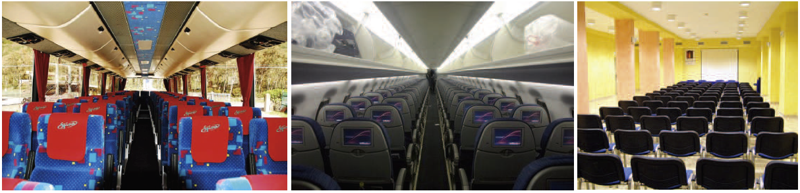
Which are the important elements?
cabinets
ceiling
cabinets
ceiling
ceiling
cabinets
cabinets
wall
screen
window
window
window
column
seat
seat
window
seat
seat
window
seat
seat
seat
seat
seat
seat
seat
seat
seat
seat
seat
seat
seat
seat
seat
seat
seat
seat
seat
seat
seat
seat
seat
seat
seat
seat
seat
seat
Similar objects, and similar spatial layout
Different lighting, different materials, different “stuff”
Notes:
36
And then in these 3 images, the space is the same, the layout is the same, the objects are the same, but there are still different scenes, with different functions, and it is very important to see the difference, because if you are seating there, you are going nowhere.
----------------------------------
And sometimes, both objects and layout are similar, and you can still recognize that these 3 environments are radically different. And it is a critical recognition task, because
If you sit in the last one, you are going nowhere
What remains is the “space” and the image statistics
What can be an alternative to objects?

Slide 37
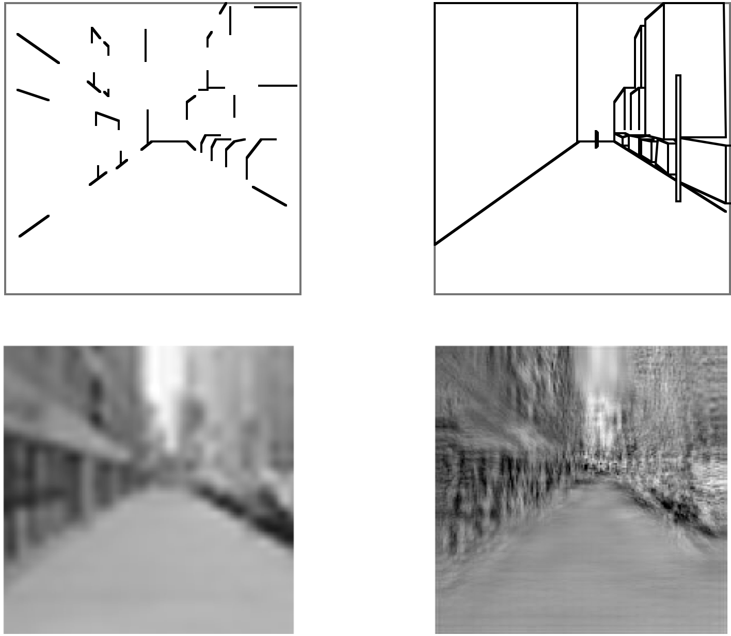
Scene emergent features
“Recognition via features that are not those of individual objects but “emerge” as objects are brought into relation to each other to form a scene.” – Biederman 81
Biederman, 1981
Biederman, 1981
Suggestive edges and junctions
Simple geometric forms
Bruner and Potter, 1969
Oliva and Torralba, 2001
Blobs
Textures
Notes:
but there is an intriguing alternative view that proposes scene recognition from global features. This approach is also interesting, from a computer vision standpoint, because object recognition by computers is an unsolved problem.
Here we are going to see how far we can push scene recognition without having any object-level understanding of scenes.

Slide 38
Global Image Descriptors
Tiny images (Torralba et al, 2008)
Color histograms
Self-similarity (Shechtman and Irani, 2007)
Geometric class layout (Hoiem et al, 2005)
Geometry-specific histograms (Lalonde et al, 2007)
Dense and Sparse SIFT histograms
Berkeley texton histograms (Martin et al, 2001)
HoG 2x2 spatial pyramids
Gist scene descriptor (Oliva and Torralba, 2008)
Texture
Features
Notes:
So we’re going to perform scene categorization using various computational features which have no explicit object awareness.
These features encode, for each image, statistics of color, self similarity, geometric layout, and texture
most of these features aren't new, although a few are improvements of recent approaches.
We make no claim that these are biologically plausible.
Highlight - texture features:

Slide 39







Global Texture Descriptors
Bag of words
Spatially organized textures
M. Gorkani, R. Picard, ICPR 1994
A. Oliva, A. Torralba, IJCV 2001
Sivic et. al., ICCV 2005
Fei-Fei and Perona, CVPR 2005
Non localized textons
Walker, Malik. Vision Research 2004
…
…
S. Lazebnik, et al, CVPR 2006
R. Datta, D. Joshi, J. Li, and J. Z. Wang, Image Retrieval: Ideas, Influences, and Trends of the New Age, ACM Computing Surveys, vol. 40, no. 2, pp. 5:1-60, 2008.
Notes:
The dominant computational models of the last decade all fit into this category.
For instance, on the left we have texture models with no spatial information – they aggregate local texture properties into a global histogram. Local texture properties can be measured in different ways – SIFT-like features or filter banks; they can sampled at interest points or densely overlapped.
On the right are models with spatial information, such as the gist scene descriptor or the spatial pyramid.
All of these various design possibilities are represented in our feature set.

Slide 40




Gist descriptor
Oliva and Torralba, 2001
Apply oriented Gabor filters
over different scales
Average filter energy
in each bin
8 orientations
4 scales
x 16 bins
512 dimensions
Similar to SIFT (Lowe 1999) applied to the entire image
M. Gorkani, R. Picard, ICPR 1994; Walker, Malik. Vision Research 2004; Vogel et al. 2004;
Fei-Fei and Perona, CVPR 2005; S. Lazebnik, et al, CVPR 2006; …
Notes:
40
Here is one example of global representation. Most of other approaches follow a very similar structure. The next slide shows why it makes sense.

Slide 41



Global scene descriptors
The “gist” of a scene: Oliva & Torralba (2001)
http://people.csail.mit.edu/torralba/code/spatialenvelope/

Slide 42

Gist descriptor

Slide 43
Gist descriptor
V = {energy at each orientation and scale} = 6 x 4 dimensions
80 features
| v_{t} |
PCA
G
Oliva, Torralba. IJCV 2001

Slide 44
Example visual gists
Global features (I) ~ global features (I’)
Oliva & Torralba (2001)

Slide 45


Textons
Kmeans over a set of
vectors on a collection
of images
Vector of filter responses
at each pixel
Filter bank
Malik, Belongie, Shi, Leung, 1999

Slide 46



Textons
Filter bank
K-means (100 clusters)
Malik, Belongie, Shi, Leung, 1999
Walker, Malik, 2004

Slide 47
Bag of words
Bag of words model
65
17
23
36
Spatially organized textures
7
8
0
0
0
2
0
0
7
0
4
0
20
0
0
0
1
1
1
0
2
14
0
3
3
3
0
12
4
0
0
4
16
3
6
0
1
1

Slide 48

Bag of words &
spatial pyramid matching
Sivic, Zisserman, 2003. Visual words = Kmeans of SIFT descriptors
S. Lazebnik, et al, CVPR 2006

Slide 49
Better Bags of Visual Features
More advanced quantization / encoding methods that are near the state-of-the-art in image classification and image retrieval.
  Soft assignment (a.k.a. Kernel Codebook)
  VLAD
  Fisher Vector
Deep learning has taken attention away from these methods.

Slide 50

Standard Kmeans Bag of Words
http://www.cs.utexas.edu/~grauman/courses/fall2009/papers/bag_of_visual_words.pdf

Slide 51

Motivation
Bag of Visual Words is only about counting the number of local descriptors assigned to each Voronoi region
Why not including other statistics?
http://www.cs.utexas.edu/~grauman/courses/fall2009/papers/bag_of_visual_words.pdf

Slide 52






















We already looked at the Spatial Pyramid
level 0
level 1
level 2
But today we’re not talking about ways to preserve spatial information.

Slide 53
Motivation
Bag of Visual Words is only about counting the number of local descriptors assigned to each Voronoi region
Why not including other statistics? For instance:
    mean of local descriptors
http://www.cs.utexas.edu/~grauman/courses/fall2009/papers/bag_of_visual_words.pdf

Slide 54
Motivation
Bag of Visual Words is only about counting the number of local descriptors assigned to each Voronoi region
Why not including other statistics? For instance:
    mean of local descriptors
    (co)variance of local descriptors
http://www.cs.utexas.edu/~grauman/courses/fall2009/papers/bag_of_visual_words.pdf

Slide 55
Simple case: Soft Assignment
Called “Kernel codebook encoding” by Chatfield et al. 2011. Cast a weighted vote into the most similar clusters.

Slide 56

Simple case: Soft Assignment
Called “Kernel codebook encoding” by Chatfield et al. 2011. Cast a weighted vote into the most similar clusters.
This is fast and easy to implement (try it for Project 4!) but it does have some downsides for image retrieval – the inverted file index becomes less sparse.

Slide 57





VLAD
① assign descriptors
μ ₂
μ₁
Given a codebook ,
e.g. learned with K-means, and a set of
local descriptors :
  ① assign:
  ②③ compute:
  concatenate v_{i}’s + normalize
μ ₃
μ ₄
x
μ ₅
② compute x- μ _{i}
③ v_{i}=sum x- μ _{i} for cell i
v₅
v₁
v₂
v₃
v₄
Jégou, Douze, Schmid and Pérez, “Aggregating local descriptors into a compact image representation”, CVPR’10.
Notes:
Intuition – you’re encoding the updates to each centroid if you were running the kmeans algorithm.

Slide 58

A first example: the VLAD
A graphical representation of
Jégou, Douze, Schmid and Pérez, “Aggregating local descriptors into a compact image representation”, CVPR’10.
Notes:
K=16 centroids / clusters. Blue is positive red is negative. SIFT layout.

Slide 59

The Fisher vector
Score function
Given a likelihood function with parameters λ, the score function of a given sample X is given by:
→ Fixed-length vector whose dimensionality depends only on # parameters.
Intuition: direction in which the parameters λ of the model should we modified to better fit the data.

Slide 60

Aside: Mixture of Gaussians (GMM)
For Fisher Vector image representations,
is a GMM.
GMM can be thought of as “soft” kmeans.
Each component has a mean and a standard deviation along each direction (or full covariance)
0.4
0.05
0.5
0.05
Notes:
But how did we find the Gaussian Mixture model for our feature encoding? Very similar to kmeans.

Slide 61

Missing Data Problems: Outliers
You want to train an algorithm to predict whether a photograph is attractive. You collect annotations from Mechanical Turk. Some annotators try to give accurate ratings, but others answer randomly.
Challenge: Determine which people to trust and the average rating by accurate annotators.
Annotator Ratings
10
8
9
2
8
Photo: Jam343 (Flickr)

Slide 62

Missing Data Problems: Object Discovery
You have a collection of images and have extracted regions from them. Each is represented by a histogram of “visual words”.
Challenge: Discover frequently occurring object categories, without pre-trained appearance models.
http://www.robots.ox.ac.uk/~vgg/publications/papers/russell06.pdf

Slide 63

Missing Data Problems: Segmentation
You are given an image and want to assign foreground/background pixels.
Challenge: Segment the image into figure and ground without knowing what the foreground looks like in advance.
Foreground
Background
Slide: Derek Hoiem

Slide 64
Missing Data Problems: Segmentation
Challenge: Segment the image into figure and ground without knowing what the foreground looks like in advance.
Three steps:
If we had labels, how could we model the appearance of foreground and background?
Once we have modeled the fg/bg appearance, how do we compute the likelihood that a pixel is foreground?
How can we get both labels and appearance models at once?
Background
Foreground
Slide: Derek Hoiem

Slide 65
Maximum Likelihood Estimation
If we had labels, how could we model the appearance of foreground and background?
Background
Foreground
Slide: Derek Hoiem

Slide 66
Maximum Likelihood Estimation
data
parameters
Slide: Derek Hoiem

Slide 67
Maximum Likelihood Estimation
Gaussian Distribution
Slide: Derek Hoiem
Notes:
Assume data is i.i.d. and solve using partial derivatives.

Slide 68
Maximum Likelihood Estimation
Gaussian Distribution
Slide: Derek Hoiem

Slide 69


Example: MLE
Parameters used to Generate
fg: mu=0.6, sigma=0.1
bg: mu=0.4, sigma=0.1
im
labels
>> mu_fg = mean(im(labels))
mu_fg = 0.6012
>> sigma_fg = sqrt(mean((im(labels)-mu_fg).^2))
sigma_fg = 0.1007
>> mu_bg = mean(im(~labels))
mu_bg = 0.4007
>> sigma_bg = sqrt(mean((im(~labels)-mu_bg).^2))
sigma_bg = 0.1007
>> pfg = mean(labels(:));
Slide: Derek Hoiem

Slide 70
Probabilistic Inference
2. Once we have modeled the fg/bg appearance, how do we compute the likelihood that a pixel is foreground?
Background
Foreground
Slide: Derek Hoiem

Slide 71
Probabilistic Inference
Compute the likelihood that a particular model generated a sample
component or label
Slide: Derek Hoiem

Slide 72
Probabilistic Inference
Compute the likelihood that a particular model generated a sample
component or label
Slide: Derek Hoiem

Slide 73
Probabilistic Inference
Compute the likelihood that a particular model generated a sample
component or label
Slide: Derek Hoiem

Slide 74
Probabilistic Inference
Compute the likelihood that a particular model generated a sample
component or label
Slide: Derek Hoiem

Slide 75

Example: Inference
Learned Parameters
fg: mu=0.6, sigma=0.1
bg: mu=0.4, sigma=0.1
im
>> pfg = 0.5;
>> px_fg = normpdf(im, mu_fg, sigma_fg);
>> px_bg = normpdf(im, mu_bg, sigma_bg);
>> pfg_x = px_fg*pfg ./ (px_fg*pfg + px_bg*(1-pfg));
p(fg | im)
Slide: Derek Hoiem

Slide 76

Mixture of Gaussian* Example: Matting
Figure from “Bayesian Matting”, Chuang et al. 2001
Notes:
Bayesian matting is not exactly mixture of Gaussians. There are multiple Gaussians, but each unknown pixel is expected to be a combination of exactly two of them.

Slide 77





Mixture of Gaussian* Example: Matting
Result from “Bayesian Matting”, Chuang et al. 2001

Slide 78
Dealing with Hidden Variables
3. How can we get both labels and appearance models at once?
Background
Foreground
Slide: Derek Hoiem

Slide 79
Mixture of Gaussians
mixture component
component model parameters
component prior
Slide: Derek Hoiem

Slide 80
Mixture of Gaussians
With enough components, can represent any probability density function
  Widely used as general purpose pdf estimator
Slide: Derek Hoiem

Slide 81
Segmentation with Mixture of Gaussians
Pixels come from one of several Gaussian components
  We don’t know which pixels come from which components
  We don’t know the parameters for the components
Slide: Derek Hoiem

Slide 82
Simple solution
Initialize parameters
Compute the probability of each hidden variable given the current parameters
Compute new parameters for each model, weighted by likelihood of hidden variables
Repeat 2-3 until convergence
Slide: Derek Hoiem

Slide 83
Mixture of Gaussians: Simple Solution
Initialize parameters
Compute likelihood of hidden variables for current parameters
Estimate new parameters for each model, weighted by likelihood
Slide: Derek Hoiem

Slide 84
Expectation Maximization (EM) Algorithm
Goal:
Log of sums is intractable
Jensen’s Inequality
for concave funcions, such as f(x)=log(x)
See here for proof: www.stanford.edu/class/cs229/notes/cs229-notes8.ps
Slide: Derek Hoiem

Slide 85
Expectation Maximization (EM) Algorithm
Goal:
E-step: compute
M-step: solve
Slide: Derek Hoiem

Slide 86

This looks like a soft version of kmeans!

Slide 87


Slide 88


Slide 89


Slide 90


Slide 91


Slide 92


Slide 93


Slide 94


Slide 95


Slide 96


Slide 97
EM for Mixture of Gaussians (on board)
E-step:
M-step:

Slide 98
EM for Mixture of Gaussians (on board)
E-step:
M-step:
Slide: Derek Hoiem

Slide 99
EM Algorithm
Maximizes a lower bound on the data likelihood at each iteration
Each step increases the data likelihood
  Converges to local maximum
Common tricks to derivation
  Find terms that sum or integrate to 1
  Lagrange multiplier to deal with constraints
Slide: Derek Hoiem

Slide 100
Mixture of Gaussian demos
http://www.cs.cmu.edu/~alad/em/
http://lcn.epfl.ch/tutorial/english/gaussian/html/
Slide: Derek Hoiem

Slide 101
“Hard EM”
Same as EM except compute z* as most likely values for hidden variables
K-means is an example
Advantages
  Simpler: can be applied when cannot derive EM
  Sometimes works better if you want to make hard predictions at the end
But
  Generally, pdf parameters are not as accurate as EM
Slide: Derek Hoiem

Slide 102
Missing Data Problems: Outliers
You want to train an algorithm to predict whether a photograph is attractive. You collect annotations from Mechanical Turk. Some annotators try to give accurate ratings, but others answer randomly.
Challenge: Determine which people to trust and the average rating by accurate annotators.
Annotator Ratings
10
8
9
2
8
Photo: Jam343 (Flickr)

Slide 103
Missing Data Problems: Object Discovery
You have a collection of images and have extracted regions from them. Each is represented by a histogram of “visual words”.
Challenge: Discover frequently occurring object categories, without pre-trained appearance models.
http://www.robots.ox.ac.uk/~vgg/publications/papers/russell06.pdf

Slide 104
What’s wrong with this prediction?
P(foreground | image)
Slide: Derek Hoiem

Slide 105

Next class
MRFs and Graph-cut Segmentation
Slide: Derek Hoiem

Slide 106
Missing data problems
Outlier Detection
  You expect that some of the data are valid points and some are outliers but…
  You don’t know which are inliers
  You don’t know the parameters of the distribution of inliers
Modeling probability densities
  You expect that most of the colors within a region come from one of a few normally distributed sources but…
  You don’t know which source each pixel comes from
  You don’t know the Gaussian means or covariances
Discovering patterns or “topics”
  You expect that there are some re-occuring “topics” of codewords within an image collection. You want to…
  Figure out the frequency of each codeword within each topic
  Figure out which topic each image belongs to
Slide: Derek Hoiem

Slide 107
Running Example: Segmentation
Given examples of foreground and background
  Estimate distribution parameters
  Perform inference
Knowing that foreground and background are “normally distributed”
Some initial estimate, but no good knowledge of foreground and background

Slide 108
The Fisher vector
Relationship with the BOV
FV formulas:
0.4
0.05
0.5
0.05
Perronnin and Dance, “Fisher kernels on visual categories for image categorization”, CVPR’07.

Slide 109

The Fisher vector
Relationship with the BOV
FV formulas:
    gradient wrt to w
    ≈
    → soft BOV
    = soft-assignment of patch t to Gaussian i
0.4
0.05
0.5
0.05
Perronnin and Dance, “Fisher kernels on visual categories for image categorization”, CVPR’07.

Slide 110

The Fisher vector
Relationship with the BOV
FV formulas:
    gradient wrt to w
    ≈
    → soft BOV
    = soft-assignment of patch t to Gaussian i
    → compared to BOV, include higher-order statistics (up to order 2)
Let us denote: D = feature dim, N = # Gaussians
    BOV = N-dim
    FV = 2DN-dim
    gradient wrt to μ and σ
0.4
0.05
0.5
0.05
Perronnin and Dance, “Fisher kernels on visual categories for image categorization”, CVPR’07.

Slide 111
The Fisher vector
Relationship with the BOV
FV formulas:
    gradient wrt to w
    ≈
    → soft BOV
    = soft-assignment of patch t to Gaussian i
    → compared to BOV, include higher-order statistics (up to order 2)
FV much higher-dim than BOV for a given visual vocabulary size
FV much faster to compute than BOV for a given feature dim
    gradient wrt to μ and σ
0.4
0.05
0.5
0.05
Perronnin and Dance, “Fisher kernels on visual categories for image categorization”, CVPR’07.

Slide 112
The Fisher vector
Dimensionality reduction on local descriptors
Perform PCA on local descriptors:
→ uncorrelated features are more consistent with diagonal assumption of covariance matrices in GMM
→ FK performs whitening and enhances low-energy (possibly noisy) dimensions

Slide 113


The Fisher vector
Normalization: variance stabilization
→ Variance stabilizing transforms of the form:
(with α=0.5 by default)
can be used on the FV (or the VLAD).
→ Reduce impact of bursty visual elements
Jégou, Douze, Schmid, “On the burstiness of visual elements”, ICCV’09.

Slide 114

Datasets for image retrieval
INRIA Holidays dataset: 1491 shots of personal Holiday snapshot
500 queries, each associated with a small number of results 1-11 results
1 million distracting images (with some “false false” positives)
Hervé Jégou, Matthijs Douze and Cordelia Schmid
Hamming Embedding and Weak Geometric consistency for large-scale image search, ECCV'08

Slide 115

Examples
Retrieval
Example on Holidays:
From: Jégou, Perronnin, Douze, Sánchez, Pérez and Schmid, “Aggregating local descriptors into compact codes”, TPAMI’11.
Notes:
64 feature dimensions

Slide 116
Examples
Retrieval
Example on Holidays:
second order statistics are not essential for retrieval
From: Jégou, Perronnin, Douze, Sánchez, Pérez and Schmid, “Aggregating local descriptors into compact codes”, TPAMI’11.

Slide 117
Examples
Retrieval
Example on Holidays:
second order statistics are not essential for retrieval
even for the same feature dim, the FV/VLAD can beat the BOV
From: Jégou, Perronnin, Douze, Sánchez, Pérez and Schmid, “Aggregating local descriptors into compact codes”, TPAMI’11.

Slide 118
Examples
Retrieval
Example on Holidays:
second order statistics are not essential for retrieval
even for the same feature dim, the FV/VLAD can beat the BOV
soft assignment + whitening of FV helps when number of Gaussians ↑
From: Jégou, Perronnin, Douze, Sánchez, Pérez and Schmid, “Aggregating local descriptors into compact codes”, TPAMI’11.

Slide 119
Examples
Retrieval
Example on Holidays:
second order statistics are not essential for retrieval
even for the same feature dim, the FV/VLAD can beat the BOV
soft assignment + whitening of FV helps when number of Gaussians ↑
after dim-reduction however, the FV and VLAD perform similarly
From: Jégou, Perronnin, Douze, Sánchez, Pérez and Schmid, “Aggregating local descriptors into compact codes”, TPAMI’11.

Slide 120
Examples
Classification
Example on PASCAL VOC 2007:
From: Chatfield, Lempitsky, Vedaldi and Zisserman,
“The devil is in the details: an evaluation of recent
feature encoding methods”, BMVC’11.
 | Feature dim | mAP
VQ | 25K | 55.30
KCB | 25K | 56.26
LLC | 25K | 57.27
SV | 41K | 58.16
FV | 132K | 61.69

Slide 121
Examples
Classification
Example on PASCAL VOC 2007:
→ FV outperforms BOV-based techniques including:
  VQ: plain vanilla BOV
  KCB: BOV with soft assignment
  LLC: BOV with sparse coding
From: Chatfield, Lempitsky, Vedaldi and Zisserman,
“The devil is in the details: an evaluation of recent
feature encoding methods”, BMVC’11.
 | Feature dim | mAP
VQ | 25K | 55.30
KCB | 25K | 56.26
LLC | 25K | 57.27
SV | 41K | 58.16
FV | 132K | 61.69

Slide 122
Examples
Classification
Example on PASCAL VOC 2007:
→ FV outperforms BOV-based techniques including:
  VQ: plain vanilla BOV
  KCB: BOV with soft assignment
  LLC: BOV with sparse coding
→ including 2nd order information is important for classification
From: Chatfield, Lempitsky, Vedaldi and Zisserman,
“The devil is in the details: an evaluation of recent
feature encoding methods”, BMVC’11.
 | Feature dim | mAP
VQ | 25K | 55.30
KCB | 25K | 56.26
LLC | 25K | 57.27
SV | 41K | 58.16
FV | 132K | 61.69

Slide 123
Packages
The INRIA package:
http://lear.inrialpes.fr/src/inria_fisher/
The Oxford package:
http://www.robots.ox.ac.uk/~vgg/research/encoding_eval/
Vlfeat does it too!
http://www.vlfeat.org

Slide 124

What about skipping quantization / summarization completely?
In Defense of Nearest-Neighbor Based Image Classification
Boiman, Shechtman, Irani. CVPR 2008

Slide 125
Summary
We’ve looked at methods to better characterize the distribution of visual words in an image:
  Soft assignment (a.k.a. Kernel Codebook)
  VLAD
  Fisher Vector
  No quantization

Slide 126



Learning Scene Categorization
Forest path
Vs.
all
Living - room
Vs.
all
Notes:
For a given feature and kernel, we can imagine all of the test images as being embedded in some space. A good feature is one that allows a classifier, such as an SVM, to divide one category from all of the others. For instance, a classifier may divide forests from non-forests, or living rooms from non-living rooms.

Slide 127

Scene recognition
100 training samples per class
SVM classifier in both cases
Human
performance

Slide 128










Feature Accuracy
Humans [68.5]
Classifier: 1-vs-all SVM with histogram intersection, chi squared, or RBF kernel.
Notes:
Reveal these in this order:
Chance, Tiny Image, Geometric Layout, Color Histogram, Gist, Texton Histogram, textons, SSIM, hog 2x2, all, missing features
We also set new benchmark on the old database 88% vs 81% (96% is human performance on that dataset) (Lazebnik et al 2005).

Slide 129





















A look into the results
Airplane cabin (64%)
Van interior
Discotheque
Toyshop
Art gallery (38%)
Iceberg
Hotel room
Kitchenette
…
All the results available on the web
Notes:
we have a lot of results, with visualization savailable on the web, for instance..
some of these confusions seem similar to the types of mistakes that humans would make. In order to quantify this, lets first take a look at the confusion

Slide 130

Training images
Correct classifications
Miss-classifications
Monastery
Cathedral
Castle
Abbey
Toy shop
Van
Discotheque
Airplane cabin
Subway
Stage
Restaurant
Airport terminal
Restaurant
patio
Courtyard
Canal
Alley
Harbor
Coast
Athletic
field
Amphitheater
Xiao, Hays, Ehinger, Oliva, Torralba; maybe 2010

Slide 131

Human vs Machine Performance

Slide 132







A 397 x 397 confusion matrix
>15%
Sandbar
Machine = 75%
10%
Sandbar
5%
Natural canal
Machine = 5%
Beach
Human = 52%
0%

Slide 133

Human and Computer
Confusion Overlap
Proportion
Notes:
Not only are the false alarms intuitively similar to the type of mistakes humans make, we can quantify this phenomena -- for each category, we plot how often the most confusing category was the same for humans and each feature. The features are listed in order of performance. In general, features that perform better are more likely to make the same mistakes that humans make.
Humans have far fewer confusions – For each test category, humans average 2 confusing categories while the computational method averages 10 confusing categories.

Slide 134

Humans good
Comp. good
Humans bad
Comp. bad
Human good
Comp. bad
Human bad
Comp. good
Notes:
but human performance isn’t necessarily an upper limit…
To further compare human performance with our computational model (all features), here are the categories for which human and computer performance was most similar and least similar.
It’s not often the case that humans fail to understand the scene.
Also, Different training data than computational experiments,

Slide 135
transition to scene detection
Use justification that Krista and Jianxiong sent.
summarize that with such a detailed, specific scene taxonomy it becomes much more frequent to transition between scene categories in a single image.

Slide 136

Beach
Village
Harbor

Slide 138



Local Scene Detection
Notes:
simple sliding window just like object detection.
this could be a more powerful form of context.

Slide 139

Confident Subscene Detections

Slide 140
transition to summary / conclusion

Slide 141

Database and source code available at
http://groups.csail.mit.edu/vision/SUN/
Additional details available:
SUN Database: Large-scale Scene Recognition from Abbey to Zoo. Jianxiong Xiao, James Hays, Krista A. Ehinger, Aude Oliva, Antonio Torralba.
CVPR 2010.
Notes:
In summary –
new database, with a human benchmark and extensive computational benchmark. database and code is available online at URL. More details about all of this available in our CVPR paper.

Slide 142
How do we do better than 40%?
Features from deep learning on ImageNet get 42%
Fisher vector encoding gets up to 47.2%

Slide 143

B. Zhou, A. Lapedriza, J. Xiao, A. Torralba, and A. Oliva. “Learning Deep Features for Scene Recognition using Places Database.” Advances in Neural Information Processing Systems 27 (NIPS), 2014
Notes:
Also, this method gets 91.5% on the 15 scene database

Slide 144
Questions
How does this relate to the human vision work of so-and-so
Shouldn’t human performance be near 100% for a reasonably constructed database?
How rigorously was the database constructed? Did you verify with multiple annotators?
How do you get ground truth for Scene detection?

