Slide 1
Object Detectors Emerge in Deep Scene CNNs
Bolei Zhou, Aditya Khosla, Agata Lapedriza, Aude Oliva, Antonio Torralba
Massachusetts Institute of Technology

Slide 2
CNN for Object Recognition
Large-scale image classification result on ImageNet
CNN methods
Figure from Olga Russakovsky ECCV'14 workshop

Slide 3
How Objects are Represented in CNN?
Conv1
Conv2
Conv3
Conv4 Pool5
DrawCNN: visualizing the units' connections

Slide 4
How Objects are Represented in CNN?
Deconvolution
Zeiler, M. et al. Visualizing and Understanding Convolutional Networks,ECCV 2014.
Strong activation image
Girshick, R., Donahue, J., Darrell, T., Malik, J.: Rich feature hierarchies for accu-rate object detection and semantic segmentation. CVPR 2014
Back-propagation
Simonyan, K. et al. Deep inside convolutional networks: Visualising image classification models and saliency maps. ICLR workshop, 2014

Slide 5
Object Representations in Computer Vision
Part-based models are used to represent objects and visual patterns.
-Object as a set of parts
-Relative locations between parts
Figure from Fischler & Elschlager (1973)

Slide 6
Object Representations in Computer Vision
Constellation model
Deformable Part model
Weber, Welling & Perona (2000), Fergus, Perona & Zisserman (2003)
P. Felzenszwalb, R. Girshick, D. McAllester, D. Ramanan (2010)
Bag-of-word model
Class-specific graph model
Lazebnik, Schmid & Ponce(2003), Fei-Fei Perona (2005)
Kumar, Torr and Zisserman (2005), Felzenszwalb & Huttenlocher (2005)

Slide 7
Learning to Recognize Objects
brambling
terrier
Possible internal representations:
Object parts
Textures
Attributes

Slide 8
How Objects are Represented in CNN?
CNN uses distributed code to represent objects.
Conv1
Conv2
Conv3
Conv4 Pool5
Agrawal, et al. Analyzing the performance of multilayer neural networks for object recognition. ECCV, 2014 Szegedy, et al. Intriguing properties of neural networks.arXiv preprint arXiv:1312.6199, 2013.
Zeiler, M. et al. Visualizing and Understanding Convolutional Networks, ECCV 2014.

Slide 9
Scene Recognition
Given an image, predict which place we are in.
Bedroom
Harbor

Slide 10
Learning to Recognize Scenes
bedroom
mountain
Possible internal representations:
Objects (scene parts?)
Scene attributes
Object parts
Textures

Slide 11
CNN for Scene Recognition
Places Database: 7 million images from 400 scene categories
#
scene category
Places-CNN: AlexNet CNN on 2.5 million images from 205 scene categories.
Scene Recognition Demo: 78% top-5 recognition accuracy in the wild
http://places.csail.mit.edu
Zhou, et al. NIPS, 2014.

Slide 12
ImageNet CNN and Places CNN
ImageNet CNN for Object Classification
Same architecture: AlexNet
Places CNN for Scene Classification
Places

Slide 13
Data-Driven Approach to Study CNN
Neuroscientists study brain
d
ImageNet CNN Places CNN
200,000 image stimuli of objects and scene categories (ImageNet TestSet+SUN database)

Slide 14
Estimating the Receptive Fields
Estimated receptive fields
pool1
Actual size of RF is much smaller than the theoretic size
conv3 pool5
Segmentation using the RF of Units
More semantically meaningful

Slide 15
Annotating the Semantics of Units
Top ranked segmented images are cropped and sent to Amazon Turk for annotation.

Slide 16
Annotating the Semantics of Units
Pool5, unit 76; Label: ocean; Type: scene; Precision: 93%

Slide 17
Annotating the Semantics of Units
Pool5, unit 13; Label: Lamps; Type: object; Precision: 84%

Slide 18
Annotating the Semantics of Units
Pool5, unit 77; Label:legs; Type: object part; Precision: 96%

Slide 19
Annotating the Semantics of Units
Pool5, unit 112; Label: pool table; Type: object; Precision: 70%

Slide 20
Annotating the Semantics of Units
Pool5, unit 22; Label: dinner table; Type: scene; Precision: 60%

Slide 21
Distribution of Semantic Types at Each Layer
1
Object detectors emerge within CNN trained to classify scenes, without any object supervision!

Slide 22
Histogram of Emerged Objects in Pool5
ImageNet-CNN (59/256)

Slide 23
Histogram of Emerged Objects in Pool5
Places-CNN (151/256)

Slide 25
Evaluation on SUN Database
Evaluate the performance of the emerged object detectors

Slide 26
Evaluation on SUN Database
Correlation:0.53
Correlation:0.84

Slide 27
Conclusion
We show that object detectors emerge inside a CNN trained to classify scenes, without any object supervision.
Object detectors for free!
Places database, Places CNN, and unit annotations could be downloaded at
http://places.csail.mit.edu

Slide 28
Beyond AlexNet

Slide 29
VERY DEEP CONVOLUTIONAL NETWORKS FOR LARGE-SCALE IMAGE RECOGNITION
Karen Simonyan & Andrew Zisserman 2015
These are the “VGG” networks.
“Perceptual Loss” in generative deep learning refers to these networks

Slide 30
Notes:
Compared to Alex-Net – Deeper, smaller convolutions, more parameters

Slide 31
Notes:
Compared to Alex-Net – Deeper, smaller convolutions, more parameters

Slide 32
Going Deeper with Convolutions
Christian Szegedy, Wei Liu, Yangqing Jia, Pierre Sermanet, Scott Reed,
Dragomir Anguelov, Dumitru Erhan, Vincent Vanhoucke, Andrew Rabinovich 2015
This is the “Inception” architecture or “GoogLeNet”
*The architecture blocks are called “Inception” modules and the collection of them into a particular net is “GoogLeNet”

Slide 34
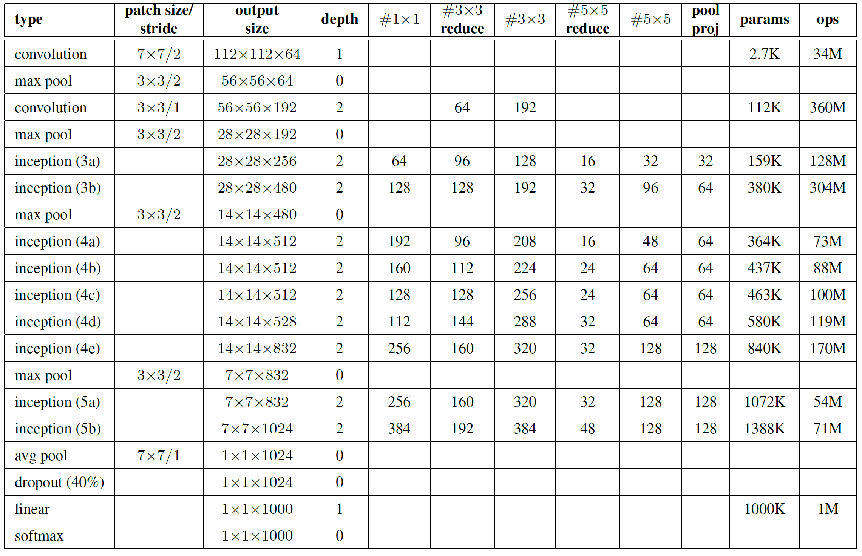
Only 6.8 million parameters. AlexNet ~60 million, VGG up to 138 million

Slide 37
Surely it would be ridiculous to go any deeper…
To be continued with ResNet

