Slide 1
FogStore: A Geo-Distributed Key-Value Store Guaranteeing Low Latency for Strongly Consistent Access
Harshit Gupta and Umakishore Ramachandran
Georgia Institute of Technology (Georgia Tech)

Slide 2
Outline
Motivation
FogStore design
FogStore implementation
Evaluations

Slide 3
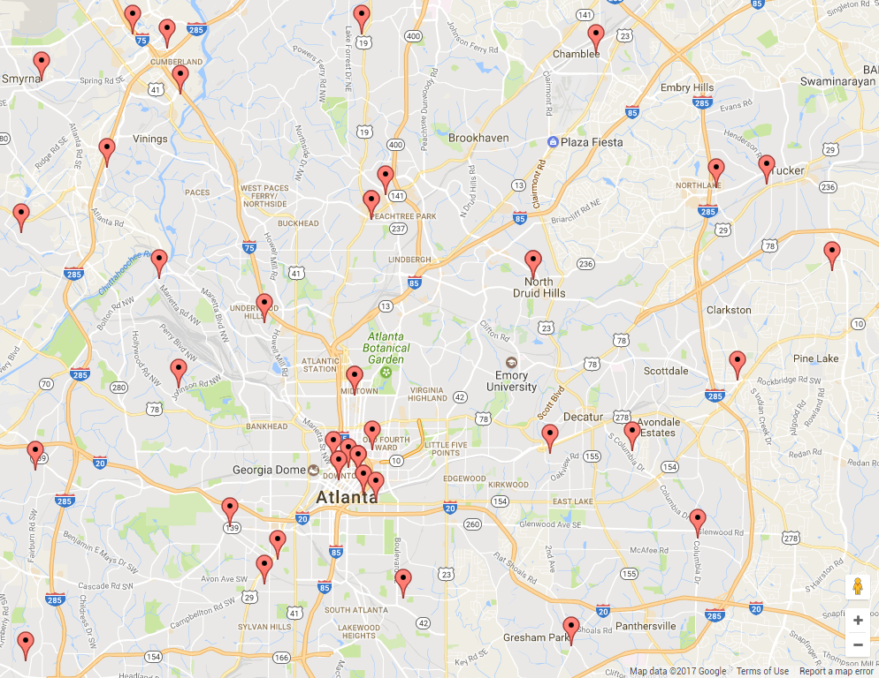
Fog/Edge Computing
Fog should offer same platform services as Cloud
Application state management
Apache Flink & Samza : stream processing engines
Foglets : fog computing execution runtime (DEBS ‘16)
CloudPath : multi-tier cloud computing framework (SEC ‘17)
Access to application state in critical path of logic
Low-latency, high throughput access to state
Multiple compute entities share state
Application components operating in same context
Out-of-core state backend
Can’t use cloud-based data-stores
Location of Central Offices around Atlanta (potential fog location candidates) http://www.marigolddirect.com/lists/co.php

Slide 4
Latency, Consistency and Fault-tolerance
Requirements :
Low-latency is a fundamental requirement for fog computing
Fog computing prone to geographically correlated failures
First-cut solution : eventually consistent geo-replicated store
Geo-replication ⇒ tolerance from correlated failures
Eventual consistency ⇒ low-latency operations
Problems [with eventual consistency]:
Stream-based situation awareness applications need strong consistency guarantees [3]
Coping with eventual consistency in application layer is complicated [4]
[3] Affetti, Lorenzo. Consistent stream processing: Doctoral symposium. 11th ACM, DEBS ’17.
[4] Shute, Jeff et al. F1: A distributed sql database that scales. Proceedings of the VLDB Endowment, 6(11):1068–1079, 2013
Notes:
Verify strong consistency argument

Slide 5
Latency, Consistency and Fault-tolerance
Strong consistency should be provided by datastore itself
Majority quorum-based read/update operations
Read V1
Update succeeded
V1
V1
V1
V1
Bob
Alice
V0

Slide 6
Latency, Consistency and Fault-tolerance
Strong consistency should be provided by datastore itself
Majority quorum-based read/update operations
Two extremes of replica placement :
In-proximity to clients
Low-latency execution of quorum read/update
Low tolerance from geographically correlated failures
Widely geo-distributed replicas
High tolerance from geo-correlated failures
High latency of read/update operations
Latency and fault-tolerance conflict when strong consistency is required

Slide 7
Idea behind FogStore
Achieve both low-latency and fault-tolerance with high consistency (Utilize application characteristics)
Meant for situation-awareness applications
Interaction with physical environment
Relevance of a data-item dependent on client’s context
Not every data-item relevant to a given client
Conversely, not all clients interested in a given data-item
E.g. a smart city’s data relevant to residents of that city
Notes:
NEED TO ADD SOMEWHERE THAT CERTAIN APPS LIKE BIG DATA ANALYSIS WORK WITH EVENTUALLY CONSISTENT DATA

Slide 8
Motivating use-case : Vehicle tracking
Append vehicle detection to state
Insert
(Licence#, Locn, Time)
Notes:
Add more details into step 6

Slide 9
Motivating use-case : Vehicle tracking
Fetch set of recent detections of that vehicle
Insert
(Licence#, Locn, Time)
Recent detections
Notes:
Add more details into step 6

Slide 10
Motivating use-case : Vehicle tracking
Update trajectory of vehicle
Insert
(Licence#, Locn, Time)
Recent detections
Last detection → Current detection
Notes:
Add more details into step 6

Slide 11
Motivating use-case : Vehicle tracking
Access to state in critical control flow path
Events tagged with spatio-temporal context
Spatio-temporal locality of state access
Insert
(Licence#, Locn, Time)
Recent detections
Last detection → Current detection
Notes:
Add more details into step 6

Slide 12
Idea behind FogStore
FogStore provides :
Low-latency strongly consistent access to relevant data
IoT applications sharing state in a smart city
Eventually consistent access to non-relevant data
Streaming analytics requiring aggregate information (e.g. Confluent Kafka Connect)

Slide 13
Contributions
Develop notion of relevance for data in situation-awareness applications
Propose location-aware replica placement strategy
Low-latency and fault-tolerance
Tolerant to skews in input workload distribution
Differential consistency guarantees
Strong consistency (serializability) for relevant data
Eventual consistency for non-relevant data
Extend Apache Cassandra with above changes and quantify performance improvements
Compare against off-the-shelf Cassandra
Evaluation of tolerance from geographically correlated failures
Evaluation of skew tolerance

Slide 14
Relevance of data : Context-of-Interest
Situation-awareness applications interacting with physical environment
Interest in data based on spatio-temporal locality
E.g. smart cars interested in status of traffic lights within same city
E.g. vehicle detection relevant for 5 kilometres and 30 minutes
A data-item is more relevant in a certain context than another
Application specific definition of relevance
Called Context-of-Interest (CoI)
CoI formalized as a geographical region around the event
Parameter CoISize
Size defined by application
Relevant items accessed with strong consistency
Non-”relevant” items accessed with eventual consistency
CoI for event E

Slide 15
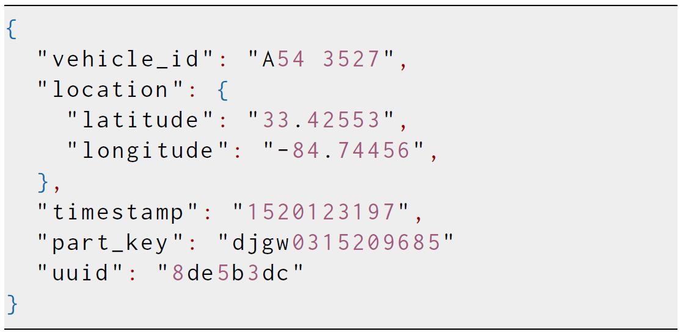
Data model
Spatial and temporal fields
Partition key field “part_key”
Used to partition data-items across nodes
Derived from item context
Drives replica placement and quorum formation
Supported queries
SELECT * FROM vehicle_detections WHERE vehicle_id == “A54 3527” AND location IN ((lat, lng), radius)
UPDATE traffic_light_status SET north_status=green WHERE signal_id == “33” AND location == (lat, lng)
Notes:
MUTABLE data-items, focussed for this talk

Slide 16
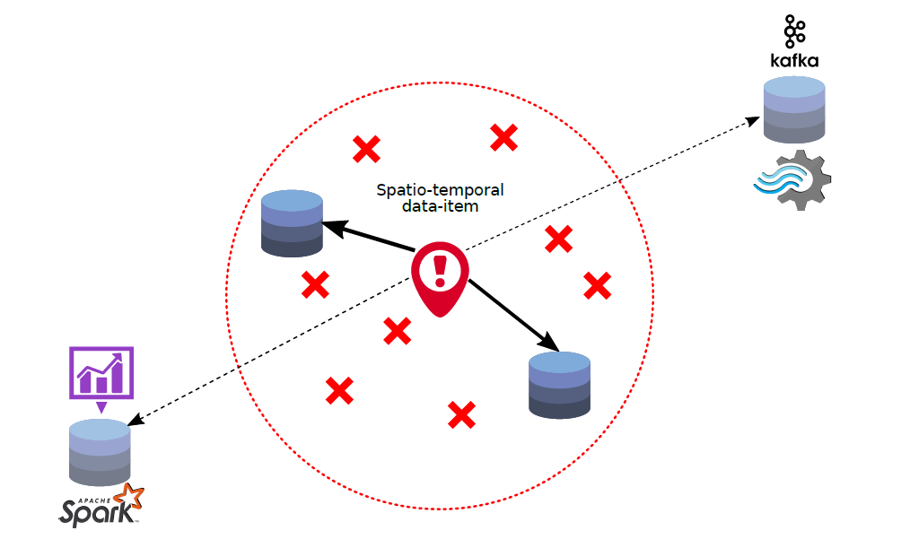
Context-aware placement
Two types of replicas for each data-item
InCoI replicas
Placed in proximity to Context-of-Interest
At max InCoiDist away from data-item
Serve clients inside Context-of-Interest
Low-latency access to relevant data
OutCoI replicas
Geographically distributed
At least OutCoiDist from data-item
Serve clients outside CoI for non-critical operations (data analytics, etc.)
Tolerance from geographically correlated failures
OutCoIDist
InCoIDist

Slide 17
Differential consistency
Two types of replicas for each data-item
InCoI replicas
Strongly consistent
Part of quorum for all reads/writes
OutCoI replicas
Eventually consistent
Updates propagated asynchronously to them
OutCoIDist
InCoIDist

Slide 18
Latency-Consistency tradeoff
For a given data-item
Client inside CoI (data relevant) ⇒ read quorum of InCoI replicas ⇒ low latency + high consistency
Client outside CoI (data not relevant) ⇒ read any OutCoI replicas ⇒ low latency + eventual consistency

Slide 19
Handling workload skews
Input workload generated by activity in physical world
Workload distribution contingent on activity distribution
Localized data storage can lead to hotspots
Nodes close to activity hotspots heavily loaded
Poor load balancing
Location-agnostic placement ideal for load balancing
Used by off-the-shelf Cassandra
Poor proximity of data to clients
Hybrid data placement strategy required

Slide 20
Implementation

Slide 21
Cassandra : Replication
13
Client write request (K, V)
1
99
29
hash (K) = 32
8
2
92
7
43
3
6
4
61
85
5
72

Slide 22
Cassandra : Replication
13
Client write request (K, V)
1
99
29
hash (K) = 32
8
2
92
7
43
3
Primary Replica
6
4
61
85
5
72

Slide 23
Cassandra : Replication
Client write request (K, V)
1
hash (K) = 32
8
2
7
3
Primary Replica
6
4
5
Secondary Replicas
Notes:
Add consistency level information. Maybe another slide with read consistency level.

Slide 24
Cassandra : Consistency (Quorum)
Client write request (K, V)
1
hash (K) = 32
8
2
7
3
Primary Replica
6
4
5
Secondary Replicas
Notes:
Add consistency level information. Maybe another slide with read consistency level.

Slide 25
Cassandra : Consistency (Quorum)
Client write request (K, V)
1
hash (K) = 32
8
2
Done !
7
3
Primary Replica
6
4
5
Secondary Replicas
Notes:
Add consistency level information. Maybe another slide with read consistency level.

Slide 26
Implementation sub-parts
Locality-aware data partitioning
Selection of InCoI and OutCoI replicas
Consistency tuning : Quorum selection

Slide 27
Construction of partition key
Hybrid scheme for latency and load-balancing
Location-aware
Consistent hashing
Token for datastore node calculated similarly
Geolocation → g-bit geohash
Random k-bit integer
Length of spatial encoding impacts latency
Larger “g” ⇒ higher proximity ⇒ lower latency
Consistent hash
g bits
djgw
0315209685
k bits
Spatial encoding
Notes:
Mention consitent hashing before

Slide 28
Node token formation
1
djgp
6542893745
Node Location
Random String
8
2
djgp
2147536942
7
3
Spatial encoding
6
4
djgp
0589644378
5

Slide 29
How does partition key work ?
{ event_type = “car_accident”, location = (33.4259, -84.5569), timestamp = 1525341757 }
1
djgp
6542893745
8
2
djgp
3365789145
djgp
2147536942
7
3
{ event_type = “temperature”, location = (33.4259, -84.5569), timestamp = 1525341757 ,
value = 33.4 }
6
4
djgp
0589644378
5
djgp
1698722364
Notes:
All nodes with same spatial encoding part are candidates for load-balancing.

Slide 30
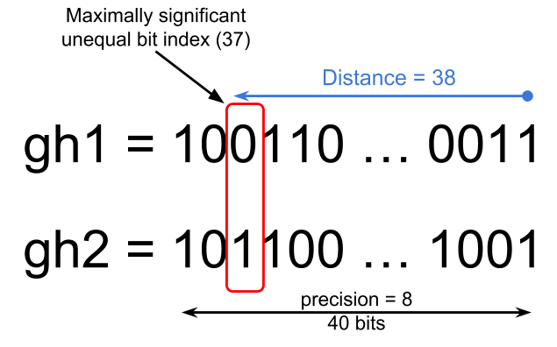
Replica placement policy
Use a distance metric for spatial encodings
Use 2 threshold values for selecting replica nodes
InCoIDist : maximum distance between data-item’s location hash and In-CoI replica’s location hash
OutCoIDist : minimum distance between data-item’s location hash and Out-CoI replica’s location hash
OutCoIDist
InCoIDist
Notes:
More about the algorithm

Slide 31
CoI-aware consistency tuning
Quorum formed on the basis of client’s location
Client inside CoI : access quorum of InCoI replicas
Strongly consistent data access
Low-latency as replicas are in proximity
Client outside CoI : read from any replica
Eventually consistent data access
Low-latency as need to wait for the closest replica
All updates operations have to synchronously update InCoI replicas

Slide 32
Evaluations

Slide 33
Comparison against typical replication policies
FogStore
Strongly consistent Cassandra (off-the-shelf)
Eventually consistent Cassandra (off-the-shelf)
Notes:
Workload generated uniformly from the region

Slide 34
Comparison against typical replication policies
Geo-distributed datastore infrastructure
4 nodes inside Atlanta and 4 in remote datacenters
Replication factor = 3 (2 local + 1 remote)
Host and network emulation : Maxinet
Distance → WAN latency estimation#
Experiments run on Microsoft Azure
16 cores
64GiB RAM
# http://wintelguy.com/wanlat.html
Notes:
Workload generated uniformly from the region

Slide 35
Comparison against typical replication policies
Yahoo Cloud System Benchmark for workload generation
4 client nodes running 4 threads each
Each YCSB client colocated with a local (Atlanta) node
Mimics a situation-awareness application
Variables
Read/update proportion (20%, 50%, 80%)
Key distribution (hotspot, latest, Zipfian)
Notes:
Workload generated uniformly from the region

Slide 36
Read latency distribution

Slide 37
Throughput comparison
Notes:
Reads are faster than writes due to read quorum = 1 . Higher read% implies higher throughput .

Slide 38
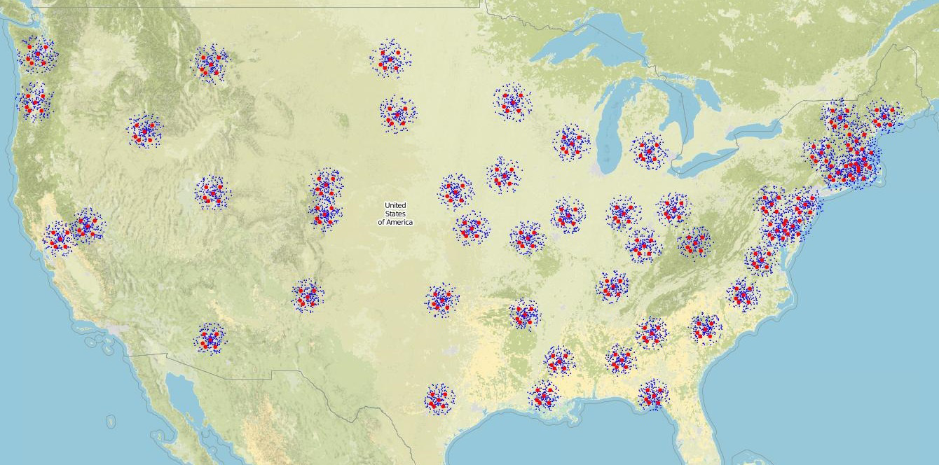
Fault tolerance evaluation
Limitations of scale in emulation setup
Resort to simulation
Simulate replica placement policy
Two large-scale topologies
AT&T backbone network ¹
USA State Capitals
1 : http://www.topology-zoo.org/
Notes:
Find citation about correlated failures

Slide 39
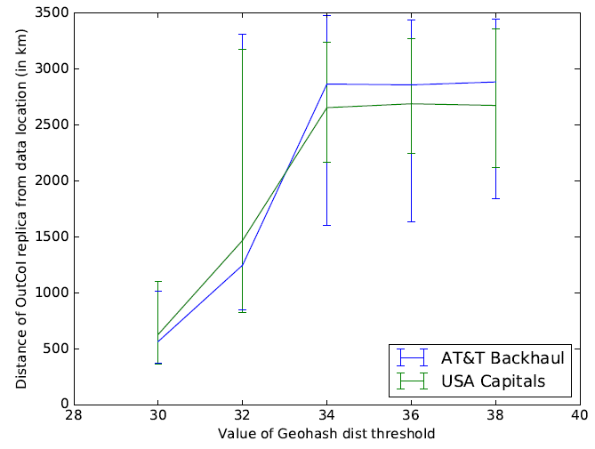
Fault tolerance evaluation
Simulate replica placement algorithm
Y-axis : Dist. of OutCoI replica from data-item X-axis : OutCoIDist threshold
Encoding distance > 34 ⇒ distance > 2500 KMs between replicas ⇒ tolerance from geographically correlated failures
Notes:
Find citation about correlated failures

Slide 40
Conclusion
Context-aware replica placement
In proximity ⇒ low latency
Geo-distributed ⇒ fault-tolerance
Context-based differential consistency
Inside Context-of-Interest ⇒ high consistency
Outside Context-of-Interest ⇒ eventual consistency
Improvement in performance over off-the-shelf Cassandra
Fault-tolerance comparable to geo-replication

Slide 41
Future Works
Low storage capacity on fog nodes
Interplay between cloud DCs
Erasure coding
Efficient failover strategies
Consistency guarantees ?
Federation of edge storage providers

Slide 42
Thank you !

Slide 43
Chur !

Slide 44
Rough idea of what consistency and CoI mean
If clients C1 & C2 are inside CoI, and C3, C4 outside
Operations of C1 and C2 are mutually serializable
No guarantees between operations of C3 and C4
What about between C1 and C3 ?
Perhaps add a diagram on the lines of serializability example

Slide 45
Related work on latency-consistency tradeoff
Characterization of latency-consistency tradeoff [2]
Probabilistic CAP systems - operate close to CAP’s impossibility envelope
Given probabilistic latency requirement, optimize consistency
Don’t perform placement for fault-tolerance - latency tradeoff
Probabilistically choosing between Strong and Eventual consistency [3]
Transforms discrete consistency level choices to a continuous tunable value
Machine learning techniques for predicting consistency level satisfying latency and staleness [4]
Adaptive model to select consistency level that satisfies SLA
[2] Rahman, Muntasir Raihan, et al. "Characterizing and adapting the consistency-latency tradeoff in distributed key-value stores." ACM Transactions on Autonomous and Adaptive Systems (TAAS) 11.4 (2017): 20.
[3] McKenzie, Marlon, Hua Fan, and Wojciech Golab. "Fine-tuning the consistency-latency trade-off in quorum-replicated distributed storage systems." Big Data (Big Data), 2015 IEEE International Conference on. IEEE, 2015.
[4] Sidhanta, Subhajit, et al. "Adaptable SLA-Aware Consistency Tuning for Quorum-Replicated Datastores." IEEE Transactions on Big Data 3.3 (2017): 248-261.

Slide 46
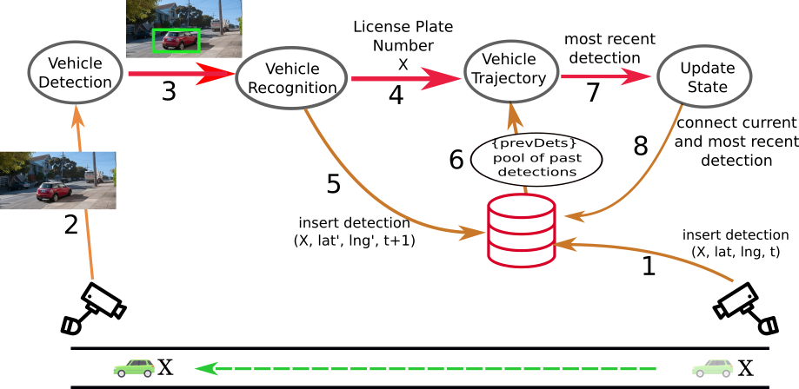
Motivating use-case : Vehicle tracking
Access to state in critical control flow path
Events tagged with spatio-temporal context
Spatio-temporal locality of state access
Notes:
Add more details into step 6

Slide 47
Differential consistency
Two types of replicas for each data-item
InCoI replicas : Strongly consistent
Serve clients inside Context-of-Interest for critical operations
Part of quorum for all reads/writes by clients inside Context-of-Interest
Updates are applied synchronously
Provide low-latency access to consistent data to clients in CoI
OutCoI replicas : Eventually consistent
Serve clients outside CoI for non-critical operations (data analytics, etc.)
Updates propagated asynchronously to them
Provide tolerance from geographically correlated failures

Slide 48
Implementation challenges
Partition data (replica placement) to nodes based on location
Maintain differentially consistent replicas
Location aware replica selection for queries (based on client context)
Inside CoI ⇒ consistent data access
Outside CoI ⇒ eventually consistent data access
Data partitioning has to be tolerant to skews in workload

Slide 49
Range query decomposition
(gh²_{min}, gh²_{max})
60
59
58
60
65
(gh⁴_{min}, gh⁴_{max})
R
R
55
62
64
(lat, lng)
(lat, lng)
57
54
56
61
63
Blocks of Geohash encoding
(gh¹_{min}, gh¹_{max})
(gh³_{min}, gh³_{max})
Brahim, Mohamed Ben, et al. "Spatial data extension for Cassandra NoSQL database." Journal of Big Data 3.1 (2016): 11.
Extract contiguous subsequences of Geohash encoding

Slide 50
Range sub-query execution
1
For each contiguous subsequence
djhc
6542893745
8
2
(djgp, djgz)
djgp
2147536942
Min part_key
7
Query targets
3
djgp
0000000000
djgz
9999999999
Max part_key
djgp
0589644378
6
4
5
djgn
0624593501

Slide 51
Evaluation setup
MaxiNet network emulator
Extension of MiniNet for emulation on cluster of servers
Support for Dockerized applications
Network latencies calculated using WAN Latency Estimator (http://wintelguy.com/wanlat.html)
Underlying hardware specs
16 vCPUs
64 GB RAM

Slide 52
Comparison against typical replication policies
For FogStore
|Read quorum| = 1
|Write quorum| = 2
Variables
Read/update proportion (20%, 50%, 80%)
Key distribution (hotspot, latest, Zipfian)
Metrics
Read/update latency
Operation throughput (ops per sec)
Client-centric consistency

Slide 53
Client-observed consistency
Associate timestamp with each key version
Keep track of most recently written version
Check if read returns most recent version
Report violation if mismatch
Strongly consistent Cassandra and FogStore have ZERO violations
By design, read and write quorums overlap
Percentage of reads returning inconsistent results
With eventually consistent Cassandra
Notes:
Why is 50% reads Latest so different from other Latest ?

Slide 54
Update latency distribution

Slide 55
Spatial range query performance
Data-distribution performed on basis of location
Range queries may require reading from multiple nodes
Range queries of the form (L, R, T)
Circular region centred at location L with radius R
Events with type T
Use eventually consistent datastore as baseline
Use event type to partition events
All events of a range-query can be found on a single node
{ event_type = “car_accident”, location = (33.4259, -84.5569), timestamp = 1525341757 }

Slide 56
Spatial range query performance
Database preloaded with 4000 events of 10 different types
Range query centre L chosen uniformly
Event type T chosen uniformly from the 10 types
R (radius of range query) varied
Latency of range query measured
Notes:
How is L chosen ? How is T chosen ?

Slide 57
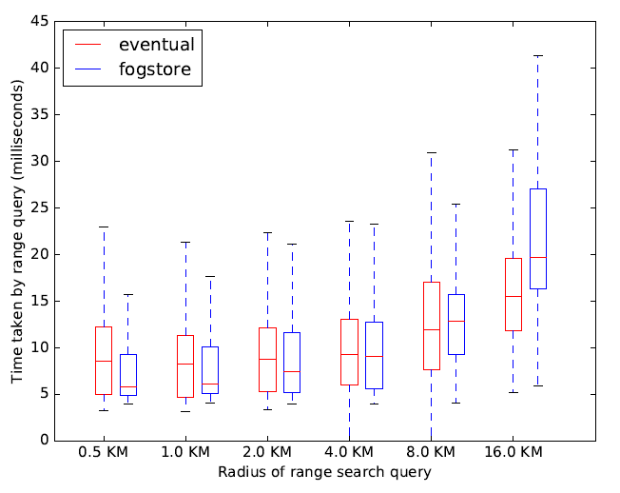
Spatial range query performance
Results aggregated across 5000 queries
Performance comparable to eventually consistent store
Increasing range radius increases latency
More nodes to gather results from
Improvement more clear with larger number of nodes
Off-the-shelf Cassandra’s location-agnostic placement
Current emulation platform has limitations

Slide 58
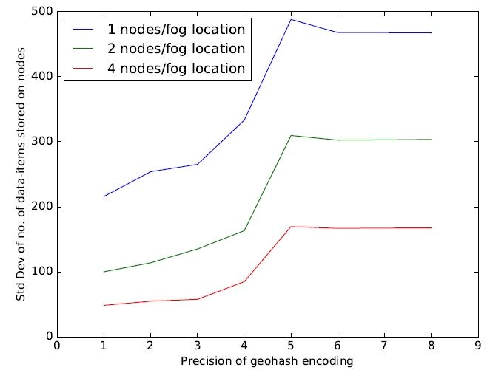
Balancing load across nodes
Higher geohash precision ⇒ higher spatial proximity ⇒ lower load balancing
Geohash encoding precision > 5 ⇒ all nodes have distinct tokens ⇒ no more load balancing
Replication policy able to utilize higher number of available nodes
Increase in nodes/location improves load balancing
Lower is better
Standard deviation of number of data-items on each node (lower ⇒ better load-balancing)

Slide 59
Balancing load across nodes
Load balancing within same location
Skews in workload cause data-distribution hotspots
Due to spatial proximity of replica placement
Simulation of replica placement
64 fog locations in Atlanta
Traffic generated from Atlanta region
80% data-items from 20% area (hotspot)
Variables
Precision of Geohash encoding in node token ⇒ Load balancing across locations
Number of nodes at each location ⇒ load balancing on the same location
Metric
Standard Devn. ([#data-items placed on each node])
Load balancing across locations

Slide 60
Fault tolerance evaluation
Fog infrastructure lacks well defined datacenters/regions
Spatial encoding translates 2D location to 1D value
Does not always preserve distance between points
Simulate replica placement algorithm
Real-world geo-distributed infrastructure topologies
AT&T backbone network
USA capital cities : each city hosting fog nodes
Data-items generated from around the fog locations

Slide 61
Fault tolerance evaluation
Variable : Min Geohash distance (OutCoIDist) threshold
For OutCoI replica placement
Metric : Distance of OutCoI replicas from data location
Tolerance from geographically correlated failures

