Slide 1
OneEdge: An Efficient Control Plane for Geo-Distributed Infrastructures
Enrique Saurez, Harshit Gupta,
Alexandros Daglis, and Umakishore Ramachandran
Problem: Scheduling to ensure correct functionality and performance for situation-awareness applications over geo-distributed infrastructures.
Key takeaways:
Make spatial affinity and end-to-end latency requirements 1st class citizens for scheduling.
Hybrid centralized-distributed control-plane architecture for agility.
Notes:
12 secs
Hello everyone. I am Harshit Gupta, and this is Enrique Saurez from Georgia Tech.
We are going to be presenting the work we did with Profs Alexandros Daglis and Umakishore Ramachandran, called “OneEdge: An Efficient Control Plane for Geo-Distributed Infrastructures”.

Slide 2
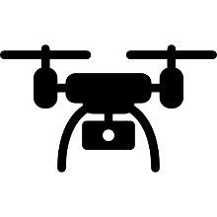
Situation-Awareness Applications
Sense
Process
Actuate
Sense-process-actuate control loop
Two main categories
Coordinated E.g., collaborative autonomous driving
Standalone E.g., autonomous drone navigation
Application Requirements
Spatial Affinity: Coordination of close-by clients
Low end-to-end processing latency
Collaborative Autonomous Driving
Autonomous Drone Navigation
End-to-end latency requirement
Spatial affinity requirement
Notes:
1 min
We target situation-awareness applications,
(click) which sense data from the environment, process it and perform actions based on extracted insights
(click) Such applications can typically be classified into two categories.
(click) First, coordinated applications, require inter-client coordination for correct functionality.
An example is a collaborative autonomous driving application that fuses together the views of close-by cars and sends the fused view back to them.
(click) The other category is standalone, in which each client’s processing is independent of others.
An example is navigation control for an autonomous drone, which uses computer vision to detect obstacles and navigate.
(click) Such applications have specific requirements.
(click) Firstly, coordinated applications require that clients in proximity to each other be served by the same application instance so that they can share information among each other.
(click) Secondly, end-to-end latency of the application is a key performance requirement for both application types.

Slide 3
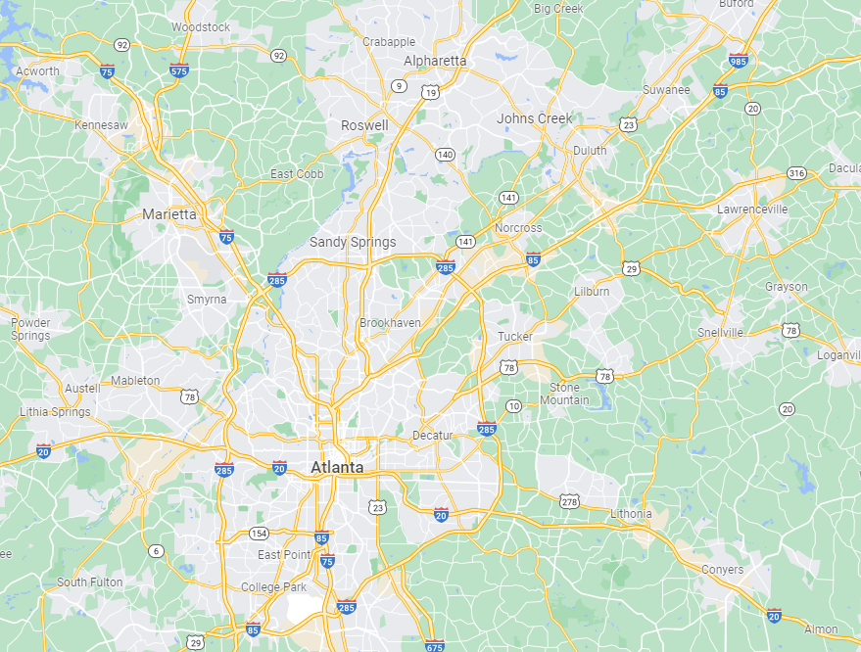
Geo-Distributed Edge Infrastructure
Micro data centers (µDC) near clients
Geo-distributed to ensure coverage
Form a resource continuum with cloud
Limited resource capacity per µDC
Power constraints
Space constraints
Alpharetta
Lawrenceville
Marietta
Sandy Springs
Lilburn
Downtown Atlanta
Notes:
17 secs
To serve latency-sensitive applications, geo-distributed edge micro Datacenters in proximity to clients has been proposed as a viable alternative to cloud datacenters.
These edge micro DCs form a continuum of resources with cloud datacenters.
However the capacity of each micro DC is limited due to power and space constraints.

Slide 4
Problem: Control Plane Architecture
Physical infrastructure is non-uniform
High and variable network latency
Limited and variable resources on µDCs
Client mobility
Results in SLO violation
Must adapt application placement
Via continuous monitoring of applications
Low deployment latency is key to avoiding SLO violations
< 60% utilized
> 90% utilized
Low network latency
High network latency
High communication delay
Spatial region 1
Spatial region 2
Notes:
1 minute 5 seconds
Another aspect of our target applications is continuous client mobility, which results in violation of latency and spatial-affinity SLOs, and application placement needs to be dynamically adapted to keep meeting the SLOs. This requires monitoring observed application metrics and triggering a migration in the event of SLO violation.
Given the stringent end-to-end latency requirements, high rate of sensing and frequent mobility-driven SLO violations, the low deployment latency is desirable to ensure that dynamic adaptation of application placement is agile and SLO violations are minimized.

Slide 5
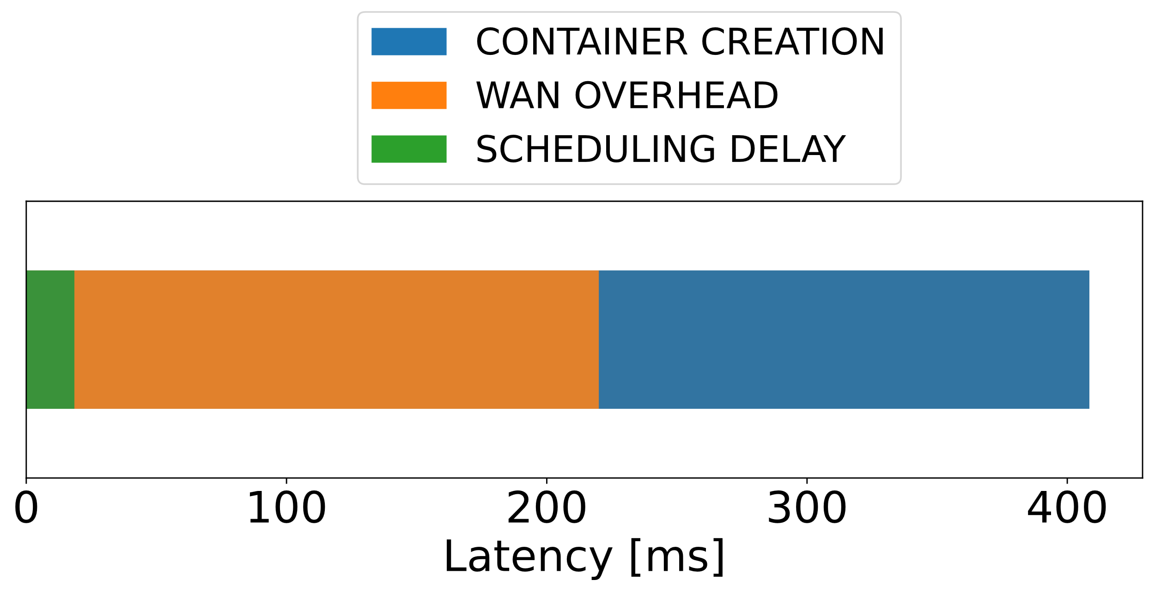
Limitations of the state-of-the-art
Control Plane
Significant WAN overhead in centralized architectures
Multiple round-trips over WAN to clients and µDCs
Not ideal for diverse application types
Only coordinated applications need global knowledge
Standalone app instances are independent
Centralized scheduling ➔ higher SLO violations
Lacks native support for monitoring client geo-location and end-to-end latency
Central Controller
Infrastructure State
Deploy
Wide Area Network
Deployment Latency [ms]
Notes:
1 min 15 secs
(click) Typical control-planes rely on a centralized decision-maker for application scheduling,
(click) which is separated from clients and edge micro-datacenters by the Wide Area Network .
(click) This architecture imposes significant overhead due to repeated wide-area traversals between the central controller and clients and micro-datacenters.
(click) This is shown through our evaluation of Kubernetes with network latency of 40 ms between the controller and worker nodes.
(click) WAN overhead consumes a significant portion of the end-to-end deployment latency.
(click) Next, the state-of-the-art uses the same centralized architecture to serve applications with diverse requirements.
(click) Centralized scheduling enables the use of global infrastructure state for decision-making. Which is suitable for coordinated applications which need to discover the right application instance serving the client’s current spatial region.
(click) However instances of standalone apps can be independently scheduled.
(click) Forcing them to be centrally scheduled leads creates a bottleneck and increases end-to-end deployment latency. This ultimately results in the controller being less responsive to SLO violations.
(click) Furthermore, state-of-the-art control-planes don’t support monitoring client geo-location and end-to-end latency natively, which is required for continuous SLO satisfaction in the presence of client mobility.

Slide 6
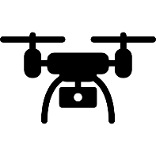
Design Overview and Principles
Spatial affinity req.
End-to-end latency req.
Challenges
Solutions
Expose application requirements to the control-plane
SLO satisfaction under non-uniform infrastructure
Site Manager
Central Controller
Low agility of centralized scheduling
Two-level control-plane architecture
End-to-end latency
Achieve end-to-end visibility of app metrics
Cross-component metrics aggregation
Geo-location
Notes:
45 secs
We now present the design principles that guide our proposed control-plane architecture.
* (click) To provide SLO satisfaction under non-uniform infrastructure,
(click) We expose spatial affinity and end-to-end latency requirement to the control-plane as key inputs to the scheduling policy.
(click) To deal with the lack of agility of centralized-only scheduling in state-of-the-art,
(click) we propose a two-level control-plane architecture, wherein we extend decision-making to the edge sites in the form of a Site Manager component.
(click) To obtain end-to-end visibility of application metrics during client mobility
(click), we perform monitoring and aggregation of client geo-location and end-to-end latency across application components.

Slide 7
Control Plane Mechanisms
Spatial affinity
End-to-end latency
Control plane decides using
E2E latency
Spatial affinity
µDC resource capacity
SLO satisfaction via monitoring
Latency
Spatial data
Reconfiguration on SLO violation
Control Plane
Deploy
Network Proximity
+
Resources Available
Deployment Request
Location
E2E Latency
Network Proximity
+
Resources Available
Location
Spatial Region 1
Spatial Region 2
Spatial and Latency SLOs drive control plane decisions
Notes:
Now, we will discuss the design principles in more detail. First focusing on the control plane mechanisms.
(Click) The first point of contact of any client into the infrastructure is the control plane.
(Click)The client will send…
(Click) Then, the control plane decides where to deploy the corresponding application components using:
… to cater to all the requirements of the application.
(Click) Let’s now see the next most important task of the control plane…
(Click) It would then keep monitoring the Spatio-temporal metrics…
This information would help the system detect any potential violation of the application requirements, like, for example,
Mobility
Latency violation
(Click) The monitoring data would be used for application reconfiguration and migration. It would use the …
(Click) To find a better-suited micro-data center to host the application or connect to an already running instance for that spatial region
In summary, OneEdge decisions are primarily SLO-driven from first-class spatial and latency metrics better suited for situation-awareness applications.

Slide 8
Two-level Hybrid Control Plane Architecture
Control Plane
Two top-level entities
Site Manager
Autonomous decisions
Central Controller
Multi-µDC decisions
Reconciles conflicting needs
Low-latency decisions
Standalone applications
Spatial affinity
Coordinated applications
Monitoring
Controller
Central Controller
Monitoring
Digest
Monitoring
Digest
Site Manager
Site Manager
Deployment Request
Monitoring
Monitoring
Deployment Request
µDC
µDC
Two-level hybrid architecture reconciles conflicting application needs
Notes:
Next, we will analyze the …. of OneEdge.
(Click) Previously we discussed that the controller makes all the decisions, with the help of the monitoring
(Click) If we have a centralized …. micro-datacenters and client could be farther away, like the micro-data center and client on the left, which can be problematic for ….
Availability
Providing SLOs
(Click) To solve this limitation, we propose …
(Click) …It is the local entity in charge of managing each micro-data center autonomously….has complete control over the deployment of applications locally.
(Click) This design has a second benefit …
Without sending raw logs
The problem with a design where only site managers exist is that cross-micro datacenter coordination cannot be performed easily.
(Click) This is why the centralized controller exists.
(Click) coordinating decisions …
Required, for example, to deploy coordinated applications for a specific spatial region correctly.
(Click) There is still a need to monitor …
Not all data is sent
Decision can still be performed locally.
(Click) This two-level hybrid architecture reconciles two conflicting needs
(Click) First, … For example… the drone can directly contact the site manager … will autonomously deploy
(Click) Second, …., which requires global knowledge to be performed. For example …. the deployment …., which knows all the spatial regions ….
(Click) This two-level hybrid architecture reconciles the conflicting needs of the different types of situation-awareness applications.

Slide 9
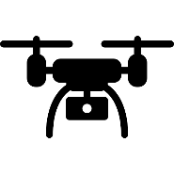
Experimental Methodology
Control plane comparisons
Centralized
Decentralized
Microbenchmarks
End-to-End Evaluations
Platform
Emulate metropolitan areas: Azure Regions
Applications
Standalone: Drone navigation
Coordinated: Cooperative autonomous cars
Mixed Workload
San Francisco Cabs Dataset
Carla simulator
Realistic input sensor traces
Central US
Central
Controller
West US
East US
South Central US
Notes:
We compared OneEdge against two architectures:
(click) centralized without spatial information, and a fully decentralized architecture.
(Click) We did both Microbenchmarks and End To End evaluations.
(Click) In the End-to-End evaluations,
For the platform, we emulated multiple metropolitan areas resources using different Azure regions
(Click) like central us, east us and others.
(Click) We used a mixed workload with both types of applications
(Click) We used a mockup version of the drone navigation application.
(Click) And a cooperative autonomous cars application.
(Click) To generate the workload. For mobility, we used both the San Francisco cabs dataset and the Carla simulator. As well as , realistic input sensor traces for both.

Slide 10
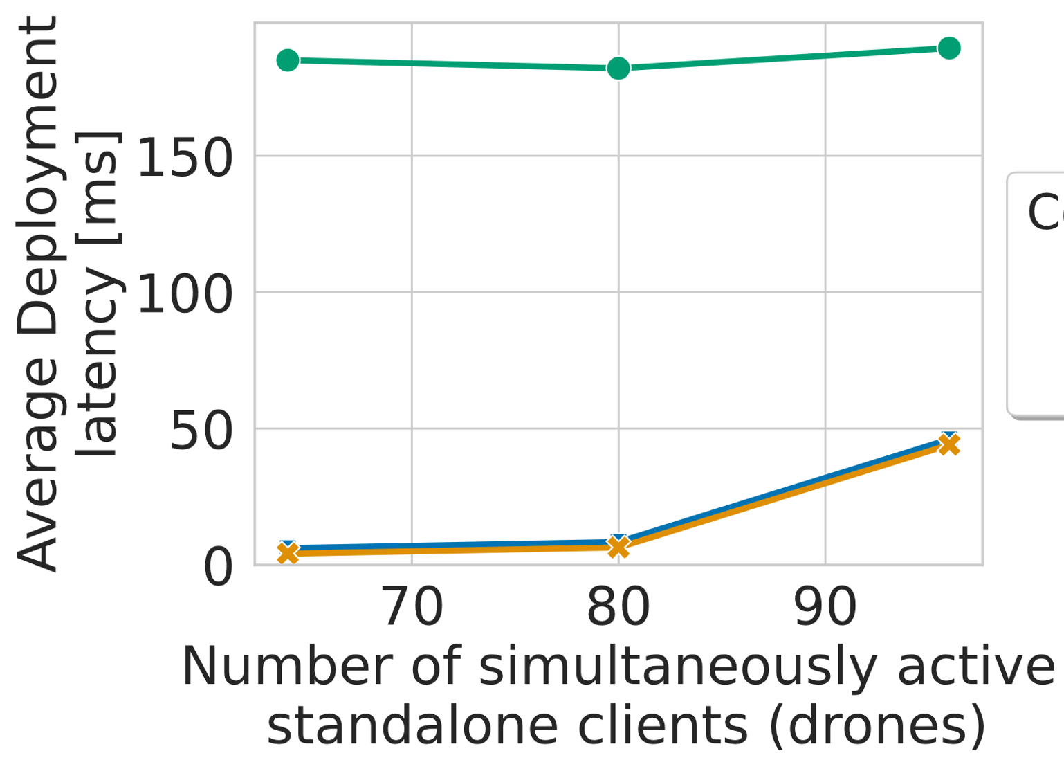
Evaluation Highlights
Metrics
Deployment Latency
Application’s Spatial Alignment
Results
Lower deployment latency
Standalone applications
Higher spatial alignment
Coordinated applications
100%
50%
Spatial Region 1
Spatial Region 2
OneEdge provides the best of both architectures
Notes:
Now, we present some highlights of the End to …
(Click) And we focus on two main metrics.
(Click) First, deployment latency is the duration until the client has access to a fully functional instance.
(Click) Second, it is the application's spatial alignment; spatially adjacent clients should share the same application instance. Then, the spatial alignment is the percentage of clients at a given instant that are sharing the correct application instance per region.
(Click) On this graph, we can ….
Here a lower number is better.
This shows that OneEdge achieves lower deploy latency … almost identical for a decentralized design, and much better than centralized.
(Click) On the next graph, we show the …. Here, a 100% is a perfect alignment.
OneEdge has the higher … Centralized has the worst results,
Centralized worst, given that it does not have spatial information and just selects a close-by micro-datacenters with spare capacity to deploy the application.
OneEdge does better than decentralized because proximity to a micro-data center does not perfectly align with the spatial regions.
(Click) This shows that OneEdge provides the best of both architectures for situation-awareness applications.

Slide 11
Additional contributions in the paper
Mechanisms to reduce the drawbacks of autonomous decisions
Trade-off between latency and load balance
State management coordination mechanisms
Efficiently support autonomous and multi-site decisions
Detailed architecture description
Proactive and reactive control plane actions
Dynamic monitoring
Programming model and taxonomy for applications
The need of multi-µDC deployments
Notes:
1. The paper covers different areas that we did not have time to discuss in this presentation.
2. In the paper we further discuss efficient mechanisms to both reduce the drawbacks of autonomous decisions, and for state management across control plane components.
3. As well as a detailed architecture description, and a programming model for situation-awareness applications in geo-distributed infrastructure.

Slide 12
Conclusion
OneEdge is an agile control plane for
Situation-awareness applications
Geo-distributed edge infrastructures
Main Features
Supports both autonomous and multi-µDC control plane actions
Low end-to-end deployment latency similar to decentralized
Decision quality comparable to an optimal centralized
Notes:
In Conclusion
OneEdge is an agile control plane designed for
situation-awareness applications and geo-distributed edge infrastructure.
The main features of OneEdge are:
that it supports both autonomous and multi micro-data center control planes actions,
with both
A low E2E latency similar to a decentralized architecture and
decision quality comparable to an optimal centralized architecture.
Our end-to-end results demonstrated all of these features.

Slide 13
Backup slides

Slide 14
OneEdge: System Architecture

Slide 15
Exemplar Situation-Awareness Application
Sub-regional View fuses sensed views
Of cars in the same spatial locale
Regional View performs higher level aggregation
Across adjacent spatial locales

Slide 16
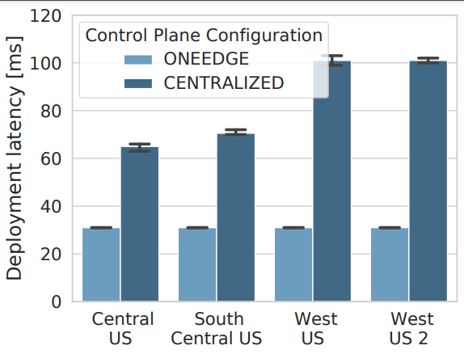
Comparison of Deployment latency
OneEdge vs. Centralized control-plane architecture
Standalone app clients present in each Metro area
Low load scenario to avoid congestion in scheduler’s queue

Slide 17
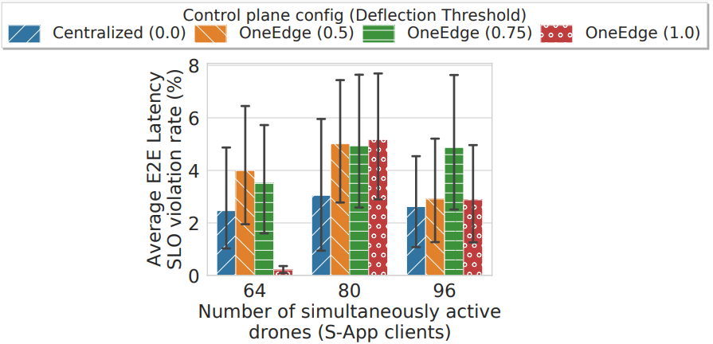
Latency SLO violations in end-to-end experiments

