Slide 1
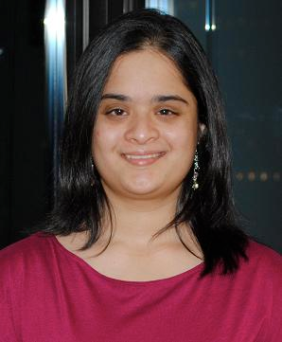
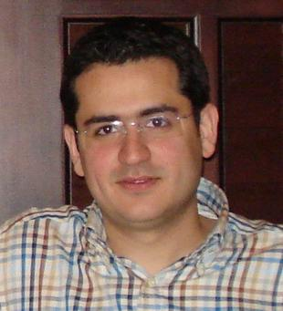
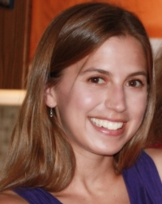
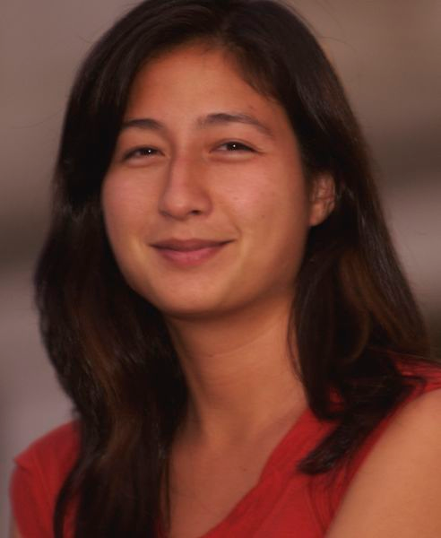
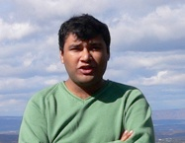
Attributes
Devi Parikh
Virginia Tech
Ali Farhadi
UW
Kristen Grauman
UT Austin
Tamara Berg
UNC (Fall 13)
Abhinav Gupta
CMU

Slide 2
Introduction
Papers
Workshops
Conference sessions
Different
Models
Applications
Types
…
Estimate
(15 at this conference)
Goal: Give you a structured overview of various research efforts involving attributes
Slide credit: Devi Parikh

Slide 3
Schedule
8:30 to 9:00: Introduction
9:00 to 10:00: Offline uses of attributes
10:00 to 10:15: Q&A
10:15 to 10:30: Break
10:30 to 11:00: Offline uses of attributes (cont.)
11:00 to 11:45: Online uses of attributes
11:45 to noon: Q&A
Noon to 1:30: Lunch
1:30 to 3:25: Attributes as features
3:25 to 4:00: Break
4:00 to 4:45: Describing images
4:45 to 5:30: Discovering a vocabulary of attributes
5:30 to 6:00: Pointers to resources and concluding remarks
All material will be posted online
PLEASE interrupt with questions.
Slide credit: Devi Parikh

Slide 4
Why attributes?
Why recognition?
Why would a robot need to recognize a scene?
Can I walk around here? Is this walkable?
Slide credit: Devi Parikh

Slide 5
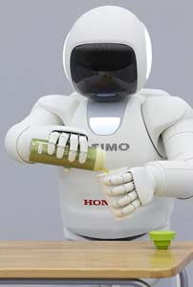
Why attributes?
Why would a robot need to recognize an object?
How hard should I grip this? Is it brittle?
Slide credit: Devi Parikh

Slide 6
Why attributes?
How humans naturally describe visual concepts
Image search
I want elegant silver sandals with high heels
Slide credit: Devi Parikh

Slide 7
Why attributes?
How humans think of concepts
Domain knowledge helpful to build visual models
Zebras have stripes.
Slide credit: Devi Parikh

Slide 8
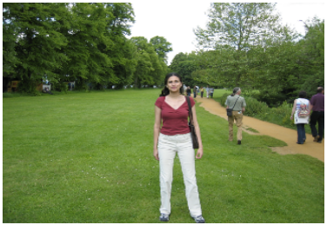
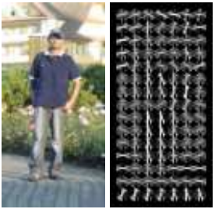
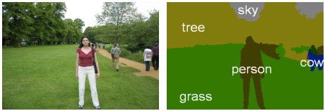
What are attributes?
Outdoor, Peaceful, Natural, Green,…
Mid-level concepts
Higher than low-level features
Lower than high-level categories
Shared across categories
Human-understandable (semantic)
Machine-detectable (visual)
Female, Long-hair, Young …
Dalal and Triggs, 2005
Slide credit: Devi Parikh
Ladicky et al, 2010

Slide 9
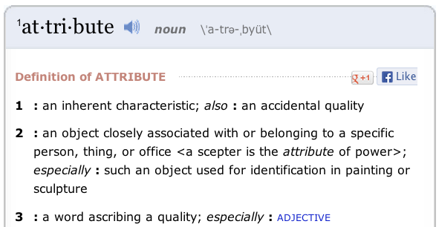
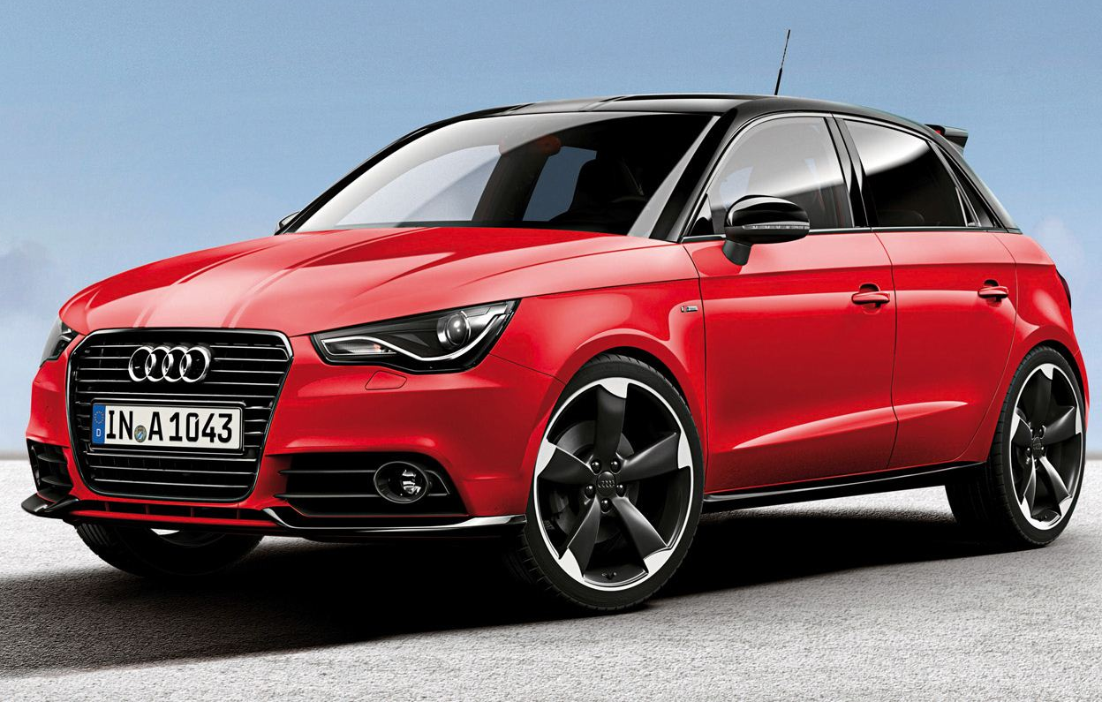
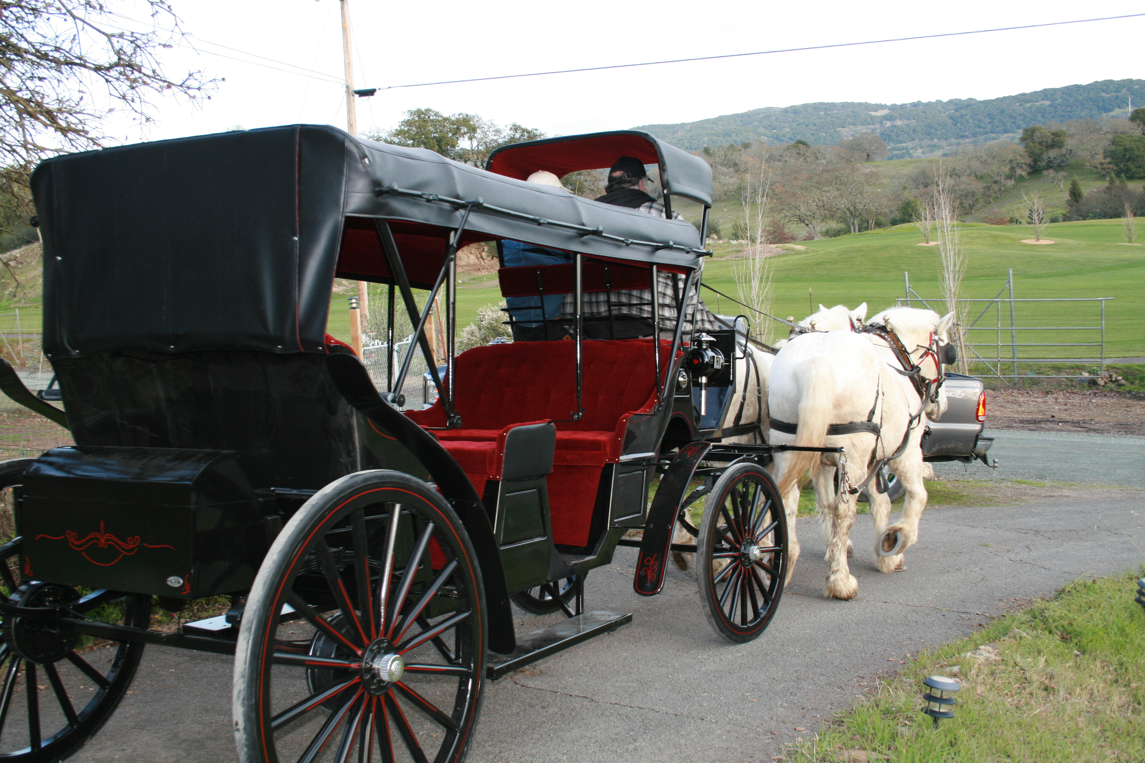
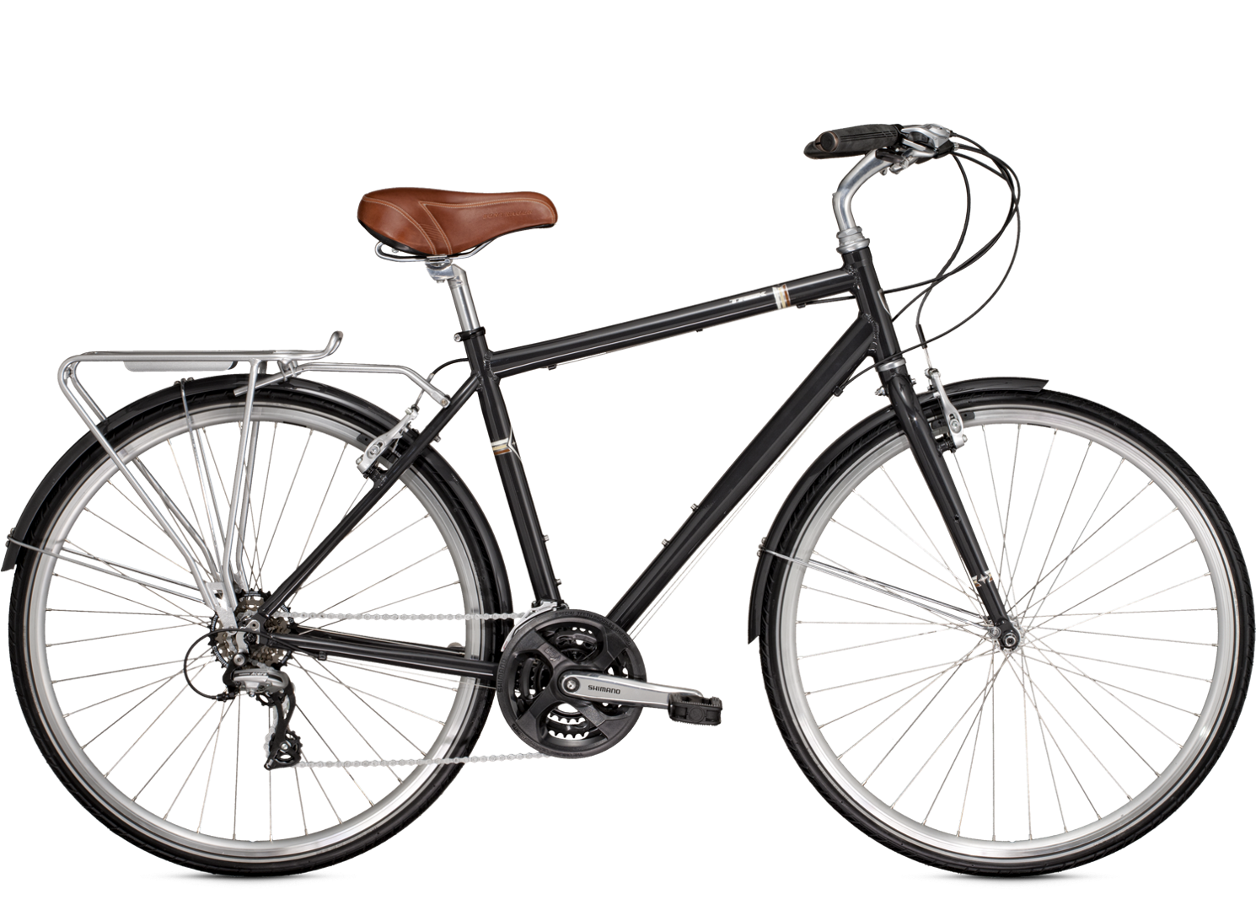
What are attributes?
Material, Appearance, Function, …
Any adjective
Statements about visual concepts
Objects, scene: Nouns
Actions: Verbs
Distinctions less critical in how to predict attributes
Distinctions important in uses of attributes for improving computer vision
Parts often semantic, shared, mid-level
Can be used as attributes
Slide credit: Devi Parikh

Slide 10
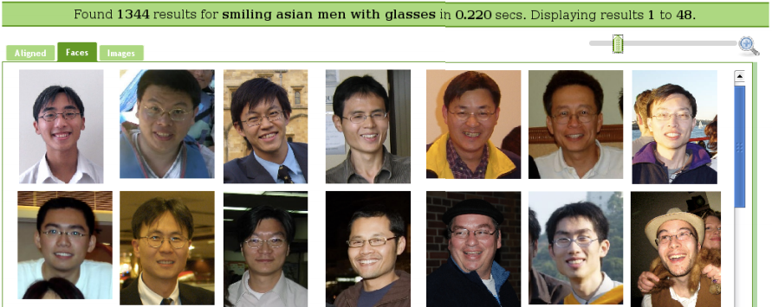
Example Attributes
Face Tracer Image Search
“Smiling Asian Men With Glasses”
Kumar et al. 2008
Slide credit: Devi Parikh

Slide 11
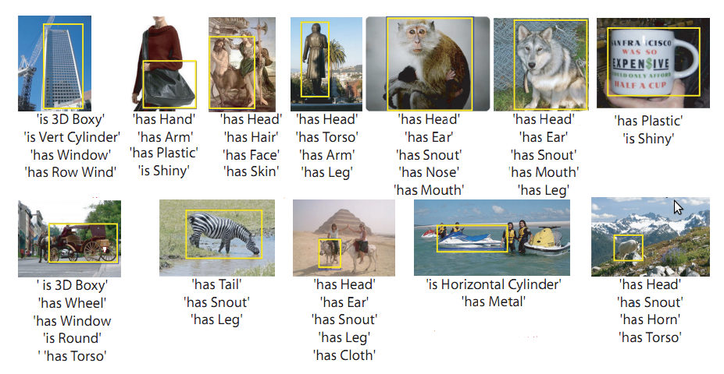
Example Attributes
Farhadi et al. 2009
Slide credit: Devi Parikh

Slide 12
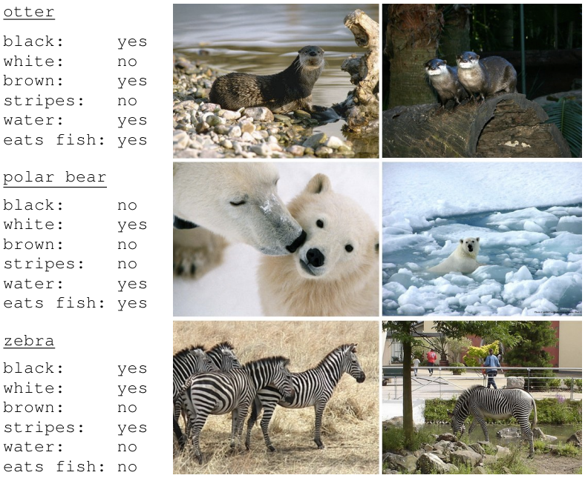
Example Attributes
Lampert et al. 2009
Slide credit: Devi Parikh

Slide 13
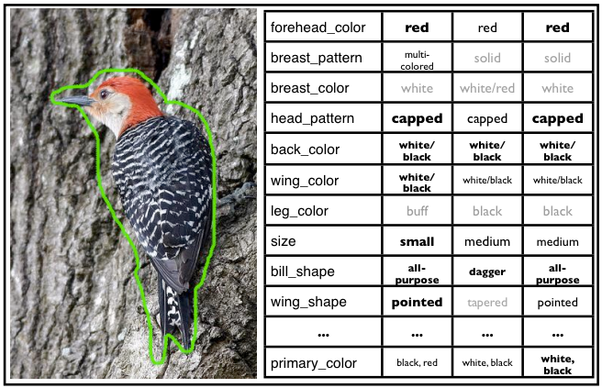
Example Attributes
Welinder et al. 2010
Slide credit: Devi Parikh

Slide 14
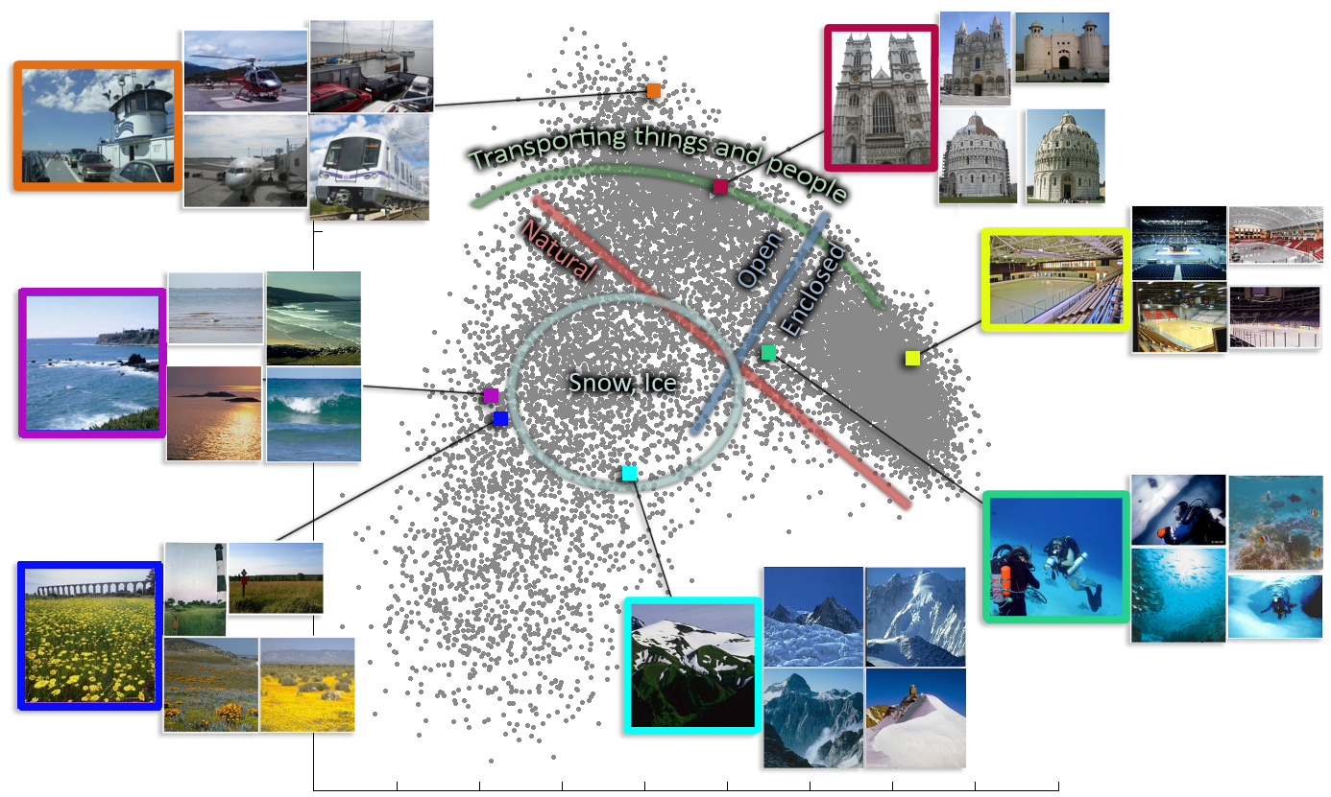
Example Attributes
Patterson and Hays 2011
Slide credit: Devi Parikh

Slide 15
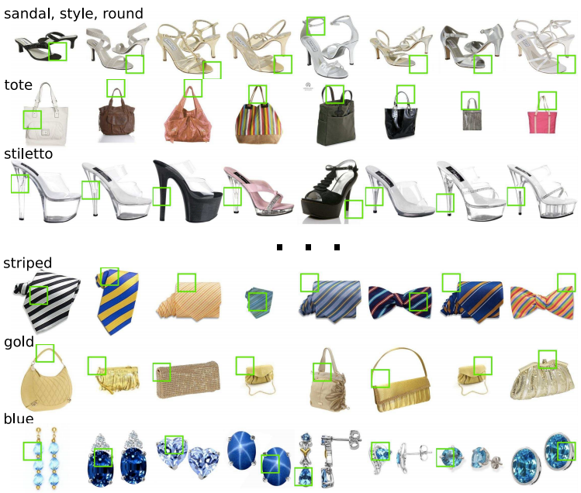
Example Attributes
Berg et al. 2010
Slide credit: Devi Parikh

Slide 16
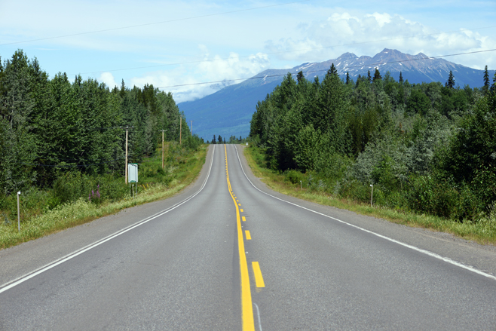
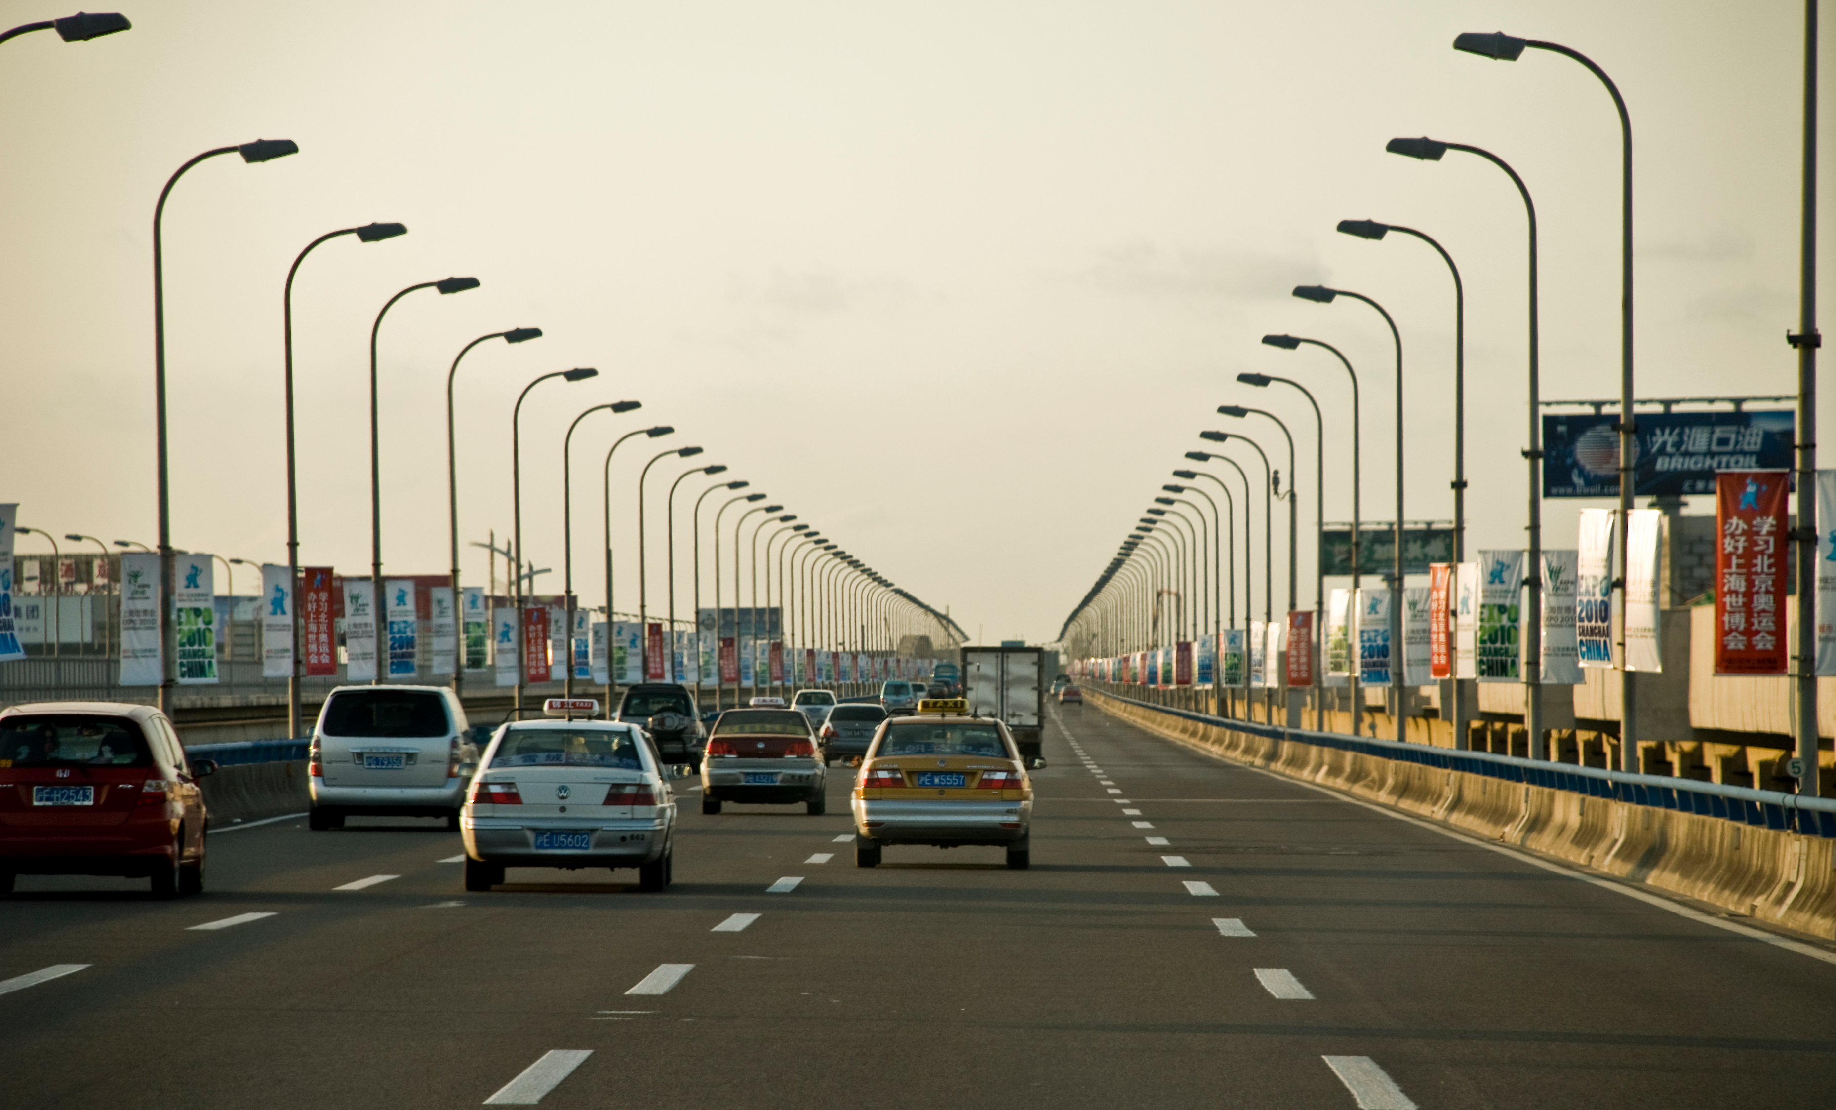
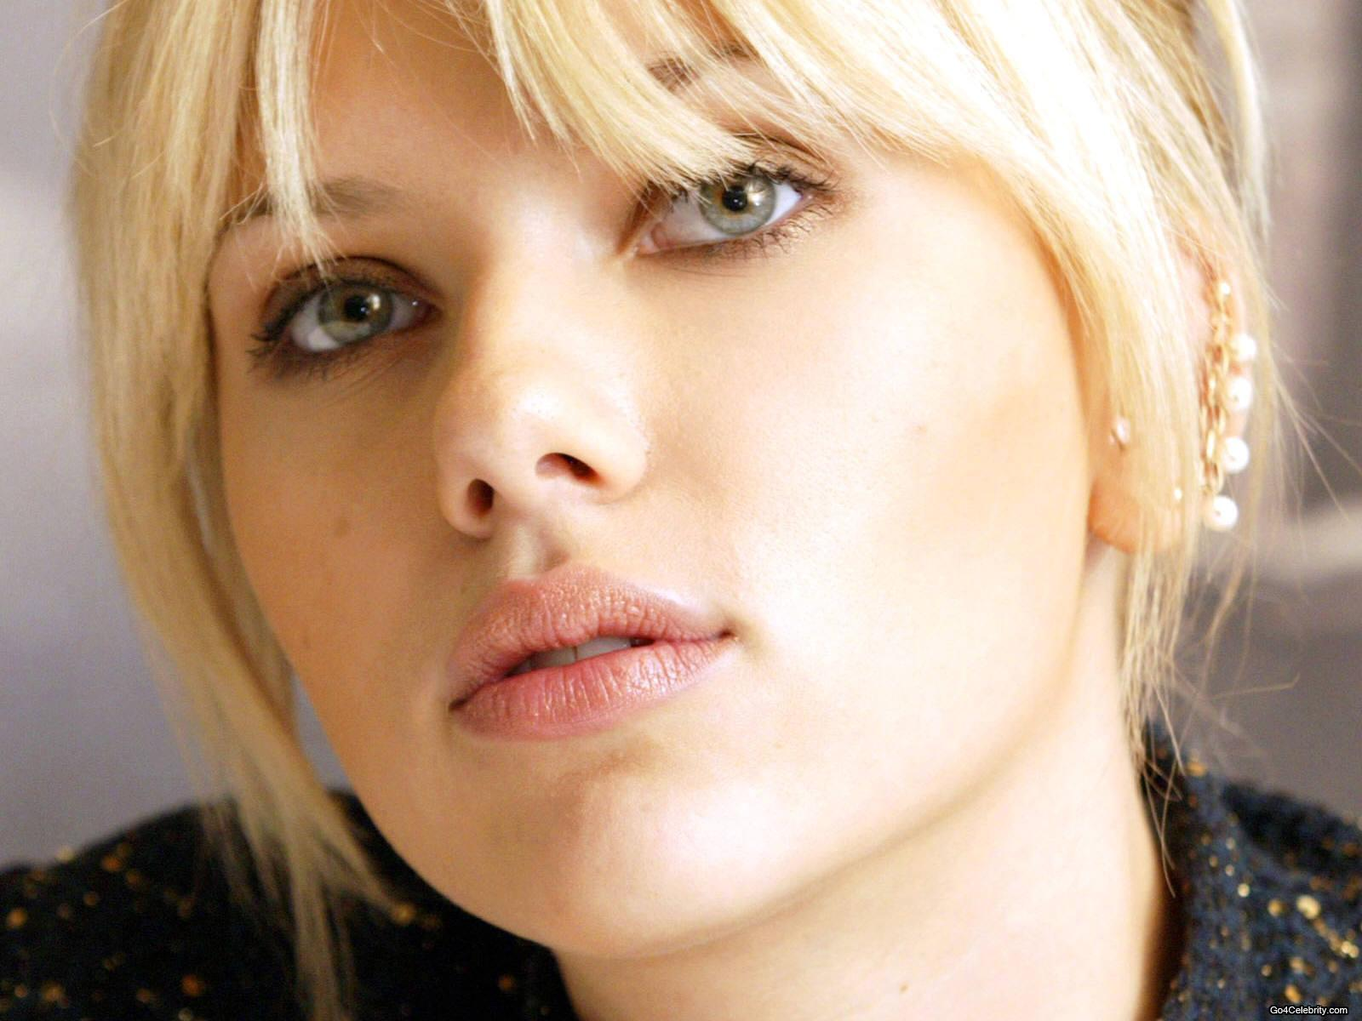
Relative Attributes
> natural
< smiling
Parikh and Grauman 2011
Slide credit: Devi Parikh

Slide 17
Some Notation
Vocabulary of attributes:
Image features:
Slide credit: Devi Parikh

Slide 18
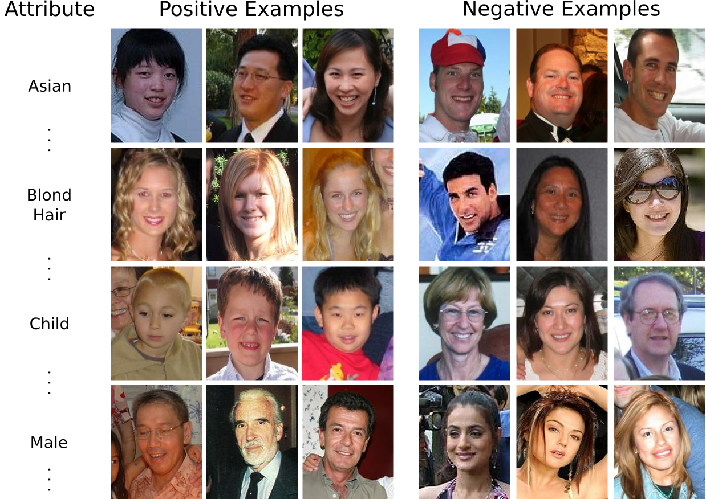
Attribute Models
Classifiers for binary attributes
(Or confidence)
Kumar et al. 2010
Slide credit: Devi Parikh

Slide 19
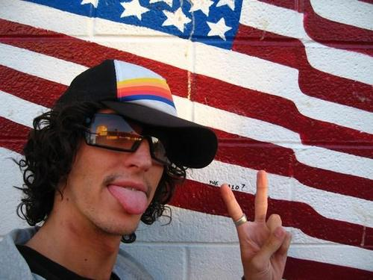
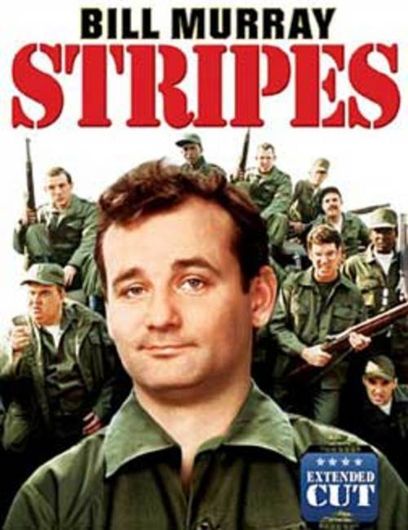
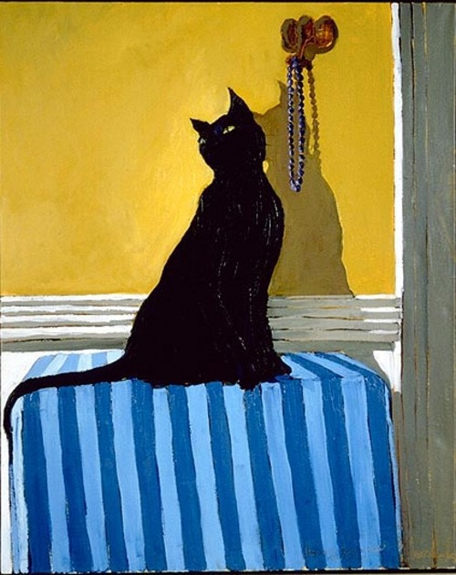
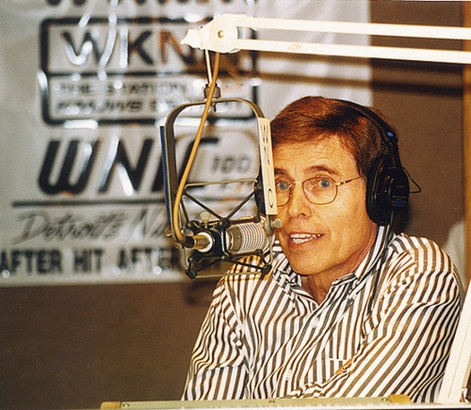
Attribute Models
Noisy labels !
Weakly supervised learning
“stripes”
Positive training images (unsegmented)
Attribute
model
“things”
Negative training images
Ferrari et al. 2007
Slide adapted from Vittorio Ferrari by Devi Parikh

Slide 20
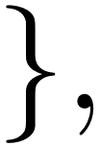
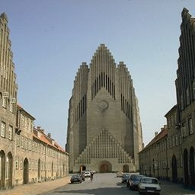
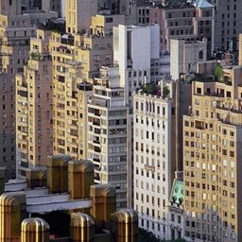
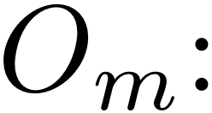
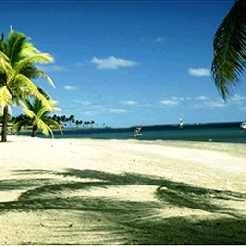
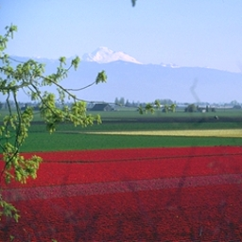
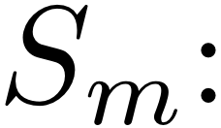
Attribute Models
Ranking functions for relative attributes
For each attribute
open
Supervision is
Slide credit: Devi Parikh

Slide 21
Attribute Models
Image features
Learn a scoring function
Learned parameters
that best satisfies constraints:
Max-margin learning to rank formulation of Joachims 2002
Slide credit: Devi Parikh

Slide 22
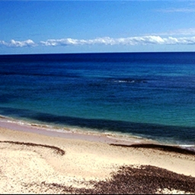
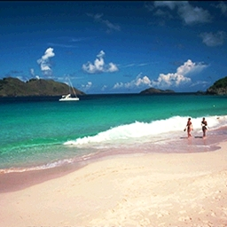
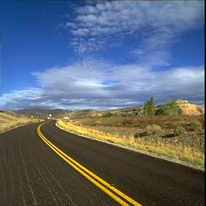
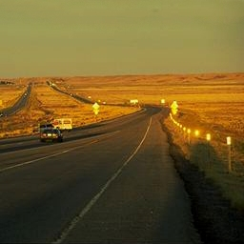
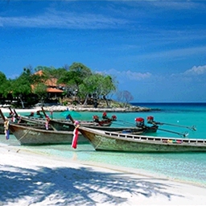
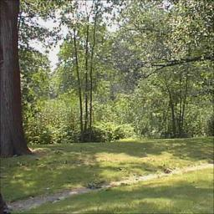
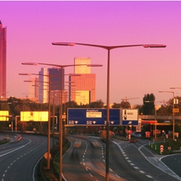
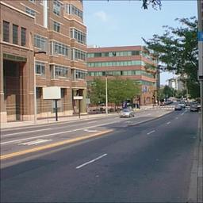
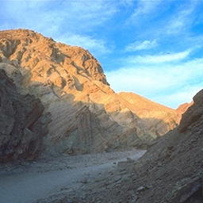
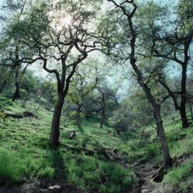
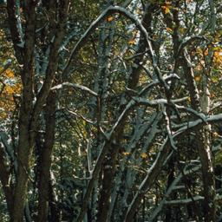
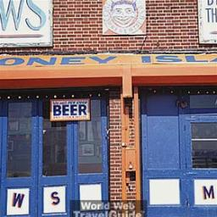
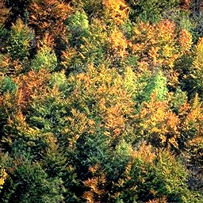
Attribute Models
Real value
(strength of attribute presence)
Density
“I am 60% sure this person is smiling”
(Binary Classifier Confidence)
“This person is smiling 60%”
(Attribute Strength)
“Person A is smiling more than Person B”
(Relative Attribute)
Slide credit: Devi Parikh

Slide 23
Offline Uses of Attributes

Slide 24
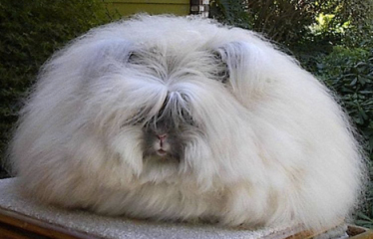
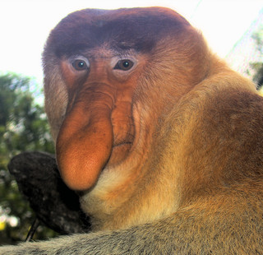
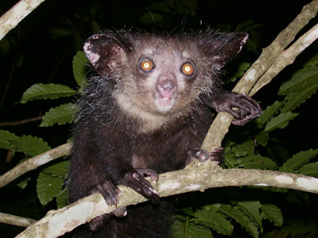
Zero-shot Learning
Aye-ayes
Are nocturnal
Live in trees
Have large eyes
Have long middle fingers
Which one of these is an aye-aye?
Humans can learn from descriptions (zero examples).
Slide adapted from Christoph Lampert by Devi Parikh

Slide 25
Zero-shot Learning
Seen categories with labeled images
Train attribute predictors
Unseen categories
No examples, only description
 | bear | turtle | rabbit
furry
big
… | … | … | …
Slide credit: Devi Parikh

Slide 26
Zero-shot Learning
Test image:
Test class:
Classification:
Slide credit: Devi Parikh

Slide 27
Zero-shot Learning
Lampert et al. 2009
zebra
striped 1
4-legs 1
large 0
…
is independent of given
0 for all other
prior (e.g. uniform)
estimate from data or uniform
(assuming uniform priors above)
outputs of binary classifiers
Slide credit: Devi Parikh
Notes:
p(z|\bm{x}) & = \sum_{\bm{a} \in \{0,1\}^M}p(z,\bm{a}|\bm{x}) \\
& = \sum_{\bm{a} \in \{0,1\}^M}p(z|\bm{a},\bm{x})p(\bm{a}|\bm{x})\\
& = \sum_{\bm{a} \in \{0,1\}^M}p(z|\bm{a})p(\bm{a}|\bm{x})\\
& = \sum_{\bm{a} \in \{0,1\}^M}\frac{p(\bm{a}|z)p(z)}{p(\bm{a})}p(\bm{a}|\bm{x})\\
& = \prod_{m=1}^{M} p(a_m|\bm{x})

Slide 28
Zero-shot Learning
 | bear | turtle | rabbit
furry
big
… | … | … | …
Test image
Farhadi et al. 2009
Slide credit: Devi Parikh

Slide 29
Relative Zero-shot Learning
Training: Images from S seen categories and
Descriptions of U unseen categories
Need not use all attributes, or all seen categories
Testing: Categorize image into one of S+U categories
Age:
Hugh
Clive
Scarlett
Jared
Miley
Smiling:
Miley
Jared
Slide credit: Devi Parikh
Notes:
Now that we have learnt relative attributes, they enable two novel applications. The first is zero-shot learning of categories via relative comparisons. The set-up is the following. During training, we have images from S seen categories, and only descriptions of U unseen categories relative to these S categories. By description we mean the following. Let’s say we have learnt two relative attributes Young and Smiling. These can be learnt using either a subset of the S seen categories as shown here or using an independent set of images. Then we can describe the unseen categories relative to the seen categories. For instance, CO is older than SJ, but younger than HL. MC is younger than ZE, and is also more smiling than him.
Note that not all attributes need to be used to describe the unseen categories, and every unseen category need not be related to every seen category.
At test time, an image may belong to one of the seen or unseen categories.

Slide 30
Relative Zero-shot Learning
Parikh and Grauman 2011
Can predict new classes based on their relationships to existing classes – without training images
Age:
Hugh
Clive
Scarlett
S
Jared
Miley
Clive
Smiling
Smiling:
Miley
Jared
Miley
J
H
Age
Infer image category using max-likelihood
Slide credit: Devi Parikh
Notes:
So based on this information, images from the seen categories and descriptions of unseen categories, how do we build models for the seen and unseen categories?
We employ a generative approach and build a Gaussian distribution for each category in the relative attribute space. For the seen categories, we use the response of each image to the learnt attributes to build this distribution. For example, HL is perhaps not very young and doesn’t smile much, and hence occupies this region in the relative attributes space. SJ is young and smiles a lot, and sits here. JL’s model is here.
Now for the unseen categories, we take an approach of max-likelihood parameter transfer. We utilize the provided description to build the corresponding Gaussian models. This constraint says that CO is older than SJ but younger than HL. So we place the mean youth value of of CO’s model to be half-way between SJ and HL’s means. That would be here. We don’t have information about how much CO smiles. So we will assume that he smiles as much as an average celebrity does, and place his smiling mean at the average of all smiling means among the seen categories. That would be here. This defines the region where we believe CO would lie in our relative attributes space. Please see the paper for details on how we determine the covariance matrices for unseen categories.
As for MC, our description says that she is younger than ZE. But this is a one-sided constraint. So we place her average youth value to be on the left, and as far from ZE as consecutively aged celebrities are on average from each other within our seen categories. That would be this. Similarly for how much MC smiles.
Now that we have constructed models for all seen and unseen categories, at test time, an image is assigned to the category that gives it the highest likelihood.
We can thus teach the machine to predict novel classes, simply by relating it to classes it has seen before, without needing any training images

Slide 31
Learning with a few examples
Active Learning
Slide credit: Devi Parikh

Slide 32
Is this a giraffe?
No.
Is this a giraffe?
Yes.
Is this a giraffe?
No.
Slide credit: Devi Parikh
Notes:
In the traditional active learning setting, after looking at a few examples, the learner identifies an image that is confusing and asks the teacher for a label. “Is this a giraffe?”. In this case, the teacher says no. The learner updates her model, and identifies another confusing image and asks, “Is this a giraffe?”. The teacher says yes. Is this a giraffe? No.

Slide 33
Parkash and Parikh, 2012
Focused feedback
Knowledge of the world
Current belief
I think this is a giraffe. What do you think?
No, its neck is too short for it to be a giraffe.
Learner learns better from its mistakes
Accelerated discriminative learning with few examples
[Animals with even shorter necks]
Ah! These must not be giraffes either then.
……
Feedback on one, transferred to many
Slide credit: Devi Parikh
Notes:
The learner, picks a confusing image. Then instead of just demanding a label for the image, the learner gives the example some thought and determines its belief about the example, and communicates it to the teacher. If it thinks this image is a giraffe, it says “I think this is a giraffe. What do you think?” The teacher says “No this is not a giraffe, because its neck is too short for it to be a giraffe.”. With this, the learner realizes that if this animal’s neck is too short for it to be a giraffe, than all animals with even shorter necks than the query image must not be giraffes either. Hence resulting in a much better understanding of giraffes.
At a high-level, In our proposed active learning paradigm, the learner conveys his/her current belief about an actively chosen query. If wrong, the supervisor provides focused feedback that conveys the teacher’s knowledge about the world. The learner takes the feedback provided on one image and transfers it to many previously unlabeled images. This results in (1) the classifier learning better from its mistakes and (2) accelerated learning with few labeled examples.

Slide 34
Attributes-based Feedback
Attribute predictors:
Forest
No,
It is too open to be a forest
a₁
a₂
…
a_{M}
Unlabeled pool of images
Unlabeled pool of images
Not Forest
Openness
Slide credit: Devi Parikh

Slide 35
Attributes-based Feedback
Attribute predictors:
Forest
No,
It is too open to be a forest
a₁
a₂
…
a_{M}
Unlabeled pool of images
Unlabeled pool of images
Classifiers:
h₁
h₂
…
h_{K}
Not Forest
Slide credit: Devi Parikh

Slide 36
Biswas and Parikh, CVPR 2013
I think this is a giraffe. What do you think?
No, its neck is too short for it to be a giraffe.
[Animals with even shorter necks]
Ah! These must not be giraffes either then.
……
[Giraffes]
Ah! These must have longer necks than this image.
……
Slide credit: Devi Parikh
Notes:
The learner, picks a confusing image. Then instead of just demanding a label for the image, the learner gives the example some thought and determines its belief about the example, and communicates it to the teacher. If it thinks this image is a giraffe, it says “I think this is a giraffe. What do you think?” The teacher says “No this is not a giraffe, because its neck is too short for it to be a giraffe.”. With this, the learner realizes that if this animal’s neck is too short for it to be a giraffe, than all animals with even shorter necks than the query image must not be giraffes either. Hence resulting in a much better understanding of giraffes.
At a high-level, In our proposed active learning paradigm, the learner conveys his/her current belief about an actively chosen query. If wrong, the supervisor provides focused feedback that conveys the teacher’s knowledge about the world. The learner takes the feedback provided on one image and transfers it to many previously unlabeled images. This results in (1) the classifier learning better from its mistakes and (2) accelerated learning with few labeled examples.

Slide 37
Biswas and Parikh, CVPR 2013
……
Slide credit: Devi Parikh
Notes:
The learner, picks a confusing image. Then instead of just demanding a label for the image, the learner gives the example some thought and determines its belief about the example, and communicates it to the teacher. If it thinks this image is a giraffe, it says “I think this is a giraffe. What do you think?” The teacher says “No this is not a giraffe, because its neck is too short for it to be a giraffe.”. With this, the learner realizes that if this animal’s neck is too short for it to be a giraffe, than all animals with even shorter necks than the query image must not be giraffes either. Hence resulting in a much better understanding of giraffes.
At a high-level, In our proposed active learning paradigm, the learner conveys his/her current belief about an actively chosen query. If wrong, the supervisor provides focused feedback that conveys the teacher’s knowledge about the world. The learner takes the feedback provided on one image and transfers it to many previously unlabeled images. This results in (1) the classifier learning better from its mistakes and (2) accelerated learning with few labeled examples.

Slide 38
Biswas and Parikh, CVPR 2013
……
Slide credit: Devi Parikh
Notes:
The learner, picks a confusing image. Then instead of just demanding a label for the image, the learner gives the example some thought and determines its belief about the example, and communicates it to the teacher. If it thinks this image is a giraffe, it says “I think this is a giraffe. What do you think?” The teacher says “No this is not a giraffe, because its neck is too short for it to be a giraffe.”. With this, the learner realizes that if this animal’s neck is too short for it to be a giraffe, than all animals with even shorter necks than the query image must not be giraffes either. Hence resulting in a much better understanding of giraffes.
At a high-level, In our proposed active learning paradigm, the learner conveys his/her current belief about an actively chosen query. If wrong, the supervisor provides focused feedback that conveys the teacher’s knowledge about the world. The learner takes the feedback provided on one image and transfers it to many previously unlabeled images. This results in (1) the classifier learning better from its mistakes and (2) accelerated learning with few labeled examples.

Slide 39
Biswas and Parikh, CVPR 2013
……
Slide credit: Devi Parikh
Notes:
The learner, picks a confusing image. Then instead of just demanding a label for the image, the learner gives the example some thought and determines its belief about the example, and communicates it to the teacher. If it thinks this image is a giraffe, it says “I think this is a giraffe. What do you think?” The teacher says “No this is not a giraffe, because its neck is too short for it to be a giraffe.”. With this, the learner realizes that if this animal’s neck is too short for it to be a giraffe, than all animals with even shorter necks than the query image must not be giraffes either. Hence resulting in a much better understanding of giraffes.
At a high-level, In our proposed active learning paradigm, the learner conveys his/her current belief about an actively chosen query. If wrong, the supervisor provides focused feedback that conveys the teacher’s knowledge about the world. The learner takes the feedback provided on one image and transfers it to many previously unlabeled images. This results in (1) the classifier learning better from its mistakes and (2) accelerated learning with few labeled examples.

Slide 40
Biswas and Parikh, CVPR 2013
Update long-neck relative attribute
……
Slide credit: Devi Parikh
Notes:
The learner, picks a confusing image. Then instead of just demanding a label for the image, the learner gives the example some thought and determines its belief about the example, and communicates it to the teacher. If it thinks this image is a giraffe, it says “I think this is a giraffe. What do you think?” The teacher says “No this is not a giraffe, because its neck is too short for it to be a giraffe.”. With this, the learner realizes that if this animal’s neck is too short for it to be a giraffe, than all animals with even shorter necks than the query image must not be giraffes either. Hence resulting in a much better understanding of giraffes.
At a high-level, In our proposed active learning paradigm, the learner conveys his/her current belief about an actively chosen query. If wrong, the supervisor provides focused feedback that conveys the teacher’s knowledge about the world. The learner takes the feedback provided on one image and transfers it to many previously unlabeled images. This results in (1) the classifier learning better from its mistakes and (2) accelerated learning with few labeled examples.

Slide 41
Biswas and Parikh, CVPR 2013
I think this is a giraffe. What do you think?
No, its neck is too short for it to be a giraffe.
Learn or update attribute models on-the-fly
Start with an unlabeled pool of image and learn categories and attributes from scratch
Actively select image for this form of feedback
[Animals with even shorter necks]
Ah! These must not be giraffes either then.
……
[Giraffes]
Ah! These must have longer necks than this image.
……
Slide credit: Devi Parikh
Notes:
The learner, picks a confusing image. Then instead of just demanding a label for the image, the learner gives the example some thought and determines its belief about the example, and communicates it to the teacher. If it thinks this image is a giraffe, it says “I think this is a giraffe. What do you think?” The teacher says “No this is not a giraffe, because its neck is too short for it to be a giraffe.”. With this, the learner realizes that if this animal’s neck is too short for it to be a giraffe, than all animals with even shorter necks than the query image must not be giraffes either. Hence resulting in a much better understanding of giraffes.
At a high-level, In our proposed active learning paradigm, the learner conveys his/her current belief about an actively chosen query. If wrong, the supervisor provides focused feedback that conveys the teacher’s knowledge about the world. The learner takes the feedback provided on one image and transfers it to many previously unlabeled images. This results in (1) the classifier learning better from its mistakes and (2) accelerated learning with few labeled examples.

Slide 42
Questions?

