Slide 1
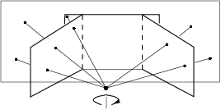
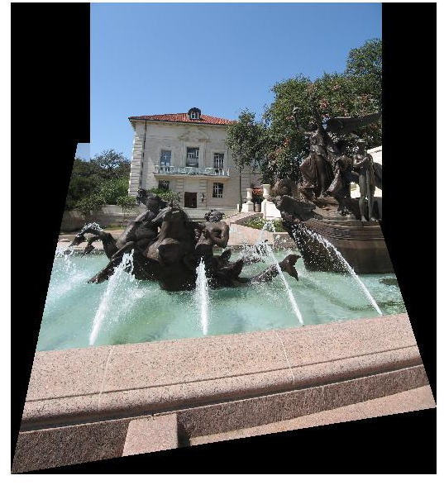
Image warping and stitching
Disclaimer: Many slides have been borrowed from Kristen Grauman, who may have borrowed some of them from others. Any time a slide did not already have a credit on it, I have credited it to Kristen. So there is a chance some of these credits are inaccurate.
Slide credit: Kristen Grauman

Slide 2
Topics overview
Class Intro
Features & filters
Grouping & fitting
Multiple views and motion
Recognition
Video processing
Slide credit: Kristen Grauman

Slide 3
Topics overview
Class Intro
Features & filters
Grouping & fitting
Multiple views and motion
Recognition
Video processing
Slide credit: Kristen Grauman

Slide 4
Topics overview
Class Intro
Features & filters
Grouping & fitting
Multiple views and motion
  Homography and image warping
  Local invariant features
  Image formation
  Epipolar geometry
  Stereo and structure from motion
Recognition
Video processing
Slide credit: Kristen Grauman

Slide 5
Topics overview
Class Intro
Features & filters
Grouping & fitting
Multiple views and motion
  Homography and image warping
  Local invariant features
  Image formation
  Epipolar geometry
  Stereo and structure from motion
Recognition
Video processing
Slide credit: Kristen Grauman

Slide 6
Main questions
Alignment: Given two images, what is the transformation between them?
T
Warping: Given a source image and a transformation, what does the transformed output look like?
T
Slide credit: Kristen Grauman

Slide 7

Motivation for feature-based alignment:
Image mosaics
Slide credit: Kristen Grauman
Image from http://graphics.cs.cmu.edu/courses/15-463/2010_fall/

Slide 8




Parametric (global) warping
Examples of parametric warps:
translation
rotation
aspect
perspective
affine
Slide credit: Kristen Grauman
Source: Alyosha Efros

Slide 9
Parametric (global) warping
T
p = (x,y)
p’ = (x’,y’)
Transformation T is a coordinate-changing machine:
p’ = T(p)
What does it mean that T is global?
  Is the same for any point p
  can be described by just a few numbers (parameters)
Let’s represent T as a matrix:
p’ = Mp
Source: Alyosha Efros

Slide 10
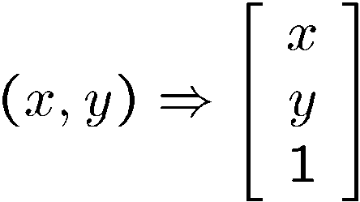
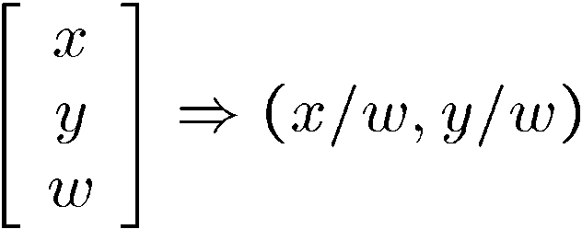
Homogeneous coordinates
To convert to homogeneous coordinates:
homogeneous image
coordinates
Converting from homogeneous coordinates
Slide credit: Kristen Grauman

Slide 11
Fitting an affine transformation
Assuming we know the correspondences, how do we get the transformation?
Slide credit: Kristen Grauman

Slide 12
2D Affine Transformations
Affine transformations are combinations of …
  Linear transformations, and
  Translations
Parallel lines remain parallel
Slide credit: Kristen Grauman

Slide 13
Projective Transformations
Projective transformations:
  Affine transformations, and
  Projective warps
Parallel lines do not necessarily remain parallel
Slide credit: Kristen Grauman

Slide 14
Fitting an affine transformation
Assuming we know the correspondences, how do we get the transformation?
Slide credit: Kristen Grauman

Slide 15
RANSAC: General form
RANSAC loop:
Randomly select a seed group of points on which to base transformation estimate (e.g., a group of matches)
Compute transformation from seed group
Find inliers to this transformation
If the number of inliers is sufficiently large, re-compute estimate of transformation on all of the inliers
Keep the transformation with the largest number of inliers
Slide credit: Kristen Grauman

Slide 16

RANSAC example: Translation
Putative matches
Source: Rick Szeliski

Slide 17
RANSAC example: Translation
Select one match, count inliers
Slide credit: Kristen Grauman

Slide 18
RANSAC example: Translation
Select one match, count inliers
Slide credit: Kristen Grauman

Slide 19
RANSAC example: Translation
Find “average” translation vector
Slide credit: Kristen Grauman

Slide 20
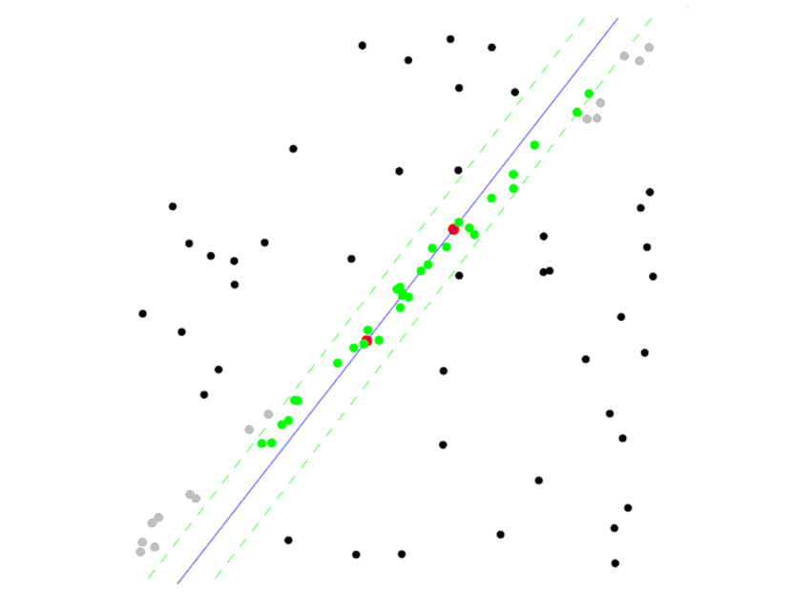
RANSAC pros and cons
Pros
  Simple and general
  Applicable to many different problems
  Often works well in practice
Cons
  Lots of parameters to tune
  Doesn’t work well for low inlier ratios (too many iterations,
  or can fail completely)
  Can’t always get a good initialization
  of the model based on the minimum
  number of samples
Lana Lazebnik

Slide 21
Today
Image mosaics
  Fitting a 2D transformation
    Affine, Homography
  2D image warping
  Computing an image mosaic
Slide credit: Kristen Grauman

Slide 22
HP frames commercials
http://www.youtube.com/watch?v=2RPl5vPEoQk
Slide credit: Kristen Grauman

Slide 23
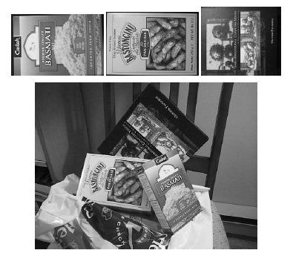
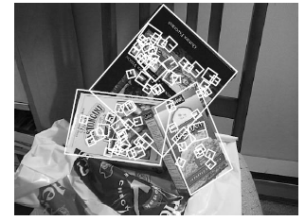
Recall: fitting an affine transformation
Affine model approximates perspective projection of planar objects.
Slide credit: Kristen Grauman
Figures from David Lowe, ICCV 1999

Slide 24
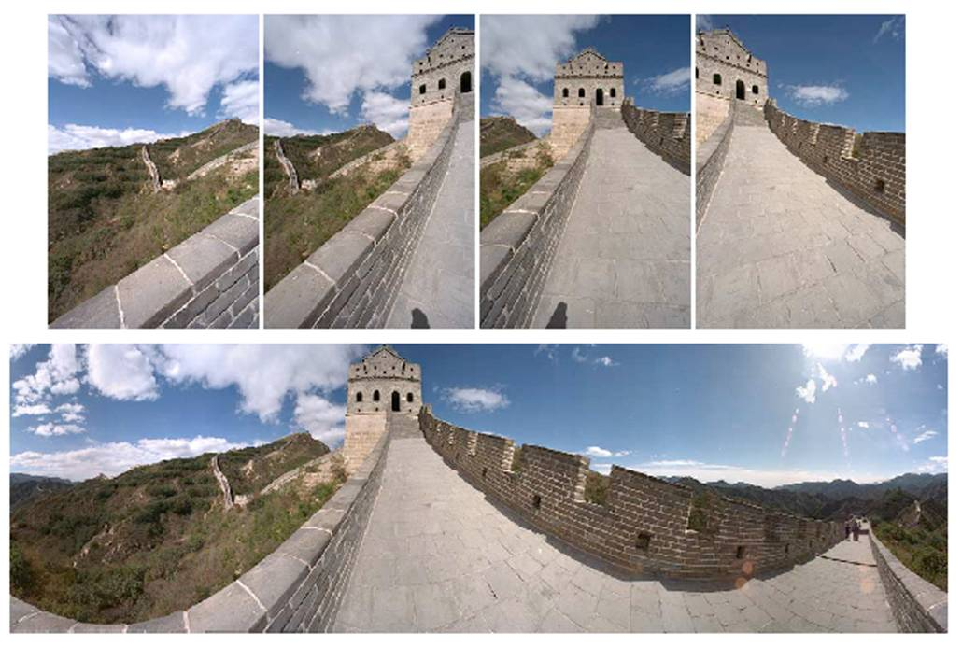

Mosaics
. . .
image from S. Seitz
Obtain a wider angle view by combining multiple images.
Slide credit: Kristen Grauman

Slide 25
How to stitch together a panorama (a.k.a. mosaic)?
Basic Procedure
  Take a sequence of images from the same position
    Rotate the camera about its optical center
  Compute transformation between second image and first
  Transform the second image to overlap with the first
  Blend the two together to create a mosaic
  (If there are more images, repeat)
Source: Steve Seitz

Slide 26
Mosaics
. . .
image from S. Seitz
Obtain a wider angle view by combining multiple images.
Slide credit: Kristen Grauman

Slide 27
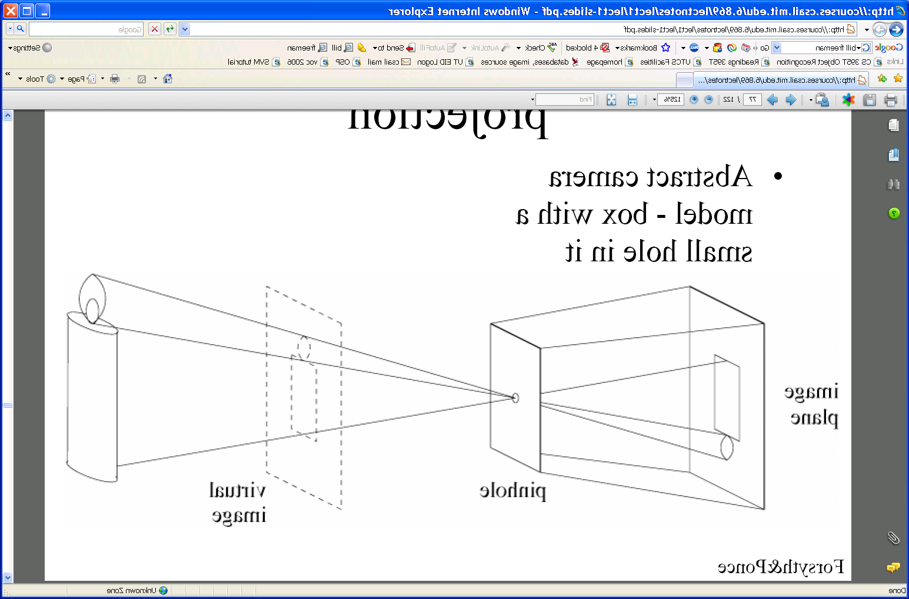
Pinhole camera
Pinhole camera is a simple model to approximate imaging process, perspective projection.
Image plane
Virtual image
pinhole
If we treat pinhole as a point, only one ray from any given point can enter the camera.
Slide credit: Kristen Grauman
Fig from Forsyth and Ponce

Slide 28
Mosaics: generating synthetic views
real
camera
synthetic
camera
Can generate any synthetic camera view
as long as it has the same center of projection!
Source: Alyosha Efros

Slide 29
Image reprojection
mosaic PP
The mosaic has a natural interpretation in 3D
  The images are reprojected onto a common plane
  The mosaic is formed on this plane
  Mosaic is a synthetic wide-angle camera
Source: Steve Seitz

Slide 30
Image reprojection
Basic question
  How to relate two images from the same camera center?
    how to map a pixel from PP1 to PP2
PP2
Answer
  Cast a ray through each pixel in PP1
  Draw the pixel where that ray intersects PP2
Observation:
Rather than thinking of this as a 3D reprojection, think of it as a 2D image warp from one image to another.
PP1
Source: Alyosha Efros

Slide 31
Image reprojection: Homography
A projective transform is a mapping between any two PPs with the same center of projection
  rectangle should map to arbitrary quadrilateral
  parallel lines aren’t
  but must preserve straight lines
called Homography
PP2
PP1
p’
H
p
Source: Alyosha Efros

Slide 32
Homography
…
…
To compute the homography given pairs of corresponding points in the images, we need to set up an equation where the parameters of H are the unknowns…
Slide credit: Kristen Grauman

Slide 33
Solving for homographies
p’ = Hp
Upto a scale factor.
Constraint Frobenius norm of H to be 1.
Need at least 4 correspondences, the more the better
Problem to be solved:
s.t. ||h||² = 1
where vector of unknowns h = [a,b,c,d,e,f,g,h,i]^{T}
Slide credit: Adapted by Devi Parikh from Kristen Grauman

Slide 34
Solving for homographies
p’ = Hp
h1 = [a
b
c]
H = [h₁^{T}]
[h₂^{T}]
[h₃^{T}]
x’ = h₁^{T}p/h₃^{T}p
y’ = h₂^{T}p/h₃^{T}p
h₁^{T}p - x’(h₃^{T}p) ⁼ 0
h₂^{T}p - y’(h₃^{T}p) ⁼ 0
(p_{i},p’_{i})
h = [h1
h2
h3]
L = [ ………………….
p_{i}^{T} 0 -x_{i}’p_{i}^{T}
0 p_{i}^{T} -y_{i}’p_{i}^{T}
………………….]
Lh = 0
Min ||Lh||²
s.t. ||h||² = 1
Min h^{T}L^{T}Lh
s.t. ||h||² = 1
Min x^{T}Ax (A = L^{T}L, x = h)
s.t. ||x||² = 1
Sol: eigen vector of A corresponding to smallest eigen value
Slide credit: Devi Parikh

Slide 35
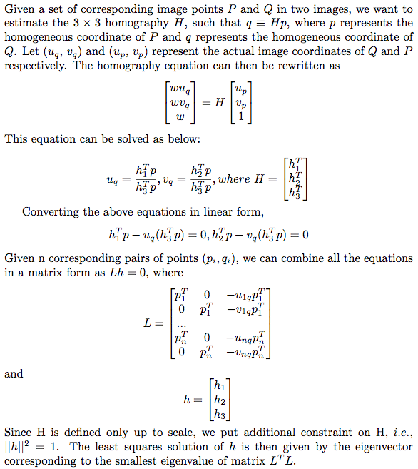
Map co-ordinates to [0,2] range for numerical stability
Slide credit: Devi Parikh

Slide 36
Homography
To apply a given homography H
  Compute p’ = Hp (regular matrix multiply)
  Convert p’ from homogeneous to image coordinates
p’
H
p
Slide credit: Kristen Grauman

Slide 37
Today
Image mosaics
  Fitting a 2D transformation
    Affine, Homography
  2D image warping
  Computing an image mosaic
Slide credit: Kristen Grauman

Slide 38
Image warping
T(x,y)
y
y’
x
x’
f(x,y)
g(x’,y’)
Given a coordinate transform and a source image f(x,y), how do we compute a transformed image g(x’,y’) = f(T(x,y))?
Slide from Alyosha Efros, CMU

Slide 39
Forward warping
T(x,y)
y
y’
x
x’
f(x,y)
g(x’,y’)
Send each pixel f(x,y) to its corresponding location
(x’,y’) = T(x,y) in the second image
Q: what if pixel lands “between” two pixels?
Slide from Alyosha Efros, CMU

Slide 40
Forward warping
T(x,y)
y
y’
x
x’
f(x,y)
g(x’,y’)
Send each pixel f(x,y) to its corresponding location
(x’,y’) = T(x,y) in the second image
Q: what if pixel lands “between” two pixels?
A: distribute color among neighboring pixels (x’,y’)
  Known as “splatting”
Slide from Alyosha Efros, CMU

Slide 41
Inverse warping
T⁻¹(x,y)
y
y’
x
x
x’
f(x,y)
g(x’,y’)
Get each pixel g(x’,y’) from its corresponding location
(x,y) = T⁻¹(x’,y’) in the first image
Q: what if pixel comes from “between” two pixels?
Slide from Alyosha Efros, CMU

Slide 42
Inverse warping
T⁻¹(x,y)
y
y’
x
x
x’
f(x,y)
g(x’,y’)
Get each pixel g(x’,y’) from its corresponding location
(x,y) = T⁻¹(x’,y’) in the first image
Q: what if pixel comes from “between” two pixels?
A: Interpolate color value from neighbors
  nearest neighbor, bilinear…
>> help interp2
Slide from Alyosha Efros, CMU

Slide 43





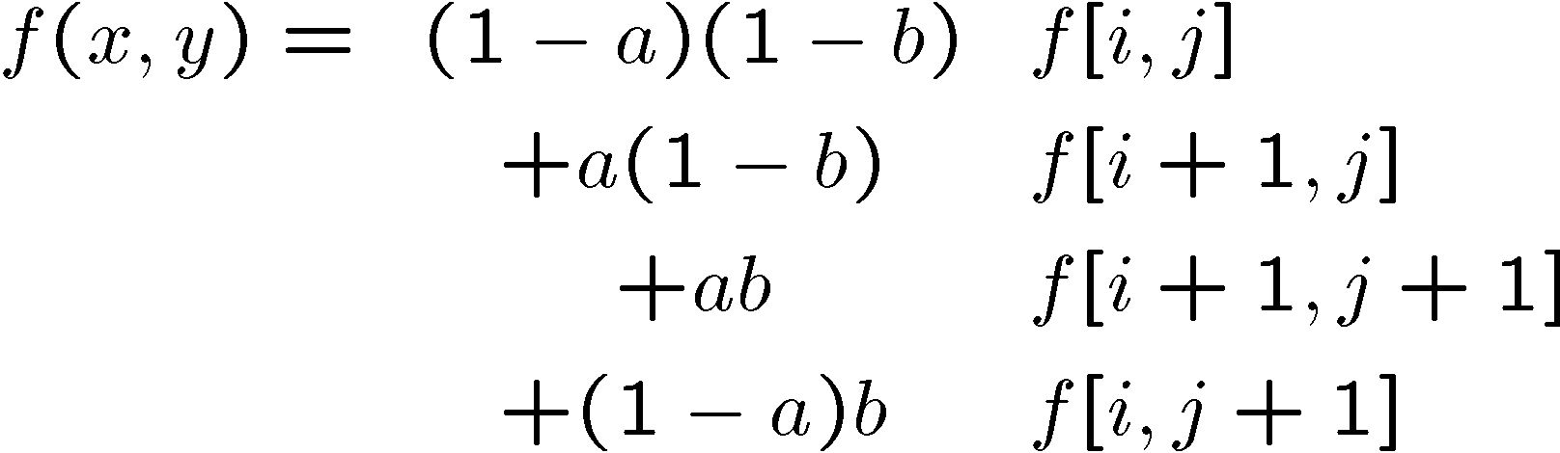
Bilinear interpolation
Sampling at f(x,y):
Slide from Alyosha Efros, CMU

Slide 44
Recap: How to stitch together a panorama (a.k.a. mosaic)?
Basic Procedure
  Take a sequence of images from the same position
    Rotate the camera about its optical center
  Compute transformation (homography) between second image and first using corresponding points.
  Transform the second image to overlap with the first.
  Blend the two together to create a mosaic.
  (If there are more images, repeat)
Source: Steve Seitz

Slide 45


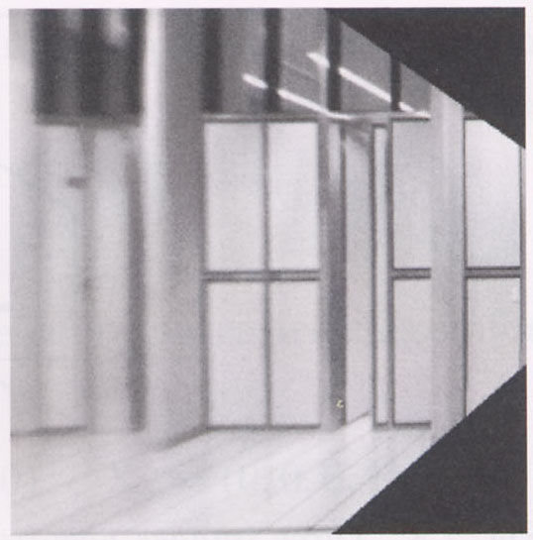
Image warping with homographies
image plane in front
image plane below
black area
where no pixel
maps to
Source: Steve Seitz

Slide 46
Image rectification
p’
p
Slide credit: Kristen Grauman

Slide 47
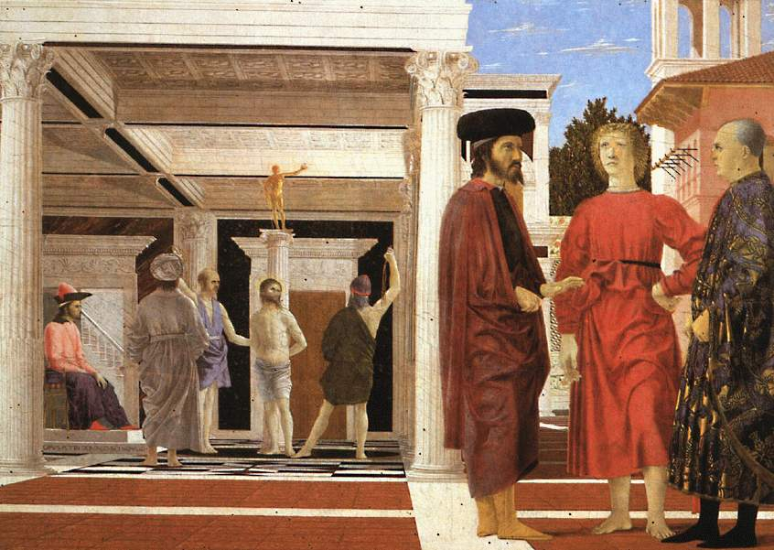


Analysing patterns and shapes
What is the shape of the b/w floor pattern?
Homography
The floor (enlarged)
Automatically
rectified floor
Slide from Antonio Criminisi

Slide 48
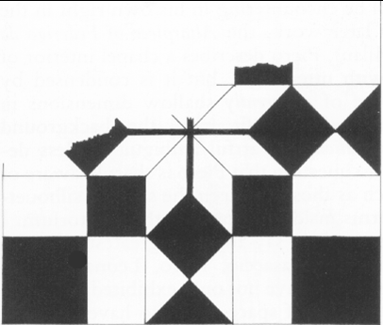
Analysing patterns and shapes
Automatic rectification
From Martin Kemp The Science of Art
(manual reconstruction)
Slide from Antonio Criminisi

Slide 49
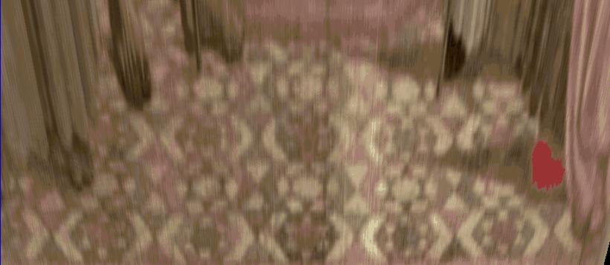
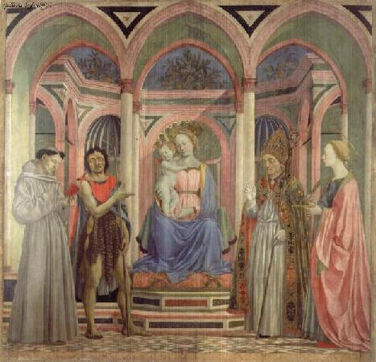
Analysing patterns and shapes
What is the (complicated)
shape of the floor pattern?
Automatically rectified floor
St. Lucy Altarpiece, D. Veneziano
Slide from Criminisi

Slide 50
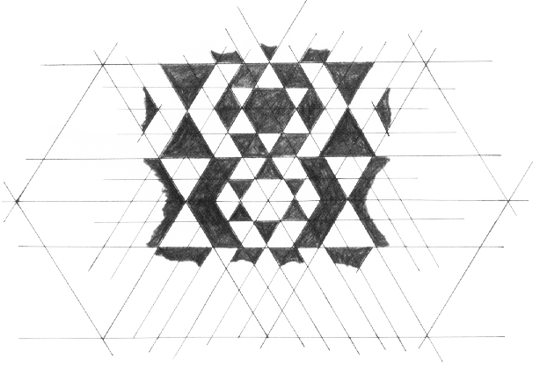
Analysing patterns and shapes
Automatic
rectification
From Martin Kemp, The Science of Art
(manual reconstruction)
Slide from Criminisi

Slide 51
Changing camera center
Does it still work?
synthetic PP
PP1
PP2
Source: Alyosha Efros

Slide 52
Recall: same camera center
real
camera
synthetic
camera
Can generate synthetic camera view
as long as it has the same center of projection.
Source: Alyosha Efros

Slide 53

…Or: Planar scene (or far away)
PP3
PP1
PP2
PP3 is a projection plane of both centers of projection, so we are OK!
This is how big aerial photographs are made
Source: Alyosha Efros

Slide 54
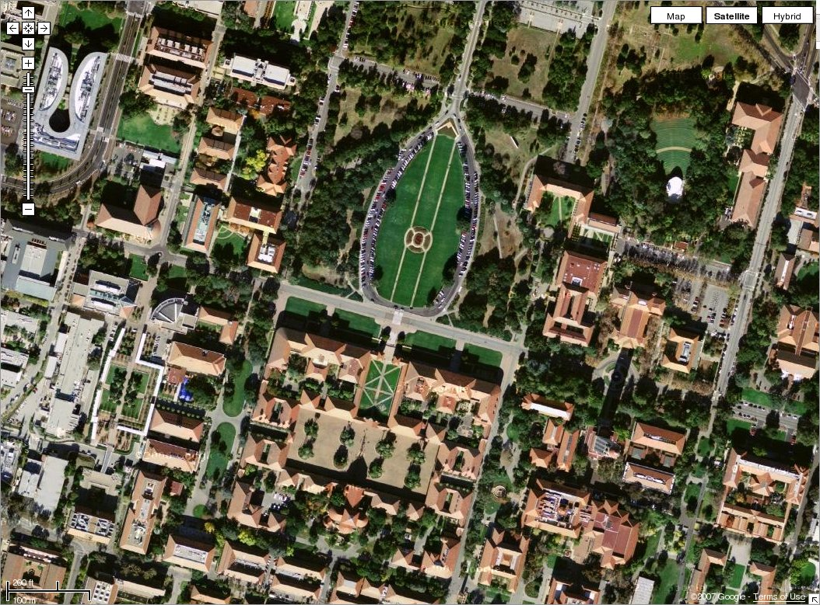

Slide 55
RANSAC for estimating homography
RANSAC loop:
1. Select four feature pairs (at random)
2. Compute homography H (exact)
3. Compute inliers where SSD(p_{i}’, Hp_{i})< ε
4. Keep largest set of inliers
5. Re-compute least-squares H estimate on all of the inliers
Slide credit: Steve Seitz

Slide 56


Robust feature-based alignment
Source: L. Lazebnik

Slide 57


Robust feature-based alignment
Extract features
Source: L. Lazebnik

Slide 58
Robust feature-based alignment
Extract features
Compute putative matches
Source: L. Lazebnik

Slide 59
Robust feature-based alignment
Extract features
Compute putative matches
Loop:
  Hypothesize transformation T (small group of putative matches that are related by T)
Source: L. Lazebnik

Slide 60
Robust feature-based alignment
Extract features
Compute putative matches
Loop:
  Hypothesize transformation T (small group of putative matches that are related by T)
  Verify transformation (search for other matches consistent with T)
Source: L. Lazebnik

Slide 61

Robust feature-based alignment
Extract features
Compute putative matches
Loop:
  Hypothesize transformation T (small group of putative matches that are related by T)
  Verify transformation (search for other matches consistent with T)
Source: L. Lazebnik

Slide 62
Summary: alignment & warping
  Write 2d transformations as matrix-vector multiplication (including translation when we use homogeneous coordinates)
  Perform image warping (forward, inverse)
  Fitting transformations: solve for unknown parameters given corresponding points from two views (affine, projective (homography)).
  Mosaics: uses homography and image warping to merge views taken from same center of projection.
Slide credit: Kristen Grauman

Slide 63
Later: which features should we match?
Slide credit: Kristen Grauman

Slide 64
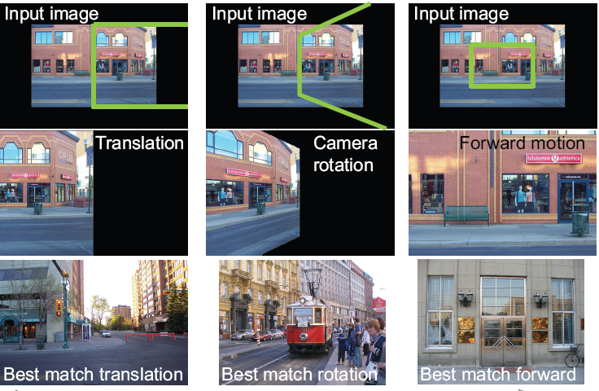
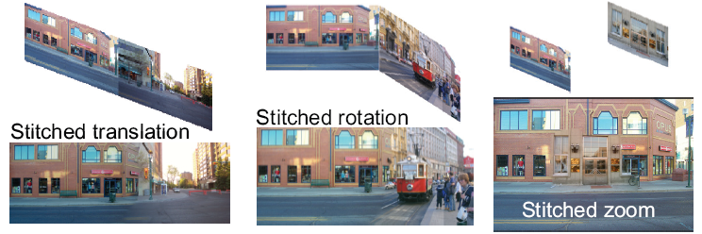
Creating and Exploring a Large Photorealistic Virtual Space
Current view, and desired view in green
Synthesized view from new camera
Induced camera motion

Slide 65
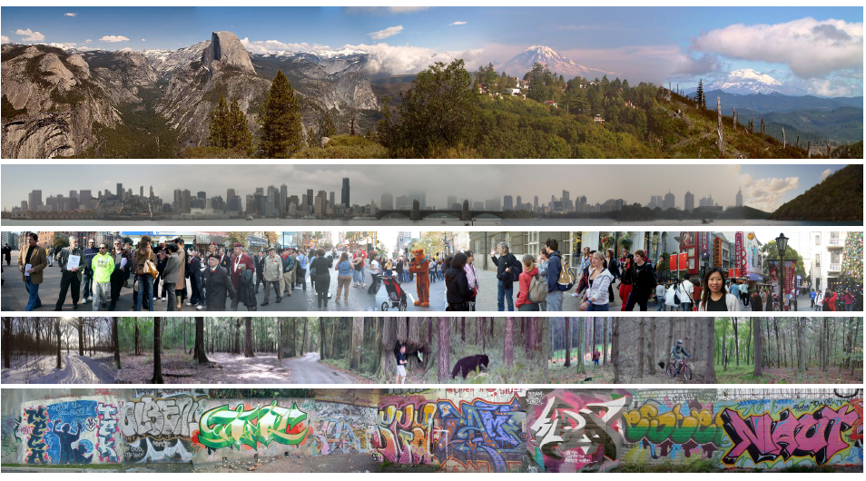
Creating and Exploring a Large Photorealistic Virtual Space
Josef Sivic, Biliana Kaneva, Antonio Torralba, Shai Avidan and William T. Freeman, Internet Vision Workshop, CVPR 2008.
http://www.youtube.com/watch?v=E0rboU10rPo

Slide 66
Questions?
Slide credit: Devi Parikh

