Slide 1
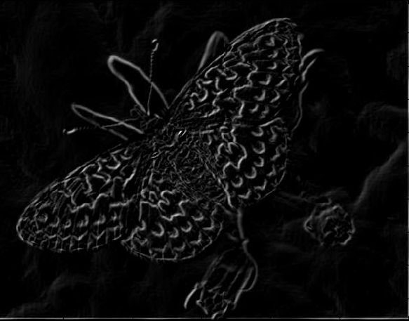
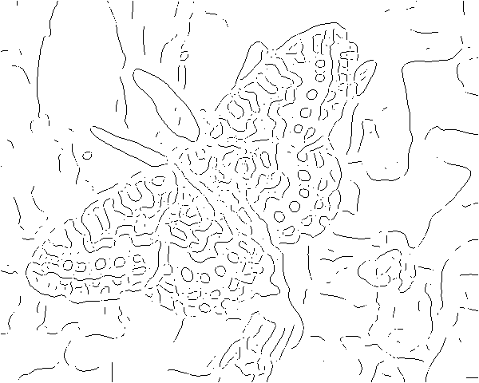
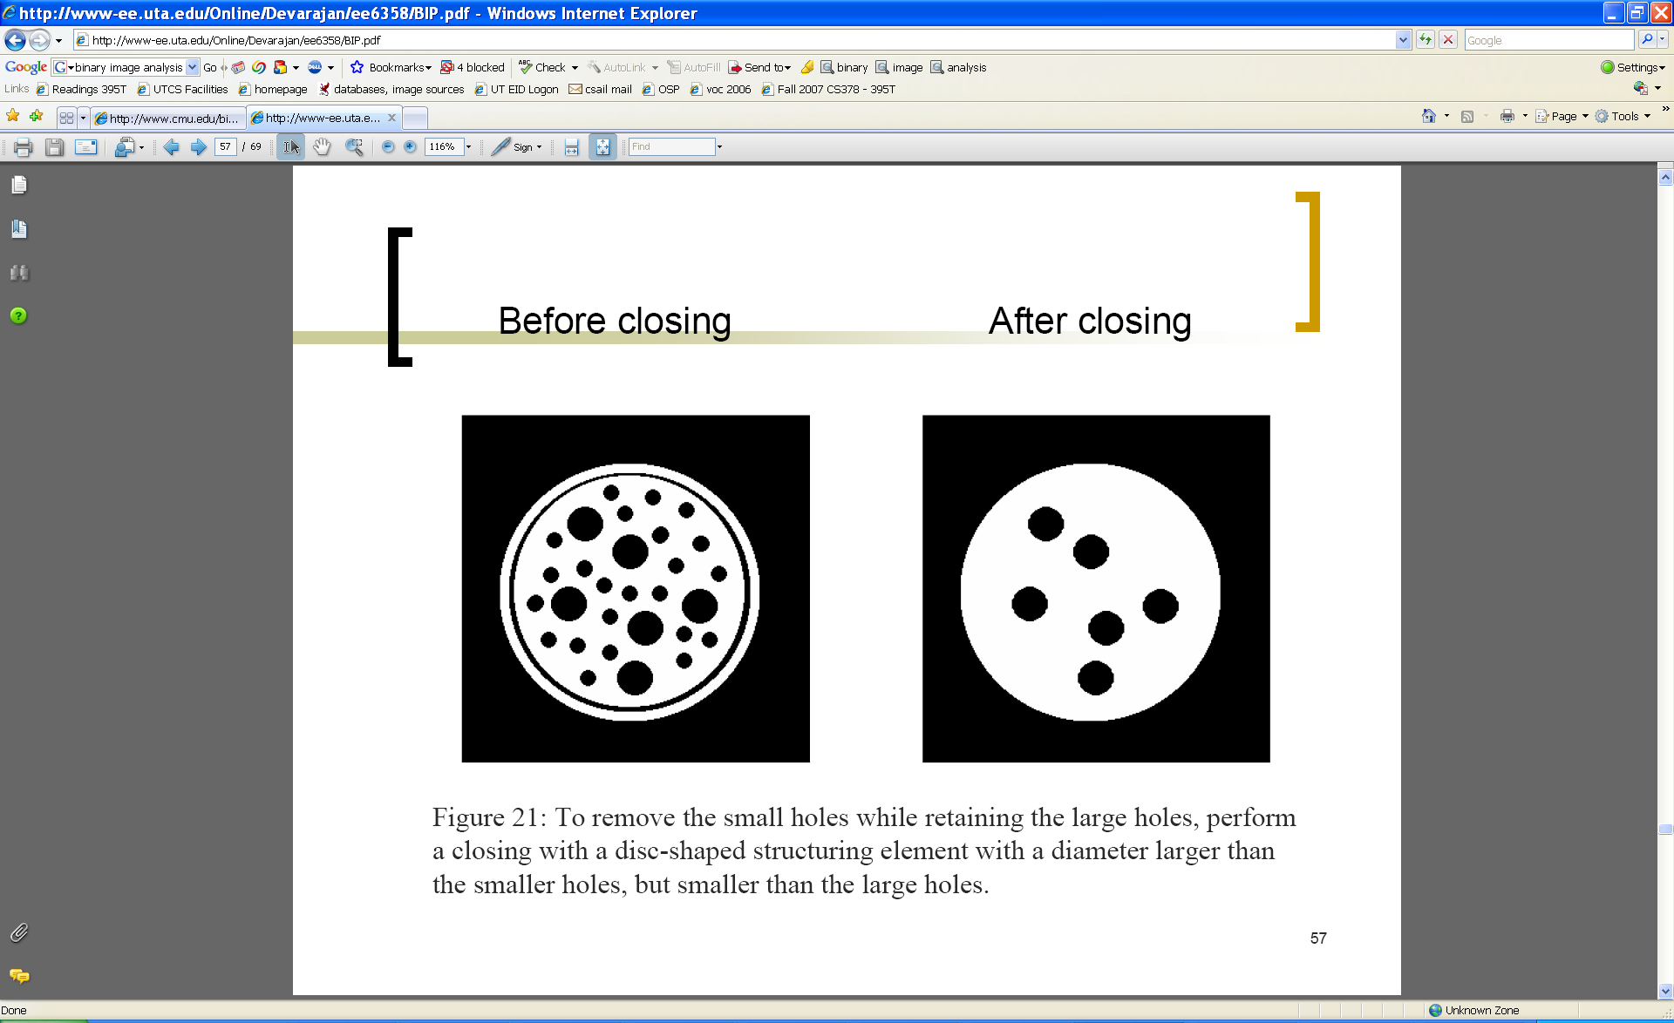
Edges and Binary Image Analysis
Devi Parikh
Disclaimer: Many slides have been borrowed from Kristen Grauman, who may have borrowed some of them from others. Any time a slide did not already have a credit on it, I have credited it to Kristen. So there is a chance some of these credits are inaccurate.

Slide 2
Announcements
PS1 is out
  Due Wed 9/11 < 11:59 pm
Slide credit: Devi Parikh

Slide 3
Topics overview
Intro
Features & filters
  Filters
  Gradients
  Edges
  Blobs/regions
  Local patterns
Grouping & fitting
Multiple views and motion
Recognition
Video processing
Slide credit: Kristen Grauman

Slide 4
Topics overview
Intro
Features & filters
  Filters
  Gradients
  Edges
  Blobs/regions
  Local patterns
Grouping & fitting
Multiple views and motion
Recognition
Video processing
Slide credit: Kristen Grauman

Slide 5
Previously
Filters allow local image neighborhood to influence our description and features
  Smoothing to reduce noise
  Derivatives to locate contrast, gradient
Seam carving application:
  use image gradients to measure “interestingness” or “energy”
  remove 8-connected seams so as to preserve image’s energy.
Slide credit: Kristen Grauman

Slide 6
Today
Edge detection and matching
  process the image gradient to find curves/contours
  comparing contours
Binary image analysis
  blobs and regions
Slide credit: Kristen Grauman

Slide 7

Edge detection
Goal: map image from 2d array of pixels to a set of curves or line segments or contours.
Why?
Main idea: look for strong gradients, post-process
Figure from J. Shotton et al., PAMI 2007
Figure from D. Lowe
Slide credit: Kristen Grauman

Slide 8
Gradients → edges
Primary edge detection steps:
1. Smoothing: suppress noise
2. Edge enhancement: filter for contrast
3. Edge localization
  Determine which local maxima from filter output are actually edges vs. noise
    Threshold, Thin
Slide credit: Kristen Grauman

Slide 9
Thresholding
Choose a threshold value t
Set any pixels less than t to zero (off)
Set any pixels greater than or equal to t to one (on)
Slide credit: Kristen Grauman

Slide 10
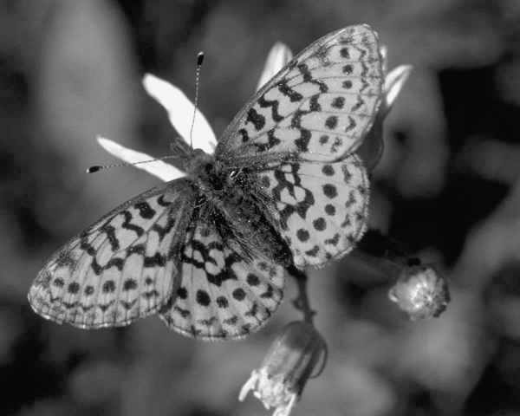
Original image
Slide credit: Kristen Grauman

Slide 11
Gradient magnitude image
Slide credit: Kristen Grauman

Slide 12
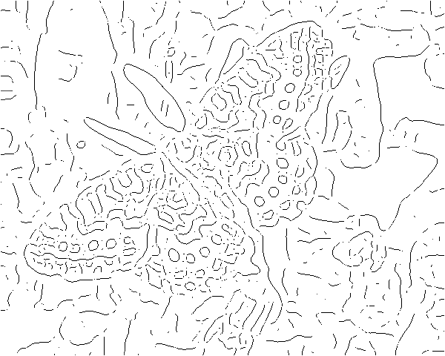
Thresholding gradient with a lower threshold
Slide credit: Kristen Grauman

Slide 13
Thresholding gradient with a higher threshold
Slide credit: Kristen Grauman

Slide 14
Canny edge detector
Filter image with derivative of Gaussian
Find magnitude and orientation of gradient
Non-maximum suppression:
  Thin wide “ridges” down to single pixel width
Linking and thresholding (hysteresis):
  Define two thresholds: low and high
  Use the high threshold to start edge curves and the low threshold to continue them
MATLAB: edge(image, ‘canny’);
>>help edge
Slide credit: David Lowe, Fei-Fei Li

Slide 15

The Canny edge detector
original image (Lena)
Slide credit: Steve Seitz

Slide 16

The Canny edge detector
norm of the gradient
Slide credit: Kristen Grauman

Slide 17

The Canny edge detector
thresholding
Slide credit: Kristen Grauman

Slide 18

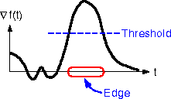
The Canny edge detector
How to turn these thick regions of the gradient into curves?
thresholding
Slide credit: Kristen Grauman

Slide 19

Non-maximum suppression
Check if pixel is local maximum along gradient direction
Select single max across width of the edge
Requires checking interpolated pixels p and r
Slide credit: Kristen Grauman

Slide 20

The Canny edge detector
Problem: pixels along this edge didn’t survive the thresholding
thinning
(non-maximum suppression)
Slide credit: Kristen Grauman

Slide 21
Hysteresis thresholding
Use a high threshold to start edge curves, and a low threshold to continue them.
Slide credit: Steve Seitz

Slide 22
Hysteresis thresholding
original image
high threshold
(strong edges)
low threshold
(weak edges)
hysteresis threshold
Slide credit: Fei-Fei Li

Slide 23
Hysteresis thresholding
http://users.ecs.soton.ac.uk/msn/book/new_demo/thresholding/
Slide credit: Kristen Grauman

Slide 24
Recap: Canny edge detector
Filter image with derivative of Gaussian
Find magnitude and orientation of gradient
Non-maximum suppression:
  Thin wide “ridges” down to single pixel width
Linking and thresholding (hysteresis):
  Define two thresholds: low and high
  Use the high threshold to start edge curves and the low threshold to continue them
MATLAB: edge(image, ‘canny’);
>>help edge
Slide credit: David Lowe, Fei-Fei Li

Slide 25
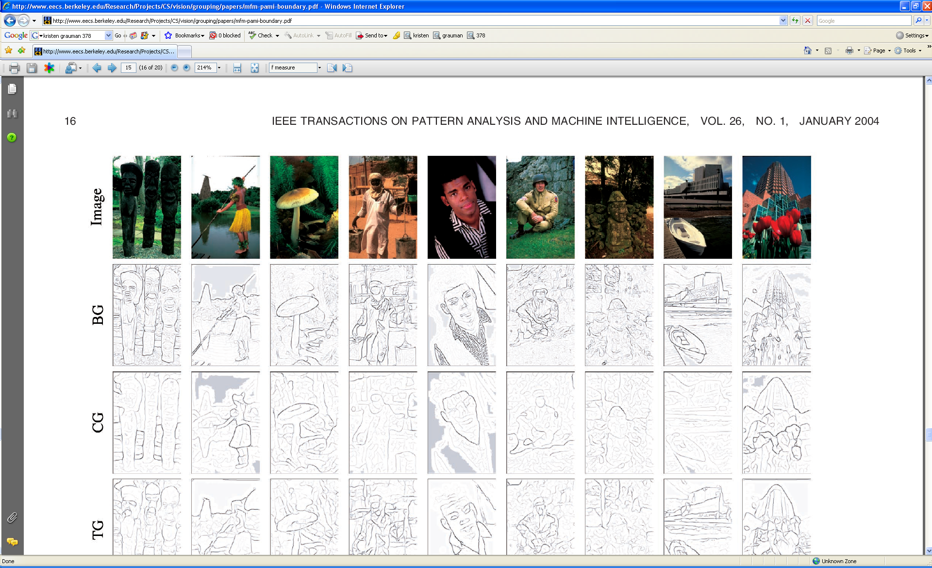
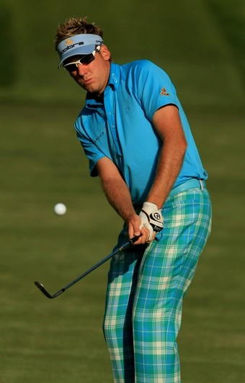
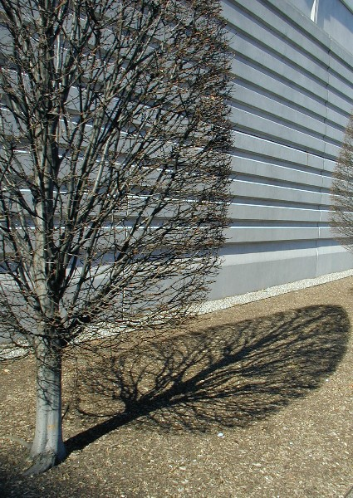

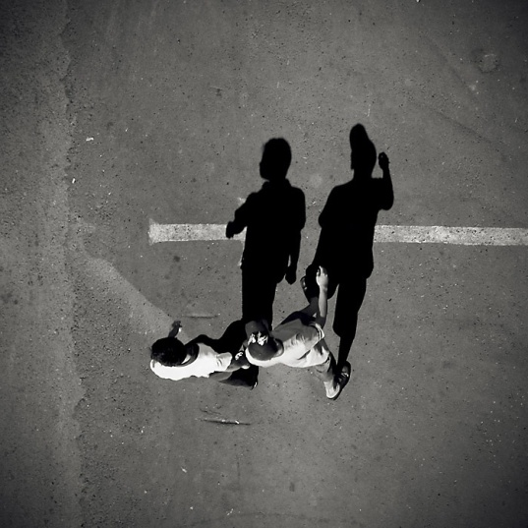
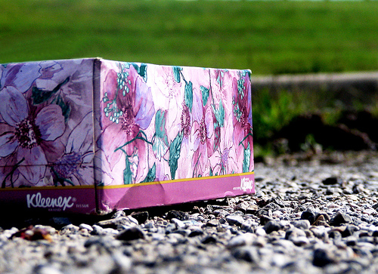
Low-level edges vs. perceived contours
Background
Texture
Shadows
Slide credit: Kristen Grauman

Slide 26



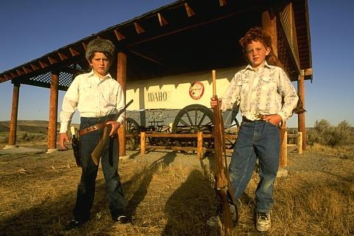


Low-level edges vs. perceived contours
image
human segmentation
gradient magnitude
Berkeley segmentation database:
http://www.eecs.berkeley.edu/Research/Projects/CS/vision/grouping/segbench/
Slide credit: Svetlana Lazebnik

Slide 27
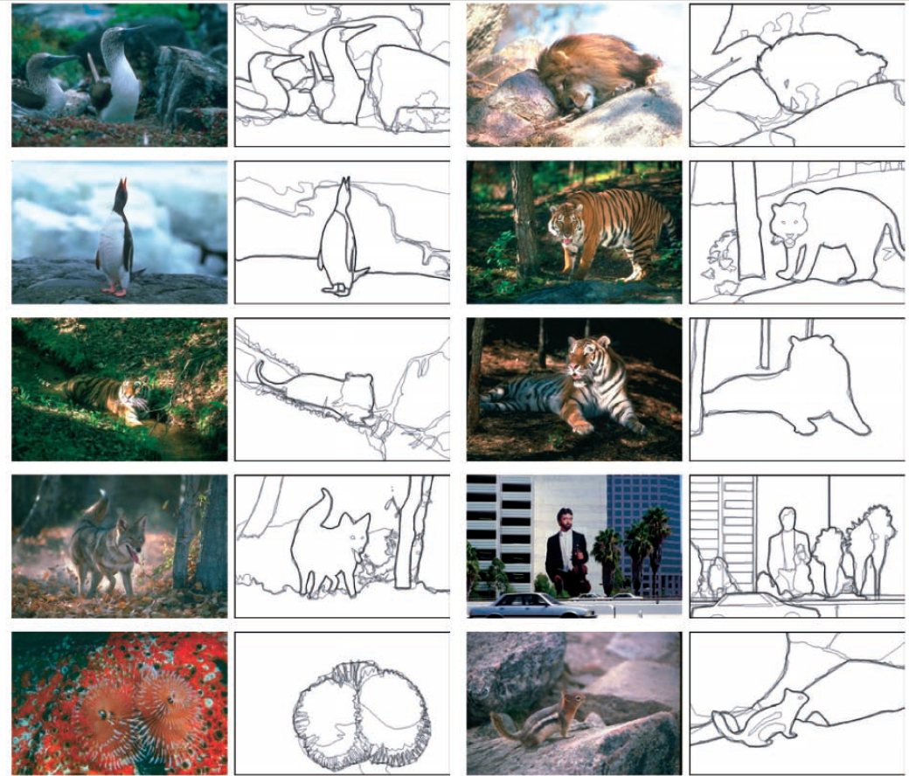
Learn from humans which combination of features is most indicative of a “good” contour?
[D. Martin et al. PAMI 2004]
Human-marked segment boundaries
Slide credit: Kristen Grauman

Slide 28
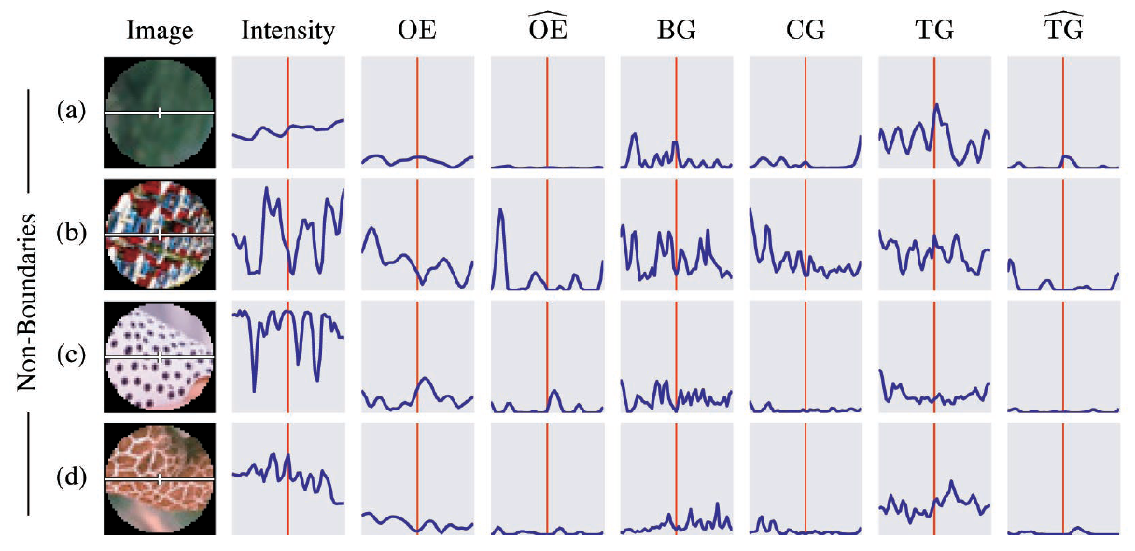
What features are responsible for perceived edges?
Feature profiles (oriented energy, brightness, color, and texture gradients) along the patch’s horizontal diameter
[D. Martin et al. PAMI 2004]
Slide credit: Kristen Grauman

Slide 29
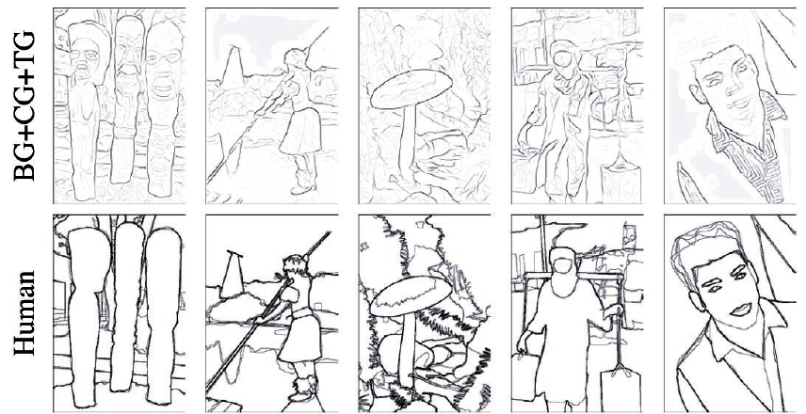
Slide credit: Kristen Grauman
[D. Martin et al. PAMI 2004]

Slide 30
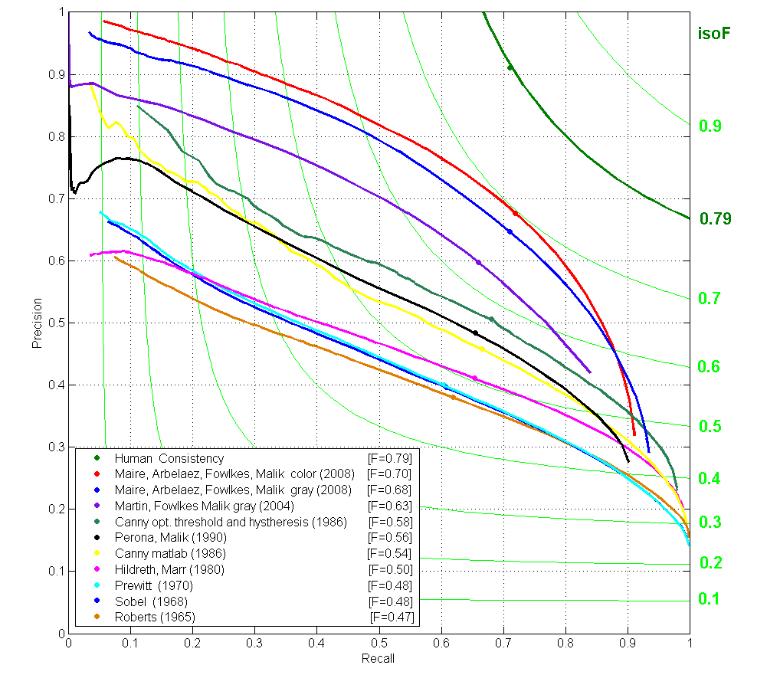
State-of-the-Art in Contour Detection
Canny+opt thresholds
Human agreement
Canny
Prewitt, Sobel, Roberts
Learned with combined features
Source: Jitendra Malik: http://www.cs.berkeley.edu/~malik/malik-talks-ptrs.html
Slide credit: Adapted by Devi Parikh from Kristen Grauman

Slide 31
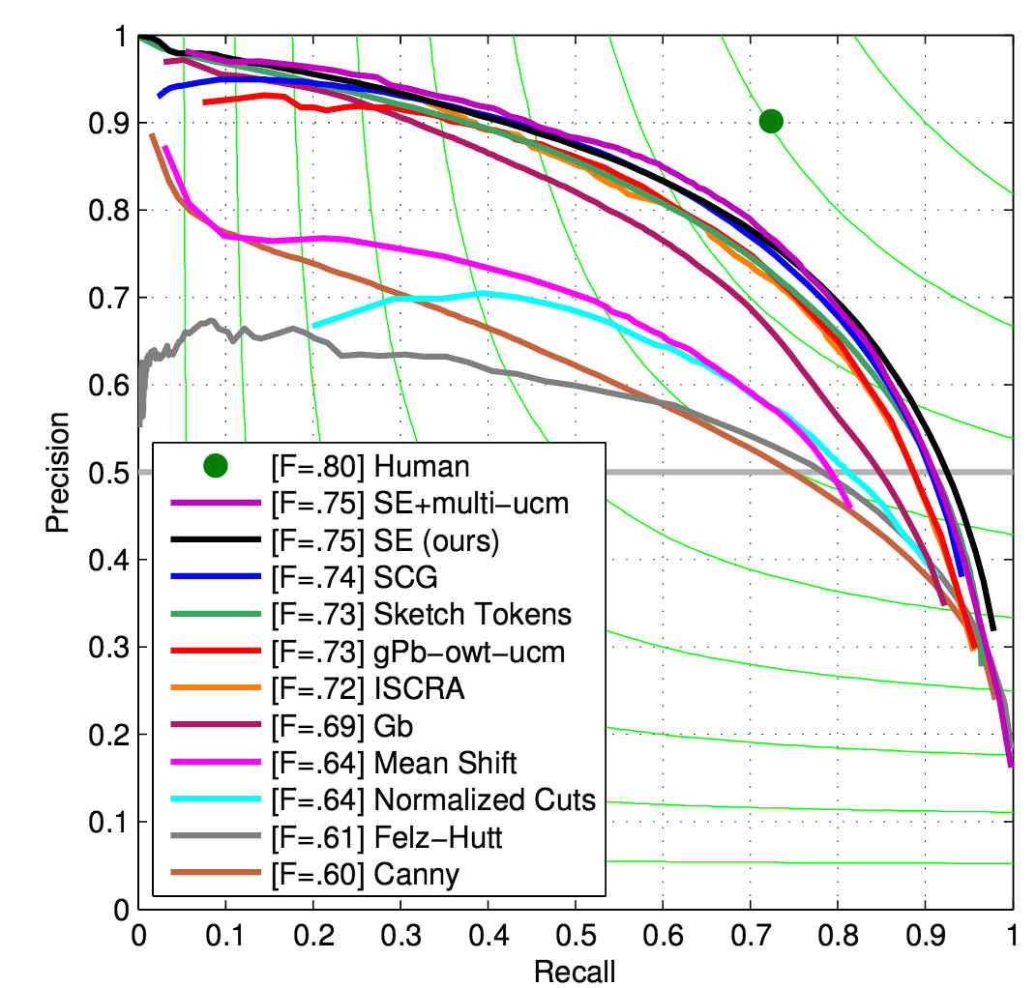
Figure from: Dollar and Zitnick, PAMI 2015
Slide credit: Devi Parikh

Slide 32
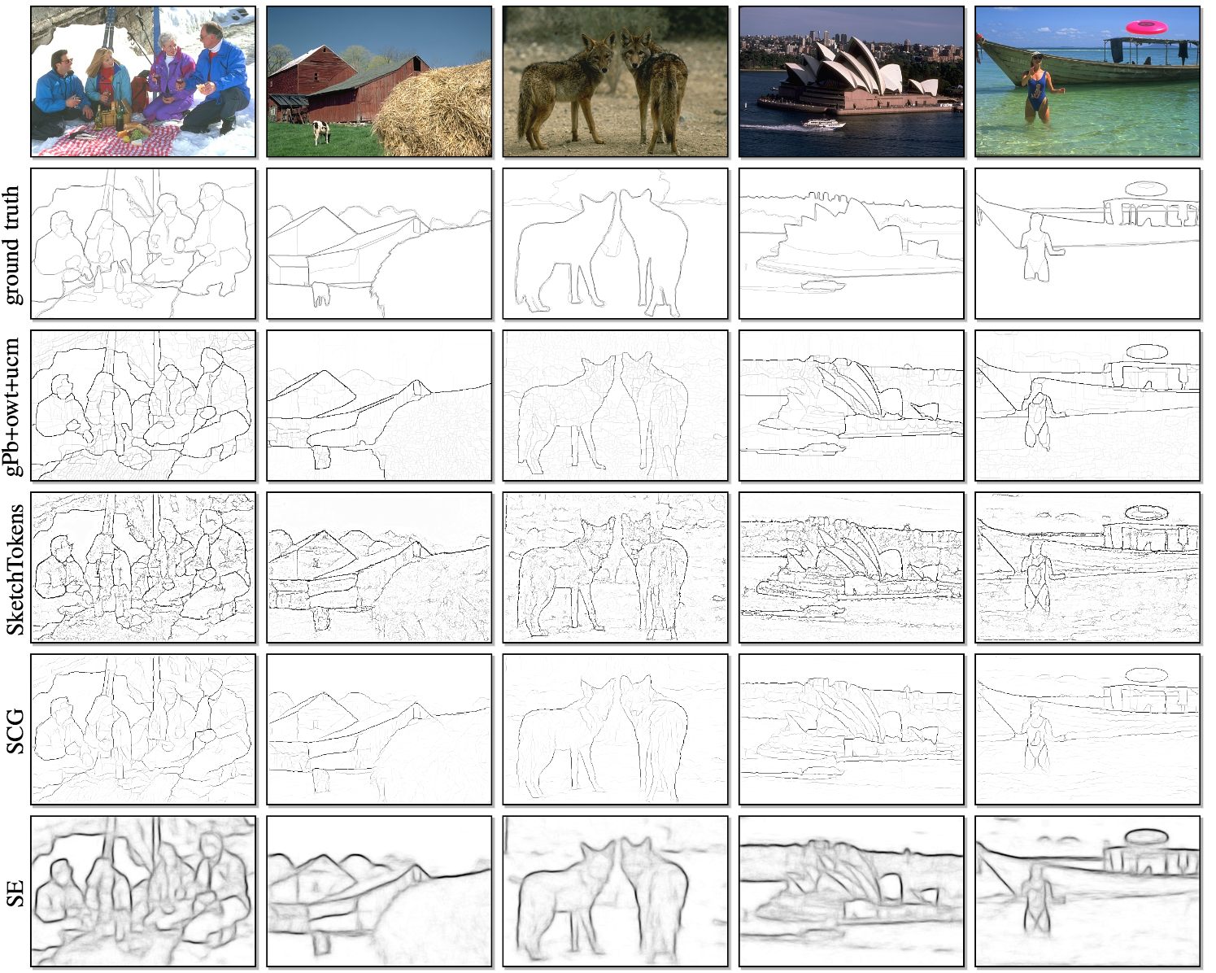
Slide credit: Devi Parikh
Figure from: Dollar and Zitnick, PAMI 2015

Slide 33
Today
Edge detection and matching
  process the image gradient to find curves/contours
  comparing contours
Binary image analysis
  blobs and regions
Slide credit: Kristen Grauman

Slide 34
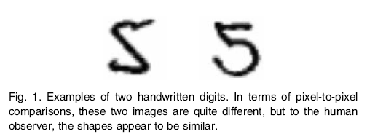
Slide credit: Kristen Grauman
Figure from Belongie et al.

Slide 35
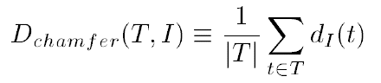
Chamfer distance
Average distance to nearest feature
Set of points in image
Set of points on (shifted) template
Minimum distance between point t and some point in I
Slide credit: Kristen Grauman

Slide 36
Chamfer distance
Slide credit: Kristen Grauman

Slide 37
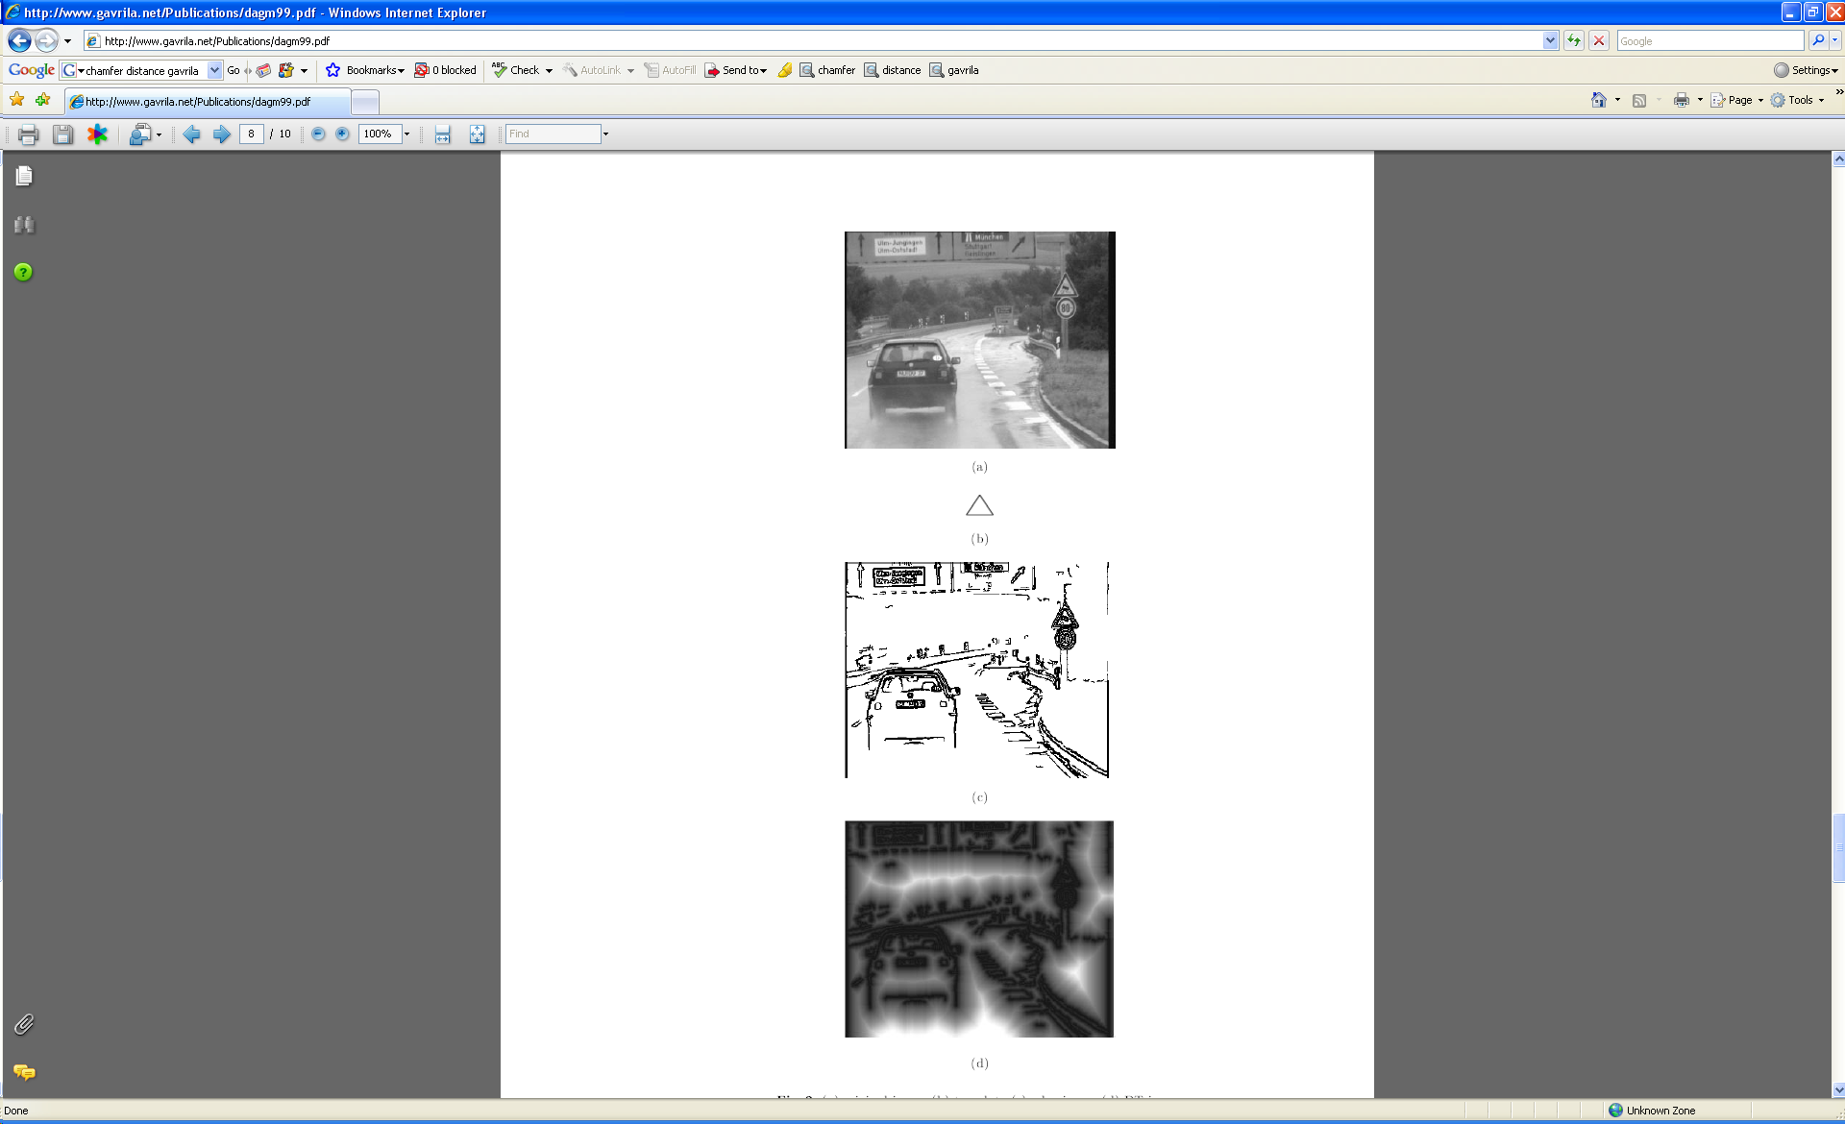
Chamfer distance
Average distance to nearest feature
How is the measure different than just filtering with a mask having the shape points?
How expensive is a naïve implementation?
Edge image
Slide credit: Kristen Grauman

Slide 38
Distance transform
Image features (2D)
Distance Transform
1
0
1
2
3
4
3
2
1
0
1
2
3
3
2
1
1
0
1
2
3
2
1
0
1
0
0
1
2
1
0
1
2
1
1
2
1
0
1
2
3
2
2
2
1
0
1
2
4
3
3
2
1
0
1
2
5
4
4
3
2
1
0
1
Distance Transform is a function that for each image pixel p assigns a non-negative number corresponding to distance from p to the nearest feature in the image I
Features could be edge points, foreground points,…
Slide credit: Yuri Boykov

Slide 39

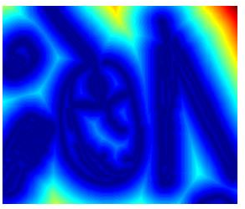

Distance transform
original
edges
distance transform
Value at (x,y) tells how far that position is from the nearest edge point (or other binary mage structure)
>> help bwdist
Slide credit: Kristen Grauman

Slide 40
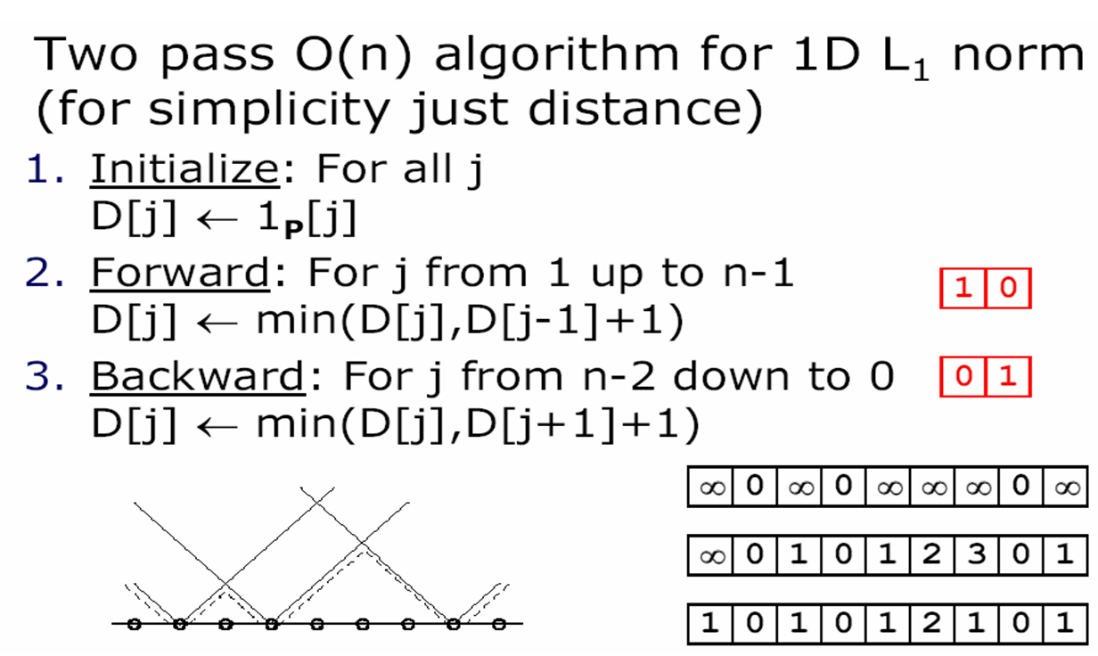
Distance transform (1D)
// 0 if j is in P, infinity otherwise
Slide credit: Adapted by Kristen Grauman from Dan Huttonlocher

Slide 41
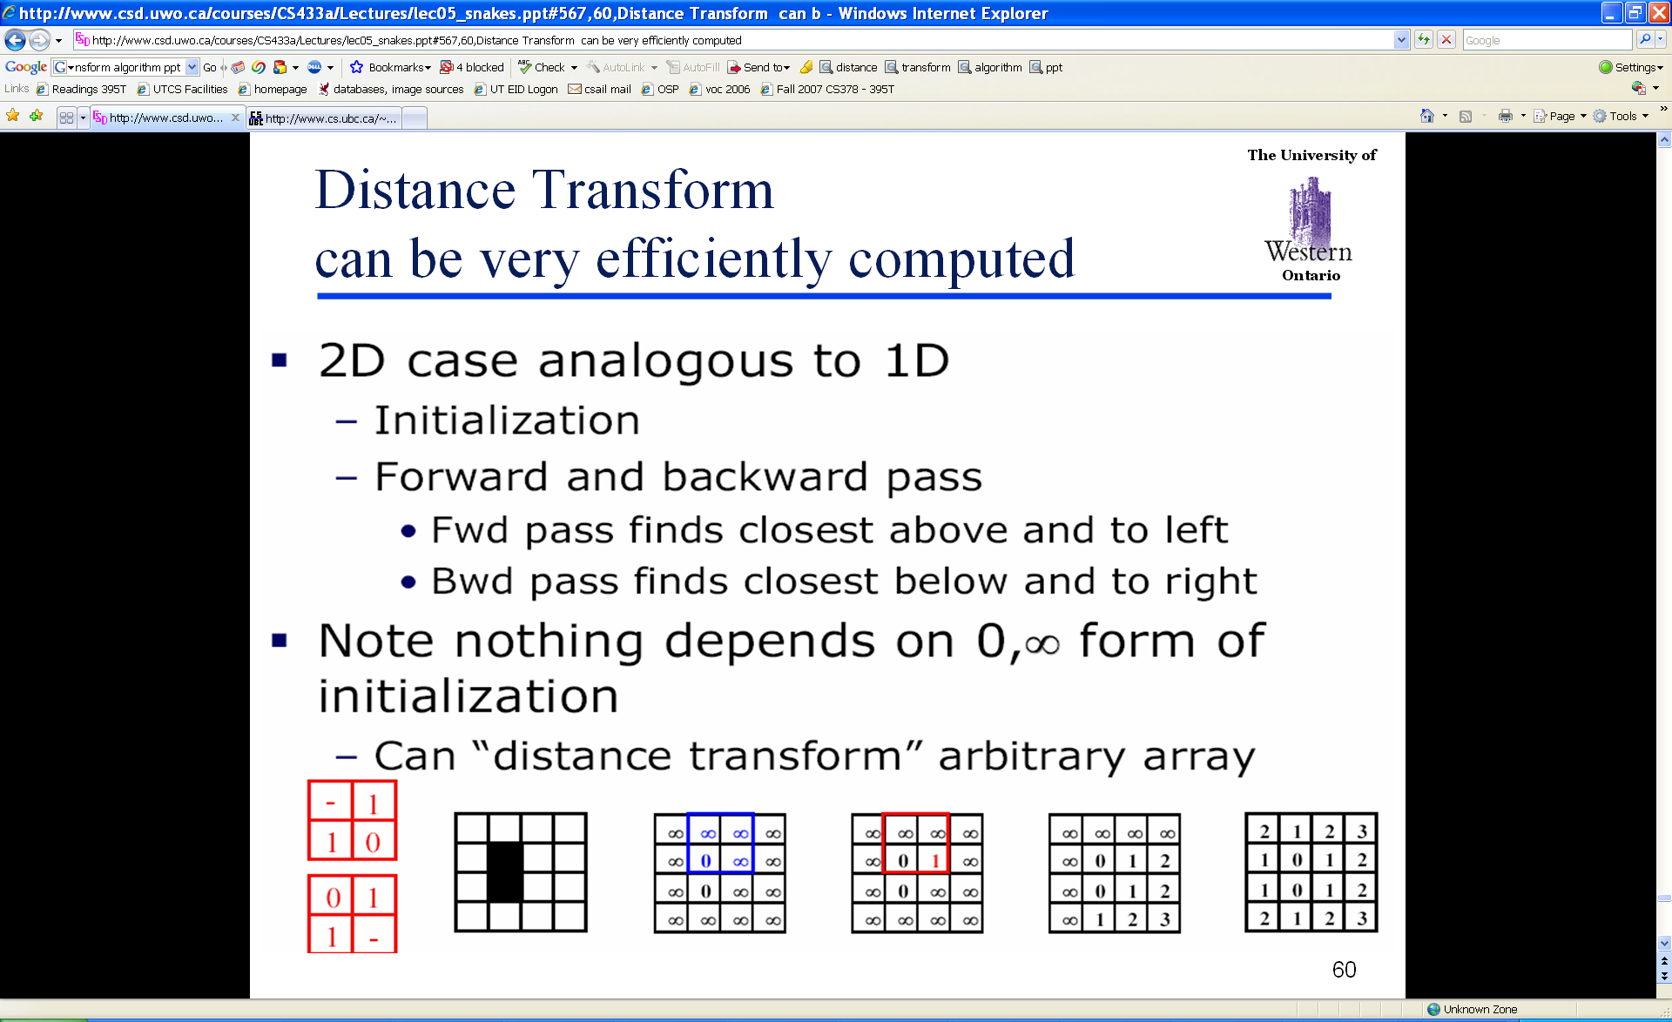
Distance Transform (2D)
Slide credit: Adapted by Kristen Grauman from Dan Huttonlocher

Slide 42
Chamfer distance
Average distance to nearest feature
Edge image
Distance transform image
Slide credit: Kristen Grauman

Slide 43
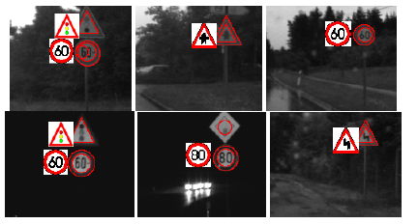
Chamfer distance
Edge image
Distance transform image
Slide credit: Kristen Grauman
Fig from D. Gavrila, DAGM 1999

Slide 44
Chamfer distance: properties
Sensitive to scale and rotation
Tolerant of small shape changes, clutter
Need large number of template shapes
Inexpensive way to match shapes
Slide credit: Kristen Grauman

Slide 45
Today
Edge detection and matching
  process the image gradient to find curves/contours
  comparing contours
Binary image analysis
  blobs and regions
Slide credit: Kristen Grauman

Slide 46
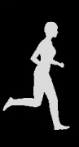
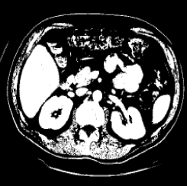
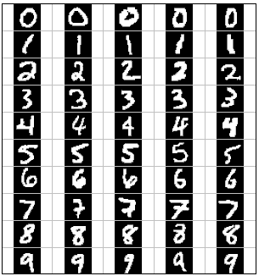
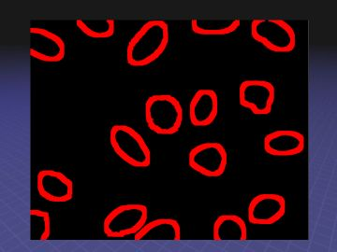
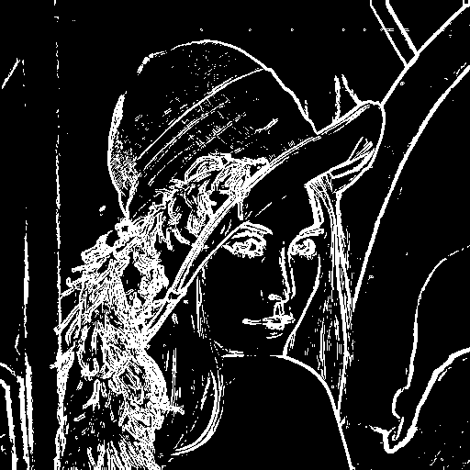
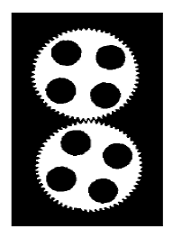
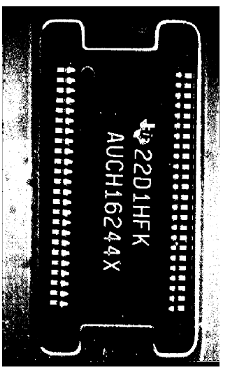
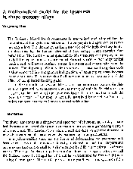
Binary images
Slide credit: Kristen Grauman

Slide 47
Binary image analysis: basic steps
Convert the image into binary form
  Thresholding
Clean up the thresholded image
  Morphological operators
Extract separate blobs
  Connected components
Describe the blobs with region properties
Slide credit: Kristen Grauman

Slide 48
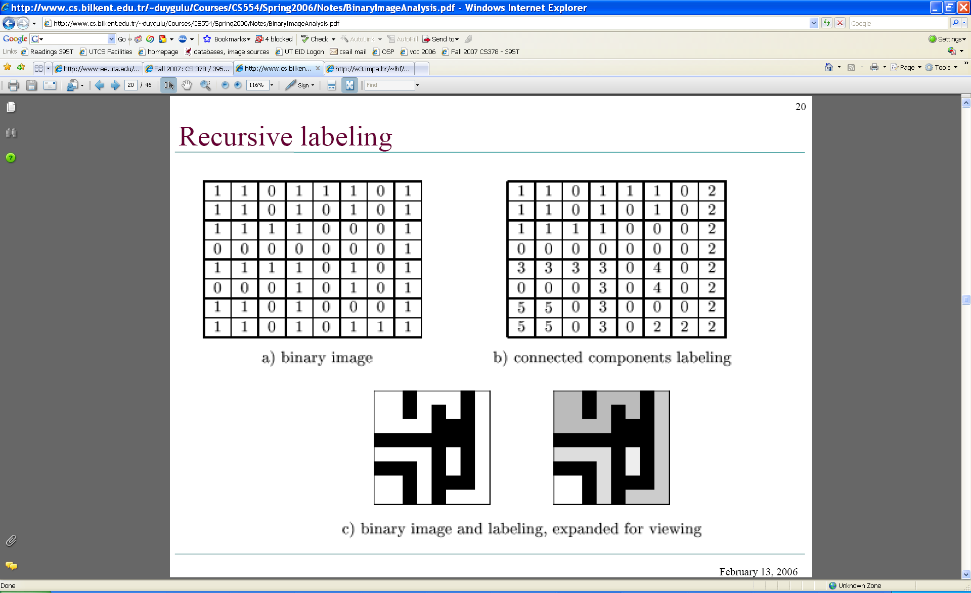
Binary images
Two pixel values
  Foreground and background
  Mark region(s) of interest
Slide credit: Kristen Grauman

Slide 49



Thresholding
Grayscale -> binary mask
Useful if object of interest’s intensity distribution is distinct from background
Example http://homepages.inf.ed.ac.uk/rbf/CVonline/LOCAL_COPIES/FITZGIBBON/simplebinary.html
Slide credit: Kristen Grauman

Slide 50
Thresholding
Given a grayscale image or an intermediate matrix → threshold to create a binary output.
Example: edge detection
Gradient magnitude
fg_pix = find(gradient_mag > t);
Looking for pixels where gradient is strong.
Slide credit: Kristen Grauman

Slide 51
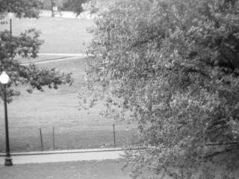
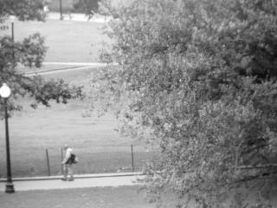
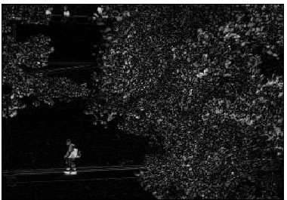
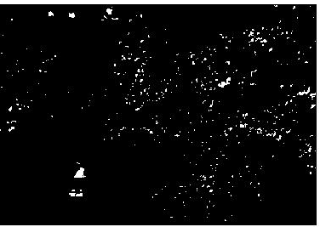
Thresholding
Given a grayscale image or an intermediate matrix → threshold to create a binary output.
Example: background subtraction
-
=
Looking for pixels that differ significantly from the “empty” background.
Slide credit: Kristen Grauman
fg_pix = find(diff > t);

Slide 52
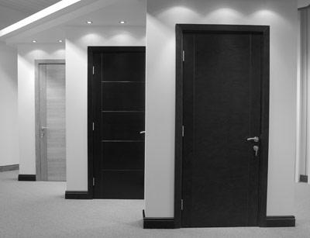
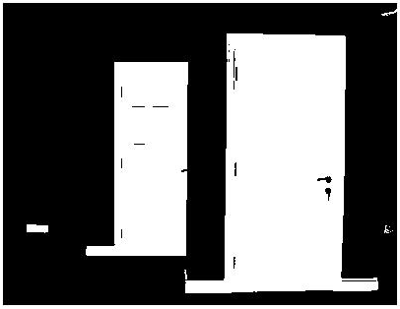
Thresholding
Given a grayscale image or an intermediate matrix → threshold to create a binary output.
Example: intensity-based detection
fg_pix = find(im < 65);
Looking for dark pixels
Slide credit: Kristen Grauman

Slide 53
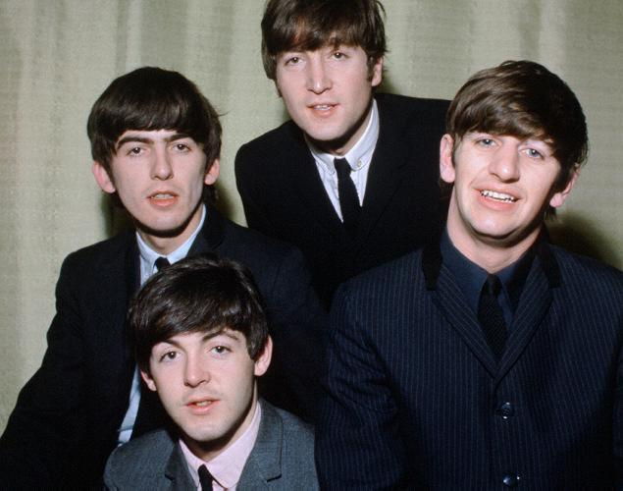
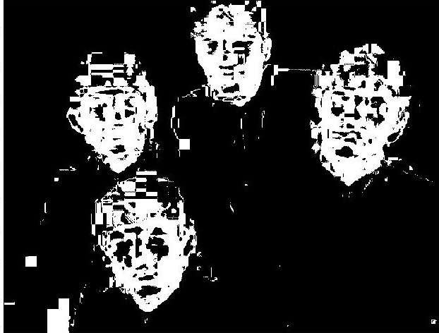
Thresholding
Given a grayscale image or an intermediate matrix → threshold to create a binary output.
Example: color-based detection
fg_pix = find(hue > t1 & hue < t2);
Looking for pixels within a certain hue range.
Slide credit: Kristen Grauman

Slide 54
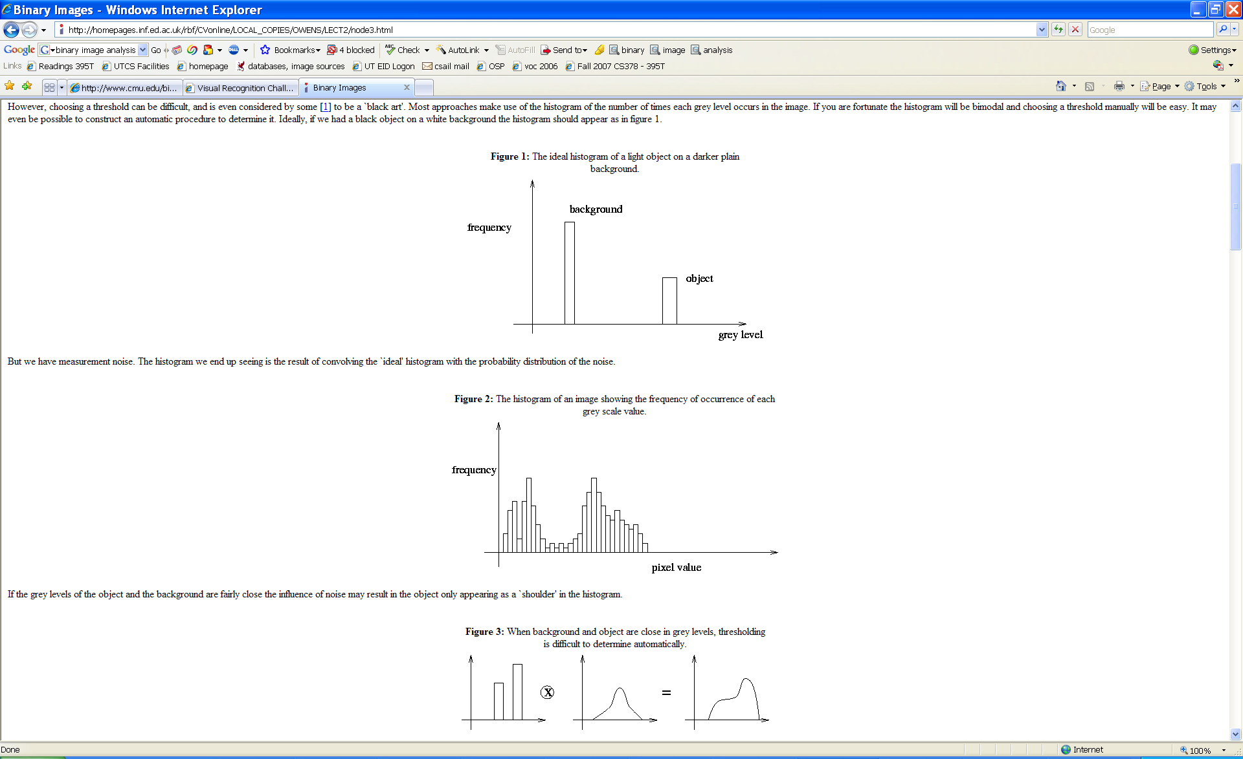
A nice case: bimodal intensity histograms
Ideal histogram, light object on dark background
Actual observed histogram with noise
Images: http://homepages.inf.ed.ac.uk/rbf/CVonline/LOCAL_COPIES/OWENS/LECT2/node3.html
Slide credit: Kristen Grauman

Slide 55
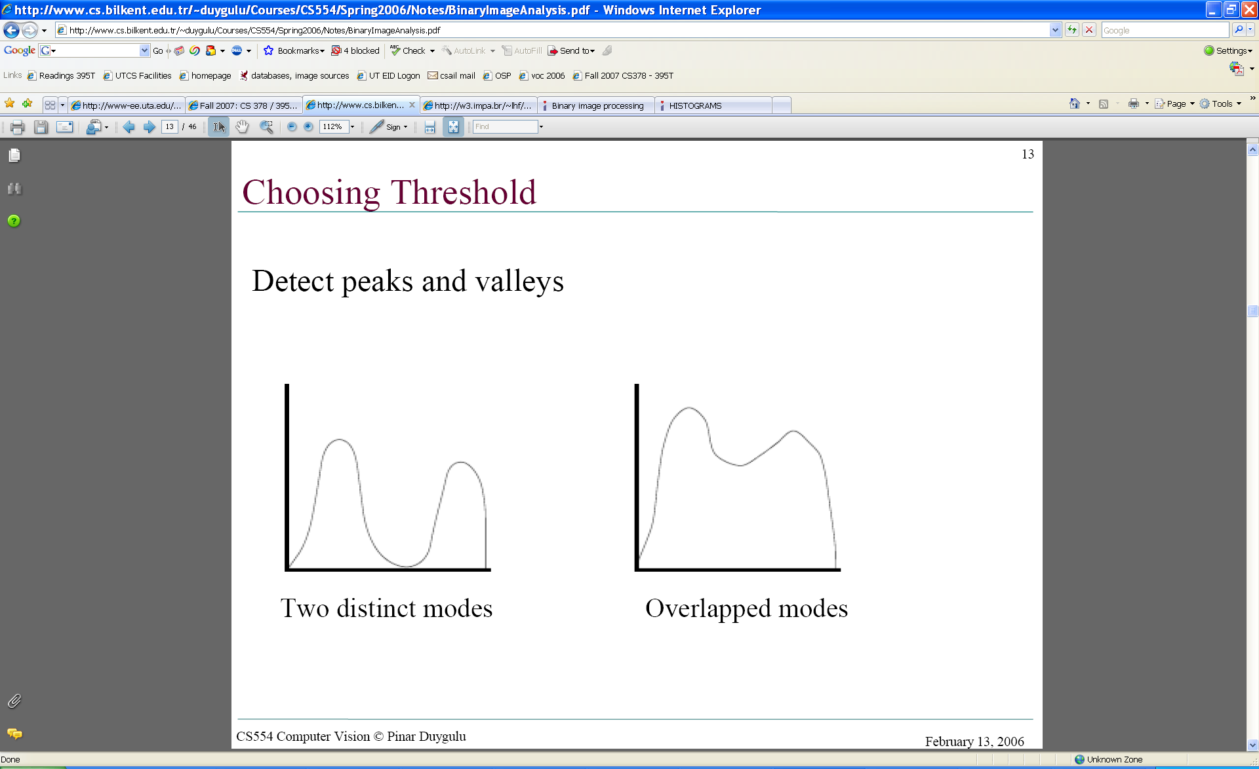
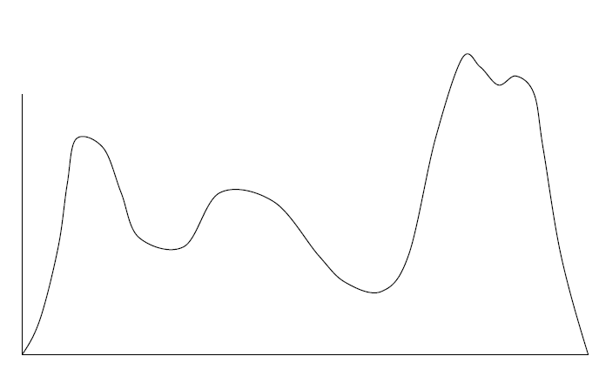
Not so nice cases
Slide credit: Shapiro and Stockman

Slide 56
Issues
What to do with “noisy” binary outputs?
  Holes
  Extra small fragments
How to demarcate multiple regions of interest?
  Count objects
  Compute further features per object
Slide credit: Kristen Grauman

Slide 57
Morphological operators
Change the shape of the foreground regions via intersection/union operations between a scanning structuring element and binary image.
Useful to clean up result from thresholding
Basic operators are:
  Dilation
  Erosion
Slide credit: Kristen Grauman

Slide 58
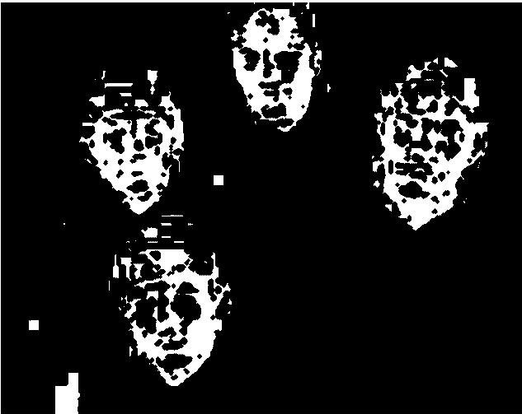
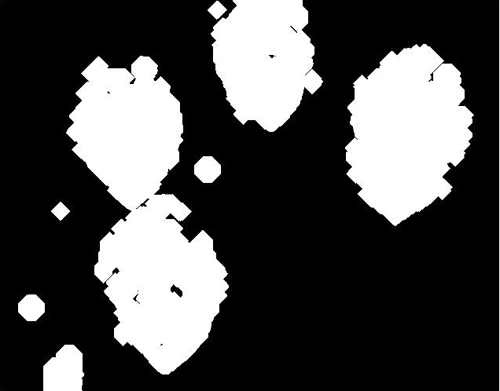
Dilation
Expands connected components
Grow features
Fill holes
Before dilation
After dilation
Slide credit: Kristen Grauman
Notes:
Disk strel, 5 pixels wide

Slide 59

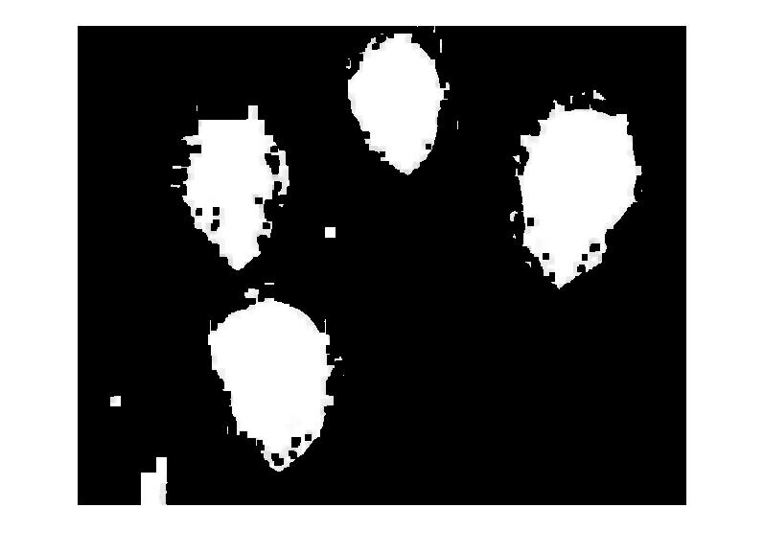
Erosion
Erode connected components
Shrink features
Remove bridges, branches, noise
Before erosion
After erosion
Slide credit: Kristen Grauman

Slide 60
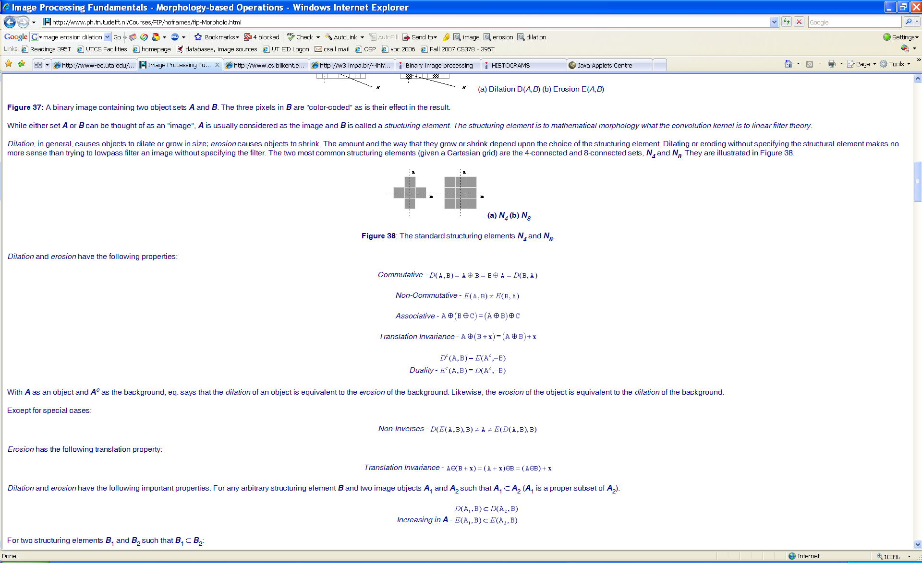
Structuring elements
Masks of varying shapes and sizes used to perform morphology, for example:
Scan mask across foreground pixels to transform the binary image
>> help strel
Slide credit: Kristen Grauman

Slide 61
Dilation vs. Erosion
At each position:
Dilation: if current pixel is foreground, OR the structuring element with the input image.
Slide credit: Kristen Grauman

Slide 62
Example for Dilation
Input image
1 | 0 | 0 | 0 | 1 | 1 | 1 | 0 | 1 | 1
1
1
1
Structuring Element
Output Image
1 | 1
Slide credit: Adapted by Kristen Grauman from T. Moeslund

Slide 63
Example for Dilation
Input image
1 | 0 | 0 | 0 | 1 | 1 | 1 | 0 | 1 | 1
Structuring Element
1
1
1
Output Image
1 | 1
Slide credit: Kristen Grauman

Slide 64
Example for Dilation
Input image
1 | 0 | 0 | 0 | 1 | 1 | 1 | 0 | 1 | 1
Structuring Element
1
1
1
Output Image
1 | 1 | 0
Slide credit: Kristen Grauman

Slide 65
Example for Dilation
Input image
1 | 0 | 0 | 0 | 1 | 1 | 1 | 0 | 1 | 1
Structuring Element
1
1
1
Output Image
1 | 1 | 0 | 0
Slide credit: Kristen Grauman

Slide 66
Example for Dilation
Input image
1 | 0 | 0 | 0 | 1 | 1 | 1 | 0 | 1 | 1
Structuring Element
1
1
1
Output Image
1 | 1 | 0 | 1 | 1 | 1
Slide credit: Kristen Grauman

Slide 67
Example for Dilation
Input image
1 | 0 | 0 | 0 | 1 | 1 | 1 | 0 | 1 | 1
Structuring Element
1
1
1
Output Image
1 | 1 | 0 | 1 | 1 | 1 | 1
Slide credit: Kristen Grauman

Slide 68
Example for Dilation
Input image
1 | 0 | 0 | 0 | 1 | 1 | 1 | 0 | 1 | 1
Structuring Element
1
1
1
Output Image
1 | 1 | 0 | 1 | 1 | 1 | 1 | 1
Slide credit: Kristen Grauman

Slide 69
Example for Dilation
Input image
1 | 0 | 0 | 0 | 1 | 1 | 1 | 0 | 1 | 1
Structuring Element
1
1
1
Output Image
1 | 1 | 0 | 1 | 1 | 1 | 1 | 1
Slide credit: Kristen Grauman

Slide 70
Example for Dilation
Input image
1 | 0 | 0 | 0 | 1 | 1 | 1 | 0 | 1 | 1
Structuring Element
1
1
1
Output Image
1 | 1 | 0 | 1 | 1 | 1 | 1 | 1 | 1 | 1
Note that the object gets bigger and holes are filled.
>> help imdilate
Slide credit: Kristen Grauman

Slide 71
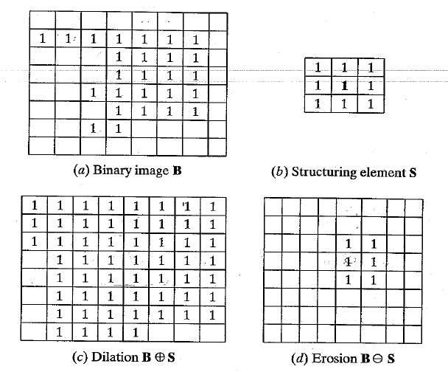
2D example for dilation
Slide credit: Shapiro & Stockman

Slide 72
Dilation vs. Erosion
At each position:
Dilation: if current pixel is foreground, OR the structuring element with the input image.
Erosion: if every pixel under the structuring element’s nonzero entries is foreground, OR the current pixel with S.
Slide credit: Kristen Grauman

Slide 73
Example for Erosion (1D)
Input image
1 | 0 | 0 | 0 | 1 | 1 | 1 | 0 | 1 | 1
1
1
1
Structuring Element
_
Output Image
0
Slide credit: Kristen Grauman

Slide 74
Example for Erosion (1D)
Input image
1 | 0 | 0 | 0 | 1 | 1 | 1 | 0 | 1 | 1
1
1
1
Structuring Element
_
Output Image
0 | 0
Slide credit: Kristen Grauman

Slide 75
Example for Erosion
Input image
1 | 0 | 0 | 0 | 1 | 1 | 1 | 0 | 1 | 1
Structuring Element
1
1
1
Output Image
0 | 0 | 0
Slide credit: Kristen Grauman

Slide 76
Example for Erosion
Input image
1 | 0 | 0 | 0 | 1 | 1 | 1 | 0 | 1 | 1
Structuring Element
1
1
1
Output Image
0 | 0 | 0 | 0
Slide credit: Kristen Grauman

Slide 77
Example for Erosion
Input image
1 | 0 | 0 | 0 | 1 | 1 | 1 | 0 | 1 | 1
Structuring Element
1
1
1
Output Image
0 | 0 | 0 | 0 | 0
Slide credit: Kristen Grauman

Slide 78
Example for Erosion
Input image
1 | 0 | 0 | 0 | 1 | 1 | 1 | 0 | 1 | 1
Structuring Element
1
1
1
Output Image
0 | 0 | 0 | 0 | 0 | 1
Slide credit: Kristen Grauman

Slide 79
Example for Erosion
Input image
1 | 0 | 0 | 0 | 1 | 1 | 1 | 0 | 1 | 1
Structuring Element
1
1
1
Output Image
0 | 0 | 0 | 0 | 0 | 1 | 0
Slide credit: Kristen Grauman

Slide 80
Example for Erosion
Input image
1 | 0 | 0 | 0 | 1 | 1 | 1 | 0 | 1 | 1
Structuring Element
1
1
1
Output Image
0 | 0 | 0 | 0 | 0 | 1 | 0 | 0
Slide credit: Kristen Grauman

Slide 81
Example for Erosion
Input image
1 | 0 | 0 | 0 | 1 | 1 | 1 | 0 | 1 | 1
Structuring Element
1
1
1
Output Image
0 | 0 | 0 | 0 | 0 | 1 | 0 | 0 | 0
Slide credit: Kristen Grauman

Slide 82
Example for Erosion
Input image
1 | 0 | 0 | 0 | 1 | 1 | 1 | 0 | 1 | 1
Structuring Element
1
1
1
Output Image
0 | 0 | 0 | 0 | 0 | 1 | 0 | 0 | 0 | 1
Note that the object gets smaller
>> help imerode
Slide credit: Kristen Grauman

Slide 83
2D example for erosion
Slide credit: Shapiro & Stockman

Slide 84

Opening
Erode, then dilate
Remove small objects, keep original shape
Before opening
After opening
Slide credit: Kristen Grauman

Slide 85
Closing
Dilate, then erode
Fill holes, but keep original shape
Before closing
After closing
Applet: http://bigwww.epfl.ch/demo/jmorpho/start.php
Slide credit: Kristen Grauman

Slide 86



Morphology operators on grayscale images
Dilation and erosion typically performed on binary images.
If image is grayscale: for dilation take the neighborhood max, for erosion take the min.
original
dilated
eroded
Slide credit: Kristen Grauman

Slide 87
Issues
What to do with “noisy” binary outputs?
  Holes
  Extra small fragments
How to demarcate multiple regions of interest?
  Count objects
  Compute further features per object
Slide credit: Kristen Grauman

Slide 88
Connected components
Various algorithms to compute
  Recursive (in memory)
  Two rows at a time (image not necessarily in memory)
  Parallel propagation strategy
Slide credit: Kristen Grauman

Slide 89
Recursive connected components
Find an unlabeled pixel, assign it a new label
Search to find its neighbors, and recursively repeat to find their neighbors til there are no more
Repeat
Demo http://www.cosc.canterbury.ac.nz/mukundan/covn/Label.html
Slide credit: Kristen Grauman

Slide 90

Connected components
Identify distinct regions of “connected pixels”
Slide credit: Shapiro and Stockman

Slide 91

Connectedness
Defining which pixels are considered neighbors
4-connected
8-connected
Slide credit: Chaitanya Chandra

Slide 92

Connected components
We’ll consider a sequential algorithm that requires only 2 passes over the image.
Input: binary image
Output: “label” image, where pixels are numbered per their component
Note: foreground here is denoted with black pixels.
Slide credit: Kristen Grauman

Slide 93

Sequential connected components
Slide credit: Adapted by Kristen Grauman from J. Neira

Slide 94
Sequential connected components
Slide credit: Kristen Grauman

Slide 95
Sequential connected components
Slide credit: Kristen Grauman

Slide 96
Sequential connected components
Slide credit: Kristen Grauman

Slide 97

Connected components
Slide credit: Pinar Duygulu

Slide 98
Region properties
Given connected components, can compute simple features per blob, such as:
  Area (num pixels in the region)
  Centroid (average x and y position of pixels in the region)
  Bounding box (min and max coordinates)
  Circularity (ratio of mean dist. to centroid over std)
A2=170
A1=200
Slide credit: Kristen Grauman

Slide 99

Circularity
[Haralick]
Slide credit: Shapiro & Stockman

Slide 100
Binary image analysis: basic steps (recap)
Convert the image into binary form
  Thresholding
Clean up the thresholded image
  Morphological operators
Extract separate blobs
  Connected components
Describe the blobs with region properties
Slide credit: Kristen Grauman

Slide 101
Matlab
N = hist(Y,M)
L = bwlabel (BW,N);
STATS = regionprops(L,PROPERTIES) ;
  'Area'
  'Centroid'
  'BoundingBox'
  'Orientation‘, …
IM2 = imerode(IM,SE);
IM2 = imdilate(IM,SE);
IM2 = imclose(IM, SE);
IM2 = imopen(IM, SE);
Slide credit: Kristen Grauman

Slide 102

Example using binary image analysis: OCR
[Luis von Ahn et al. http://recaptcha.net/learnmore.html]
Slide credit: Kristen Grauman

Slide 103

Example using binary image analysis: segmentation of a liver
Slide credit: Li Shen

Slide 104





Example using binary image analysis:
Bg subtraction + blob detection
…
Slide credit: Kristen Grauman

Slide 105

Example using binary image analysis:
Bg subtraction + blob detection
Slide credit: Kristen Grauman

Slide 106

Example using binary image analysis:
Bg subtraction + blob detection
University of Southern California
http://iris.usc.edu/Projects/detect/detection-result.html
Slide credit: Kristen Grauman

Slide 107
Binary images
Pros
  Can be fast to compute, easy to store
  Simple processing techniques available
  Lead to some useful compact shape descriptors
Cons
  Hard to get “clean” silhouettes
  Noise common in realistic scenarios
  Can be too coarse of a representation
  Not 3d
Slide credit: Kristen Grauman

Slide 108
Summary
Operations, tools
Features, representations
Derivative filters
Smoothing, morphology
Thresholding
Connected components
Matched filters
Histograms
Edges, gradients
Blobs/regions
Local patterns
Color distributions
Textures (next)
Slide credit: Kristen Grauman

Slide 109
Topics overview
Intro
Multiple views and motion
Features & filters
  Filters
  Gradients
  Edges
  Blobs/regions
  Local patterns
Grouping & fitting
Recognition
Video processing
Slide credit: Kristen Grauman

Slide 110

Coming up
Texture
  Read 10.5
Slide credit: Adapted by Devi Parikh from Kristen Grauman

Slide 111
Questions?

