Slide 1
Algorithms & Adaptivity Gaps for stochastic probing
(2nd December, 2015)
Sahil singla
Joint work with Anupam gupta and viswanath nagarajan

Slide 2
Stochastic probing
Only 1 hour before shops close!
Orienteering Constraint

Slide 3
Stochastic probing
Only 1 hour before shops close!
0.4
Orienteering Constraint
20 min
0.8
30 min
20 min
20 min
0.25
0.5
30 min
15 min
25 min
15 min
0.5
Remark: If probabilities 1 & nodes distinct, then Orienteering Problem [Blum et al. FOCS’03]

Slide 4
Stochastic probing
0.4
0.8
20 min
Input:
Graph & Metric
Probabilities:
Independently Present
Function
(e.g., # Distinct Items)
Constraints
(e.g., 1 hour Orienteering)
OUTPUT:
Maximize the Expected Function Value
30 min
20 min
20 min
0.25
0.5
30 min
15 min
25 min
0.5
15 min
Notes:
QUESTION is coming!

Slide 5
Simple strategy
0.4
0.8
20 min
30 min
15 min
15 min
20 min
20 min
0.5
0.5
0.25
0.5
25 min
25 min
30 min
15 min
0.5
0.5
25 min
20 min
20 min
15 min
0.5
0.4
0.8
0.5+0.5+0.4 =1.4
0.5(1+0.5+0) +
0.5(0+0.5+0.8) =1.4
Can we Get Better?
Notes:
QUESTION is coming!

Slide 6
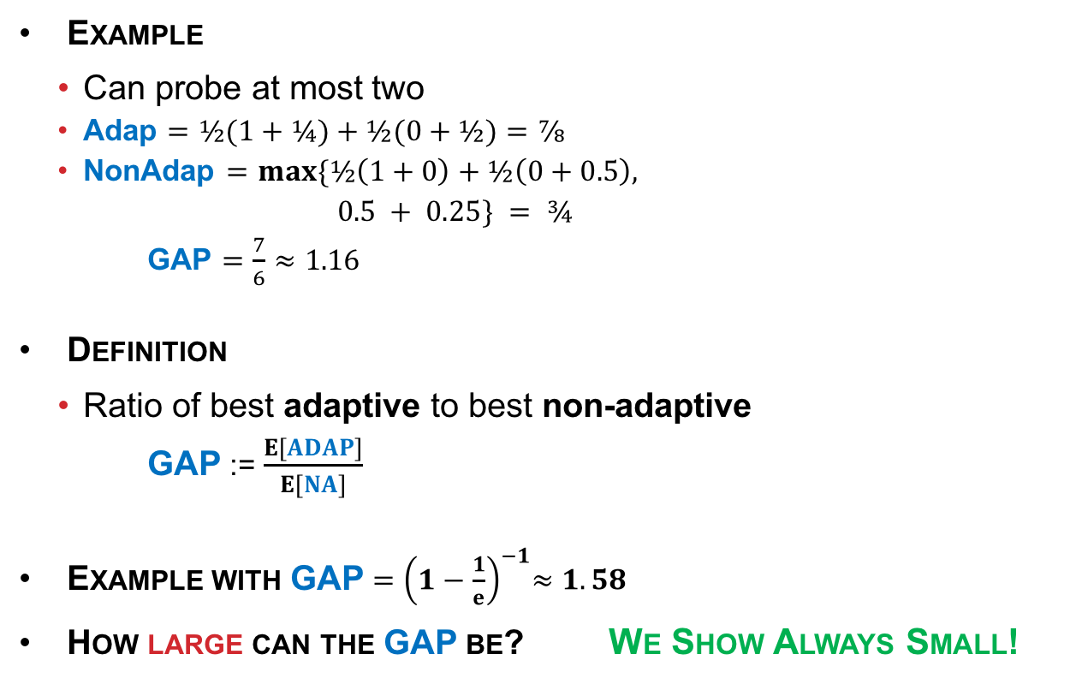
Adaptivity gap
0.5
Example
  Can probe at most two
  Adap $=½(1+¼)+½(0+½)=⅞$
  NonAdap $=max⁡\{½\left(1+0\right)+½\left(0+0.5\right),$
  $0.5 + 0.25\} = ¾$
  GAP $=\frac{7}{6}≈1.16$
Definition
  Ratio of best adaptive to best non-adaptive
  GAP := $\frac{E[ADAP]}{E[NA]}$
Example with GAP ${=\left(1−\frac{1}{e}\right)}^{−1}≈1.58$
How large can the GAP be? We Show Always Small!
Yes
No
0.5
0.5
0.25
0.5
0.25

Slide 7
best adaptive strategy
Decision Tree
Yes
No
Yes
No
Yes
No
No
Yes
Every Root-Leaf Path at most 1 Hour
Can be Exponential Sized

Slide 8
OUTLINE
Stochastic Probing
Adaptivity GAP
Why Care About Adaptivity GAP?
Proof of Small Adaptivity GAP
Conclusions

Slide 9

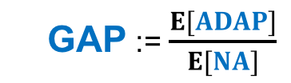

Why Care about Adaptivity gap?
BEST ADAPTIVE
Goal: Bound Ratio
$≤α$.GAP
Adaptivity GAP
  GAP := $\frac{E[ADAP]}{E[NA]}$
BEST NON-ADAPTIVE
ALGORITHM
Approx ratio $α$

Slide 10


Why Care about Adaptivity gap?
Focus on Non-Adaptive Paths
Easier to Represent
  No exponential sized tree
Easier to Find
  Smaller search space
Easier to Bound
ADAP
$α.$GAP
GAP
NON-ADAP
ALGO
$$α$$

Slide 11
results
Theorem 1: Adaptivity Gap for
Constraints = Orienteering
Function = Number of Distinct Items
is at most 3.
ADAP
$α.$GAP
GAP
NON-ADAP
ALGO
$$α$$
Theorem 2: Adaptivity Gap for
Constraints = Downward-Closed
Function = Non-Negative Submodular
is a constant.
Examples
  Weighted items
  Knapsack constraints

Slide 12
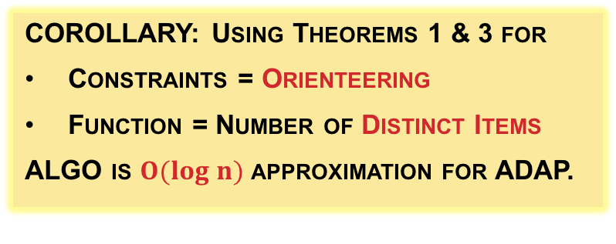
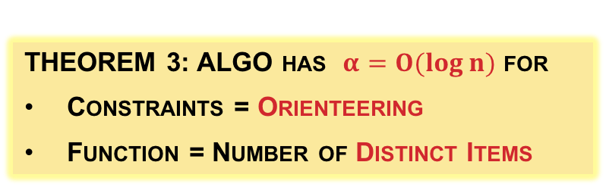
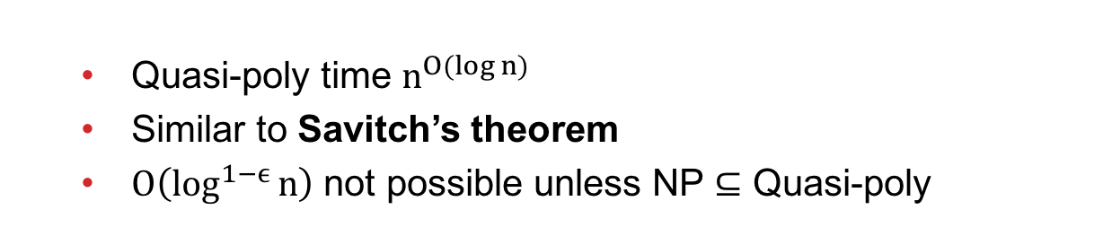
A Non-Adaptive algorithm
Chekuri and Pal – FOCS’05
Theorem 3: ALGO has $α=O(log⁡n)$ for
Constraints = Orienteering
Function = Number of Distinct Items
ADAP
$α.$GAP
GAP
NON-ADAP
ALGO
$$α$$
  Quasi-poly time $n^{O(log n)}$
  Similar to Savitch’s theorem
  $O\left(\log^{1−ϵ}{n}\right)$ not possible unless NP $⊆$ Quasi-poly
Corollary: Using Theorems 1 & 3 for
Constraints = Orienteering
Function = Number of Distinct Items
ALGO is $O(log n)$ approximation for ADAP.

Slide 13
Prior work
Assumes Simple Constraints (e.g., any k items)
  Bound ADAP using LP
  Compare ALGO to LP
  [GN-IPCO’13], [DGV-FOCS’04],
  [ANS-WINE’08], [ASW-STACS’14]
We Want General Constraints (e.g., Orienteering)
  Can we bound ADAP using LP?
  Not Always!
ADAP
LP
NON-ADAP
ALGO

Slide 14
OUTLINE
Stochastic Probing
Adaptivity GAP
Why Care About Adaptivity GAP?
Proof of Small Adaptivity GAP
Conclusions

Slide 15
TWO IDEAS
ADAP
$α.$GAP
GAP
NON-ADAP
ALGO
Theorem 1: Adaptivity Gap for
Constraints = Orienteering
Function = Number of Distinct Items
is at most 3.
$$α$$
Yes
No
Yes
No
Yes
No
No
Yes
NO
0.7
0.3
YES
1. Random Root-Leaf Path Good
  Only show existence
2. Stem-By-Stem Induction
  Stem Lemma
0.5
0.5
0.2
0.8
0.3
0.7

Slide 16
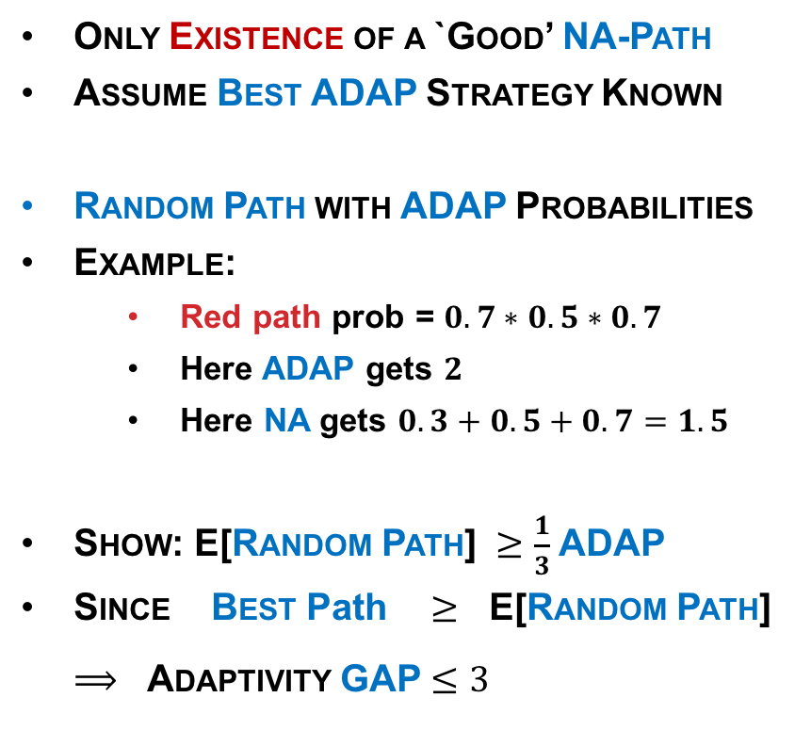
Random root-leaf path
  Only Existence of a `Good’ NA-Path
  Assume Best ADAP Strategy Known
  Random Path with ADAP Probabilities
  Example:
    Red path prob = $0.7∗0.5∗0.7$
    Here ADAP gets $2$
    Here NA gets $0.3+0.5+0.7=1.5$
  Show: E[Random Path] $≥$ $\frac{1}{3}$ADAP
  Since Best Path $≥$ E[Random Path]
  $⟹$ Adaptivity GAP $≤3$
NO
0.7
0.3
YES
0.5
0.5
0.2
0.8
0.3
0.7
Notes:
Like Going TWICE

Slide 17
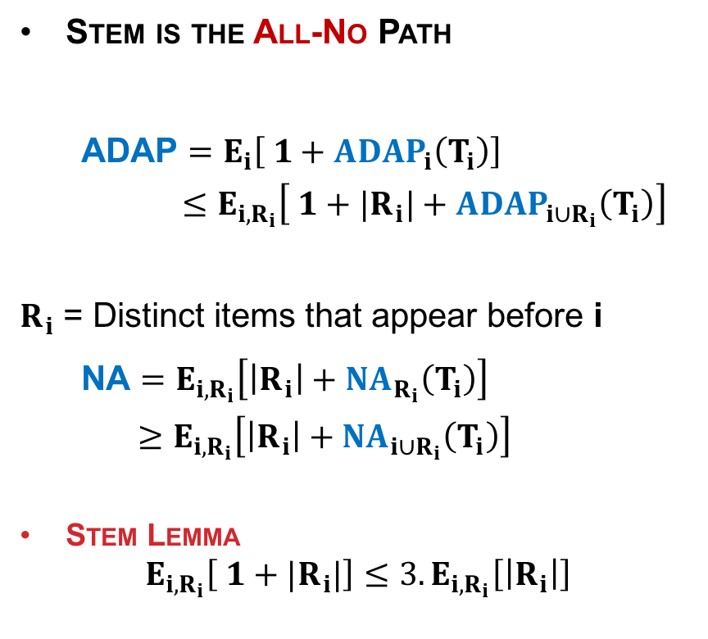

Stem-by-stem induction
Stem is the All-No Path
  ADAP $=E_{i}\left[ 1+ADAP_{i}\left(T_{i}\right)\right]$
    $≤E_{i,R_{i}}\left[ 1+|R_{i}|+ADAP_{i∪R_{i}}\left(T_{i}\right)\right]$
$R_{i}$ = Distinct items that appear before i
  NA $=E_{i,R_{i}}\left[\left|R_{i}\right|+NA_{R_{i}}\left(T_{i}\right)\right]$
  $≥E_{i,R_{i}}\left[\left|R_{i}\right|+NA_{{i∪R}_{i}}\left(T_{i}\right)\right]$
    Stem Lemma
    $E_{i,R_{i}}\left[ 1+|R_{i}|\right]≤3.E_{i,R_{i}}\left[\left|R_{i}\right|\right]$
NO
YES
0.3
0.7
0.3
0.7
0.5
0.5
0.2
0.8
0.5
0.5
i
0.2
0.8
0.2
0.8
0.3
0.7
$$T_{i}$$

Slide 18
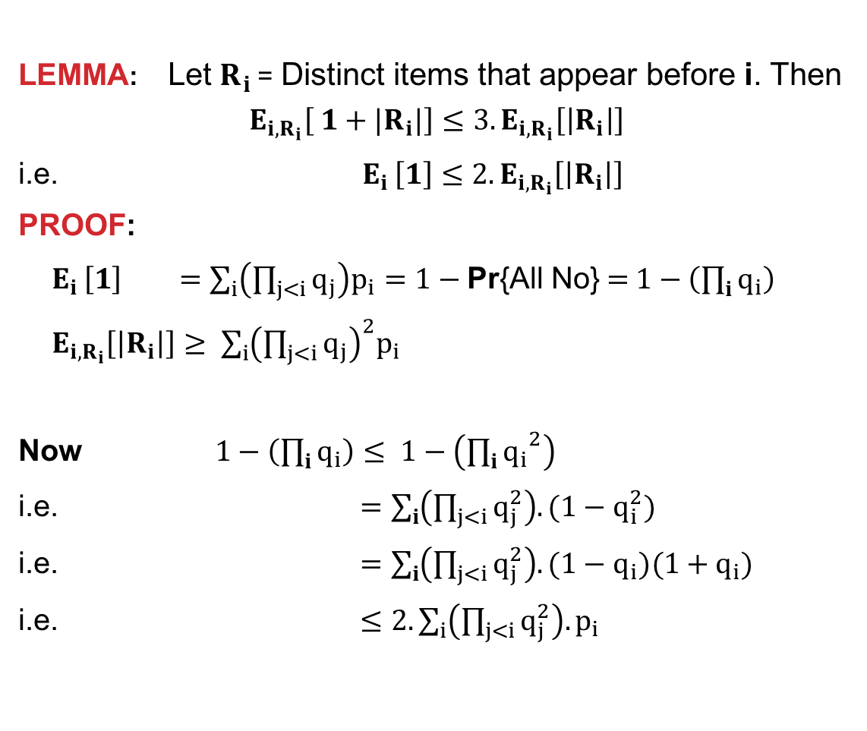






Stem lemma
    LEMMA: Let$R_{i}$ = Distinct items that appear before i. Then
    $$E_{i,R_{i}}\left[ 1+|R_{i}|\right]≤3.E_{i,R_{i}}\left[\left|R_{i}\right|\right]$$
    i.e. $E_{i }\left[1\right]≤2.E_{i,R_{i}}\left[\left|R_{i}\right|\right]$
PROOF:
    $E_{i }\left[1\right]$ $=\sum_{i}{\left(\prod_{j<i}{q_{j}}\right)p_{i}}=1−\text{Pr}\text{\{}\text{All} \text{No}\text{\}}$ = $1−\left(\prod_{i}{q_{i}}\right)$
    $E_{i,R_{i}}\left[\left|R_{i}\right|\right]≥$ $\sum_{i}{{\left(\prod_{j<i}{q_{j}}\right)}^{2}p_{i}}$
    Now $1−\left(\prod_{i}{q_{i}}\right)≤ 1−\left({\prod_{i}{q_{i}}}^{2}\right)$
i.e. $=\sum_{i}{\left(\prod_{j<i}{q_{j}^{2}}\right).(1−q_{i}^{2})}$
i.e. $=\sum_{i}{\left(\prod_{j<i}{q_{j}^{2}}\right).(1−q_{i})(1+q_{i})}$
i.e. $≤2.\sum_{i}{\left(\prod_{j<i}{q_{j}^{2}}\right).p_{i}}$
NO
YES
$q_{1}=$0.7
$p_{1}=$0.3
$q_{2}=$0.5
$p_{2}=$0.5
$q_{3}=$0.2
$p_{3}=$0.8
Notes:
Note LHS is not ONE here

Slide 19
OUTLINE
Stochastic Probing
Adaptivity GAP
Why Care About Adaptivity GAP?
Proof of Small Adaptivity GAP
Conclusions

Slide 20
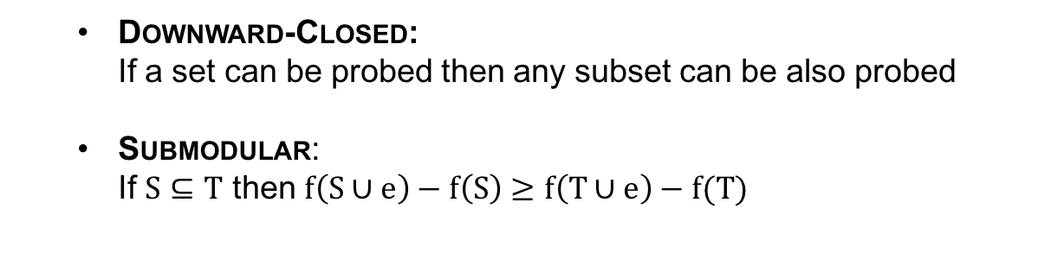
extensions
Theorem 4: Adaptivity Gap for
Constraints = Downward-Closed
Function = Non-Negative Monotone Submodular
is at most 3.
  Downward-Closed:
  If a set can be probed then any subset can be also probed
  Submodular:
  If $S⊆T$ then $f\left(S∪e\right)−f\left(S\right)≥f\left(T∪e\right)−f(T)$
Theorem 2: Adaptivity Gap for
Constraints = Downward-Closed
Function = Non-Negative Non-Monotone Submodular
is a constant.

Slide 21
Proof idea
Yes
No
Yes
No
No
Yes
Random Root-Leaf Path
  Show Existence
Stem-By-Stem Induction
  Generalized Stem Lemma

Slide 22
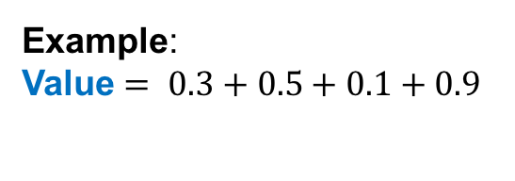
Connected Dominating Set
Stochastic Version
Given :
  Graph G=(V,E)
  Budget k (e.g. k=2)
  Edge activation probabilities
  Constraints = Connected set of k nodes
  Function = number of dominated nodes.
  Goal : Maximize function
Non-Stochastic Version by Khuller et al. SODA’14
0.3
0.4
0.3
0.4
0.8
0.9
0.5
0.8
0.9
0.5
0.1
0.1
0.3
0.3
0.7
0.7
0.9
0.2
0.9
0.2
Example:
Value $= 0.3+0.5+0.1+0.9$

Slide 23
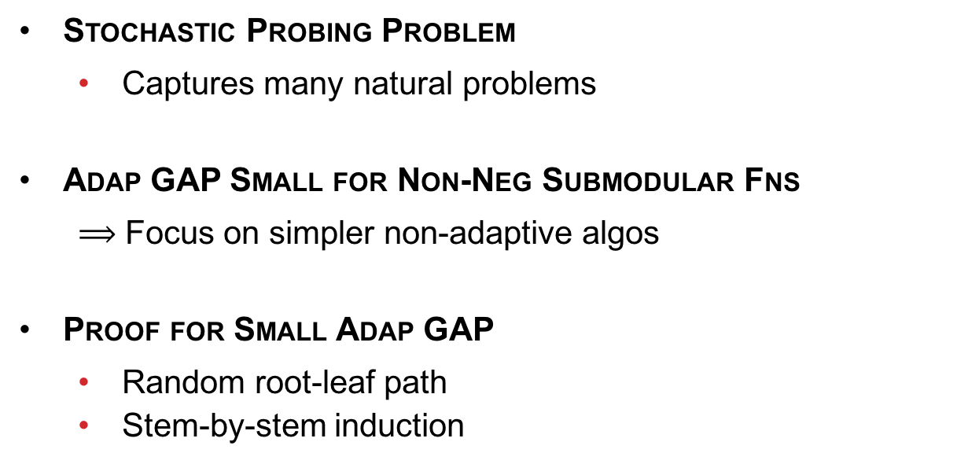
summary
ADAP
$α.$GAP
GAP
Stochastic Probing Problem
  Captures many natural problems
Adap GAP Small for Non-Neg Submodular Fns
  $⟹$ Focus on simpler non-adaptive algos
Proof for Small Adap GAP
  Random root-leaf path
  Stem-by-stem induction
NON-ADAP
ALGO
$$α$$
Questions?

Slide 24
references
A. Gupta, V. Nagarajan, and S. Singla. `Algorithms and Adaptivity Gaps for Stochastic Probing’. SODA’16.
A. Blum, S. Chawla, D. Karger, T. Lane, A. Meyerson, M. Minkoff. `Approximation Algorithms for Orienteering and Discounted-Reward TSP’. FOCS’03.
C. Chekuri and M. Pal. `A Recursive Greedy Algorithm for Walks in Directed Graphs’. FOCS’05.
A. Gupta and V. Nagarajan. `A Stochastic Probing Problem with Applications’. IPCO’13.
B.C. Dean, M.X. Goemans, and J. Vondrak. `Approxmiating the Stochastic Knapsack Problem: The Benefit of Adaptivity’. FOCS’04.
A. Asadpour, H. Nazerzadeh, and A. Saberi. `Maximizing Stochastic Monotone Submodular Functions’. WINE’08.
M. Adamczyk, M. Sviridenko, and J. Ward. `Submodular Stochastic Probing on Matroids’. STACS’14.
S. Khuller, M. Purohit, and K.K. Sarpatwar. `Analyzing the optimal neighborhood: algorithms for budgeted and partial connected dominating set problems’. SODA’14.
Emma Watson’s picture taken from Wikipedia.

