Slide 1
Improved Truthful Combinatorial Auctions with Submodular Bidders
October 4th, 2019
Sahil singla
Institute for Advanced Study and Princeton University
Joint work with Sepehr Assadi

Slide 2
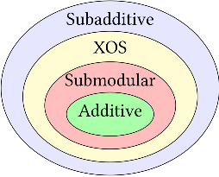
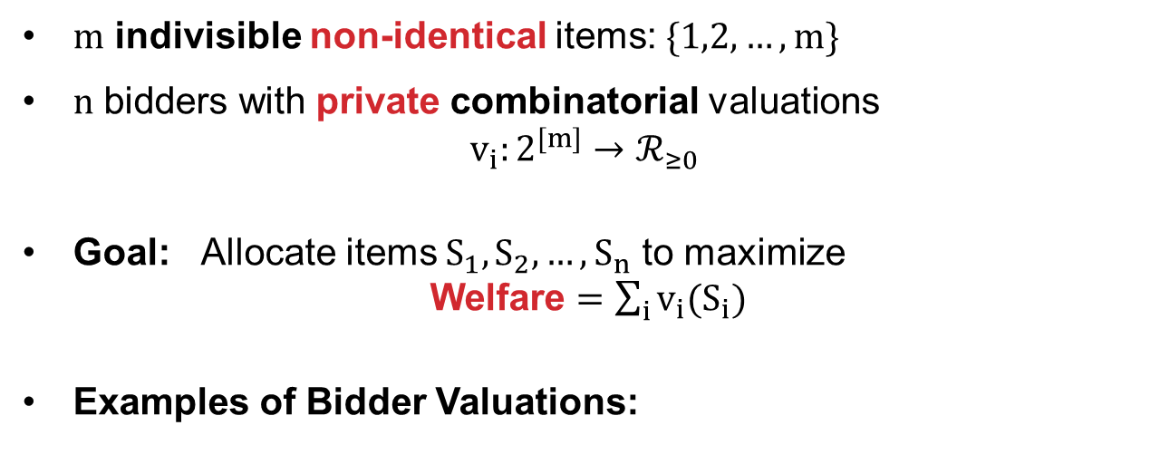
Combinatorial Auctions: Welfare Maximization
$m$ indivisible non-identical items: $\{1,2,…, m\}$
$n$ bidders with private combinatorial valuations $v_{i}:2^{[m]}→ℛ_{≥0}$
Goal: Allocate items $S_{1},S_{2},…, S_{n}$ to maximize Welfare $=\sum_{i}{v_{i}(S_{i})}$
Examples of Bidder Valuations:
$m$ items
$n$ bidders

Slide 3
Purely Algorithmic Question
Suppose valuations $v$ given, can we efficiently maximize welfare?
Easy for additive, otherwise how are valuations given?
Value Oracle: query $v_{i}(S)$
Greedy gives $½$ approx for submodular
Continuous greedy gives $1−\frac{1}{e}$ approx (this is tight)
Demand Oracle: (can simulate value oracle)
For additive prices $p:[m]→ℛ_{≥0}$, query $argmax_{S}\{v_{i}\left(S\right)−p\left(S\right)\}$
Known $1−\frac{1}{e}+ϵ$ approx for submod. ($>1−δ$ is hard)
Tight $1−\frac{1}{e}$ for XOS and $\frac{1}{2}$ for subadditive bidders
Vondrak’08
$m$ items
Feige-Vondrak’06
Feige’06
How to Handle Strategic Bidders?
$n$ bidders

Slide 4
Truthful Combinatorial Auctions
$m$ indivisible non-identical items: $\{1,2,…, m\}$
$n$ strategic buyers with private valuations: $v_{i}:2^{[m]}→ℛ_{≥0}$
Goal: Design a “truthful mechanism” that allocates items $S_{1},S_{2},…, S_{n}$ to maximize welfare: $\sum_{i}{v_{i}(S_{i})}$
Deterministic Mechanism $\left(a\left(v\right),p(v)\right)$: Given valuations $v$, returns allocations $a(v)$ and payments $p(v)$
Truthful: $v_{i}\left(a\left(v_{i},v_{−i}\right)\right)−p_{i}\left(v_{i},v_{−i}\right)≥$ $v_{i}\left(a\left(v_{i}′,v_{−i}\right)\right)−p_{i}\left(v_{i}′,v_{−i}\right)$
Randomized Truthful Mechanisms:
Universally Truthful: Distribution over determ truthful mech
Truthful in Expectation: Bidders maximize expected utility
No incentive to lie
$m$ items
$n$ bidders

Slide 5
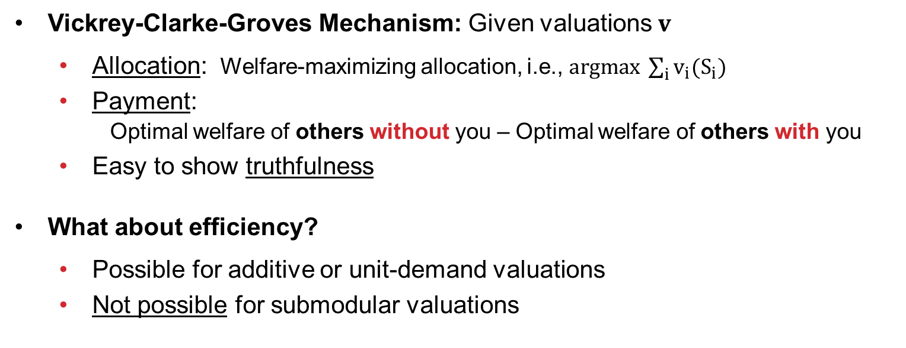
VCG Mechanism
Generalizes 2nd-price Auction
Vickrey-Clarke-Groves Mechanism: Given valuations $v$
Allocation: Welfare-maximizing allocation, i.e., $argmax \sum_{i}{v_{i}(S_{i})}$
Payment: Optimal welfare of others without you – Optimal welfare of others with you
Easy to show truthfulness
What about efficiency?
Possible for additive or unit-demand valuations
Not possible for submodular valuations
Find a Truthful and Efficient Mechanism that Approximates Welfare?

Slide 6
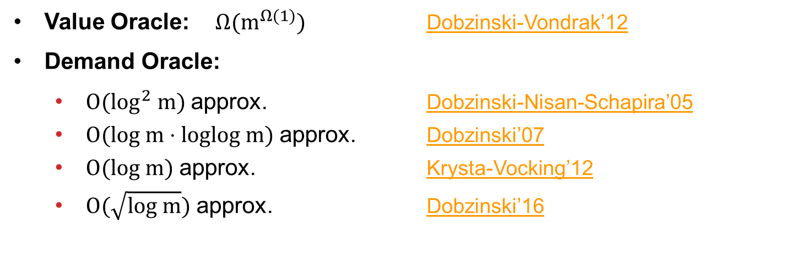
What is Known?
Value Oracle: $Ω(m^{Ω(1)})$ Dobzinski-Vondrak’12
Demand Oracle:
$O(log^{2} m)$ approx. Dobzinski-Nisan-Schapira’05
$O(log m⋅loglog m)$ approx. Dobzinski’07
$O(log m)$ approx. Krysta-Vocking’12
$O(\sqrt{log m})$ approx. Dobzinski’16
can we get $O(1)$ approx?
Thm [Assadi-S’19]: For Submodular Valuations, a Poly Time Universally Truthful Mechanism with $O({\left(loglog m\right)}^{3})$ approx
Remark: Also holds for XOS valuations.

Slide 7
OUTLINE
Introduction: Truthful Combinatorial Auctions
Preliminaries: Fixed-Price Auctions
Our Price-Learning Mechanism
Analysis: Learnable-or-Allocatable Lemma

Slide 8
Supporting Prices & Fixed-Price Auctions
Submodular/XOS $v_{i}$ implies there exist additive functions $a_{k}^{i}$ s.t.
$$v_{i}(S)=\max_{k}\{a_{k}^{i}\left(S\right)\}$$
Fixed-Price Auction (FPA)
Set fixed prices $p$
Bidders arrive in adversarial order and select best subset of remaining items: $argmax_{S⊆Remaining}\{v_{i}\left(S\right)−p\left(S\right)\}$
Clearly truthful and efficient given $p$
Supporting price for $S$: $$\underset{k}{argmax}\{a_{k}^{i}\left(S\right)\}$$
LEMMA [Folklore]: If an Allocation $\left(S_{1}, …,S_{n}\right)$ has Supporting Prices $q$ then FPA with $p=½⋅q$ has welfare $≥½⋅\sum_{i}{v_{i}\left(S_{i}\right)}$.
Take Away: If we know optimum supporting prices, we are done!

Slide 9
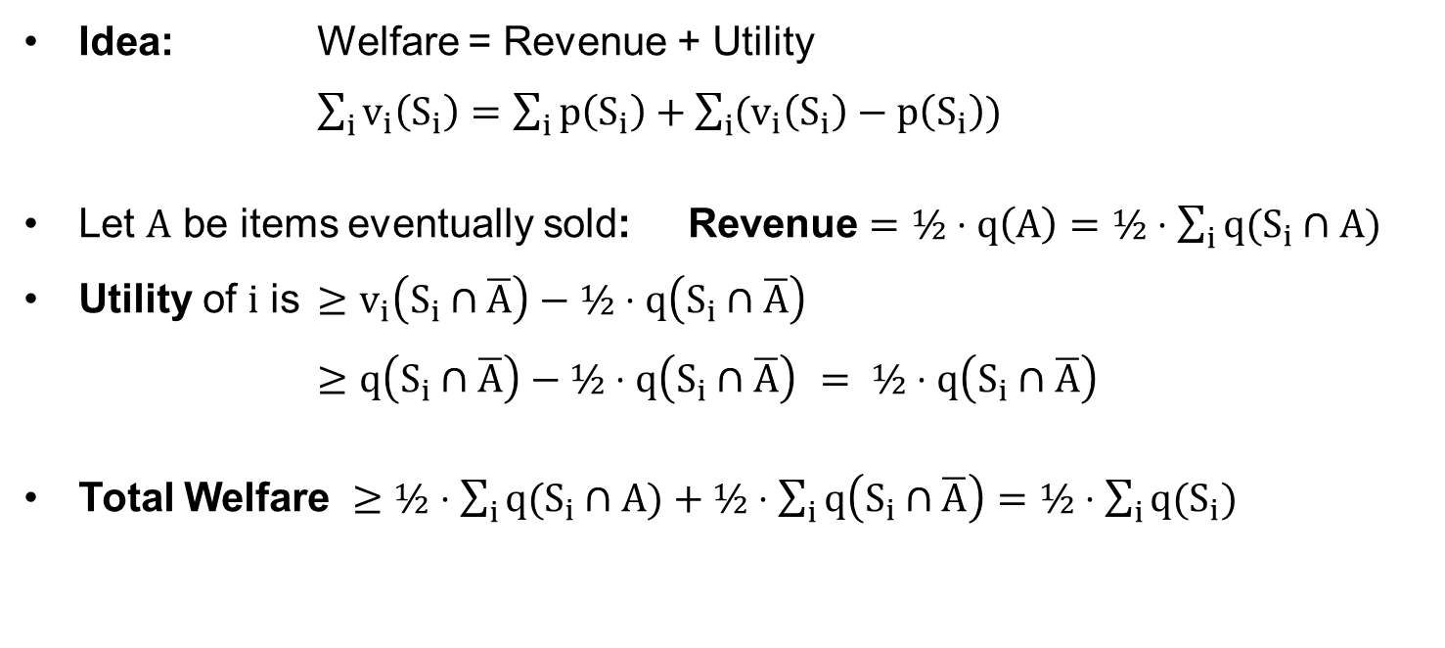
Proving the Folklore Lemma
LEMMA [Folklore]: If an Allocation $\left(S_{1}, …,S_{n}\right)$ has Supporting Prices $q$ then FPA with $p=½⋅q$ has welfare $≥½⋅\sum_{i}{v_{i}\left(S_{i}\right)}=½⋅\sum_{i}{q\left(S_{i}\right)}$.
Idea: Welfare = Revenue + Utility
$\sum_{i}{v_{i}\left(S_{i}\right)}=\sum_{i}{p\left(S_{i}\right)}+\sum_{i}{(v_{i}\left(S_{i}\right)−p\left(S_{i}\right))}$
Let $A$ be items eventually sold: Revenue $=½⋅q\left(A\right)=½⋅\sum_{i}{q(S_{i}∩A)}$
Utility of $i$ is $≥v_{i}\left(S_{i}∩\overline{A}\right)−½⋅q\left(S_{i}∩\overline{A}\right)$
$≥q\left(S_{i}∩\overline{A}\right)−½⋅q\left(S_{i}∩\overline{A}\right)$ $= ½⋅q\left(S_{i}∩\overline{A}\right)$
Total Welfare $≥½⋅\sum_{i}{q(S_{i}∩A)}+½⋅\sum_{i}{q\left(S_{i}∩\overline{A}\right)}=½⋅\sum_{i}{q(S_{i})}$
$\left(S_{1}, …,S_{n}\right)$ partitions $[m]$
Q.E.D.

Slide 10
$O\left(\log{m}\right)$ Approximation
With constant probability, run VCG on entire bundle. Otherwise,
Randomly partition bidders into $N_{0}$ and $N_{1}$
Ignore bidders $N_{0}$ but ask them their valuations
Gives $Θ(1)$ approx to OPT by concentration (VCG takes care of corner cases)
Optimal supporting prices are in $\left[\frac{OPT}{2m},OPT\right]$
After exponential bucketing, guess the optimal prices $q$ w.p. $\frac{1}{log m}$
Run FPA with prices $\frac{q}{2}$ on $N_{1}$
$$N_{0}$$
$$N_{1}$$
Can we Learn Prices Better?

Slide 11
OUTLINE
Introduction: Truthful Combinatorial Auctions
Preliminaries: Fixed-Price Auctions
Our Price-Learning Mechanism
Analysis: Learnable-or-Allocatable Lemma

Slide 12
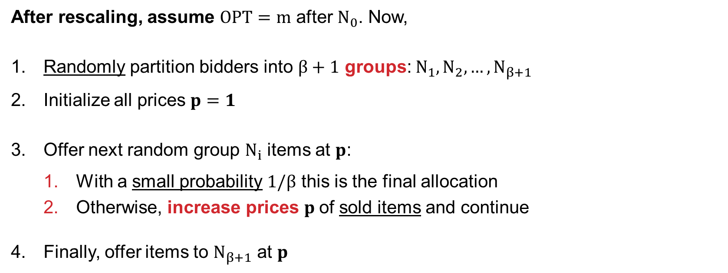
Our Price-Learning Mechanism
$β≔loglog m$
After rescaling, assume $OPT=m$ after $N_{0}$. Now,
Randomly partition bidders into $β+1$ groups: $N_{1},N_{2},…,N_{β+1}$
Initialize all prices $p=1$
Offer next random group $N_{i}$ items at $p$:
With a small probability $1/β$ this is the final allocation
Otherwise, increase prices $p$of sold items and continue
Finally, offer items to $N_{β+1}$ at $p$
Relation to Secretary Prob
$$N_{1}$$
$$N_{β+1}$$
Allocatable
Learnable
Take Away: Use Fixed Price Auctions as “proxy” to learn prices
How to increase prices?

Slide 13
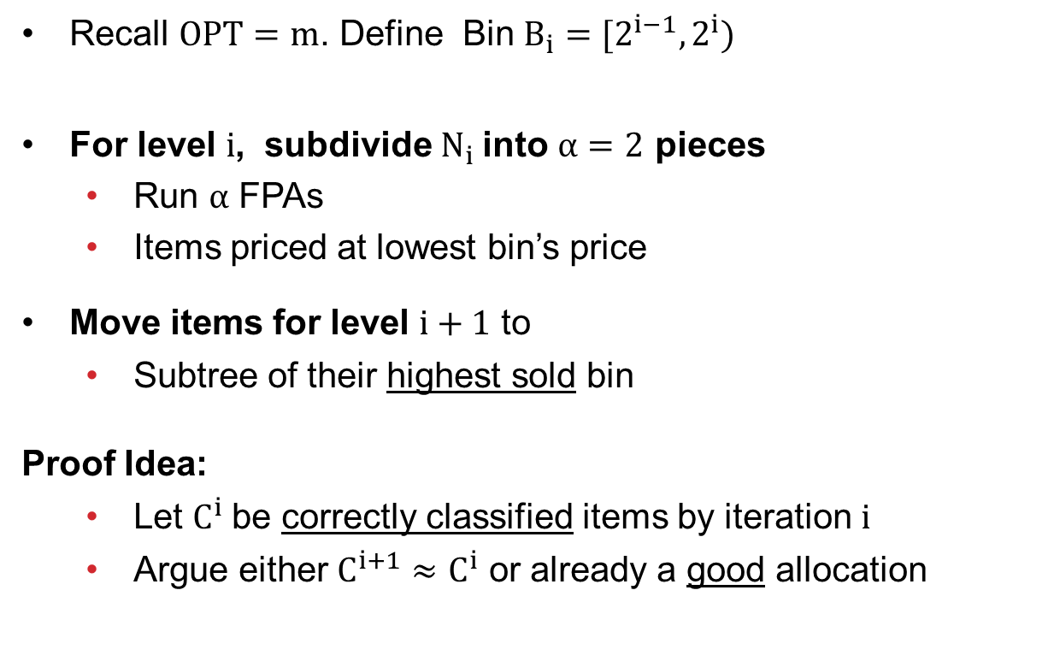
A Price-Tree to Increase Prices
Recall $OPT=m$. Define Bin $B_{i}=[2^{i−1},2^{i})$
For level $i$, subdivide $N_{i}$into $α=2$ pieces
Run $α$ FPAs
Items priced at lowest bin’s price
Move items for level $i+1$ to
Subtree of their highest sold bin
Proof Idea:
Let $C^{i}$be correctly classified items by iteration $i$
Argue either $C^{i+1}≈C^{i}$ or already a good allocation
height $=β$
$$B_{1},B_{2},B_{3},B_{4},B_{5},B_{6},B_{7},B_{8}$$
$$B_{1},B_{2},B_{3},B_{4}$$
$$B_{5},B_{6},B_{7},B_{8}$$
$$B_{1},B_{2}$$
$$B_{3},B_{4}$$
$$B_{5},B_{6}$$
$$B_{7},B_{8}$$
$$B_{1}$$
$$B_{2}$$
$$B_{3}$$
$$B_{4}$$
$$B_{5}$$
$$B_{6}$$
$$B_{7}$$
$$B_{8}$$
Notice $q\left(C^{1}\right)≈m$

Slide 14
OUTLINE
Introduction: Truthful Combinatorial Auctions
Preliminaries: Fixed-Price Auctions
Our Price-Learning Mechanism
Analysis: Learnable-or-Allocatable Lemma

Slide 15
Main Lemma
$C^{i}$are correctly classified items till $i$
$q^{i}$are optimal support prices ignoring $N_{<i}$
LEMMA [Assadi-S’19]: For iteration $i∈[β]$, conditioned on first $i−1$ iterations
Either $E\left[q^{i+1}\left(C^{i+1}\right)\right]≥q^{i}\left(C^{i}\right)−\frac{OPT}{3β}$ (LEARNABLE)
Or $E\left[FPA^{i}\right]≥\frac{OPT}{1000 β^{2}}$ (ALLOCATABLE)
Take Away: Either prices can be improved or already good.
$sold$ = set of items sold in this iteration
Proof in Two Steps:
Show $E\left[q^{i}\left(sold\right)\right]+β⋅E\left[FPA^{i}\right]≥ q^{i}\left(C^{i}\right)$ (Mostly sold)
Show $E\left[q^{i}\left(sold\right)\right]≈E\left[q^{i}\left(C^{i+1}\right)\right]≈E\left[q^{i+1}\left(C^{i+1}\right)\right]$ (Losses)
Crucially uses random arrival order

Slide 16
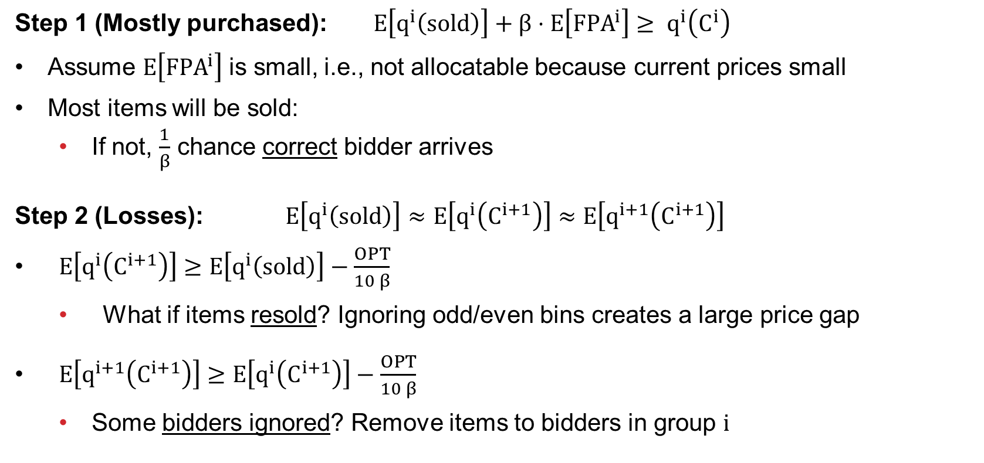
Learnable or Allocatable Proof Idea
Step 1 (Mostly purchased): $E\left[q^{i}\left(sold\right)\right]+β⋅E\left[FPA^{i}\right]≥ q^{i}\left(C^{i}\right)$
Assume $E\left[FPA^{i}\right]$ is small, i.e., not allocatable because current prices small
Most items will be sold:
If not, $\frac{1}{β}$ chance correct bidder arrives
Step 2 (Losses): $E\left[q^{i}\left(sold\right)\right]≈E\left[q^{i}\left(C^{i+1}\right)\right]≈E\left[q^{i+1}\left(C^{i+1}\right)\right]$
$E\left[q^{i}\left(C^{i+1}\right)\right]≥E\left[q^{i}\left(sold\right)\right]−\frac{OPT}{10 β}$
What if items resold? Ignoring odd/even bins creates a large price gap
$E\left[q^{i+1}\left(C^{i+1}\right)\right]≥E\left[q^{i}\left(C^{i+1}\right)\right]−\frac{OPT}{10 β}$
Some bidders ignored? Remove items to bidders in group $i$

Slide 17
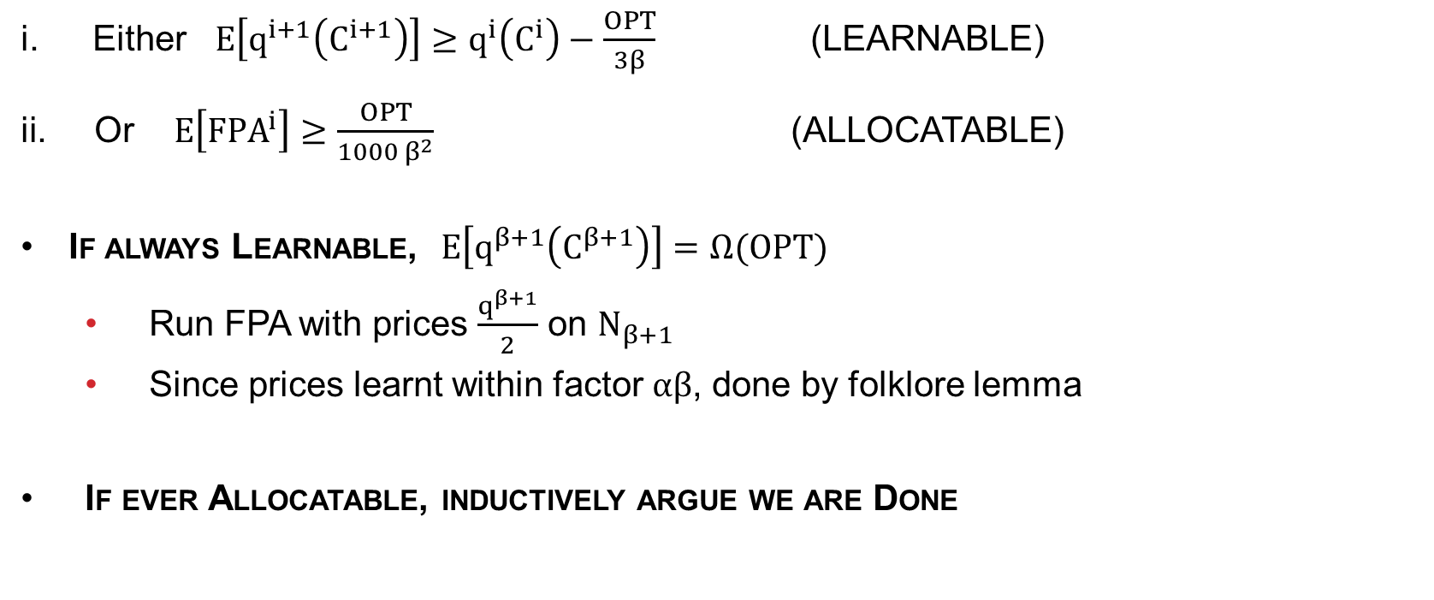
Wrapping Up
Either $E\left[q^{i+1}\left(C^{i+1}\right)\right]≥q^{i}\left(C^{i}\right)−\frac{OPT}{3β}$ (LEARNABLE)
Or $E\left[FPA^{i}\right]≥\frac{OPT}{1000 β^{2}}$ (ALLOCATABLE)
If always Learnable, $E\left[q^{β+1}\left(C^{β+1}\right)\right]=Ω(OPT)$
Run FPA with prices $\frac{q^{β+1}}{2}$ on $N_{β+1}$
Since prices learnt within factor $αβ$, done by folklore lemma
If ever Allocatable, inductively argue we are Done

Slide 18
Conclusion
Getting $O{\left(loglog m\right)}^{3}$ approx. truthful mechanism
Use Fixed Price Auctions as “proxy” to learn prices
Use a Price-Tree to update prices for Fixed Price Auctions
Main tool: Learnable-or-Allocatable Lemma
What is the optimal approximation ratio?
We know $O{\left(loglog m\right)}^{3}$ is not optimal
Extend to subadditive valuations?
Questions?

