Slide 1
Improved Truthful Mechanisms for Subadditive Combinatorial Auctions: Breaking the Logarithmic Barrier
Jan 10th, 2021
Sahil singla
Institute for Advanced Study and Princeton University
Joint with Sepehr Assadi and Thomas Kesselheim

Slide 2
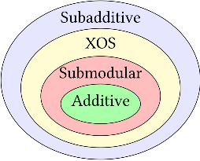
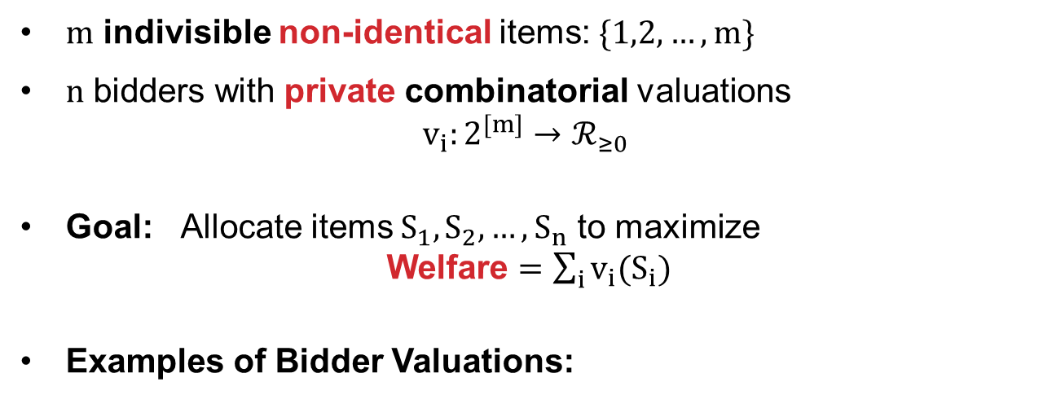
Combinatorial Auctions: Welfare Maximization
$m$ indivisible non-identical items: $\{1,2,…, m\}$
$n$ bidders with private combinatorial valuations $v_{i}:2^{[m]}→ℛ_{≥0}$
Goal: Allocate items $S_{1},S_{2},…, S_{n}$ to maximize Welfare $=\sum_{i}{v_{i}(S_{i})}$
Examples of Bidder Valuations:
$m$ items
$n$ bidders

Slide 3
Purely Algorithmic Question
Suppose valuations $v$ given, can we maximize welfare in polytime?
Easy for additive, otherwise how are valuations given?
Value Oracle: query $v_{i}(S)$
Greedy gives $2$ approx for submodular
Demand Oracle: (can simulate value oracle)
Tight $\frac{e}{e−1}$ approx for XOS
$2$ approx for subadditive bidders
Lehmann- Lehmann- Nisan’06
Feige’06
$m$ items
How to Handle Strategic Bidders?
$n$ bidders

Slide 4
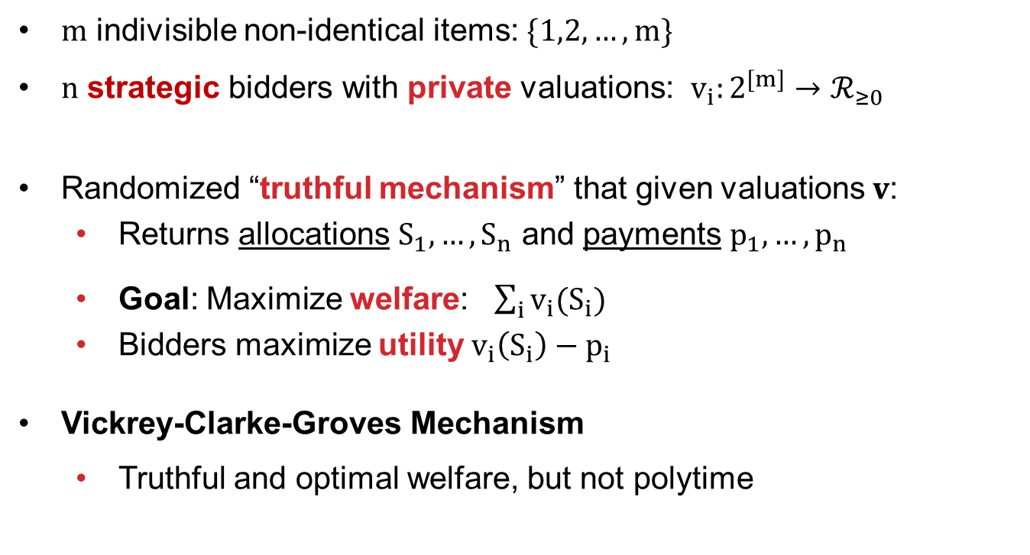
Truthful Combinatorial Auctions
$m$ indivisible non-identical items: $\{1,2,…, m\}$
$n$ strategic bidders with private valuations: $v_{i}:2^{[m]}→ℛ_{≥0}$
Randomized “truthful mechanism” that given valuations $v$:
Returns allocations $S_{1}, …, S_{n}$ and payments $p_{1},…, p_{n}$
Goal: Maximize welfare: $\sum_{i}{v_{i}(S_{i})}$
Bidders maximize utility $v_{i}\left(S_{i}\right)−p_{i}$
Vickrey-Clarke-Groves Mechanism
Truthful and optimal welfare, but not polytime
No incentive to lie
$m$ items
Generalizes 2nd-price Auction
$n$ bidders
Any Truthful and Polytime Mechanism that Approximates Welfare?

Slide 5
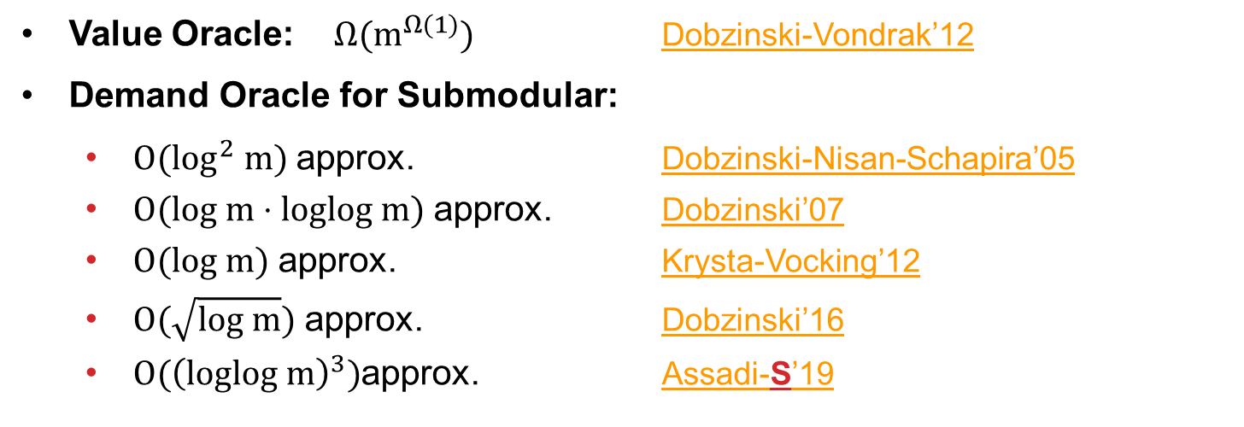
What is Known?
Value Oracle: $Ω(m^{Ω(1)})$ Dobzinski-Vondrak’12
Demand Oracle for Submodular:
$O(log^{2} m)$ approx. Dobzinski-Nisan-Schapira’05
$O(log m⋅loglog m)$ approx. Dobzinski’07
$O(log m)$ approx. Krysta-Vocking’12
$O(\sqrt{log m})$ approx. Dobzinski’16
$O({\left(loglog m\right)}^{3})$approx. Assadi-S’19
Subadditive
can we get $O(1)$ approx?
THM [Assadi-Kesselheim-S’21]: For Subadditive Bidders, a Polytime Universally Truthful Mechanism with $O({\left(loglog m\right)}^{3})$ approx
Remark: For Submodular/XOS valuations we get $O({\left(loglog m\right)}^{2})$ approx.

Slide 6
OUTLINE
Introduction: Truthful Combinatorial Auctions
Posted-Price Mechanisms
Our Binary-Search Mechanism

Slide 7
Fixed-Price Auctions
Fixed-Price Auction (FPA)
Set fixed prices $p∈ℛ_{≥0}^{m}$
Bidders arrive in adversarial order and select best subset of remaining items: $argmax_{S⊆Remaining}\{v_{i}\left(S\right)−\sum_{j∈S}{p(j)}\}$
Truthful since $p$ fixed and Polytime due to Demand Oracle
For single-item auction, FPA with $p=\text{2}\text{nd}{max\{v}_{i}\}+ϵ$ gives optimal welfare
$$Welfare=Revenue+Utility$$
Do Prices Always
Exist with High Welfare?
LEMMA: Exist prices $p$s.t. FPA gives
$2$ approx for Submod/XOS
$O\left(loglog m\right)$ approx for Subadd
Folklore
Dutting, Kesselheim, Lucier’20
How to Learn Such Prices?

Slide 8
Warm-up: Single Item Welfare Maximization
Offline Algorithm: Run 2nd-price auction
Online Algorithm: Secretary-problem based mechanism
Randomly partition bidders into $N_{0}$ and $N_{1}$
Ignore bidders $N_{0}$ but ask them their values
Set price $p=\max_{i∈N_{0}}{v_{i}}$. Run FPA on $N_{1}$
Gives $4$-approx:
With probability $¼$, both 2nd-highest bidder in $N_{0}$ and highest bidder in $N_{1}$
No incentive to lie
$$N_{0}$$
$$N_{1}$$
How to Sell Multiple Items?

Slide 9
Warm-up: $\tilde{O}\left(\log{m}\right)$ Approx for Multiple Items
With constant probability, run 2nd price auction on the entire bundle. Otherwise,
Randomly partition bidders into $N_{0}$ and $N_{1}$
Ignore bidders $N_{0}$ but ask them their valuations
Gives estimate of OPT by concentration (2nd price auction handles corner cases)
Optimal prices are in $\left[\frac{OPT}{2m},OPT\right]$
After exponential bucketing, guess prices $p$ w.p. $\frac{1}{log m}$
Run FPA with prices $p$on $N_{1}$
$$N_{0}$$
$$N_{1}$$
How to Handle Subadditive values?
Challenges:
All prices not correctly guessed
We only get $Ω(log m)$ approx
For Submod/XOS, $O\left({\left(loglog m\right)}^{3}\right)$ approx:
Prices already robust
Learn prices in rounds
Assadi-S’19

Slide 10
FPA for Subadditive Values
Let ${\{S}_{i}^{∗}\}$be optimal allocation
LEMMA [Dutting-Kesselheim-Lucier’20]: For any bidder $i$, there exist prices $p(S_{i}^{∗})$ and a distribution $λ$ over $2^{S_{i}^{∗}}$ such that for any sold items $T⊆S_{i}^{∗}$,
$$E_{S⊆S_{i}^{∗}}λ_{S}\left[v_{i}\left(S∖T\right)−p(S)\right]+p\left(T\right) ≥ \frac{1}{α}v_{i}\left(S_{i}^{∗}\right)$$
$$E[Utility_{i}]$$
$$Rev(T)$$
$α=O(loglog m)$ for subadd
$α=O(1)$ for submodular
Take-Aways:
Exist prices s.t. either bidder $i$ has a large utility or items already sold
Prices not robust: We lose additively for incorrectly priced items (in $p(T)$)

Slide 11
OUTLINE
Introduction: Truthful Combinatorial Auctions
Posted-Price Mechanisms
Our Binary-Search Mechanism

Slide 12
Our Binary-Search Mechanism
$β≔$ $loglog m$
Assume $OPT=m$ is given. Since all item prices in $\left\{1,…, m\right\}$, define Bin $B_{j}=[2^{j−1},2^{j})$
Randomly partition bidders into rounds: $N_{1},N_{2},…,N_{β+1}$
We do $β+1$ FPAs in rounds, and one of them is randomly the final allocation
In round $i$ (tree level), offer items to $N_{i}$ at binary search prices $p$
Binary search on prices
$$B_{1},B_{2},B_{3},B_{4},B_{5},B_{6},B_{7},B_{8}$$
$$B_{1},B_{2},B_{3},B_{4}$$
$$B_{5},B_{6},B_{7},B_{8}$$
$$B_{1},B_{2}$$
$$B_{3},B_{4}$$
$$B_{5},B_{6}$$
$$B_{7},B_{8}$$
$$B_{1}$$
$$B_{2}$$
$$B_{3}$$
$$B_{4}$$
$$B_{5}$$
$$B_{6}$$
$$B_{7}$$
$$B_{8}$$
Take-Away: Use FPAs as “proxy” to learn prices
Each item has its own path

Slide 13
Main Lemma
$α=O(\log{\log{m}})$ for subadditive
$β=O(\log{\log{m}})$
LEMMA [Assadi-Kesselheim-S’21]: For any bidder $i$,
$$E\left[Utility_{i}+Rev(S_{i}^{∗})\right]≥\frac{1}{2α{\left(β+1\right)}^{2}}v_{i}(S_{i}^{∗})$$
Crucially use bidders arrive in random rounds
Take-Away: Either bidder $i$ has a large utility or these items sold at a “good” price
Corollary: For Subadditive Valuations, we get $O({\left(loglog m\right)}^{3})$ approx
Proof: Summing over all bidders $i$,
$$\sum_{i=1}^{n}{E\left[Utility_{i}+Rev(S_{i}^{∗})\right]}≥\frac{1}{2α{\left(β+1\right)}^{2}}\sum_{i=1}^{n}{v_{i}\left(S_{i}^{∗}\right)}$$
Recall ${\{S}_{i}^{∗}\}$ partitions
all $m$ items
$$Total Welfare$$
$$OPT$$

Slide 14
Main Lemma
$α=O(\log{\log{m}})$ for subadditive
$β=O(\log{\log{m}})$
LEMMA [Assadi-Kesselheim-S’21]: For any bidder $i$,
$$E\left[Utility_{i}+Rev(S_{i}^{∗})\right]≥\frac{1}{2α{\left(β+1\right)}^{2}}v_{i}(S_{i}^{∗})$$
Crucially use bidders arrive in random rounds
Proof Idea: Condition on rounds in which bidders except $i$ arrive. Consider path of any item in $S_{i}^{∗}$. We are in one of 3 cases:
Item correctly priced at leaf:
Bidder $i$ could arrive in last round and buy this item
Item lost because sold earlier at a higher price:
We already get large $Rev(S_{i}^{∗})$
Item lost because not sold even at a lower price:
Bidder $i$ could arrive in this round and buy this item
Take-Away: Suffices to give $i$ chance of picking any item in $S_{i}^{∗}$
Finally, combine with Dutting, Kesselheim, Lucier’20

Slide 15
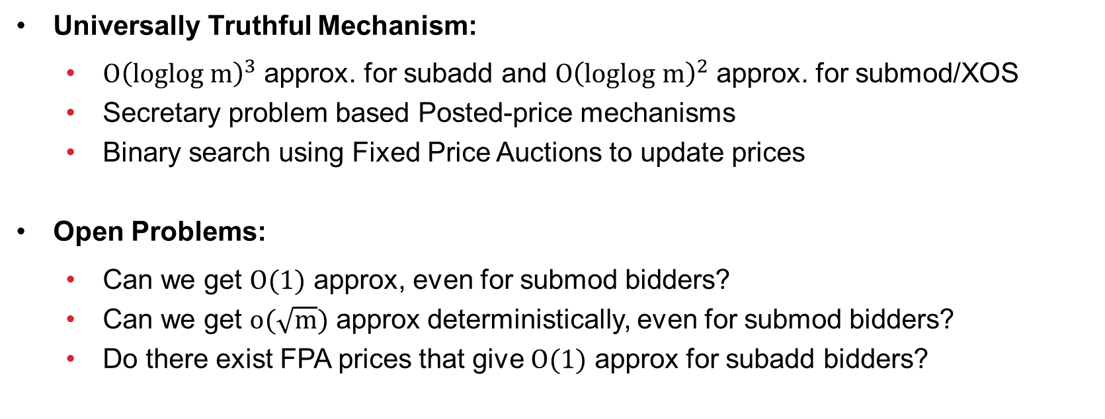
Conclusion
Universally Truthful Mechanism:
$O{\left(loglog m\right)}^{3}$ approx. for subadd and $O{\left(loglog m\right)}^{2}$ approx. for submod/XOS
Secretary problem based Posted-price mechanisms
Binary search using Fixed Price Auctions to update prices
Open Problems:
Can we get $O(1)$ approx, even for submod bidders?
Can we get $o(\sqrt{m})$ approx deterministically, even for submod bidders?
Do there exist FPA prices that give $O(1)$ approx for subadd bidders?
Thank You

Slide 16
FURTHER SLIDES

Slide 17
FPA for Subadditive Values
Let ${\{S}_{i}^{∗}\}$be optimal allocation
LEMMA [Dutting-Kesselheim-Lucier’20]: For any bidder $i$, there exist prices $p(S_{i}^{∗})$ and a distribution $λ$ over $2^{S_{i}^{∗}}$ such that for any sold items $T⊆S_{i}^{∗}$,
$$E_{S⊆S_{i}^{∗}}λ_{S}\left[v_{i}\left(S∖T\right)−p(S)\right]+p\left(T\right) ≥ \frac{1}{α}v_{i}\left(S_{i}^{∗}\right)$$
$$E[Utility_{i}]$$
$$Rev(T)$$
$α=O(loglog m)$ for subadd
$α=O(1)$ for submodular
Takeaways:
Exist prices s.t. either bidder $i$ has a large utility or items already sold
Prices not robust: We lose additively for incorrectly priced items (in $p(T)$)
Corollary: Exist prices $p$s.t. FPA gives $O\left(loglog m\right)$ approx for subadditive bidders
Proof Idea: Since ${\{S}_{i}^{∗}\}$ partitions all $m$ items, use above lemma to set item prices

Slide 18
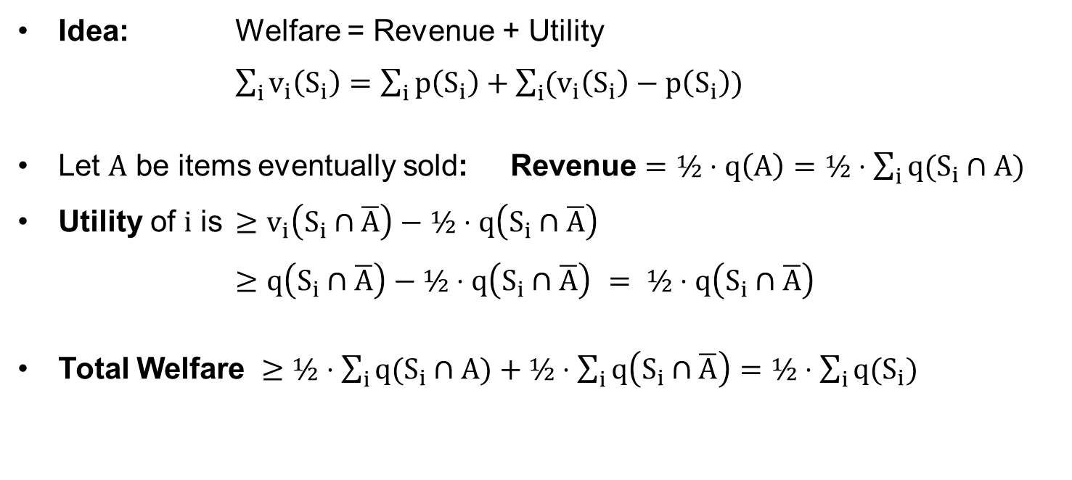
Proving the Folklore Lemma
LEMMA [Folklore]: If an Allocation $\left(S_{1}, …,S_{n}\right)$ has Supporting Prices $q$ then FPA with $p=½⋅q$ has welfare $≥½⋅\sum_{i}{v_{i}\left(S_{i}\right)}=½⋅\sum_{i}{q\left(S_{i}\right)}$.
Idea: Welfare = Revenue + Utility
$\sum_{i}{v_{i}\left(S_{i}\right)}=\sum_{i}{p\left(S_{i}\right)}+\sum_{i}{(v_{i}\left(S_{i}\right)−p\left(S_{i}\right))}$
Let $A$ be items eventually sold: Revenue $=½⋅q\left(A\right)=½⋅\sum_{i}{q(S_{i}∩A)}$
Utility of $i$ is $≥v_{i}\left(S_{i}∩\overline{A}\right)−½⋅q\left(S_{i}∩\overline{A}\right)$
$≥q\left(S_{i}∩\overline{A}\right)−½⋅q\left(S_{i}∩\overline{A}\right)$ $= ½⋅q\left(S_{i}∩\overline{A}\right)$
Total Welfare $≥½⋅\sum_{i}{q(S_{i}∩A)}+½⋅\sum_{i}{q\left(S_{i}∩\overline{A}\right)}=½⋅\sum_{i}{q(S_{i})}$
$\left(S_{1}, …,S_{n}\right)$ partitions $[m]$
Q.E.D.

Slide 19
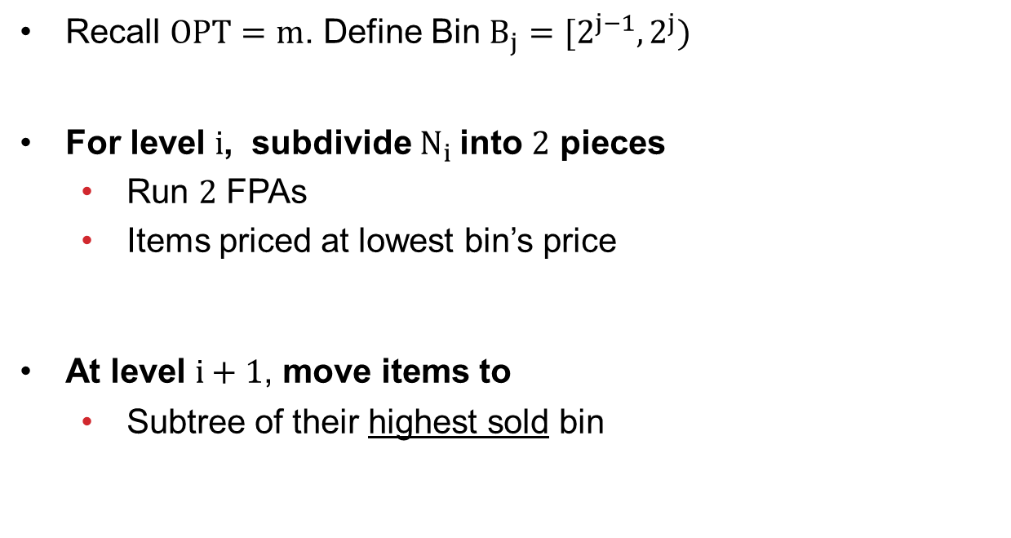
Binary Search for Item Prices
Binary search on prices
Recall $OPT=m$. Define Bin $B_{j}=[2^{j−1},2^{j})$
For level $i$, subdivide $N_{i}$into $2$ pieces
Run $2$ FPAs
Items priced at lowest bin’s price
At level $i+1$, move items to
Subtree of their highest sold bin
height $=β$
$$B_{1},B_{2},B_{3},B_{4},B_{5},B_{6},B_{7},B_{8}$$
$$B_{1},B_{2},B_{3},B_{4}$$
$$B_{5},B_{6},B_{7},B_{8}$$
$$B_{1},B_{2}$$
$$B_{3},B_{4}$$
$$B_{5},B_{6}$$
$$B_{7},B_{8}$$
$$B_{1}$$
$$B_{2}$$
$$B_{3}$$
$$B_{4}$$
$$B_{5}$$
$$B_{6}$$
$$B_{7}$$
$$B_{8}$$
Each item has its own Path

