Slide 1
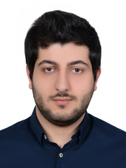
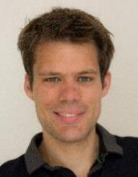
Bandit Algorithms for Multi-stage Stochastic Optimization
Nov 10th, 2022
Sahil singla
Georgia Tech
Khashyar Gatmiry
Thomas Kesselheim
Yifan Wang

Slide 2
Stochastic Optimization
Stochastic Optimization on Product Distributions
Given $n$ independent distributions: $X_{1}\sim 𝓓_{1}, …,X_{n}\sim 𝓓_{n}∈[0,1]$
Design an algorithm/policy $Alg$
Goal: Maximize a given objective in expectation
$$𝔼[f\left(Alg, X_{1},X_{2},…,X_{n}\right)]$$
Examples
Prophet Inequality
Pandora’s Box
Auctions: Myerson’s Single-Item, Sequential Posted Pricing
Stochastic Probing
What if the distributions
are unknown?

Slide 3
Prophet Inequality
n independent distributions: $X_{1}\sim 𝓓_{1}, …,X_{n}\sim 𝓓_{n}$
See $X_{i}$ one-by-one: immediately select/reject
Select $≤1$ to maximize value
Generalizations to matroid, matching, …
Applications in mechanism design, online algorithms, …
Krengel-Sucheston-Garling’78
What is the
optimal policy?
Value = $6$
Selected
X₁$=$4
X₂
X₃
X₁
X₂$=6$
X₃$=2$
X₄$=$10
X₄

Slide 4
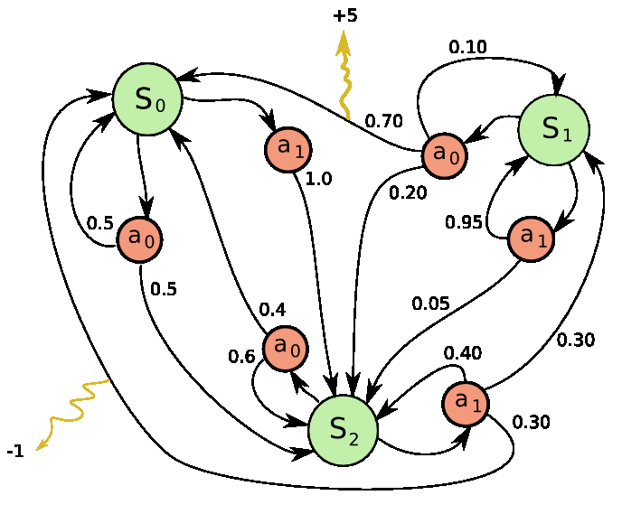
Optimal Policy
Thresholds
$$1$$
Prophet Inequality: Reverse dynamic program
Define $V_{n}^{∗}=𝔼[X_{n}]$ and $V_{i}^{∗}=𝔼\left[\max\left\{V_{i+1}^{∗},X_{i}\right\}\right]$
Policy: Set thresholds $τ_{i}≔V_{i+1}^{∗}$
Generally: A Markov Decision Process
Can solve optimally, ignoring computation
Many techniques to efficiently find (approximately-)optimal policies
$$0$$
$$1$$
$$2$$
$$3$$
$$n−1$$
$$n$$
Time
What if the distributions are unknown?
States, Actions, Rewards

Slide 5
Unknown Distributions: Learning Optimal Policy
Online Learning for Stochastic Optimization
Repeated game over T days. We play ${Alg}^{t}$ on day $t$
Random reward $f\left({Alg}^{t}, X_{1}^{t},X_{2}^{t},…,X_{n}^{t}\right)∈[0,1]$
Want to minimize expected regret:
$T⋅𝔼\left[f\left(Opt, X_{1},X_{2},…,X_{n}\right)\right]−\sum_{t}{f\left({Alg}^{t}, X_{1}^{t},X_{2}^{t},…,X_{n}^{t}\right)}$
Other Models for Unknown Distributions
Competitive ratio from samples: Compare to hindsight optimum
Learning parametrized distributions like Gaussian or Exponential
PAC model: How many samples to get $𝔼\left[OPT\right]−ϵ$
Feedback:
Full: Sample $X_{1}^{t},X_{2}^{t},…,X_{n}^{t}$
Bandit: Only reward $f(…)$
Can we get $o_{n}(T)$ regret?

Slide 6
Stochastic vs. Adversarial Online Learning
Stochastic: For $X_{i}^{t}$ drawn i.i.d. from $𝓓_{i}$
$T⋅𝔼\left[f\left(Opt, X_{1},X_{2},…,X_{n}\right)\right]−\sum_{t}{f\left({Alg}^{t}, X_{1}^{t},X_{2}^{t},…,X_{n}^{t}\right)}$
Adversarial: For $X_{i}^{t}$ chosen adversarially
$\max_{Alg} \sum_{t}{f\left(Alg, X_{1}^{t},X_{2}^{t},…,X_{n}^{t}\right)}−\sum_{t}{f\left({Alg}^{t}, X_{1}^{t},X_{2}^{t},…,X_{n}^{t}\right)}$
Lemma (GKSW’22): For Prophet Ineq., any full-feedback online algorithm incurs $Ω(T)$ regret in adversarial setting.
Can we get $o_{n}(T)$ regret for stochastic settings?

Slide 7
OUTLINE
Introduction: Online Learning for Stochastic Optimization
Preliminaries: Full Feedback
Bandit Feedback: Prophet Inequality
Further Results and Open Questions

Slide 8
Stochastic Online Learning
Observation: For full-feedback stochastic Prophet Ineq., any algo has $Ω(\sqrt{T})$ regret.
Thresholds
Suppose $X_{1}=0.5$ with probability $1$
Suppose $X_{2}=Bernoulli(p)$ where $p=0.5±\frac{1}{\sqrt{T}}$
We need $Ω(T)$ samples to learn if $p>0.5$ or not.
$$1$$
$$𝔼[X_{2}]$$
$$0$$
$$1$$
$$2$$
Time
Can we get ${\tilde{O}}_{n}(\sqrt{T})$ regret for stochastic settings?

Slide 9
Full Feedback Online Learning
Just Discretize
Discretize to assume distribution $𝓓_{i}$ has poly(T) support in $[0,1]$: often incurs only $o_{n}(\sqrt{T})$ regret.
For many stochastic problems, this reduces the number of policies to $T^{O(n)}$.
Run Multiplicative Weights to get regret
$$\sqrt{T⋅log(\# experts) }=\sqrt{Tn⋅log T }$$
Examples: Prophet Ineq., Pandora’s Box, Auctions, Stochastic Probing,….
Not true
for auctions
Can we make it computationally efficient?

Slide 10
From PAC Learning to Online Learning
Guo-Huang-Tang-Zhang COLT’21, STOC’19
If $\hat{𝓓}≽𝓓$ then ${OPT}_{𝓓}(\hat{𝓓})≥{OPT}_{𝓓}(𝓓)$
THM: For Strongly Monotone Pbs, $\tilde{O}(n/ϵ^{2})$ samples suffice to learn $ϵ$-optimal policies.
Proof idea: Run the optimal policy on the Product-Empirical distribution. Carefully envelope this distribution to bound Total-Variation distance.
Corollary: For full-feedback stochastic Prophet Ineq./Pandora’s Box/Single-item-auction, we get $\tilde{O}(\sqrt{nT})$ regret in polytime.
Doubling trick: After $2^{i}$ days we recompute a policy and run it for the next $2^{i}$ days.
Thm (GKSW’22): For full-feedback stochastic Prophet Ineq., $\tilde{O}(\sqrt{T})$ regret in polytime.

Slide 11
OUTLINE
Introduction: Online Learning for Stochastic Optimization
Preliminaries: Full Feedback
Bandit Feedback: Prophet Inequality
Further Results and Open Questions

Slide 12
Online Learning with Bandit Feedback
Online Learning for Stochastic Optimization
Repeated game over T days. We play ${Alg}^{t}$ on day $t$
Bandit Feedback: Random reward $f\left({Alg}^{t}, X_{1}^{t},X_{2}^{t},…,X_{n}^{t}\right)∈[0,1]$
Minimize expected regret: $T⋅𝔼\left[f\left(Opt, X_{1},X_{2},…,X_{n}\right)\right]−\sum_{t}{f\left({Alg}^{t}, X_{1}^{t},X_{2}^{t},…,X_{n}^{t}\right)}$
Reduction to Full-Feedback
Assume for each $i$ we have a policy with i.i.d. reward from $𝓓_{i}$
Explore: Get $\frac{T^{2/3}}{n}$ samples from each $𝓓_{i}$. So, regret $≤\frac{T^{2/3}}{n}$
Exploit: Best-policy on the learnt Product-Empirical distribution
Guo-Huang-Tang-Zhang’21 implies $\tilde{O}(n{T)}^{2/3}$ regret
Can we get $o_{n}(T)$ regret?
Not true
for auctions
Can we get
${\tilde{O}}_{n}(\sqrt{T})$ regret?

Slide 13
Prophet Inequality with Bandit Feedback
Model
Repeated game over T days: decreasing thresholds $τ_{1}^{t}≥τ_{2}^{t}≥…≥τ_{n}^{t}=0$
Reward is the first $X_{i}^{t}≥τ_{i}^{t}$
Goal is to minimize regret: $T⋅OPT−Total reward of Alg$
Challenges even for $n=2$ boxes
We don’t see who gets selected
Reward function not Lipshitz, continuous, or concave
Interesting partial-
feedback models
Thresholds
$$1$$
$$τ^{∗}=𝔼[X_{2}]$$
$$τ$$
Can we get $\tilde{O}(\sqrt{T})$ regret?
$$0$$
$$1$$
$$2$$
Time

Slide 14
Two Boxes: $O(\sqrt{T})$ regret
Run $\log{T}$ phases with $k$-th phase of length $O\left(2^{k}\right)>\sqrt{T}$.
Invariant: At the end of $k$-th phase, output $\left[ℓ_{k+1},u_{k+1}\right]⊆\left[ℓ_{k},u_{k}\right]$ such that
$τ^{∗}∈\left[ℓ_{k+1},u_{k+1}\right]$
Per-day regret $≤\frac{1}{\sqrt{2^{k+1}}}$ for all $τ∈\left[ℓ_{k+1},u_{k+1}\right]$
We don’t get $u_{k+1}−ℓ_{k+1}≤\frac{1}{\sqrt{2^{k+1}}}$
Proof idea:
Define a bounding function $δ_{k}\left(τ\right)$ s.t.
Per-day regret $≤|δ_{k}\left(τ\right)|$ for all $τ∈\left[ℓ_{k},u_{k}\right]$
Can learn ${\hat{δ}}_{k}\left(τ\right)$ s.t. $|{\hat{δ}}_{k}\left(τ\right)−δ_{k}\left(τ\right)|≤\frac{1}{\sqrt{2^{k}}}$
Solve for ${\hat{δ}}_{k}\left(τ\right)=±\frac{1}{\sqrt{2^{k}}}$ to get $\left[ℓ_{k+1},u_{k+1}\right]$
Thresholds
$$1$$
$$u_{k}$$
$$τ^{∗}=𝔼[X_{2}]$$
$$τ$$
$$ℓ_{k}$$
$δ_{k}\left(τ\right)≔$ ${(F}_{1}\left(u_{k}\right)−F_{1}(ℓ_{k}))⋅(τ−τ^{∗})$
$$0$$
$$1$$
$$2$$
Time
$=$ $Δ\left(τ\right)−(R\left(u_{k}\right)−R(ℓ_{k}))$
Learnable playing thresholds $ℓ_{k},u_{k}$

Slide 15
$O_{n}(\sqrt{T})$ regret
Takeaways:
Refine interval without incurring too much regret
Define $δ_{k}\left(τ\right)$ that bounds regret and can be learnt with small regret
Thm (GKSW’22): For bandit-feedback stochastic Prophet Ineq.: $\tilde{O}(\sqrt{T}⋅poly(n))$ regret.
Proof idea:
Maintain and update $\left[ℓ_{k,i},u_{k,i}\right]∋τ_{i}^{∗}$ for each $X_{i}$
New challenges when updating $\left[ℓ_{k,i},u_{k,i}\right]$:
The probability of reaching $X_{i}$ could be very small
Need to be careful about errors due to $X_{j}$ for $j>i$

Slide 16
OUTLINE
Introduction: Online Learning for Stochastic Optimization
Preliminaries: Full Feedback
Bandit Feedback: Prophet Inequality
Further Results and Open Questions

Slide 17
Pandora’s Box with Bandit Feedback
Interview $≤n$ candidates. Hire at most $1$
Value of $i$ : $X_{i}$ from known distribution $𝓓_{i}$
Find $X_{i}$ : known price $π_{i}$ to interview
Goal: Polytime adaptive interview policy to maximize expected
$\max_{i∈Interviewed}{X_{i}} −\sum_{j∈Interviewed}{π_{j}}$
Optimal policy is polytime computable
Weitzman’79
Thm (GKSW’22): For bandit-feedback stochastic Pandora’s Box.: $\tilde{O}(\sqrt{T}⋅poly(n))$ regret.
Proof idea: Intervals $\left[ℓ_{k,i},u_{k,i}\right]$on Weitzman’s indices and bounding functions $δ_{k,i}^{′}\left(τ\right)$.

Slide 18
Summary and Open Problems
Summary
Online Learning for stochastic problems on Product Distributions
Full-feedback: ${\tilde{O}}_{n}(\sqrt{T})$ regret for Strongly Monotone problems
Bandit-feedback: ${\tilde{O}}_{n}(\sqrt{T})$ regret for Prophet Ineq, Pandora’s Box, SPPMs.
Open Problems
Tight dependency on n? Partial-feedback between Bandit & Full-Feedback?
Can we be robust to errors in feedback?
More general techniques for Bandit Stochastic Optimization, e.g., stochastic pbs with approximations?
Questions?

