Slide 1
Approximation Schemes for a Unit-Demand Buyer with Independent Items via Symmetries
Pravesh Kothari, Divyarthi Mohan, Ariel Schvartzman,
Sahil Singla, S. Matthew Weinberg
FOCS 2019

Slide 2
How to Maximize Revenue?

Slide 3

Selling a Single Item
v(⚽)= x
v(⚽)
~ $F_{}$

Slide 4
Truthful Mechanism
No incentive to lie
Mechanism M’
f(v)
Truthful Mechanism M
v
f(v)
v
v = v(⚽)
~ $F_{}$
Q. Find an Optimal Truthful Mechanism

Slide 5
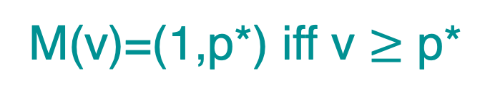
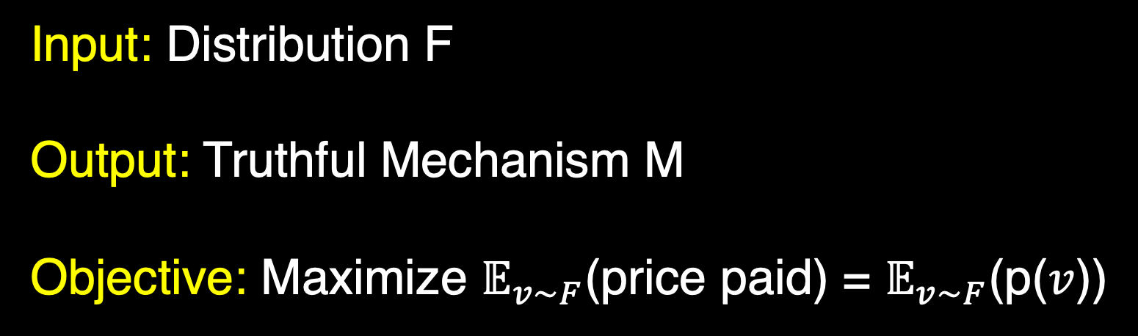
Selling a Single Item
Input: Distribution F
Output: Truthful Mechanism M
Objective: Maximize $𝔼_{v\sim F}$(price paid) = $𝔼_{v\sim F}$(p($v$))
M(v)=(a(v),p(v)) (allocation, price)
[Myerson 1981] p* = argmax p(1-F (p))
M(v)=(1,p*) iff v $≥$ p*

Slide 6

Selling Multiple Items
v(⚽) ~ $F_{1}$
v(⚾) ~ $F_{2}$
v(🏀) ~ $F_{3}$

Slide 7
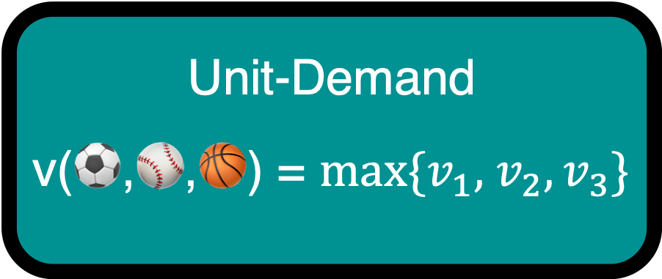
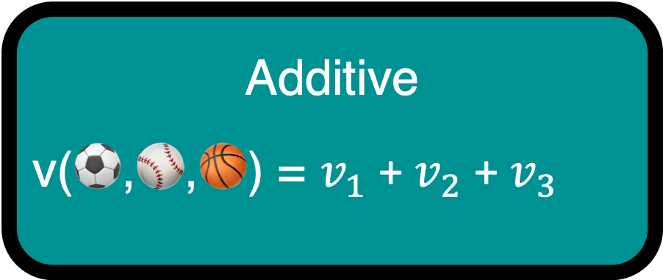

Valuation for Multiple Items
Unit-Demand
v(⚽,⚾,🏀) = $max\{v_{1},$ $v_{2},v_{3}\}$
$v_{1}$ = v(⚽) ~ $F_{1}$
$v_{2}$ = v(⚾) ~ $F_{2}$
$v_{3}$ = v(🏀) ~ $F_{3}$
Additive
v(⚽,⚾,🏀) = $v_{1}$ + $v_{2}$ + $v_{3}$

Slide 8

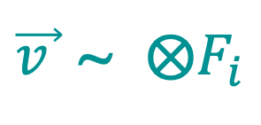
Selling n Independent Items
$v_{1}$= v(⚽) ~ $F_{1}$
$v_{2}$= v(⚾) ~ $F_{2}$
.
.
.
$v_{n}$= v(🏀) ~ $F_{n}$
.
.
.
Unit-Demand
$\vec{v }$ ~ $⨂F_{i}$

Slide 9

Selling n Items – Computational Problem
Input: n Independent Distributions $F_{i}$.
Output: Truthful Mechanism M.
(M($\vec{v}$)= (a($\vec{v}$),p($\vec{v}$))
Objective: Maximize $𝔼_{\vec{v}\sim F}$(p($\vec{v}$))
HARD
Unit-Demand
Q. Find Optimal Truthful Mechanism in poly-time

Slide 10
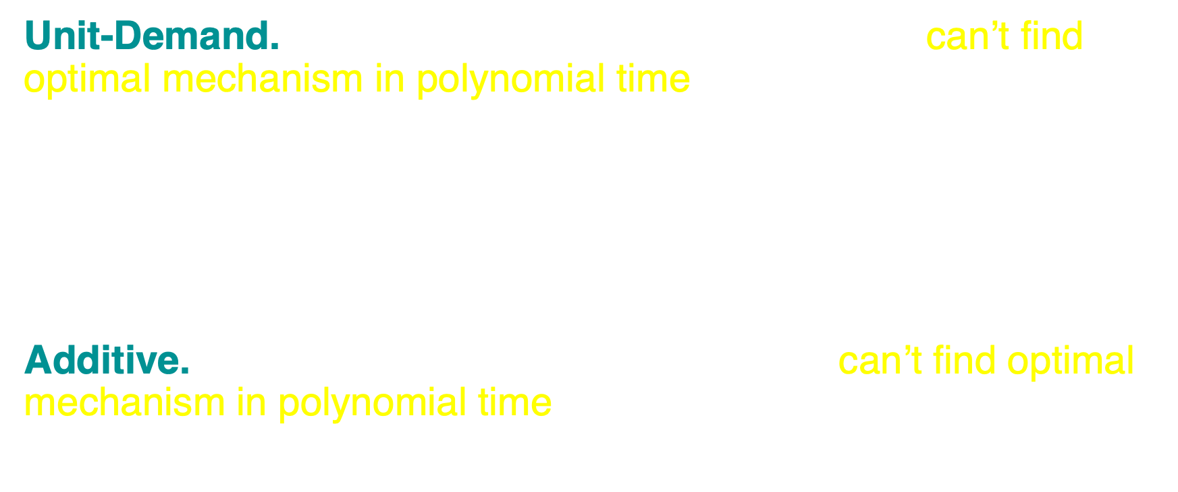
Maximizing Revenue is Hard!
[Chen et al. 2015]
Unit-Demand. If all $F_{i}$have support size 3 or larger can’t find optimal mechanism in polynomial time unless PH collapses.
Additive. If all $F_{i}$ have support size 2 or larger can’t find optimal mechanism in polynomial time unless ZPP ⊇P^{#P}.
[Daskalakis et al. 2014]
Notes:
Story time

Slide 11
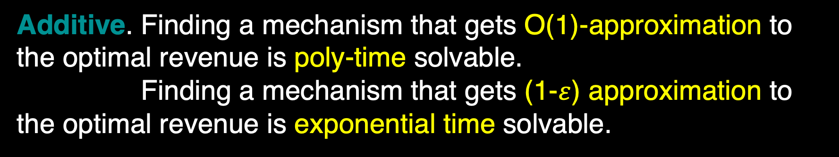
Approximation!
[Chawla et al. 2007, Chawla et al. 2010]
Unit-Demand. Finding a mechanism that gets ¼-approximation to the optimal revenue is poly-time solvable.
[Li and Yao 2013, Hart and Nisan 2012, Babaioff et al. 2014, Yao 2015, Rubinstein and Weinberg 2015, Chawla and Miller 2016, Cai and Zhao 2017, Babaioff et al. 2017, ... ]
Additive. Finding a mechanism that gets O(1)-approximation to the optimal revenue is poly-time solvable.
Finding a mechanism that gets (1-$ε$) approximation to the optimal revenue is exponential time solvable.
Notes:
Hype up

Slide 12

Main Result - QPTAS
Can we do better?
[This paper]
Unit-Demand. We can find a (1-$ε$) approximation to the optimal mechanism in quasi-polynomial time.
Note: The Distributions can be Unbounded!

Slide 13
Roadmap
Unbounded Distributions
Symmetric Distributions
Reduction
Symmetrize
Bounded* Distributions

Slide 14
Reduction
Polytime reduction from (1-ε)-approximation for unbounded distributions to an additive O(poly(ε))-approximation for almost-bounded distributions.
Unbounded Distributions
Almost-Bounded Distributions
(1-ε) OPT
OPT - O(poly(ε))
[Babaioff et al. 2017]
Additive. “Almost”-Reduction to a Bounded Distribution
[This paper]
Sub-Additive (Unit-Demand). True Reduction to Almost-Bounded Distribution

Slide 15

Challenge
Can’t ignore high-valued buyers if we want (1- $ε$) of OPT.
Consider n i.i.d. items are U[0, 1] wp 1-1/$n^{2}$, and have value H wp 1/$n^{2}$.
  Focusing the core: set price ~1, get revenue ~1.
  Focusing the tail: set price H for all item, get revenue O(H/ $n$).
  If both quantities comparable, won't get better than O(1)-appx doing one.
  Both is tricky!
Almost-bounded distributions have a bounded interval support except for one high value. Eg. [0,1] U {H}

Slide 16
Take-Away I
Unbounded Distributions
Poly-time
Almost-Bounded Distributions
(1-ε) OPT
OPT - O(poly(ε))
Can’t ignore high-valued buyers
But can capture them with one high number!

Slide 17
Roadmap
?
Unbounded Distributions
Symmetric Distributions
Reduction
Symmetrize
Bounded* Distributions

Slide 18
Bounded Distribution – Are we done?
n independent items. Item i takes value 2 wp 1/i and 1 ow.
There are 2^{n} many different types of buyer.
Q. Is there a PTAS for Bounded Distributions?

Slide 19

Symmetric Distributions are Solvable!
[Daskalakis and Weinberg 2012] D on n items s.t. can partition into s groups $G_{1},G_{2}, …,G_{s}$ where items in the same group are i.i.d. each with support size at most c, then can find the optimal mechanism in time O(n^{cs}).
Optimal mechanism in poly-time!

Slide 20

Symmetric Distributions
A distribution D is symmetric with respect to permutation $σ$if f($a_{1}, a_{2}, …, a_{n}$) = f($a_{σ(1)}, a_{σ(2)}, …, a_{σ(n)}$).
This reduces the problem size!
Can group together “equivalent” types of buyers and treat them similarly.
v(⚽) = 5
v(🏀) = 8
v(⚽) = x
v(🏀) = y
Swap ⚽ 🏀
v(⚽) = y
v(🏀) = x
v(⚽) = 8
v(🏀) = 5

Slide 21
Symmetric Distributions
For eg. Selling n i.i.d. ⚽s, each v(⚽) ~ U {1, 2}
There are 2^{n} many different types of buyers.
Only need to know how many items are valued at 1 and 2.
One representative r(k) for all of types with exactly k number of 1.
Number of representatives O(n).

Slide 22

Symmetric Distributions are Solvable!
[Daskalakis and Weinberg 2012] D on n items s.t. can partition into s groups $G_{1},G_{2}, …,G_{s}$ where items in the same group are i.i.d. each with support size at most c, then can find the optimal mechanism in time O(n^{cs}).
Because number of representatives is O(n^{cs}) --- In each group, number of items with value x is at most n items. There are c different values.

Slide 23

Symmetric Distributions are Solvable!
[Daskalakis and Weinberg 2012] D on n items s.t. can partition into s groups $G_{1},G_{2}, …,G_{s}$ where items in the same group are i.i.d. each with support size at most c, then can find the optimal mechanism in time O(n^{cs}).
Marginals have small support
Few distinct Marginals

Slide 24
Take-Away II
Bounded product distributions are a mystery
Symmetries are awesome!

Slide 25
Roadmap
Unbounded Distributions
Symmetric Distributions
Reduction
Symmetrize
Bounded* Distributions

Slide 26

Symmetrize
Any Bounded* Unit-Demand
$$≈$$
Bounded* Unit-Demand
Symmetric, small supports,
small # marginals

Slide 27

Challenge – Preserve Revenue
Suppose $D_{1}$ and $D_{2}$ are “close”, “similar” etc.
How much revenue do we get using mechanism M?
M can be Optimal for $D_{1}$, but gets 0 revenue for $D_{2}!$

Slide 28

Revenue of “Close” Distributions
$D_{1}$: 100 w.p. ½ and 0 o.w.
$D_{2}$: 99 w.p. ½ and 0 o.w.
Mechanism M: Set price 100
M is Optimal for $D_{1}$. Gets 50 Revenue
M gets 0 revenue for $D_{2}$

Slide 29
Symmetrize
Any Bounded* Unit-Demand
$$≈$$
Bounded* Unit-Demand
Symmetric, small supports,
small # marginals
OPT Mechanism M’
Discount prices
Almost Optimal Revenue

Slide 30
Take-Away III
Symmetric distributions are special
Careful transformation to symmetric distributions

Slide 31
Main Result
[This paper]
Unit-Demand. We can find a (1-$ε$) approximation to the optimal mechanism in quasi-polynomial time.
Key Step 1. Reducing Unbounded Distributions to Bounded* Distributions
Key Step 2. Symmetrizing Bounded* Distributions

Slide 32

Menu Complexity
A Menu is a collections of all possible distinct outcomes (a(v),p(v)) of a Mechanism.
Menu $≡$ Truthful Mechanism. Since v prefers (a(v),p(v)) over any other (a(w),p(w)).
Menu Complexity is the number of distinct outcomes, i.e. size of the menu

Slide 33
Symmetric Menu Complexity
Generalization of Menu Complexity.
Given a group Σ, and an allocation, price pair (a, p), also offer (σ(a), p) for all permutations σ in Σ.
List a more compact menu. But offer all the corresponding permutations.

Slide 34
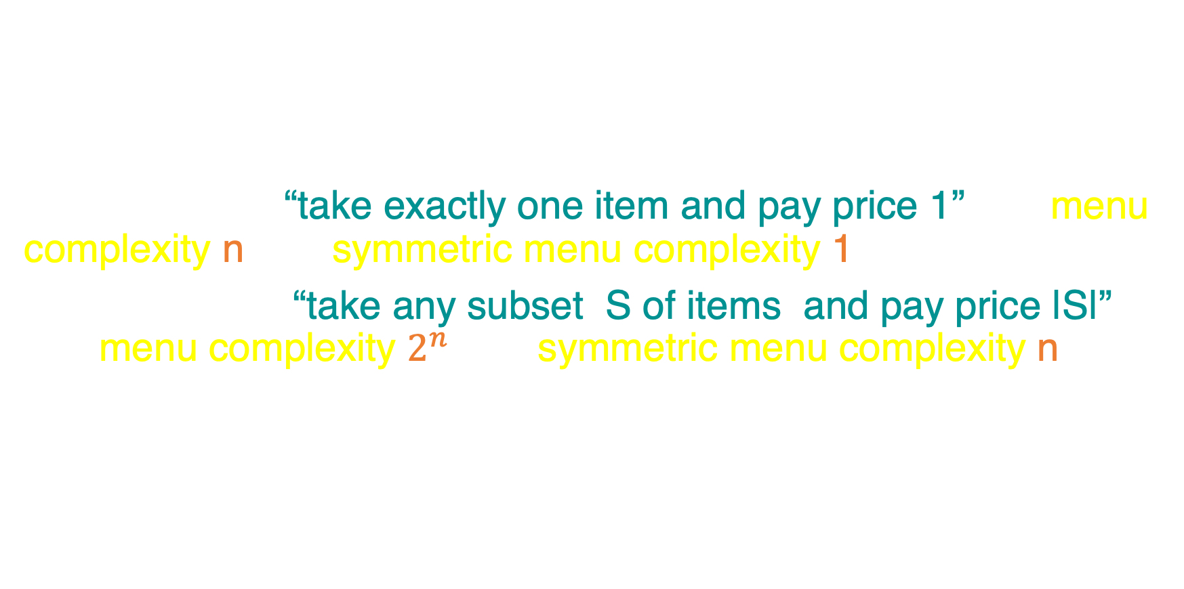
Symmetric Menu Complexity
Symmetric Menu Complexity $≤$ Menu Complexity
E.g.
(i) Menu-“take exactly one item and pay price 1” has menu complexity n and symmetric menu complexity 1.
(ii) Menu-“take any subset S of items and pay price |S|” has menu complexity $2^{n}$ and symmetric menu complexity n.

Slide 35
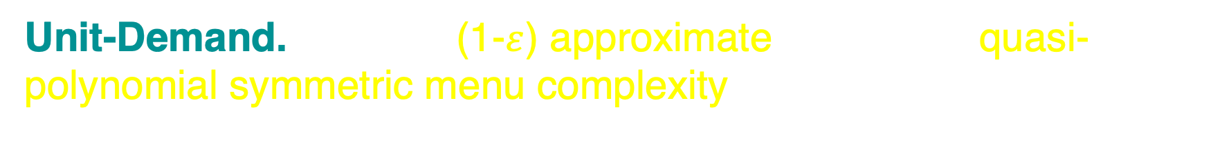
Main Result – Part 2
[This paper]
Unit-Demand. There is (1-$ε$) approximate menu with quasi-polynomial symmetric menu complexity.

Slide 36
More Results
Additive. Approximate Selling Separately has linear SMC.
Unit-Demand i.i.d. PTAS & Poly SMC.
Additive i.i.d. QPTAS & Quasi-poly SMC.
Additive, Small support. QPTAS & Quasi-poly SMC. (Distinct Marginals)
Sub-Additive. Finite time & SMC

Slide 37
Summary
First sub-exponential upper-bound for a general class of distributions!
A true reduction of unbounded distributions to almost-bounded distributions for sub-additive buyers.
Can exploit symmetries in seemingly asymmetric distributions.
Symmetric Menu Complexity.
Future Work
Thank you!
Can we get Sub-ExpTAS for additive?
Can we get a PTAS for unit-demand?
Generalize to multiple bidders?

