Slide 1
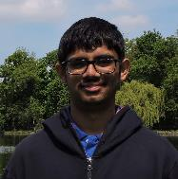
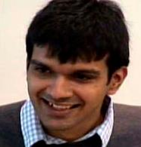
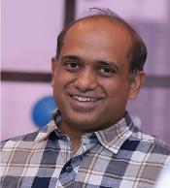
Online Discrepancy with Recourse for Vectors and Graphs
Sahil singla
Georgia Tech
Anupam Gupta
Vijaykrishna Gurunathan
Ravishankar Krishnaswamy
Amit Kumar

Slide 2
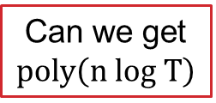
Vector Balancing
Offline Vector Balancing:
Given $n$ dimens vectors $v_{1},v_{2},…,v_{T}$ with ${\left\|v_{t}\right\|}_{∞}≤1$
Color them $ε_{t}∈\{1,−1\}$
Signed-sum nearly balanced ${\left\|\sum_{t}{ε_{t}}v_{t}\right\|}_{∞}$
Observations:
Easy for 1-dim: 0.7, 0.9, -0.8, 0.7,… can ensure $\left|\sum_{τ≤t}{ε_{τ}}v_{τ}\right|$ $≤1$
Random coloring: $T^{1/2} \log^{1/2}{n}$
0
discrepancy vector
How to handle even 2-dim?
Std. deviation
per coordinate
Chernoff + union bd
over n coordinates
Can we get $poly\left(n log T\right)$

Slide 3
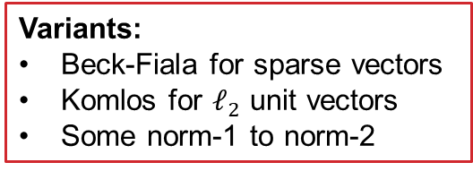
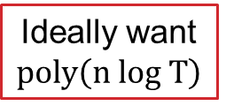
Motivation and Background
Offline Vector Balancing:
Given $v_{1}, …,v_{T}$ with ${\left\|v_{t}\right\|}_{∞}≤1$, minimize ${\left\|\sum_{t}{ε_{t}}v_{t}\right\|}_{∞}$
Applications:
Fair-division / RCTs / Scheduling
Basic problem in discrepancy theory
What’s known for offline:
Barany-Grinberg’81 + Spencer’86 gives $O(\sqrt{n})$
Variants:
Beck-Fiala for sparse vectors
Komlos for $ℓ_{2}$ unit vectors
Some norm-1 to norm-2
What can we do Online?
Items/Subjects come one-by-one
Ideally want $poly\left(n log T\right)$

Slide 4
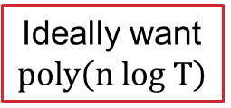
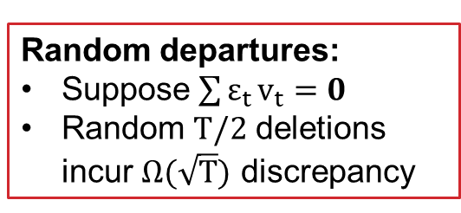
Online Vector Balancing
Ideally want $poly\left(n log T\right)$
What about adversarial online arrivals?
$v_{t}$ is orthogonal to $d_{t−1}=\sum_{τ<t}{ε_{τ}}v_{τ }$
$ℓ_{2}^{2}$-norm increases by n each time step $⇒$ $ℓ_{2}$-norm becomes $Ω(\sqrt{T})$
Recent works on online arrivals:
Stochastic Bansal-Jiang-Makrand-Meka-S’21
Oblivious adversary Alweiss-Liu-Sawhney’21
$$v_{t}$$
$$d_{t−1}$$
Random departures:
Suppose $\sum{ε_{t}}v_{t}=0$
Random $T/2$ deletions incur $Ω(\sqrt{T})$ discrepancy
Cannot handle: Adaptive arrivals or Departures

Slide 5
Online Discrepancy with Recourse
What if some colors can be changed?
In step $t$ (arrival/departure), recolor a “small” # vectors
Discrepancy is always small
Amortized recourse per step, i.e., $\frac{Total \#Recolorings}{T}$
Other online problems with Recourse
Network design
Clustering
Matching
Scheduling
Set cover
Fully-dynamic vector balancing: What is the minimum recourse needed to get $poly\left(n log T\right)$ recourse?
Naively, O(T) recourse suffices

Slide 6
Main Results
[Gupta-Gurunathan-Krishnaswamy-Kumar-S]:
Thm (Fully-dynamic vector balancing):
Algorithm with $O(\sqrt{n})$ discrepancy and $O(n log T)$ amortized recourse.
For Komlos setting (vectors with $ℓ_{2}$-norm $≤1$), algorithm with $O(\sqrt{log n})$ discrepancy and $O(n log T)$ amortized recourse.
Proof via distributed Barany-Grinberg
Thm (Fully-dynamic edge orientation):
Algorithm with $polylog(n)$ discrepancy and $polylog(n)$ amortized recourse.
Equivalent to vector balancing for 2-sparse ${\left\{+1,−1,0\right\}}^{n}$ vectors
Proof via expander decomposition and local search

Slide 7
OUTLINE
Online Discrepancy with Recourse
Dynamic Vector Balancing via Distributed Barany-Grinberg
Dynamic Edge Orientation via Expander Decomposition and Local Search
Conclusion and Open Problems

Slide 8
Offline Barany-Grinberg
Given $v_{1}, …,v_{T}$ with ${\left\|v_{t}\right\|}_{∞}≤1$, minimize ${\left\|\sum_{t}{ε_{t}}v_{t}\right\|}_{∞}$
Reducing $T$ vectors to $n$ vectors:
Find a basic solution $x^{∗}$ to the LP: $\sum_{t}{x_{t}}v_{t}=0$ for $−1≤x_{t}≤1$
Get integral and fractional colors: $\left[n\right]=I∪F$.
Fix $≥T−n$ vector colors in $I$
Solve $<n$ fractional color vectors in $F:$ $\sum_{t∈F}{ε_{t}}v_{t}=\sum_{t∈F}{x_{t}^{∗}}v_{t}$
Now random coloring gives $O(\sqrt{n log n})$, but Spencer’86 gives $O(\sqrt{n})$
Challenge: An insertion/deletion could drastically change the basic solution

Slide 9
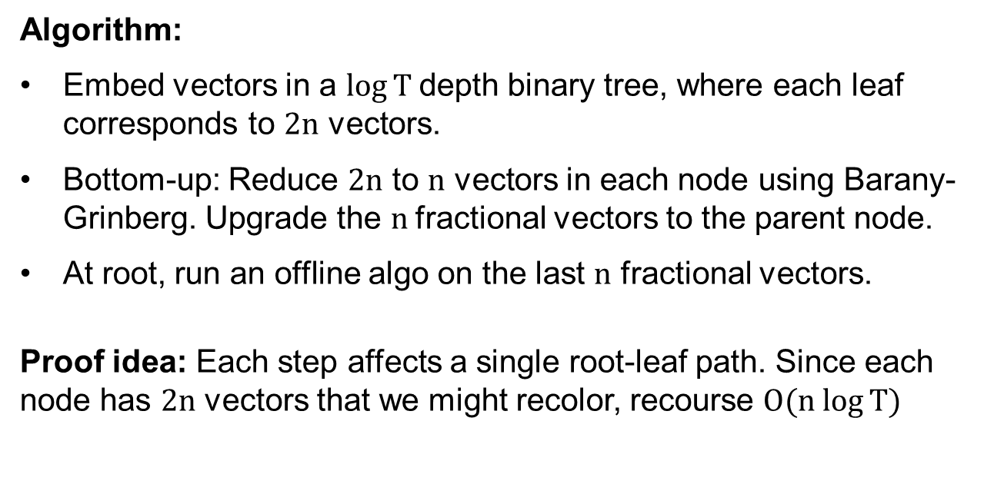
Distributed Barany-Grinberg
Thm (Fully-dynamic vector balancing):
Algorithm with $O(\sqrt{n})$ discrepancy and $O(n log T)$ amortized recourse.
Algorithm:
Embed vectors in a $log⁡T$depth binary tree, where each leaf corresponds to $2n$ vectors.
Bottom-up: Reduce $2n$ to $n$ vectors in each node using Barany-Grinberg. Upgrade the $n$fractional vectors to the parent node.
At root, run an offline algo on the last $n$ fractional vectors.
Proof idea: Each step affects a single root-leaf path. Since each node has $2n$ vectors that we might recolor, recourse $O(n log⁡T)$

Slide 10
OUTLINE
Online Discrepancy with Recourse
Dynamic Vector Balancing via Distributed Barany-Grinberg
Dynamic Edge Orientation via Expander Decomposition and Local Search
Conclusion and Open Problems

Slide 11
Dynamic Edge Orientation
Edges dynamically inserted/removed in a graph. Maintain edge orientations s.t. each vertex has a small signed degree:
$$\max_{v} \left|\#incoming \left(v\right)−\#outgoing(v)\right|$$
What’s known for offline for a fixed graph:
$O(1)$ discrepancy via Beck-Fiala
Unclear for dynamic graphs
Thm (Fully-dynamic edge orientation):
Algorithm with $polylog(n)$ discrepancy and $polylog(n)$ amortized recourse.
High-level idea:
Dynamically decompose into nearly-regular edge-disjoint expanders
Run local-search algorithm on each expander

Slide 12
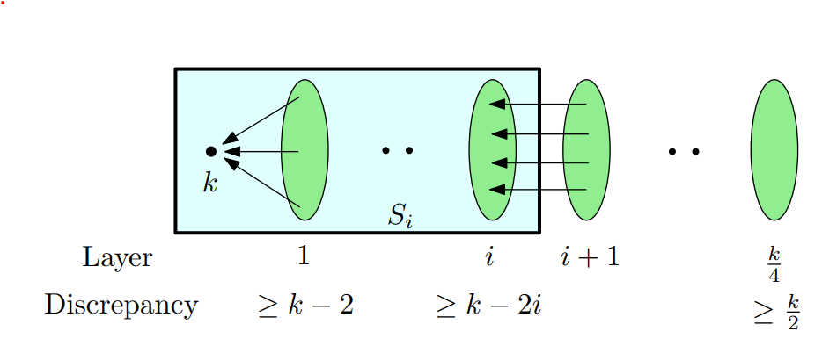
Step 2: Local Search on Expanders
Assume regularity for simplicity
Local Search: Flip edge $u→v$ if decreases $max⁡\{|d_{u}|, |d_{v}|\}$
Lemma : Local optimum for regular $ϕ$-expander has discrepancy $O(\frac{1}{ϕ}log m)$
Proof idea:
Let root have the largest discrep $k$ (say +ve).
At local optimum, edge $u→v$ implies $d_{u}≥ d_{v}−2$
Rooted directed graph, let $S_{i}$ be vertices with a path of length $≤i$
CLAIM: $\left|E(S_{k})\right|≥ \left|{E(S}_{k−1})\right|⋅(1+\frac{ϕ}{3})$
Hence, $k$ can only be logarithmic
root
There exist non-expanding graphs with bad local-optimum

Slide 13
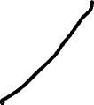
Step 1: Dynamic Expander Decomposition
Static Expander Decomposition
Gives nearly-regular $\frac{1}{polylog(n)}$ expanders
Dynamic Expander Decomposition
Insertions easy to handle. Need to handle deletions in expanders.
Expanders might change drastically: Use expander pruning to remove $ΔP$ with small volume
Quickly find a locally-optimal coloring for $G\left[V∖ΔP\right]$ “Gradually” remove edges of $ΔP$ while performing local search
Saranurak-Wang’19 , Bernstein et al.’20

Slide 14
OUTLINE
Online Discrepancy with Recourse
Dynamic Vector Balancing via Distributed Barany-Grinberg
Dynamic Edge Orientation via Expander Decomposition and Local Search
Conclusion and Open Problems

Slide 15
Conclusion
Dynamic Vector Balancing:
Near-optimal discrepancy with $\tilde{O}(n)$ amortized recourse
Distributed Barany-Grinberg
Dynamic Edge Orientation
$\tilde{O}(1)$ discrepancy with $\tilde{O}(1)$ amortized recourse
Expander decomposition + Local Search
Open Problems for Dynamic Vector Balancing
Near-optimal discrepancy with $\tilde{O}(1)$ recourse, or even $\tilde{O}(\sqrt{n})$ recourse?
Better bounds for sparse vectors (a.k.a. Beck-Fiala)?
Questions?

Slide 16
Further SLIDES

